Slide 1

WEB GIS FOR RECOVERY OF LOST ARCHEOLOGICAL ARTIFACTS
Karen Adkins
Penn State Master of Geographic Information Systems Capstone Proposal
Advisor: Jim Detwiler
Notes:
Hi, I’m Karen Adkins and my capstone project proposal is A Web GIS for Recovery of Lost Archaeological Artifacts. Jim Detwiler is my advisor and I’d like to thank Jim for his support and guidance on this proposal.

Slide 2
Presentation Overview
Introduction
Background
Goals and Objectives
Proposed Methodology
Challenges/Limitations
Anticipated Results
Notes:
I will start with a brief introduction of myself, then I will present background information followed by objectives and methodology. I’ll wrap up with challenges and limitations and anticipated results.

Slide 3

Introduction
Senior Hydrography Project Lead for the U.S. Geological Survey National Geospatial Technical Operations Center (USGS NGTOC)
  Project/Program management for National Hydrography
  Certified Project Management Professional (PMP)
Why did I choose this topic?
  Enjoy visiting public historic parks in Colorado and surrounding states
  News about geospatial technology contributing to archaeological discoveries
  Literature around the problem of illegal artifact collecting and how it destroys cultural knowledge
Notes:
In my day job I serve as the Senior Hydrography Project Lead for the U.S. Geological Survey National Geospatial Technical Operations Center – or for an easier acronym, the USGS NGTOC. I provide project and program management for the USGS National Hydrography, which encompasses the hydrography datasets available in The National Map.
Why did I choose this topic? I have always enjoyed exploring Colorado’s parks, and some of my favorites are historically themed such as Mesa Verde National Park and Hovenweep National Monument. Archaeological discoveries using geospatial technology such as lidar have made the news in recent years, as has news about the looting of archaeological sites for valuable artifacts. I have learned that the problem of illegal artifact collecting is one of great importance from a historic and cultural perspective.

Slide 4
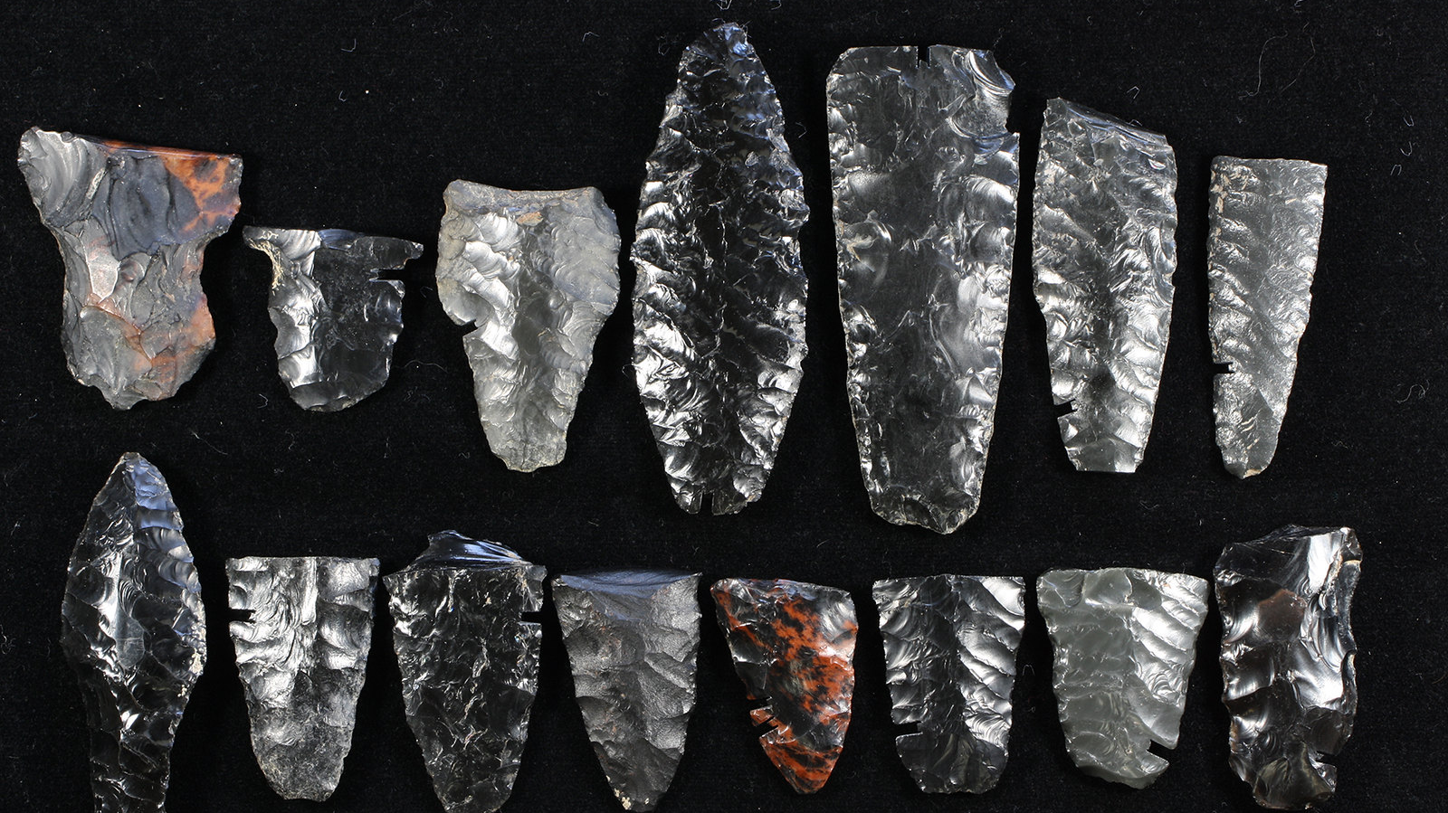
Background
Archaeological Artifact Theft
Photo Credit: Katrina Lancaster. Retrieved from https://www.flickr.com/photos/50169152@N06/16098243393
Notes:
First I will give some background the problem of theft of archaeological artifacts.

Slide 5
Theft of Artifacts
United Nations Educational, Scientific and Cultural Organization (UNESCO) 1970 Convention on the Means of Prohibiting and Preventing the Illicit Import, Export and Transfer of Ownership of Cultural Property
  Triggered by illegal trade in cultural objects among the drug and weapons trade
  Established an international treaty for the purpose of engaging member states in the fight against illicit trade in cultural heritage items
  Ratified by 140 member nations to date
In the United States:
  Archaeological Resources Protection Act (ARPA)
  Native American Graves Protection and Repatriation Act (NAGPRA)
Notes:
Illegal trade in artifacts and other cultural objects has been a problem for many years. The United Nations Educational, Scientific and Cultural Organization, UNESCO, in 1970 developed the international treaty to fight the issue of trade in artifacts and cultural objects which was fueling the trade in drugs and weapons. To date 140 member nations have ratified the treaty.
In the U.S. laws have been developed and resources allocated to enforce these laws. The Archaeological Resources Protection Act, ARPA, protects archaeological sites and makes collecting artifacts on public lands illegal. The Native American Graves Protection and Repatriation Act, NAGPRA, protects Native American graves from illegal looting and destruction. Violation of these laws can result in stiff fines and jail time for offenders.

Slide 6
Theft of Artifacts
People still do it:
  Interest or fascination with the past
  Desire to collect artifacts, often rare or striking specimens
  Knowledge of the value with intent to sell, often to fund other illegal activities or to fund war and terrorist efforts
Notes:
But people still commit these crimes. People are fascinated with the past, and collectors seek rare and beautiful objects to add to their collections. Often artifacts are taken with the intent to sell in order to fund other illegal activities.

Slide 7
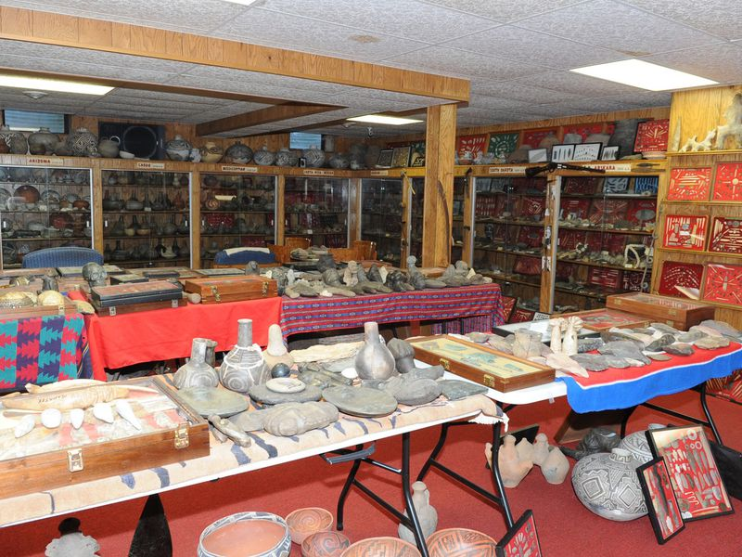
Artifacts at Donald C. Miller's home in Waldron, Indiana seized by the Federal Bureau of Investigation (FBI) in 2014. Photo credit: FBI. Retrieved from https://www.smithsonianmag.com/smart-news/fbi-trying-return-thousands-stolen-artifacts-including-native-american-remains-amassed-indiana-collector-180971604/
Notes:
This image shows the vast collection of an amateur archaeologist whose home was raided by the FBI in 2014 for possessing illegally obtained artifacts and bones from Native American graves. Many of the 42,000 plus artifacts in this collection were found to be illegally obtained, and the FBI is still working to return or repatriate some of the artifacts.

Slide 8

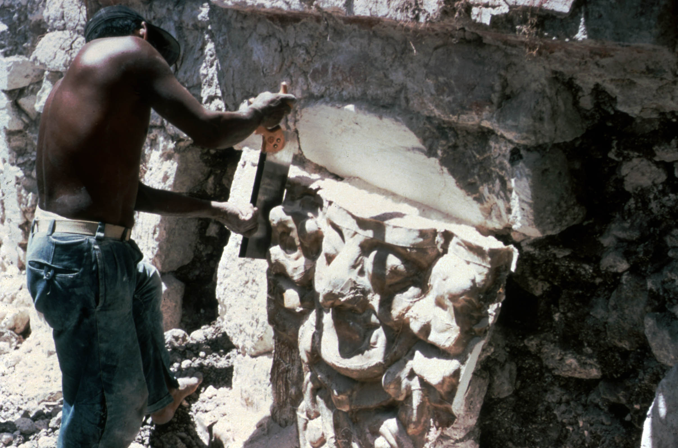
Looters preparing and removing a building façade from a site in Campeche, Mexico in the late 1960’s. Retrieved from https://traffickingculture.org/data/placeres/
Notes:
These images are examples of how looters don’t only take loose objects but also artifacts such as these wall carvings in a Mexico site. As you can see looting and taking artifacts can be very destructive to sites.

Slide 9
Why it matters
“Beyond the obvious legal violations, some collectors do not understand the moral, historical, and scientific implications of separating an item from where it was found, and thus separating it from its historical context, its story, and from what it could tell us about how it was used and valued in the past. The item simply becomes an object, and its larger meaning is lost. The piece of the historical and cultural puzzle that it would have provided is likely gone forever, and when human remains are involved, the spiritual link is disturbed.”
Benderson, J. (2016, March). Cultural Property Law. United States Attorney’s Bulletin: 64 (2), 1.
Notes:
What I have come to learn is that loss of artifacts from sites is a loss of historical meaning, or context, of the artifact and the place where it came from. This quote from Judith Benderson, former attorney for the Executive Office of U.S. Attorneys who dealt with cultural law, stresses the importance of the historical context of artifacts and how the meaning of the item is lost when it is separated from its origin. As she says here, “some collectors do not understand the moral, historical, and scientific implications of separating an item from where it was found…” “The piece of the historical and cultural puzzle that it would have provided is likely gone forever, and when human remains are involved, the spiritual link is disturbed.”

Slide 10
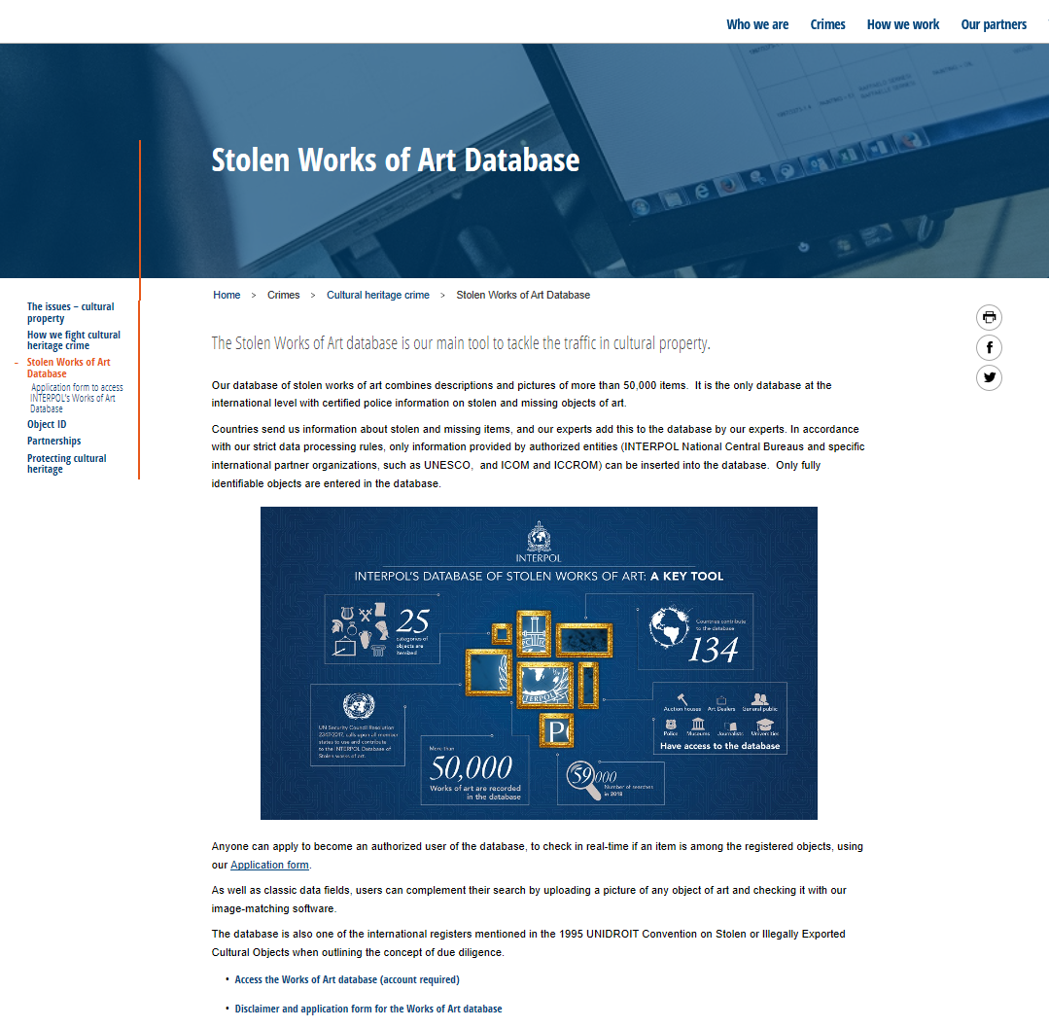
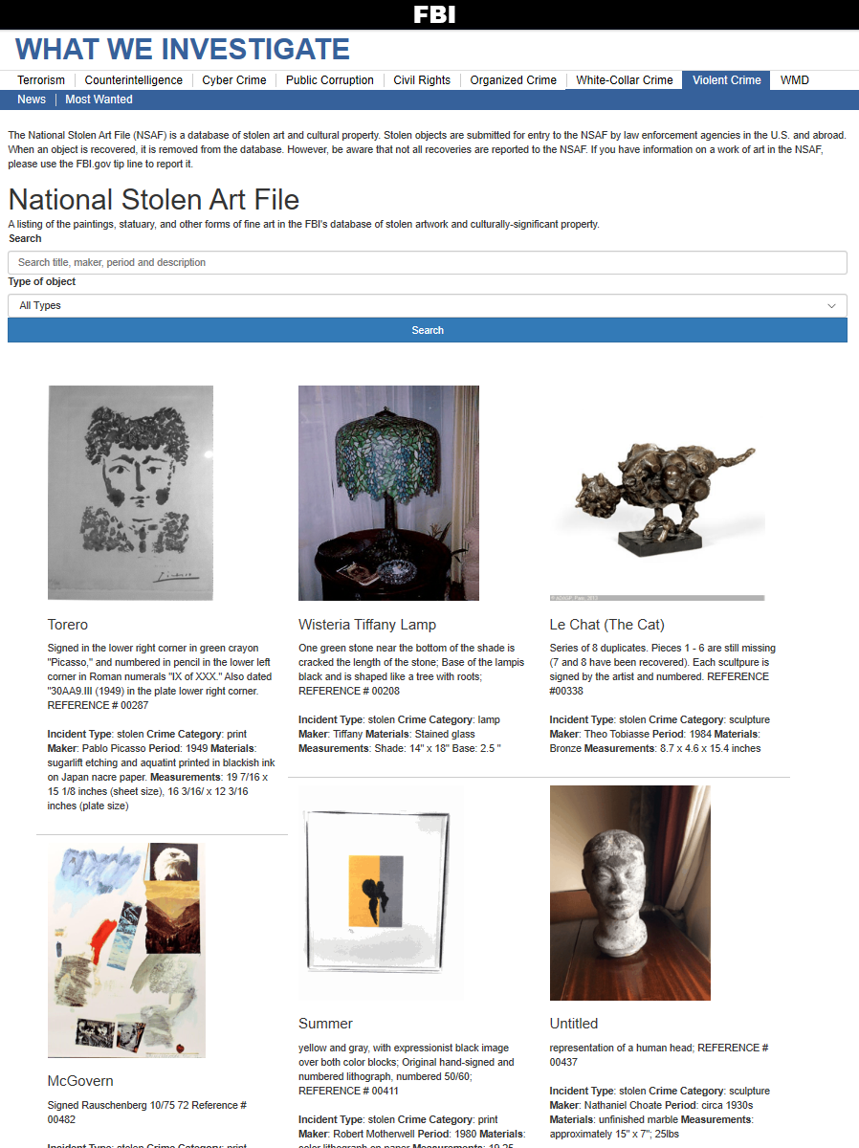
Cultural Theft Databases
Public databases of stolen cultural items
Art, artifacts, etc.
Text-based searches
Lack tools for spatial searches, reporting sightings
Notes:
In the effort to combat illegal trade, cultural theft databases have been developed by organizations including Interpol and the FBI. These public databases are called “stolen art databases” as these include many cultural items such as artifacts, artwork, recordings, and other items. Visitors to these sites can perform text-based searches, but these databases don’t provide spatial context for searches and offer limited mechanisms for reporting sightings of stolen objects beyond directing visitors to contact the organizations via phone or email. The information in the database comes from police reports and the users of these databases are most often traders in antiquities and insurers performing due diligence on items. Recovery of stolen items is a challenge and reported recovery rates are low, well under 10%.

Slide 11
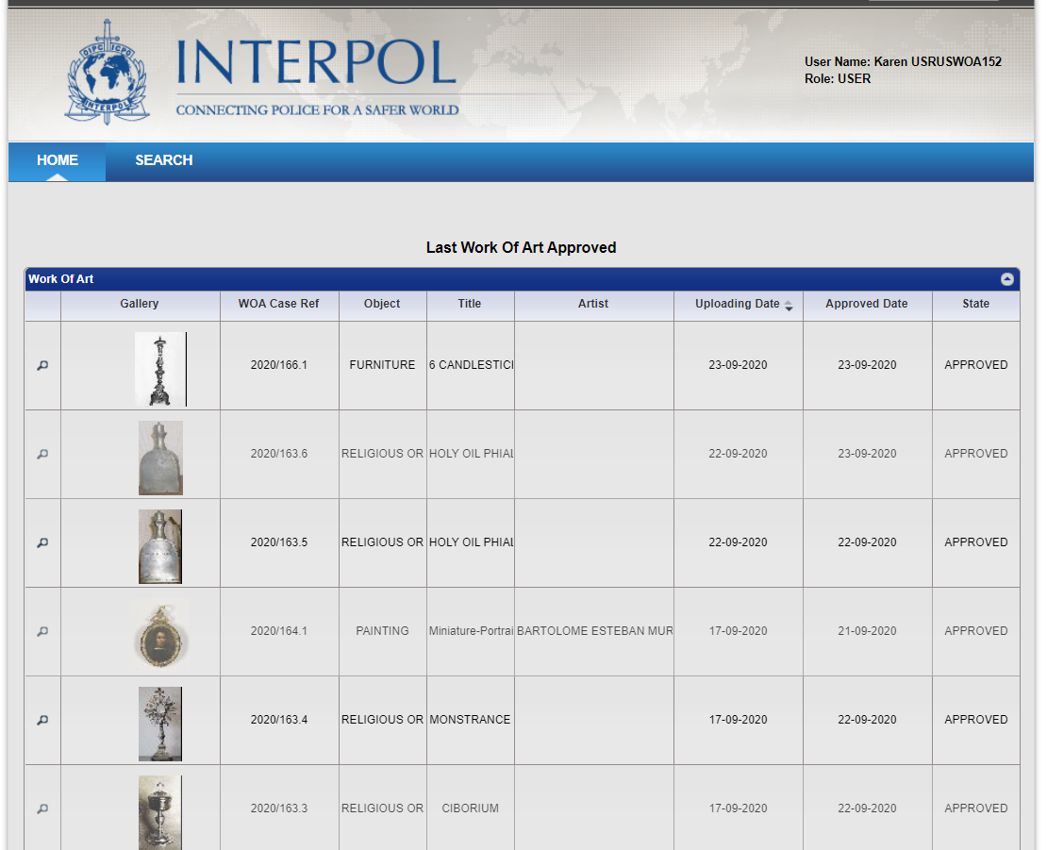
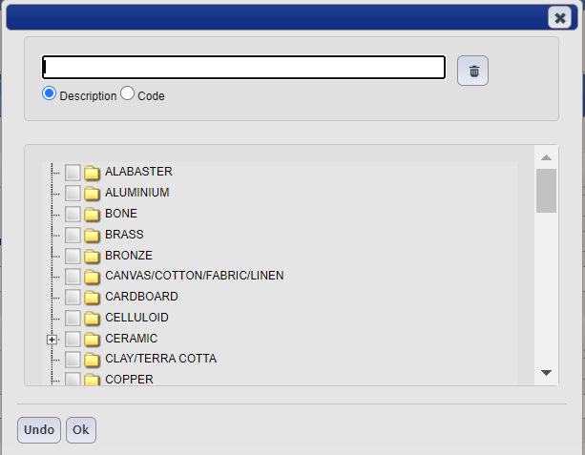
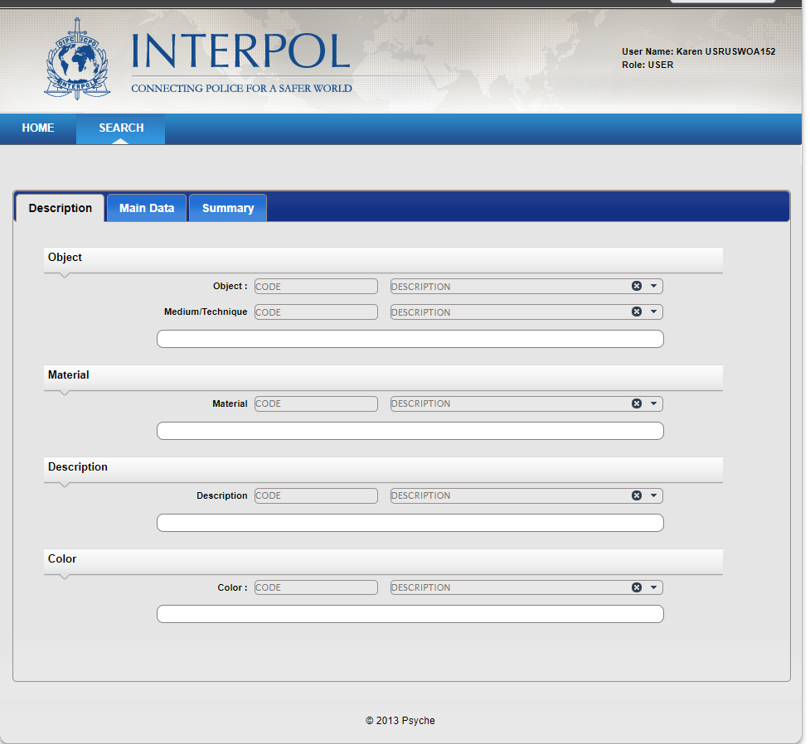
Notes:
This is the web interface for the INTERPOL database. As you can see, searches can be performed as text queries to locate objects.

Slide 12
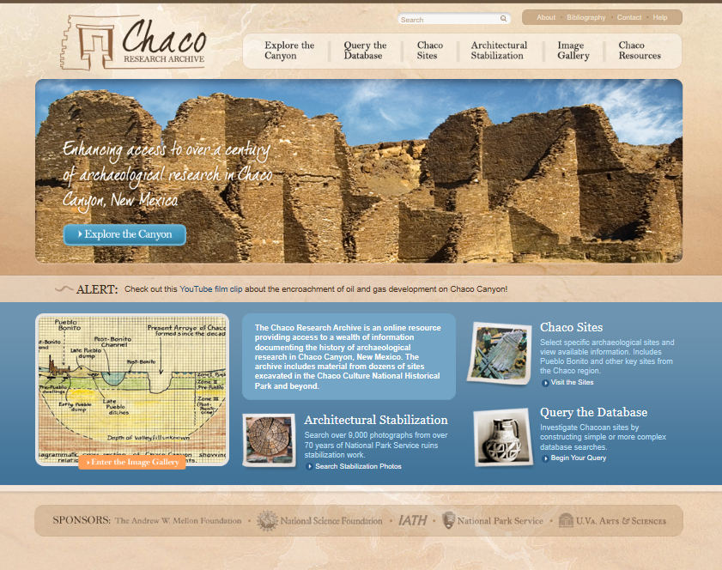
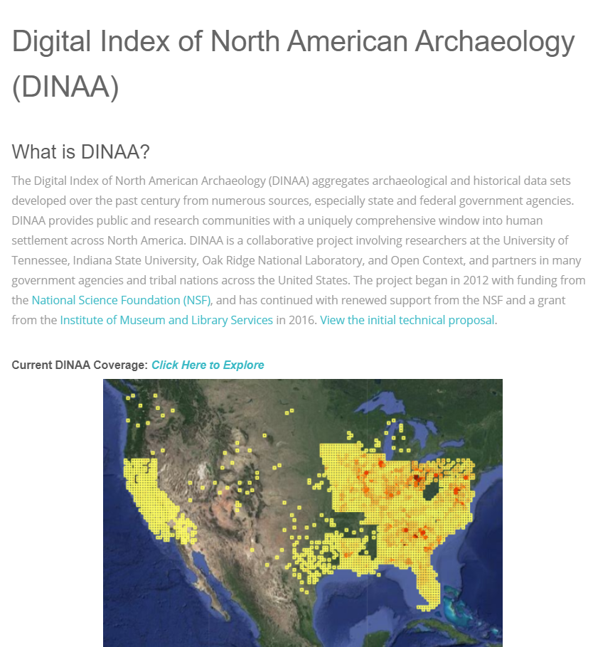
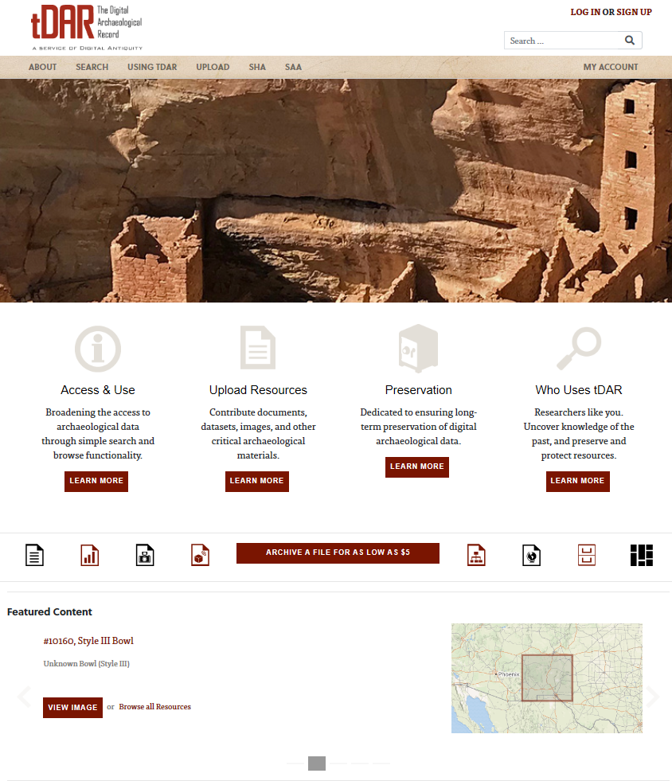
Archaeology Databases
Public databases of archaeological sites and artifacts
Share research
Historical information
Lack information on lost/stolen artifacts
Notes:
Public archaeological databases can provide a wealth of information, but these databases are designed to share research and historical information. Users of these databases are primarily archaeologists, teachers, and researchers. These databases do not publicize lost and stolen artifacts, and in my research, I found only one organization with a list of artifacts stolen from a state museum on the website.

Slide 13
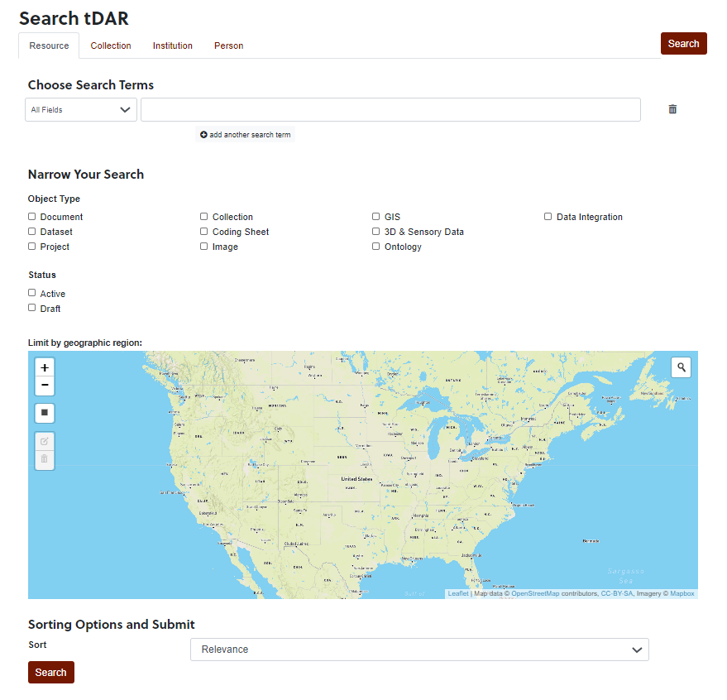
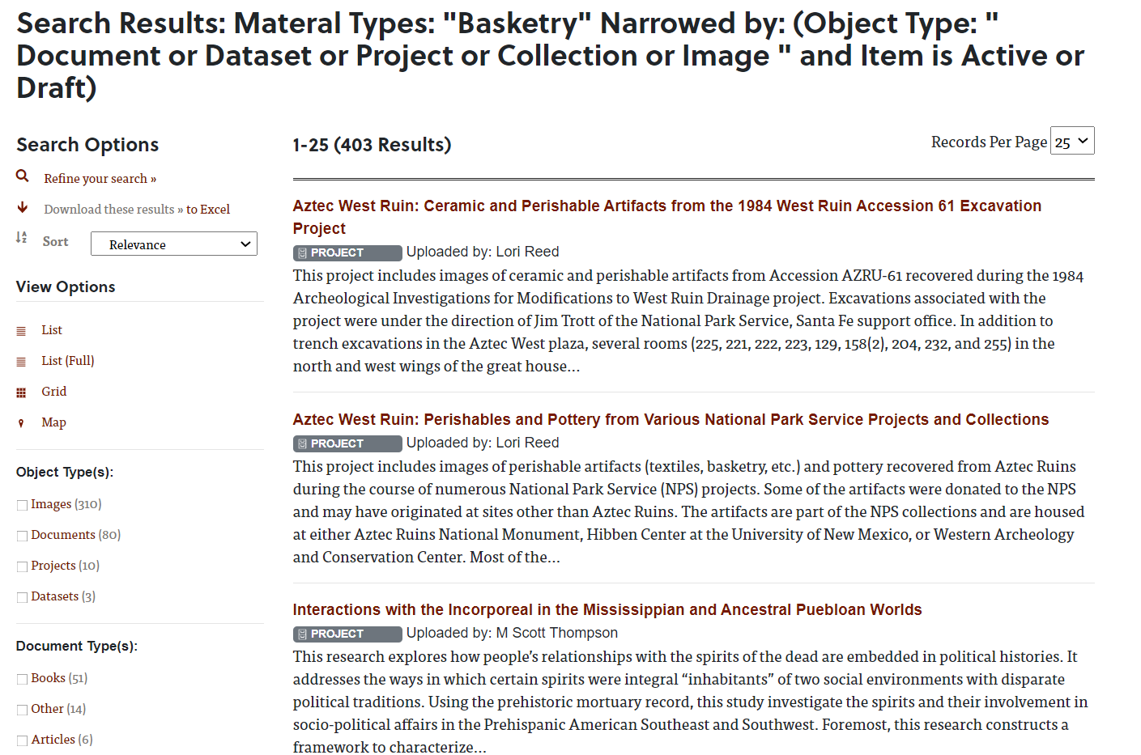
Notes:
This is the interface of the Digital Archaeological Record, tDAR. It is a little more user-friendly than the INTERPOL database with search controls and has an option to search by geographic region. Summary research information is returned, and the user can delve deeper into the information.

Slide 14
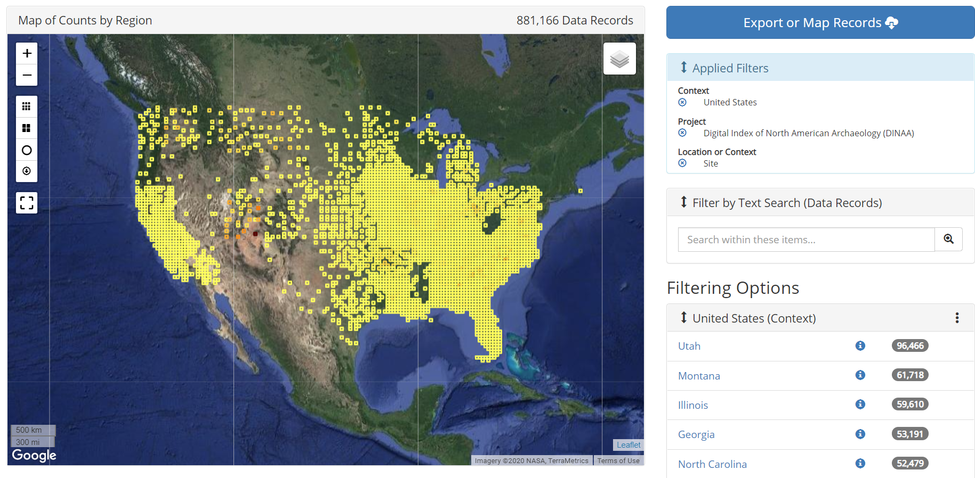
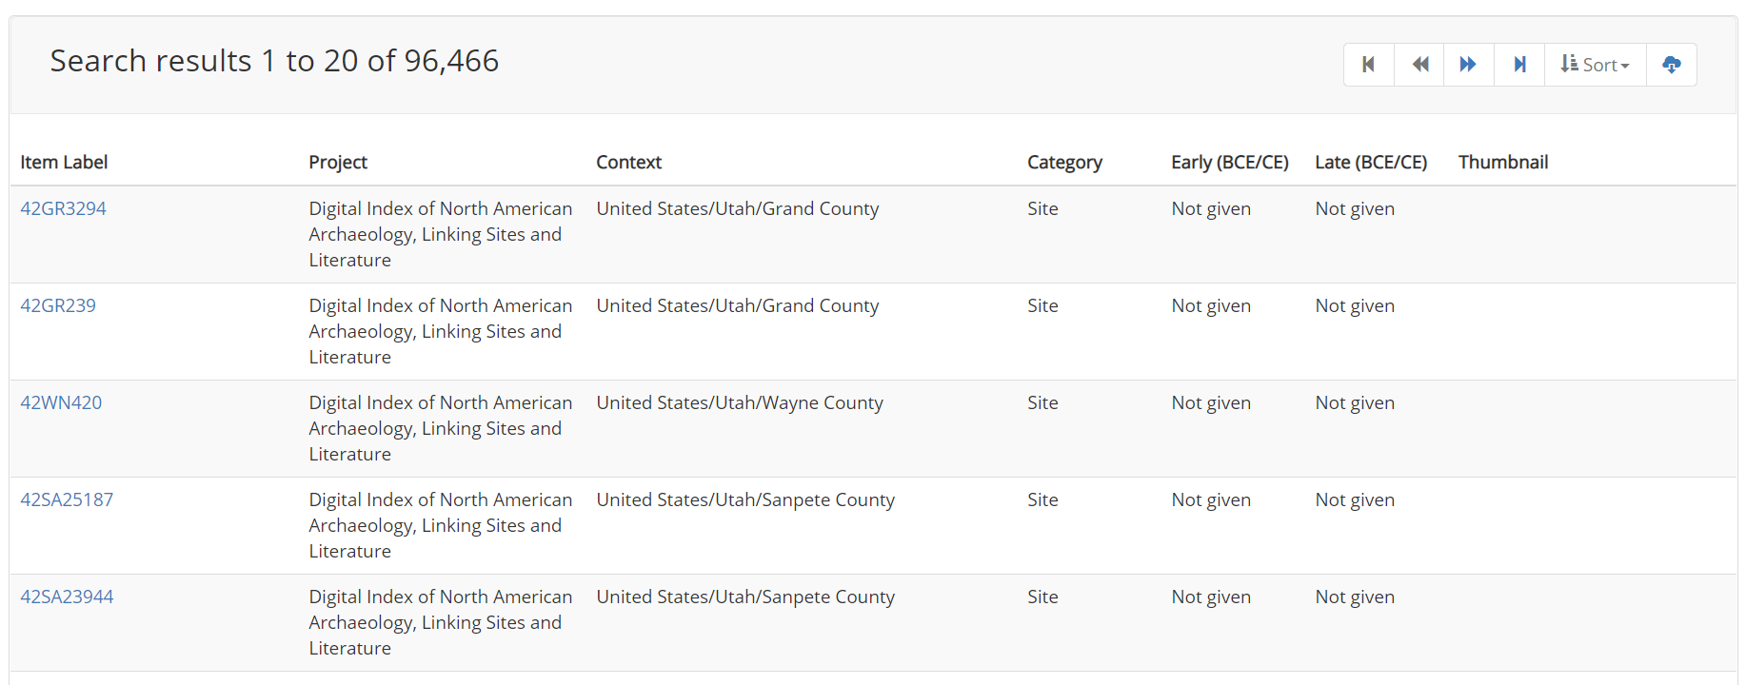
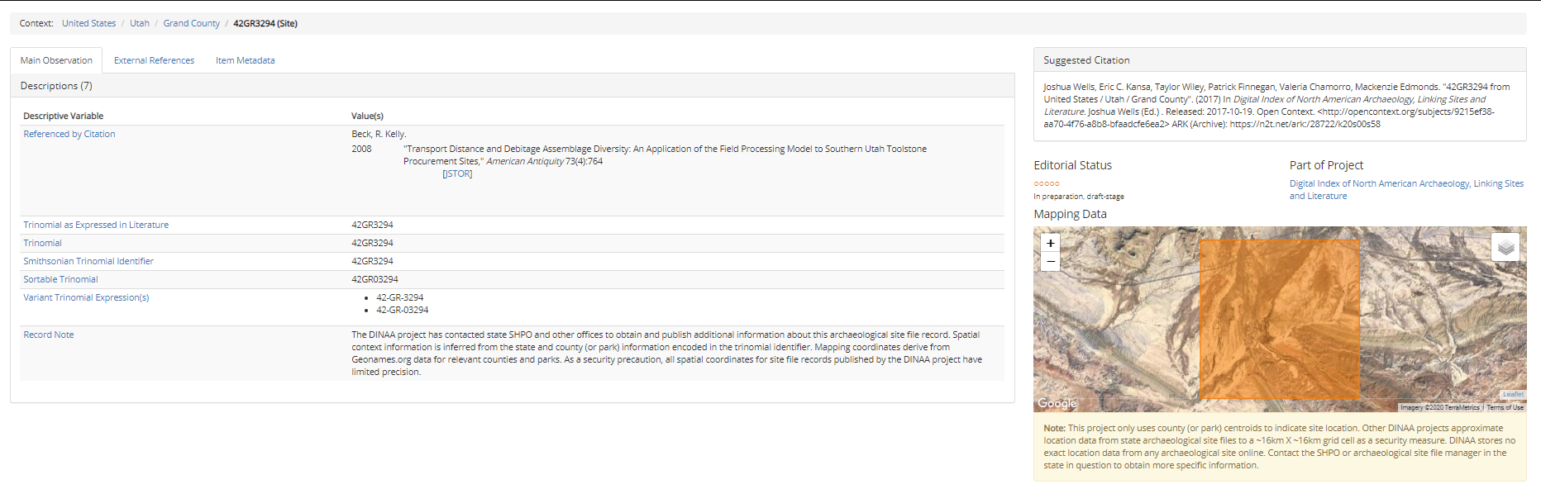
Notes:
This is the interface for the Digital Index of North American Archaeology, DINAA. Recent improvements to DINAA include a selectable map interface. Tabular records are returned for searches and the user can delve into more information about the research, culture, and other details of the record.

Slide 15
Methodology
Web GIS for Artifact Recovery
Photo Credit: Katrina Lancaster. Retrieved from https://www.flickr.com/photos/50169152@N06/16098243393
Notes:
Reviewing these databases caused me to think about how to build a better system for reporting and tracking lost artifacts. In my literature review the main shortcomings of theft databases centered around limitations of text-based searches, lack of linkages and shared objectives between theft and archaeology databases, and lack of public sourcing for information that can aid in recovery of stolen items.

Slide 16
Goals and Objectives
Create a prototype GIS database to store and share information about lost artifacts, reported sightings, and recovered artifacts that can be accessed through a web platform for mapping and analysis.
Engage the public and encourage widespread involvement in the effort to locate and recover artifacts through a web-accessible map application.
Enable visualization of sightings and recovery of artifacts in a web platform.
Notes:
I have three primary objectives for this project. First is to create a GIS database to store and share information about stolen artifacts, reported sightings, and recovered artifacts that can be accessed through a web platform for mapping and analysis. Second, I want to engage and encourage the public to become involved in artifact recovery through a web-accessible map application. Lastly, I want to enable visualization of sightings and recovery of artifacts in a web platform. I believe employing a cloud-based collaborative web GIS system will help achieve the objectives.

Slide 17
Notes:
This diagram demonstrates how I envision the system. The approach for this project is using Esri’s ArcGIS Enterprise and ArcGIS Online. I chose to work with the Esri cloud platform because it offers a full range of configurable web maps, tools, and apps that can be shared within and outside of an organization.

Slide 18


Database
Feature classes with domains
  Archaeological sites, generalized to protect sensitive locations
  Public collection locations
  User report locations
Tables
  Artifact reference
  Artifact image links
  Unique identifiers for users, reports, and artifacts
Notes:
The database for my project will be created using ArcGIS Pro. I plan to include feature classes that will contain generalized location data for archaeological sites, locations of public collections such as museums, and user report locations. Note that archaeological site locations are considered sensitive and require protection from looters, which is why generalized locations will be created. Tables will be created to store reference information about submitted artifacts and associated images. I plan to use unique identifiers for artifacts, users, and submitted reports. Original identifiers from the artifact submissions can be maintained for reference back to any origin databases. The data will be published to ArcGIS Online as web layers, where the layers will be used to create web maps that will be incorporated into the web apps used to populate and maintain the data.

Slide 19
Web Applications
Content Submitter
Reviewer/Reporter
Add/edit items
Individual or batch
Upload images
Find locations, sites
Find artifacts
View images, basic information
Links to more information
Report sighting of an item
  Geographic location
  URL
Notes:
I plan to create web applications for two types of users using ArcGIS Web AppBuilder. The first is the content submitter, who will need to have the ability to add and edit information about stolen artifacts and upload images associated with artifacts. The second type of user is the reviewer/reporter, who will review information about stolen artifacts and report sightings. This user could be an amateur archaeologist, collector, or anyone else interested in recovery of artifacts.

Slide 20
Process - INTERPOL
Notes:
This is the process I encountered to gain access to the INTERPOL Stolen Works of Art database. I had to submit a request for access through the website, then fill out a form as directed by an email from INTERPOL. I submitted the form and a was later sent an email with my account information. The process took a few weeks to accomplish.

Slide 21
Notes:
This is a simple use case for INTERPOL Psyche database. The user must navigate to the database after logging in, then has three choices to search the database. They can browse a list of over 50,000 items, perform a custom search, or upload an image to use the site’s image matching service to find an item. In the custom search the user finds items through browsing a catalog to populate search fields. Once an item is found, the user can view the record and print a PDF of the item or send a “signal” or brief text message about the item. While the database and web interface is robust, it is primarily text-based and lacks a geographic component.

Slide 22
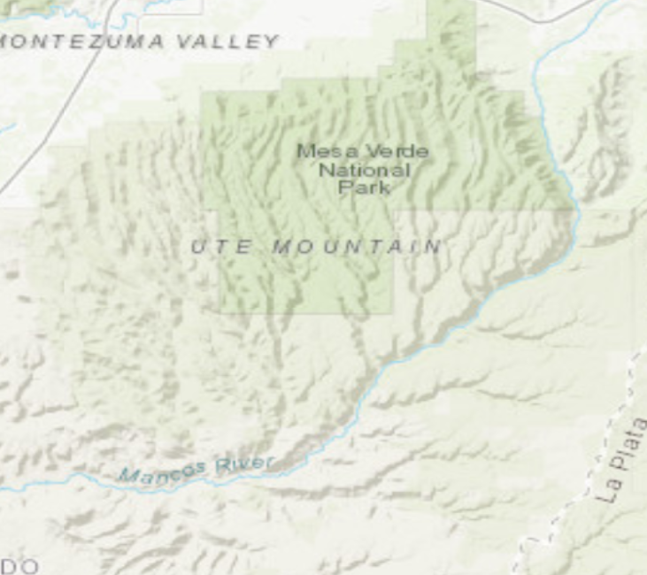
Notes:
This is a simple use case for new web application. This approach improves the experience by taking the user to the application upon login and provides intuitive choices when searching for information. The workflow is simplified and guides the user through using the application, and the basis of the application is a geographic component.

Slide 23
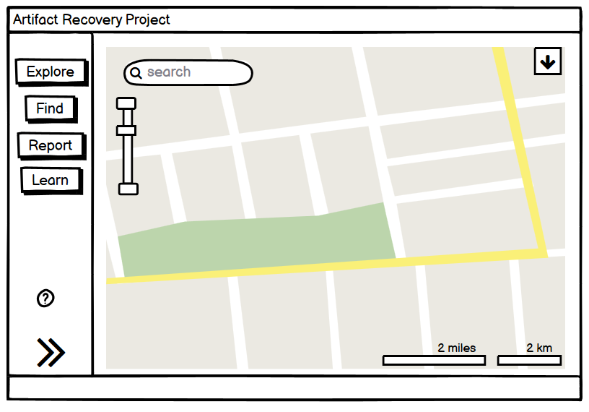
Wireframe
Notes:
This is a basic wireframe of the web app that the Reporter/Reviewer will use. Various configurations are available for web apps, this one represents a foldable configuration. I intend the design to be simple with controls that are easy for users to understand.

Slide 24
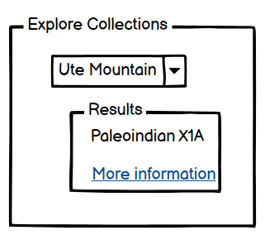


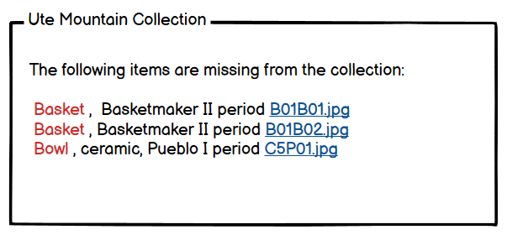


Notes:
First item is to explore collections. When selecting the Explore button, a panel will open with a drop-down list from which the user can choose a collection. The map will zoom to that location and the user can click on the area and choose from a list of items.

Slide 25
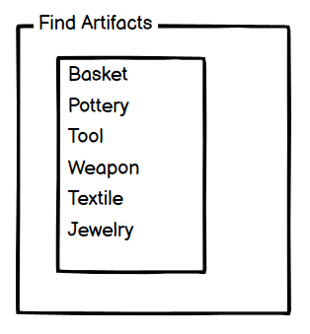
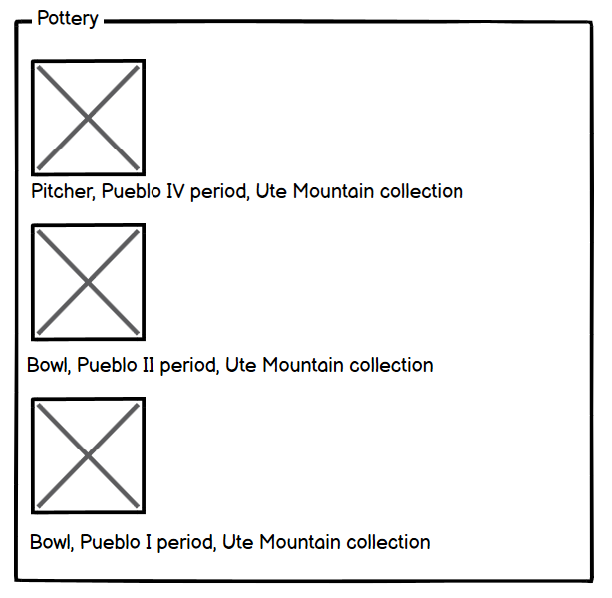
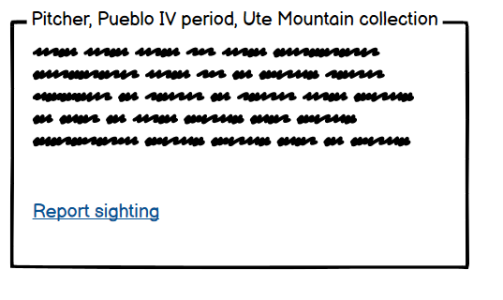
Notes:
The next item is Find, another method to search for artifacts. This panel provides a list of artifact categories where users choose the category they want to search. The user selects an item, and information about the item is returned with a link to report a sighting.

Slide 26
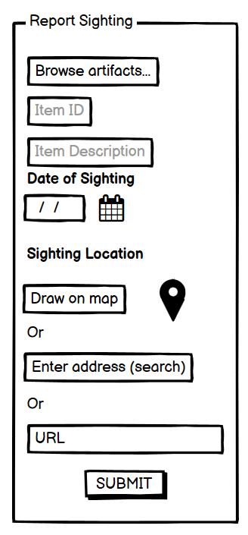
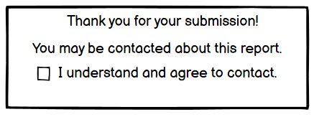
Notes:
The Report button opens a panel with a fillable form. If the user chose the “report sighting” from a previous search, certain fields will be auto-populated with the item details. The user reports the date and location of the sighting. The location can be drawn on the map by the user, an address in a search field, or as a URL if the user found the item online.

Slide 27
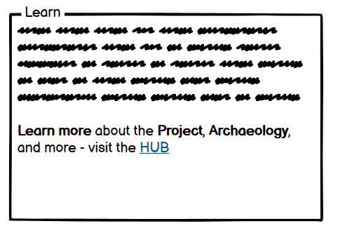
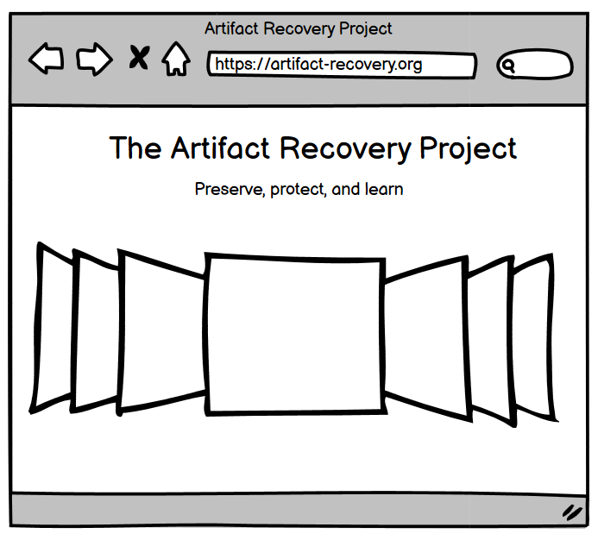
Notes:
The last item is Learn. Selecting this button brings up a panel with information about the project and a link to the Hub. An Esri Hub is a website portal organized around an initiative, where collaborators and the public can contribute information and get access to educational materials, applications, maps, and more.

Slide 28
Dashboards
User dashboard in GlobalXplorer. Yates, D. (2018). "Crowdsourcing Antiquities Crime Fighting: A Review of GlobalXplorer." Advances in archaeological practice:
a journal of the Society of American archaeology 6(2): 173-178. DOI: https://doi-org.ezaccess.libraries.psu.edu/10.1017/aap.2018.8.
Notes:
Dashboards are configurable web apps that display interactive information such as charts, graphs, and maps on a single screen. Dashboards can be configured to support operational monitoring and decision making or tailored to a specific audience. I intend to create dashboards for the content submitter and the reviewer/reporter. With a dashboard each user can visualize and track information about thefts and reports but customized to their specific interests in the data. This image is an example of a similar type of dashboard created for GlobalXplorer, a crowdsourced project for evaluation of satellite images to identify looting of archaeological sites. While this is not an example of an ArcGIS Dashboard, it demonstrates how dashboards can be effective interfaces for users to track their progress and encourage ongoing participation. An operations dashboard can be deployed as well for the host organization.

Slide 29
Analysis
Spatial Analysis
  hotspots
  risk analysis
  distance travelled
Temporal
  frequency of thefts and sightings,
  timeframes when thefts occur (seasonality),
  time to recover artifacts. (bullets)
Notes:
The host organization and collaborators will have the ability to analyze the data. Types of analysis may be spatial, such as hotspots, risk analysis, and distance travelled; and temporal, such as frequency of thefts and sightings, timeframes when thefts occur (seasonality), and time to recover artifacts.

Slide 30
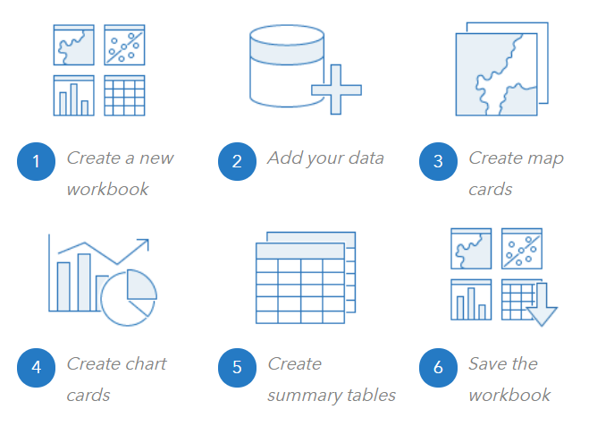
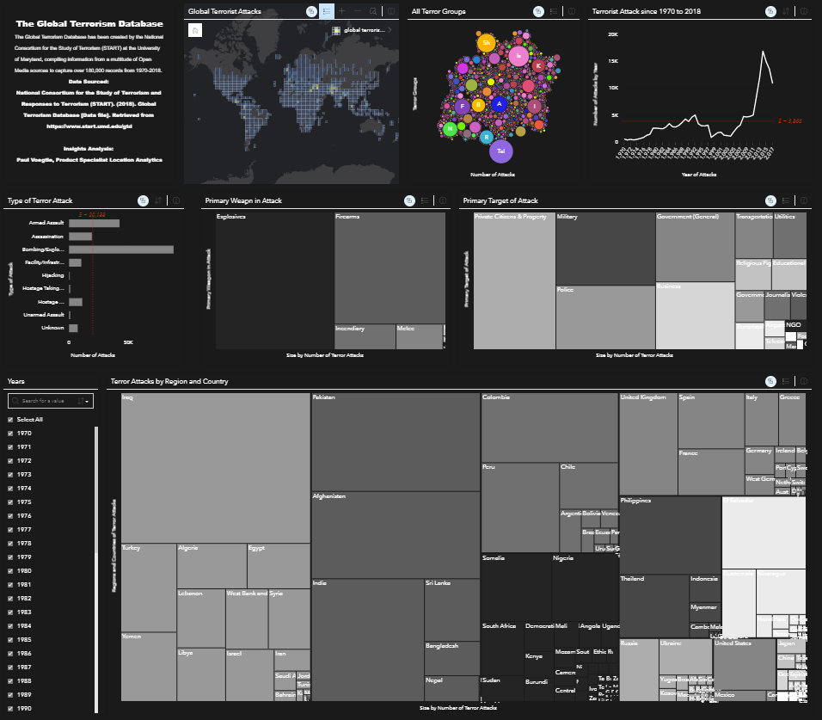
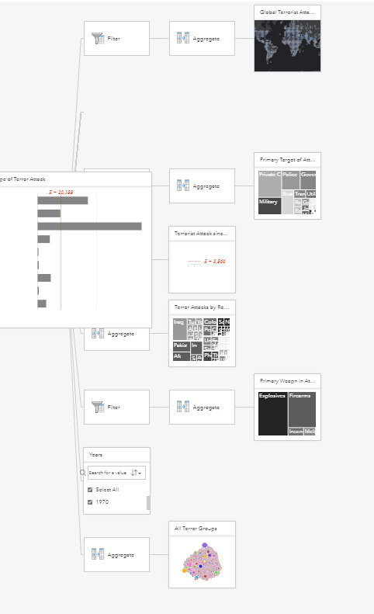
Analysis
Esri Insights: https://doc.arcgis.com/en/insights/latest/get-started/get-started-with-workbooks.htm
Notes:
Insights for ArcGIS is what Esri calls a “workbench” and it is available in ArcGIS Online where you can bring data together to perform visual analysis. The user creates a workbook and can drag & drop data into analysis workflows and create multiple “cards” for displaying analysis results. This tool would be used by the organizational users to analyze the data and prepare results. This can be used by the organization in the future as data is enriched by the application users.

Slide 31
Challenges/Limitations
Lack of institutional knowledge
  Next step: outreach to subject matter experts for participation
ArcGIS Web AppBuilder limitations
  Customization using additional tools, development may be required (ArcGIS App Studio, ArcGIS Web AppBuilder Developer Edition)
Not solving the problem of lack of linkages between research and theft databases
  Project provides an alternative solution

Slide 32
Anticipated Results
Prototype WebGIS solution that engages collaborators and the public.
Demonstrate how a web GIS platform can be used to apply spatial methods to encourage broad participation in the pursuit of artifact recovery.

Slide 33
Timeline
Nov-Dec 2020
Jan-March 2021
March-May 2021
June-Oct 2021
Seek SMEs
Design Database
Build/Test Components
Finalize & present
Notes:
Possible venues for presenting are Esri User Conference, GIS-Pro, GIS in the Rockies, Applied Geography Conference, Great Basin Anthropological Conference, National Congress of American Indian Repatriation Conference.

Slide 34
References
Durney, M. (2011). How an Art Theft’s Publicity and Documentation Can Impact the Stolen Object’s Recovery Rate. Journal of Contemporary Criminal Justice, 27(4), 438-448. doi:10.1177/1043986211418886. Retrieved from https://doi-org.ezaccess.libraries.psu.edu/10.1177%2F1043986211418886
Benderson, J. (2016, March). Cultural Property Law. United States Attorney’s Bulletin: 64 (2), 1.
Casana, J. (2015). "Satellite Imagery-Based Analysis of Archaeological Looting in Syria." Near Eastern Archaeology 78(3): 142-152. Retrieved from https://www.journals.uchicago.edu/doi/10.5615/neareastarch.78.3.0142
Design & development of GlobalXplorer: http://www.mskellybrooks.com/?p=249
Digital Index of North American Archaeology (DINAA) (n.d.). Open Context. http://ux.opencontext.org/archaeology-site-data/
Fu, P. (2018). Getting To Know Web GIS (3rd edition). Esri Press.
GlobalXplorer° (2019). About GlobalXplorer° Saving the Past, for Our Future. https://www.globalxplorer.org/about
Grove, L., Thomas, S., & Daubney, A. (2018). Fool’s gold? A critical assessment of sources of data on heritage crime. Disaster Prevention and Management: An International Journal, 29(1), 10-21. doi:10.1108/DPM-07-2018-0232. Retrieved from http://ezaccess.libraries.psu.edu/login?url=https://search-proquest-com.ezaccess.libraries.psu.edu/docview/2333578734?accountid=13158
INTERPOL (2020, May 6). 101 arrested and 19,000 stolen artefacts recovered in international crackdown on art trafficking. https://www.interpol.int/News-and-Events/News/2020/101-arrested-and-19-000-stolen-artefacts-recovered-in-international-crackdown-on-art-trafficking
Kansa, S. W., et al. (2020). "Archaeological Analysis in the Information Age: Guidelines for Maximizing the Reach, Comprehensiveness, and Longevity of Data." Advances in Archaeological Practice 8(1): 40-52. Retrieved from https://www-cambridge-org.ezaccess.libraries.psu.edu/core/journals/advances-in-archaeological-practice/article/archaeological-analysis-in-the-information-age-guidelines-for-maximizing-the-reach-comprehensiveness-and-longevity-of-data/ECC4B731D8A8DD374D1461ADE99ACA5D
Katz, B. (2019, March 4). The F.B.I. Is Trying to Return Thousands of Stolen Artifacts, Including Native American Burial Remains. Smithsonian Magazine. https://www.smithsonianmag.com/smart-news/fbi-trying-return-thousands-stolen-artifacts-including-native-american-remains-amassed-indiana-collector-180971604/

Slide 35
References
Lofholm, N. (2009, July 6). Emotions run hot over artifact raids in Utah. The Denver Post. https://www.denverpost.com/2009/07/06/emotions-run-hot-over-artifact-raids-in-utah/
Quintero, M. S., Smuts, K., Mlungwana, N., & Wiltshire, N. (2016). SAHRIS: South Africa's integrated, web-based heritage management system. Journal of Cultural Heritage Management and Sustainable Development, 6(2), 138-152. Retrieved from http://ezaccess.libraries.psu.edu/login?url=https://search-proquest-com.ezaccess.libraries.psu.edu/docview/1815690206?accountid=13158
Roodt C., Bensen, B. Databases for Stolen Art: Progress, prospects and limitations. South African Crime Quarterly No 52 (2015): June 2015. https://doi.org/10.4314/sacq.v52i1.1. Retrieved from https://journals.assaf.org.za/sacq/article/view/26
Smithsonian Trinomial (2020, September 24). In Wikipedia https://en.wikipedia.org/w/index.php?title=Smithsonian_trinomial&oldid=747737026
Society of American Archaeology (n.d.). About Archaeology – What is Archaeology? https://www.saa.org/about-archaeology/what-is-archaeology.
TED (February 2016). Help discover ancient ruins — before it's too late. Sarah Parcak [Video]. https://www.ted.com/talks/sarah_parcak_help_discover_ancient_ruins_before_it_s_too_late?utm_campaign=tedspread&utm_medium=referral&utm_source=tedcomshare
Unesco (2019). Legal Texts on illicit trafficking. https://en.unesco.org/fighttrafficking/1970
Yates, D. (2018). "Crowdsourcing Antiquities Crime Fighting: A Review of GlobalXplorer." Advances in archaeological practice : a journal of the Society of American archaeology 6(2): 173-178. DOI: https://doi-org.ezaccess.libraries.psu.edu/10.1017/aap.2018.8. Retrieved from https://www-cambridge-org.ezaccess.libraries.psu.edu/core/journals/advances-in-archaeological-practice/article/crowdsourcing-antiquities-crime-fighting/18455B45E9E812EF7A58F8363C1E8546

Slide 36
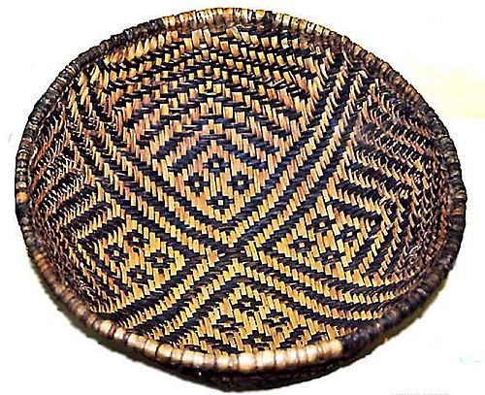
Questions?
Thank you!
Karen Adkins
kfa13@psu.edu
Basket of Basketmaker Pueblo People. Photo credit: National Park Service.

