Slide 1
Urban Growth impacts on HCA and Class Location Changes Using Remote Sensing and LiDAR Data Collection
Michael Aguilera
GEOG 596A Peer Review
Advisor - Patrick Kennelly
Penn State University

Slide 2
Agenda
Introduction and Background
Goals and Objectives
Proposed Methodology
Project Timeline
Anticipated Results
Potential Venues

Slide 3
Introduction
Background
Pipeline Integrity & Risk Management
Change Detection
HCA – High Consequence Areas
Class Location
Remote Sensing and LiDAR
Photo credit: City of Sacramento

Slide 4
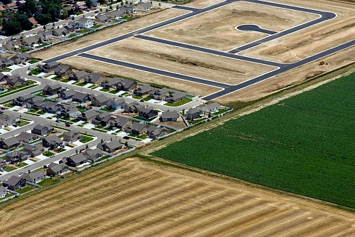
Background
About the Problem
Human Activity – Urban Growth
New Construction
Housing Developments
Businesses
Commercial
Transportation
Land Clearance
Photo credit: Urban Sprawl and Development
Notes:
The rapid expansion of the geographic extent of cities and towns, often characterized by low-density residential housing, single-use zoning, and increased reliance on the private automobile for transportation.
Pipelines experience class change due to urban sprawl and land use changes such as the creation of a new public park or the expansion of a subdivision. Pipeline integrity teams must ensure pipelines are properly classified and then upgrade sections where classification levels have increased.
New high rise buildings being built in downtown big cities, trying to meet the demand of housing.
Businesses, skyrise buildings for large companies
High Speed Rail Stations.

Slide 5
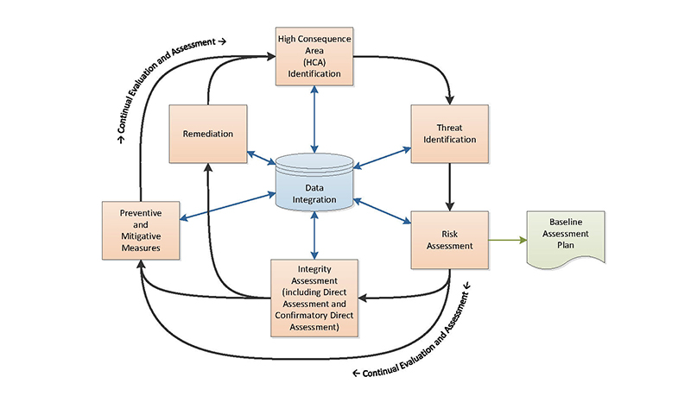
Pipeline Integrity and Risk Management
PHSMA
Regulations
Risks
Incidents
Palm City, FL 2009
San Bruno, CA 2010
Sissonville, WV 2012
Photo credit: Integrity Management of Gas Transmission Pipelines in High Consequence Areas (ntsb.gov)
Notes:
PHMSA – Pipeline and Hazardous Materials Safety Administration. Agency was created in 2004 by U.S. Department of Transportation. The agency is responsible for developing and enforcing regulations for the safe, reliable, and environmentally sound operation of the US's 2.6 million mile pipeline transportation.
“PHMSA's mission is to protect people and the environment by advancing the safe transportation of energy and other hazardous materials that are essential to our daily lives. To do this, the agency establishes national policy, sets and enforces standards, educates, and conducts research to prevent incidents. We also prepare the public and first responders to reduce consequences if an incident does occur.“
Palm City, FL
San Bruno, CA - The ruptured pipeline was determined to be an HCA pipeline segment and was covered by PG&E’s IM program. The pipeline segment was installed in 1956 during a relocation project. The post-accident investigation found that the segment was poorly welded with a visible seam weld flaw that grew to a critical size over time.
Sissonville, WV - The ruptured pipeline was not an HCA pipeline segment and therefore not covered by the operator’s IM program. However it was interconnected in a system that included two adjacent HCA pipelines. All three pipelines were protected against external corrosion threats using external coating and cathodic protection

Slide 6
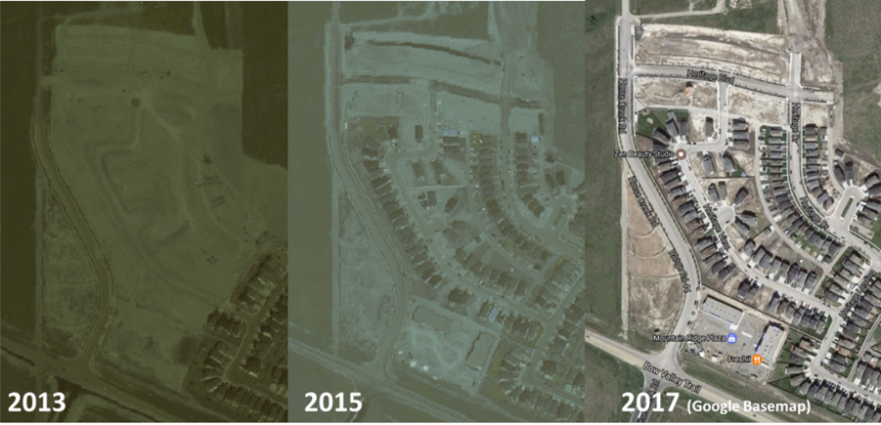
Change Detection
Photo Credit: Enview
Photo Credit: Building Change Detection
Notes:
“The surface of the earth changes continuously due to the natural phenomena or human activities. The process of identifying the changes which has occurred over time on the earth surface is called change detection. Change detection of earth’s surface is carried out effectively in the field of remote sensing using various techniques.” (Mishra et al. 2017)

Slide 7
Class Location
What is Class Location?
Overview of Class 1 – 4
How often does Class Location change?
Leak Survey
MAOP
Photo Credit: ProductPage-HCA (looknorthservices.com)
Notes:
A Class location unit is an area that extends "220 yards (200 meters) on either side of the centerline of any continuous 1- mile (1.6 kilometers) length of pipeline (Title 49 § 192.5, Transportation of Natural and Other Gas by Pipeline: Minimum Safety Standards). Each separate dwelling unit in a multiple dwelling unit building is counted as a separate building intended for human occupancy.“
Pipeline locations are classified as follows (although there are exceptions which are rather complex):
A Class 1 location is (1) An offshore area; or (2) any "class location unit that has 10 or fewer buildings intended for human occupancy.
A Class 2 location is any class location unit that has 11 to 45 ("more than 10 but fewer than 46") buildings intended for human occupancy.
A Class 3 location is (1) Any class location unit that has "46 or more buildings intended for human occupancy" or (2) an area where the pipeline lies within "100 yards (91 meters)" of a common gathering place, which is described as "either a building or a small, well-defined outside area (such as a playground, recreation area, outdoor theater, or other place of public assembly) that is occupied by 20 or more persons on at least 5 days a week for 10 weeks in any 12-month period. (The days and weeks need not be consecutive.)“
A Class 4 location is any class location unit where "buildings with four or more stories above ground are prevalent.“
Pipelines experience class change due to urban sprawl and land use changes such as the creation of a new public park or the expansion of a subdivision. Pipeline integrity teams must ensure pipelines are properly classified and then upgrade sections where classification levels have increased.

Slide 8
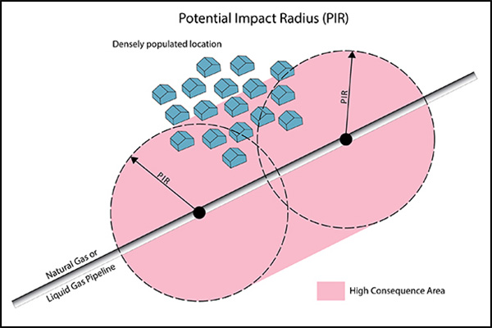
High Consequence Areas
What is HCA?
Potential Impact Radius
Integrity Management
Photo Credit: PHMSA
Notes:
The extent of the Potential Impact Radius (PIR) from the pipeline depends on the contents and pressure within pipeline. If the PIR contains a densely populated area or other designated feature such as a school, then an HCA is established, as shown in shaded area.
These class designations are used to determine an HCA, which is established by one of two methods set forth in Title 49 § 192.903:
A Class 3 or Class 4 location or any area in a Class 1 or 2 location where "the potential impact radius is greater than 660 feet (200 meters), and the area within a potential impact circle contains 20 or more buildings intended for human occupancy"; or any area in a Class 1 or Class 2 location where "the potential impact circle contains an identified site.“
The area within "a potential impact circle" containing (1) An "identified site," or (2) 20 or more buildings intended for human occupancy, with exceptions.
Potential impact radius (PIR) means the radius of a circle within which the potential failure of a pipeline could have significant impact on people or property, as shown in the illustration above.
Identifying locations where a pipeline failure might impact an HCA.
Repairing identified pipeline defects.
Conducting a risk analysis to identify the most significant pipeline threats.
Regularly evaluating all information about the pipeline including threats.
Periodically evaluating the effectiveness of the integrity management program.

Slide 9
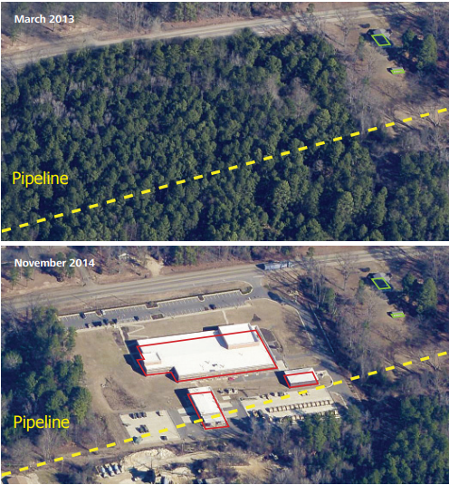
Remote Sensing and LiDAR
Data is collected quickly and high accuracy is maintained
High Resolution and Sample Density
Ortho Imagery Products
Repetitive coverage
Improvements in technology
Swath/Pulse tracking
Wider Area Mapping / Data Collection
Additional data which can be helpful when reclassifying
Notes:
Automatically update the database of structure locations by quickly and accurately identifying new buildings, changes to existing structures, and any removed buildings.

Slide 10
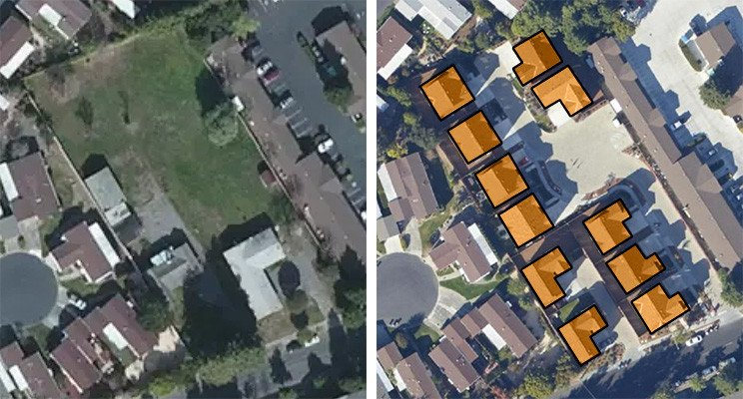
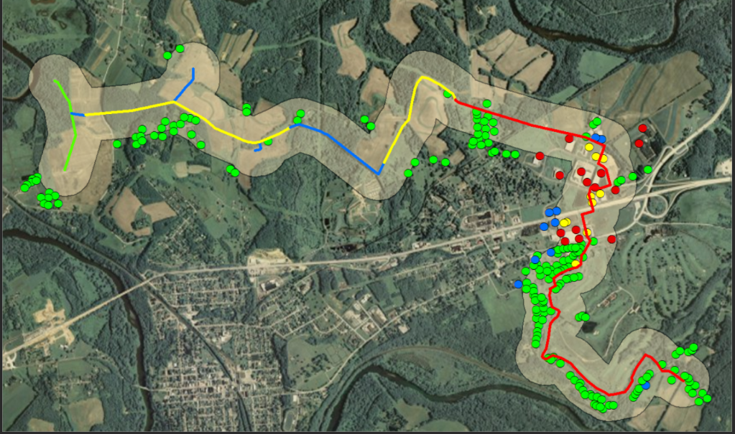
Photo Credits: Enview and Pacific Gas & Electric

Slide 11
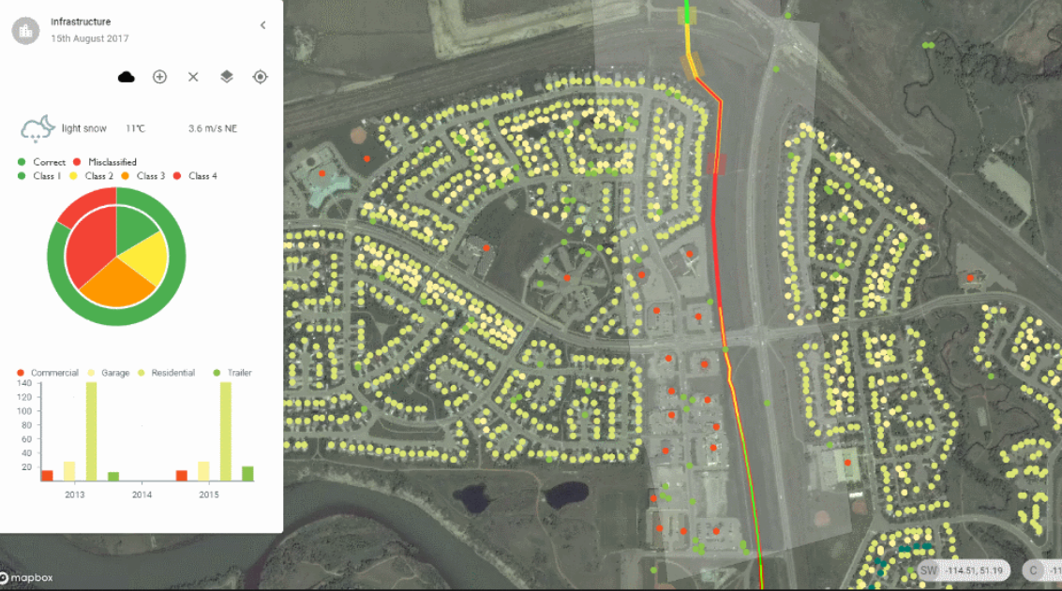
Photo Credit: LookNorth Services

Slide 12
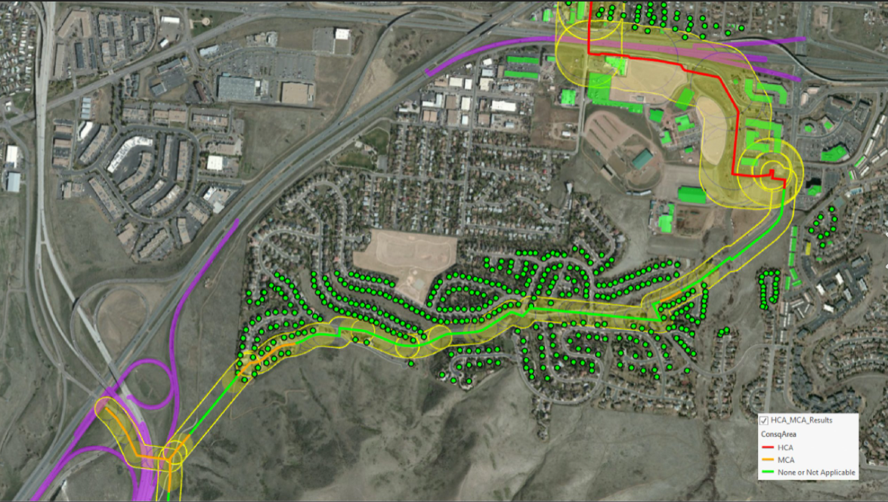

Slide 13
Goals and Objectives

Slide 14
Goals and Objectives
Determining the Class Location and HCA change differences between the Bay Area and Sacramento Regions.
Interpreting the affects of urban growth on HCA and Class Location changes to Gas Pipeline System.

Slide 15
Proposed Methodology

Slide 16
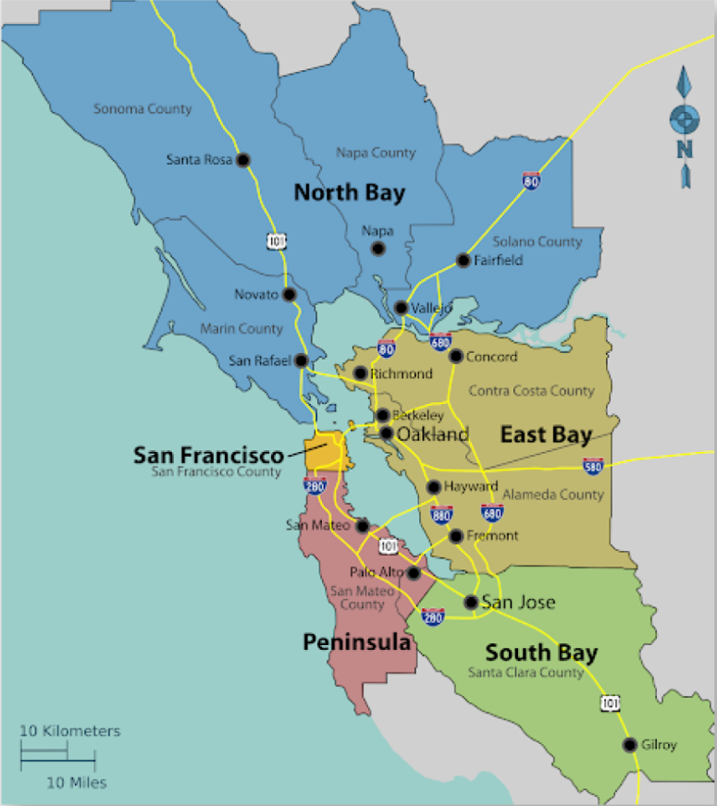
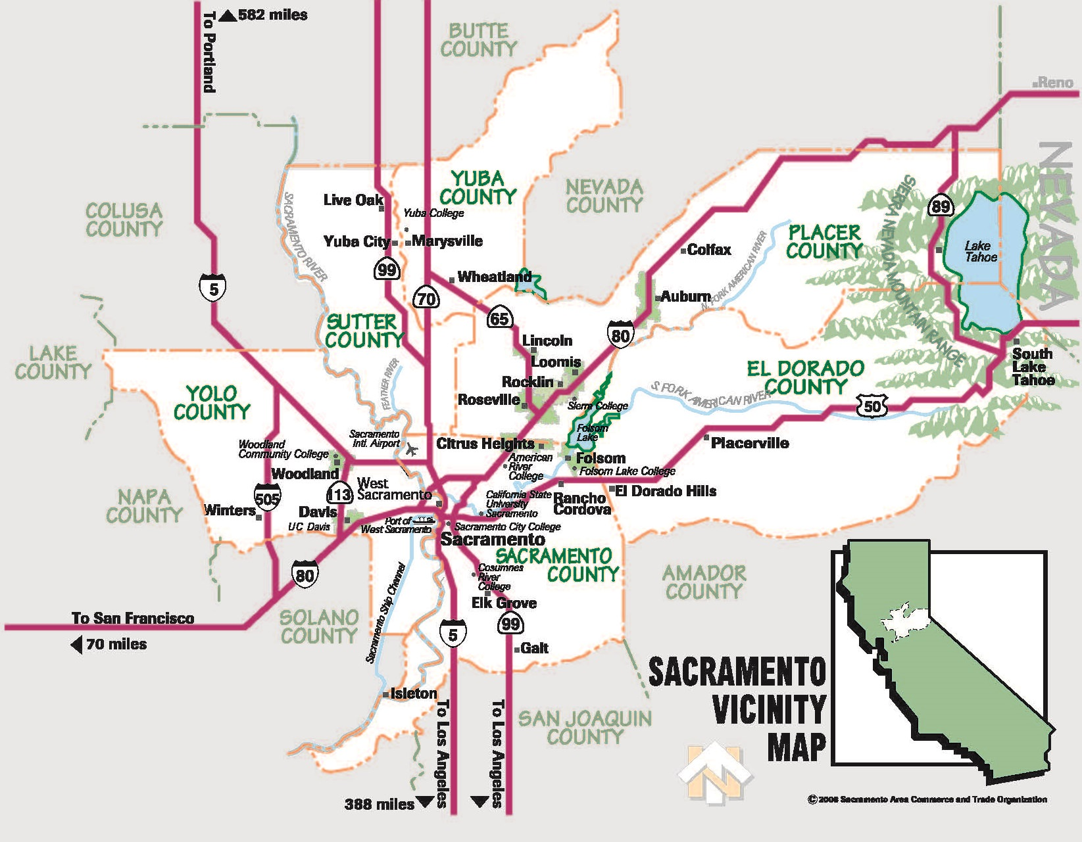
Study Area
Bay Area Region
Sacramento Region
Photo Credit: Sacramento County

Slide 17
Process Workflow
Creation of Ortho Imagery
Image Acquisition
Point Cloud Generation
Ground Filtering
OrthoMoasic Creation
Identify HCA’s
(See Below)
Create Dashboards, Web Apps, and Maps
Class 3 Locations
Choose Method to Identify Pipe Segments
Identify HCA’s
Class Location
Class 4 Locations
PIR Containing Identified Sites
Re-Evaluate HCA’s using New Information
Area Outside Class 3 or 4 with PIR > 660 ft and 20 or more Buildings Intended for Human Occupancy
Document New HCA’s
PIR Buffer
PIR containing 20 or more Buildings Intended for Human Occupancy
PIR Containing Identified Sites

Slide 18
Project Timeline

Slide 19
Project Timeline
596A Presentation, May 2021
Gather Data, June 2021
Present at Conference or PSU Zoom Session Fall 2021
Submit Abstract , May 2021
Analysis, July – September 2021

Slide 20
Anticipated Results

Slide 21
Anticipated Results
Deliverables
Web Map of updated HCA / Class Location layer.
Dashboard showing changes in HCA in the Study Areas. (Entire Gas System – long term)
Create a feature service.
Short Term Goal
Application to show which buildings affected changes in HCA/Class Location to the Gas Transmission Pipeline system.
Long Term Goal
Dashboard can be user friendly and displaying up to date changes in HCA and Class Location.

Slide 22
Potential Venues

Slide 23
Potential Venues
Illinois GIS Conference - October 17th – 19th , 2021
GIS in the Rockies Sept 28-30th, 2021
Abstract due Aug 31st
Penn State Zoom Session

Slide 24
References
Akbulut, Z., Özdemir, S., Acar, H. et al. Automatic Building Extraction from Image and LiDAR Data with Active Contour Segmentation. J Indian Soc Remote Sens 46, 2057–2068 (2018)
Akbulut, Z., Özdemir, S., Acar, H., Dihkan, M., and Karsli, F., Automatic Extraction of Building Boundaries from High Resolution Images with Active Contour Segmentation. International Journal of Engineering and Geosciences (IJEG), Vol; 3; , Issue; 1, pp. 036-042, February, 2018.
Rasha Alshehhi, Prashanth Reddy Marpu, Wei Lee Woon, Mauro Dalla Murab, Simultaneous extraction of roads and buildings in remote sensing imagery with convolutional neural networks. ISPRS Journal of Photogrammetry and Remote Sensing. Volume 130, August 2017, Pages 139-149.
Bouziani, M., Goïta, K., He, D.-C., 2010. Automatic change detection of buildings in urban environment from very high spatial resolution images using existing geodatabase and prior knowledge. ISPRS Journal of Photogrammetry and Remote Sensing, 65, pp. 143–153. ‘
Brown, Rick. "Pipeline Safety Enhancement Plan Impacts On Gas System Planning." Paper presented at the PSIG Annual Meeting, Santa Fe, New Mexico, May 2012.
Cohesive Solutions (2019). PHMSA Location Classifications and HCA’s. https://www.gomaximo.org/wp-content/uploads/2018/01/GOMaximo-2018-Cohesive-PHMSA-Class-Locations-and-HCA.pdf
Federal_User_Community. Natural Gas Interstate and Intrastate Pipelines. (2020). [Data file]. Retrieved from https://services2.arcgis.com/FiaPA4ga0iQKduv3/arcgis/rest/services/Natural_Gas_Interstate_and_Intrastate_Pipelines_1/FeatureServer
Ishimaru, N. & Iwamura, K. & Kagawa, Y. & Hino, T.. (2012). Housediff: A map-based building change detection from high resolution satellite imagery using geometric optimization method. ISPRS - International Archives of the Photogrammetry, Remote Sensing and Spatial Information Sciences. XXXIX-B4. 73-78. 10.5194/isprsarchives-XXXIX-B4-73-2012.
Karantzalos K. (2015) Recent Advances on 2D and 3D Change Detection in Urban Environments from Remote Sensing Data. In: Helbich M., Jokar Arsanjani J., Leitner M. (eds) Computational Approaches for Urban Environments. Geotechnologies and the Environment, vol 13. Springer
Leis, B. N., and Rahman, S. (August 1, 1994). "Risk-Based Considerations in Developing Strategies to Ensure Pipeline Integrity—Part I: Theory." ASME. J. Pressure Vessel Technol. August 1994; 116(3): 278–283. https://doi.org/10.1115/1.2929588
Mishra, Shivangi & Shrivastava, Priyanka & Dhurvey, Priyanka. (2017). Change Detection Techniques in Remote Sensing: A Review. International Journal of Wireless and Mobile Communication for Industrial Systems. 4. 1-8. 10.21742/ijwmcis.2017.4.1.01.

Slide 25
References
Pacific Gas and Electric Company Natural Gas Transmission Pipeline Rupture and Fire, San Bruno, California, September 9, 2010. PAR-11/01. Washington, DC: NTSB. http://www.ntsb.gov/doclib/reports/2011/PAR1101.pdf
Porter, T, & Donaho, D. "Pipeline Integrity Data: Managing Past, Present, Future." Proceedings of the 2014 10th International Pipeline Conference. Volume 2: Pipeline Integrity Management. Calgary, Alberta, Canada. September 29–October 3, 2014. V002T06A024. ASME. https://doi.org/10.1115/IPC2014-33708
Pushparaj, J., & Hegde, A. V. (2017). A comparative study on extraction of buildings from Quickbird-2 satellite imagery with & without fusion. Cogent Engineering, 4(1), 1291118.
National Transportation Safety Board (NTSB). 2014 PHMSA. Integrity Management of Gas Transmission Pipelines in High Consequence Areas. https://www.ntsb.gov/safety/safety-studies/Documents/SS1501.pdf
National Transportation Safety Board (NTSB). 2014. Columbia Gas Transmission Corporation Pipeline Rupture, Sissonville, West Virginia, December 11, 2012. PAR-14/01. Washington, DC: NTSB. http://www.ntsb.gov/doclib/reports/2014/PAR1401.pdf
Rupture of Florida Gas Transmission Pipeline and Release of Natural Gas Near Palm City, Florida, May 4, 2009. PAB-13/01. Washington, DC: NTSB. http://www.ntsb.gov/doclib/reports/2013/PAB1301.pdf
Stephens, MJ, Leewis, K, & Moore, DK. "A Model for Sizing High Consequence Areas Associated With Natural Gas Pipelines." Proceedings of the 2002 4th International Pipeline Conference. 4th International Pipeline Conference, Parts A and B. Calgary, Alberta, Canada. September 29–October 3, 2002. pp. 759-767. ASME. https://doi.org/10.1115/IPC2002-27073
Tran, T.H.G.; Ressl, C.; Pfeifer, N. Integrated Change Detection and Classification in Urban Areas Based on Airborne Laser Scanning Point Clouds. Sensors 2018, 18, 448.
Wilson, D, Colquhoun, I, & Carnes, D. "Strengthening the Current Class Location Designation System." Proceedings of the 2018 12th International Pipeline Conference. Volume 2: Pipeline Safety Management Systems; Project Management, Design, Construction, and Environmental Issues; Strain Based Design; Risk and Reliability; Northern Offshore and Production Pipelines. Calgary, Alberta, Canada. September 24–28, 2018. V002T02A013. ASME. https://doi.org/10.1115/IPC2018-78672
Yuan, F., Sawaya, K.E., Loeffelholz, B.C., Bauer, M.E., 2005. Land cover classification and change analysis of the Twin Cities (Minnesota) Metropolitan Area by multitemporal Landsat remote sensing. Remote Sensing of Environment, 98, pp. 317–328.

Slide 26
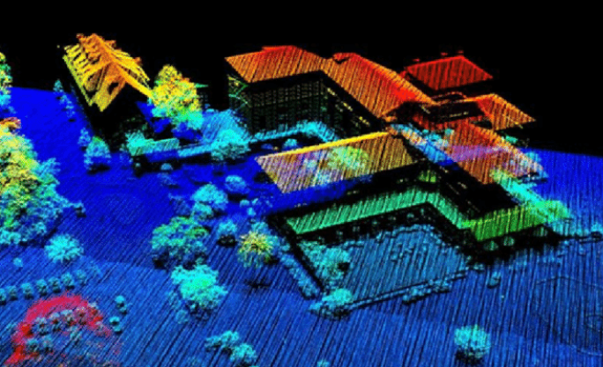
Questions

