Slide 1

GEOSTATISTICAL SEISMIC ANALYSIS AND HAZARD ASSESSMENT;
UNITED ARAB EMIRATES
College of Earth and Mineral Sciences
Diena Al-Dogom
Karen Schuckman
Rami Al-Ruzouq

Slide 2
Overview
Introduction
Objectives
Study Area
Problem Definition
Spatial Data
Methodology
Results and Analysis
Conclusion and Future work

Slide 3
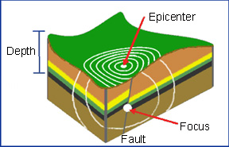
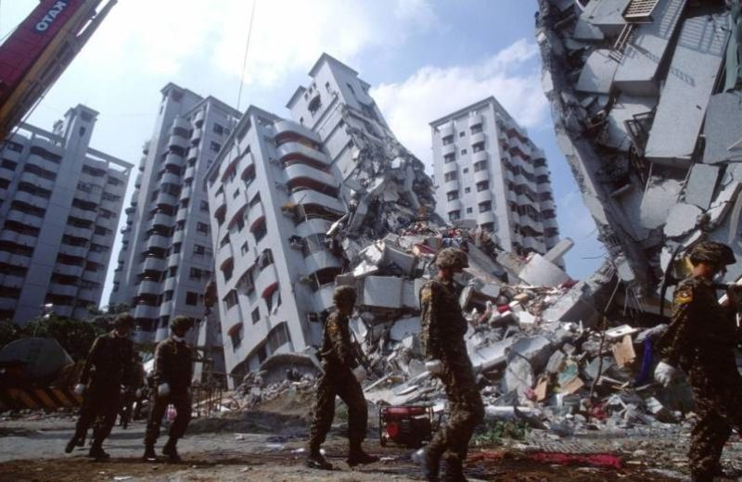
Introduction
Earthquake is the shaking of the Earth surface, resulting from the sudden release of energy in the Earths lithosphere that creates seismic waves.
Earthquake have a substantial effect on human lives, infrastructures and economy. Even though it is considered as a short period disaster, its impact on the affected area could last for years.
Earthquake are described by its magnitude, speed of onset, frequency, duration, and its geographic location (epicenter location).

Slide 4
Objectives
Identify and map-related geological, geophysical factors and their weighted contribution in seismic activity at UAE.
Perform spatial-temporal statistical analysis for earthquake events within Arabian plates along with its directional distribution.
Develop Peak Ground Acceleration (PGA) map.
Utilize Analytic Hierarchy Process (AHP) along with weighted overlay analysis to prepare Seismic Hazard Zonation Map (SHZM) for UAE.

Slide 5
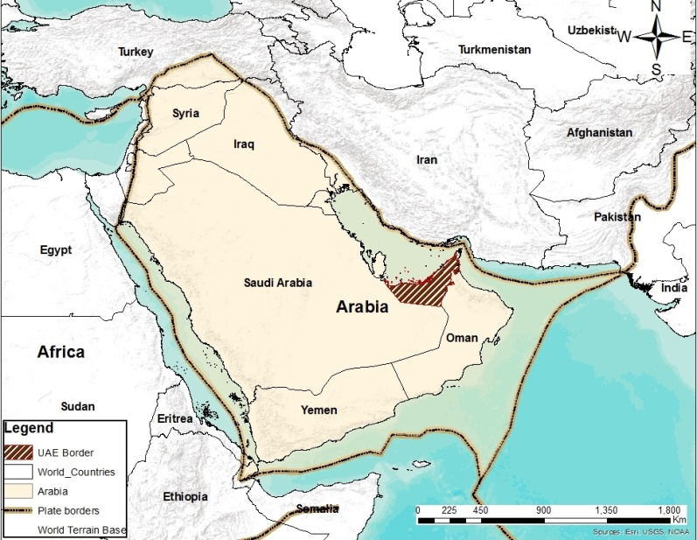
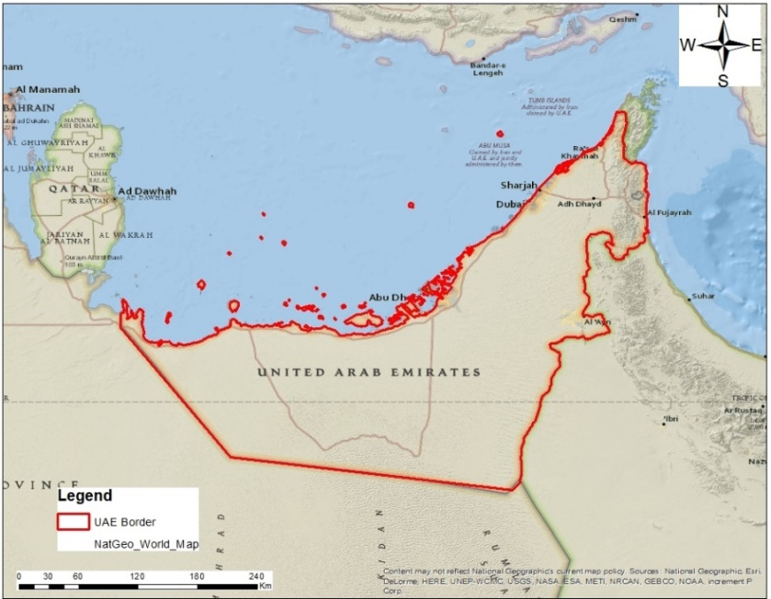
Study Area
UAE is located at the Arabian plate, western Asia at the southeast end of the Arabian Peninsula.
UAE total area is 83,600 km2, its population estimate :
    2005 was 4,106,427
    2016 was 9,269,612
UAE coast stretches for more than 650 km (404 mi) along the southern shore of the Arabian Sea.

Slide 6
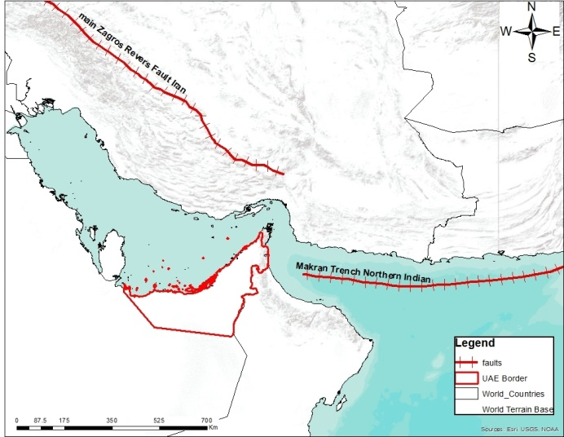

Problem Definition
Previous studies described UAE as low seismic activity area (Aldama-Bustos et al., 2009) where seismic hazards have been classified as insignificant (Pascucci et al., 2008).
UAE’s proximity to major faults and active seismic sources.
UAE’s extensive urban development activities and financial investments, and it’s rapidly growing population reveal an urgent need to examine and study the region’s seismic risk (Al-Ruzouq et al., 2017).

Slide 7
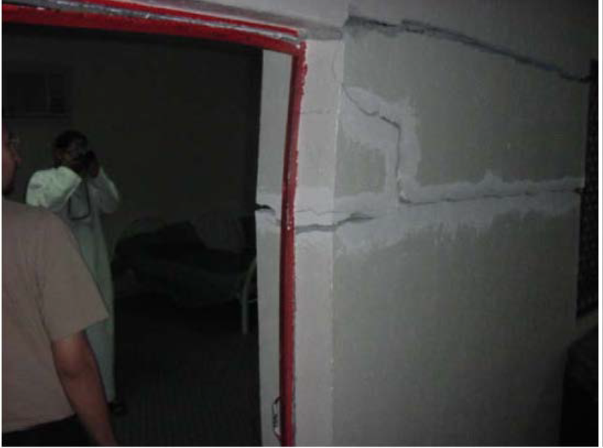
Problem Definition
Reported damage around Masafi area, after the March 11th, 2002 moderate earthquake (Al Shamsi, 2013).

Slide 8

Spatial Data
Earthquake events
Earthquake catalogue (Deif et, 2017)
Digital Elevation Model (DEM)
USGS
Faults Lines
ArcGIS online map
Soil
UAE Atlas Map
Geology
Landsat 8 images

Slide 9
Methodology
Spatial Data
  Earthquake Catalog
  Faults line
  DTM
  SOIL
  Geology
2. Data Processing
  Statistical Analysis
  Geo-referencing
  Mosaicking
  Classification
  Slope generation
  Distance generation
3. AHP
  Weighting
  Ranking
  Reclassifying

Slide 10
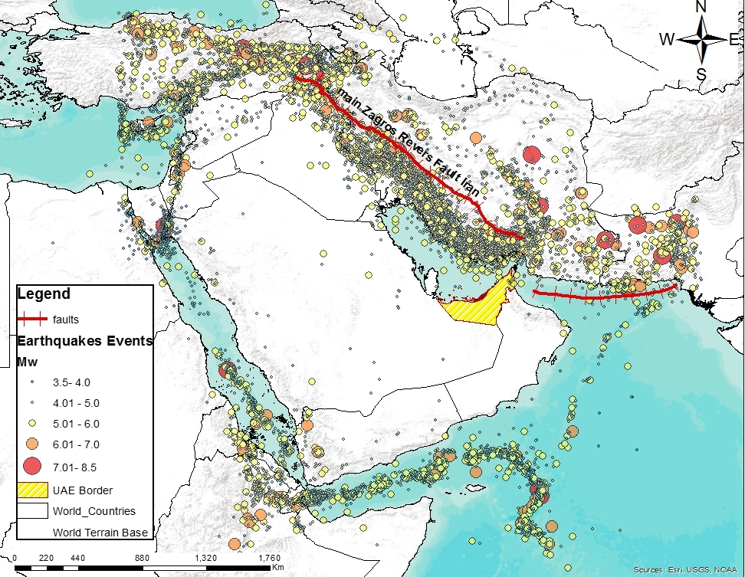
Methodology
Faults Lines
(AlHomoud el, 2004)
Earthquake catalogue
(Deif et, 2017)

Slide 11



Methodology
Kernel Density
Estimator (KDE)
Earthquake
events
Faults Lines
ArcGIS online map
Anselin local
Moran’s I
Getis–Ord Gi*
Peak Ground Acceleration (PGA)
Directional Distribution

Slide 12
Methodology
Earthquake
events
KDE
KDE was applied to create a continuous surface of earthquake density based on earthquakes magnitudes to show the location of the most powerful earthquakes.
KDE shows a peak at the location of the event and decreases with the increasing of the distance from the event until reaching zero at the search radius distance from the event.
Getis–Ord Gi*
Soil
UAE Atlas Map
Anselin local
Moran’s I

Slide 13
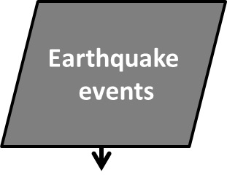
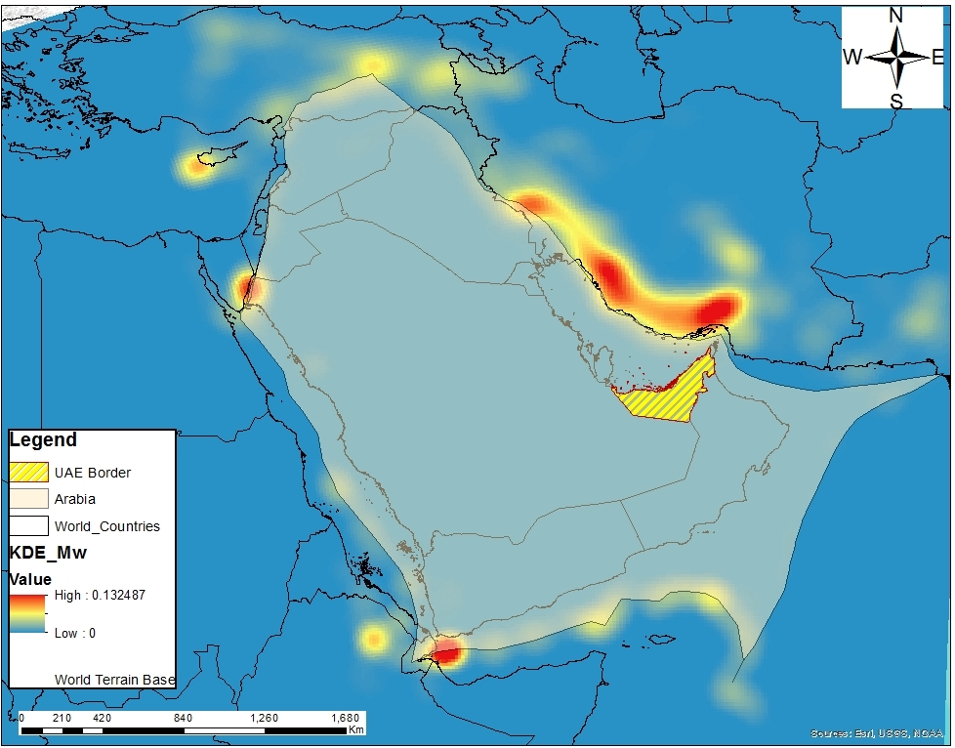

Methodology
Getis–Ord Gi*
Soil
UAE Atlas Map
Anselin local
Moran’s I

Slide 14

Methodology
Positive values for the Anselin local Moran’s I index show that an event has neighboring events with the same high or low attribute values; and is part of a spatial cluster. On the other hand, negative values showed different values of neighboring events and considered to be an outlier.
Moreover, the p-value must be less than 0.05 (p<0.05) to considered statistically significant.
Getis–Ord Gi*
Soil
UAE Atlas Map
Anselin local
Moran’s I

Slide 15
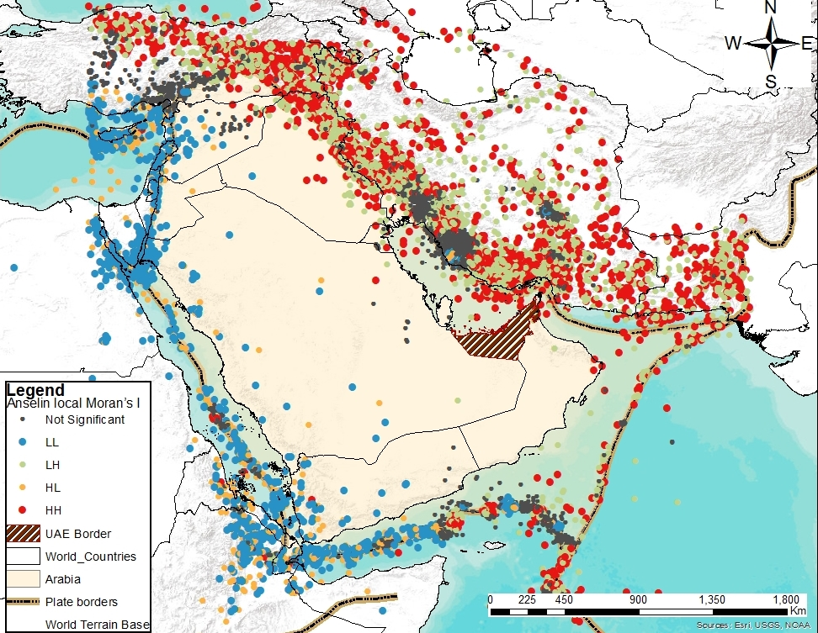


Methodology
Getis–Ord Gi*
Soil
UAE Atlas Map
Anselin local
Moran’s I

Slide 16

Methodology
Gi* navigates locality based on nearby events or a set distance and gets a Z score.
Statistically significant positive Z scores mean hotspot area, the higher the Z score is, the more intense the clustering of hotspots.
Statistically significant negative Z score means cold spot area, the lesser the Z score, the more intense the clustering cold spots.
Getis–Ord Gi*
Soil
UAE Atlas Map
Anselin local
Moran’s I

Slide 17
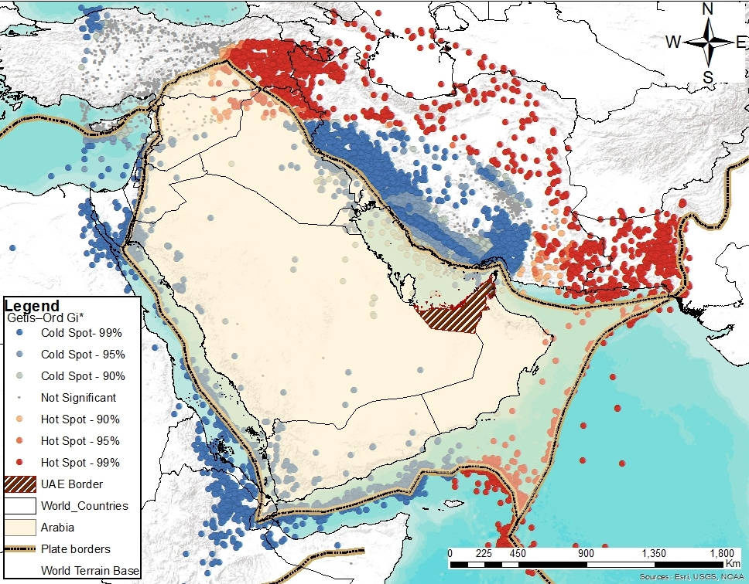


Methodology
Soil
UAE Atlas Map
Anselin local
Moran’s I

Slide 18

Methodology
PGA is equal to the maximum ground acceleration that occurred during earthquake shaking at a location.
The attenuation relationship or Ground Motion Prediction Equations (GMPEs) describes the decrease in PGA (for an earthquake of (M) magnitude) with the distance from the earthquake epicenter (R).
PGA map has been developed using the attenuation relation addressed by IIEES (Zare, 2002).
PGA
Soil
UAE Atlas Map
Anselin local
Moran’s I

Slide 19
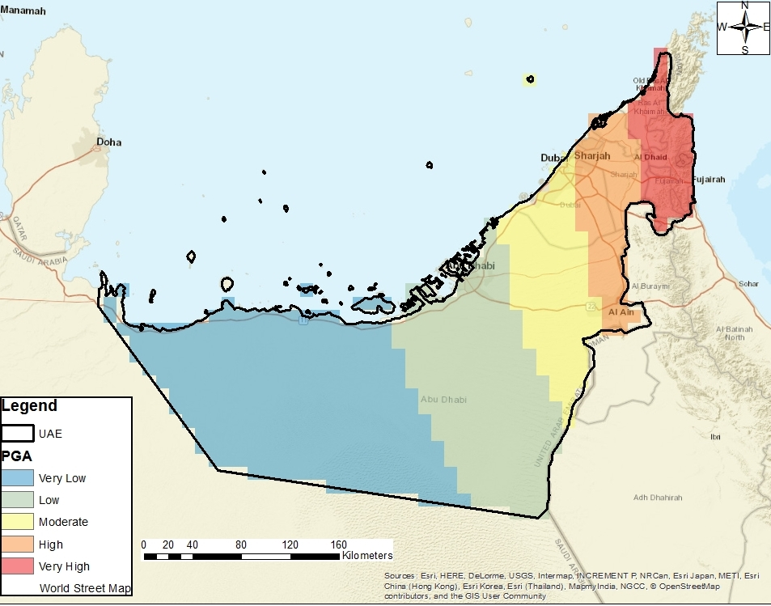



Methodology
Soil
UAE Atlas Map
Anselin local
Moran’s I

Slide 20
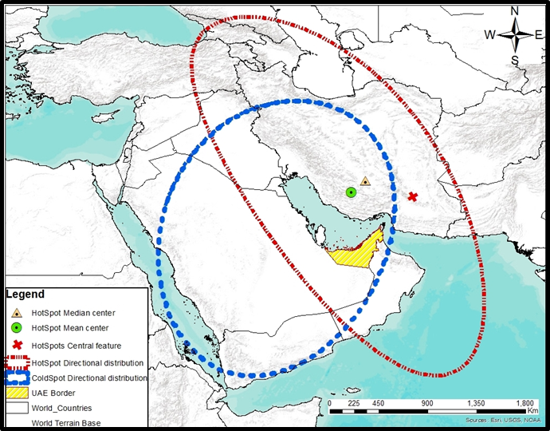
Methodology
Directional
Distribution
Directional distribution (standard deviational ellipse) used to measure the geographic distribution of earthquakes
It creates standard deviational ellipses show the spatial characteristics of earthquake events such as directional trends, central tendency, and dispersion.
Soil
UAE Atlas Map
Anselin local
Moran’s I

Slide 21
Methodology
Digital Elevation Model (DEM)
USGS ASTER Digital Elevation Model with 30m resolution.
The influence of topography is an important factor in the mapping of the earthquake hazards.
Even though there is no large variation in the slope along the study area but due to the population growth and expansion of urban areas near the mountains, slope effect had to be considered in this study.
Increase factors of topography are derived from the study area DEM
Soil
UAE Atlas Map
Anselin local
Moran’s I

Slide 22

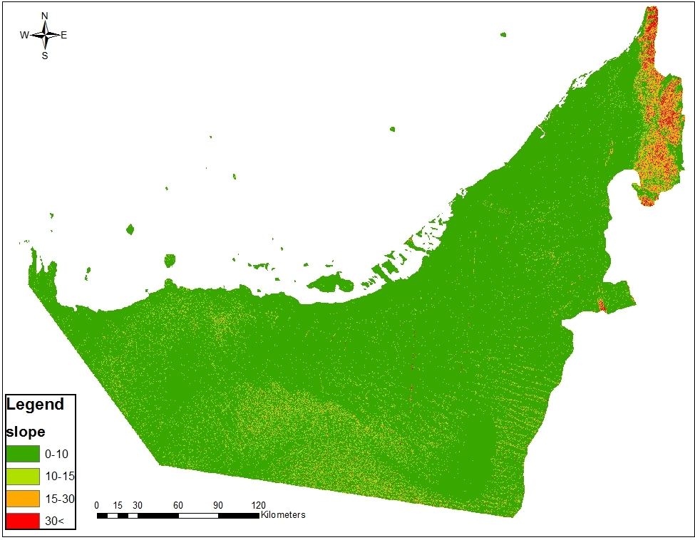
Methodology
Slope map
Soil
UAE Atlas Map
Anselin local
Moran’s I

Slide 23

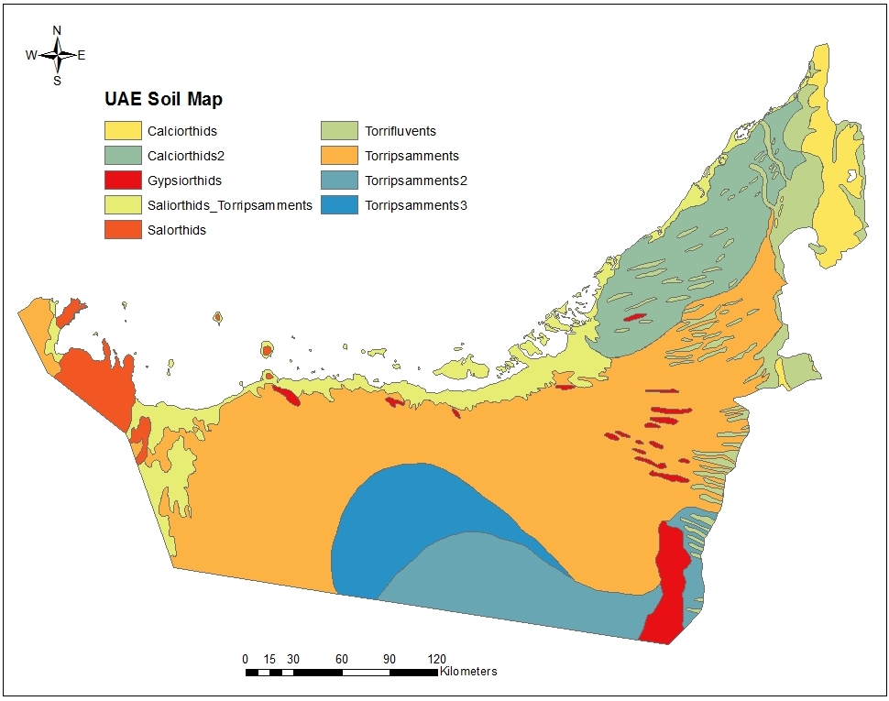
Methodology
Soil map is an efficiency factor that contributes in investigating the seismicity of an area.
In this study atlas soil map for the study area (acquired from University of Sharjah) has been scanned, georeferenced and digitized.
Soil
UAE Atlas Map
Anselin local
Moran’s I

Slide 24

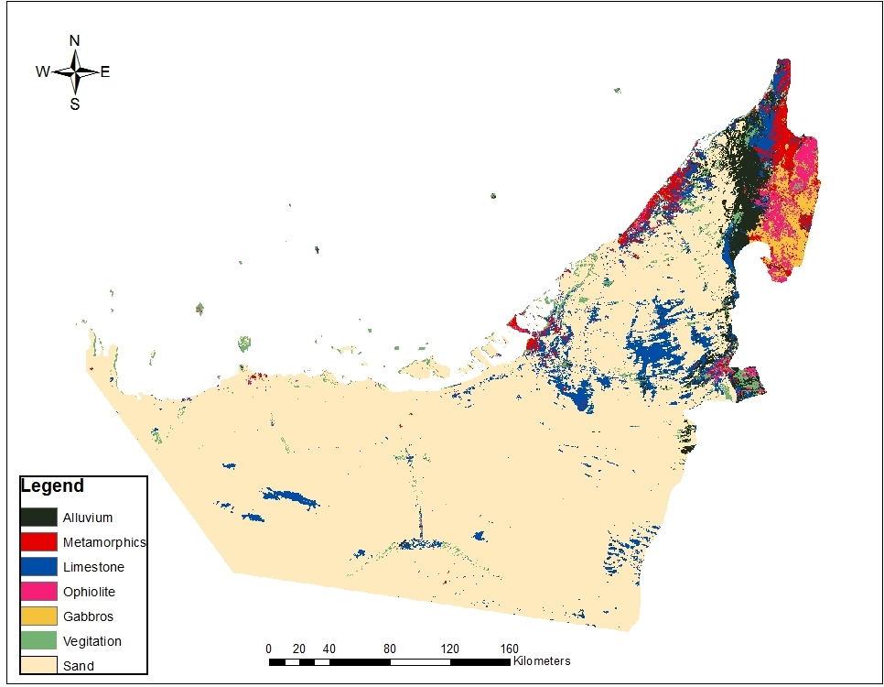
Methodology
Landsat 8 free of cloud cover for the year 2017 were downloaded from USGS web site then mosaicked.
Band combinations (6,7,4) made the input for the supervised classification. (Mwaniki et, 2015)
The ground truth samples were taken from Atlas UAE geology map
Soil
UAE Atlas Map
Anselin local
Moran’s I

Slide 25
Methodology
Distance
Map
Slope
Map
Geology
Map
Soil
Map
PGA
Map

Slide 26
Methodology
AHP is a method that allows the consideration of both objective and subjective factors in ranking alternatives.
AHP assists the decision-making process by organizing the alternative solutions to a specific problem in a hierarchical decision model (Erden and Karaman, 2012).
Slope
Map

Slide 27
Methodology
Taking into consideration experts opinion, and after literature review the pairwise comparison matrix had been developed to assign the suitable weights.

Slide 28
Methodology
According to experts opinion, literature review, and after generating the pairwise comparison matrix each of the considered factors (that includes PGA, and distance from main faults, slope, soil, geology maps) had been reclassified and ranked.

Slide 29
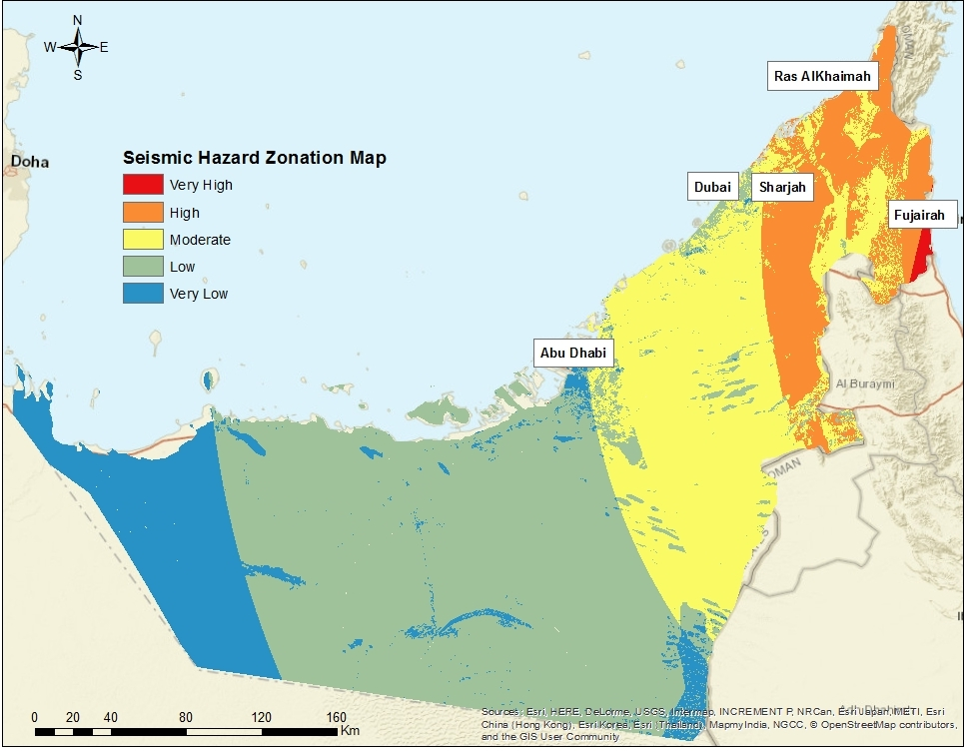
Methodology

Slide 30
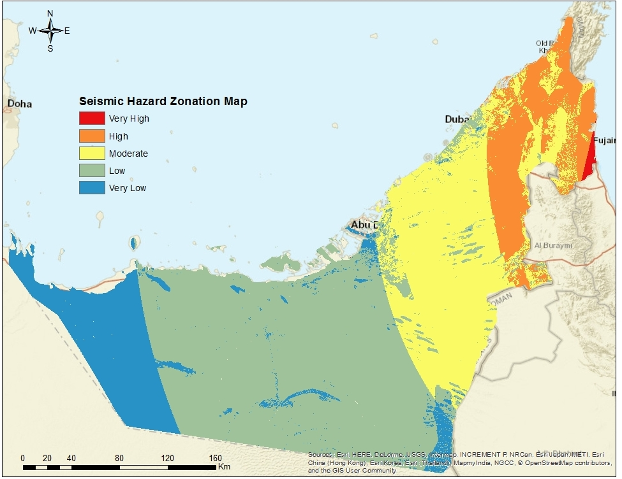
Results and Analysis
Five risk zones had been developed according to the region earthquake hazard
The amplification effect of the PGA, slope, and source to site distance parameters reach its highest at the Fujairah and Old Ras al-Khaimah emirates.
The amplification effect of the geology and soil parameters reach its highest at the middle and southern parts of the study area.

Slide 31

Results and Analysis
“very high” risk zone is located in Fujairah city covering 202 km2 highly populated spot.
“high” risk zone covers some areas within Fujairah, Ras AlKhaimah, and Sharjah covering 7436 km2.
Sharjah and Dubai cities ranging from “High” to moderate zones.
Abu Dhabi city stands relatively far from seismic hot spots and major faults and placed in the low seismic risk zone.

Slide 32
Conclusion and Future work
This study represents an effort to investigate the temporal and spatial distribution of earthquakes at the Arabian plate between the years 1900 and 2015 and its correlation with UAE location.
Earthquake events were found to occur in cluster basically in the northern and southeastern parts of the Arabian plate.
Distances from Arabian plate earthquakes hotspots location had been used to generate PGA maps for the UAE.
In this study, various geospatial factors (include distance map, PGA, geology, soil, and slope maps) had been considered to locate the hazardous zones and develop UAE SHZM.

Slide 33
Conclusion and Future work
SHZM shows that coastal and downtown areas at Fujairah emirates are most vulnerable and its population is on a very high-risk zone.
10.78% of total study area falls under the high-risk zone, 25.91% under moderate risk, and 48.95% under low-risk zone.
The SHZM map is expected to increase the awareness for earthquake hazards.
Different emergency management procedures and vulnerability studies should be considered.

Slide 34
Questions?

