Slide 1
The Potential Effect of Modern Erosion on Surface Runoff
Using LIDAR to Estimate Erosion
Melissa Albino Hegeman
October 27, 2014
Advisor: Dr. Patrick Drohan

Slide 2
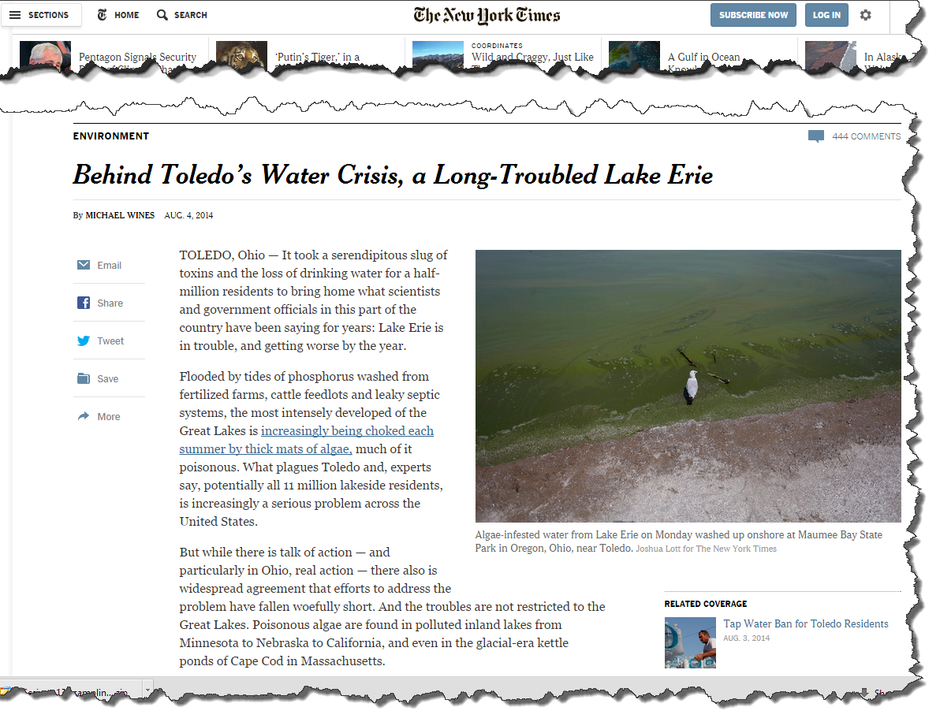
In the news...
Notes:
You might have heard about Toledo, Ohio’s drinking water problems this summer. A toxic algae bloom in Lake Erie contaminated the cities drinking water. This was in part due to nutrients from agriculture that allowed the bloom to grow. Other nutrient sources also part of the problem.

Slide 3
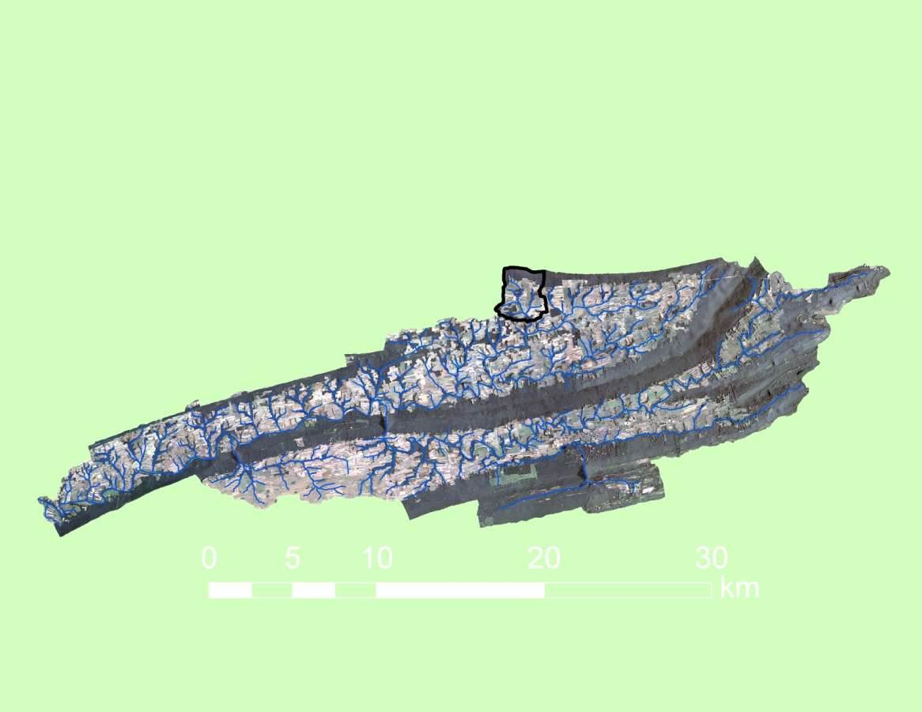
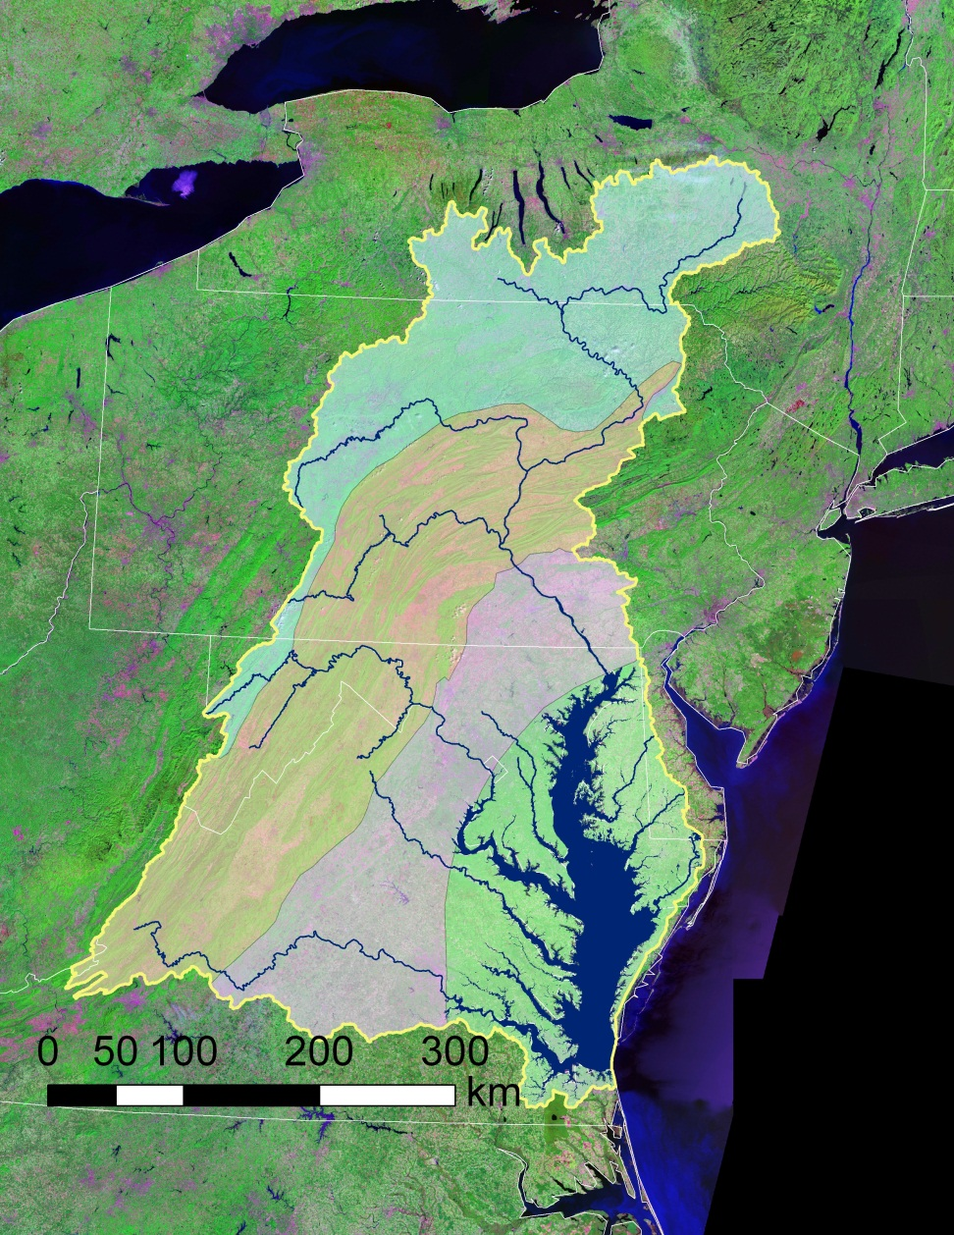

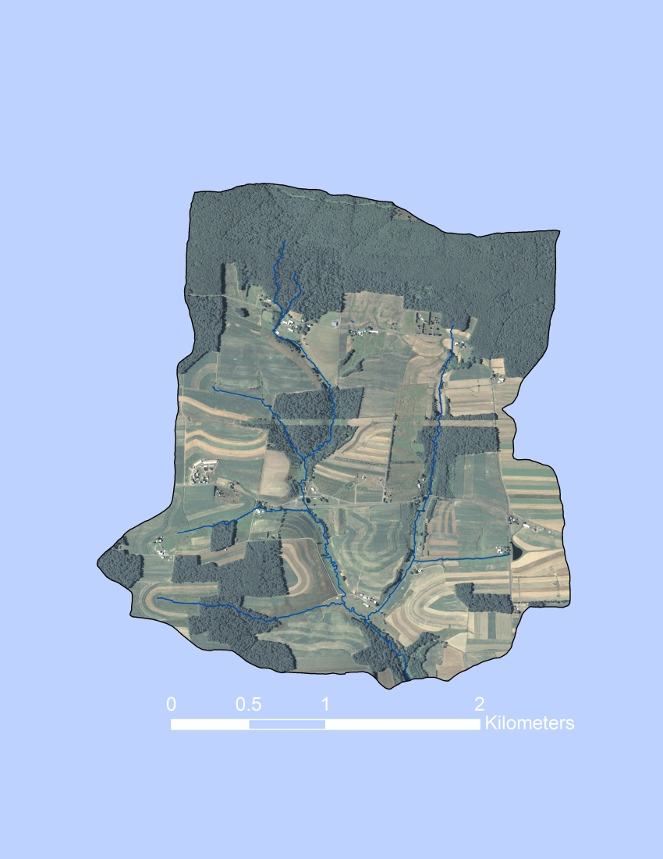
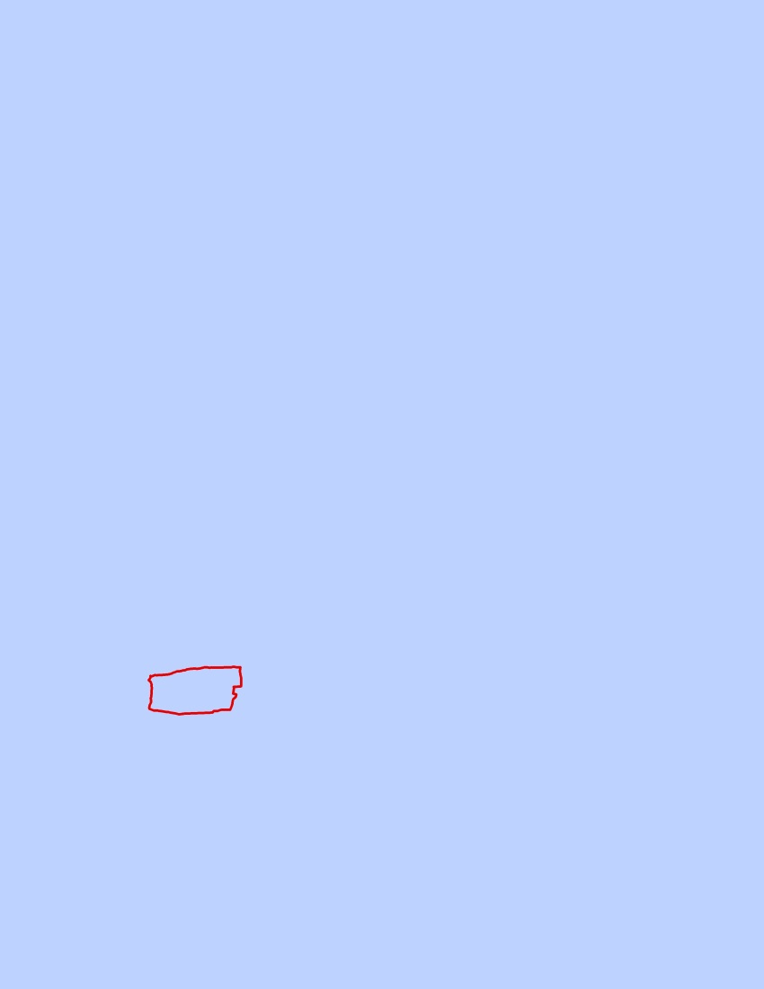
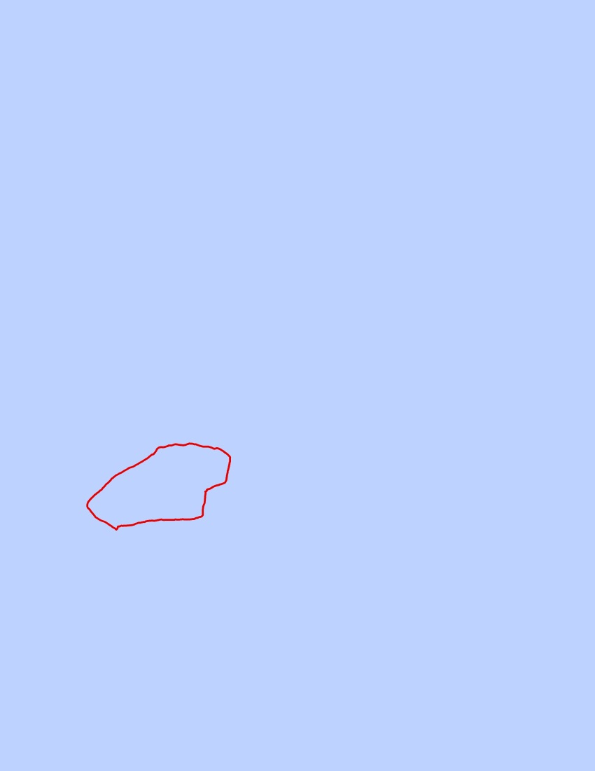
Variable Source Area hydrology of Chesapeake Bay uplands
WE-38
Klingerstown, PA
Allegheny
Plateau
WE-38 Watershed (7.3 km²)
Ridge &
Valley
Piedmont
Coastal
Plain
FD-36 (40 ha)
Mattern (11 ha)
Notes:
The Chesapeake Bay holds more than 18 trillion gallons of water.
The Bay receives about half its water from an enormous 64,000-square-mile watershed.
The Chesapeake Bay watershed includes parts of six states – Delaware, Maryland, New York, Pennsylvania, Virginia and West Virginia – and the entire District of Columbia.
About 150 streams, creeks and rivers drain to the Chesapeake Bay watershed.

Slide 4
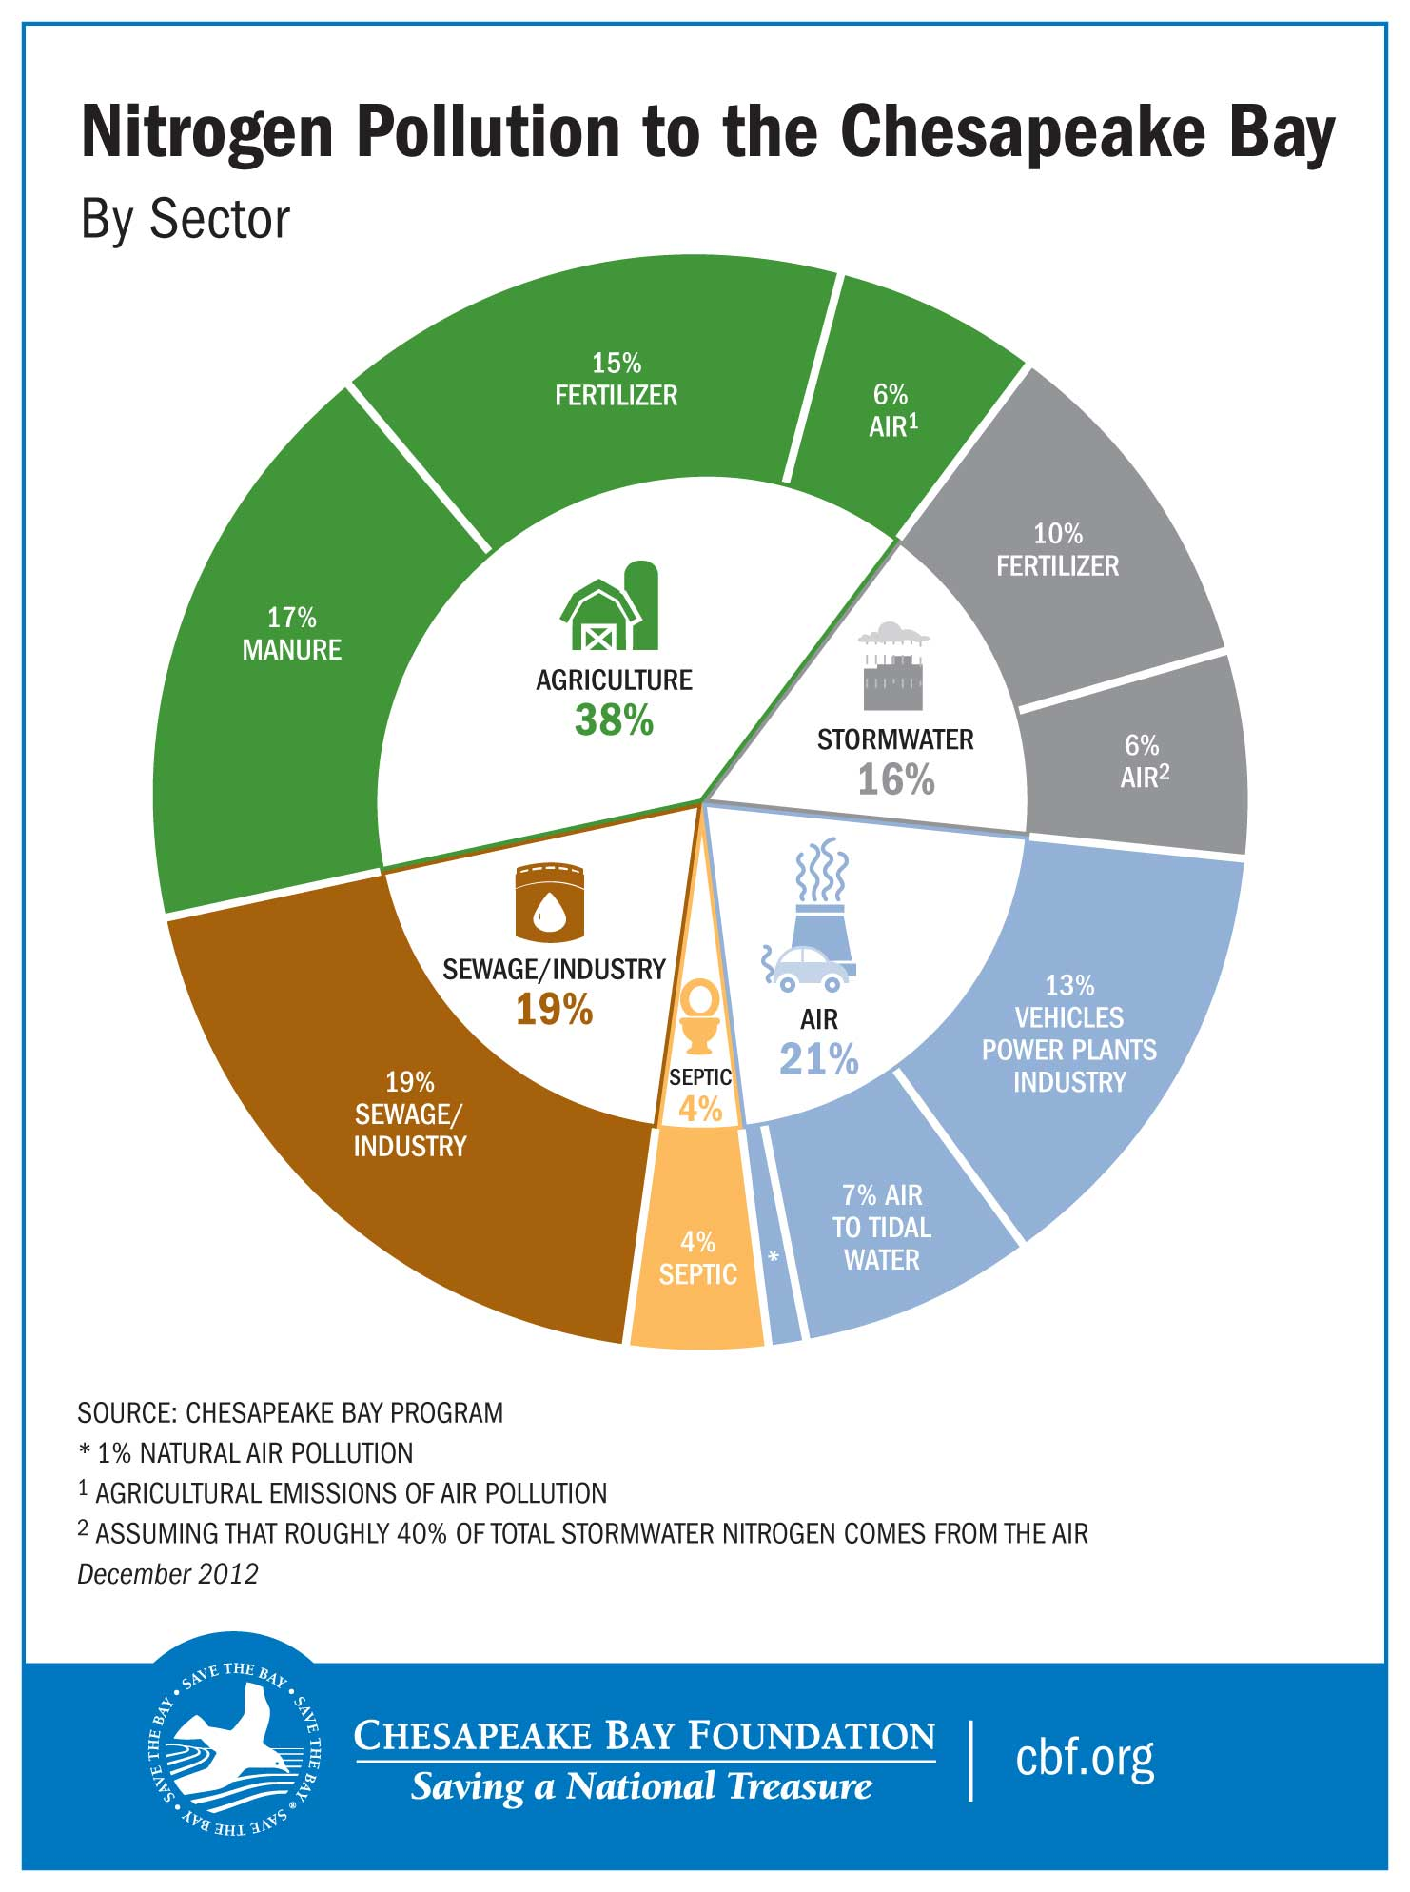
Notes:
Nutrients—primarily nitrogen and phosphorus—are essential for the growth of all living organisms in the Chesapeake Bay. However, excessive nitrogen and phosphorus degrade the Bay's water quality.
As land use patterns change and the watershed's population grows, the amount of nitrogen, phosphorus, and sediment entering the Bay's waters increases tremendously.
Each year, roughly 300 million pounds of polluting nitrogen reaches the Chesapeake Bay—about six times the amount that reached the bay in the 1600s.
A large amount of this nitrogen and phosphorus reaches the Bay via surface runoff.

Slide 5
The Fertilizer Forecaster Project
Penn State’s Soil Characterization Laboratory has a long term project with the USDA-ARS to predict surface runoff on agricultural landscapes.
This will eventually result in an application that can advise farmers when and where to apply fertilizer and manure.

Slide 6
Three basic mechanisms that generate surface runoff
Infiltration excess (IE) runoff
Rainfall rate
Rainfall
Infiltration rate
Saturation excess (SE) runoff
Perched SE runoff
Rainfall
Rainfall
runoff
layer
return flow
restrictive
Notes:
Nutrients enter the Bay via runoff, which can be generated in three ways.
Infiltration excess is produced when rainfall exceeds the ability for water to enter the soil (summer t-storms).
Saturation excess occurs when the soil volume fills with water (Fall or Spring rain events)
Perched water over a subsoil restrictive layers.
Restrictive layers are subsurface soil horizons that transmit water very slowly. They can form naturally (high clay, low porosity, high density).
They can also occur at the interface between two soils that have very different textures. Such situations can occur naturally during landslide events, eolian deposition or via erosion.

Slide 7
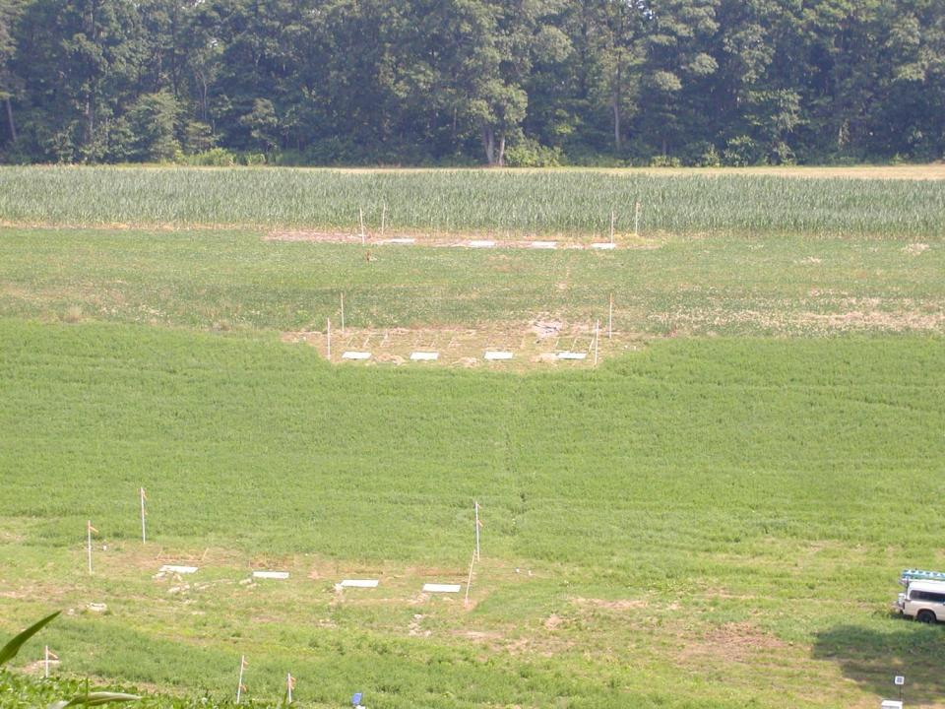
Restrictive layers in subsoils enhance surface runoff generation
Infiltration excess
Saturation excess
46 L
92 L
Berks soil
No restrictive layer, well drained
Albrights soil
restrictive layer, poorly drained
4620 L
Notes:
6
This is a hillslope…note the truck in the lower right for scale.
Restrictive layers can cause surface runoff to form very quickly due to a soil have a shallower depth to hold water.
In this figure you can see that the SE contributes a lot of water on this hillslope to the lower position due to the restrictive layer in the subsoil.

Slide 8
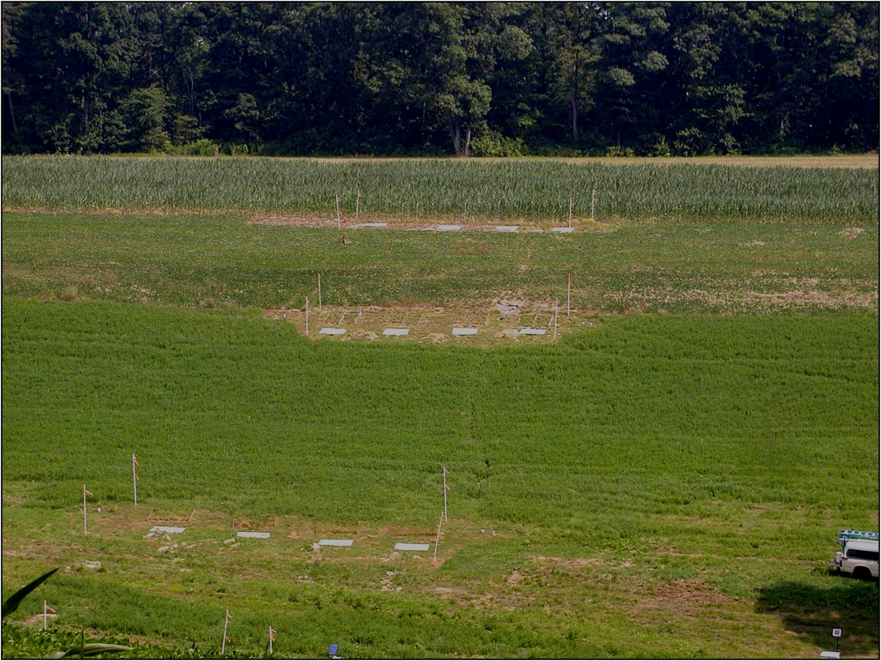
which can lead to large phosphorus (P) losses,
even from modest sources
Total P
<1 kg/ha/yr
Mehlich-3 P - 177 mg/kg
Applied P - 55 kg/ha/yr
1 kg/ha/yr
6 kg/ha/yr
Mehlich-3 P – 144
Applied P – 97
Berks soil
No fragipan, well drained
Mehlich-3 P – 78
Applied P – 0
Albrights soil
Fragipan, poorly drained
Notes:
7
P is a hard nutrient to manage for because it becomes bound in the soil very easily.
If you look at the nutrients applied on this hillslope versus what's already in the soil (Mehlich test) you can see that the high amount of P applied upslope ould be washed down the slope with runoff.

Slide 9
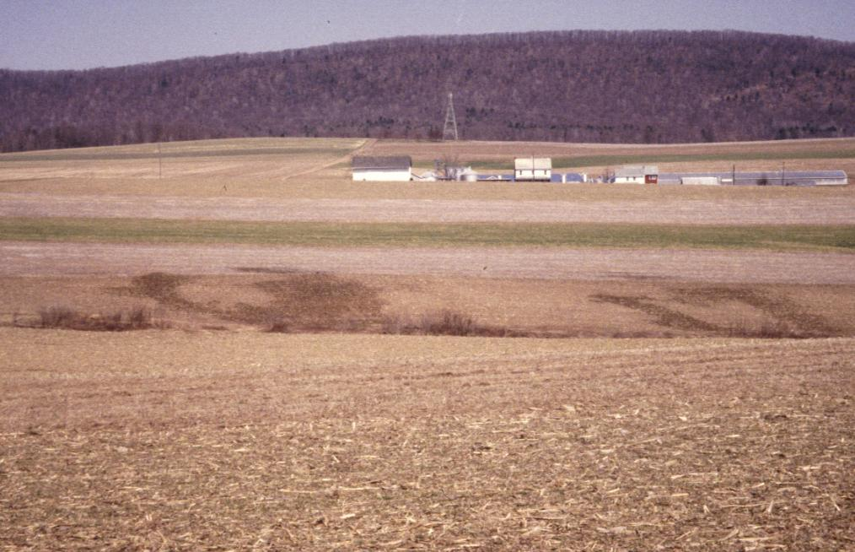
Phosphorus Index – a strategic tool for critical source area (CSA) identification
Runoff producing areas
Notes:
8
To put this in context on a different hillslope example, we see we have three zones of high P application (the red, yellow and green (low application) and a zone of runoff production.

Slide 10
CSAs represent regions
with the highest P loss potential
Notes:
9
Where these intersect we get what’s called a critical source area for nutrient runoff. These are high-priority areas to manage on farms to minimize runoff.

Slide 11
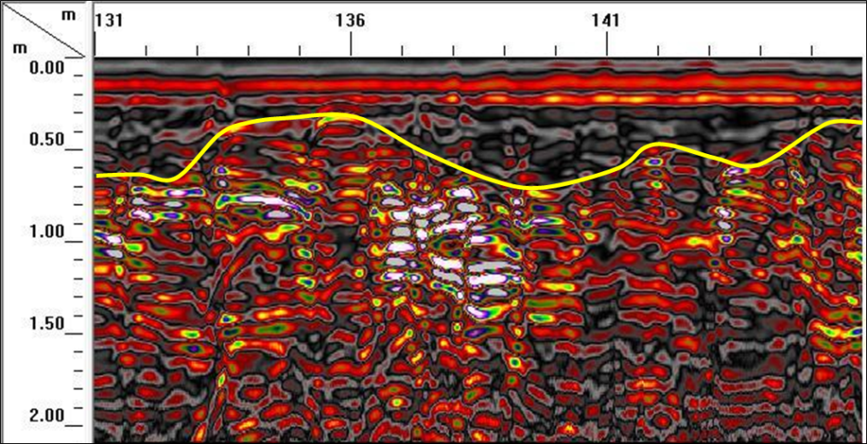
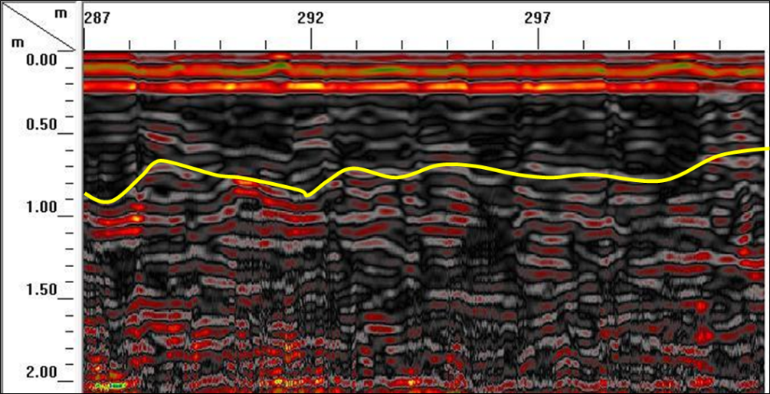
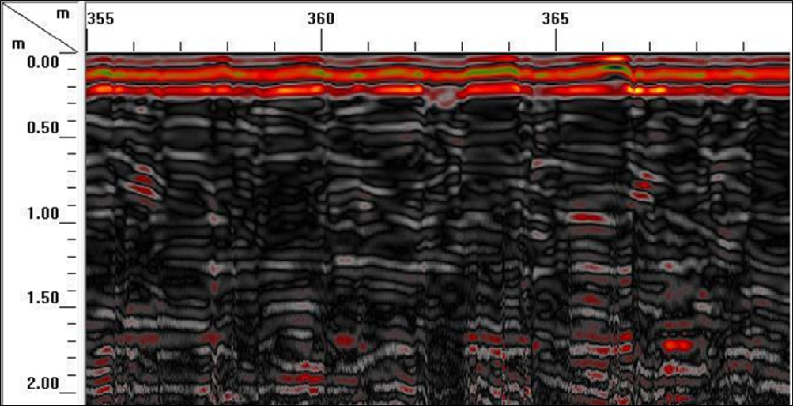
Near-stream
Mid-slope
Up-slope
Notes:
One goal of Dr. Drohan’s research is to try to develop high resolution models of restrictive layers so that we can better map landscapes prone to agricultural runoff.
This is an example of a ground penetrating radar image of a hillslope with the restrictive layer noted in yellow where present.

Slide 12
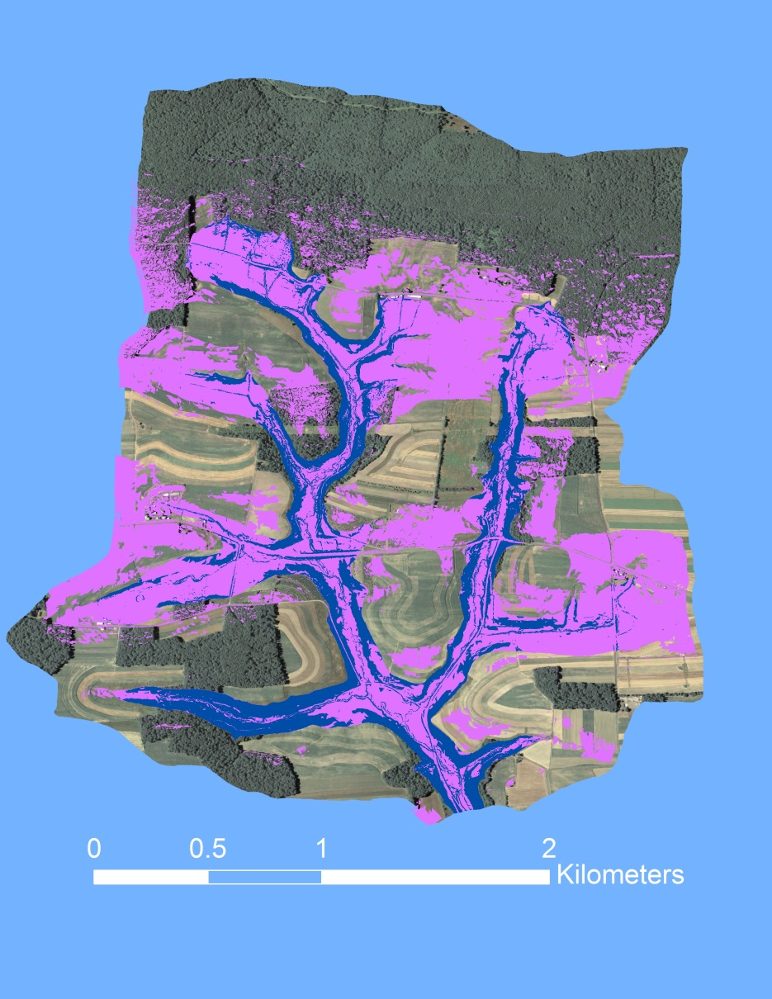
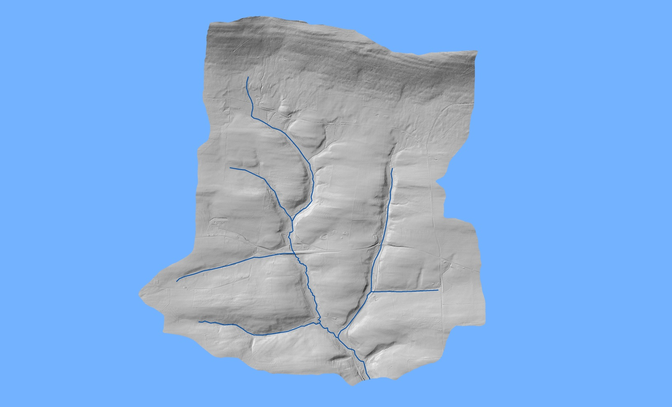
Results and outcomes
Digitally modeling and mapping soil restrictive layers
Depth to restrictive layer
LiDAR DEM (0.5 m resolution)
0.65 m
0.85 m
Linear regression between depth to restrictive layer and geomorphic variables (e.g., slope, aspect, etc.)
Notes:
Dr. Drohan has been working with the USDA-ARS (Tony Buda and Pete Kleinman) to model subsurface restrictive layers.
Here we see an example LIDAR image of the watershed I am working in (left) and an example of the geomorphic models that are predicting subsurface restrivtive layers at two diffeent depths.
These models were developed using ground penetrating radar of the restrictive layers that had been described in many different soil pits.
Note that restrictive layers were found at two different depths. Upslope the RL is shallower but at the footslope the RL is often deeper.

Slide 13
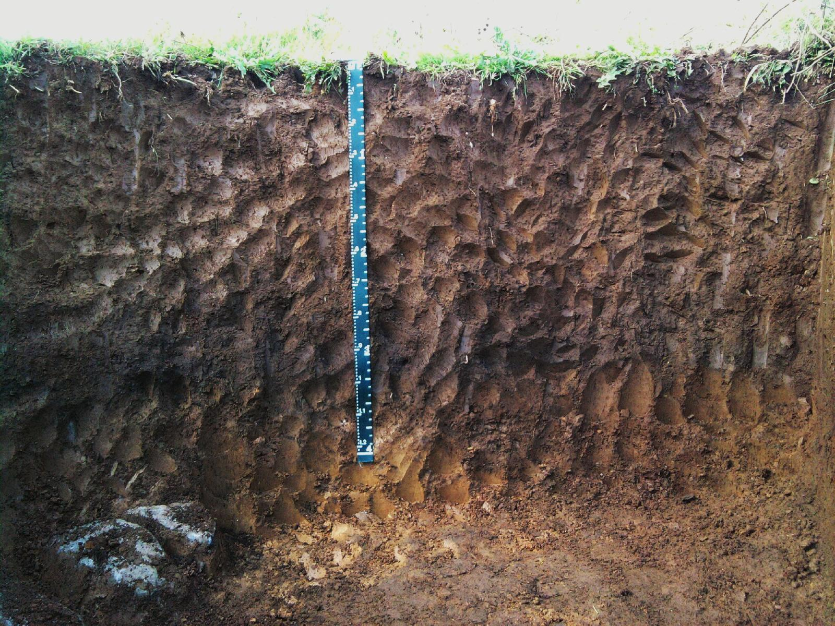

Slide 14
My Hypothesis
Modern erosion creates perched water that may increase surface runoff
Notes:
The idea is that eroded soil can be deposited over an existing soil layer. The boundary between these two layers is not permeable, so it may catch some water and prevent it from reaching the main water table.
??? This may cause the soil to reach saturation sooner and lead to SE surface runoff. Being able to locate these areas will lead to better predictions. ????

Slide 15
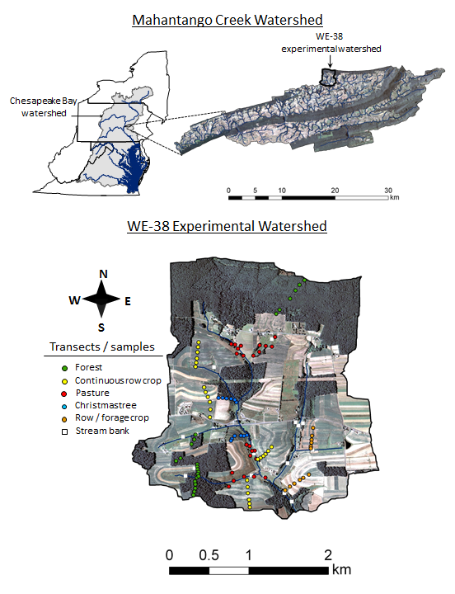
My Part
Study area-WE-38 experimental watershed
Use available high-resolution LIDAR data sets to identify areas of post-European erosion and sedimentation
Notes:
Use available LIDAR to look for erosion in the WE-38 experimental watershed.

Slide 16
The Data
High Resolution LIDAR (0.5 m resolution)
Ground level LIDAR from postprocessing of the data
15 cm vertical accuracy
2007
2011
Notes:
The ground lidar will be used for the calculations

Slide 17
Methods
LIDAR data
QC data: make sure differences aren’t due to errors within the data
Raster:
Highlight areas with gains/losses in elevation.
Raster Calculator
LIDAR data
Notes:
Use the raster calculator to subtract one dataset from the other. This will highlight areas that have lost elevation and areas that gained elevation. It will then be important to determine that these differences weren’t caused by any systematic error in the data due to differences in collection method, etc.
Note on the raster calculations: This is a huge amount of data. I will probably have to create a smaller test area within the dataset to verify the process. It might need to be completed in parts depending on how long it takes to run the calculations.

Slide 18
Methods
LIDAR data
QC data: make sure differences aren’t due to errors within the data
Raster:
Highlight areas with gains/losses in elevation.
Raster Calculator
LIDAR data
Notes:
Note on the raster calculations: This is a huge amount of data. I will probably have to create a smaller test area within the dataset to verify the process. It might need to be completed in parts depending on how long it takes to run the calculations.

Slide 19
Methods
LIDAR data
QC data: make sure differences aren’t due to errors within the data
Raster:
Highlight areas with gains/losses in elevation.
Raster Calculator
LIDAR data
Notes:
The metadata list an accuracy within 15 centimeters, so that needs to be taken into account.

Slide 20
Anticipated Results
A raster that highlights areas with a change in elevation – is there a significant difference between the two datasets?
If there is a difference, does it match
Corroborate to geomorphic and GPR mapping

Slide 21
Potential Presentation Venues
Northeast Organic Farming Association of NY
Pennsylvania Association of Sustainable Agriculture
Empire State Growers Expo
Mid Atlantic Fruit and Vegetable Conference
Norther Grain Growers Association Conference

Slide 22
References
Buda, Anthony R., Peter J.a. Kleinman, M.s. Srinivasan, Ray B. Bryant, and Gary W. Feyereisen. "Effects of Hydrology and Field Management on Phosphorus Transport in Surface Runoff." Journal of Environment Quality 38.6 (2009): 2273. Print.
Buda, Anthony R., Peter J. A. Kleinman, M. S. Srinivasan, Ray B. Bryant, and Gary W. Feyereisen. "Factors Influencing Surface Runoff Generation from Two Agricultural Hillslopes in Central Pennsylvania." Hydrological Processes 23.9 (2009): 1295-312. Print.

Slide 23
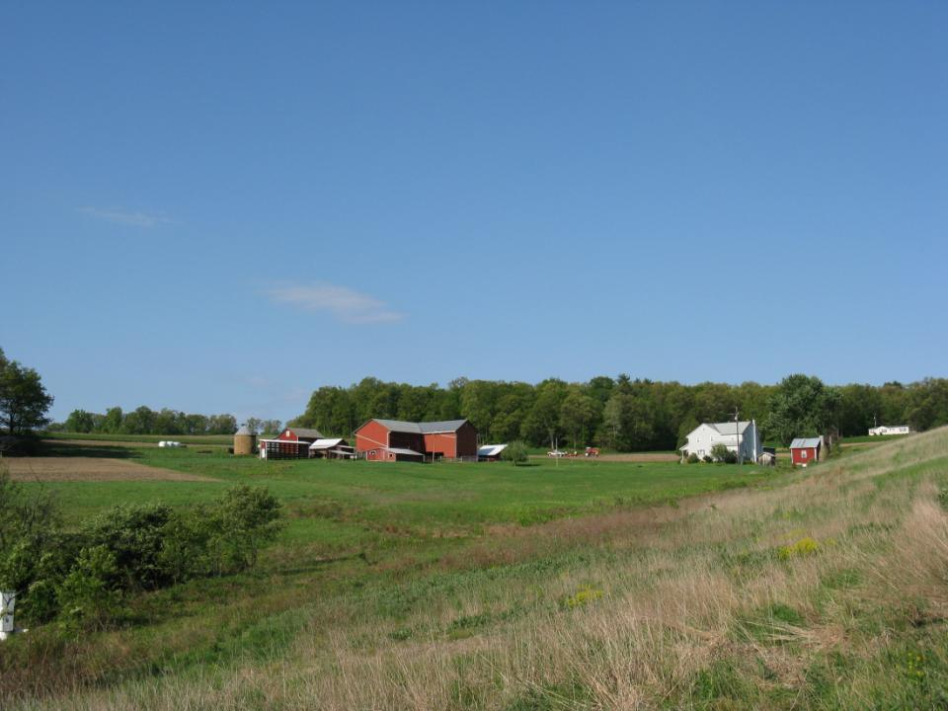






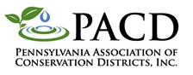

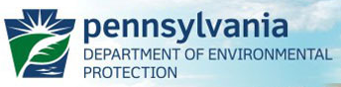



Thank you
Partners
Middle Atlantic
River Forecast
Center

