Slide 1
Using Citizen Science and Volunteered Geographic Information to Augment Biological Collections Data
J Ryan Allen
Advisor: Joe Bishop

Slide 2
Background
Undergraduate Degree in Environmental, Population and Organism Biology.
Work background in Museum Collections .
Worked to georeference the museum specimens based on narrative locations.
Latest project is digitizing museum specimens to allow for greater public access.
Notes:
My undergraduate degree is from the University of Colorado in Environmental, Population and Organism Biology so for most of my time at Penn State I have attempted to focus my projects on some aspect relating to biology. I am interested in museum studies and biodiversity informatics, biogeography and niche modeling and these interests lead me to Geographic Information Systems. For my capstone project I am interested in examining the potential roles that citizen science and volunteered geographic information could have when combined with data from museum collections.

Slide 3
Potential Sources of Biological Data for a Geographic Information System
Biological Collections: between 2.5 and 3 billion specimens world wide (Pyke and Ehrlich 2010).
Surveys: record data on species observance and location but do not require a physical specimen (Kelling 2008). Typically are not focused on a specific question but are often the genesis of future studies (Dickenson 2010).
Citizen Science: projects where scientific data is collected by non-scientists (Goodchild 2007).
Notes:
Biological Collections: Preserved physical specimens housed in Natural History Museums. Estimates of the number of specimens housed in the worlds museums and herbaria are between 2.5- 3 billion specimens that have been collected over the past 300 years (Pyke and Ehrlich 2010).
Surveys: Survey and monitoring approaches record data on species observance and location and do not require a physical specimen; if provided in a consistent format they can potentially be used to augment location data associated with biological collections (Kelling 2008). Can be either a citizen science project or a more specific scientific endeavor.
Citizen Science: Directed or non-directed projects where data is collected by non-scientists. (Goodchild 2007).

Slide 4
Definitions:
Volunteered Geographic Information or VGI: the collection of user generated content that includes a geographic component (Goodchild 2007).
Crowdsourcing: the act of outsourcing the collection or processing of information to the general public (Howe 2006).
Notes:
I am going to go over a few definitions before I start to make sure everyone is familiar with these concepts.
Volunteered Geographic Information or VGI: the collection of user generated content that includes a geographic component (Goodchild 2007).
This is content from the general public that has been georeferenced. VGI forms the basis for projects like Wikimapia and OpenStreetMap and rely on continued contribution and recruitment of volunteers to provide data.
Crowdsourcing: the act of outsourcing the collection or processing of information to the general public (Howe 2006). In many cases with VGI the contributor may not know everything about the data they are submitting. Crowdsourcing relies on experts or experienced hobbyists within a field to help make sense of the data being submitted. In this case crowdsourcing would come from biologists or enthusiasts that know the species being photographed.

Slide 5
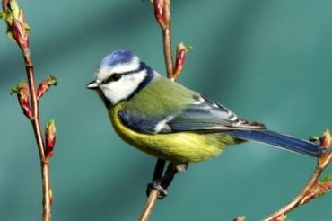
Citizen Science Projects
Christmas Bird Count started in 1900 and has grown to include over 50,000 volunteers in over 2,000 locations and provides a means for monitoring avian species diversity and abundance (National Audubon Society 2012).
Gigablitz uses volunteers around the globe to capture high resolution images of nature so individual species in the images can be identified using crowdsourcing (Gigablitz 2011).
Zooniverse has over 700,000 citizen scientists contributing to 12 projects including weather, space and cancer studies (Zooniverse 2012).
Notes:
Christmas Bird Count started in 1900 and has grown to include over 50,000 volunteers in over 2,000 locations and provides a means for monitoring avian species diversity and abundance (National Audubon Society 2012).
Gigablitz A new and innovative use of crowdsourcing was conducted by the Gigablitz project that used volunteers around the globe to capture high resolution images that were later analyzed using crowdsourcing to identify the species pictured (Gigablitz 2011).
Zooniverse has over 700,000 citizen scientists contributing to 12 projects including weather, space and cancer studies (Zooniverse 2012).

Slide 6
Biodiversity Informatics Projects
VertNet http://vertnet.org/
MaNIS
FishNet
ORNIS
HerpNET
New York Botanical Gardens Virtual Herbarium
http://sciweb.nybg.org/science2/VirtualHerbarium.asp
Symbiota http://symbiota.org/
eBird http://ebird.org/
Notes:
Although there are several different citizen science projects and informatics projects dealing with biology and or biodiversity, there seems to be a gap between the two. I think there is a great potential to combine efforts from different sources to build a larger pool of information and the role of citizen science should not be overlooked.

Slide 7
Project Goals
Build a GIS to allow museum, citizen science and survey data to be visualized together.
Allow for public involvement through citizen science observations by creating a web interface for citizen science data to be submitted and integrated in to a biological database.
Allow for observations to be georeferenced in a web interface to help facilitate future use.
Notes:
I want to build an infrastructure to allow for the submission of survey data and citizen science observations so they can be visualized alongside museum specimen data. This can help to create a more robust picture of biodiversity and a way to bridge problems associated with each source of biological information.
I plan to create geographic information system (GIS) based tools using Google Maps that will allow submission of VGI from citizen scientists about species locations that can be used for conservation biology. The central goal of this project is to create a web based portal that allows for the recording and submittal of biological observation data that can be visualized alongside biological collection data housed in research museum collections. Establishing and adhering to scientific standards similar to those collected when creating a specimen for a museum collection will help to establish relevance of the data even though they are being collected by citizen scientists.

Slide 8
Problems with Museum Collection Data
Museum data concept of the collection being “done” no new active records (Winkler 2004).
Older collections contain a location but do not often contain specific coordinates (Beaman et al. 2004).
There has been a vast increase of data on the physical environment and this increase has often outpaced the addition of species accounts (Bahn and McGill 2007).
Collection biases: some areas or species may receive more attention based on geography or research interests. Botanist effect (Moerman and Estabrook 2006).
Research focus on specific taxa.
Notes:
I mentioned previously that there are common issues with different types of data. I will start with the projects baseline information museum collections data.
Winker (2004) notes that as basic taxonomic questions are answered there is a tendency to consider the collection “done” leaving little focus on collecting new specimens. Common species may be overlooked with no accounts being documented over many years.
Older collections observations are more likely to contain a broad geographic location such as a city or a vague descriptor such as near Boulder or nothing more than a state. Older collections were often collected with a research focus on systematics rather than biogeography. This is a good illustration of the shifting use of biological collections.
The accumulation of environmental data has vastly outpaced the collection of biological observations. We have ample data on temperature and land cover but do not have the species accounts to ask complex questions (Bahn and McGill 2007).
Moerman and Estabrook (2006) were able to show an elevated number of plant species accounts in counties that contain a university as compared to nearby counties without a university; they refer to this as the “botanist effect” attributing increased measurement of biodiversity within a county to the number of botanists present rather than the number of species actually in residence.
Research focus: If a research museum does not have Mammalogist it is likely that that collection will have fewer mammal specimens in its collection. Research drives collections.

Slide 9
Problems with VGI and Citizen Science
What happens to the data when the project is over?
Formatting Issues: how can you merge data from multiple projects?
Validation in the absence of a physical specimen.
Variations of sampling effort: what was being surveyed and for how long? (Dickenson et al 2010)
Variation in training or experience and observational biases. (Sauer et al. 1994)
Multiple observations of the same individual.
Notes:
As the amount of species data available increases and more projects use VGI and citizen science there becomes a need to examine data storage to insure it remains available even after a project is completed or runs out of funding.
Survey data is often in varied formats and rarely available especially when funding runs out.
Problem with survey and citizen science data is validation. In the absence of a physical specimen how can the observation be identified and or verified? Image capture for conspicuous species can solve this problem. For surveys a voucher image or specimen could be used.
Some drawbacks to using citizen science include differences in sampling effort, levels of training or education, and biases for or against common and rare occurrences (Dickenson et al. 2010). Areas that have many volunteers will likely have more data submitted; this will also be true of areas where more man-hours are used to conduct surveys. Underscoring the importance of submitting all accounts (even common species) allows for a better surveillance study and helps reduce the potential problem of variances between study areas and level of study effort.
As volunteers become better trained and have contributed successfully their knowledge can be tapped to help with crowdsourcing of identification of unknown specimen accounts. By allowing volunteers to get started without a large amount of training more information can be collected that is beneficial to surveillance projects. Sauer et al. (1994) established that there is a trend of increased observer quality over time having shown that observers in the North American Breeding Bird Survey made more bird observations after gaining experience with the survey than they had in their first years working on the survey.
How much time needs to elapse before an observation at a location should be treated as a separate event? What happens when a bear wanders into town and several people submit the observation as it crosses town?

Slide 10
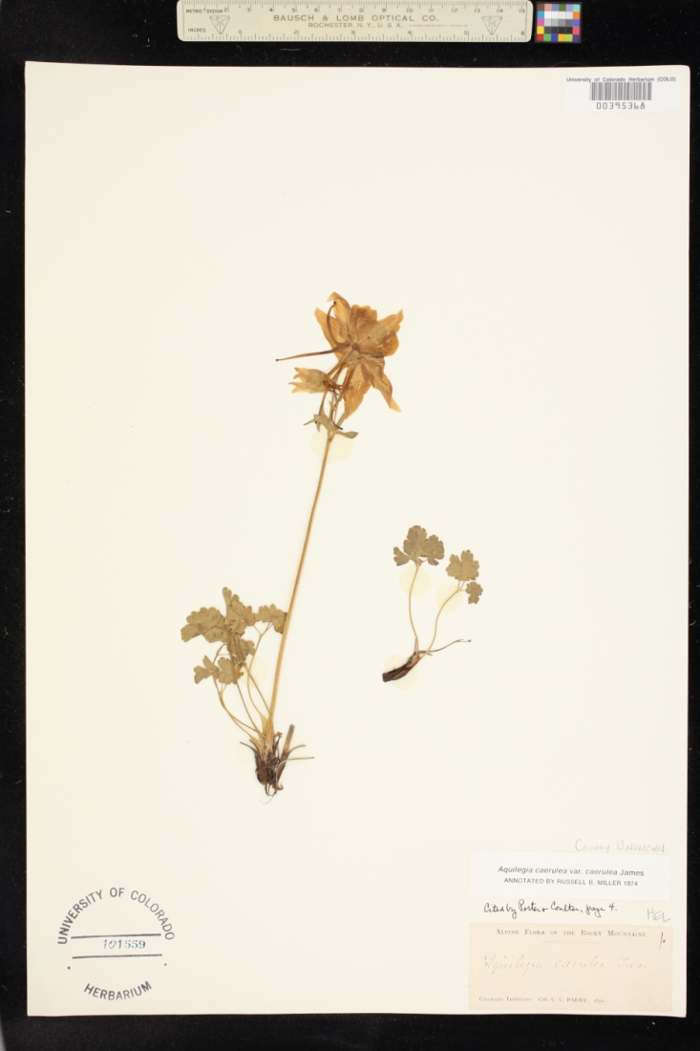
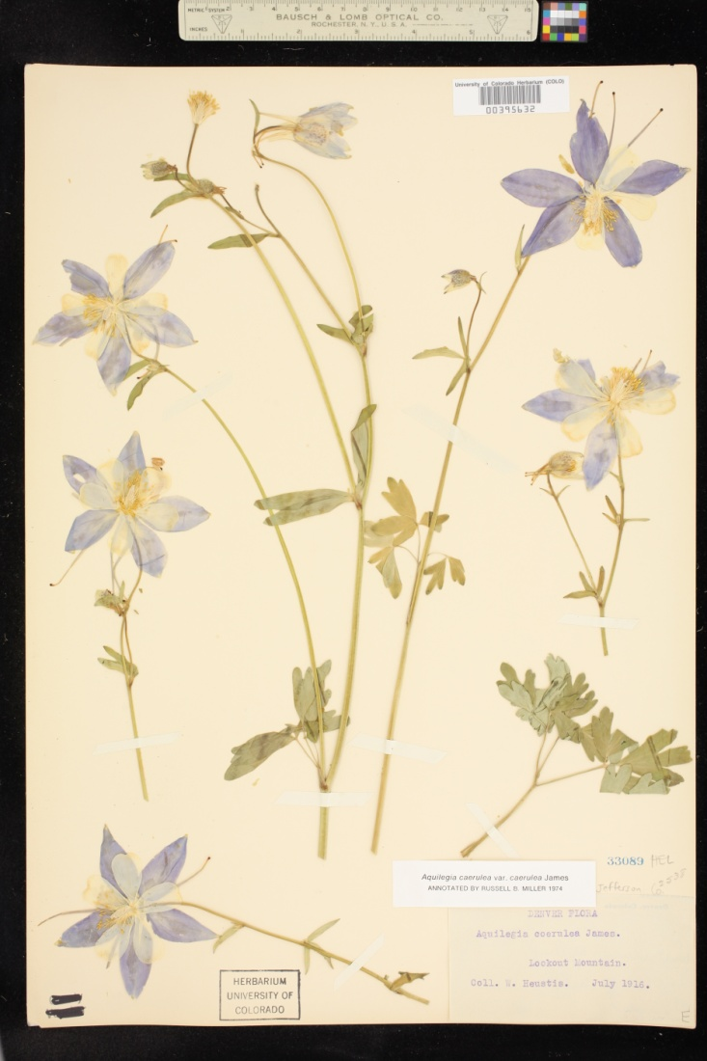
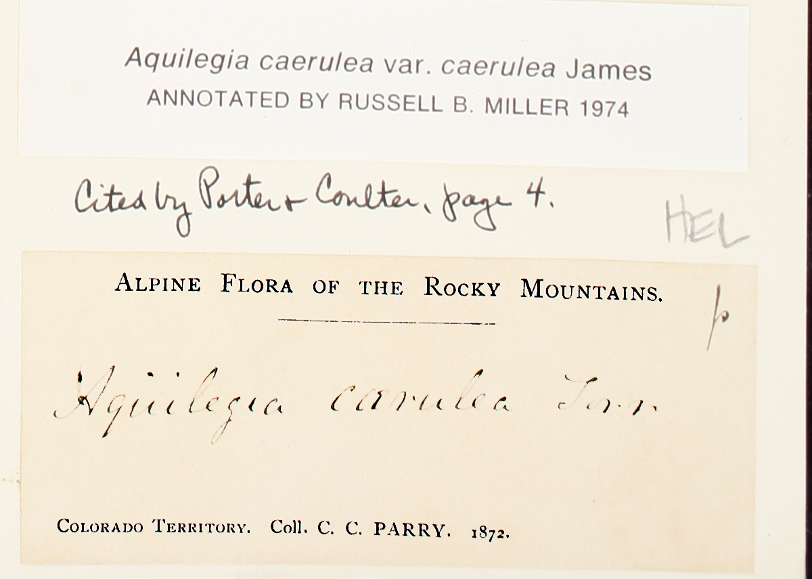
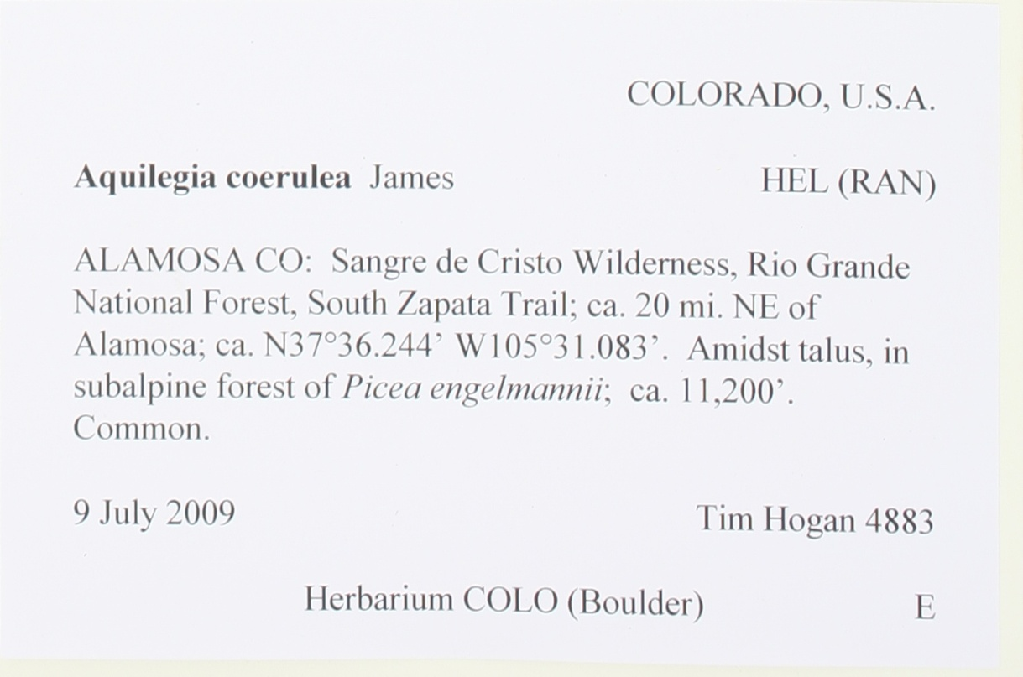
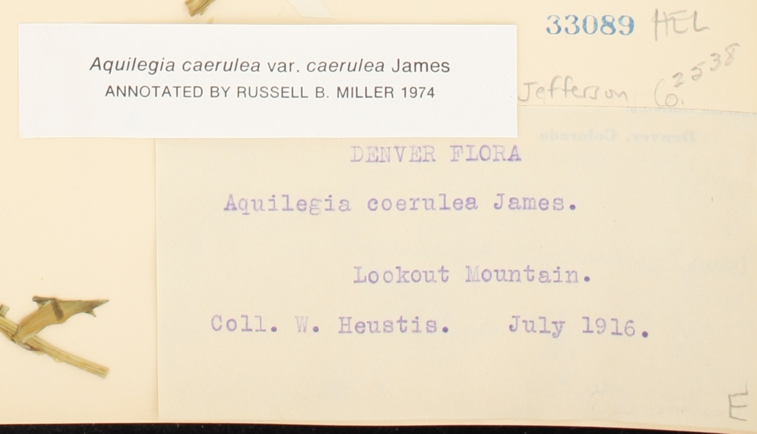
Sample Herbarium Specimens Colorado Columbine
Notes:
I am going to run through a series of three different specimens to illustrate the shift of focus on specimens through time.
The first columbine was collected in 1872 and does contain enough location information to really locate a point in space and georeference the specimen. Early museum collection efforts focused more on asking questions about taxonomy and morphology than on geography. In this case the extent of the location data is Colorado Territory and Flora of the Rocky Mountains.
The second specimen provides more information giving a physical place Lookout Mountain as well as a month and year July 1916. This information would allow us to at least find the area where the collection occurred but still leaves quite a bit of ambiguity.
The final example is a more contemporary example of the information that is associated with a collection. Here we have State, County information and date collected coupled with a narrative about where the collection occurred. The label also contains some habitat information and associated species (Engelmann’s Spruce) along with elevation and most importantly from a GIS standpoint geographic coordinates.
So what am I trying to illustrate here?
I am not trying to suggest that early scientists were doing a bad job collecting information in the field. Scientists at the end of the 19th century could never have guessed what future questions might be asked about the specimens they collected. Things like genetic sequencing and computer analysis were not even a thing of science fiction at that time. My point is that applying a little more effort to collecting information especially geographic information can move a casual observation by a citizen scientist into something that could be used in a scientific study.

Slide 11
Moving from Citizen Science to “real” Science
Typical points of data collected with museum specimens:
1) Specimen Taxonomy to the extent known at collection.
2) Location of the collection including Country, State, County and a narrative description .
3) Who made the collection.
4) When the collection occurred.
5) Institution where the collection is held.
6) Associated relevant information such as other species present, habitat and elevation.
7) Geographic Coordinates.
Notes:
It is great to submit an observation saying you were in the city of Boulder as it provides an additional datum point, however, it is even better when more specific locations can be provided as it allows for the potential to study changes at a finer scale. We want to move citizen science from historic (i.e. Colorado Territory) to modern data collection levels. Moving from data such as a Gray Wolf in Yellowstone to providing specific locations and geographic coordinates can achieve this. The more we can blur the line between science and citizen science the more potential uses there will be for the data collected in these projects.
Basic collection information for a museum specimen includes taxonomy (i.e., family, genus and species data), location such as state, county and municipality, and finally the date the collection was made and who made the collection. Further information can include habitat data, elevation and associated species that were collected or observed nearby.

Slide 12
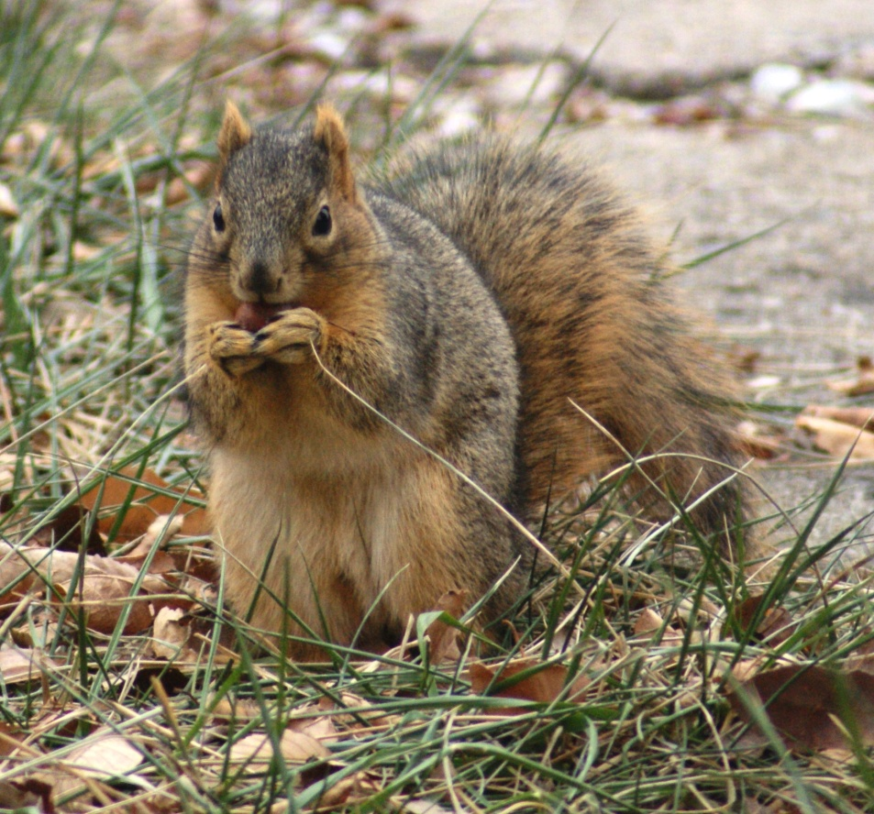
Sciurus niger rufiventer in Boulder County
The fox squirrel is a good example for this project in that it illustrates several of the previous points.
Collections being “done.”
Older collections often provide an inadequate location to geocode.
This is a conspicuous easily identifiable species even in a photograph.
Notes:
This is one of the more common species seen in Boulder but the last collected observation for Boulder County was in 1963.
Older collections often do not have as detailed of location data as more contemporary collections. 7 of 16 just list Boulder another 4 list the University of Colorado campus.
For readily identifiable species a photograph can often provide enough proof of a species account that they can be used as a voucher for that species occurring at a specific point and time.

Slide 13
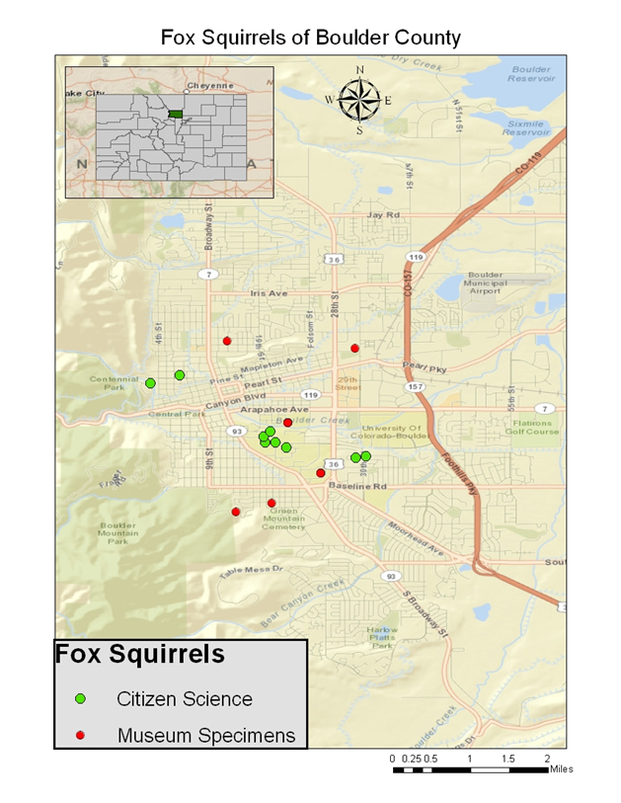
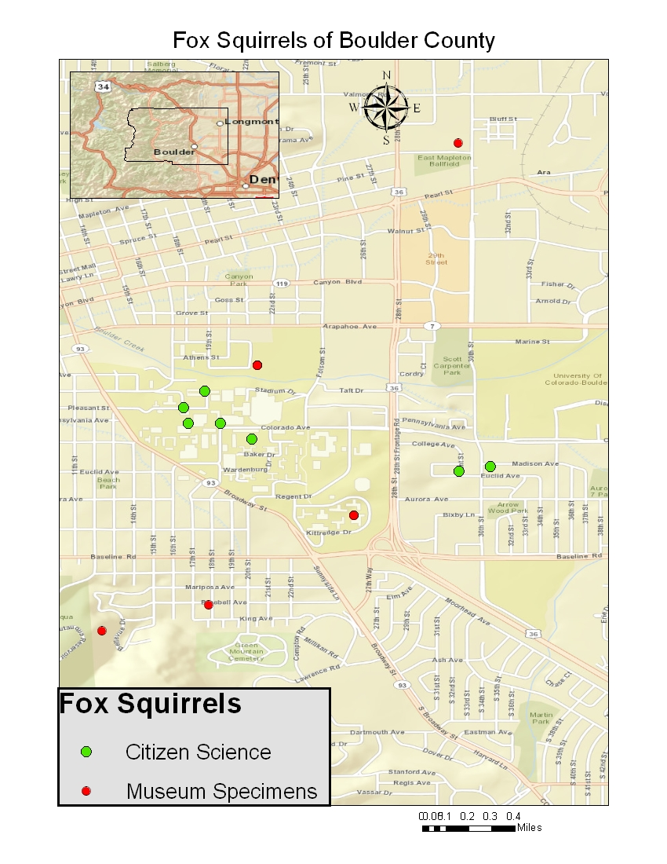
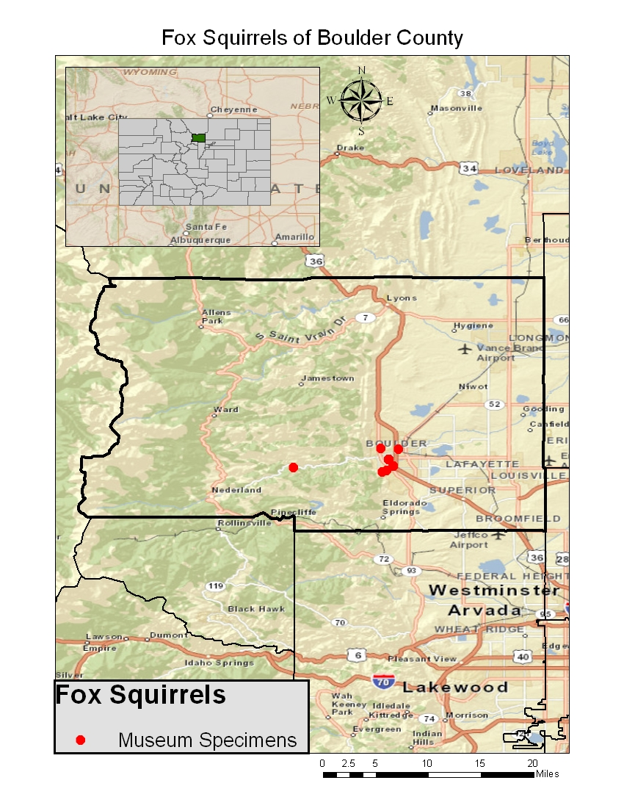
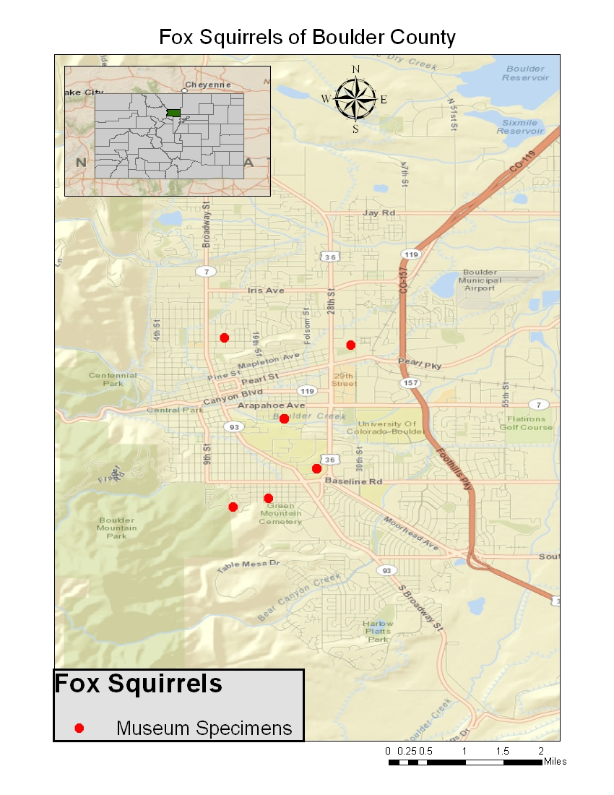
Museum and Citizen Science Observations of Sciurus niger rufiventer in Boulder County
Notes:
I took the georeferenced locations for all of the Fox Squirrels in the University of Colorado Collection and created a map using ArcMap. As mentioned above many of the locations are repeated so even though there are 16 observations seen here many are not unique and overlap.
From here I made a conscious effort to note the location of fox squirrels I saw while going about my daily life to illustrate how citizen observations could be used in conjunction with museum data. I then added the observations I made walking to and from work or happened to make over the course of the week. These new observations contain more specific location narratives and allow for finer georeferencing.

Slide 14
Portal Design
Database set up to allow for user queries.
PHP scripting to access and query the database.
HTML coding to create the user interface.
Google API to provide the geographic visualizations of the data and to allow observations to be georeferenced before being submitted.
Notes:
So how do I plan to do all of this? What needs to be put in place?
The database will be housed online and will be accessed using PHP scripts. PHP is a server side scripting language that allows dynamic content such as specimens in a database to be integrated into a webpage.
HTML or Hyper Text Markup Language is a programming language that is often used to create websites.
Google Application Programming Interface (API) is a language that is used to create web maps and mashups that combine data with mapping to create web content that includes geographic visualizations.

Slide 15
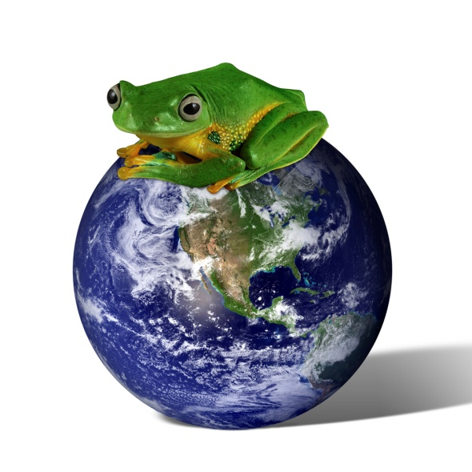
Data Points
University of Colorado Museum houses approximately 4,000 Amphibians, Reptiles and Mammals from Boulder County.
~1200 Mammals
~1500 Amphibians
~1200 Reptiles
Notes:
The Database will be populated using previously georeferenced specimens from the University of Colorado Museum that are currently stored in MaNIS and HerpNET (VertNet). The initial scope will be limited to Boulder County Colorado and will include only specimens from the mammal, reptile and amphibian collections. Data from these sources will provide historical baseline information for the project, however, the specimens are not all georeferenced so the data pool will be smaller than the number of specimens. The scope of the project may need to shift as I am just one person and not working on a grant. I am more interested in herpetology and this would be my natural leaning but it is a bit harder to make citizen science observations of reptiles in the middle of winter than it is for mammals.

Slide 16
Sample interface
Notes:
This is a rough mockup of how I see the application functioning.
Search functions would be created using drop down menus to select pre-populated information for searches.
I think it is important to make sure that data from different sources can be viewed simultaneously, however, it is important that this information is differentiated. For this reason observations from different sources will be color coded and users will be able to turn various sources on and off. This is done through a series of check boxes below the drop down menus.
Lastly the system will have the ability for user submitted VGI.

Slide 17
Data Submission
Making submission field mirror data typically recorded for museum collections will raise quality standard for citizen science.
Need to facilitate the combination of data from multiple sources.
Notes:
The form will be set up to include information typically associated with museum collections. By focusing on creating high level scientific observations the data will be more useful. An important aspect of this is allowing the observer to submit an image of the observation so identification can be validated.
Not all observations will be identified by the collector. In cases where an image is captured but the observer does not know what they have seen species could be identified using crowdsourcing.
People generally do not know the geographic location of the places they visit so an integral piece of allowing users to submit VGI is to include tools to allow users to georeference their observations (Goodchild 2007).

Slide 18
Discussion
Great potential of increasing biological data when we get the various sources to talk.
Different sources of data have different limitations.
Setting standards can help bridge the gap between citizen science and “real” science.
Notes:
The greatest potential for increasing our collective knowledge base comes in using VGI and citizen scientists to document the occurrence of various species that can be used in conjunction with museum and survey data to monitor species and populations.
Remaining cognizant of potential problems from Citizen Science, VGI and crowdsourcing such as sampling bias, differences in training levels, and the potential to ignore common occurrences will help to increase the validity of citizen science projects.
Setting rigorous standards can help to bridge the gap between citizen science and science in its traditional sense.

Slide 19
Project implications
Allow for general observation of species through citizen science.
Create a means for different data types to “talk” to each other so they can be visualized together.
Involving the general public in conservation efforts and fostering an interest in the natural world through citizen science.
Community involvement in conservation efforts has been shown to be positively correlated with the success of conservation projects (Brooks 2006).
Notes:
Allow for general observation of species through citizen science. Incorporating citizen science with museum data has the potential to close spatial and temporal gaps in the data. Facilitate the general collection of data that could provide baseline information for future focused studies.
Create a means for different data types to “talk” to each other so they can be visualized together. I firmly believe that in this instance the sum is much greater than the individual types of data if they can be integrated into a single system.
Involving the general public in conservation efforts and fostering an interest in the natural world through citizen science. Community involvement in conservation efforts has been shown to be positively correlated with the success of conservation projects (Brooks 2006). Getting the public involved with the natural world helps to foster respect for nature.

Slide 20
Project Timeline
January: Build PHP form to allow for the submission of data to the database and begin to collect sample information.
February: aggregate historical data from MANIS and HERPNET for Boulder County and make sure it is cleaned up so it will work in a database.
March: begin to build the web interface and visualization format.
July: Present at Society for Conservation GIS.

Slide 21
Acknowledgements
University of Colorado Museum
Botany Collection
Mammal Collection
Reptile and Amphibian Collection
National Science Foundation
VertNet
HerpNet
MaNIS
Penn State Online GIS Program and Instructors
Joe Bishop, Justine Blanford, Jim Detwiler
Notes:
I would like to thank the University of Colorado Museum which provided the base collection data used in this presentation. Specifically the Botany, Mammal and Reptile and Amphibian collections were used as data points in this proposal. The National Science Foundation for funding VertNet that is currently used to serve the University of Colorado Mammal and Reptile and Amphibian databases (MaNIS and HerpNet respectively). I would also like to thank my instructors throughout the MGIS program especially Joe Bishop, Justine Blanford and Jim Detwiler who’s courses have greatly contributed to my ability to pursue this project.

Slide 22
Works Cited
Bahn, V. and McGill, B.J.(2007). Can niche-based distribution models outperform spatial interpolation? Global Ecology and Biogeography, 16(6), 733-742.
Beaman, R., J. Wieczorek, and S. Blum. (2004). Determining Space from Place for Natural History Collections in a Distributed Digital Library Environment. D-Lib Magazine 10 (5). ISSN 1082-9873. http://dlib.org/dlib/may04/beaman/05beaman.html
Dickenson, J.L., Zuckerberg, B., and Bonter, D.N. (2010). Citizen Science as an Ecological Research Tool: Challenges and Benefits. Annual Revue Ecology, Evolution and Systematics, 41:149–72.
GigaBlitz (2011). GigaBlitz Event Seeks Citizen Scientists to Capture Images of Nearby Biodiversity. (2011, Nov 10). Targeted News Service, pp. n/a. Retrieved from http://search.proquest.com/docview/903122907?accountid=13158
Goodchild, M.F. (2007). Citizens as Sensors: The World of Volunteered Geography. Geojournal, vol. 69, no. 4, pp. 211-221, 2007.
Howe, J. (2006). The Rise of Crowdsourcing. Wired Magazine. June 2006.
Kelling, S. (2008). Significance of organism observations: Data discovery and access in biodiversity research. Report for the Global Biodiversity Information Facility, Copenhagen.
Moerman, D. E. and Estabrook, G.F. (2006). The botanist effect: counties with maximal species richness tend to be home to universities and botanists. Journal of Biogeography 33:1969-1974.
National Audubon Society (2012). Christmas Bird Count retrieved 10/10/2012 from http://birds.audubon.org/christmas-bird-count
Sauer,J.R., Peterjohn, B.G. and Link, W.A. (1994). Observer Differences in the North American Breeding Bird Survey work(s). The Auk, 111 (1): 50-62.
Winkler, K. (2004). Natural History Museums in a Postbiodiversity Era. BioScience, 54 (5): 455-459.
Zooniverse (2012). Zooniverse Real Science Online retrieved 11/05/12 from https://www.zooniverse.org/

