Slide 1
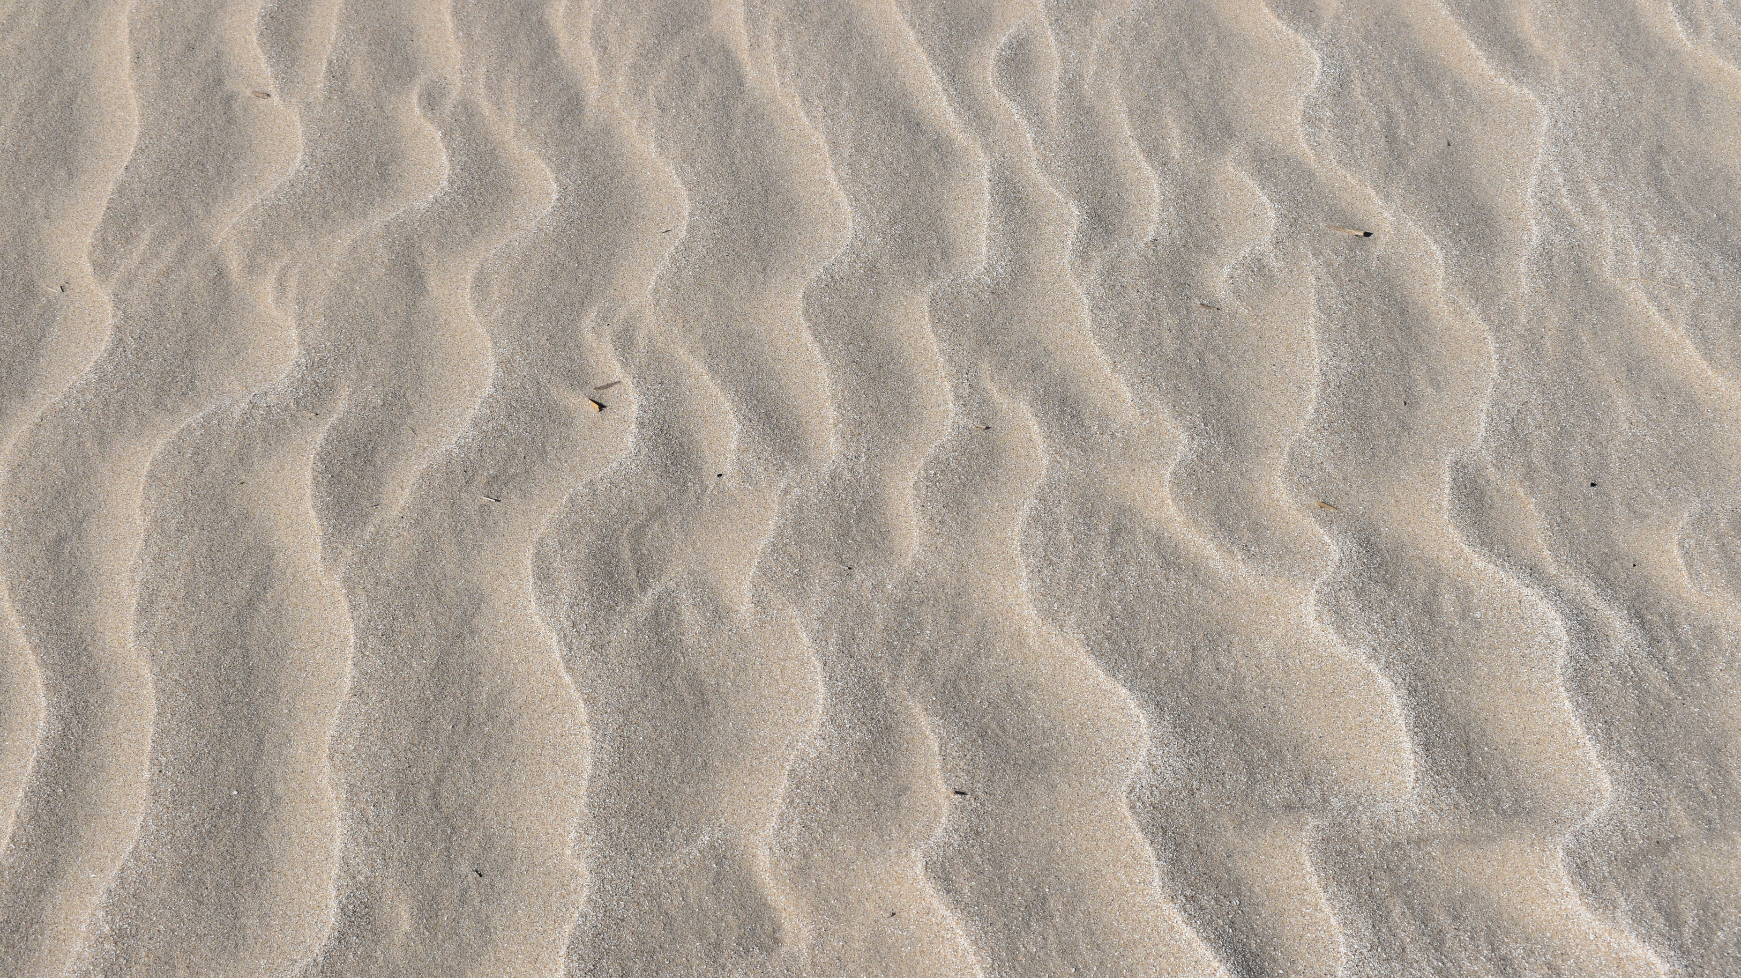
Effects of the Rollover Pass Closure on Coastal Erosion– Bolivar Peninsula, TX
Gregory Alliger

Slide 2
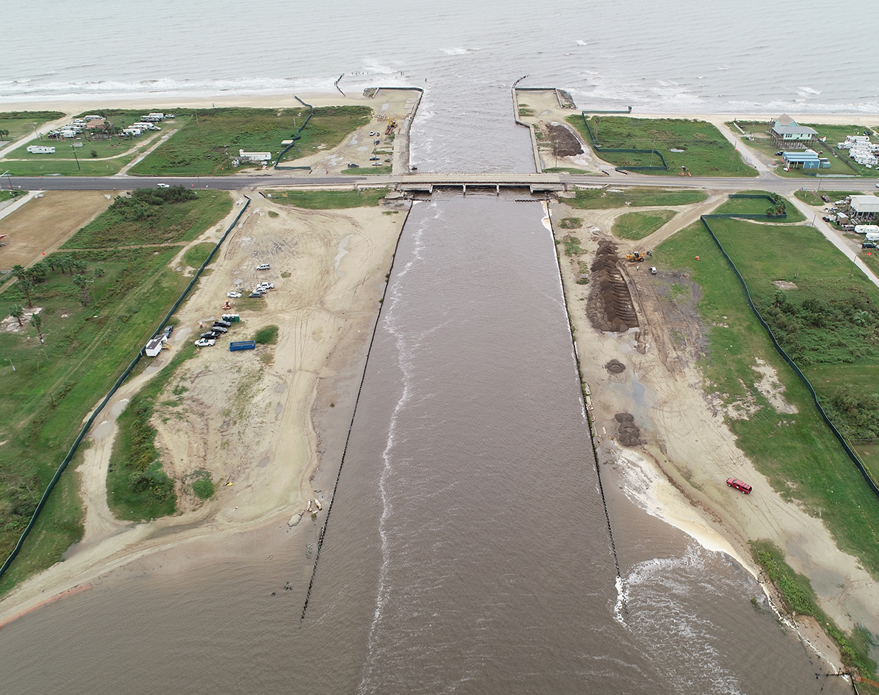
Background – Rollover Pass
Beach erosion rates at Rollover Pass on the Bolivar Peninsula have been of interest to the state of Texas since the Texas Parks and Wildlife Department (TPWD) constructed the pass in 1955, linking East Bay to the Gulf of Mexico, and yearly erosion increased. In autumn of 2019, a state-approved contractor began work to permanently close the pass, in hopes of reducing beach erosion, ultimately reducing costs of dredging the Gulf Intercoastal Waterway and future beach nourishment projects (Taylor Engineering, 2010).
Two separate studies, noted in Taylor Engineering, 2010, found additional yearly beach erosion rates between 9,000 and 26,000 cubic yards near Rollover Pass and shoreline retreat rates of 1.41 feet per year were found in Galveston County from 2000 to 2007 (Paine, Mathew, & Caudle 2011). HDR Engineering Inc. found a net loss of 44 feet of shoreline on the Bolivar Peninsula from 2005 to 2012.
Image from Taylor Engineering, Inc.
Notes:
Add inset map with bolivar peninsula

Slide 3
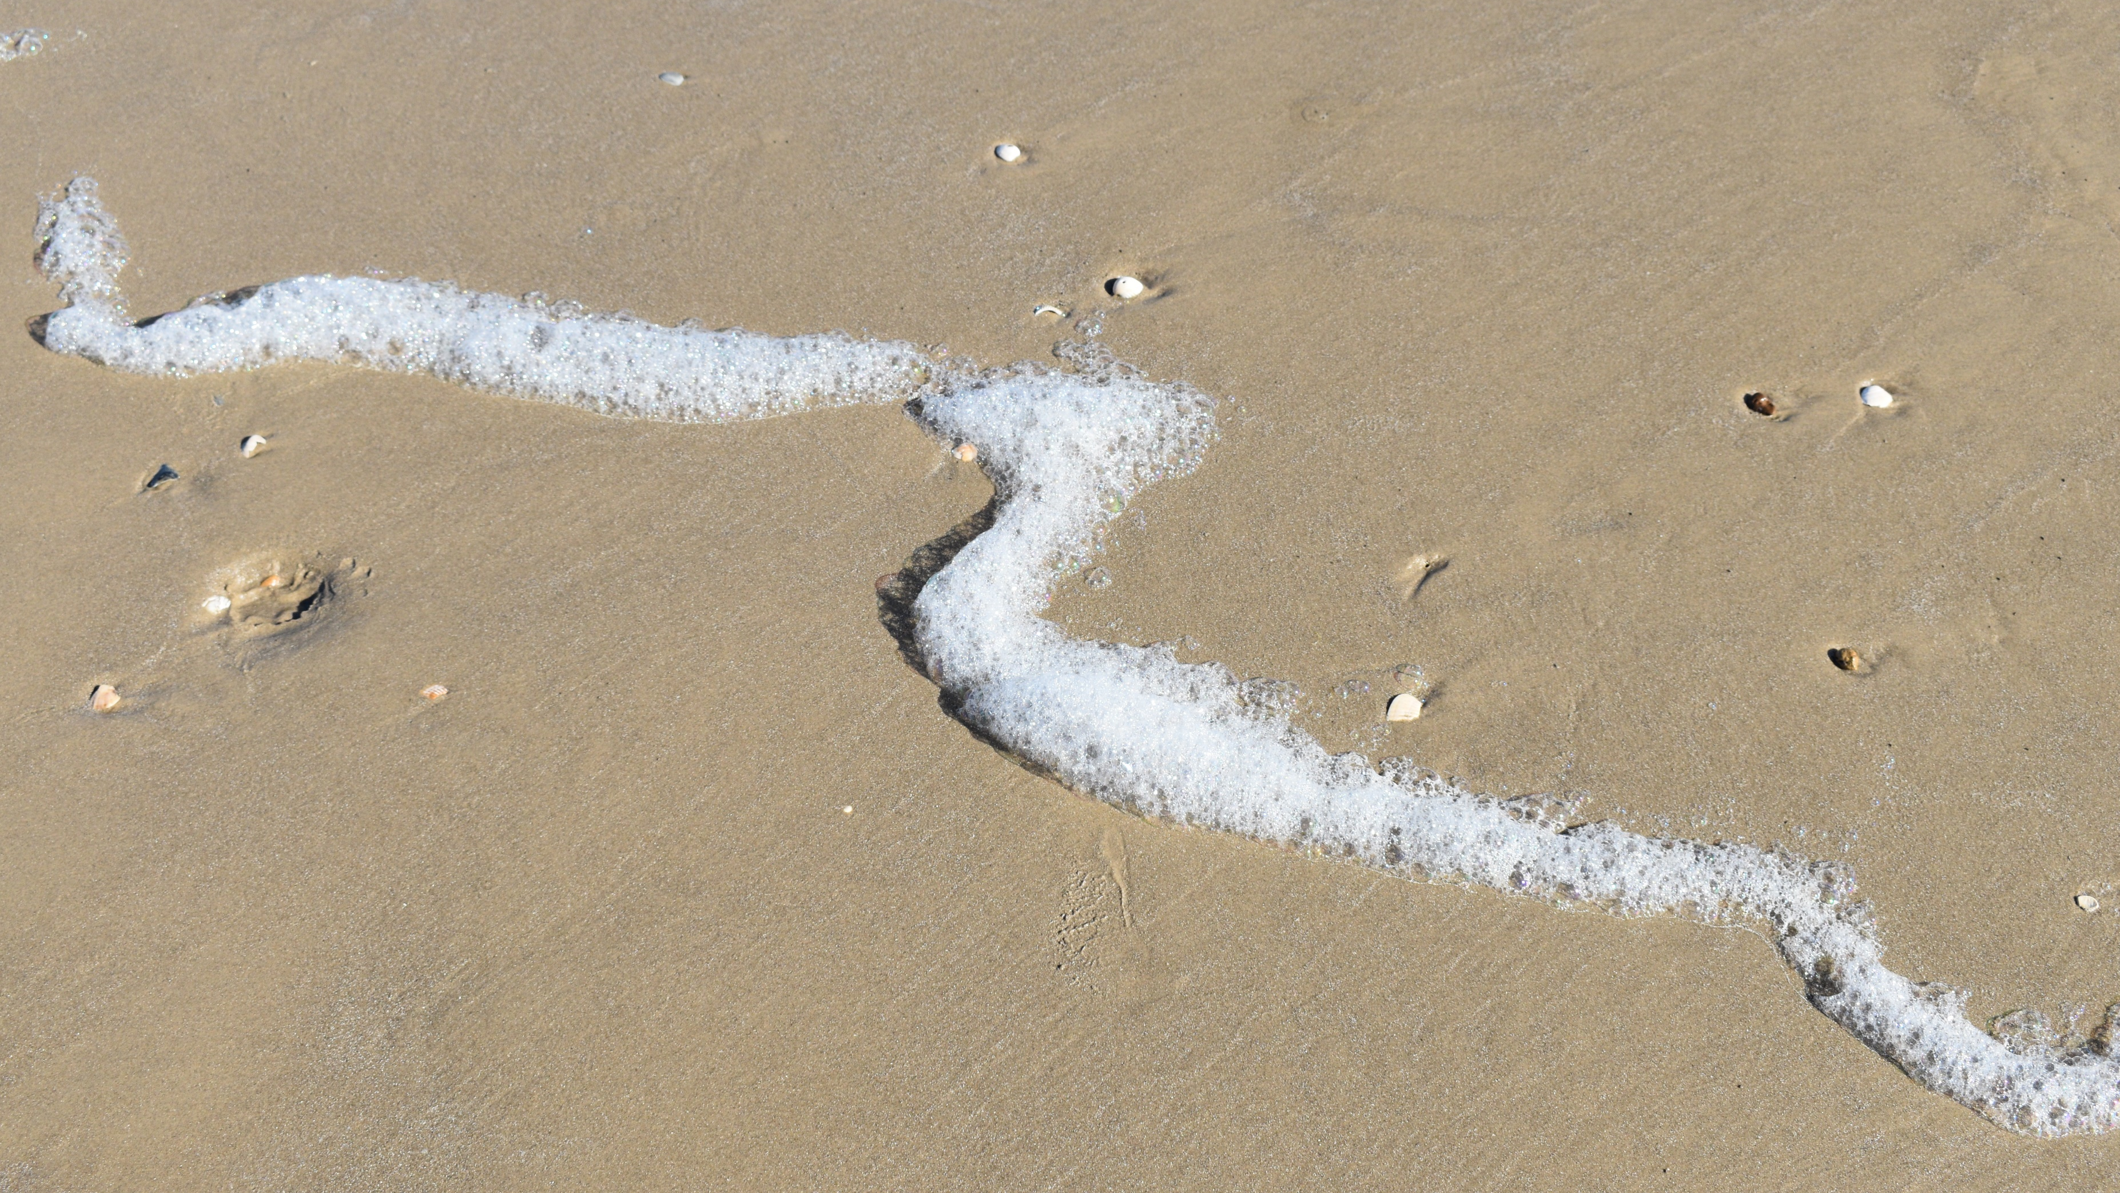
Study Goal
Determine if yearly erosion rates in the proximity of Rollover Pass have decreased one year after its the closure.

Slide 4
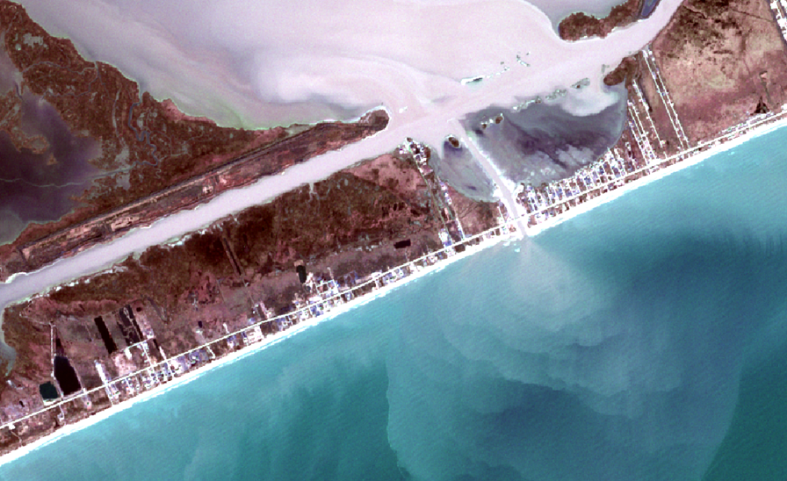
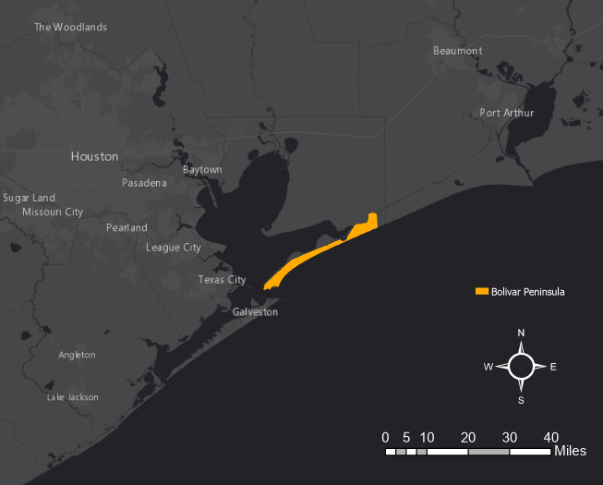
Study Area
Bolivar Peninsula located southeast of the city of Houston in Galveston County.
It generally extends NE to SW and terminates at Bolivar Roads, the entrance to Galveston Bay and the Houston Ship Channel
Bounded by Gulf of Mexico to the south and the Galveston Bay system to the north.
Net longshore transportation of sediment generally to the southwest (TGLO, 2014).
Prior to the opening of Rollover Pass, beach erosion was on the order of five feet per year.
Beach erosion was approximately seven to eight feet per year after Rollover Pass opened.
Erosion was worse within the first mile southwest of the pass than the subsequent 10 miles (TGLO, 2010).
The study area for this project is the beach approximately three miles to the southwest of the pass and one mile to the northeast of the pass.

Slide 5
Beach Geomorphology
Typical longshore current is disrupted by the manmade pass. The inflow current deposits sand in the Gulf Intercoastal Waterway and East Bay, leading to increased erosion SW of the pass due to lack of sand deposition.
Wave Retreat
Wave Approach
Longshore Current
Pass Inflow Current
Notes:
Additional concerns: Sea level rise, subsidence, hurricanes (Bolivar is susceptible to overwash even from weak tropical systems due to flat, low nature)

Slide 6
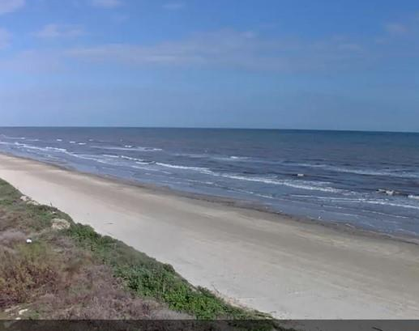
Method
Develop a six-year time series of shoreline positions along Bolivar Peninsula from Sentinel 2 satellite imagery. This will include five years prior to the close of Rollover Pass and one year after.
Yearly and total shoreline changes are compared to the shoreline change from December 2019 to December 2020, which represents the first full year the pass has been closed since the 1950’s.
Shoreline positions are corrected using tidal information gathered based on the time each image was acquired, as well as average beach slope data.

Slide 7
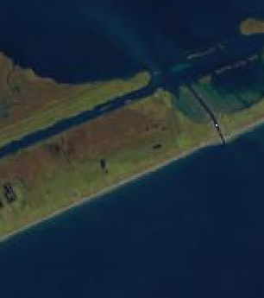
Data Options
Sentinel 2 Satellite Data
R,G,B and NIR in 10m Resolution
Good mix between temporal resolution and spatial resolution
Freely available for download
One of the data inputs used by CoastSat toolbox
Landsat 7 and 8 Satellite Data
30m Resolution
One of the data inputs used by the CoastSat toolbox
Other Options
Planet Dove – Four-band, 3m resolution
NAIP Imagery - ~1m resolution
Notes:
Landsat 7 and 8*

Slide 8
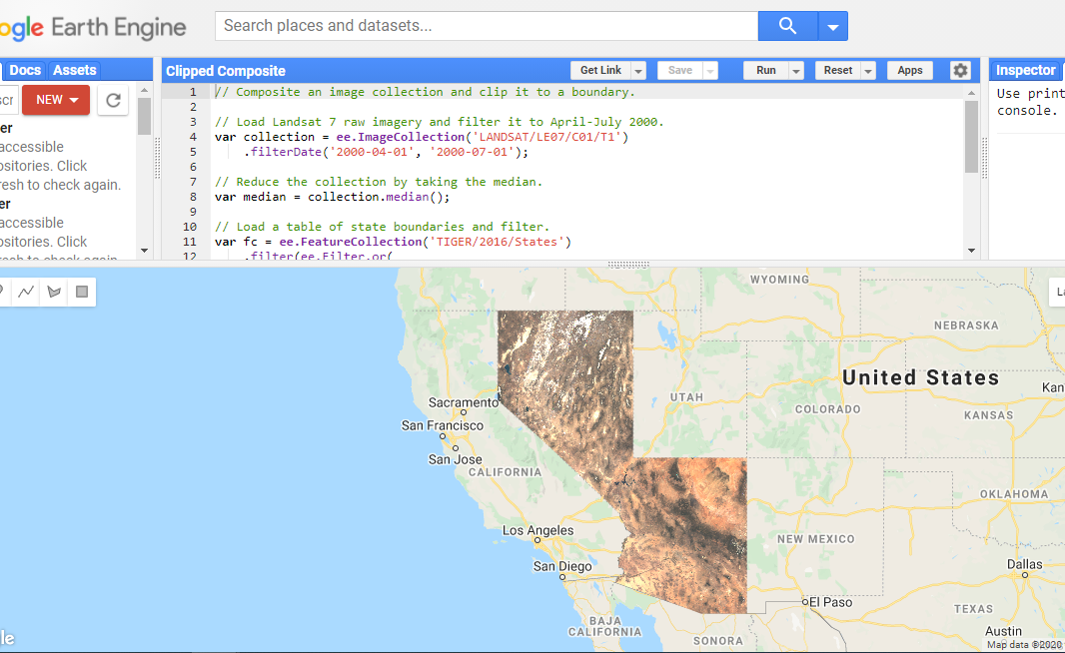
Google Earth Engine
“Earth Engine is a platform for scientific analysis and visualization of geospatial datasets, for academic, non-profit, business and government users” (Gorelick, et al., 2017).
Powered by Google Cloud Platform
Access to multi-petabyte catalog of satellite imagery, such as Sentinel and Landsat
Ability to write geoprocessing codes in Python or Javascript
Web-based Integrated Development Environment (IDE)

Slide 9
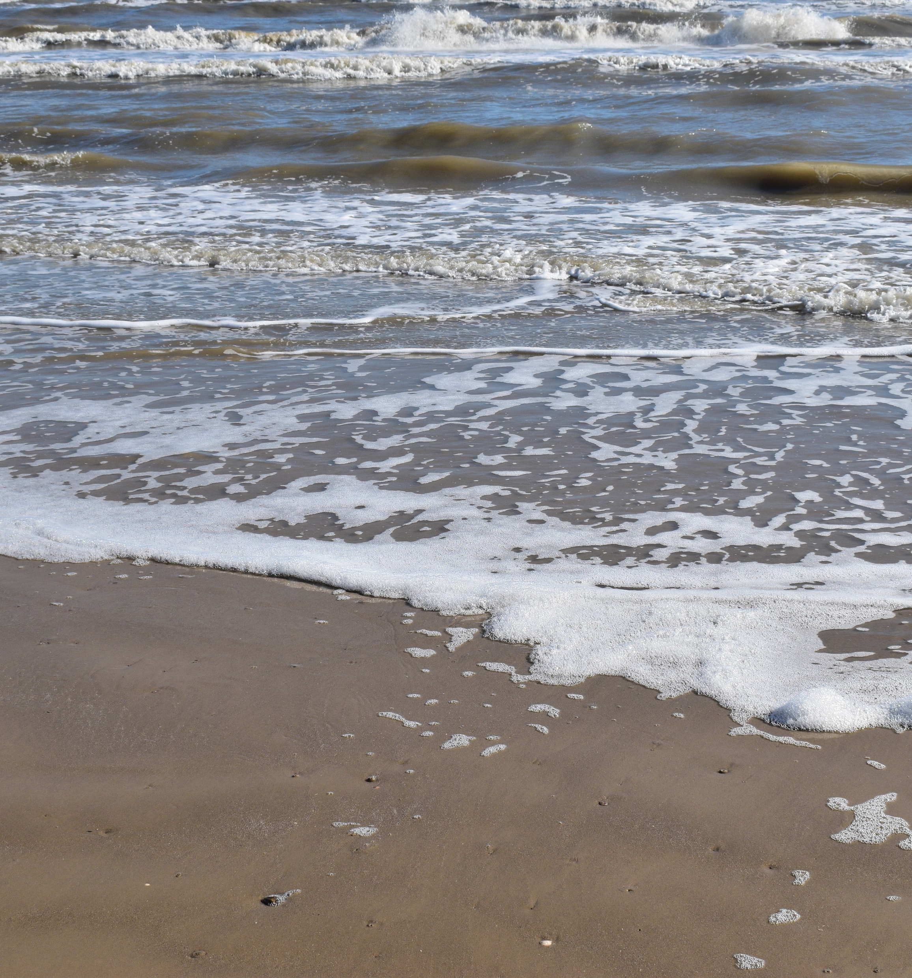
CoastSat Toolbox
CoastSat is a Python toolbox for Google Earth Engine that allows the extraction of coastline positions on sandy beaches from a time series of Sentinel 2 and Landsat images.
“Retrieval of the images from the GEE archive.”
Via Google Earth Engine Python API
“Pre-processing of the multispectral images (cloud masking, pansharpening and down-sampling).”
Limit images containing too many cloud pixels using QA band for the imagery
Sentinel 2 imagery (SWIR1) is downsampled to 10m using bilinear interpolation algorithm
“Sub-pixel resolution shoreline extraction.”
Instantaneous shoreline at image acquisition time
Four-class image classification
Sub-pixel (fuzzy border segmentation)
“Time-series of shoreline position along shore-normal transects.”
Coast location correction
Uses average beach slope and information from local tide gauges
(Vos, et al., 2019).
Notes:
2.ii.: Four classes, water, white water, sand, other
2.iii.: MNDWI, water is negative, sand is positive – ranges from 1 to -1

Slide 10
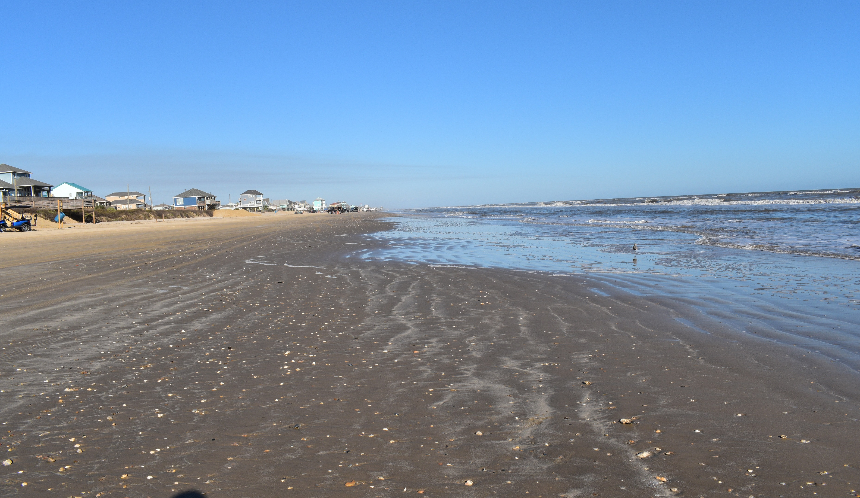
Coast Location Correction
The CoastSat author, Vos, et al., 2019, recommends correcting the shoreline location for beaches with large tides or flat beaches.
Bolivar is microtidal (tides 3’ or less) but has a very flat beach.
The formula used is as follows:
$∆x=\frac{z_{ref} − z_{wl} }{m}$
$∆x$ is the correctional shift along the researcher’s chosen transects.
$z_{ref}$ is the reference elevation. In this case the mean water line (MWL) of 0.37m.
$z_{wl}$ is the water level at the time of the satellite image capture.
This is determined using the image metadata and local tide gauge data.
$m$ is the calculated beach slope.
This is determined using transect profiles as shown on the next slide.
Point along transect at detected shoreline
Detected shoreline
Point along transect at corrected shoreline
Corrected shoreline

Slide 11
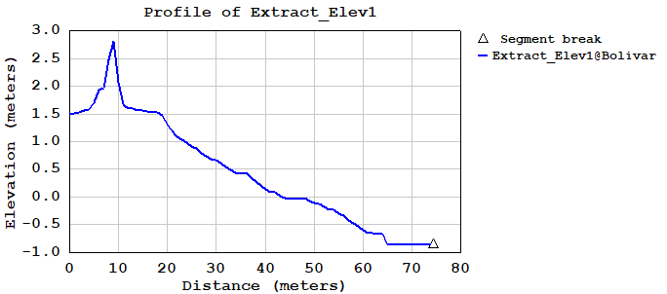
Calculating Beach Slope
Beach slope is calculated from a 50cm LiDAR-derived DEM. Using a shoreline developed as a LiDAR breakline for this data, transects are calculated every 100m. Profiles are created, and beach slope is calculated in the same fashion as Doran, K.S., Long, J.W., Overbeck, J.R. USGS (2015).
All resulting slopes are averaged, and this is used in the correction formula
Dune Crest
Dune Toe
Slope
Mean High Water Line

Slide 12
Accuracy Assessment
Field survey
A GPS/GNSS unit, yet to be specified, will be used
100m readings at most recent high water mark
Tide levels are variable, seasonally and due to weather. High water may occur at different areas as the sandy beach changes.
A transect will be drawn perpendicular to measured shoreline at surveyed locations
Error distance along transect measured between surveyed shoreline and satellite-detected shoreline within one month of image collection.

Slide 13
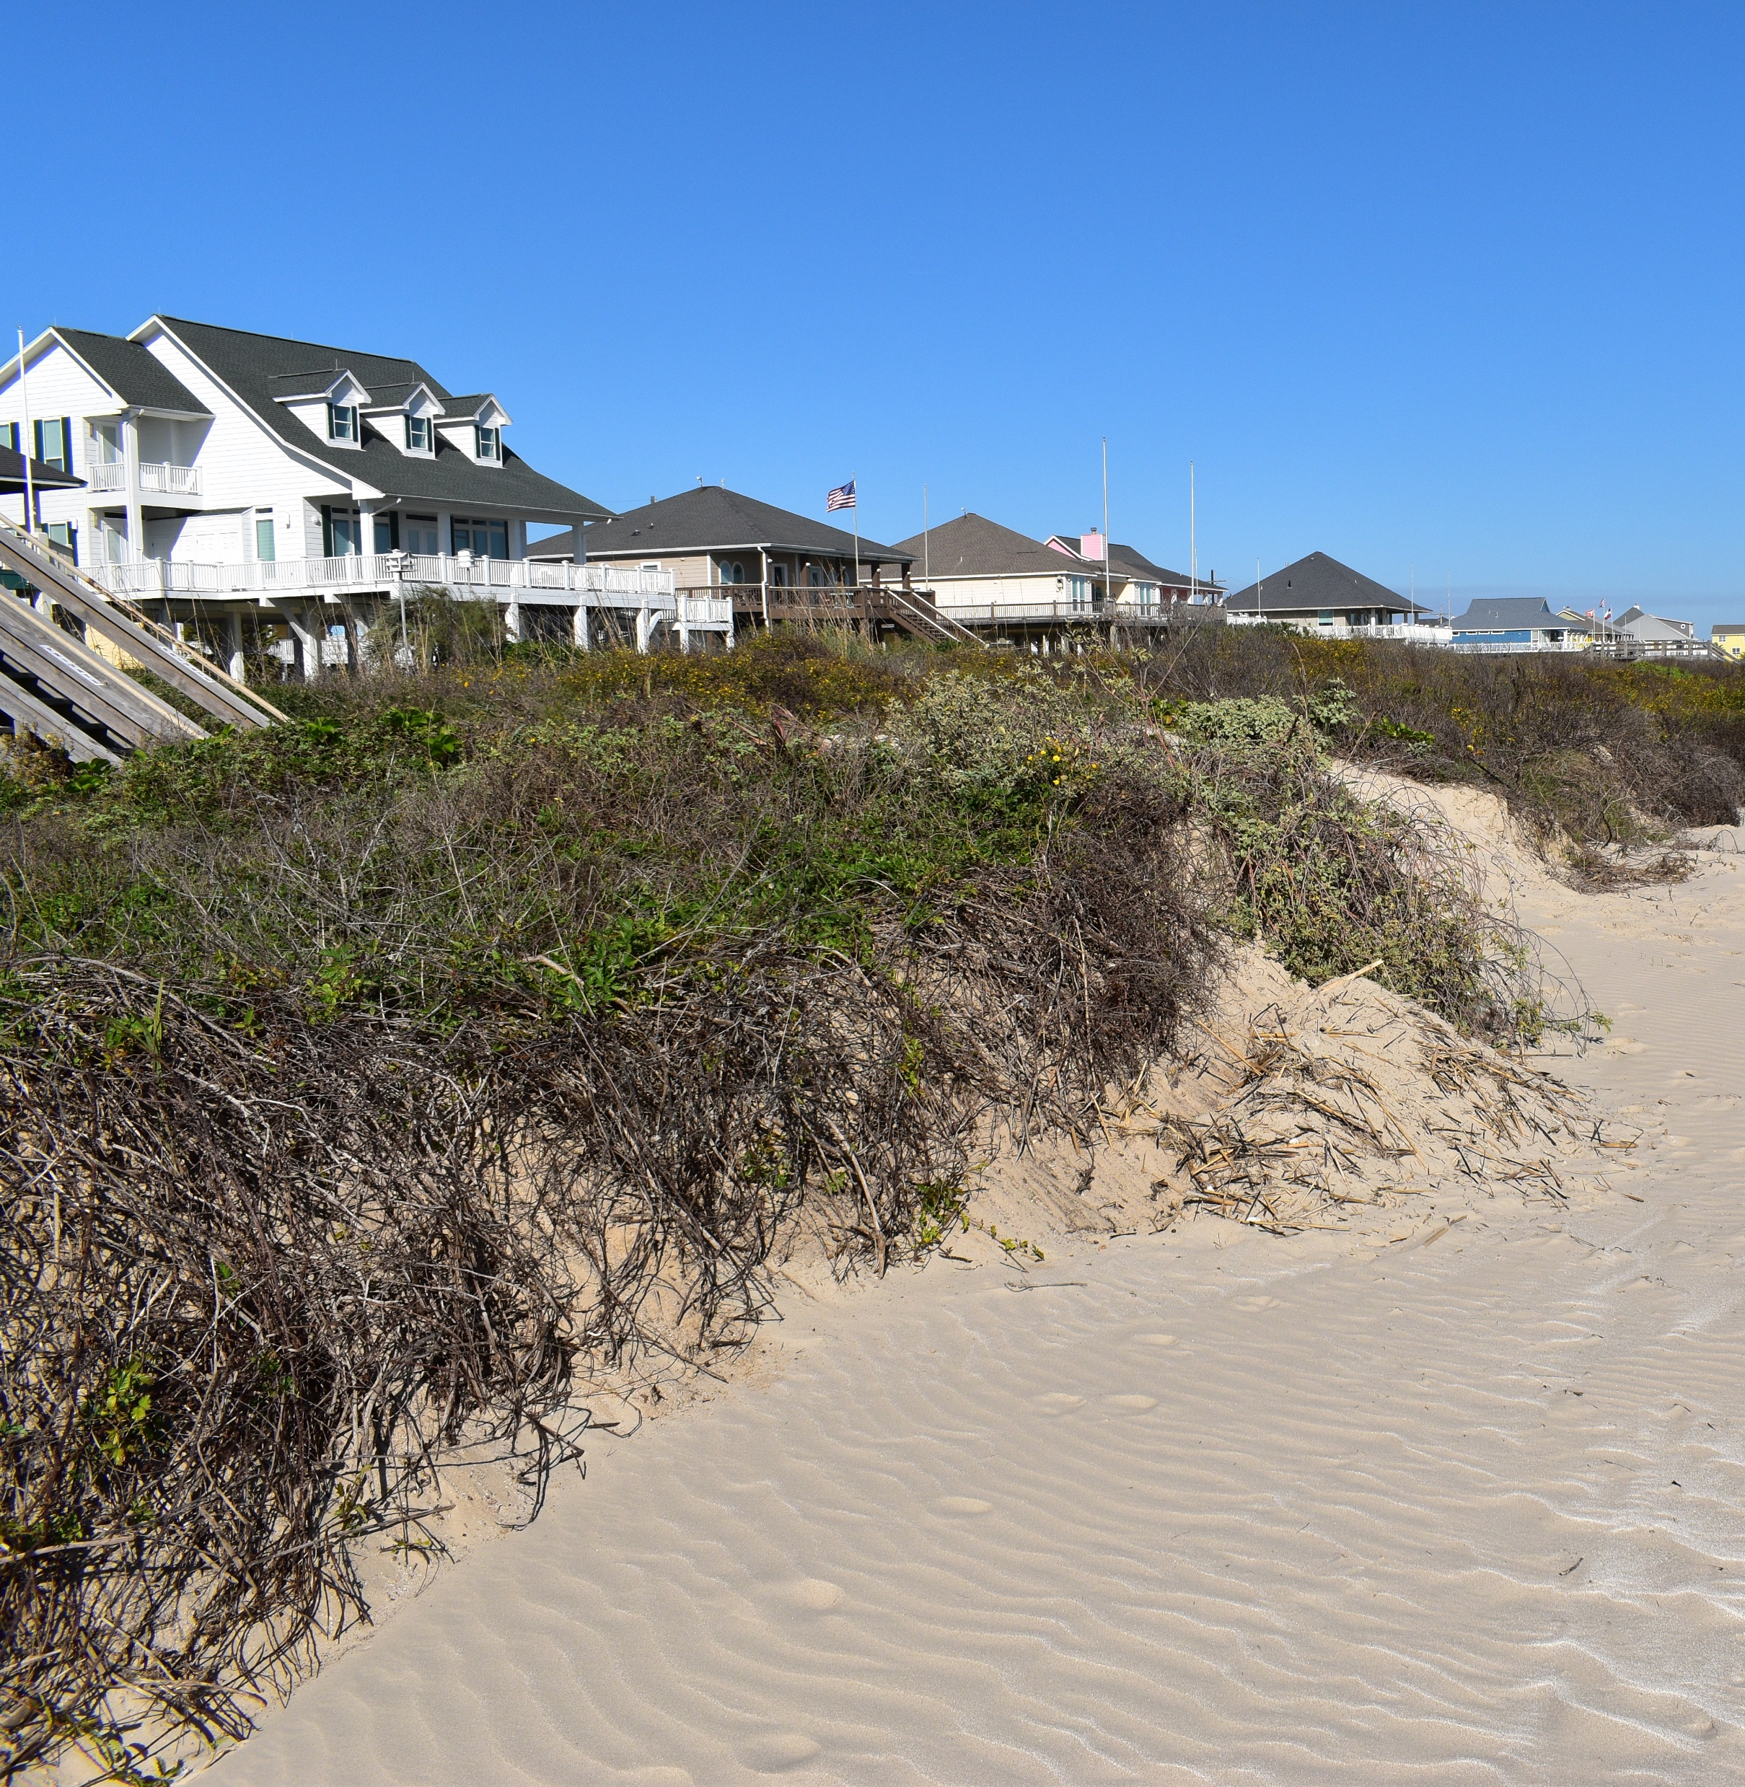
Possible Pitfalls
Major storm and surge action on Bolivar in 2020
Hurricane Hanna
Tropical storm warnings
Coastal flooding
Hurricane Laura
Category 4 landfall 72 miles from Rollover Pass
Hurricane warnings
Storm surge
TS Beta
Tropical storm warnings
Storm surge
Hurricane Delta
Category 2 landfall 86 miles from Rollover Pass
Storm surge
Coastal flooding
Field survey
Determining shoreline due to car traffic
Notes:
Expecting to see significant erosion due to storm action in 2020
From experience, car traffic obliterates high water marks making it difficult to map shoreline in the field

Slide 14
Citations
Addo, K. A., Jayson-Quashigah, P. N., & Kufogbe, K. S. (2012). Quantitative Analysis of Shoreline Change Using Medium Resolution Satellite Imagery in Keta, Ghana. Marine Science, 1(1), 1-9. doi:10.5923/j.ms.20110101.01
Andreou, G. M. (2018). Monitoring the impact of coastal erosion on archaeological sites: the Cyprus Ancient Shoreline Project. Antiquity, 92(361), 1-6. https://doi.org/10.15184/aqy.2018.
Aryastana, P., Ardantha, I. M., & Candrayana, K. W. (2018). Coastline change analysis and erosion prediction using satellite images. MATEC Web of Conferences, 197, 13003. doi:10.1051/matecconf/201819713003
Bishop-Taylor, R., Sagar, S., Lymburner, L., Alam, I., & Sixsmith, J. (2019). Sub-Pixel Waterline Extraction: Characterising Accuracy and Sensitivity to Indices and Spectra. Remote Sensing, 11(24), 2984. doi:10.3390/rs11242984
Bruno, M., Molfetta, M., Pratola, L., Mossa, M., Nutricato, R., Morea, A., . . . Chiaradia, M. (2019). A Combined Approach of Field Data and Earth Observation for Coastal Risk Assessment. Sensors, 19(6), 1399. doi:10.3390/s19061399
Chowdhury, S., Battalio, R., Chandrasekera, C., Collins, I., Gangai, J., Hatheway, D., Noble, R., Seymour, D. FEMA (2005). Storm Wave Characteristics: FEMA Coastal Flood Hazard Analysis and Mapping Guidelines Focused Study Report.
County of Galveston, State of Texas (2006). Galveston County Dune Protection and Beach Access Plan.
Deamour, M.J. (2002). Looking for Hms Fox (1799): A Model For Applying Barrier Island Geomorphology To Shipwreck Survey (Master’s Thesis, Florida State University) Retrieved from https://www.researchgate.net/publication/34273442_Looking_for_HMS_Fox_1799_a_model_for_applying_barrier_island_geomorphology_to_shipwreck_survey
Dewidar, Kh & Frihy, Omran. (2010). Automated techniques for quantification of beach change rates using Landsat series along the North-eastern Nile Delta, Egypt. Journal of Oceanography and Marine Science. 1. 28-39.
Doran, K.S., Long, J.W., Overbeck, J.R. USGS (2015). A Method for Determining Average Beach Slope and Beach Slope Variability for U.S. Sandy Coastlines. (Report 2015-1053).
Elnabwy, M. T., Elbeltagi, E., Banna, M. M., Elshikh, M. M., Motawa, I., & Kaloop, M. R. (2020). An Approach Based on Landsat Images for Shoreline Monitoring to Support Integrated Coastal Management—A Case Study, Ezbet Elborg, Nile Delta, Egypt. ISPRS International Journal of Geo-Information, 9(4), 199. doi:10.3390/ijgi9040199
Kankara, R., Selvan, S. C., Markose, V. J., Rajan, B., & Arockiaraj, S. (2015). Estimation of Long and Short Term Shoreline Changes Along Andhra Pradesh Coast Using Remote Sensing and GIS Techniques. Procedia Engineering, 116, 855-862. doi:10.1016/j.proeng.2015.08.374
Kelly, J. T., & Gontz, A. M. (2019). Rapid Assessment of Shoreline Changes Induced by Tropical Cyclone Oma Using CubeSat Imagery in Southeast Queensland, Australia. Journal of Coastal Research, 36(1), 72. doi:10.2112/jcoastres-d-19-00055.1
Mullick, M. R., Islam, K. M., & Tanim, A. H. (2019). Shoreline change assessment using geospatial tools: A study on the Ganges deltaic coast of Bangladesh. Earth Science Informatics, 13(2), 299-316. doi:10.1007/s12145-019-00423-x
Novellino, A., Engwell, S. L., Grebby, S., Day, S., Cassidy, M., Madden-Nadeau, A., . . . Hunt, J. (2020). Mapping Recent Shoreline Changes Spanning the Lateral Collapse of Anak Krakatau Volcano, Indonesia. Applied Sciences, 10(2), 536. doi:10.3390/app10020536
Paine, J.G., Mathew, S., Caudle, T. Texas General Land Office (2011). Texas Gulf Shoreline Change Rates through 2007. Bureau of Economic Geology.
Pardo-Pascual, J., Sánchez-García, E., Almonacid-Caballer, J., Palomar-Vázquez, J., Santos, E. P., Fernández-Sarría, A., & Balaguer-Beser, Á. (2018). Assessing the Accuracy of Automatically Extracted Shorelines on Microtidal Beaches from Landsat 7, Landsat 8 and Sentinel-2 Imagery. Remote Sensing, 10(2), 326. doi:10.3390/rs10020326
Pourkerman, M., Marriner, N., Morhange, C., Djamali, M., Amjadi, S., Lahijani, H., . . . Shah-Hoesseini, M. (2018). Tracking shoreline erosion of “at risk” coastal archaeology: The example of ancient Siraf (Iran, Persian Gulf). Applied Geography, 101, 45-55. doi:10.1016/j.apgeog.2018.10.008
Stockdon, H.F., Doran, K.J., Thompson, D.M., Sopkin, K.L., Plant, N.G., and Sallenger, A.H. USGS (2012). National Assessment of Hurricane-Induced Coastal Erosion Hazards: Gulf of Mexico. (Report 2012-1084).
Texas General Land Office (2014). Beach and Shoreline Changes Along the Upper Texas Coast: Recovery from Hurricane Ike. HDR Engineering, Inc.
Texas General Land Office (2010). Analysis of Rollover Pass Impacts to Adjacent Beaches and the Littoral System. Taylor Engineering, Inc.
Toure, S., Diop, O., Kpalma, K., & Maiga, A. (2019). Shoreline Detection using Optical Remote Sensing: A Review. ISPRS International Journal of Geo-Information, 8(2), 75. doi:10.3390/ijgi8020075
Vos, K., Splinter, K. D., Harley, M. D., Simmons, J. A., & Turner, I. L. (2019). CoastSat: A Google Earth Engine-enabled Python toolkit to extract shorelines from publicly available satellite imagery. Environmental Modelling & Software, 122, 104528. doi:10.1016/j.envsoft.2019.104528
Vries, S. D., Do, A. T., & Stive, M. J. (2019). The Estimation and Evaluation of Shoreline Locations, Shoreline-Change Rates, and Coastal Volume Changes Derived from Landsat Images. Journal of Coastal Research, 35(1), 56. doi:10.2112/jcoastres-d-18-00021.1
Weber, K.M., List, J.H., & Morgan K.L.M. US Geological Survey (2005). An Operational Mean High Water Datum for Determination of Shoreline Position from Topographic Lidar Data. (Report 2005-1027).
Wu, Chung-Sheng & Taylor, A. & Chen, J. & Shaffer, W. Meteorological Development Laboratory, National Weather Service/NOAA, Silver Spring, Maryland. (2004). Wave-Induced Surges During Hurricane Opal.
Zed, A. A., Soliman, M., & Yassin, A. (2018). Evaluation of using satellite image in detecting long term shoreline change along El-Arish coastal zone, Egypt. Alexandria Engineering Journal, 57(4), 2687-2702. doi:10.1016/j.aej.2017.10.005

