Slide 1
Leveraging autonomous vehicle sensor data for urban infrastructure management
GEOG 596A Peer review presentation
spring 2 Term 2018
Advisor: Jan Oliver Wallgrün
By: Ben Alonzo
Notes:
Hello and welcome. My peer review presentation is titled Leveraging Autonomous Vehicle Sensor Data for Urban Infrastructure Management.

Slide 2
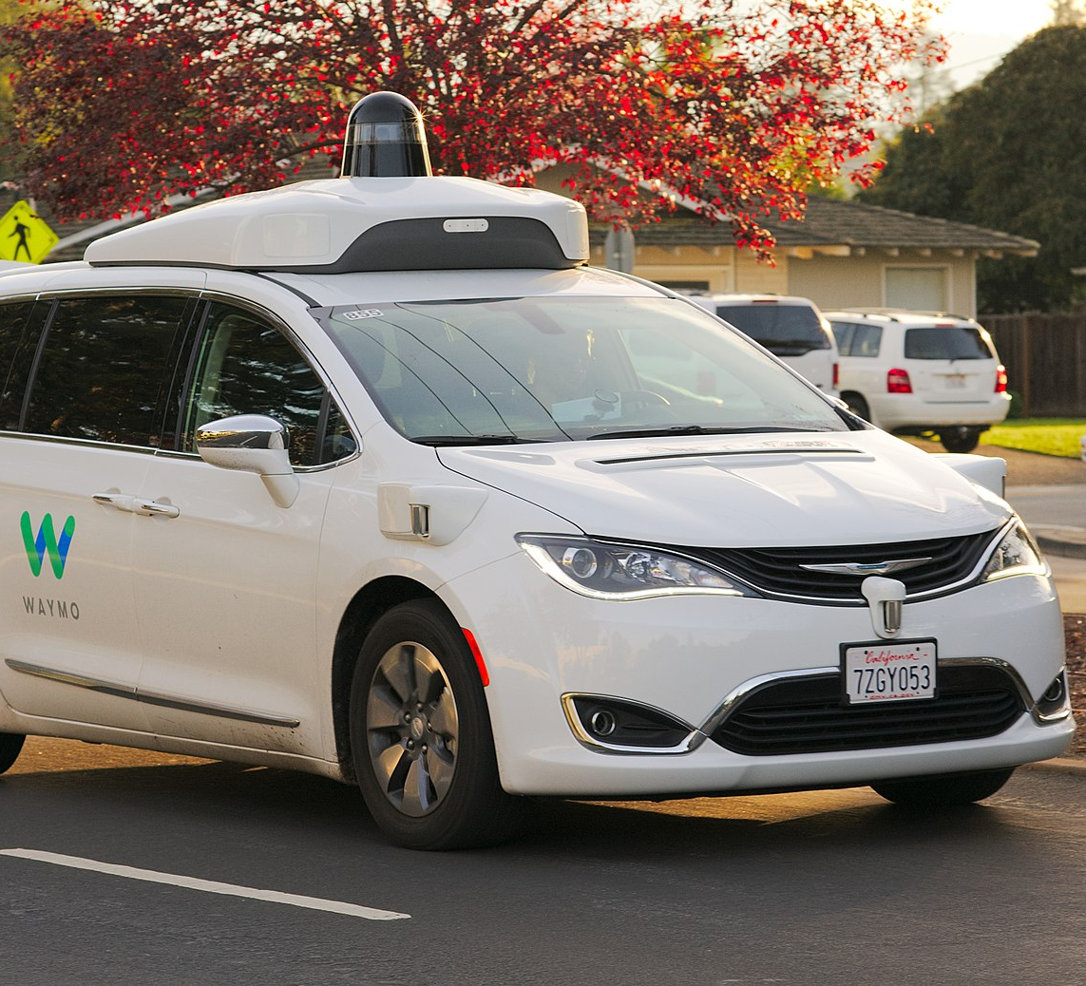
What is aN Autonomous car?
Vehicle Capable of self navigation without driver input
Also called automated, driverless, or self-driving ¹
Source: Waymo
Notes:
So, what is an autonomous vehicle? Simply put, it’s a vehicle capable of independent navigation.

Slide 3
Vehicle automation Classification system ²
Level 0
No Automation
Level 1
Drive Assistance
Level 2
Partial Automation
Level 3
Conditional Automation
Level 4
High Automation
Level 5
Full Automation
Notes:
They can be classified in levels ranging from 0 to 5, from no automation to complete independence. Cars in development by Waymo have reached Level 4.

Slide 4
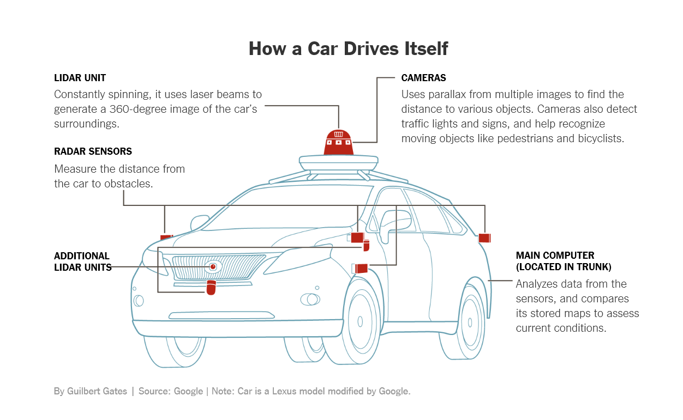
Autonomous vehicle Sensors
Cameras
LiDAR
GPS
Radar
Notes:
These vehicles require special hardware to perform automated tasks including LiDAR, depth and RGB cameras, radar, GPS and other sensors. They also include additional processing power, storage, and communications equipment. The vehicle essentially becomes a ‘remote’ sensing platform.

Slide 5
Major Companies Developing this Technology
Waymo
Tesla
Uber
Delphi
General Motors
Ford
Volkswagen
Nissan
Notes:
Many companies are investing in this technology, such as Google and major auto-makers.

Slide 6
Impact and Deployment scenarios
Deployment
Commercial Taxi/Ridesharing Service Fleets
Deliveries and Terrestrial Shipping
Public Transportation System Expansion
Trucking Fleets
Private Vehicle Owners
Impact
Public Transit Use and Mobility
Traffic
Urban Planning and Zoning
Smart Infrastructure
Notes:
Any of these deployment scenarios will significantly increase the number of sensors capturing LiDAR data and images of our roads, and adjacent assets like signs, trees, light poles, etc.

Slide 7
reasons to care
Massive number of sensors on the road
Potentially generating geospatial big data
Leveraging sensors and data
Increased innovation and decreasing costs for sensors such as LiDAR
Notes:
So, why should geospatial professionals care about any of this? There’s a new drive for innovation and decreasing costs of sensors like LiDAR, increasing the number of sensors gathering big geospatial data, and all the potential applications that could derive from this.

Slide 8
GIS Problem
Infrastructure and Asset management of signs, trees, etc. in GIS
Outdated information due to time, labor, and cost
Notes:
Let’s keep those reasons in mind as we look at a common GIS implementation. Many cities use GIS to help inventory and manage road infrastructure like road condition and markings, signage and other adjacent assets. These geospatial databases often have outdated information due to the cost and labor required to have field crews assessing those assets. Can we potentially leverage autonomous vehicle sensor data to keep such inventory more current?

Slide 9
Main Project questions
How can the resulting sensor data be leveraged in GIS?
Can we implement change detection and object classification methods in point cloud data to automate updates to geospatial features in an infrastructure assets database?
Notes:
This leads to my main project questions. [Read questions]

Slide 10
Initial Challenge
Lack of access to actual vehicle sensor data with on demand runs through study area to capture asset changes
Solution
Use editable model able to simulate LiDAR, Camera RGB and Camera sensors and output data
Challenge
Notes:
My very first problem is that I don’t have access to AV sensor hardware to generate the data needed to assess these questions. The solution could be to simulate the whole process to generate sensor data with software. Fortunately there are resources for that.

Slide 11
Main Project questions
How can the resulting sensor data be leveraged in GIS?
Can we implement change detection and object classification methods in point cloud data to automate updates to geospatial features in infrastructure assets database?
Are results from simulated data sufficiently reliable?
Notes:
The simulation component does add an additional question to the project. [Read 3rd question]

Slide 12
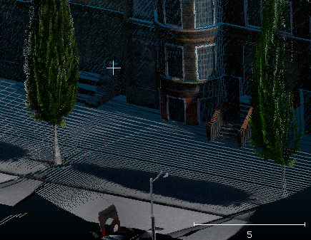
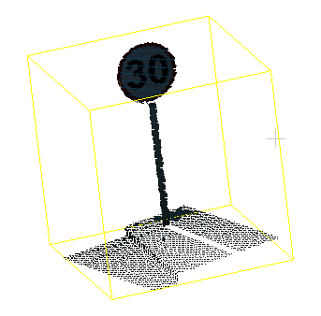
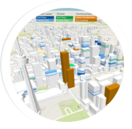
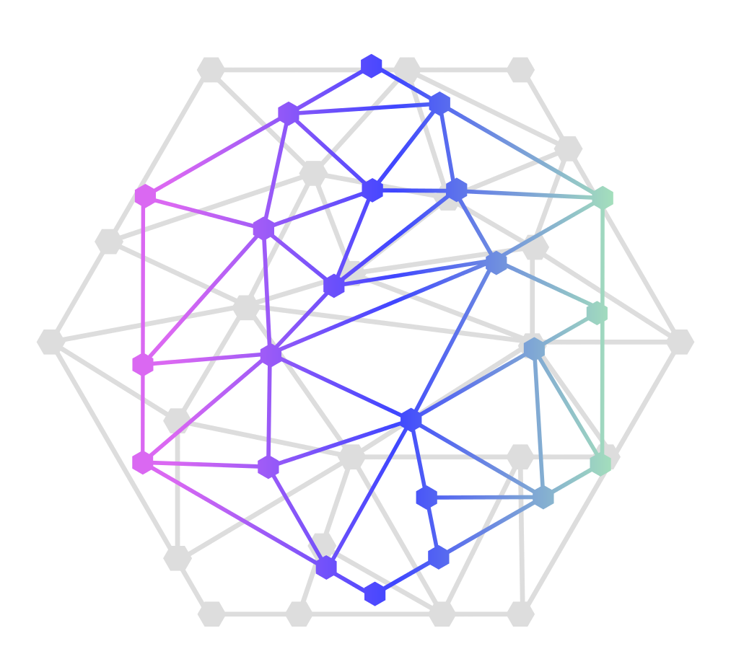
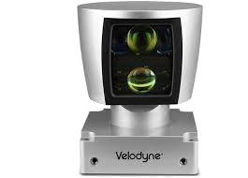
MAIN IDEA & FLOWCHART
SIMULATION
SENSOR DATA ANALYSIS
GIS DATABASE
Build 3D Urban Model
Point Cloud Post-Processing
Infrastructure Assets
PROCESS
Run Vehicle Simulation
Reconcile and Update
Algorithms and Analysis
Visualize and Manage
Change Detection
Machine Learning
Feature Extraction
Generate Sensor Data
LiDAR
Camera
TOOLS
Unreal Engine 4
CARLA Simulator
CloudCompare
Python
Tools & Algorithms
PostGIS
JavaScript Mapping
Images Source: www.vecteezy.com
Notes:
We start out with the simulation using the Unreal Engine 4 video game engine to create a 3D model of a study area in San Diego. We can then use the CARLA Simulator plugin to simulate an autonomous vehicle trip and to generate and export virtual sensor data like LiDAR. The second part is the analysis and includes post-processing the LiDAR point cloud using the CloudCompare software, and testing algorithms, tools, and code to automate change detection and feature extraction with machine learning training. In the third and final part, these results of the analysis are integrated into the PostGIS database to keep it updated, and also includes a web map for stakeholders.

Slide 13
Expected Results
Determination of viability of using this simulated data in this context
Assessing suitability of algorithms or tools for point cloud and image change detection for asset features
Custom code, tools, and scripts used to support the analysis
Feasibility of integrating analysis results with geospatial database of infrastructure assets
Analysis Results
Tools and Scripts
Data
Study area geospatial data asset inventory
3D model in UE4
JavaScript Web map viewer
Notes:
So, what are the expected results from this project? The analysis results should help answer the main questions. The project should also create tools and scripts developed, and also generate data for the model and GIS database.

Slide 14
CARLA Simulator DEMO
Notes:
Let’s take a quick look at the simulation software that will make this project possible. Unreal Engine 4 by Epic Games will be for modeling the study area. The CARLA Simulator is a plugin actively developed by the Computer Vision Center at the Universitat Autònoma de Barcelona (UAB) with support from Intel and Toyota.

Slide 15
Notes:
[Before starting video] Here we have the Unreal Engine 4 Editor with the CARLA Simulator plugin integrated and with the included town model. This is the environment where you would replicate your study area model and modify infrastructure assets before running multiple simulation events. Let’s play a quick video moving around this editor. [Play video] [Describe video as it plays]

Slide 16
Notes:
[Before starting video] Here we are running an automated CARLA simulation, which is setup with a Python script to run a particular path, a certain number of cameras and type of LiDAR sensors, and the frequency of capturing the data and saving it to disk. [Start playing video] Depending on the parameters this can be very demanding on your computer system, so I’ve set it to not generate sensor data continuously and the resulting point cloud will gave many gaps. I’ll have to run this on a high performance machine on a cloud provider like Azure or AWS.

Slide 17
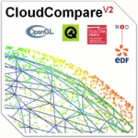
CloudCompare
DEMO
Notes:
Once the CARLA simulation run the sensor data can be accessed as multiple .ply format point cloud files. At this stage post-processing like merging can be started with the CloudCompare software, which is open source and originally developed by researches at the Électricité de France state utility company.

Slide 18
Notes:
This video shows the CloudCompare interface. [Start the video] Here all the exported .ply files are being loaded in the background. [Describe video]

Slide 19
Perform change detection analysis
Explore existing published algorithms from available literature
Develop Machine Learning training and automation for images and point clouds
Examine CloudCompare plugins
Notes:
At this point we have the needed data to experiment with algorithms, tools, and methods to determine if we are able to achieve our goal detect changes, recognize features, and automate such process.

Slide 20
Geospatial Data model
Create geospatial database with vector features for manageable assets reflecting those from map simulation
Include curbs, light poles, street lights, traffic signs, lane marking, etc.
High Definition Map Accuracy
Notes:
Create PostGIS database for managing the infrastructure assets from the study area model.

Slide 21
CesiumJS
DEMO
Notes:
The Cesium JavaScript library can be used to create interactive 3D web applications.

Slide 22
Notes:
This quick video shows one of the demos showcased on the Cesium site. [Start video and describe]

Slide 23
Focus on Open Source
Unreal Engine 4
CARLA Simulator Plugin
CloudCompare
OpenLayers
Cesium
Python
Other open tools and algorithms
Notes:
This project is planned to primarily use open source components, including all these tools.

Slide 24
Sharing contributions
GitHub Repository
CARLA Simulator Python API scenario scripts
CARLA Simulator San Diego Study Area Custom Model/Map
Point cloud classification and change detection tools and/or scripts
CloudCompare plugin?
Fork any tools that are significantly customized
Notes:
All coding contributions resulting from the project will be appropriately made available through GitHub repositories for other developers who may find them useful.

Slide 25
Summary
Create integrated system and testing environment incorporating simulation components iteratively
Streamline geospatial task of managing and updating inventory of streetscape assets in an urban setting
Use available open source components, develop necessary scripts or tools to streamline process, and share resulting code
Notes:
Just a quick recap of the goals.

Slide 26
Methodology & Workflow
CARLA Simulator
Create Custom UE4 Model of Study Area
Script Simulation Scenario with Python API
Export Simulated Sensor Data
Modify Infrastructure Assets
Iterate Process
Sensor Data Post-Processing with CloudCompare
Merge, and Apply Colors to Point Cloud
Register Real World Coordinates
Point Cloud Segmentation and Classification
Asset Inventory Geospatial Database
Load PostGIS Database with Asset Features from Study Area
Build Web Application to View and Manage Data
Easily View Analysis Results
Includes Traffic Signs, Light Poles, Curbs
Notes:
Recap of the methodology and workflow.

Slide 27
Project TimeLine
April 2018
Peer Review Presentation
Summer 2018
Build Simulation Model and Generate Sensor Data
Fall 2018
December 2018
Implement Change Detection Analysis
Now!
TBD
Conference Presentation
Complete Project and Presentation
Interpret Results
Notes:
This is the estimated timeline for the project. [Describe only if time permits]

Slide 28
References
1. Guerra, E. (2016) Planning for Cars That Drive Themselves: Metropolitan Planning Organizations, Regional Transportation Plans, and Autonomous Vehicles. Journal of Planning Education and Research, 36(2), 210-224.
2. SAE Standard J3016
http://carla.org/
https://cesiumjs.org/
https://www.unrealengine.com/en-US/blog
http://www.cloudcompare.org/
Notes:
References

Slide 29
Questions?
bxa928@psu.edu
Notes:
Any questions?

