Slide 1
A Python-Based Process for Search and Retrieval of Survey Control Data
Presented by:
Craig Amey, PS
GEOG 596:
Adviser: Dr. Frank Derby

Slide 2
Presentation Outline
Goals and Objectives
Background
Intended role of land surveyors in GIS
Realized role of land surveyors in GIS – The Problem
Project premise
Original premise
Research
Revised Premise
Research Tool Need
Research Tool Design
Conclusion
Introduction

Slide 3
Goals and Objectives
Goals:
Improve functionality, efficiency and profitability of land surveying data management .
Engage the surveying profession in the use of GIS for intra-office data management.
Objective:
Create a Python-based tool for the efficient and cost effective retrieval of land surveying data.
Use this tool to demonstrate to other surveyors the capability of GIS for intra-office uses.
Goals and Objectives

Slide 4
Land Surveyor and GIS
Public Act 299 of 1980, Michigan Compiled Laws:
Section 339.2001 (F)(iii):The practice of professional surveying includes all of the following:
(iii) Utilizing and managing land information systems through establishment of datum and local coordinate systems and points of reference.
Model Rules, as prepared by National Council of Examiners for Engineers and Surveyors, Section 210.25:
Activities Included within the Practice of Surveying … that must be accomplished by or under the responsible charge of a professional surveyor include, but are not limited to, the following:
1. The creation of maps and georeferenced databases representing authoritative locations for boundaries, the location of fixed works, or topography.
Background

Slide 5
Definitions:
Geographic Information System (GIS): “GIS has referred to spatial information whose detail, accuracy, and precision generally correspond to maps at scales of 1:20,000 of smaller.”
Typical products are those designed to support policy making and planning processes.
Land Information System (LIS): “..the term land information system (LIS) conveys a stronger orientation toward land records and a larger scale than the term GIS”. An LIS requires higher positional accuracy and detail than a GIS.
Typical products are property appraiser’s maps, maps of subdivisions, utility maps, right of way maps and all tabular records and files associated with the maps.
Source: FGCC, Multipurpose Land Information Systems, 1989
Background

Slide 6
Blending of GIS and LIS
“By 1992, the term GIS had more or less been adopted as a general heading for all projects and systems that involved land management.”
Michael Binge, Surveying GIS: The need for a multipurpose cadaster revisited.
In “GIS Guidelines for Assessors”, Urban and Regional Information Systems Association (URISA) identifies the fundamentals of GIS as:
Geographic Control Data
Base Map Data
Cadastral Data
Attribute Data
Source: Michael Binge, “Surveying GIS: The need for a multipurpose cadaster revisited”
Urisa, GIS Guidelines for Assessors.
Background

Slide 7
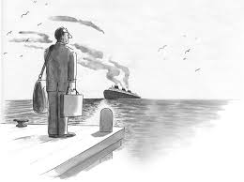
The “Problem”
“A big challenge is integrating the surveying profession with the GIS profession. There’s a growing tension between them.”
Jack Dangermond, ESRI Founder
As stated in Coordinates, March 2007
“Surveyors have missed the GIS boat”, as stated during a presentation at a recent meeting of national leaders of the surveying profession.
Why? Have we?
Background

Slide 8
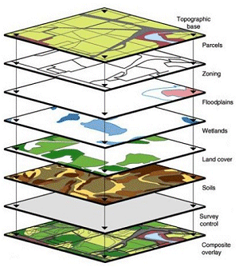
Original Premise
Surveyors are reluctant to embrace GIS because of cost.
=
Project Premise

Slide 9
Poll of Michigan Surveyors
Google products are used by many, but should be used by all surveyors.
County-based GIS systems provide online parcel-based research via ArcGIS, which may account for a significant amount of the ArcGIS usage.
Surveyors DO use GIS!
Only 13% use GIS “Never” or “Seldom”
Project Premise

Slide 10
Poll of Michigan Surveyors
Only 13.9% of surveyors consider data management to be their most important usage.
Cost is the least significant reason for not using a GIS.
The major reason is a lack of understanding of GIS capabilities.
Project Premise

Slide 11
Summary and Revised Premise
Surveying Profession and GIS
Long association
Reluctant to embrace
Cost is a concern, but not the reason
Lack of knowledge is the reason for the reluctance.
Revised Premise
It is a lack of knowledge about the potential uses of GIS that is the root of the reluctance by the surveying profession to embrace GIS.
Project Premise

Slide 12
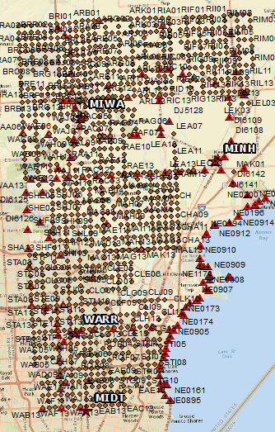
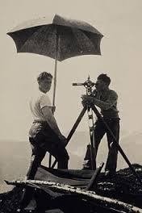
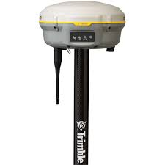
Data Sources - Horizontal
CORS
NGS
Surveyors
Remon
Office
Project Need

Slide 13
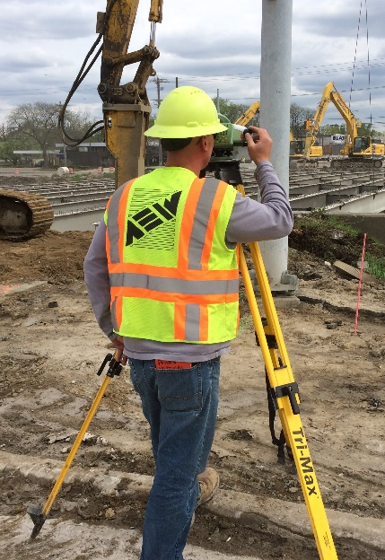
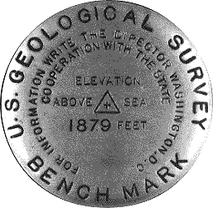
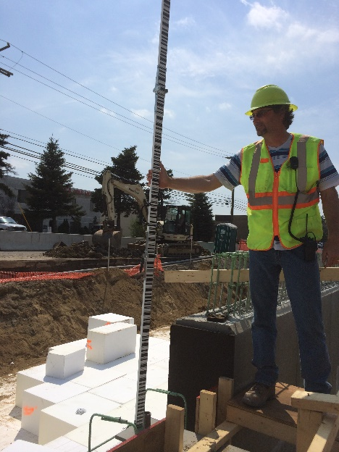
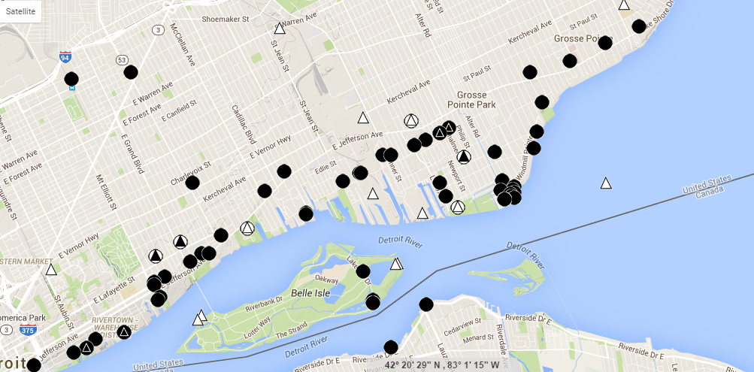
Data Sources – Vertical
Surveyors
NGS
DOT
Corps Of Eng
Munic.
Office
Project Need

Slide 14
Datum
In Metropolitan Detroit, surveyors are faced with multiple vertical datum.
A search for a benchmark requires attention to the datum required and the datum of located benchmarks
IGLD 85
IGLD 55
NGVD 29
NAVD 88
Detroit
Project Need

Slide 15
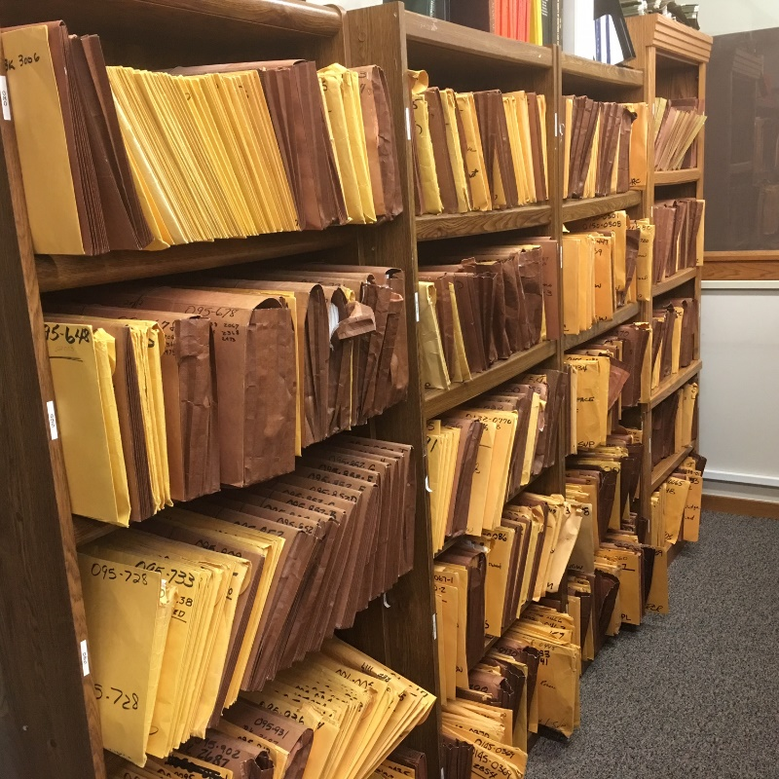
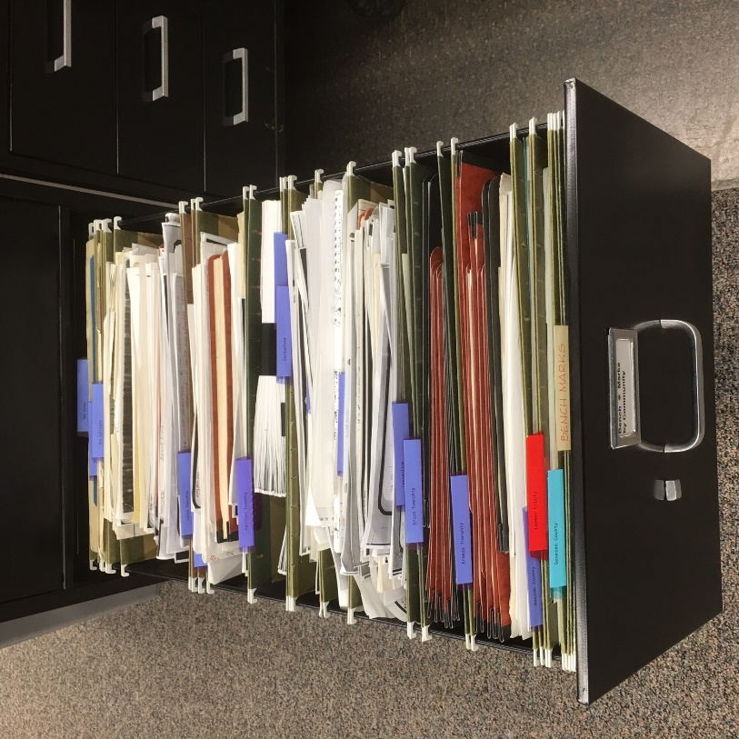
Purpose
“Historic Control GIS”
Search tool was a manual process:
Step 1: Grab a book/folder/file.
Step 2: Look for benchmark.
Step 3: Repeat till found
Results:
Time consuming
“First Found”
Project Need

Slide 16
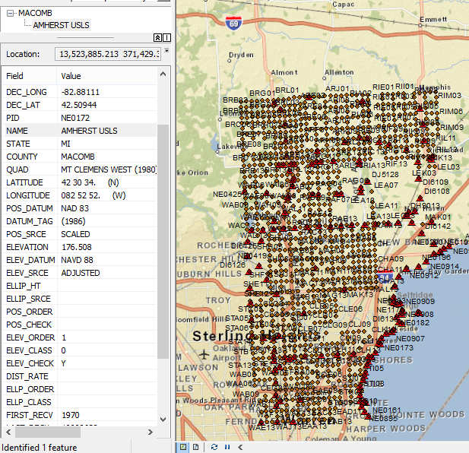
Universal Control Point Schema
Base Schema
The tool’s functionality will require a standardized table.
The table will be based on the schema developed by NGS.
Additional fields will have to be added to adapt to local control.
Project Design

Slide 17
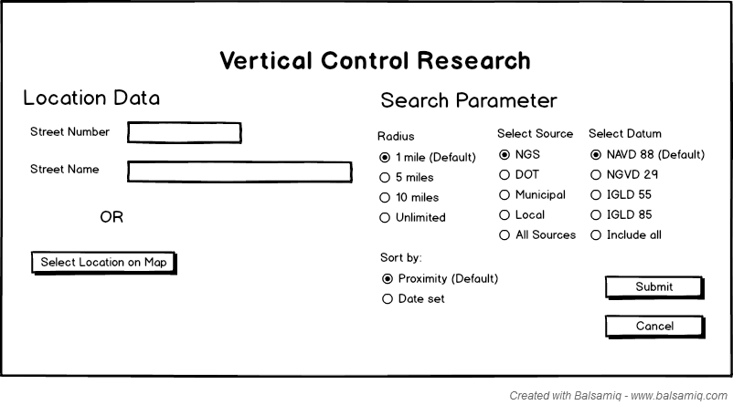
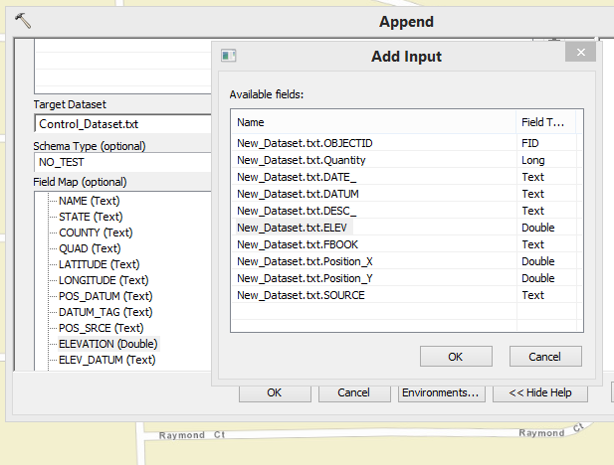
Create Data Set
Control Data
Append
Updated Control Data
Research
New Data
Project Design

Slide 18
Vertical Control Search Tool
Project Design

Slide 19
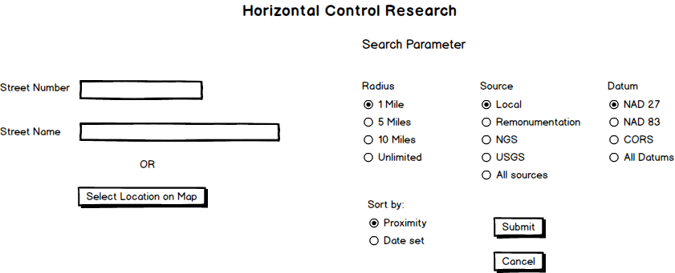
Horizontal Control Research Tool
Project Design

Slide 20
Outcomes
A research tool that will
Improve functionality
Enhance efficiency
Increase profitability
A tool and process that will demonstrate the vital use of GIS for data management within an organization. No longer will GIS just be a gateway software platform for accessing county-based data.
Conclusion

Slide 21
Presentation
Potential Presentation Venues
Michigan Society of Professional
Surveyors Annual Conference
February 16-19
Kalamazoo, MI
IMAGIN's 25th Annual Conference May 15-17, 2016 Traverse City, MI
ESRI User Conference
June 27 – July 1
San Diego CA
Conclusion

Slide 22
Acknowledgements
I would like to thank my advisor, Dr. Frank Derby, for his guidance in the selection of a suitable capstone project topic, and his invaluable insight, critique and comments during the development of this presentation.
When reflecting on my career, I realize that it is not the accomplishments that are important. It is the unique and fascinating people with whom I have worked that will define my success.
Dr. Frank Derby Associate Professor,
Engineering and Surveying Program Coordinator
Penn State University, Wilkes-Barre
Conclusion

Slide 23
Resources
National Council of Examiners for Engineers and Surveyors (NCEES), Model Rules, https://cdn.ncees.org/wp-content/uploads/2012/11/ModelRules-20151.pdf, Retrieved November 2015.
Michigan Compiled Laws, Puhttp://www.legislature.mi.gov/(S(osh0knjjce12x4hmsqknxsh5))/mileg.aspx?page=GetObject&object name=mcl-act-299-of-1980blic Act 299 of 1980, Retrieved November 2015
Coordinates, Tension between surveying and GIS: A growing challenge, March, 2007, http://mycoordinates.org/tension-between-surveying-and-gis-a-growing-challenge-jack-dangermond/, Retrieved November, 2015.
Binge, Michael, Surveying GIS: The need for a multipurpose cadastre revisited, http://www.pobonline.com/articles/86330-surveying-gis-the-need-for-a-multipurpose-cadastre-revisited, Retrieved November 2015.
The Federal Geodetic Control Committee (FGCC), Multipurpose Land Information Systems, THE GUIDEBOOK, 1989, Retrieved from http://www.ngs.noaa.gov/FGCS/tech_pub/Guidebook1of3.pdf, November 2015.
Urban Regional Information Systems Association and International Association of Assessing Officers, 1992 GIS Guidelines for Assessors, Washington D.C. and Chicago Ill., p11-13.
Conclusion

Slide 24
Title and Content Layout with List

