Slide 1
Endangered Hawaiian Moth Distribution Modeling: Influences of Native and Non-native Host Plant Distributions
Fred Amidon
GEOG 596A
26 April 2018

Slide 2
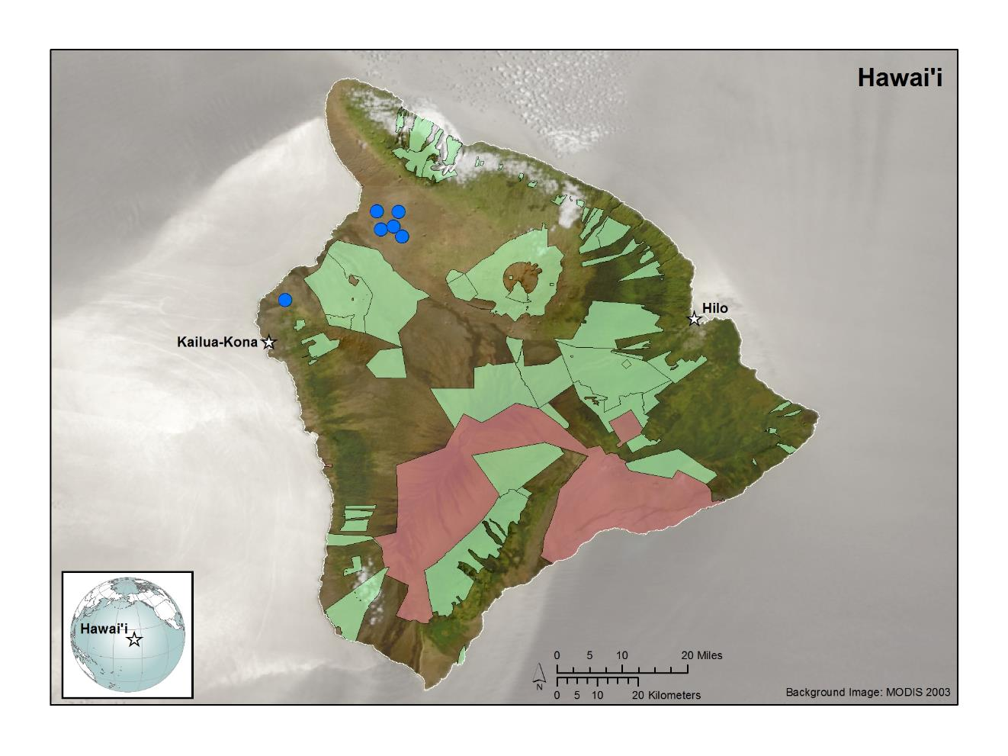
?
?
Endangered Hawaiian Moth Distribution Modeling
Slide 2 of 27
F. Amidon - GEOG 596A - 26 April 2018

Slide 3
Presentation Outline
Background
Study Goals
Species Distribution Modeling
Methods
Species Location Data
Environmental Variables
Modelling Process
Project Timeline
Endangered Hawaiian Moth Distribution Modeling
Slide 3 of 27
F. Amidon - GEOG 596A - 26 April 2018

Slide 4
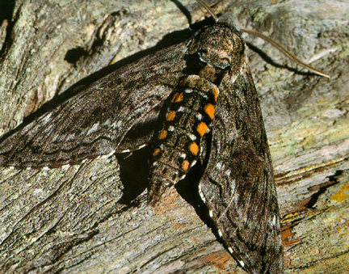
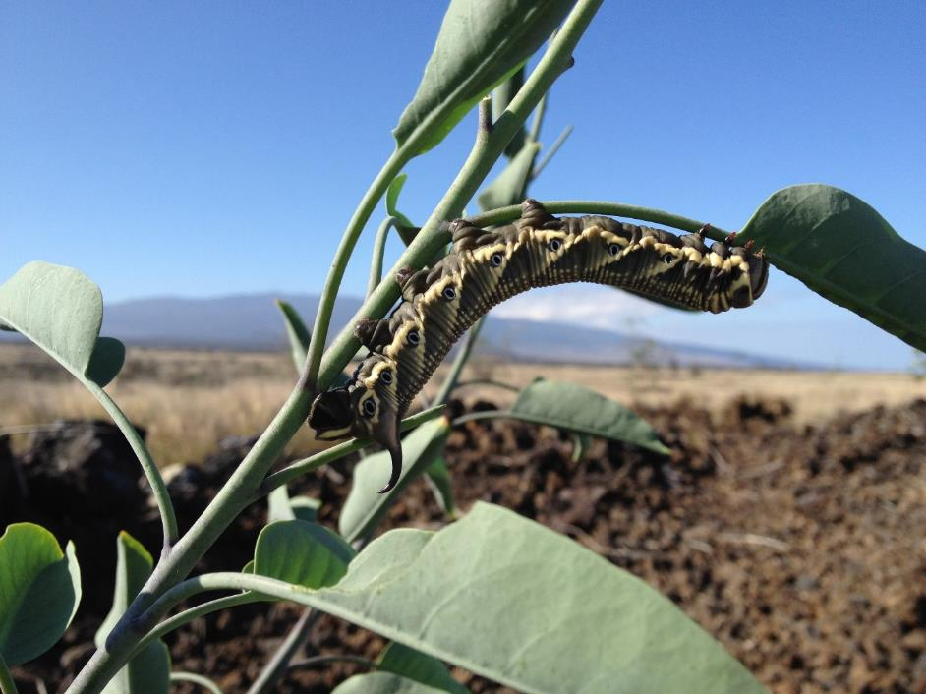
Blackburn’s Sphinx Moth
(Manduca blackburni)
Betsy Gagne
Josh Fisher
Adult
Larvae
Endangered Hawaiian Moth Distribution Modeling
Slide 4 of 27
F. Amidon - GEOG 596A - 26 April 2018

Slide 5
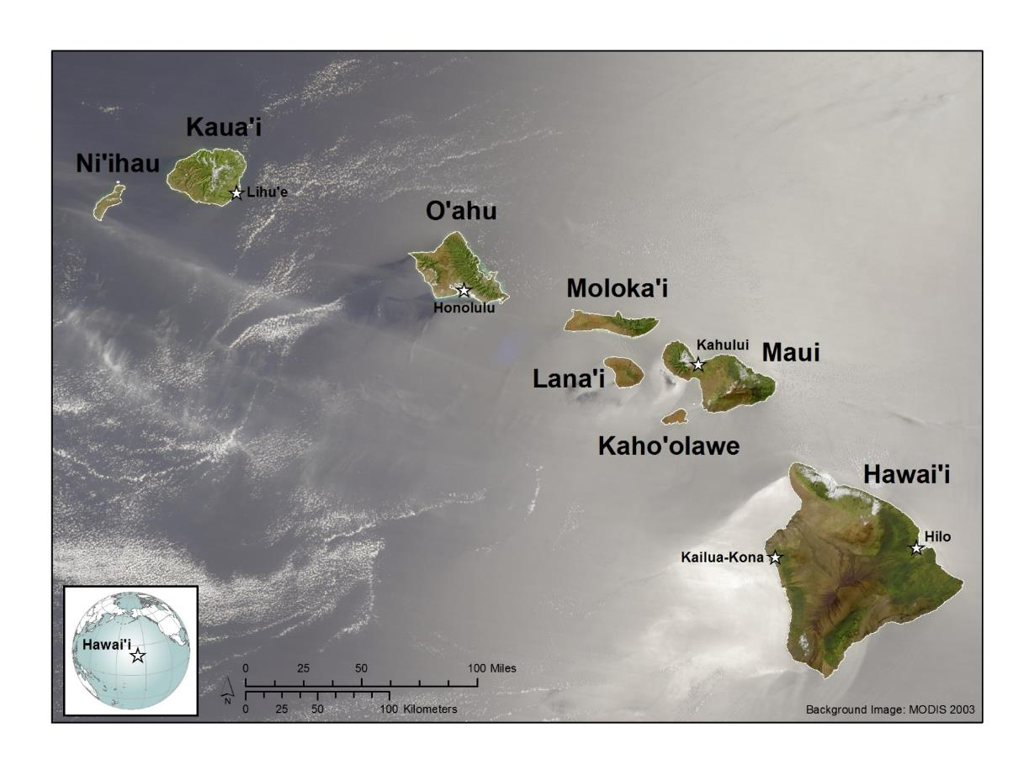
Blackburn’s Sphinx Moth’s Range
Main 8 Hawaiian Islands
Endangered Hawaiian Moth Distribution Modeling
Slide 5 of 27
F. Amidon - GEOG 596A - 26 April 2018

Slide 6
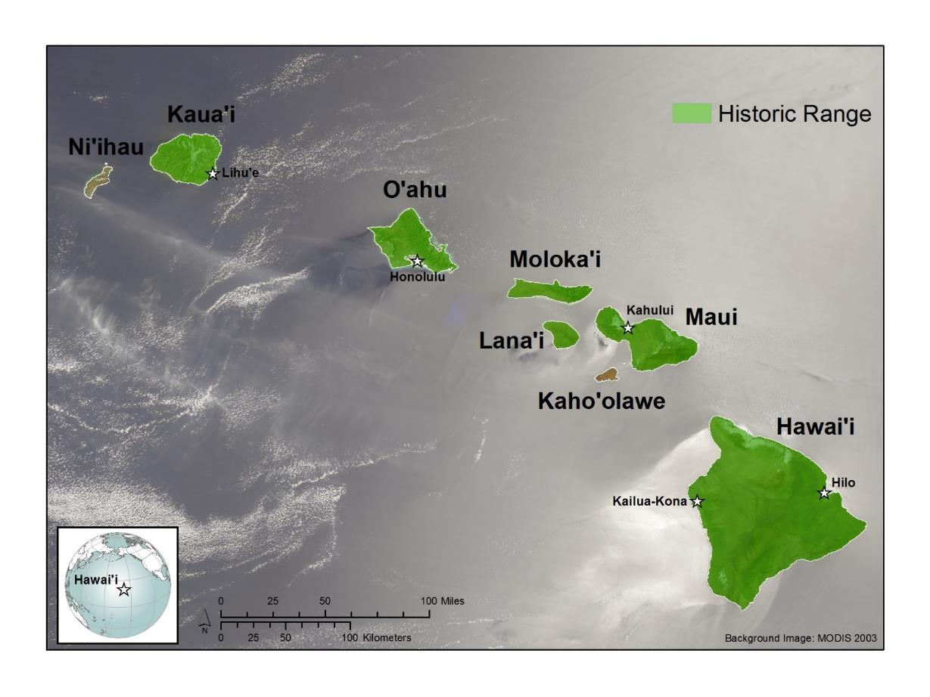
Blackburn’s Sphinx Moth’s Range (Historical)
Endangered Hawaiian Moth Distribution Modeling
Slide 6 of 27
F. Amidon - GEOG 596A - 26 April 2018

Slide 7
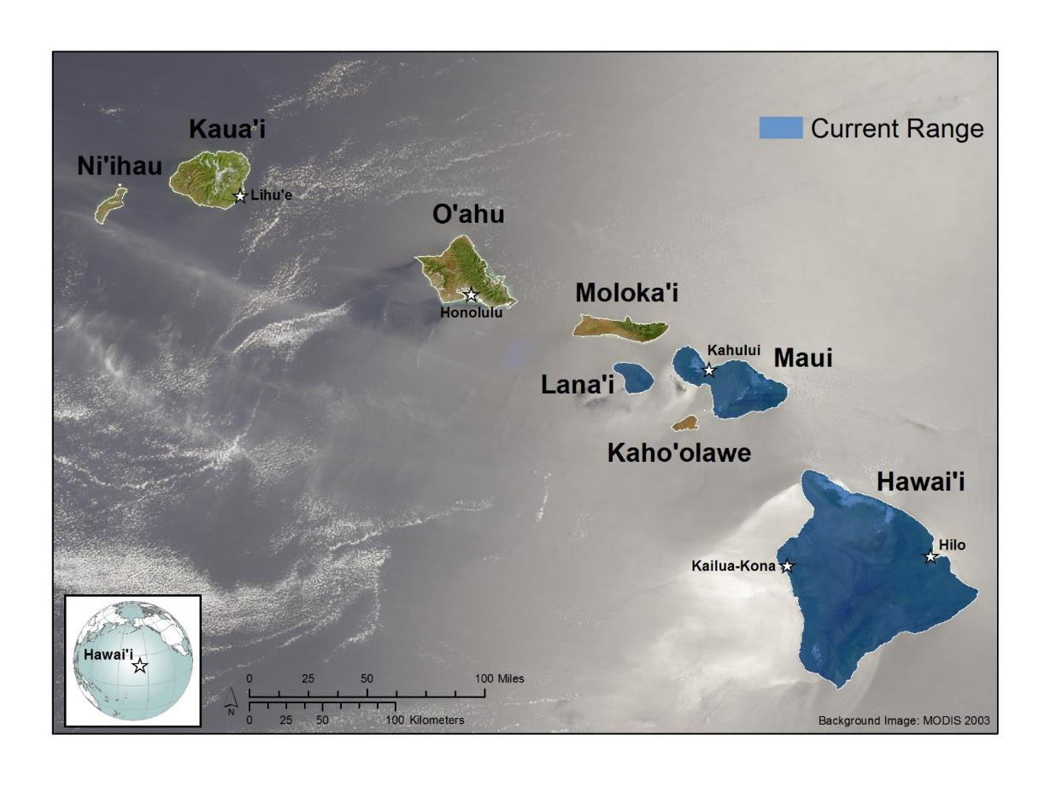
Blackburn’s Sphinx Moth’s Range (Current)
Endangered Hawaiian Moth Distribution Modeling
Slide 7 of 27
F. Amidon - GEOG 596A - 26 April 2018

Slide 8
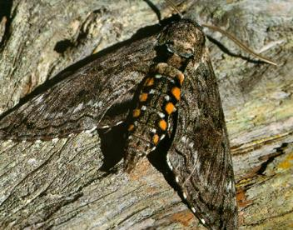
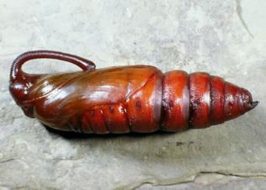
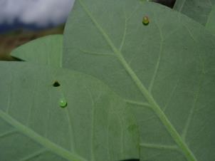
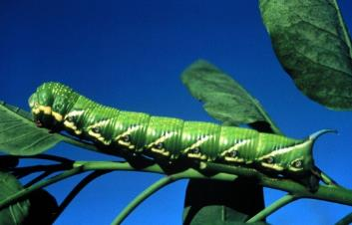
Lifecycle of the Blackburn’s Sphinx Moth
Adult
Pupae
Egg
Larvae
Adult and Larvae photo by Betsy Gagne, Egg photo by Hawaii DLNR, Manduca quinquemaculata Pupae photo by UC Irvine
Endangered Hawaiian Moth Distribution Modeling
Slide 8 of 27
F. Amidon - GEOG 596A - 26 April 2018

Slide 9
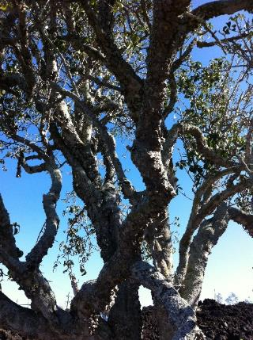
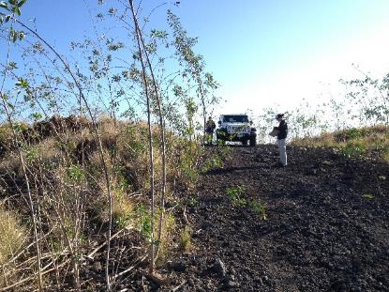
Blackburn’s Sphinx Moth Host Plants
Table: Summary of confirmed Blackburn’s sphinx moth host plants, including their status as native and non-native species in Hawai’i.
Species (common name) | Hawai’i Status
Datura stramonium (jimson weed) ¹ | Introduced
Lycopersicon esculentum (tomato) ² | Introduced
Nicotiana glauca (tree tobacco) ^{2,3} | Introduced
Nicotiana tabacum (commercial tobacco) ⁴ | Introduced
Nothocestrum breviflorum ('aiea)⁵ | Endemic (Endangered)
Nothocestrum latifolium ('aiea) ² | Endemic (Endangered)
Solanum melongena (eggplant) ⁶ | Introduced
Solanum sandwicense (pōpolo) ³ | Endemic (Endangered)
Josh Fisher
Nothocestrum latifolium ('aiea)
¹B. Hobdy 2018, personal communication, ² Riotte 1986, ³ Rubinoff and San Jose 2010, ⁴ Swezey 1924, ⁵L. Perry 2001, personal communication, ⁶Browne 1940 as cited in Riotte 1986
Josh Fisher
Nicotiana glauca (tree tobacco)
Endangered Hawaiian Moth Distribution Modeling
Slide 9 of 26
F. Amidon - GEOG 596A - 26 April 2018

Slide 10
Study Goals and Questions
Goal: Develop distribution models for the Blackburn’s sphinx moth under current and future climate change scenarios to assist managers with conservation planning.
Questions:
Are host plant distributions or environmental variables better predictors of the moth’s current distribution? How do host plants affect the moth’s current and future distribution?
Are native or non-native host plant distributions better predictors of the moth’s current distribution? How do native and non-native host plants affect the moth’s current and future distribution?
Endangered Hawaiian Moth Distribution Modeling
Slide 10 of 27
F. Amidon - GEOG 596A - 26 April 2018

Slide 11
Species Distribution Models
1000
400-800
0
Endangered Hawaiian Moth Distribution Modeling
Slide 11 of 27
F. Amidon - GEOG 596A - 26 April 2018

Slide 12
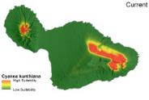
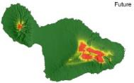
Species Distribution Models
Occurrence & Absence Data
Environmental
Variables
Environmental
Variables
Projection
Distribution Model
D
Current
C
x
x
x
B
x
A
x
x
D
Current
C
B
$$y= β_{0}+β_{1}X_{1}…β_{n}X_{n}+ε$$
A
o
Current
D
o
C
Future
B
o
A
o
o
Future
Endangered Hawaiian Moth Distribution Modeling
Slide 12 of 27
F. Amidon - GEOG 596A - 26 April 2018

Slide 13
Species Distribution Models
Occurrence & Absence Data
Environmental
Variables
Environmental
Variables
Projection
Distribution Model
D
Current
C
x
x
x
B
x
A
x
x
D
Current
C
B
A
$$y= β_{0}+β_{1}X_{1}…β_{n}X_{n}+ε$$
o
Current
D
o
C
Future
B
o
A
o
o
Future
Host Plant Distribution
Biotic interactions can influence distributions (Wisz et al. 2013)
Wisz, M.S., et al. 2013. The role of biotic interactions in shaping distributions and realized assemblages of species: implications for species distribution modelling. Biological Reviews 88:15-30.
Endangered Hawaiian Moth Distribution Modeling
Slide 13 of 27
F. Amidon - GEOG 596A - 26 April 2018

Slide 14
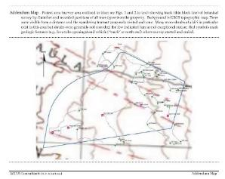
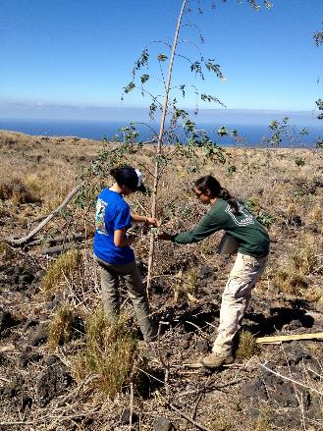
Occurrence and Absence Data
Existing Databases
Josh Fisher
Survey Reports and Unpublished Data
Endangered Hawaiian Moth Distribution Modeling
Slide 14 of 27
F. Amidon - GEOG 596A - 26 April 2018

Slide 15
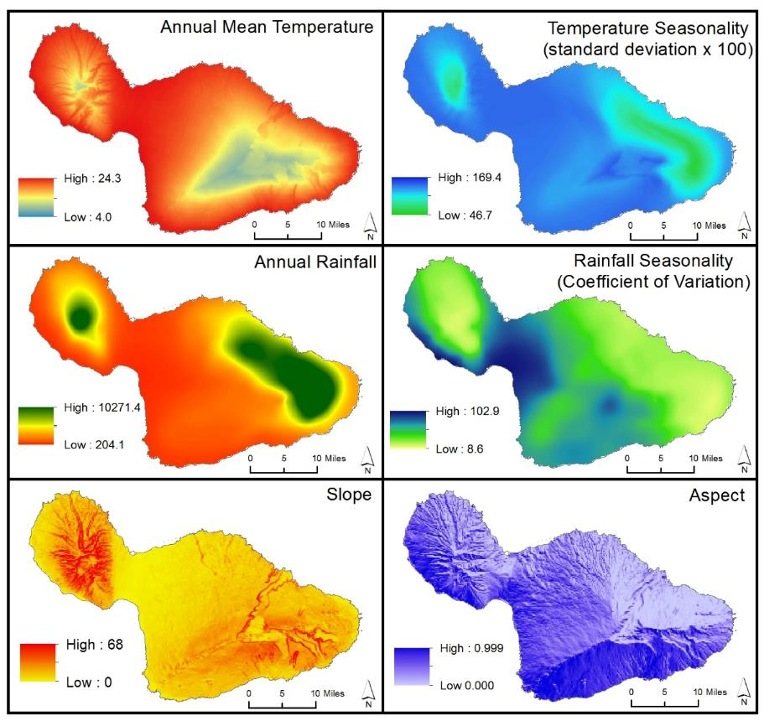
Environmental Variables
Example Data for Maui
Current
Temperature Variables
Rainfall Variables
Future (2041-2071 CMIP5)
Topographic Variables
Endangered Hawaiian Moth Distribution Modeling
Slide 15 of 27
F. Amidon - GEOG 596A - 26 April 2018

Slide 16
Modeling Process
Host Plants
Moth
Data & Model
Data & Model
Projection
Projection
Analysis
Endangered Hawaiian Moth Distribution Modeling
Slide 16 of 27
F. Amidon - GEOG 596A - 26 April 2018

Slide 17
Host Plant Data & Model Phase
Occurrence & Pseudo-absence Data
Extracted
Variables
Environmental
Variables
Distribution Model
x
x
x
P/A | A | B | C | D
X | 32 | 56 | 43 | 22
X | 31 | 62 | 44 | 33
O | 105 | 13 | 45 | 11
O | 111 | 10 | 39 | 02
O | 118 | 11 | 38 | 08
O | 107 | 14 | 43 | 10
X | 33 | 58 | 42 | 28
X | 36 | 61 | 44 | 24
x
x
x
D
C
B
A
$$y= β_{0}+β_{1}X_{1}…β_{n}X_{n}+ε$$
o
o
o
o
Model
Testing
o
Endangered Hawaiian Moth Distribution Modeling
Slide 17 of 27
F. Amidon - GEOG 596A - 26 April 2018

Slide 18
Host Plant Projection Phase
Environmental Variables
Projected Models
Current
D
Current
C
B
Distribution Model
A
Moth Model
Future
$$y= β_{0}+β_{1}X_{1}…β_{n}X_{n}+ε$$
D
Future
C
B
A
Endangered Hawaiian Moth Distribution Modeling
Slide 18 of 27
F. Amidon - GEOG 596A - 26 April 2018

Slide 19
Moth Data and Model Phase
Occurrence & Pseudo-absence Data
Biotic & Environmental
Variables
Extracted Variables
P/A | A | B | C | D | H1 | H2
X | 32 | 56 | 43 | 22 | 156 | 156
X | 31 | 62 | 44 | 33 | 174 | 174
O | 105 | 13 | 45 | 11 | 23 | 23
O | 111 | 10 | 39 | 02 | 14 | 14
O | 118 | 11 | 38 | 08 | 09 | 09
O | 107 | 14 | 43 | 10 | 24 | 24
X | 33 | 58 | 42 | 28 | 182 | 182
X | 36 | 61 | 44 | 24 | 179 | 179
Distribution Model
x
x
x
x
x
x
D
C
B
A
Non-Native Host Plant (H2)
$$y= β_{0}+β_{1}X_{1}…β_{n}X_{n}+ε$$
o
Native Host Plant (H1)
o
o
o
o
Host Plant Projection
Endangered Hawaiian Moth Distribution Modeling
Slide 19 of 27
F. Amidon - GEOG 596A - 26 April 2018

Slide 20
Questions:
Are host plant distributions or environmental variables better predictors of the moth’s current distribution? How do host plants affect the moth’s current and future distribution?
Are native or non-native host plant distributions better predictors of the moth’s current distribution? How do native and non-native host plants affect the moth’s current and future distribution?
1. Host Plant Distributions vs Environmental Variables
2. Native vs Non-Native Host Plant Distributions
2. Current vs Future
Endangered Hawaiian Moth Distribution Modeling
Slide 20 of 27
F. Amidon - GEOG 596A - 26 April 2018

Slide 21
Moth Data and Model Phase
Occurrence & Pseudo-absence Data
Biotic & Environmental
Variables
Extracted Variables
P/A | A | B | C | D | H1 | H2
X | 32 | 56 | 43 | 22 | 156 | 156
X | 31 | 62 | 44 | 33 | 174 | 174
O | 105 | 13 | 45 | 11 | 23 | 23
O | 111 | 10 | 39 | 02 | 14 | 14
O | 118 | 11 | 38 | 08 | 09 | 09
O | 107 | 14 | 43 | 10 | 24 | 24
X | 33 | 58 | 42 | 28 | 182 | 182
X | 36 | 61 | 44 | 24 | 179 | 179
Distribution Model
x
x
x
x
x
x
D
C
B
A
Scenario 1
Non-Native Host Plant (H2)
$$y= β_{0}+β_{1}X_{1}…β_{n}X_{n}+ε$$
Scenario 2
o
Native Host Plant (H1)
$$y= β_{0}+β_{1}X_{1}…β_{n}X_{n}+ε$$
o
Scenario 3
o
o
$$y= β_{0}+β_{1}X_{1}…β_{n}X_{n}+ε$$
o
Moth Analysis
Model
Testing
Host Plant Projection
Endangered Hawaiian Moth Distribution Modeling
Slide 21 of 27
F. Amidon - GEOG 596A - 26 April 2018

Slide 22
Moth Projection Phase
Biotic & Environmental
Variables
Distribution Models
Projected Model
D
C
B
A
Scenario 1
Non-Native Host Plant (H2)
Scenario 1
Native Host Plant (H1)
$$y= β_{0}+β_{1}X_{1}…β_{n}X_{n}+ε$$
D
C
Scenario 2
Moth Analysis
Scenario 2
B
$$y= β_{0}+β_{1}X_{1}…β_{n}X_{n}+ε$$
A
Non-Native Host Plant (H2)
Scenario 3
Native Host Plant (H1)
Scenario 3
$$y= β_{0}+β_{1}X_{1}…β_{n}X_{n}+ε$$
Endangered Hawaiian Moth Distribution Modeling
Slide 22 of 27
F. Amidon - GEOG 596A - 26 April 2018

Slide 23
Moth Projection Phase
Biotic & Environmental
Variables
Projected Model
Current
Future
Distribution Models
D
D
C
C
Current
Future
B
B
A
A
Scenario 1
Scenario 1
Non-Native Host Plant (H2)
Non-Native Host Plant (H2)
Scenario 1
Native Host Plant (H1)
Native Host Plant (H1)
$$y= β_{0}+β_{1}X_{1}…β_{n}X_{n}+ε$$
Current
Future
Current
Future
D
D
C
C
Scenario 2
Scenario 2
Moth Analysis
Scenario 2
B
B
A
A
$$y= β_{0}+β_{1}X_{1}…β_{n}X_{n}+ε$$
Current
Future
Current
Future
Non-Native Host Plant (H2)
Non-Native Host Plant (H2)
Scenario 3
Scenario 3
Scenario 3
Native Host Plant (H1)
Native Host Plant (H1)
$$y= β_{0}+β_{1}X_{1}…β_{n}X_{n}+ε$$
Endangered Hawaiian Moth Distribution Modeling
Slide 23 of 27
F. Amidon - GEOG 596A - 26 April 2018

Slide 24
Moth Analysis Phase
D
C
B
A
Non-Native Host Plant (H2)
Distribution Models
Native Host Plant (H1)
Biotic & Environmental
Variables
Scenario 1
Test Score
$$y= β_{0}+β_{1}X_{1}…β_{n}X_{n}+ε$$
D
C
B
Scenario 2
Test Score
A
$$y= β_{0}+β_{1}X_{1}…β_{n}X_{n}+ε$$
Scenario 3
Test Score
$$y= β_{0}+β_{1}X_{1}…β_{n}X_{n}+ε$$
Non-Native Host Plant (H2)
Native Host Plant (H1)
Endangered Hawaiian Moth Distribution Modeling
Slide 24 of 27
F. Amidon - GEOG 596A - 26 April 2018

Slide 25
Moth Analysis Phase
Projected Model
Model Overlap
(I Statistic, Warren et al 2008)
Current
Future
Current
Future
Scenario 1
Scenario 1
Scenario 1
Scenario 1
Model Difference
(Significant Difference, Januchowski et al. 2010)
Current
Future
Current
Future
Scenario 2
Scenario 2
Scenario 2
Scenario 2
Current
Future
Current
Future
Scenario 3
Scenario 3
Scenario 3
Scenario 3
Warren, D.L., R.E. Glor, M. Turelli, and D. Funk. 2008. Environmental Niche Equivalency versus Conservatism: Quantitative Approaches to Niche Evolution. Evolution 62:2868-2883.
Januchowski, S.R., R.L. Pressey, J. VanDerWal, and A. Edwards. 2010. Characterizing errors in digital elevation models and estimating the financial costs of accuracy. International Journal of Geographic Information Science 24:1327-1347.
Endangered Hawaiian Moth Distribution Modeling
Slide 25 of 27
F. Amidon - GEOG 596A - 26 April 2018

Slide 26
Project Timeline
Prep Environmental Variables | May 2018
Collect and Prep Species Location Data | May – August 2018
Modeling and Analysis | September – October 2018
Report Writing | November 2018 – February 2019
GEOG 596B | February – May 2019
Presentation | April 2019
May | June | July | Aug | Sept | Oct | Nov | Dec | Jan | Feb | Mar | Apr | May
2018
2019
Endangered Hawaiian Moth Distribution Modeling
Slide 26 of 27
F. Amidon - GEOG 596A - 26 April 2018

Slide 27
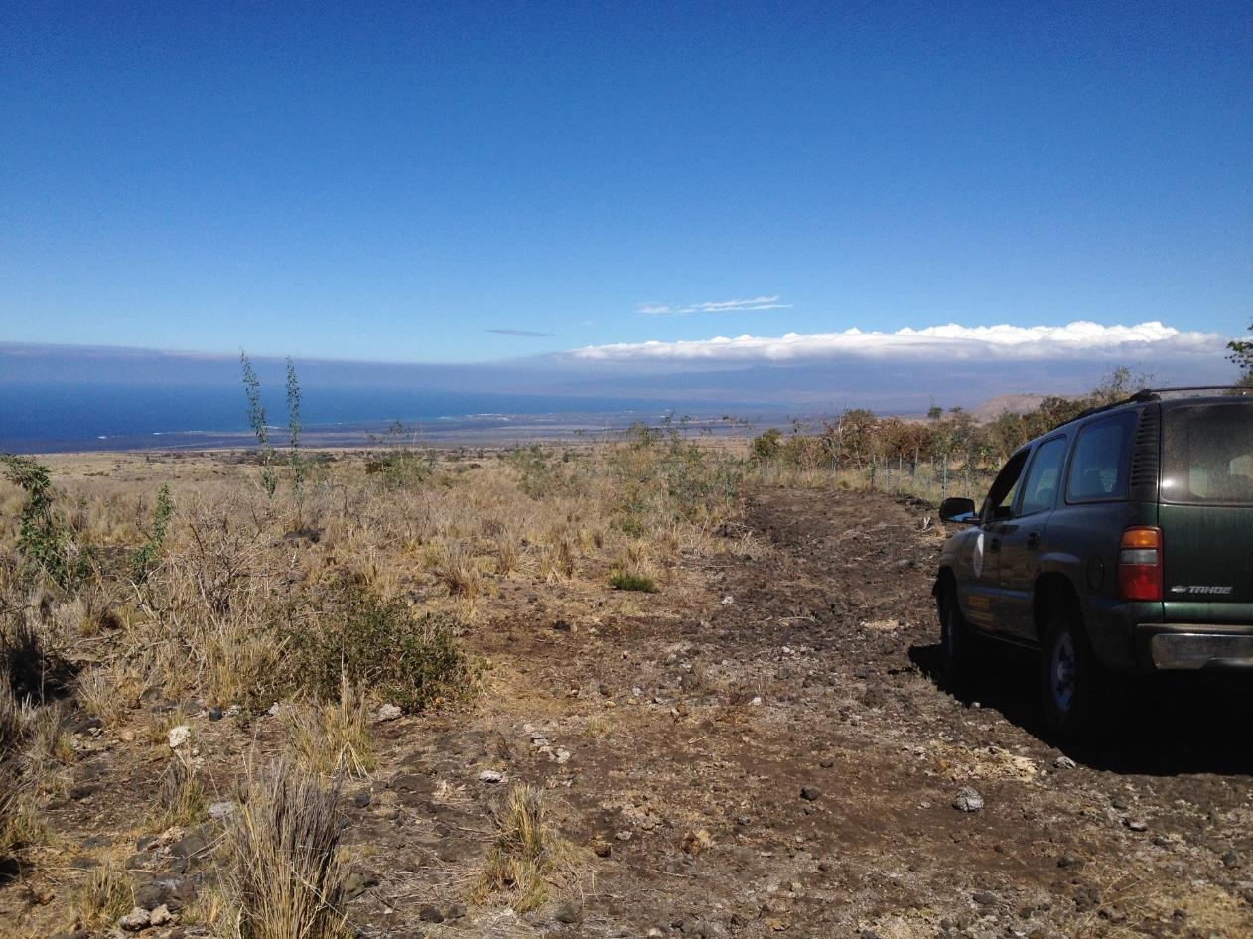
Mahalo Nui Loa
Questions?
Josh Fisher
Endangered Hawaiian Moth Distribution Modeling
Slide 27 of 27
F. Amidon - GEOG 596A - 26 April 2018

