Slide 1
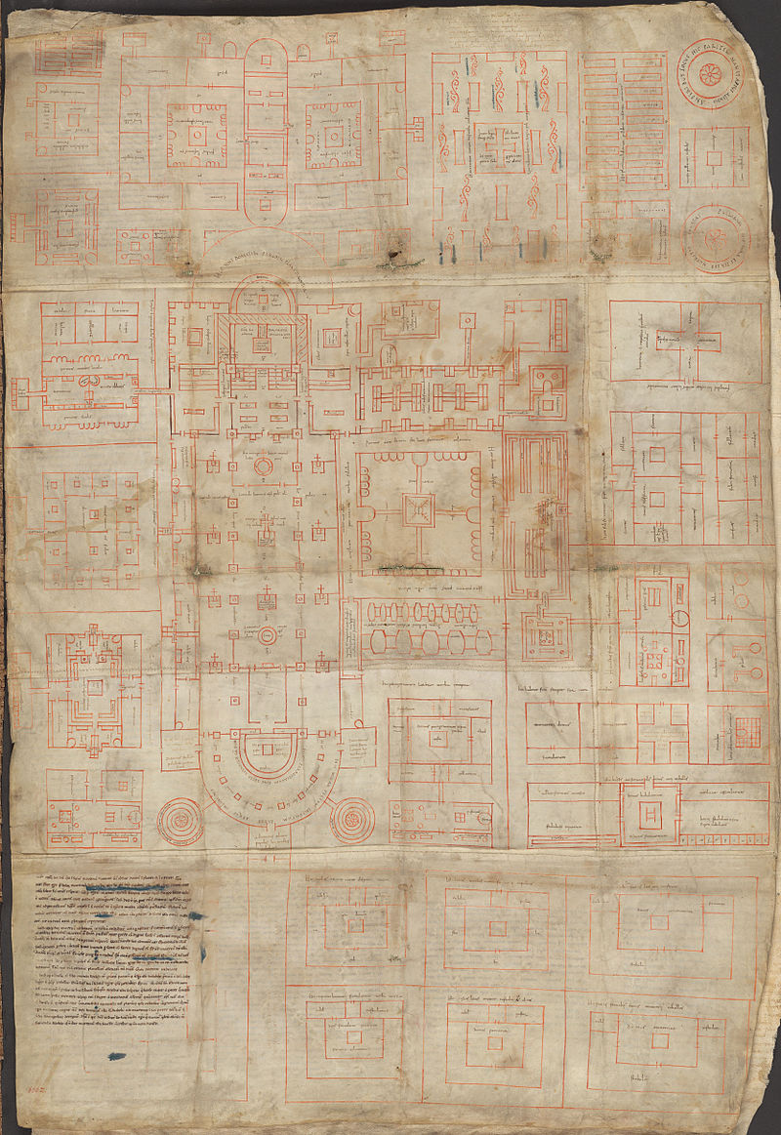
Conposito
Monasterium
Civitatem
The Plan of St. Gall: A Plausible Purpose
The Pennsylvania State University
GEOG 596A, Capstone Proposal Peer Review
Lance C. Armstrong
Academic Advisor: Professor Deryck Holdsworth
Notes:
Hello, my name is Lance Armstrong. The title of my project is “Conposito Monasterium Civitatem” which is Latin for “Planned Monastic City”. The purpose of my capstone topic is to propose the novel idea that the enigmatic drawing known as The Plan of St. Gall --that has survived since the early 9th Century-- was to be used to create a cutting-edge Benedictine monastery (actually much more than a monastery, but a planned monastic city) for the Benedictine abbey in the present Suisse city of St. Gallen.

Slide 2
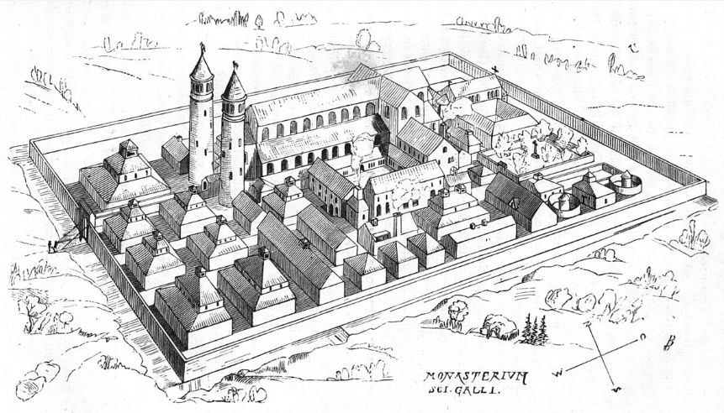
Outline
Project Objectives
Background
Literature Review/Precedents
Data
Site Selection Criteria
Methodology
Anticipated Results
Timeline
Future Opportunities
Works Cited
Artist interpretation of Plan of St. Gall if built
Notes:
I have divided my presentation into these general categories. A significant part of this presentation is providing background to the Plan of St. Gall, explaining what it is, why it is important, and what criteria can be found that allow the use of a GIS to analyze possible site locations.

Slide 3
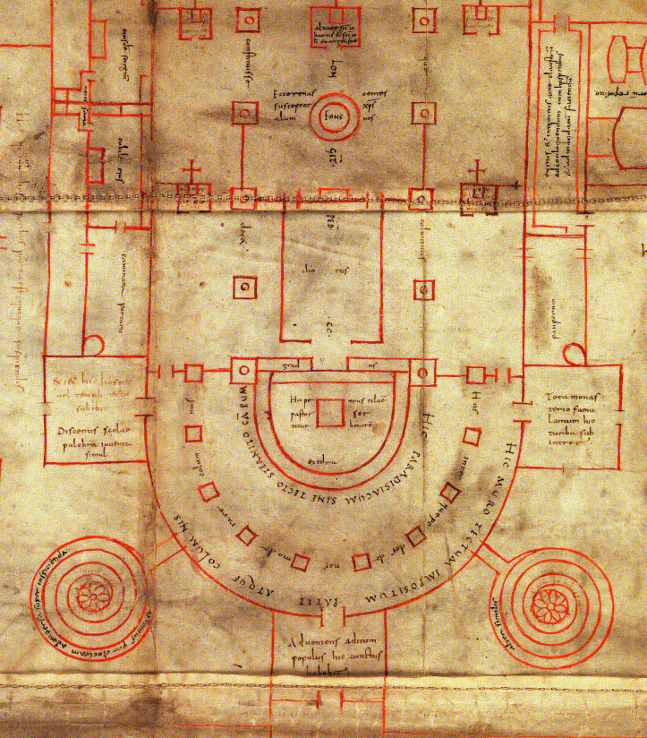
Project Objectives
Identify purposes and whether location at St. Gall was plausible
Analyze Monk/Laity Divide
Analyze site selection criteria and Identify candidate site locations for Plan of St. Gall
Detail of the 9th Century Plan of St. Gall showing Church Nave and Towers
Notes:
I have 3 project objectives. The first- which is already completed- was to discern whether it is possible that the Plan of St. Gall was designed and authored with the intent of actually being built at St. Gall, Switzerland.
Scholars from numerous fields have performed analysis and research over several decades on the Plan of St. Gall; their results have different conclusions about the purpose of the mysterious Plan of St. Gall; apart from the most general of conclusions, all of those findings are without consensus about its true purpose.
Amidst those publications there is evidence that it is entirely plausible that the plan may have been for use at the Abbey of St. Gall. Another objective is to explore a layer of design ingenuity within the Plan of St. Gall. Namely, that it solved a problem with earlier monastic complexes where the monk was not cloistered from workers and other laity in the monastery complex. The 3rd objective involves the use of geospatial data and a GIS. If it is possible that the Plan of St. Gall was a design for a significant monastic reform in the vicinity of the abbey of St. Gall, then I will identify possible candidate sites.

Slide 4
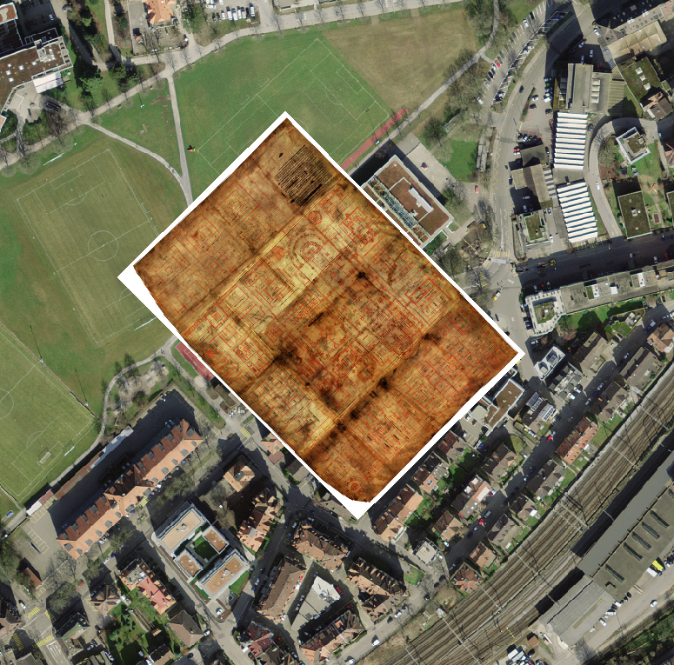
Background
What is the Plan of St. Gall?
Where and when?
Importance & mystery of the Plan of St. Gall
Why was it created?
Plausible purpose: to be built at Abbey at St. Gall
The Plan of St. Gall georeferenced in a possible site.
Notes:
To provide background, I will answer the questions “who, what, where, and why?” I will discuss the location of the plan (at least where it was housed), the proposed study area for GIS analysis, why the purpose of the plan is mysterious, why it is important, and that evidence can be found that supports the plausible possibility that the plan may have been presented to the ruling abbot of St. Gall for a cutting-edge (and perhaps utopic) monastery complex to be built at St. Gall (located in the current Suisse city of St. Gallen).

Slide 5
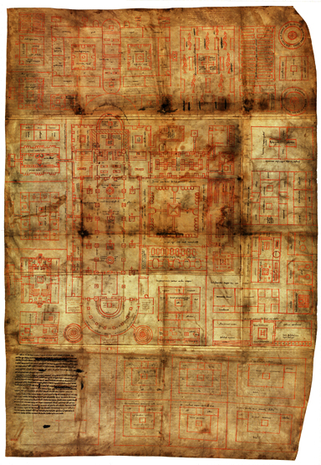
What is the Plan of St. Gall?
An architectural plan drawn on sewn-together animal hide for an ideal Benedictine Monastery during a time of progressive reform.
The original was designed and authored in AD 816-817 by monks of the Abbey of Reichenau. A copy authored in ~ AD 820 was sent to the abbot at St. Gall.
Technical name: Stiftsbibliothek Sankt Gallen, Ms 1092
Measures 45” x 31” and is presently preserved at Monastery Stiftsbibliothek in St. Gallen Switzerland.
Deliberate spatial arrangement of functional areas for ‘ideal monastery’ aimed at applying principles of Rule of St. Benedict according to the regulations put into law from Synods of Aachen in AD 816.
Large monastery complex set within functional areas for self-sufficiency. Church, cloister, refectories, scriptorium, library… Plus elements for self-sufficiency: brewery, bakery, mill, shoemaker shop.
Stiftsbibliothek Sankt Gallen, Ms 1092
Notes:
The Plan of St. Gall (technically known as Stiftsbibliothek Sankt Gallen, Ms 1092) is the only surviving major architectural drawing from the era of time between the Fall of the Roman Empire to the mid 13th Century. It is an object of intense interest among modern scholars, architects, artists and draftsmen for its uniqueness, its beauty, and the insights it provides into medieval culture. The plan is an architectural drawing on sewn-together animal hide showing an ingenious spatial arrangement for an ideal Benedictine Monastery during a time of progressive reform.
The original was designed and authored in AD 816-817 by monks of the Abbey of Reichenau. A copy authored in ~ AD 820 was sent to the abbot at Sank Gall.
The drawing measures 45” x 31” and is presently archived and preserved at Monastery Stiftsbibliothek in St. Gallen Switzerland. This past summer, I went to that abbey and obtained a 1:1 scale reproduction of the plan. I had that reproduction digitized as a high resolution TIFF file which I brought it into ArcMap, where I georeferenced it. The Plan of St. Gall shows a deliberate spatial arrangement of functional areas for an ideal monastery aimed at applying principles of Rule of St. Benedict according to the regulations put into law from Synods of Aachen in AD 816.

Slide 6
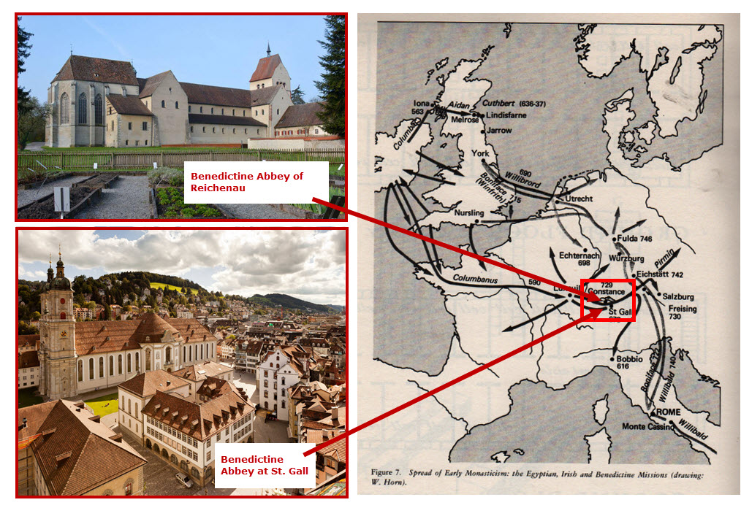
Where & When?
WHERE?
The Plan of St. Gall was designed and authored at the abbey of Reichenau Island, located on Lake Constance in Southern Germany. The plan was delivered to its sister abbey in the medieval city of St. Gallen, Switzerland. This location had its beginnings as an Irish monastic hermitage from the early 7th Century.
WHEN?
The Plan of St. Gall was designed and authored in the early 9th Century (~820 AD), almost 12 centuries ago.
Above right: Locations of Benedictine abbeys of Reichenau (Southern Germany on Lake Constance) and St. Gall (modern day eastern Switzerland). Map shows the spread of early monasticism in western Europe. The interest here is to show how the founder of St. Gall came from Ireland in the early 7th Century.
Notes:
The Plan of St. Gall was designed and authored at Reichenau Island, located on Lake Constance in Southern Germany. The plan was delivered to its sister abbey in the medieval city of St. Gallen, Switzerland.
This drawing was designed and authored in the early 9th Century (~820 AD), almost 12 centuries ago. The map in the upper, right shows the locations of the abbeys of Reichenau and St. Gall amidst the spread of early monasticism in western Europe. The images along the left side show recent pictures of those abbeys. I will be focusing attention on the Abbey of St. Gall which is seen in the lower, left.

Slide 7

Importance and Mystery of the Plan of St. Gall
The MYSTERY of the Plan of St. Gall
“…is considered a national treasure of Switzerland and remains an object of intense interest among modern scholars, architects, artists and draftsmen for its uniqueness, its beauty, and the insights it provides into medieval culture.”
“The only surviving major architectural drawing from the Fall of the Roman Empire to Circa 1250.”
"There are few single documents more important for the history of medieval art, architecture, monasticism, and, as we hope to show in this essay, devotional emotions, than the famous drawing known as the Plan of St. Gall. ”
The IMPORTANCE of the Plan of St. Gall
The purpose of the Plan of St. Gall is mysterious, if not enigmatic.
Although it is called the “earliest and most extraordinary visualization of a building complex produced in the Middle Ages” there is no consensus among academicians as to why it was created.
We know some things:
✓ The monks who authored it
✓ Date it was designed and authored
✓ Cultural and political climate that motivated the authorship
And one very plausible possibility is that the plan was to be used to create a masterwork at St. Gall…
Exploring this utilizing a GIS has not been done… yet.
Notes:
Why is the plan important? Here are a few quotes from those who have studied the plan. Words such as treasure, importance, and intense interest stand out. The purpose of the Plan of St. Gall is mysterious, if not enigmatic. Although it is called the “earliest and most extraordinary visualization of a building complex produced in the Middle Ages” there is no consensus among academicians as to why it was created. And one very plausible possibility is that the plan was to be used to create a masterwork at St. Gall… Exploring this utilizing a GIS has not been done… yet.

Slide 8
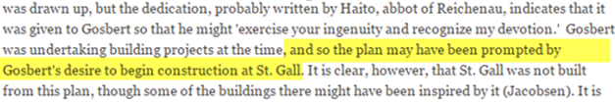

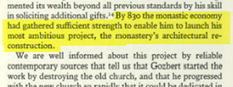
Why was the Plan of St. Gall created?
Monastic Reform:
Early 9th Century a time of monastic reform
Rule of St. Benedict
A self-sufficient monastic facility (that could be considered a Planned Monastic City)
Political:
One common interpretation of the plan’s purpose is that it was a vision for a large royal abbey for the new king (Charles the Bald) on his visit to review his new heritage in the year 829.
A plan for the abbey at St. Gall:
Highly respected work by Horn and Born and other scholars suggest that it is plausible that the plan was for an abbey at St. Gall.
Notes:
Earlier I highlighted how scholarly research over time has resulted in different explanations for the purpose of the Plan of St. Gall. Although there is no scholarly consensus on its purpose, there is agreement that the plan was created during a time of great monastic reform that also coincided with political and ecclesiastical change. In addition, some scholars hint that the plan may have been a vision for a new monastery to be built at St. Gall.
The early 9th Century was a time of monastic reform with a desire to create the perfect monastery that would embody the governing Rule. In this case, that rule was the Rule of St. Benedict, which called for creating a self-sufficient monastic facility that could be considered a Planned Monastic City. The goal was to move away from a manor type of monastery (where monks were exposed to and integrated with laity) and to progress toward an architectural form that would permit the Rule of St. Benedict to be lived out.
The highly respected work by Horn and Born --and other scholars-- suggest that it is plausible that the plan was for an abbey at St. Gall. In the lower section of this slide I have highlighted text from different scholars’ papers on the Plan of St. Gall that give credence to the possibility that the plan was indeed to be built at St. Gall.

Slide 9
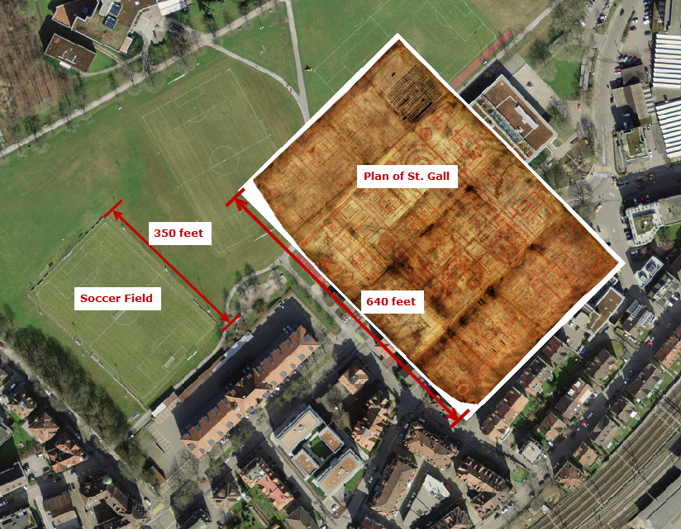
Relative size of the Plan of St. Gall
Notes:
If the monastic compound were to be built, it would enclose an area just shy of 7 acres. In this slide I show the Plan of St. Gall georeferenced to a physical area approximately+ ¾ of a mile southwest of the current abbey. The plan is rotated approximately 135 degrees from north to point toward Jerusalem (which is one of the site selection criteria that I will explain shortly). The plan measures 640’ x 460’. This graphic shows how this compares to an athletic field.

Slide 10
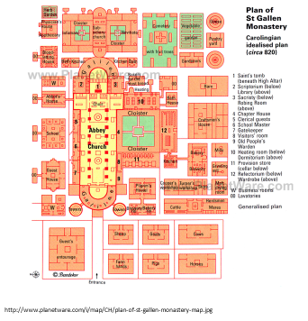
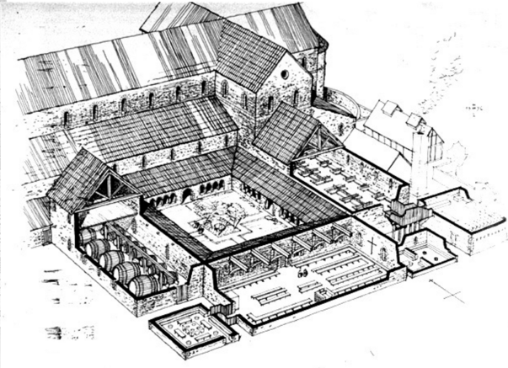

Monk/Laity Divide & Functional Areas
One interpretation of how the plan might have appeared if built showing sectional cutaway view of interior spaces.
Spaces for general/public use
Spaces dedicated primarily for monks’ usage
Within the walled monastery were components necessary for self-sufficiency.
Notes:
The Plan of St. Gall was designed to include all functions to permit self-sufficiency. The plan included dedicated housing (and lavatories) for different groups such as guests, monks, and workers. The plan included workshops, barns, and even a blood-letting house and physician’s house. The left image and the cutaway in the upper, right show what functions were contained within the Plan. The need for agricultural lands and a stream would of course be external to the walled facility.
One of the beauties of the Plan is that it arranges areas of usage so that monks were segregated from laity and workers. This is a substantial, if not a watershed achievement of 9th Century monastic reform. The image in the lower right shows areas of the Plan that I digitized based on whether they were used by laity or by monks. One question that comes from this is how spaces and usage of other Benedictine monasteries compared to the idealized Plan of St. Gall.

Slide 11
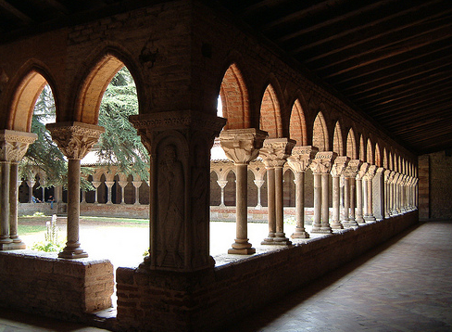
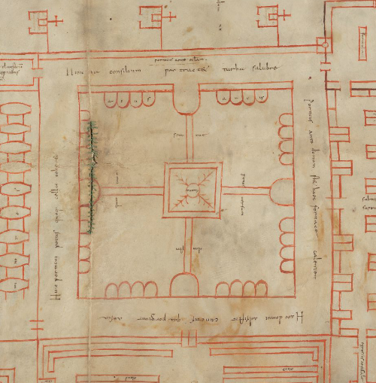
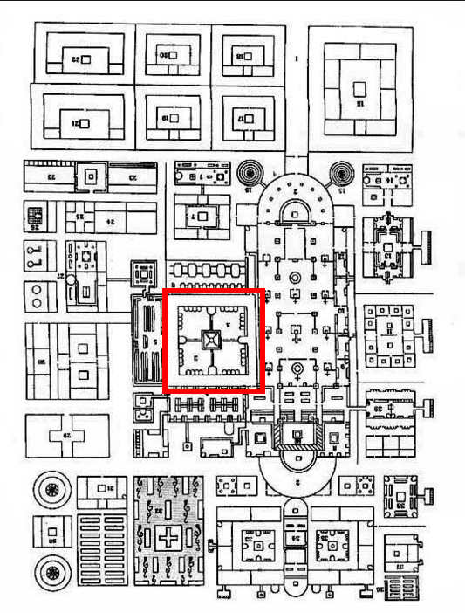
Importance of the Medieval Cloister
What is a Cloister?
Not an open space, but a wall with openings
Deliberately confines; acts as a barrier
Used year-round
The Cloister in Plan of St. Gall
Separates/segregates monks from laity and workers
Designed to provide necessary sun exposure
Example of a medieval cloister. Moissac Abbey, Tarn-et-Garonne in south-western France.
Left: Detail of the cloister of the Plan of St. Gall. Right: Cloister within entire Plan.
Notes:
To appreciate the Plan of St. Gall requires a little knowledge about a monastic space called a CLOISTER. Derived from the Latin word claustrum, a CLOISTER is a key element within a monastery and is used primarily by monks. The top, right image shows an example. Notice in that image that the space is a covered 4-sided walkway and that the interior walls are mostly solid with openings toward an inner garden. The cloister is not to be confused with earlier Greek and Roman arcades-- where the covered walkways are open and allow movement to and from the outer and inner spaces. In contrast, the medieval cloister was designed deliberately as a barrier and confined space and played a critical part of monastic spirituality. Notice near the ground the small openings to the inner garden. The cloister, as found in medieval monasteries, was used year-round. Because of the weather at St. Gall, the cloister would require a southern or southwestern orientation, which the Plan of St. Gall typifies. In addition, in this plan, the cloister is spatially-dovetailed to the church nave which points approx. 135 degrees from north; the result is that the cloister has a southwestern exposure. In addition, the cloister is arranged to isolate the monks from laity and workers. The lower images show the cloister in the Plan of St. Gall. Part of the ingenuity of the Plan of St. Gall is that it solved the problem of monks being exposed to laity and workers, which was common in earlier monasteries. In the 9th Century, monastic reform was a hot topic in Western Europe and resulted in the Synods of Aachen of AD 816-819. Ecclesiastical legislation and regulations called for monasteries to comply with the Rule of St. Benedict, resulting in deliberate arrangement of spaces to keep the monks from interaction with workers and other layman. A significant part of solving this was the proper use of the Cloister, which the Plan of St. Gall locates strategically in both location and sun exposure/aspect.

Slide 12
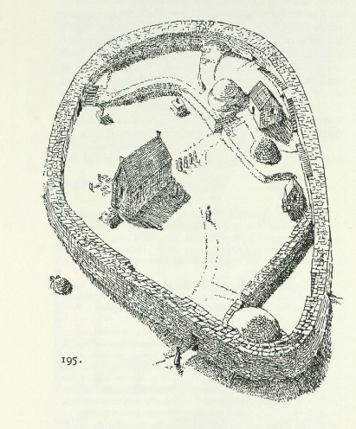
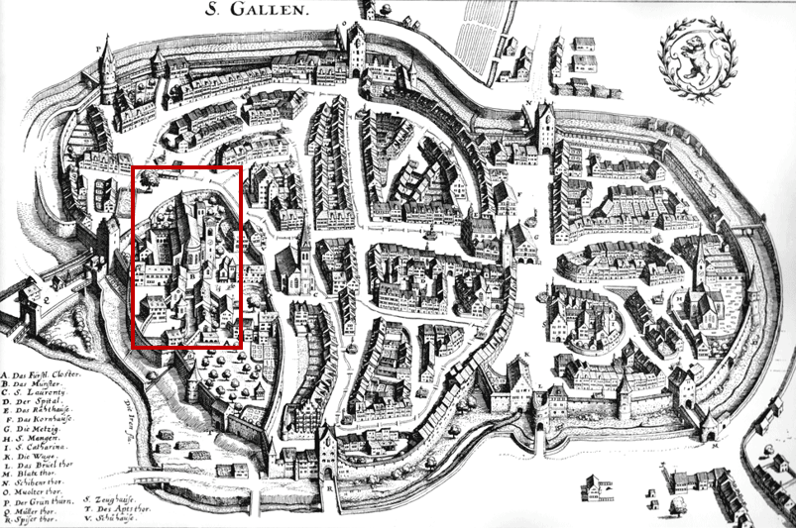
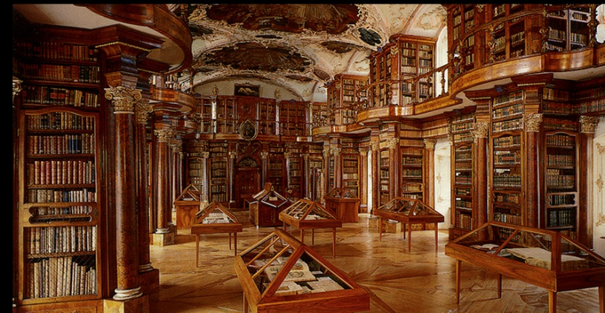
The Plan Over Time
Early Middle Ages
High Middle Ages
Late Middle Ages
400 AD
800
900
600
700
500
1000
1100
1200
Early 7th Century (approx 613 AD)
Irish monk Gallus established a hermitage on the site of the present abbey.
Designed & Authored (AD 816):
Authored by monks at Reichenau; delivered to abbot at St. Gall
St. Gall: named after a Celtic abbey founded by St. Columbus on the site of the hermitage of the missionary Irish monk, St. Gall; a Benedictine abbey was founded ca. 720; was important center of learning in Middle Ages; was ruled by abbot-princes.
Survives sieges and fires:
During late 9th Century through early 10th Century, plan was relocated due to abbey under siege. Plan has survived multiple fires over time.
Preserved: the Plan has been preserved over eleven centuries in the monastery of St. Gallen known as Stiftsbibliothek Sankt Gallen, which is a UNESCO World Heritage Site.
Beginnings:
Typical form of Irish monastic hermitage used at location that would later become abbey of St. Gall
View of St. Gall in the 17th Century. The abbey is highlighted with the red rectangle.
A view inside Stiftsbibliothek Sankt Gallen, where the Plan of St. Gall presently resides, although in a climate-controlled preservation room.
Notes:
Here is a very busy slide that provides background to the plan over time. I won’t go into all the details, but will include this in my presentation for those that may want to see it in the downloadable PowerPoint file. Suffice it to say, it is miraculous that the Plan of St., Gall survived since the early 9th century including fires and the abbey being sieged from time to time. The image in the lower right is the ornate library where the plan is presently preserved.

Slide 13
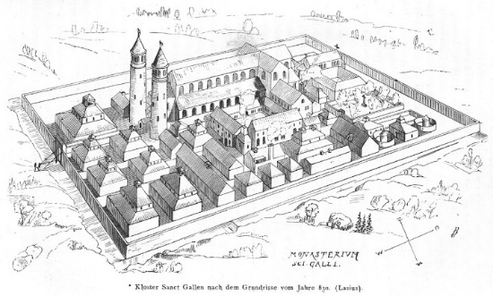
Form of Plan of St. Gall
It didn’t just appear out of thin air…
Early Middle Ages:
Continuation from Late Antiquity:
Deurbanization, Barbarian Invaders, Germanic peoples
Roman provinces became Germanic kingdoms; revived Byzantium
Episcopal cities; trading functions
Largely rural/agricultural
High Middle Ages:
Population increase
Rise in state power
Manorialism: villages, peasants owing rent and labor to nobles
Feudalism
Late Middle Ages:
Decline in Feudal system
Agrarianism shifted to urbanism
Rise of scholasticism
Economy shifted from feudal to monetary
Early Middle Ages
High Middle Ages
Late Middle Ages
400 AD
800
900
600
700
500
1000
1100
1200
395 AD
Western Roman Empire collapses
Early 7th Century (approx 613 AD)
Irish monk Gallus est’d hermitage
11th-15th Centuries:
Non-monastic towns organic growth (ex: Roman origins, Burgs)
Planned new towns (ex: Bastides)
Monasteries in Western Europe became centers of agriculture, defense, political.
Antiquity to ~650 AD:
Monastic form consisted of isolated hermits; small unstructured units; grows to include structure as hermitage, then later to include Roman elements.
~650-800 AD:
Monastic form can be ascribed to zenith of Carolingian Renovatio; just years before series of Norse invasions.
Precedents (~650 AD) :
Abbey at Fontenelle
Jumièges_Abbey
816-819 AD
Decision to use Rule of St. Benedict as ‘universal norm’ for Monastery form.
816/820 AD
Plan of St Gall is designed and authored
Notes:
One of the challenges for me in this project was answering the question “where did the form of the Plan of St. Gall come from? It didn’t appear out of thin air”. This slide summarizes what I think is an answer to that question. The top of the slide provides a general summary of the times of the middle ages, divided into early, high and late middle ages, with a timeline beneath.
In a nutshell, the form of the plan can be ascribed to the zenith of Carolingian monastic form that occurred during the mid 600s through the early 800s. One reputable expert on medieval monastic architecture claims that there are two specific monastic complexes (at Fontenell and Jumieges) that contain the “best practices” of form that may have been seen as a precedent for the design of the plan. Another important event that led to the form of the plan is the Synod of Aachen 817 which provided legislation that monastic compounds conform to the Rule of St. Benedict.

Slide 14
Other Examples of Planned Idealized Urban Form
Mormon ‘City of Zion’. 1830s
Shaker Settlement, Canterbury, NH, late 1700s
Notes:
The Plan of St. Gall can be viewed among a survey of other examples of ideal planned urban form. The Plan of St. Gall is from medieval times during the 9th century. More recent examples of plans for an ideal urban form generated by other religious groups can be found with the Mormon City of Zion (as seen in the left) which are from the early 19th Century. Another example is the Shaker Settlement from the late 18th Century, as seen in the right image.

Slide 15
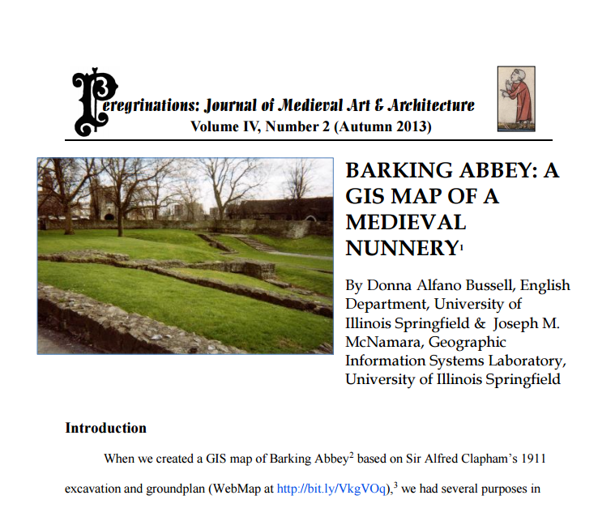

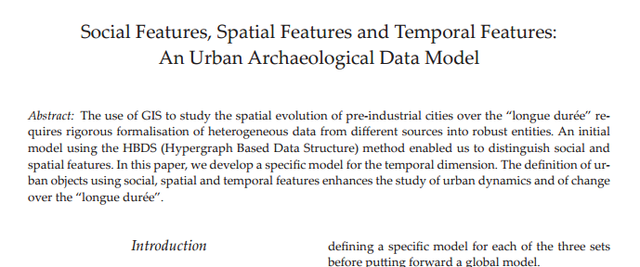
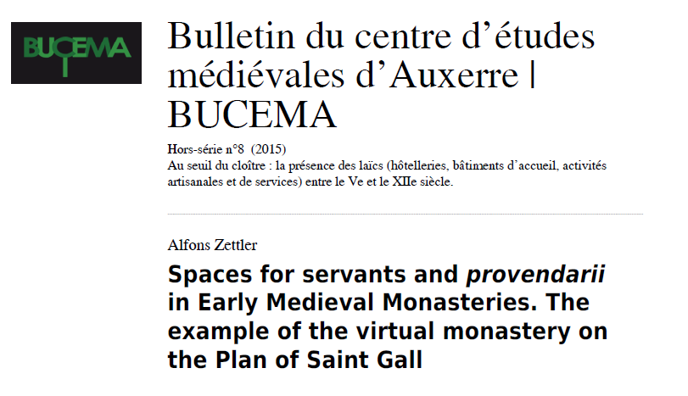
Literature Review / Precedents
Examples of work using GIS to determine site locations or analyze medieval site
Literature Review of material regarding Plan of St. Gall
Notes:
Part of this capstone presentation requires that a literature review process be completed. In forming a focused capstone topic, I did a review of previously performed work that utilized a GIS to analyze medieval sites. In addition, a significant part of this project was getting versed in the academic publications regarding the Plan of St. Gall, notably the voluminous 3-book treatise by Walter Horn and Ernest Born.

Slide 16


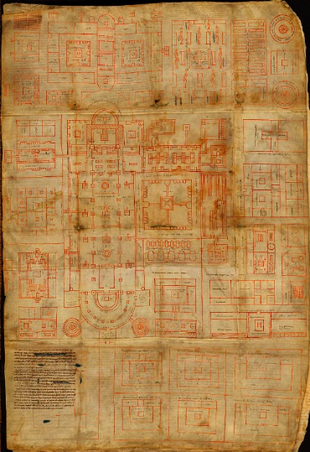
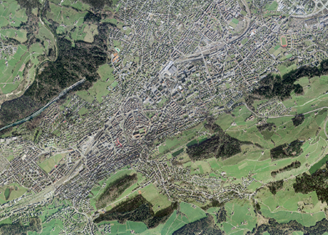
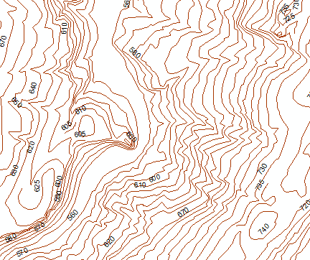
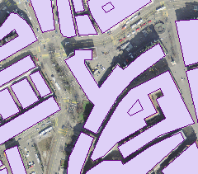
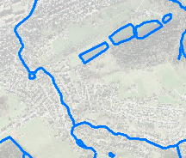
Data
Orthorectified Imagery:
50 cm resolution
Approx. 19 square kilometers
Centered on medieval core of St. Gallen, Switzerland
DHM (Digital Height Model)
Contour polylines
Vector Feature Data:
Hydrology, Streets, Buildings, etc.
Reproduction of the Plan of St. Gall
(Size is approximately 45” x 31”)
Notes:
Data used for this project were obtained from 2 sources. The reproduction of the Plan, as seen on the left side, came from the Abbey of St. Gall in Switzerland. The reproduction measures approximately 45” x 31”. I had this large sheet scanned at high resolution as a TIFF. Afterward, I brought that TIFF file into ArcMap and georeferenced it. The other data consist of orthorectified imagery, a digital height model, and vector data. These data came from the Swiss Federal Office of Topography, aka “SwissTopo”. The right side of this slide show examples of those data. The orthoimagery has 50cm resolution and covers an extent of approx. 19 sq. kilometers. The digital height model consists of contour polylines and spot height measurements. The vector data consist of features for streets, buildings, streams, rail lines, plus others. All data from SwissTopo came in the Swiss projected coordinate system.

Slide 17
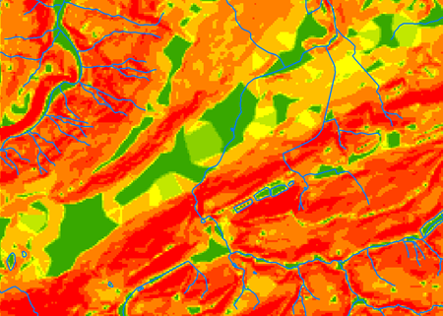
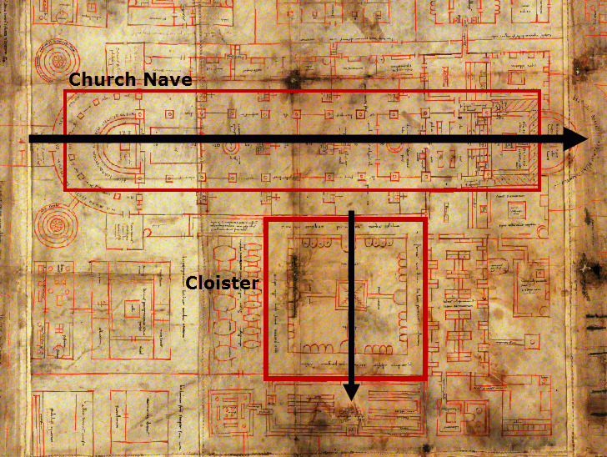
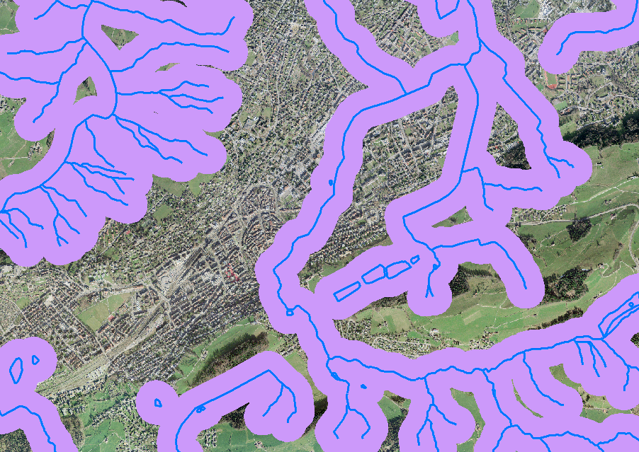
Site Selection Criteria
Dimensions of Monastery Complex
Aspect/Orientation
Proximity to Hydrology
Slope
Slope
Proximity to hydrology
Dimensions of Monastery Complex and Aspect/Orientation
Notes:
A large part of this project to date was studying the Plan of St. Gall and gaining a basic understanding of the era of monastic reform in which it was authored. From these, I was able to identify criteria that can be used in a GIS to identify candidate sites that would accommodate the building of the 7 acre monastic complex, if it had been built.
The Plan was designed without separate platforms requiring steps, so it is relatively flat. However, the plan requires a nearby stream to power the mills, so it can be deduced that the slope should have a specific range of acceptable values. The plan also needs compliance with an aspect that orients it so the church nave is oriented towards Jerusalem (approx. 135 degrees from North)

Slide 18
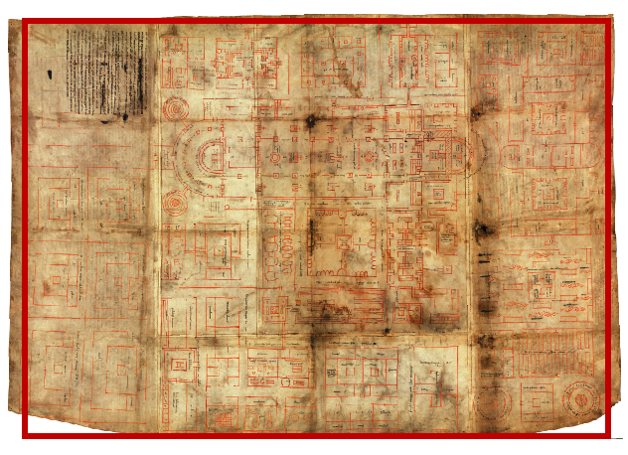
Criteria: Dimensions & Aspect
Aspect:
Church Nave points toward Jerusalem (southeast)
Ingenuity of design automatically gives the Cloister a southwestern exposure.
Size:
An area that would accommodate a site of 640’ x 460’
Outline shows where an outer protective wall would be located, encompassing an area of approximately 7 acres.
Church nave must be oriented towards Jerusalem which is approximately 135 degrees from north. At that alignment, the Cloister is given southwestern exposure, a necessary attribute since the monks utilize the cloister in year-round weather.
Notes:
Two criteria used in identifying possible sites are the dimensions of the facility and the aspect. The left image shows where an outer protective wall would be located, encompassing an area of approximately 7 acres.
The right image is rotated approximately 135 degrees from north so that it points to Jerusalem. At that alignment, the Cloister is given southwestern exposure, a necessary attribute since the monks utilize the cloister in year round weather.

Slide 19
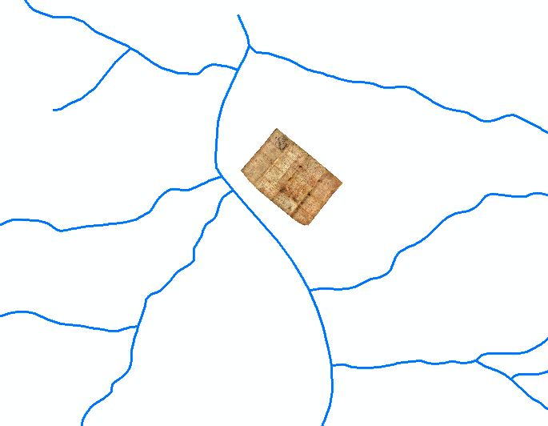
Criteria: Hydrology & Slope
Candidate site areas must be in proximity of a stream and within acceptable slope
A section of the hydrology network with Plan of St. Gall shown georeferenced to scale
Buffer created 500’ to each side of the hydrology network.
Notes:
One selection criteria is that the site be located near enough to a hydrology source so that the monastic compound can receive water, especially for the mills. The left image shows a section of the hydrology network within the study area and includes the georeferenced Plan of St. Gall for scale. The right image shows a 500’ buffer to each side of the hydrology features.

Slide 20
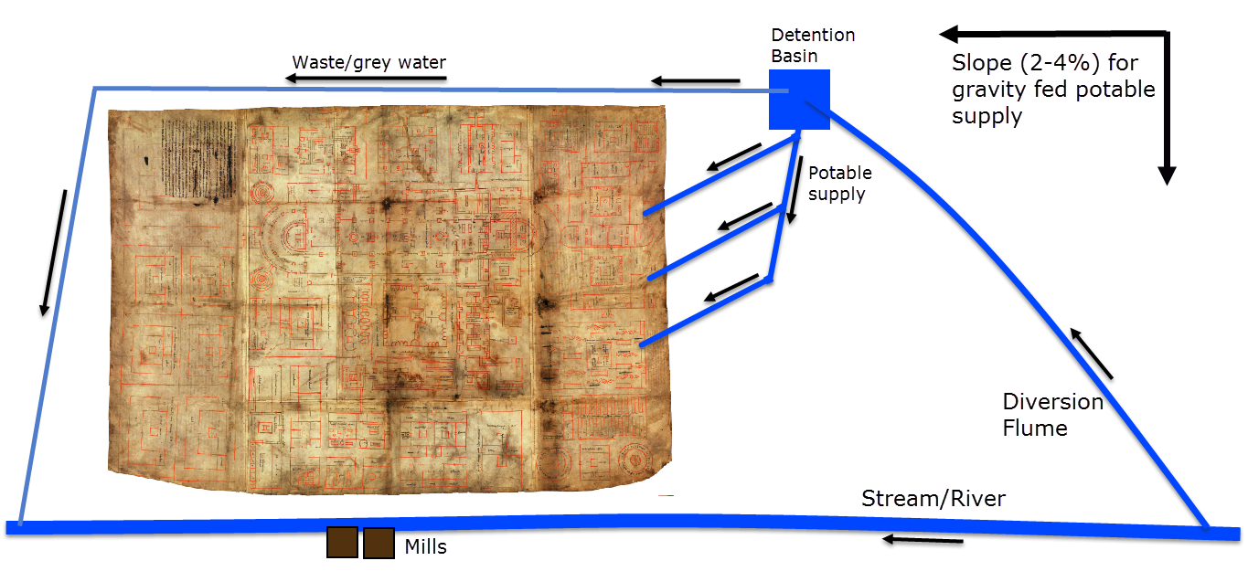
Criteria: Hydrology
Candidate site areas must be in proximity of a stream (and within acceptable slope)
Theoretical diagram of monastic complex sited relative to a water source based on location of mills.
Modeled after Horn, Walter "Water Power and the Plan of St. Gall” Journal of Medieval History 1,3 (1975): 219-58.
Notes:
An example how the plan, if built, might be sited relative to a stream. The important part to keep in mind here is that the monastic complex has to be self-sufficient, but not necessarily within the walls. The plans calls for mills, which are interpreted as requiring water as the power source because of the large production needed for the monastic community. In addition, potable water should be sourced into the walled complex which would require a slope to accommodate a gravity-based system.

Slide 21
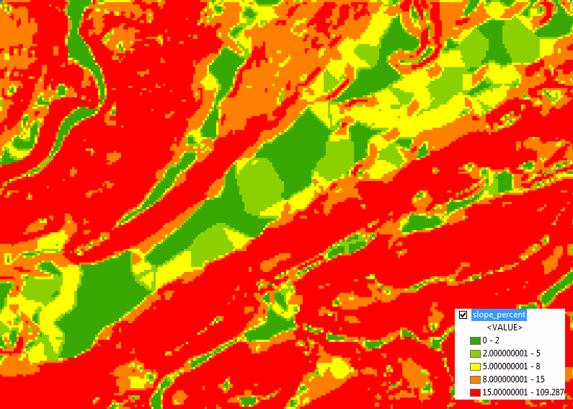
Criteria: Slope
SLOPE <= 8.0 %
Candidate site areas with slope less than or equal to 8%
Another site selection criteria is slope.
Notes:
This slide shows a Slope raster which was created from the TIN (which was created from the SwissTopo DHM) and symbolized to show “acceptable” areas of slope up to 8% (green and yellow). Areas greater than 8% slope are shown as orange and red.
In my work thus far, I determined that a maximum slope of 8% would be acceptable. At an 8% average slope, a maximum of 63’ of vertical change in relief could occur over the diagonal distance within the 460’ x 640’ complex. The built complex would benefit from being sited on terrain having a slight slope, to make it suitable for inclusion of water; yet the plan cannot be on terrain too steep as it does not account for terraced areas joined by stairs, as were commonly used for villas in the Italian hills, for example.

Slide 22
Methodology
LITERATURE REVIEW & IDENTIFY the RESEARCH QUESTION
OBTAIN DATA and DETERMINE SELECTION CRITERIA
ANALYSIS to IDENTIFY CANDIDATE SITES and PRESENT RESULTS
1
Literature Review
3
Data
Research publications and identify possible answers for “Why was the Plan of St. Gall designed and authored?”
Of the varying possibilities, determine if it plausible that the Plan could have been designed for upgrading the abbey at St. Gall?
Yes- definitely plausible.
Published evidence was found. Therefore, the specific research question can be crafted.
1. Plan of St. Gall (Scaled reproduction)
Scan 31” x 45” reproduction to high resolution .jpg
Georeference
Digitize features, add attributes
Functional Areas: monk/laity divide
2. DHM (Digital Height Model)
3. Hydrology & other vector features
4. Orthorectified 3-band imagery (19 km2)
5
Identify Candidate Sites
ArcMap Selection Process:
Select areas that satisfy specific selection criteria (see previous step)
Slope via reclassify (0-8% slope)
Create a buffer 500’ from each side of stream centerline.
Vector and Raster overlay selection processes (ie: Map Algebra) to identify candidate areas that satisfy all selection criteria.
4
Define Selection Criteria
2
Study Area/Boundary:
Medieval core and adjacent extent of St. Gallen, Switzerland
Selection Criteria:
1. Dimensions of Monastery Complex
2. Effective Monk/Laity Divide
3. Aspect of Church Nave and Cloister southwestern exposure
4. Proximity to hydrology
5. Slope
Research Question
6
Results
“What candidate sites in present day St. Gallen satisfy implicit and deduced site criteria for the Plan of St. Gall”?
Present candidate sites.
Different maps and details
Ex: an overlay against current city of St. Gallen
Notes:
This is an outline of the methodology I will be using. The next slide is a visual representation.

Slide 23
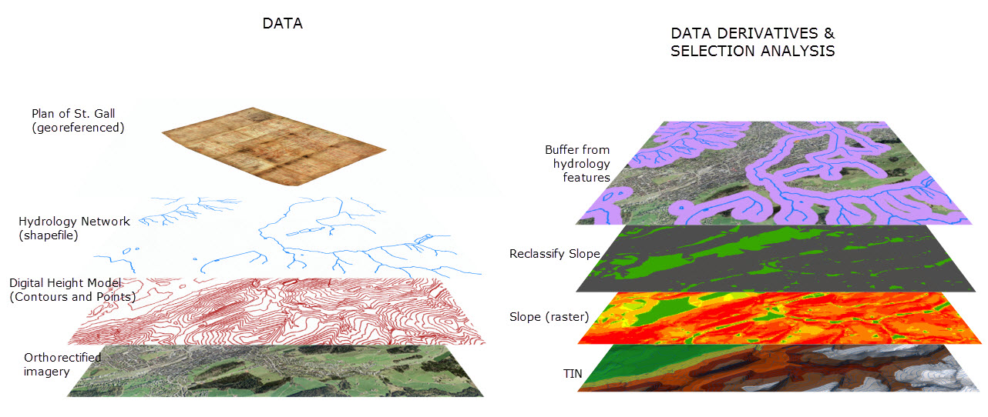
Methodology (Continued)
DATA DERIVATIVES:
1. TIN created from Digital Height Model
2. Slope created from TIN
DATA:
1. Scaled reproduction of Plan of St. Gall (georeferenced)
2. Hydrology Network and other features (shapefile)
3. Digital Height Model Contours and Base Points (in Projected Coordinate System: CH1903_LV03)
4. Orthorectified imagery of 18.6 km2 study area (3 band, 0.5 m TIFF)
DATA DERIVATIVES & SELECTION ANALYSIS:
Create TIN surface from digital height model (contours)
Create Slope from TIN surface
Selections:
Suitable areas based on Slope between 0-5%
Suitable areas based on Aspect between 135-315 degrees (TBD)
Create 500’ buffer from stream centerlines (1000’ total)
Map Algebra- select areas that are suitable slope and proximity to streams.
Notes:
Data for this project are shown on the left. Earlier I mentioned that from the abbey library, I obtained a 1:1 scale reproduction of the Plan of St. Gall (which I had scanned and then georeferenced in ArcMap). I obtained vector, raster, and height model data from SwissTopo. These data consist of a hydrology network and other features, a Digital Height Model of Contours and Base Points (in Projected Coordinate System: CH1903_LV03), and Orthorectified imagery of the study area having an area of 18.6 square km, approximately 7.2 square miles. The resolution of the orthoimagery is 50cm. From the height model I will create a TIN surface, a slope raster, and possibly an aspect raster. The slope raster will be reclassified to identify areas have slope between 0 and 8%. If I determine the Aspect raster as useful, I will use Spatial Analyst tools to identify areas that have a southeastern to western exposure (approximately 135 through 315 degrees. From the hydrology network, I will identify areas that are within 1000 feet using buffers. I plan to use 1000 feet to approximate the plan’s dimensions of 640’ x 460’. From these derivatives, I will use Map Algebra and other selection processes to identify areas within the study area that satisfy all the decision criteria.

Slide 24
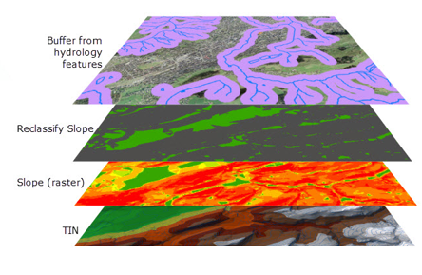
Anticipated Results
Possible areas for site locations will be determined as those areas that satisfy the set of specific selection criteria:
1. Dimensions of Monastery Complex
2. Effective Monk/Laity Divide
3. Orientation of the church nave and cloister southwestern exposure
4. Proximity to hydrology
5. Slope
Results:
Identification of several candidate areas
Possible Complication(s):
Finding areas that contain a combination of acceptable range of slope and proximity to hydrology; workaround may be short aqueduct (or similar technology) to divert water to monastery compound.
Notes:
From the steps described in the methodology, I anticipate identifying candidate areas that satisfy all the selection criteria, as identified earlier. That is, areas where the monastic complex could be built based on the size needed for the Plan’s size, acceptable range of slope, and proximity to water. A possible complication concerns how the monastic compound will integrate itself with a water source, which I will detail on the next slide.

Slide 25
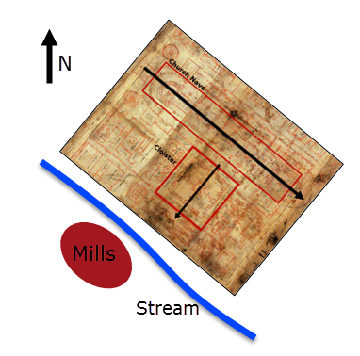
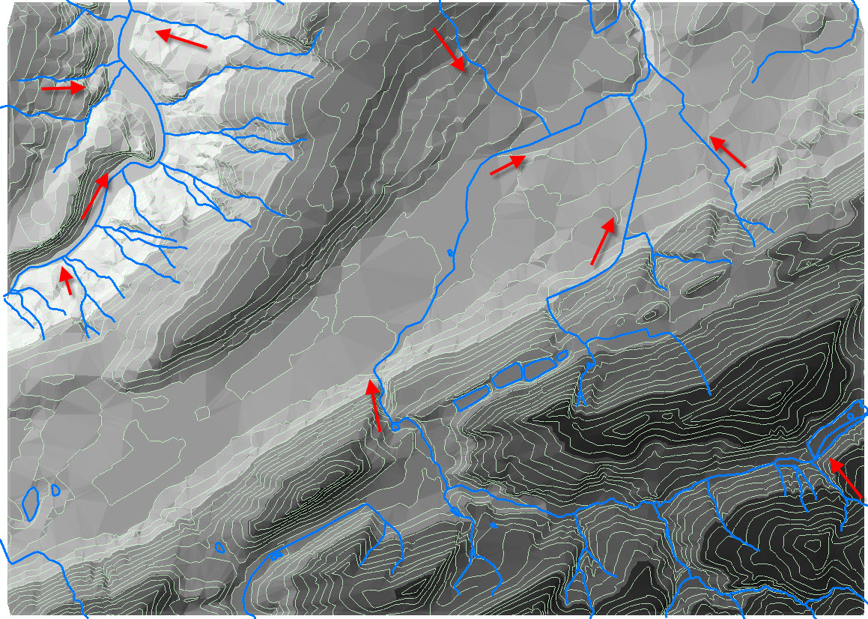
Anticipated Results
Meeting Hydrology and Orientation Requirements
Anticipated arrangement of monastic compound relative to stream based on aspect of nave and cloister and location of water-powered mills.
Orientation of church nave and cloister require approximately 135 degrees from North.
Arrows depict stream flow direction based on elevation.
Notes:
A possible complication (or opportunity) in the analysis might be how the monastic compound satisfies the requirement of being adjacent to water, particularly due to the flow direction of available stream sources and the location of the mills on the southwestern flank of the complex. The image on the right shows stream flow direction based on the height model for the extent of the 19 square kilometer study area. The image on the left shows how the monastic compound (including its water-powered mills) might be arranged relative to a stream.

Slide 26
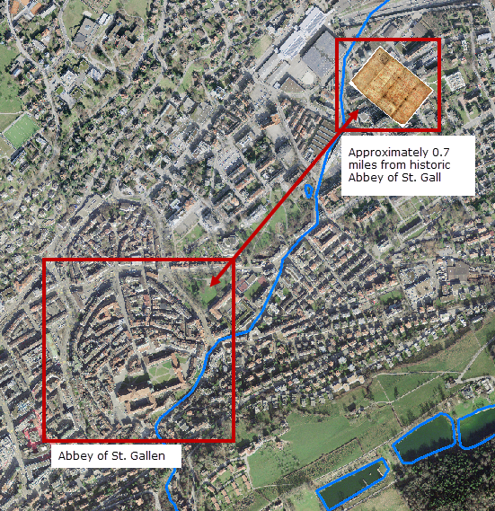
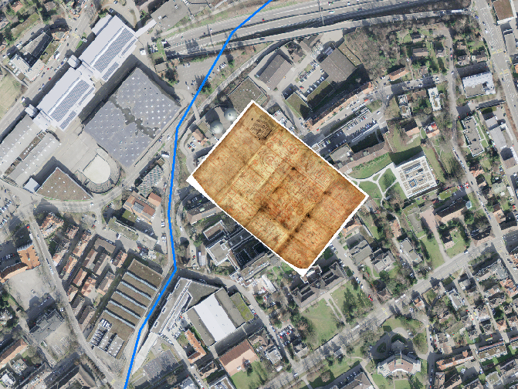
Anticipated Results
Example of a candidate location: satisfies Hydrology, Slope, and Orientation Requirements
One possible location that meets selection criteria.
Satisfies criteria for Slope, Proximity to hydrology, and Extent and aspect
Notes:
Here is one possible location for siting of the built monastery complex. The larger image on the left shows the georeferenced Plan of St. Gall with proper 135 degree orientation and adjacency to a water source. The smaller images on the right show details for the orientation, slope, and sited within much of the stream buffer.

Slide 27
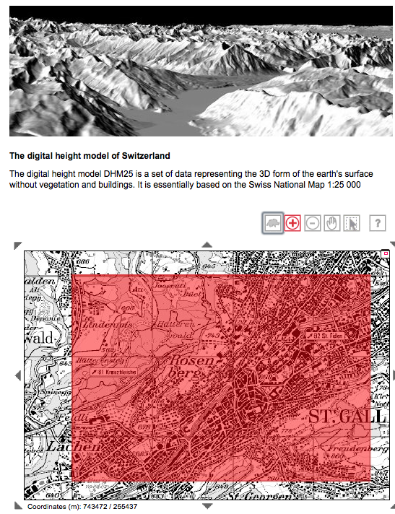
Conclusions & Future Opportunities
CONCLUSIONS
The Plan of St. Gall may have been used to build a large cutting-edge monastic complex in the vicinity of the Abbey of St. Gall.
The Plan of St. Gall contains both implicit and deduced criteria that allow a GIS to be used to identify candidate site locations.
Findings so far have explored how criteria such as slope, proximity to hydrology, facility dimensions, and requirements for orientation can be used in a GIS to identify possible candidate site locations.
FUTURE OPPORTUNITIES (Post-Capstone Project)
IMPROVE ANALYSIS
Can analysis be improved by identifying new site selection criteria? Or by refining and/or correcting existing site criteria?
EXPAND ANALYSIS
Explore relationship between the Abbey and adjacent neighborhood areas. Does data exist that allow modeling trade/commerce routes and processions to/from locations that enable the monastery complex to be self-sufficient?
EXPAND EXTENT OF STUDY AREA
This analysis used an area just over 7 square miles with the old medieval core at its center. An opportunity would be to consider a larger extent.
NEW INSIGHT FROM GIS ANALYSIS
Does the analysis performed in this project provide any new insight?
Possible sites were identified for the Plan of St. Gall
An opportunity for post-capstone analysis would be a larger study area.
Notes:
The objectives of this project were to explore the possibility that the Plan of St. Gall may have been created for the abbey at St. Gall and if so, which areas in the vicinity of the existing abbey might meet site conditions. In this stage of my capstone project, I have used a GIS to perform initial ‘Proof of Concept’ analysis using actual project data. My findings so far have explored how criteria such as slope, proximity to hydrology, facility dimensions, and requirements for orientation can be used in a GIS to identify possible candidate site locations. The remainder of my capstone work will be to complete the analysis and identify those candidate sites within the 19 sq. kilometer study area.
Future opportunities (outside of the capstone project analysis) include the possibility of improving and expanding analysis, including a larger study area.

Slide 28
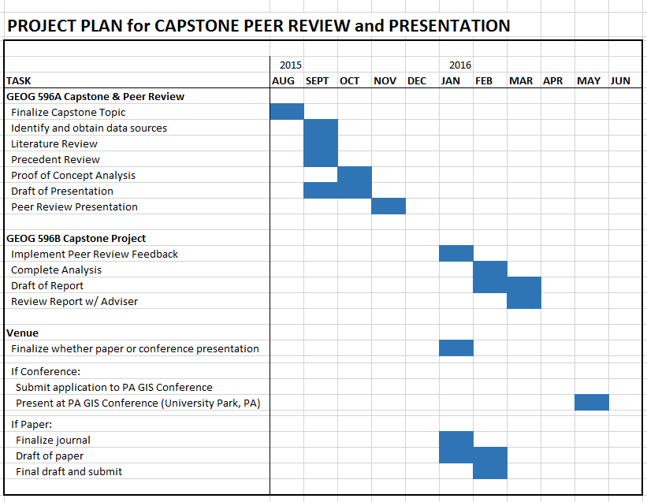

Timeline
Notes:
This slide shows the major tasks and corresponding times required since I revised my capstone topic this past summer. After tonight’s presentation, I will be making revisions per your very welcome comments and completing analysis and a writing report. I am still working with my adviser to decide whether I will be presenting my project to a conference or whether a paper will be submitted. If I go the conference route, I plan to present at the annual PA GIS Conference held May 16-18 2016 in State College, PA.

Slide 29
References
Braunfels, W. 1972. Monasteries of Western Europe: The Architecture of the Orders. London: Thames and Hudson.
Bussell, D. (n.d.). Barking Abbey: A GIS Map of a Medieval Nunnery. University of Illinois Springfield. Retrieved on August 15, 2015 from http://peregrinations.kenyon.edu/vol4_2/BussellPeregrinations42.pdf, http://uisgis1.uis.edu/flex/BarkingAbbey/
Conant, J. 1978. Carolingian and Romanesque Architecture. New Haven and London: Yale University Press.
Frazer, A. 1974. Modes of European Courtyard Design Before the Medieval Cloister. Gesta: International Center of Medieval Art, Vol. XII.
Historyofinformation.com. (n.d.). The Only Surviving Major Architectural Drawing from the Fall of the Roman Empire to Circa 1250. Retrieved on August 25, 2015 from http://www.historyofinformation.com/expanded.php?id=246.
Horn, Walter "Water Power and the Plan of St. Gall” Journal of Medieval History 1,3 (1975): 219-58
Horn, W. and Born, E. 1979. The Plan of St. Gall : a Study of the Architecture & Economy of & Life in a Paradigmatic Carolingian Monastery. Berkeley: University of California Press.
Rodier, X. and Saligny, L. (n.d.). Social Features, Spatial Features and Temporal Features: An Urban Archaeological Data Model. Retrieved on August 20, 2015 from http://archiv.ub.uni-heidelberg.de/propylaeumdok/498/1/06_09_rodier_et_al_urban.pdf.
Swisstopo.admin.ch. (n.d.). Federal Office of Topography Products. Retrieved on September 12, 2015 from http://www.swisstopo.admin.ch/internet/swisstopo/en/home/products.html.
Wikipedia.com. (n.d.). Plan of Saint Gall. Retrieved August 2, 2015 from https://en.wikipedia.org/wiki/Plan_of_Saint_Gall.
Zettler, A. (n.d.). Spaces for Servants and Provendarii in Early Medieval Monasteries. The Example of the Virtual Monastery on the Plan of Saint Gall. Retrieved on August 25, 2015 from https://cem.revues.org/13624.
Notes:
As I stated at the beginning of this presentation, a significant part of this project was digging into the details of the Plan of St. gall to discover which criteria could be selected to perform a GIS analysis for site selection. The above list of references reflect those efforts.

Slide 30
Questions?
Notes:
This concludes my presentation. Thank you for your time. I welcome any questions you may have.

