Slide 1
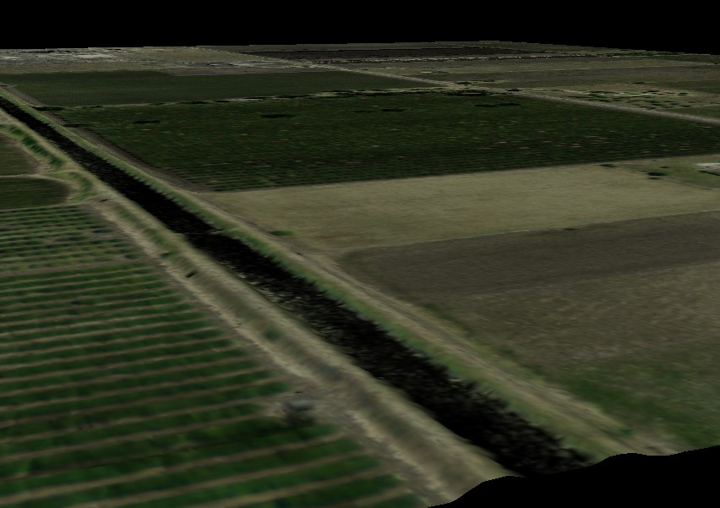
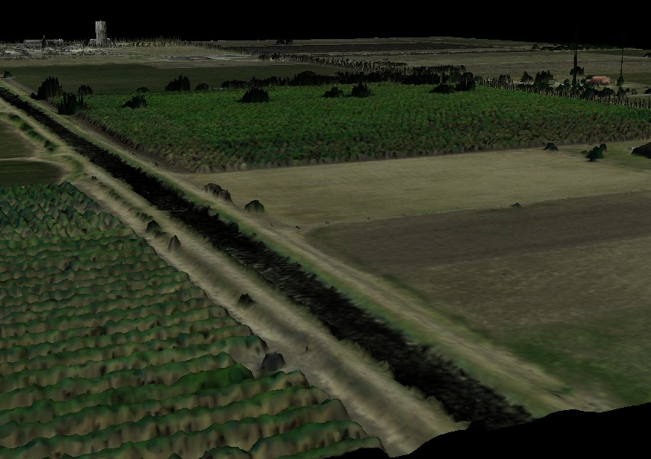
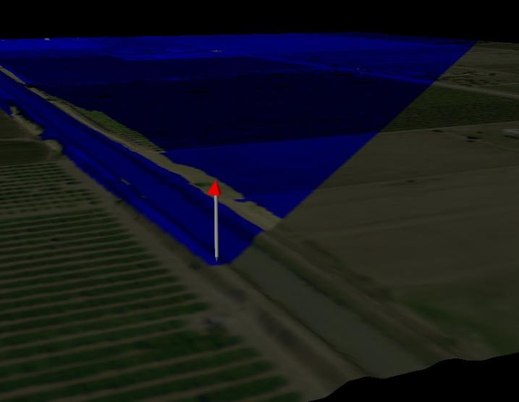
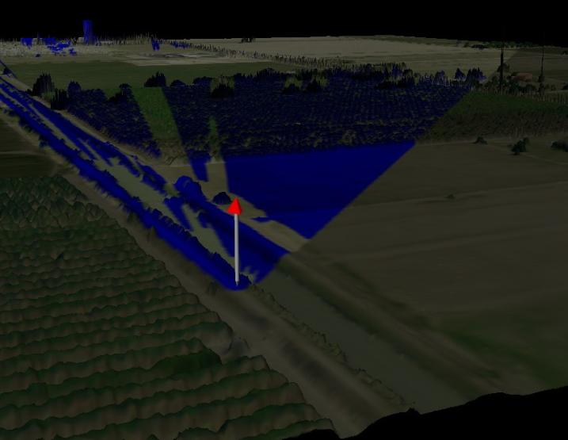
Viewshed Creation: From Digital Terrain Model to Digital Surface Model
Edward Ashton
Notes:
Pictures created using Quick Terrain Modeler and data from LiDAR elevation data map of Cameron County, TX. Cameron County: Sanborn Mapping Company, Inc, 2007, .7 Ground sample distance. See " TNRIS News." TNRIS completes the acquisition of high-resolution data for areas on the Texas Coast. http://www.tnris.state.tx.us/news.aspx?id=724 (accessed December 3, 2009).

Slide 2
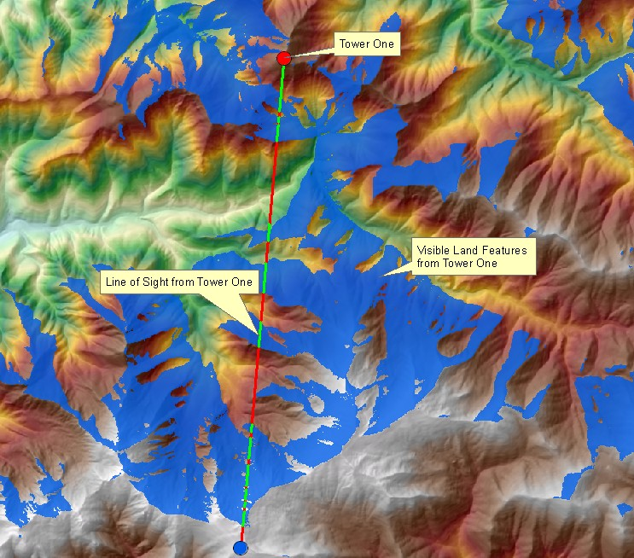
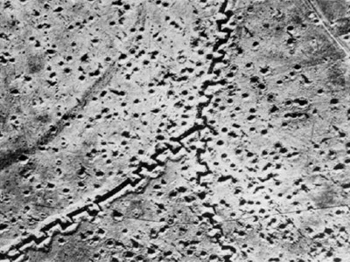
History of Viewsheds
What is a viewshed
Historical uses
Military
Notes:
2 - "Birth of a Nation Under Fire; Canada at Vimy Ridge." Military Photos.net. www.militaryphotos.net/forums/showthread.php?t=109086 (accessed December 3, 2009). (The crenellated trench - like the top of a castle chess piece in this aerial view - ensured that an invading enemy had a limited field-of-fire up and down the line.),
Viewshed identifies the cells in an input raster that can be seen from one or more observation points or lines. Each cell in the output raster receives a value that indicates how many observer points can be seen from each location. If you have only one observer point, each cell that can see that observer point is given a value of one. All cells that cannot see the observer point are given a value of zero. The observer points feature class can contain points or lines. The nodes and vertices of lines will be used as observation points. ESRI. "ArcGIS Desktop Help 9.3." ESRI. webhelp.esri.com/arcgisdesktop/9.3/index.cfm?TopicName=Performing_a_viewshed_analysis (accessed December 6, 2009).

Slide 3
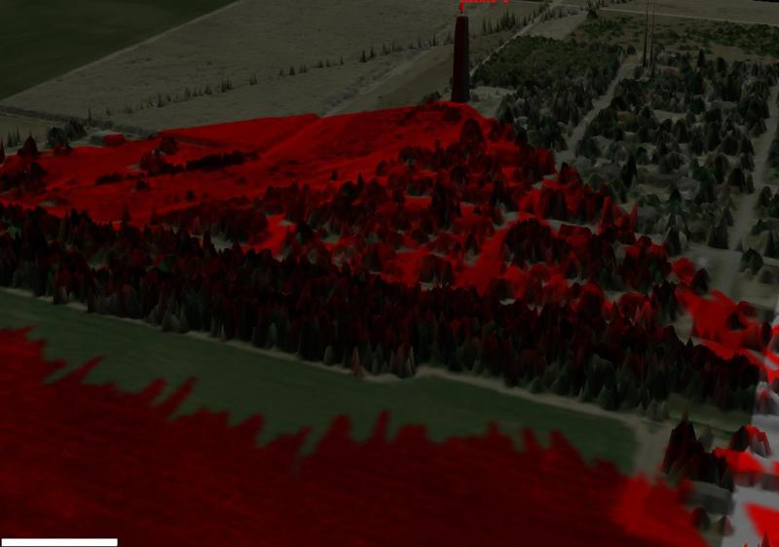
Common uses
Modern uses of viewsheds
Homeland security
Military
Commercial
Land Use Planning
Notes:
3 – South Texas using data from Cameron County Lidar Project.

Slide 4
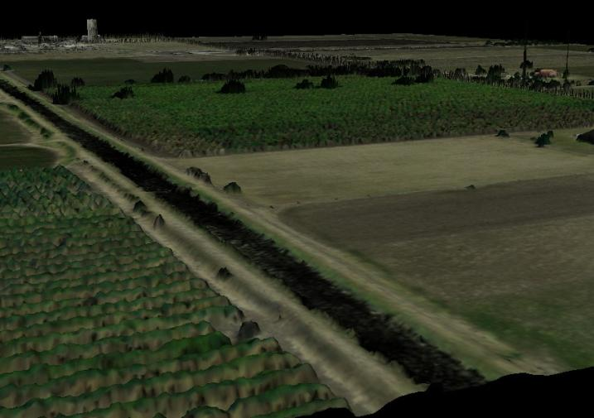
Problem
Intervisibility studies are limited by the dearth of Digital Surface Model (DSM) elevation data. Most publically available DEMs are Digital Terrain Models (DTM).
DTM
DSM
Notes:
Pictures created using Quick Terrain Modeler and data from LiDAR elevation data map of Cameron County, TX
Viewshed created with marker at 6ft
Fisher , Peter F. , and Nicholas J. Tate. "Causes and consequences of error in digital elevation models." Progress in Physical Geography 30 (2006): 467-477.
All digital data contain error and many are uncertain. Digital models of elevation surfaces consist of files containing large numbers of measurements representing the height of the surface of the earth, and therefore a proportion of those measurements are very likely to be subject to some level of
error and uncertainty. Pg 467
Our understanding of these processes and their associated errors tell us that there is a very small probability (effectively no chance) that all digital records in any DEM are correct. DEMs therefore contain endemic error, and this error can propagate through to products derived from the DEM, for example to hydrogeomorphic parameters such as catchment size and stream network characteristics (Walker and Willgoose, 1999) and surface flow dispersal areas pg 468
The crucial point is that since different methods of interpolation produce different estimates for height values at the same point, these methods will also produce different quantities of error in the DEM. In general, there seems to be no single interpolation method that is the most accurate for the interpolation of terrain data. …the accuracy to which any given terrain is approximated by the DEM will depend on the match (or mismatch) between the resolution and the spatial characteristics of the terrain: some landforms will be approximated well, others less so (Theobald, 1989). (pg 474)
For the study of error distributions in data to have any meaning, it is important to study their propagation into subsequent products or predictions. Digital elevation models are very widely used in making planning decisions and in environmental models, and it is the propagation of errors to these types of models that are of greatest interest. Unfortunately, however, such propagation is also complicated, and studies are rare. (pg 478)

Slide 5
Project Goals
Overcome limitations of DTM based viewshed
Create DSM from DTM using ancillary data sources
Measure effectiveness of process
Use publically available DEMs for DTM
To include IFSAR and LIDAR where available
Notes:
Need to add Flowchart (not sure how this would work on this slide)

Slide 6
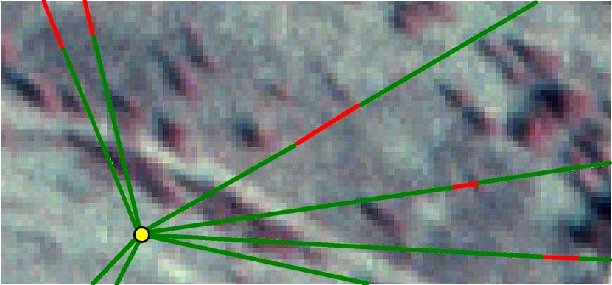
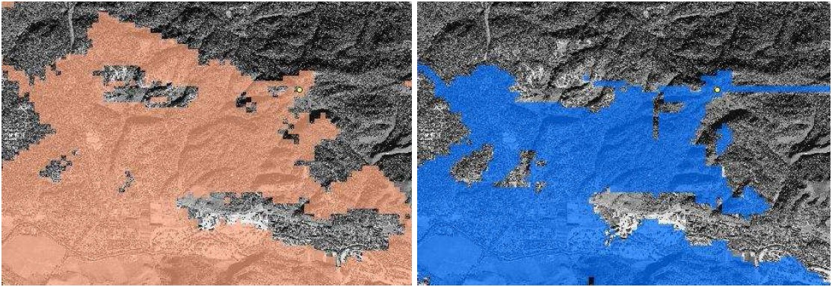
Previous Work
Swanson (2003) – Different GIS applications viewshed creation compared to in-situ observation to verify findings
Notes:
Army Corp work - Swanson, Randy. "MULTI-VENDOR LINE-OF-SIGHT APPLICATION VALIDATION AGAINST FIELD-COLLECTED DATA." ASPRS - Mapps 2003 Fall Conference: Terrain Data: Applications and Visualization Making the Connection (2003).
1st picture from work cited above - ERDAS (left) and ESRI (right) viewsheds from DTED1 at the same observer (yellow
dot). Observer height: 2 meters. Target height: 0 meters.

Slide 7
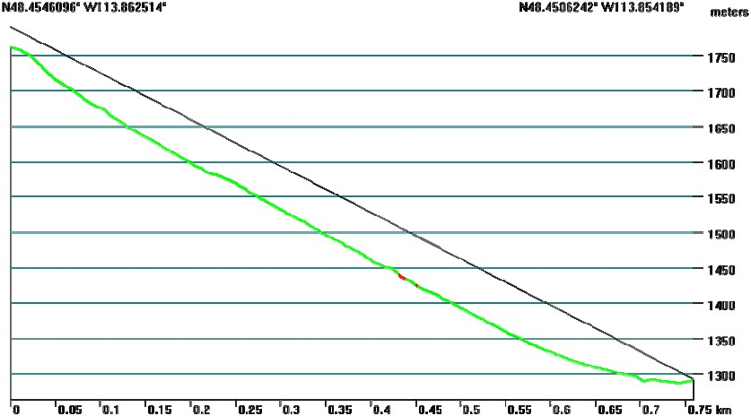
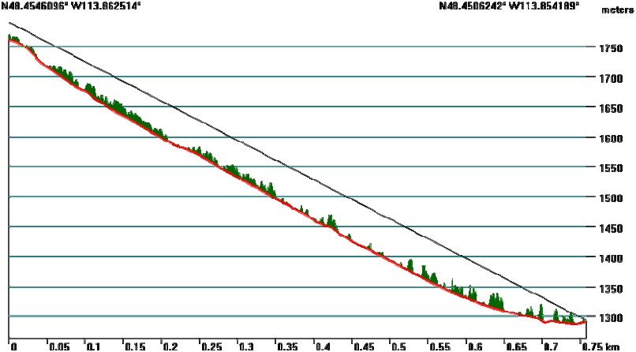
Previous Work
Guth (2009) – Proposed feasibility of using vegetation to increase accuracy of DTM
Notes:
Guth - Feasibility of using vegetation to increase accuracy – Guth, Peter L. “Incorporating Vegetation in Viewshed and Line-of-sight Algorithms” ASPRS – Mapps 2009 Specialty Conference: DIGITAL MAPPING: From Elevation to Information (2009).
Compare SRTM with NED data.
Guth, Peter L. “Using Upward Openness for Viewshed Prediction” ASPRS –2009 Annual Conference (2009).
Viewshed computations represent one of the most useful computations performed with digital elevations models
(DEMs), and one of the most expensive in terms of computational effort. When the user wants simply to compute the
viewshed for one or a small number of locations, the time required may not appear significant, but if a user wants to
computer optimal locations over a large area using a high resolution DEM, the computing effort may be prohibitive.
Sensor locations can also require additional constraints such as slope, road access, land cover types, or land ownership, which will complicate the optimal solution (or, perversely, simplify it by severely restricting the number of points that must be considered).

Slide 8
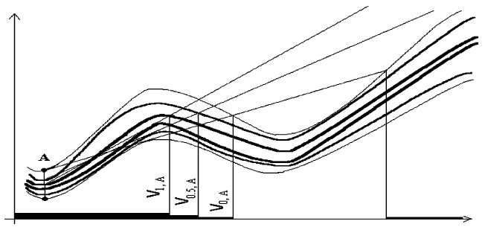
Previous Work
Fisher (1991), Beaulieu (2007), Anile, Furno, Gallo, Massolo (2003) - Fuzzy Viewsheds
Notes:
Fuzzy - Fisher, Peter F. "Simulation of the Uncertainty of a Viewshed." Tenth Annual Proceedings of the International Symposium on Computer-Assisted Cartography 1 (1991): 205-218. http://mapcontext.com/autocarto/proceedings/auto-carto-10/pdf/simulation-of-the-uncertainty-of-a-viewshed.pdf (accessed November 20, 2009). & Beaulieu, Terry. Geography 647: Final Project: Can You See That?. Calgary: University Of Calgary, 2007. & Anilea, Marcello A., Primo Furnoa, Alessandro Massolob, and Giovanni Galloa. "A fuzzy approach to visibility maps creation over." Fuzzy Sets and Systems 135, no. 1 (2003): 63-80.
1st and 2nd picture - Anilea, Marcello A., Primo Furnoa, Alessandro Massolob, and Giovanni Galloa. "A fuzzy approach to visibility maps creation over." Fuzzy Sets and Systems 135, no. 1 (2003): 63-80
Randomness plays an important role: several factors like vegetation, height of the observer, presence of unmapped human artifacts, etc. cannot be modeled in advance into a traditional DEM model. We propose the use of fuzzy terrain models to incorporate uncertainty and unpredictable variability of the landscape.
(A fuzzy approach to visibility maps creation over digital terrains Marcello A. Anilea, Primo Furnoa, Giovanni Galloa, Alessandro Massolob 2002 Elsevier Science B.V.)pg 63

Slide 9
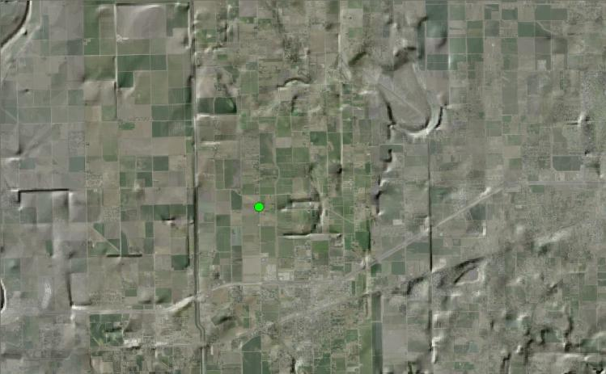
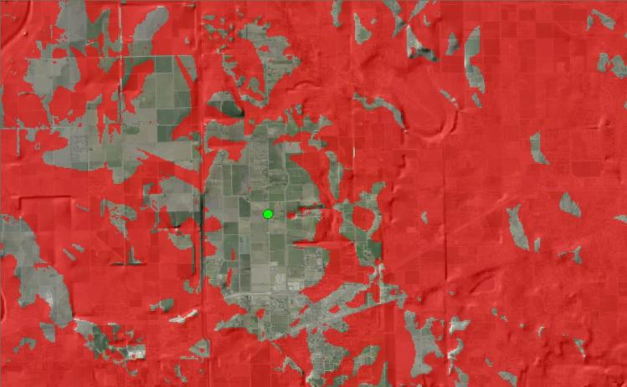
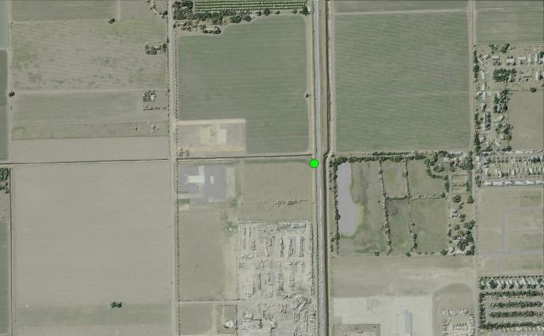
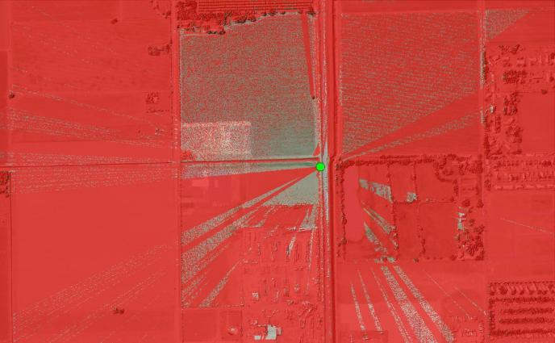
Scope of problem
Viewshed at large and small scale
Level of detail for different applications
Small scale – Earth Curvature, projection
Large scale - Detail
How much detail does scale need? Camera placement vs radar site
Notes:
1 - South Texas NED (DTM) 1/3” 6 feet from ground
2 – South Texas, Cameraon County Lidar data (DSM) 0.7 meter gsd 6 feet from ground
Fisher , Peter F. , and Nicholas J. Tate. "Causes and consequences of error in digital elevation models." Progress in Physical Geography 30 (2006): 467-477.
The evaluation of the accuracy of elevation derivatives has usually been obtained by direct comparison with measurements from higher accuracy reference surfaces (Chang and Tsai, 1991) or the real land surface (Bolstad and Stowe, 1994). Florinsky (1998) has argued, however, that such comparisons are invalid since they imply the existence of higher accuracy reference surfaces that are locally smooth and differentiable. Real terrain possesses the fractal characteristic of nondifferentiability,
and therefore zooming in to larger scales will reveal different surfaces with different gradients/aspects and different morphometry (Skidmore, 1989; 1990). (pg 478)
Guth, Peter L. THE GEOMETRY OF LINE-OF-SIGHT AND WEAPONS FAN ALGORITHMS. Annapolis: US Naval Academy, unknown.
Horizontal earth curvature determines how to compute the “straight line” path between the observer and the target. For simplicity, this is probably generally computed in the DEM grid coordinates, as shown in published figures (e.g., Yoeli, 1985; Champion and others, 1995). For intervisibility over short distances this should make no difference, but over long differences it will compute a different sight line for a UTM or a geographic DEM.
Experiments show that UTM and geodetic coordinates produce almost identical results, but the geographic coordinates differ
substantially. UTM coordinates can be used for short sight-lines, where the conformal projection preserves the azimuths. UTM coordinates can probably be used until the deviations for the correct geodetic line exceed the DEM grid spacing. Geographic coordinates can only be used for very short sight-lines—meaning that DEMs currently available for military use, DTED and SRTM, cannot use the coordinate scheme depicted in diagrams showing the intervisibility algorithm (e.g., Yoeli, 1985; Champion and others, 1995).
Maximum profile divergence between UTM and geographic coordinates as a function of profile length. For profiles less than 15 km long, the maximum deviation is under 5 m and the horizontal earth curvature can probably be ignored. Beyond 50 km the deviation will exceed 50 m and increases exponentially, and horizontal earth curvature almost certainly cannot be ignored.

Slide 10
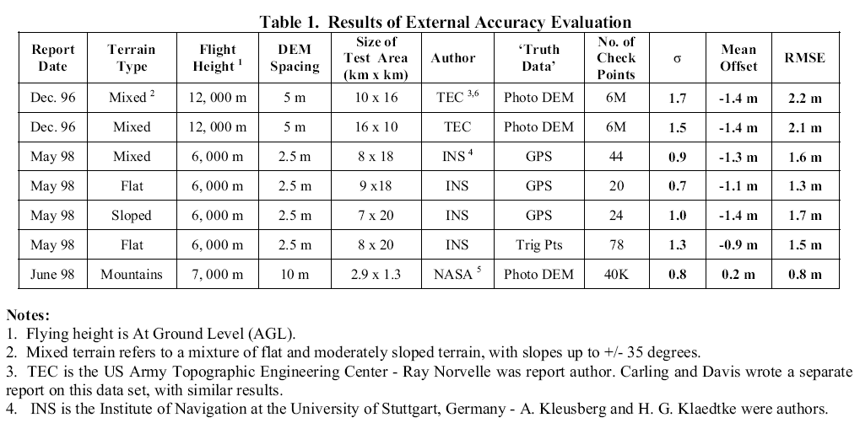
DEM Datasources
NED – DTM-Free, quality differs based on how collected (1” ,1/3” and 1/9”)
SRTM – DSM-Free, covers world, 1” and 3”
LIDAR – DTM & DSM-Free (limited availability) – Very expensive, detailed, artifacts, large amount of data
IFSAR – DSM-Expensive, artifacts in DSM
Limitations and pros of each type
Notes:
1” = 30m, 1/3” = 10m, 1/9” = 3m
Fisher , Peter F. , and Nicholas J. Tate. "Causes and consequences of error in digital elevation models." Progress in Physical Geography 30 (2006): 467-477.
Our understanding of these processes and their associated errors tell us that there is a very small
probability (effectively no chance) that all digital records in any DEM are correct. DEMs therefore
contain endemic error, and this error can propagate through to products derived from the
DEM, for example to hydrogeomorphic parameters such as catchment size and stream network
characteristics (Walker and Willgoose, 1999) and surface flow dispersal areas pg 468
Three main sources of error in DEMs are usually identified (Shearer, 1990; Li, 1992; Li and Chen, 1999; Gong et al., 2000):
1. those derived from variations in the ‘accuracy, density and distribution’ (Li and Chen, 1999: 203) of the measured source
data as determined by the specific method of data generation; 2. those derived from the processing and interpolation used to derive the DEM from the source data;
3. those resulting from the characteristics of the terrain surface being modelled in relation to the representation of the DEM.
The first two are quite clearly errors. The third, however, should be considered a matter of uncertainty. Pg 472
"National Elevation Dataset." National Elevation Dataset. http://ned.usgs.gov/Ned/faq.asp (accessed December 27, 2009).
Q: What are the NED data sources?
A: NED source data are selected from an ever-growing inventory of standard production USGS Digital Elevation Model (DEM’s), and also from an increasing number of datasets that are project- or agency-specific. The first consideration is always given to quality. Selections are made according to the following ranking, listed in order of descending priority:
-High-resolution data, typically derived from lidar or digital photogrammetry, and often with edited water bodies. If collected at a ground sample distance no coarser than 5 meters, such data may also be offered within the NED at a resolution of 1/9th arc-second.
-Moderate-resolution data, other than that compiled from cartographic contours. These data may also be derived from lidar or digital photogrammetry, or less often by Interferometric Synthetic Aperture Radar IFSAR. A typical ground sample distance is 10 meters, though it is commonly called “1/3 arc-second data”.
-10-meter DEM’s derived from cartographic contours and mapped hydrography. Most often, such data are produced by or for the USGS as a standard elevation product, and they currently account for the bulk of the NED.
-30-meter cartographically derived DEM’s. Similar in most respects to their 10-meter counterparts, though usually of lower overall quality.
-30-meter photogrammetrically derived DEM’s. These are the oldest DEM’s in the 7.5-minute series. These data were derived directly from stereo photography, either by a human operator or by an early form of electronic image correlation. They are badly marred by production artifacts that are addressed to the greatest practical extent by digital filtering within the NED production process.
-2-arc-second DEMs are a standard USGS product. They are derived from cartographic contours at a scale of 1:63,360 over the state of Alaska, and a scale of 1:100,000 elsewhere.
-1-arc-second Shuttle Radar Topography Mission (SRTM) data, to date, are only used in preference to 3 arc-second data in the Aleutian Islands.
-3-arc-second DEMs are another standard USGS product, and are generally only used within the NED as a source of fill values over large water bodies.
Q: How often is the NED updated?
A: The NED 1- and 1/3-arc-second data sets are updated on a nominal two month cycle to integrate newly “best available”, improved elevation source data. Bi-monthly updates may be skipped due to budget or data constraints.
New datasets are being released into the NED 1/9-arc-second collection on a monthly basis and in conjunction with the bi-monthly updates when possible.
Q: What is the vertical accuracy of NED data?
A: The accuracy of the National Elevation Dataset (NED) varies spatially because of the variable quality of the source digital elevation models (DEMs). As such, the NED inherits the accuracy of the source DEMs. The most recently published figure of overall absolute vertical accuracy expressed as the root mean square error (RMSE) is 2.44 meters. Details of this analysis are explained in the Vertical Accuracy of the National Elevation Dataset paper, and are published in the Digital Elevation Model Technologies and Applications: The DEM Users Manual 2nd Edition.
SRTM
The Shuttle Radar Topography Mission (SRTM) digital elevation dataset were collected by a modified radar system that flew onboard the Space Shuttle Endeavor in February 2000, using a technique known as Interferometric Synthetic Aperture Radar to generate the most complete high-resolution digital topographic database of the Earth. SRTM data were collected for approximately 80% of the Earth's surface. …. The primary difference is the elevation from the NED is a bare ground reading whereas SRTM is canopy based.
NED
Source: Maps/Aerial Photos/Lidar
Resolution: 3m, 10-m & 30-m
Dates: 1925 - Present February
Type: "Bare-Earth"
Vertical Accuracy: 2.44m RMSE (root mean square error)
SRTM
Source: Radar
Resolution: 30-m
Dates: 2000 Space Shuttle Endeavour
Type: "First Return"
Vertical Accuracy: Measured 10-m RMSE (Mission Specification)
LIDAR
Lidar is point data representing the X-Y-Z location, along with other attributes, of any terrestrial target reflecting the laser pulse. In addition to bare-earth, it typically will include buildings, trees, towers, powerlines … almost anything.
IFSAR
Li, Xiaopeng, A. Bruce Baker, and Thomas Hutt. "ACCURACY OF AIRBORNE IFSAR MAPPING." Intermap Technologies. www.intermap.com/uploads/1170699501.pdf (accessed December 28, 2009).
IFSAR systems have many advantages such as flexible system deployment, higher spatial resolution, and a lesser degree of influence from the atmosphere. These advantages provide for the creation of a product of greater accuracy.
IFSAR mapping is a very complicated process. There are many inter-related factors that affect the accuracy of the final products. These factors encompass the whole process ranging from the design, calibration, stability and practical performance of the sensor system, through to the ground target characteristics, and interaction between the system and targets, as well as processing technologies, editing, and production quality control.
The IFSAR Signal-to-Noise Ratio (SNR) of the received pulse is also altitude dependent and ultimately is one of the major components of the elevation error budget. At lower altitudes, the SNR is larger and thus the height noise is reduced thereby improving the relative accuracy; however, swath width is also reduced and overall cost increased. Fast flying speed means fast data collection, but with a reduced azimuth resolution for radar imagery.
See chart above.

Slide 11
DTM → DSM
ArcGIS Model Builder
USGS National Elevation Dataset (NED) + vegetation information and man-made structures
National Land Cover Database, Landfire, and National Biomass and Carbon Dataset.
Compare with in-situ observations, LIDAR and IFSAR DSM viewsheds.

Slide 12
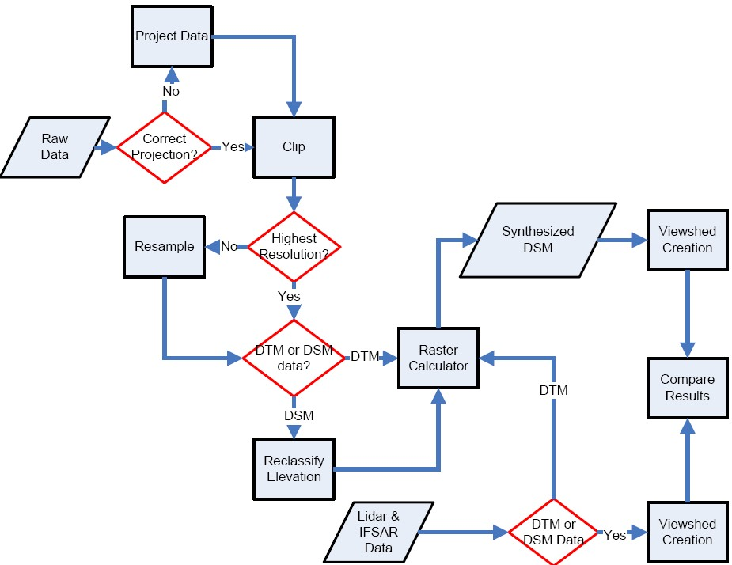
Methodology
Notes:
Look for Geographic patterns of Difference

Slide 13
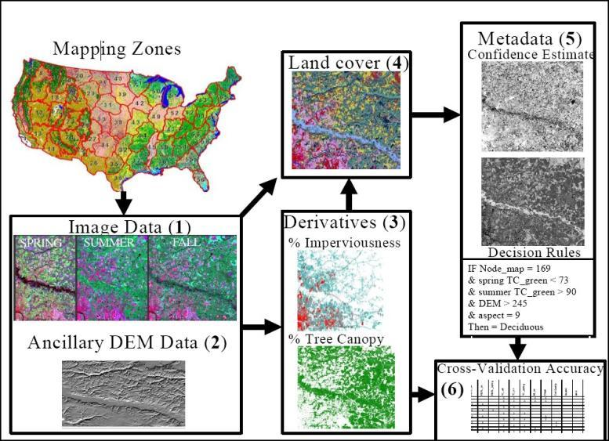
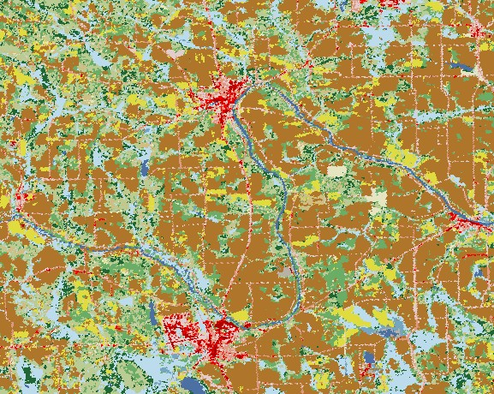
DSM Data-NLCD 2001
29 landcover categories
Resolution of 30² meters
Notes:
1st Picture USGS. "Multi-Resolution Land Characteristics Consortium (MRLC)." Multi-Resolution Land Characteristics Consortium (MRLC). http://www.mrlc.gov/nlcd.php (accessed December 28, 2009).
2nd picture USGS. "National Land Cover Database 2001." NLCD 2001 Information Sheets. www.mrlc.gov/pdf/nlcd_fact_sheet_2001.pdf (accessed December 28, 2009).
Imagery used : Landsat-7
Date Range: FY 2001 to FY 2006
USGS. "About the MRLC Program." National Land Cover Database. www.mrlc.gov/about.php (accessed December 27, 2009).
What is NLCD 1992?
NLCD 1992 (National Land Cover Dataset) was derived from the early to mid-1990s Landsat Thematic Mapper satellite data purchased under MRLC 92. This is a 21-class land cover classification scheme mapped consistently over the United States using unsupervised clustering and GIS modeling. The spatial resolution of the data is 30-meter pixels and it is in the Albers Conic Equal Area projection.
What is MRLC 2001?
MRLC 2001 is a consortium of nine federal agencies (USGS, EPA, USFS, NOAA, NASA, BLM, NPS, NRCS and USFWS) whom joined together in 1999 with 2 main goals: the acquisition of three dates of multi-seasonal Landsat 5/7 images per path/row processed to national standards, and the creation of a second generation National Land-Cover Database (NLCD 2001) covering all 50 states and Puerto Rico. This Landsat image database now covers 1,780 Landsat path/rows and is resampled to an Albers projection. Two types of image products are available including Terrain Corrected only and Terrain Corrected/At-Sensor Reflectance adjusted. Both Terrain Corrected and Terrain Corrected/At-Sensor Reflectance products are available from the USGS Earth Resources Observation and Science (EROS) Center.
What is NLCD 2001?
NLCD 2001 is a Landsat based landcover database with several independent data layers, which allow users a wide variety of potential applications. Primary components in the database include:
1.normalized imagery for three time periods per path/row,
2.ancillary data including a 30 m DEM, slope, aspect and a positional index,
3.per-pixel estimates of percent imperviousness and percent tree canopy,
4.21 classes of land-cover data derived from the imagery, ancillary data and derivatives using a Decision tree,
5.classification rules, confidence estimates and metadata from the land cover classification.
This database is being developed using a mapping zone approach, with 65 zones in the continental U.S. and 23 zones in Alaska.

Slide 14
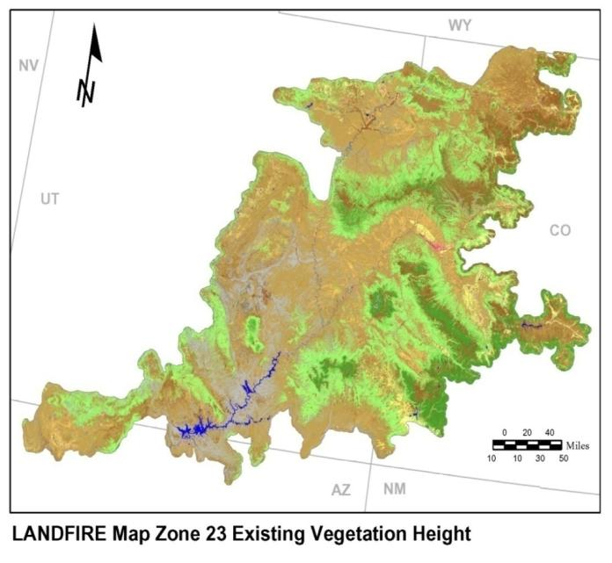
DSM Data-Land Fire
Wildland fire management
Based off NLCD
No man-made features
Resolution of 30² meters
Vegetation Heights in bins, not absolute values
Notes:
1st picture "LANDFIRE-National Product Descriptions." Existing Vegetation Height. http://www.landfire.gov/NationalProductDescriptions22.php (accessed November 20, 2009).
Wildland Fire Leadership Council (WFLC). "LANDFIRE.EXISTING_VEGETATION_HEIGHT." LANDFIRE Homepage. http://landfire.cr.usgs.gov/distmeta/servlet/gov.usgs.edc.MetaBuilder?TYPE=html&DATASET=F0H (accessed December 28, 2009).
LANDFIRE is a five-year, multi-partner wildland fire, ecosystem, and wildland fuel mapping project. This project will generate consistent, comprehensive maps and data describing vegetation, fire, and fuel characteristics across the United States in support the National Fire Plan and the Healthy Forests Restoration Act.
The LANDFIRE existing vegetation layers describe the following elements of existing vegetation for each LANDFIRE mapping zone: existing vegetation type, existing vegetation canopy cover, and existing vegetation height. Vegetation is mapped using predictive landscape models based on extensive field reference data, satellite imagery, biophysical gradient layers, and classification and regression trees.
DATA SUMMARY: The existing vegetation height (EVH) data layer is an important input to LANDFIRE modeling efforts. Canopy height is generated separately for tree, shrub and herbaceous cover life forms using training data and a series of geospatial data layers. EVH is determined by the average height weighted by species cover and based on existing vegetation type (EVT) life-form assignments. Dominant life-form height of each plot is then binned as follows: (A) Tree classes; 0-5 m, 5-10 m, 10-25 m, 25-50 m, and greater than 50 m, (B) Shrub classes; 0-0.5 m, 0.5-1.0 m, 1.0-3.0 m, greater than 3.0 m, (C) Herbaceous vegetation classes; 0-0.5 m; 0.5-1.0 m, greater than 1 m.
Decision tree models using field reference data and Landsat imagery, digital elevation model data, and biophysical gradient data, are then developed separately for each of the three life forms using C5 software. Life-form specific cross-validation error matrices are generated during this process to assess levels of accuracy of the models. Decision tree relationships are then used to generate life-form specific height class spatial data layers, which are later merged into a single composite height data layer. The final EVH layer is evaluated and rectified through a series of QA/QC measures to ensure that the life-form of the cover code matched the life-form of the existing vegetation type.
Temporal_Keyword: 1999-present
Scott, Joe. "Review and assessment of LANDFIRE canopy fuel mapping procedures." Data Products ›› Data Product Quality ›› Review. www.landfire.gov/downloadfile.php?file=LANDFIRE_Canopyfuels_and_Seamlines_ReviewScott.pdf (accessed December 28, 2009).
Accuracy of LANDFIRE canopy fuel products is low, but consistent with constraints imposed by the very large (national) extent of the effort and the high
inherent variability of the characteristics being mapped. Other canopy fuel mapping efforts have achieved greater accuracy than LANDFIRE’s products, but at greater cost per acre mapped, and by employing methods that can’t be applied at LANDFIRE’s extent. The problem of low map accuracy of LANDFIRE canopy fuel products is a greater problem for project‐level geospatial fire analyses than for the national‐level analyses which LANDFIRE was designed to support. Insufficient accuracy can be resolved by end users through a routine process of critique and calibration (refinement using local information) and refreshing (to account for changes in the landscape since the effective date of LANDFIRE products).
problems with canopy fuel related LANDFIRE data products:
• canopy cover values are too high,
• data discontinuities exist within and between map zones,
• canopy bulk density values are too low for use in FARSITE,
• canopy base height is too high to generate crown fire,
• treelist data sources may not be best for canopy fuel calculations
• alternative canopy fuel calculation programs may produce different results
• Refreshing and calibrating LANDFIRE data is needed

Slide 15
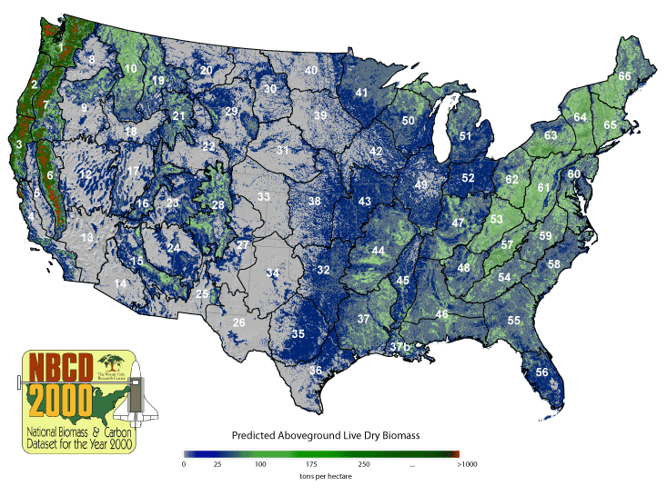
DSM Data-NBCD
Based on SRTM, NED, Landfire and NLCD-2001 Resolution of 30² meters
Estimate weighted canopy height, biomass, and carbon stock
Notes:
1st picture - "NBCD2000." The National Biomass and Carbon Dataset 2000 (NBCD 2000) . http://www.whrc.org/proposals/ALOS_Google/index.htm (accessed November 20, 2009).
"NBCD2000." The National Biomass and Carbon Dataset 2000 (NBCD 2000) . http://www.whrc.org/proposals/ALOS_Google/index.htm (accessed November 20, 2009).
Scientists at the Woods Hole Research Center are producing a high-resolution “National Biomass and Carbon Dataset for the year 2000” (NBCD2000), the first ever spatially explicit inventory of its kind. The dataset is being produced as part of a project funded under NASA’s Terrestrial Ecology Program with additional support from the Landscape Fire and Resource Management Planning Tools Project (LANDFIRE). The primary objective of the project is to generate a high-resolution (30 m), year-2000 baseline estimate of basal area-weighted canopy height, aboveground live dry biomass, and standing carbon stock for the conterminous United States.
based on an empirical modeling approach that combines USDA Forest Service Forest Inventory and Analysis (FIA) data with high-resolution InSAR data acquired from the 2000 Shuttle Radar Topography Mission (SRTM) and optical remote sensing data acquired from the Landsat ETM+ sensor. Three-season Landsat ETM+ data were systematically compiled by the Multi-Resolution Land Characteristics Consortium (MRLC) between 1999 and 2002 for the entire U.S. and were the foundation for development of both the USGS National Land Cover Dataset 2001 (NLCD 2001) and the LANDFIRE project. Products from both the NLCD 2001 (landcover and canopy density) and LANDFIRE (existing vegetation type) projects as well as topographic information from the USGS National Elevation Dataset (NED) are used within the NBCD 2000 project as spatial predictor layers for canopy height and biomass estimation. Forest survey data provided by the USDA Forest Service FIA program were made available to the project under a national Memorandum of Understanding.

Slide 16
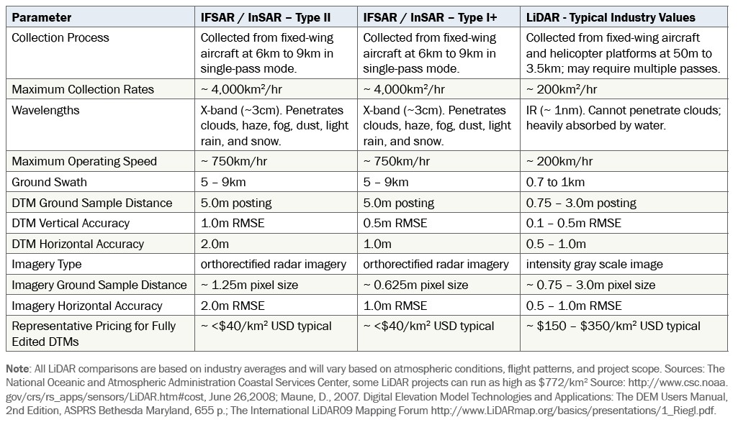
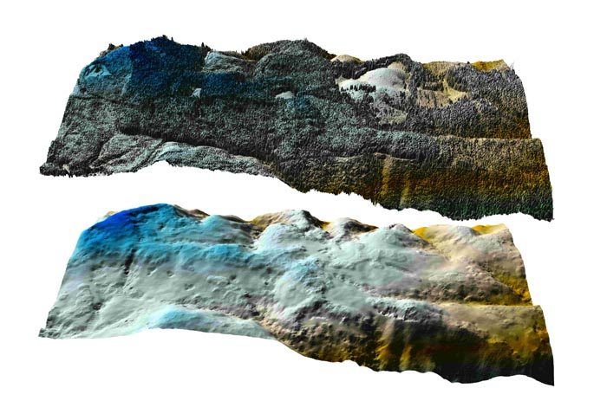
DSM Data-IFSAR
Resolution of 5² meters
DTM
Notes:
1st picture - University of Washington. "Joint Fire Science Program (JFSP)." University of Washington: Precision Foresty Cooperative. http://www.cfr.washington.edu/research.pfc/pages/jfsp.html (accessed December 4, 2009).
Intermap. "About Intermap IFSAR Mapping Technology." Our IFSAR Technology. https://www1.vtrenz.net/imarkownerfiles/ownerassets/868/brochure_IFSAR.pdf (accessed December 25, 2009).
Intermap’s proprietary airborne interferometric synthetic aperture radar (IFSAR) digital mapping technology is essentially a process of producing 3D map products by processing raw radar data collected by airborne IFSAR systems. Thematic information for a scene is derived from the synthetic aperture radar (SAR) images.
elevation data and images of the 48 contiguous states and Hawaii
IFSAR is a proven alternative to LiDAR (see graphic above)

Slide 17
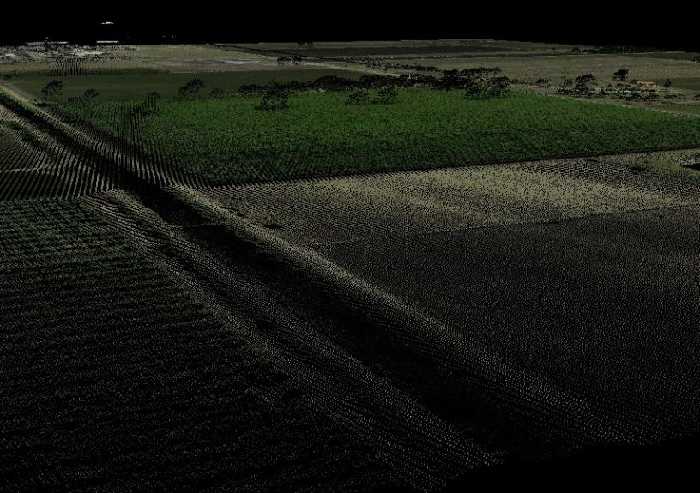
DSM Data-LIDAR
0.7 meter ground sample distance
Point cloud DSM&DTM
Notes:
Pictures created using Quick Terrain Modeler and data from LiDAR elevation data map of Cameron County, TX
Light Detection and Ranging (LIDAR)
Metadata of LiDAR elevation data map of Cameron County, TX. Cameron County: Sanborn Mapping Company, Inc, 2007.
Data Collection: Using a LH Systems ALS50 Light Detection And Ranging (LiDAR) system, 84 flight lines of standard density (1.4 meter ground sample distance) data were collected over areas in Cameron County,TX (approximately 1021 square miles). Multiple returns were recorded for each laser pulse along with an intensity value for each return. The data acquisition occurred in 36 missions between December 14, 2005 , and February 23, 2006. During the LIDAR campaign, the Sanborn field crew conducted a GPS field survey to establish final coordinates of the ground base stations for final processing of the base-remote GPS solutions.

Slide 18
Software Used
Quick Terrain Modeler
Arcview
Spatial Analyst
Military Analyst

Slide 19
In-Situ observation
Digitize using latest NAIP as basemap → Convert to raster → used to compare with finished viewsheds
Rules
-possible locations of vehicles or humans
-Vegetation = fuzzy

Slide 20
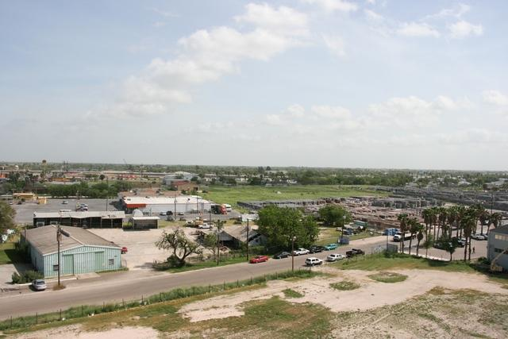
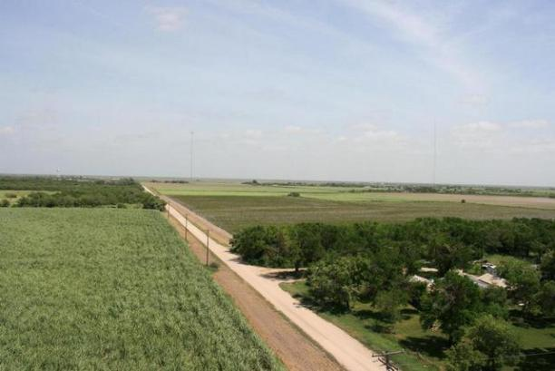
Locations for studies
Rio Grande Valley, Texas
mean slope under 1%
130 square miles
68% cultivated crops and pasture
18% developed space
14% undeveloped area.
Notes:
Pictures of South Texas collected as collaborative effort between Ed Ashton and SPA Salinas. Pictures taken in 2008

Slide 21
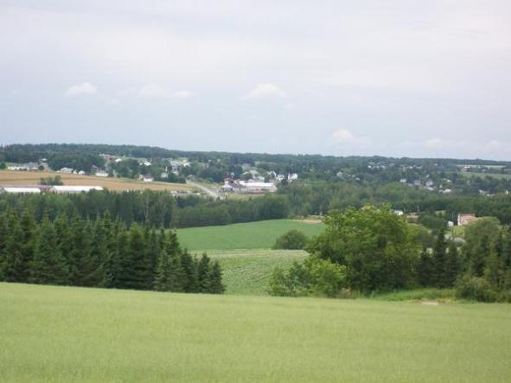
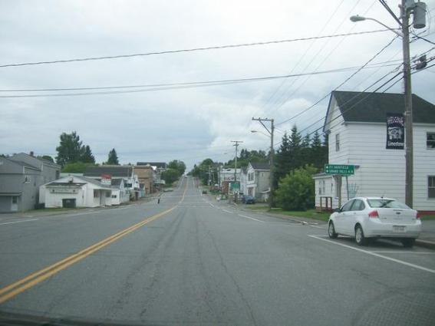
Locations for studies
Aroostook County, Maine
mean slope about 10%
120 square miles
44% cultivated crops and pasture
6% developed area
43% forest
7% undeveloped area
Notes:
Pictures of Maine taken by Ed Ashton, 2009.

Slide 22
Limitations
The 30² meters resolution of NLCD, Landfire, and NBCD limits the DSMs that can be created
Data was collected circa 2000
LIDAR data collected 2005-2007
IFSAR data collected ?? – 5 meter
NAIP imagery collected 2007 for Maine sites, 2008 for Texas Sites

Slide 23
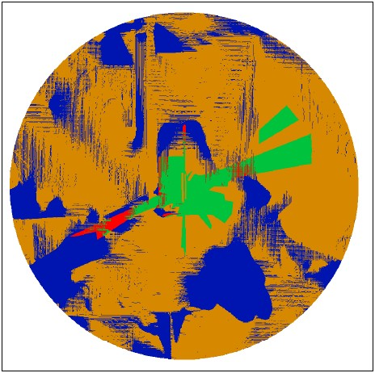
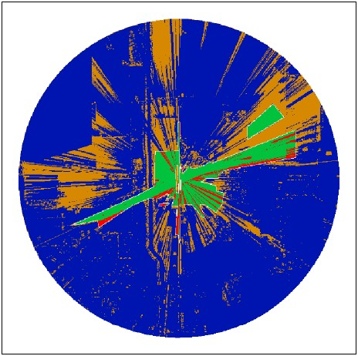
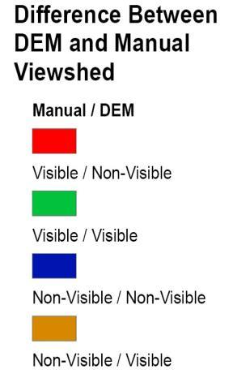
Preliminary Findings
USGS DTM vs. in-situ observation
Lidar DSM vs in-situ observation

Slide 24
Tasks to do
Obtain all the data
Verify Projection, reproject data
Go through methodology steps
Compare results
Repeat process for Maine sites

Slide 25
Predictions/Conclusions
30 meter data (NLCD, NBCD, Landfire) will yield results that while easy to create will be unsuitable for large scale viewshed in some areas.
IFSAR better results but still issues with artifacting
LIDAR best results but massive amounts of storage space and very expensive to collect and maintain.
Geographic patterns of failure and success

Slide 26
Questions

Slide 27
Possible Future considerations
How does the method used to collect the DEM affect the viewshed? GPM II, manual profiling, DLG2DEM, DCASS and LT4X
How does environment affect the results? Study done in limited terrains
How can a DTM be turned into a DSM with minimal effort? Explore using land use data, automated photogrammetric techniques, object extraction from other imagery types.
Testing in areas that does not have excessive vegetation (ie trees) and no man made structures. Does this yield similar results between a manual viewshed and using a DEM?
The manual viewshed made assumptions about what was visible and what was not. Those areas that a human or vehicle could be located and were visible to the analyst were marked as visible and everywhere else was non visible. Thus the tops of trees, the facades or buildings were marked non-visible even though the analyst could see them. How does this affect the results? How can the results be normalized to take this into consideration?
Different GIS applications compute viewsheds differently. This study explored ArcGIS only, how do other applications compare.
Notes:
Possible hide slide.

