Slide 1
Using GIS to Preposition Civil Air Patrol Assets for Disaster Relief Mission Needs: A Case Study
Jake Aytes - Presenter
Dr. Erin Long - Advisor

Slide 2
Background
Civil Air Patrol(CAP) is the US Air Force Auxiliary
Created in 1941 to fill the needs of wartime civil defense operations
Missions include Cadet Programs, Aerospace Education and Emergency Services
This case study is regarding the evolving Emergency Services mission of the CAP
Missing aircraft, missing persons, and disaster relief operations
Ground and air assets are located throughout the state
This case study will focus on the Maryland members and assets of CAP
Notes:
Not EMS
Miss AC specialty
Counter Drug/Homeland Security
Each state has a wing

Slide 3
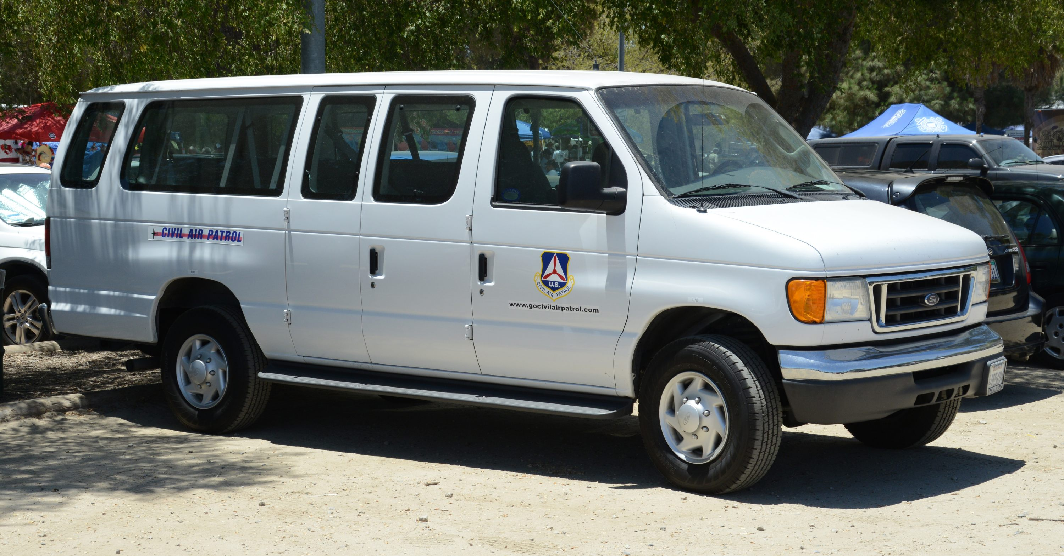
CAP Assets
Maryland has passenger vans with ground teams as their primary ground assets for disaster relief operations
Air assets include Cessna 172, 182, and GA8 Airvan aircraft
Notes:
sUAS and GIS
AP is unique capability
These respond to different needs

Slide 4
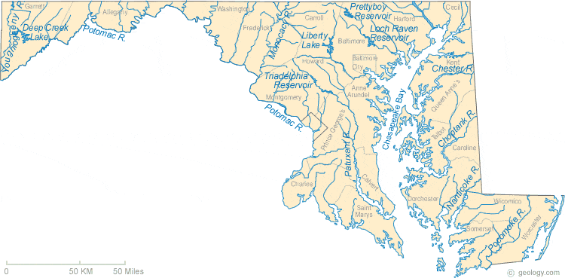
Area of Study
Maryland will be the only area of study
Associated airports, waterways, and roadways are to be used to develop en route times and safe prepositioning locations
Limiting the scope of case study to Maryland assets
Notes:
Crawl Walk Run = MD Only
4:30

Slide 5
Data
Maryland CAP asset locations from the CAP's Situational Awareness Tool
Storm Surge data provided by National Oceanic and Atmospheric Administration (NOAA)
Hurricane tracks and attributes provided by NOAA
Google Maps roadway data for route calculation of ground assets
Maryland CAP specific data provided by officials on a case-by-case basis
Notes:
Map = assets
NOAA reputable
20 years as assets likely similar to 20 years ago

Slide 6
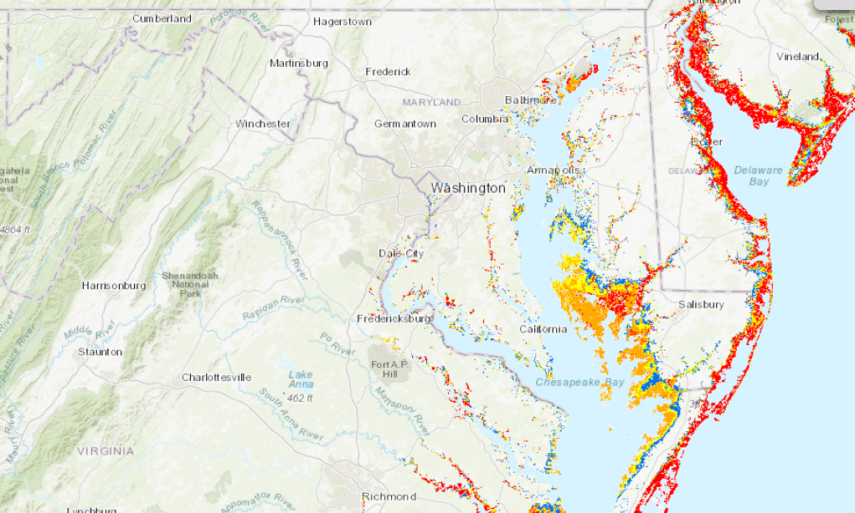
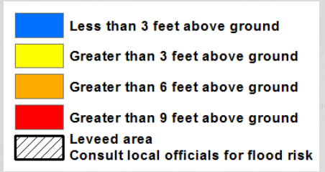
Data
Example of Category 3 Storm Surge data from provided by NOAA’s National Storm Surge Hazard Maps online

Slide 7
Workflow/Methodology
Data Collection
Study Scenarios 1-3
Collection of all data points for use throughout the study
Hurricane track refinement as the primary storm of study
Storm surge buffer using provided data as areas of interest
Infrastructure data for possible mission tasking by state or federal agencies
Scenario 1: No prepositioning
All assets "shelter in place"
Scenario 2: Current Prepositioning
Asset repositioning for maximum protection
Scenario 3: Refined Prepositioning
Asset repositioning for faster response to disaster-stricken areas

Slide 8
Workflow/Methodology
Results Comparison
Final Recommendations
Using historic needs from Federal Emergency Management Agency (FEMA) and Maryland Emergency Management Agency (MEMA) determine areas of most likely need.
Other Considerations:
Variables regarding routes for ground and air assets
Tabulated data of en route times
Disaster relief areas of interest
Airports of unlikely use
Unit locations of unlikely use
Special Flight Rules Area (SFRA)/Flight Restricted Zone (FRZ)
The final set of recommendations will be offer options for tactical commanders for unit deployment and prepositioning
B
Asset Response
A
C
Asset Safety
Notes:
Quad Chart
Ideally follow on for other disaster types or other locations

Slide 9
Objective and Intent
Generate a set of recommendations based on asset response time comparisons of the three scenarios.
Improve response of CAP ground and air assets to likely areas disaster relief need for Maryland.

Slide 10
Timeline
Phase 1 Oct – Dec 2021
Study base map generation and Scenario 1 completion
Phase 2 Dec – Jan 2022
Scenario 2 completion
Phases 3 Jan – Mar 2022
Scenario 3 completion and final results for recommendation
Phase 4 Mar- Apr 2022
Final Presentation Preparation and Revision
Start
End
Oct 2021
May 2022

Slide 11
Limitations
Maryland only case study
CAP asset only case study
Hurricane specific case study
Responding assets assumption, though relatively realistic, storms impact personnel differently and can vary greatly from real life as any planner will understand
Tasking based on historic needs of FEMA/MEMA
Notes:
Cant predict future
Possible validation through CAP SAREXs

Slide 12
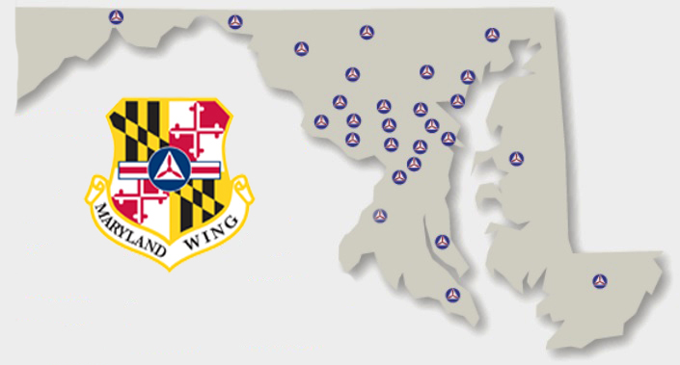
Questions or Comments

Slide 13
References
CAP Cessna 182. https://i.pinimg.com/736x/59/49/99/59499996b7cd86c0483121d6c835502e.jpg.
CAP Command Patch. https://www.dsmcap.org/wp-content/uploads/2017/09/cropped-CAP_Command_Patch-600x600.png.
“CAP Operations Situational Awareness Tool.” Cap, https://cap-gis.maps.arcgis.com/apps/MapSeries/index.html?appid=95cfa9dcbd7b4533abdb55dac8e38dea.
CAP Van. http://militarypd.50webs.com/cap122.jpg.
Hurricane Warning. https://stmichaelschurch.net/wp-content/uploads/2018/09/hurricane-warning-fi.jpg.
Maryland CAP Map. https://mdwg.cap.gov/index.php/squadrons/.
Maryland Map. https://geology.com/state-map/maps/maryland-rivers-map.gif .
“National Storm Surge Hazard Maps.” Noaa.maps.arcgis.com, https://noaa.maps.arcgis.com/apps/MapSeries/index.html?appid=d9ed7904dbec441a9c4dd7b277935fad&entry=1.

