Slide 1
Utilizing Lidar and Aerial Imagery to Identify Vernal Pool Edges in an Upland Habitat Analysis
Andrew Bagnara
Advisor: Karen Schuckman
Notes:
Hi my name is Andrew Bagnara, and this is my capstone proposal presentation titled “Utilizing Lidar and Aerial Imagery to Identify Vernal Pool Edges in an Upland Habitat Analysis.” My advisor for this project has been Karen Schuckman.

Slide 2
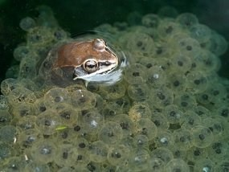
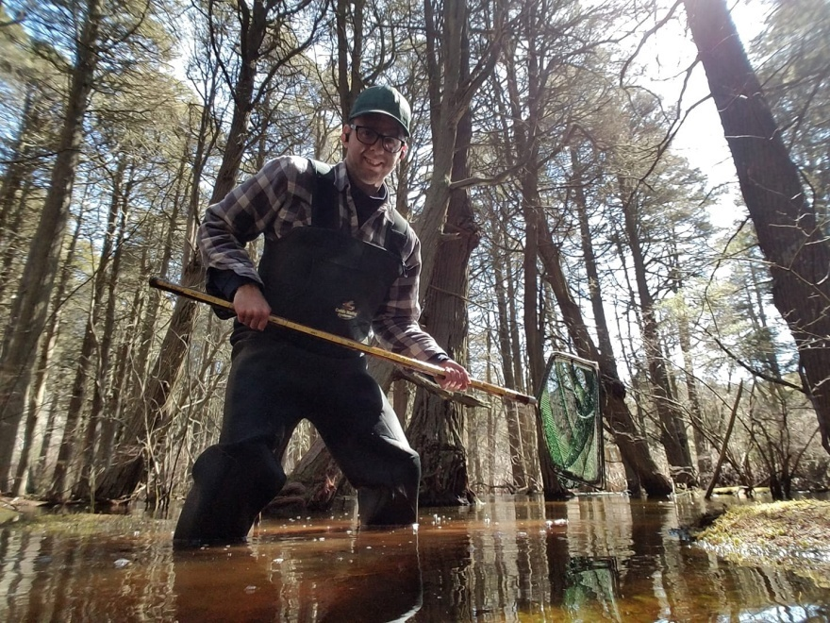
My Background in This Topic
Source: https://www.nps.gov/gaar/learn/nature/wood-frog-page-4.htm
Notes:
It’s pertinent to this presentation for me to talk about my background and how it relates to my proposal idea. After my undergrad degree, I began working in Massachusetts, specifically in Barnstable County which you may know as Cape Cod. I began here as an environmental AmeriCorps member learning about the biodiversity and fragile habitats in this unique part of the country. I would eventually become a land manager for two town-based conservation groups in which one of my major responsibilities was wetland habitat management. It was here that I was first introduced to the term ‘vernal pool’ and learned of their significance in the realm of conservation and how they are threatened due to development disturbances. The state of Massachusetts is actually one of the few that has legal protection for vernal pools if certified and delegated by local governments, so I worked to identify and certify pools as part of my management duties. The pools could sometimes be difficult to access or even notice due to their hydroperiods and size. I was able to certify a handful of vernal pools for protection while there.

Slide 3
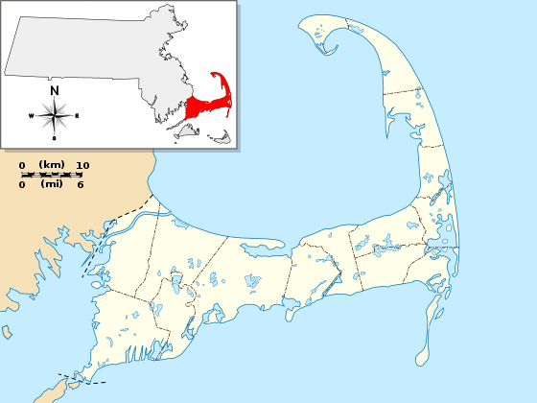
Study Area
Source: https://en.wikipedia.org/wiki/File:USA_Mass_Cape_Cod_location_map.svg
Notes:
Now that I have more skills in GIS and remote sensing, I thought returning to these habitats for a capstone project idea was a worthy cause. That’s why I have chosen to have my study area here in Cape Cod. The above image shows the boundary of Cape Cod, MA, and the exact study area will be determined based on size of data and computing resources. I’ll note here that Cape Cod and Barnstable County are both referring to the pale area of the map above.

Slide 4
Goals and Objectives
Utilize new remote sensing and lidar technologies to identify certified and potential vernal pools in Cape Cod
Visualize hydro edge boundaries from imagery and/or lidar data collected during leaf-off conditions
Compare hydro edges to vernal pool obligate species migration metrics and state regulated 100-ft upland buffer
Determine level of developmental disturbances within these buffer zones
Notes:
Here are the main goals and objectives I have for this project.
*Reads goals and Objectives
#2 (after reading goal) This is when water bodies are at their fullest through the year

Slide 5
Defining a Vernal Pool
Small (usually less than an acre), seasonal wetlands that lack perennial inlet or outlet streams and have no permanent fish populations. (Calhoun and deMaynadier, 2004)
Confined surface depressions with no permanent surface inflow or outflow with a total surface area larger than 50 m2 (Qiusheng et al., 2014)
A vernal pool is a contained basin depression lacking a permanent above ground outlet. In the Northeast, it fills with water with the rising water table of fall/winter or with the meltwater and runoff of winter /spring. (Vernal Pool Association, 2019)
Notes:
At this point, you may be familiar with the term vernal pool or vernal pond, but it would be surprising if we all had the same definition. In research, I had found while mostly similar, vernal pools were described differently from study to study. The first definition taken from a forest management guideline article on vernal pools defines them as *READS FIRST*. The second definition taken from a vernal pool lidar project which I’ll go into a lot later, describes them as *READS SECOND*. This definition is very much tailored to the type of analysis and what they could confidently call a vernal pool based on their methods and results. Another one taken from the Vernal Pool Association says *READS THIRD*.

Slide 6
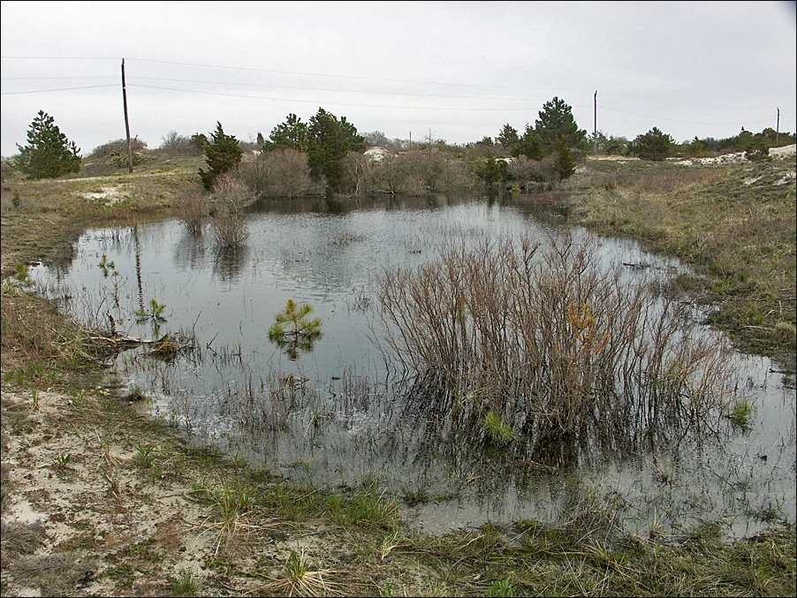
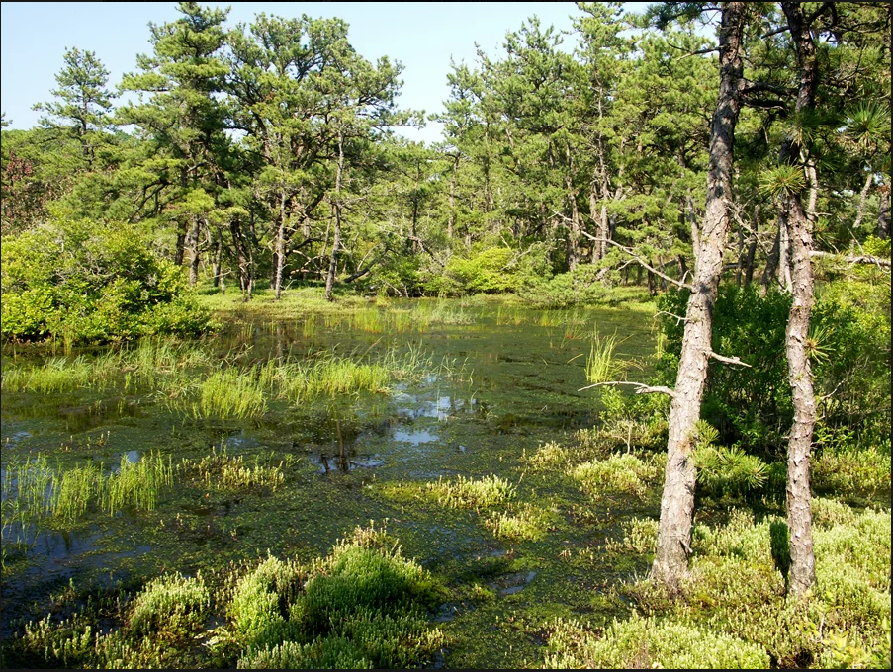
Barnstable, MA Vernal Pool (Vernal Pool Association)
Truro, MA Vernal Pool (Vernal Pool Association)
Notes:
I have a few images here to help better understand what these pools look like, both of which are located on Cape Cod. The one on the left was taken in the town of Barnstable, and it’s important to note the clear water edge in this image. In contrast, the image on the right also shows a vernal pool but one with much less uniformity in declaring the water’s edge. These images were taken at a time when the depressions contained water, so most likely during the winter. During warmer months, these pools would most likely be dry which is a key characteristic of a vernal pool. This creates a habitat safe for certain breeding species who rely on these habitats to survive because there would be no fish predation in a water body like this.

Slide 7
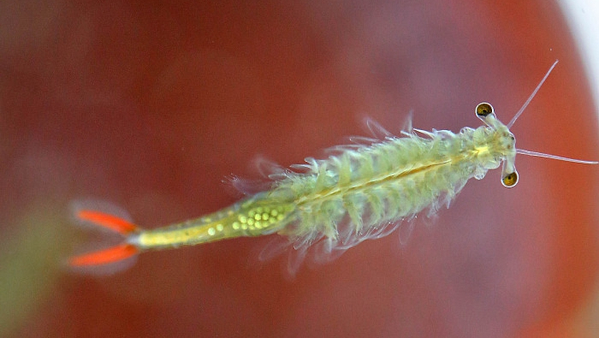
Why are vernal pools important?
Important breeding habitat for obligate and facultative species
Stepping stones to other water habitats
At risk of significant habitat loss due to development
Fairy Shrimp
Source https://news.cgtn.com/news/2019-07-04/Fairy-shrimp-from-the-era-of-dinosaurs-I31KR2epMI/index.html :
Notes:
So why are they important and the focus of my study? These habitat are critical breeding habitat for those obligate and facultative species due to the uniqueness of the changing hydro period and upland habitat in which these species spend 95% of the year in. They are also important in their role as stepping stones to other water habitats. A study done in Maine on wetland simulations concluded that the loss of small wetlands like vernal pools poses a significant risk of species extinction and the erosion of their ability to disperse to new areas. Also, development has contributed heavily to much of the habitat loss over the years. According to a study by Jamie King on their paper “Loss of Diversity as a Consequence of Habitat Destruction in California Vernal Pools”, California’s Central Valley is estimated to have lost anywhere from 50-85% of vernal pool habitat since settlement. Cape Cod has seen increases in development over the years to a lesser extent, but the importance of identifying these habitats remains.
The picture below is of an obligate species the fairy shrimp.

Slide 8
Massachusetts Definition
Massachusetts Wetlands Protection Act establishes legal definition
A big emphasis on indicator wildlife and absence of fish
State certification process provides distinct criteria for Massachusetts vernal pools
State distinguishes Potential Vernal Pools (PVP) from Certified Vernal Pools (CVP)
Notes:
The state of Massachusetts has a growing history in vernal pool management and study; and thus, has a legally backed definition. From the Mass Wetlands Protection Act, “Vernal Pool Habitat means confined basin depressions which, at least in most years, hold water for a minimum of two continuous months during the spring and/or summer, and which are free of adult fish populations, as well as the area within 100 feet of the mean annual boundaries of such depressions, to the extent that such habitat is within an Area Subject to Protection. These areas are essential breeding habitat, and provide other extremely important wildlife habitat functions during non breeding season as well, for a variety of amphibian species such as wood frog (Rana sylvatica) and the spotted salamander (Ambystoma macultum), and are important habitat for other wildlife species.”
So within that definition, we have a big emphasis on indicator wildlife as a necessity for the habitat to be vernal. This leads me into the certification process in Massachusetts for vernal pools and the 2001 effort to identify potential vernal pools using aerial imagery.

Slide 9
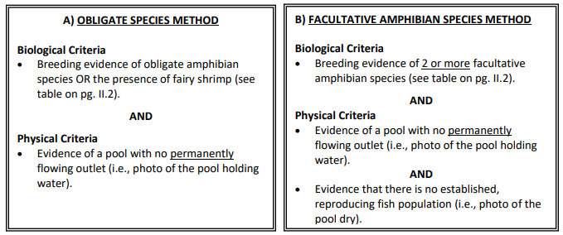
Massachusetts Certified Vernal Pools
Vernal pools can be certified by the following methods:
Source: https://www.mass.gov/doc/guidelines-for-the-certification-of-vernal-pool-habitat/download
Notes:
To become state-recognized protected habitats, Massachusetts has set up a certification process through the NHESP (Natural Heritage & Endangered Species Program) which identifies certain criteria needed tot be met. This figure shows us some of the methods required through the state certification document. *EXPLAIN PICTURE*

Slide 10
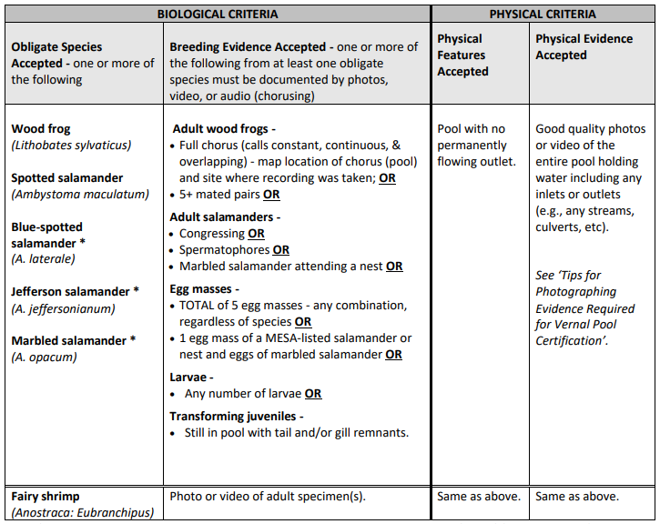
Massachusetts Certified Vernal Pools
Source: https://www.mass.gov/doc/guidelines-for-the-certification-of-vernal-pool-habitat/download
Notes:
We have more detailed information here on the various species Massachusetts has declared as obligate species for vernal pools. From the Certification Guidelines, obligate species means “vertebrate and invertebrate species that require vernal pools for all or a portion of their life cycle and are unable to successfully complete their life cycle without vernal pools.” So these listed species rely on these pools for their survival in Massachusetts.

Slide 11
History of Massachusetts Regulation Efforts for Vernal Pools
1987 amendment to Massachusetts Wetlands Protection Act -310 CMR 10.00
Surface Water Quality Standards -314 CMR 4.00
Title 5 of the MA Environmental Code -310 CMR 15.00
Forest Cutting Practices Act Regulations -304 CMR 11.00
---------------------------------------------------------------------
* Officially identified or certified vernal pools can be protected up to 100 ft from the water’s edge
Notes:
The history of vernal pool regulation in Massachusetts mainly falls into 4 pieces of legislation. Without boring you with the details of each, I’ll summarize some useful information provided by the Vernal Pool Association and Wetlands Protection Act. For a pool to be protected under the Wetlands Protection Act, it must be a state certified pool, but pools may also gain protection through the other 3 acts listed. Local governments may also enact their own regulations for protection as well while mostly adhering to the Wetlands Protection Act which protects the pool and up to 100 ft upland from the water edge.

Slide 12
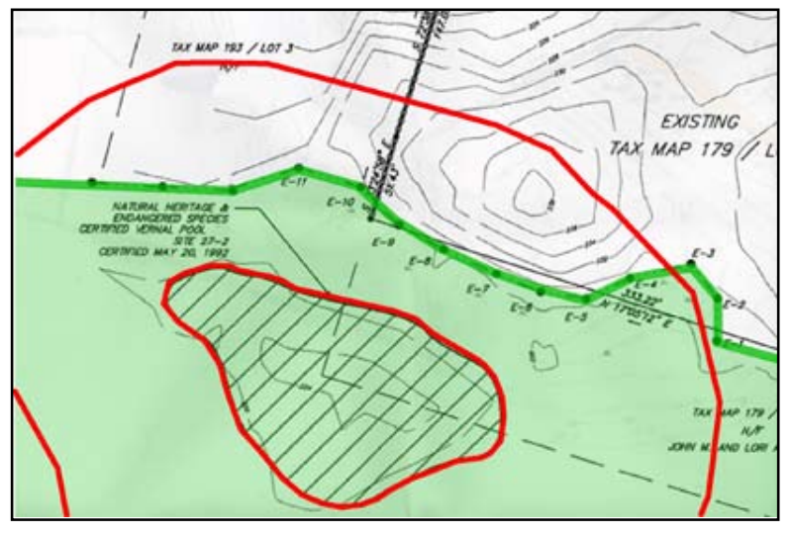
History of Massachusetts Regulation Efforts for Vernal Pools
Source: https://6289ec42-117d-420b-8d6d-9372b556ab1a.filesusr.com/ugd/f08fdb_6e3153ed68874ad4bebfa356a1138e8e.pdf
Notes:
I wanted to provide this image which comes from a document called Protecting vernal Pools by the Vernal Pool Association to help illustrate what state regulations protect in a vernal pool habitat. The inner red circle shows the water’s edge of a certified vernal pool full of water. The outer ring then represents the 100 foot line buffered from the water’s edge. So when the state says vernal pool habitat, it is referring to the area within the 100 foot line.

Slide 13
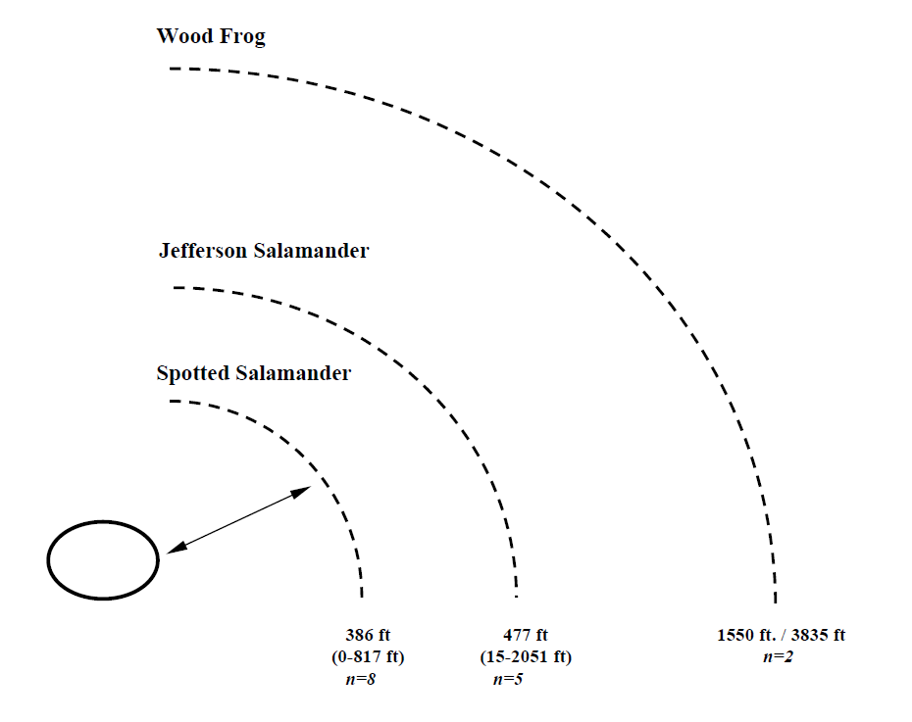
The 100-ft Upland Protection Zone
Studies have shown that the 100-foot habitat buffer can be insufficient in supporting critical terrestrial habitat
Source: https://www.maineaudubon.org/wp-content/uploads/2017/03/Best-Development-Practices-Conserving-Pool-breeding-Amph.pdf
Notes:
The 100 foot upland buffer designated by the state was established because it provided upland habitat for the breeding species, but studies have shown that just 100 feet of upland protection can be insufficient in providing enough habitat for the upland migration ranges of some of the obligate species. The spotted salamander and wood frog are both listed as obligate species in the certification document and shown in this image pulled from a document called Best Development Practices - Conserving Pool-Breeding Amphibians in Residential and Commercial Developments in the Northeastern United States. As you can see, the spotted salamander migration distances range well beyond the 100 foot buffer, and the wood frog distances are far larger. I’ll work to research more about these migration distances, but there seems to be a big disparity, mind you with expected reasons to be discussed in the next few slides.

Slide 14
The 100-ft Upland Protection Zone
“In the spring, high densities of adult salamanders and frogs occupy the habitat immediately surrounding the pool. Similarly, in early summer and early fall, large numbers of recently emerged salamanders and frogs occupy this same habitat. This zone also maintains the water quality of the pool depression and provides a source of leaves, which constitute the base of the pool food web.” (Calhoun and Klemens, 2002)
Notes:
The same management document describes the habitat currently with possibility of protection through regulations within 100 feet as follows: *READ QUOTE*.

Slide 15
Beyond 100 Feet (100-750)
“This area provides habitat for amphibians during the non-breeding season for foraging, dispersing, and hibernating. During the breeding season, adults migrate to pools through this zone.” (Calhoun and Klemens, 2002)
Notes:
Now let’s look at the habitat described beyond the 100 foot mark. *READ QUOTE*. Adults are living and moving throughout this zone in breeding seasons if allotted. Recommendations from the same document are to maintain shade, deep litter, and woody debris as well as minimize disturbances to the floor.

Slide 16
Summary of the Problem
Massachusetts state regulations have been implemented to protect vernal pool habitats
Size of area protected does not seem to fully support upland habitat for vernal pool breeding species
Notes:
With a bit of history and background of vernal pools in Massachusetts out of the way, let’s look at the summary of the perceived problem. We do have state regulations implemented to protect vernal pools which is fairly unique as most states do not have vernal pool regulations at this time. The size of the protection does seem to be controversial though as this alone does not seem enough to provide sufficient upland habitat to these breeding species. One argument that could be made though is that 100 feet is a compromise as it offers some upland protection without significantly hindering development throughout the state.

Slide 17
Theme
How protected are vernal pool upland habitats in Massachusetts based on obligate species’ migration distances?
Do current state regulations for certified vernal pools offer enough upland protection?
How does development affect available upland habitat?
Notes:
That said, I wanted to now offer up my themes going forward with my project. *READ THEME*

Slide 18
Scope of Project
Identify vernal pool habitat including upland zones for a study area in Barnstable County, MA
Determine how protected the upland habitats are considering factors such as buildings and roads in a continuously developing environment
Notes:
The scope of my project will be conducted in two phases. Phase 1 will be to identify vernal pool habitat including upland zones for a study area in Barnstable County, MA. As of now, I do not have a specific study area because of unknown system limitations with large amounts of high-res imagery. I’ll plan to look into a specific town such as Falmouth which has a good amount of existing data. If I need to go to a smaller study area though, I will.
Phase 2 will then be to determine how protected the upland habitats are with factors such as buildings and roads in a continuously developing environment.

Slide 19
Phase 1– Generating Vernal Pool Polygons
Delineate an area of interest in Barnstable County
Acquire existing lidar, imagery, vernal pool, and other data pertinent in interpretation of vernal pools
Generate depression polygons from lidar data
Utilize imagery and other ancillary data to eliminate depressions that are not water bodies and do not display characteristics of vernal pools
Compare remaining depression polygons to existing vernal pool data for accuracy of analysis
Final set of polygons will be used as potential vernal pools for the study area
Notes:
This is a brief outline of my proposed methodology starting with phase 1. I will start by identifying a study area in Cape Cod that exhibits good existing vernal pool data as well as a diverse landscape of wetlands, forests, development, etc. Then I will acquire existing lidar, imagery, vernal pool and other pertinent data of which most can be found on MassGIS. Existing, recent methods of identifying vernal pools have involved both lidar and high resolution imagery, so I plan to use a combination of both to initially identify depressions in the landscape that can be refined by using other data. One such intriguing lidar method from a study in Connecticut called An Effective Method for Detecting Potential Woodland Vernal Pools Using High-Resolution LiDAR Data and Aerial Imagery involving lidar is a stochastic depression analysis. This method extracts polygons from a lidar DEM which can be used to represent the water’s edge. A key aspect of imagery used in this phase will be high resolution 4-band imagery acquired during leaf-off conditions because many vernal pools exist in forested areas. This type of imagery increases the likelihood of identifying vernal pool habitat as these bodies of water may also be dried up during summer. As a way to check for errors in my resulting polygons, I will be using existing certified and potential vernal pool point data provided by the state.

Slide 20
Phase 2 – Upland Analysis
Upland can be analyzed by creating buffers from water edges
Buffers will represent both the 100-ft state regulated protection line and designated migration zones based on amphibian research
Analysis of ‘disturbances’ within these buffers to evaluate viability of upland habitat to these vernal pools
Notes:
Once I have created a vernal pool polygon layer for the study area, I will be creating buffers from the water’s edge representing both the migration distances and the 100 foot protected zone implying if the pool were certified, it would be protected within that 100 foot zone. The distances for migration zones will be designated after more research is done into the best representative distances of amphibians. From here, I plan to do an analysis of the amount of disturbance within these buffers to determine how much disturbance is occurring within the protected zones and how much is occurring in the migration zones. Of course disturbances would need to be defined, but I am envisioning land cover that could be classified as buildings or pavement would qualify as disturbances as they are defined that way in the Best Development Practices article referenced earlier.

Slide 21
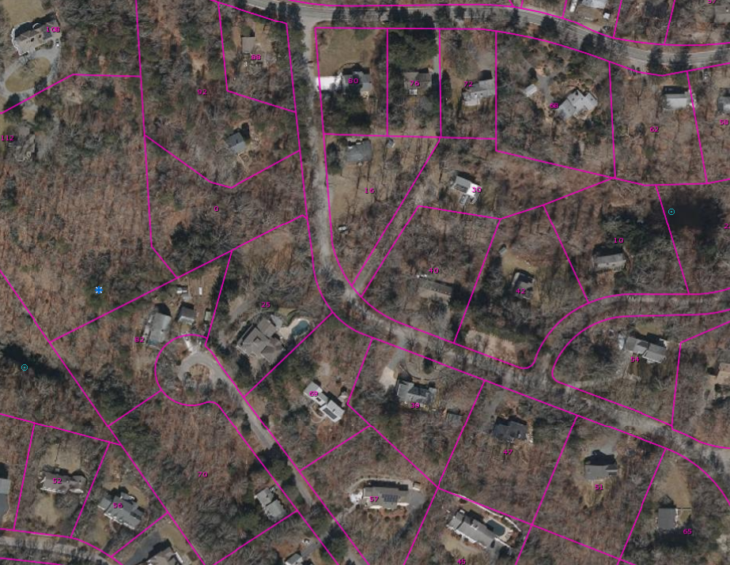
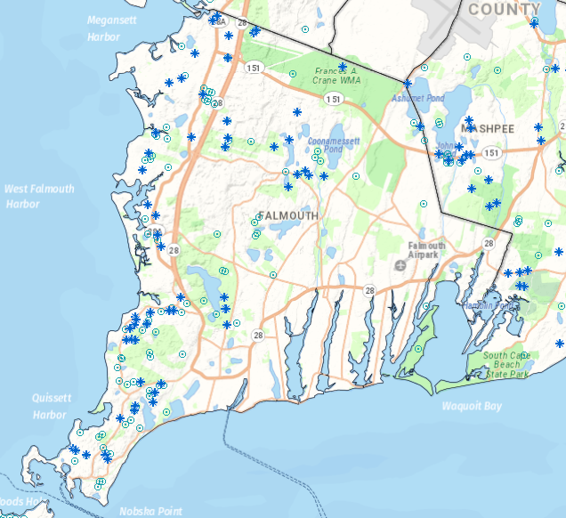
Data
Certified Vernal Pools and Potential Vernal Pools - MassGIS
Notes:
After the revisions of the Wetlands Protection Act to include vernal pool protection, The state of Massachusetts conducted an aerial imagery survey to identify potential vernal pools across the state. As this was accomplished in 2001, the methods were very of the time which included interpretation of black and white 1:12000 scale aerial photos under a stereograph to add 3 dimensional viewing. Interpreters determined which bodies of water would be worth giving the title of potential vernal pool which has been a great tool ever since to help guide folks in their field certifications. The dataset does also include points for certified pools as they come through the certification process. I plan to use this dataset as a way to check my results for accuracy. It’s important to note that my resulting polygons can not be labeled as certified vernal pools as there are no ground truth to them unless they are represented by a CVP point. These images were taken from a MassGIS data viewer and show the PVP and CVP points available in a town like Falmouth.

Slide 22
Data
USGS lidar point cloud data - 1 meter nominal point spacing, 2013-2014
4 band aerial imagery 15 cm GSD – collected between March and April 2019 during leaf-off conditions
NHD waterbodies
Structures - 2 dimensional roof outlines
Other wetlands layers if possible
Notes:
I will also plan to use the above layers for my analysis in identifying and refining the depression polygons into potential vernal pools. Lidar data will be accessed through USGS as point cloud data and has 1 meter nominal point spacing while collected from 2013-2014. The 4 band imagery tiles have a resolution of 15 cm and were collected during leaf-off conditions. These are available on MassGIS. The NHD water body dataset provides polygons of known bodies of water which will be helpful in determining if the bodies identified in my analysis have inlets or outlets. This is also available on MassGIS The structures dataset is available on MassGIS and consists of 2 dimensional roof outlines of buildings larger than 150 square feet. I am also considering available wetlands data for Massachusetts. One example would be the National Wetlands Inventory dataset created by US Fish and Wildlife Service and has been updated as recent as 2020. This would provide more reference water bodies to compare my results to.

Slide 23
Challenges
Qualifying pool edges based on time data collected
Large data size and processing power required to work with high resolution imagery
Determining what bodies of water qualify as potential vernal pools
Notes:
This project will no doubt bring about some challenges that I will need to address. I foresee a few right now including qualifying pool edges based on when the data was collected. What I mean by this is that I will need to look into various factors to qualify the water edge polygons such as how the rainfall that year compared to others It’s possible the data used represents a time when the pools were not at their maximum capacity or even mean capacity. As shown in the image below, a pool’s edge fluctuates, but I want to capture the bodies of water when full or nearly full. Additionally, working with large datasets like high resolution imagery could pose a problem when processing on my personal computer. It is possible cloud solutions may need to be consulted to advance the project along. A third challenge is determining which bodies of water would qualify as potential vernal pools as opposed to perennial wetlands Through research of previously tried methods in other research projects, I will utilize available data in a way that I believe best accomplishes this and document the methods used as I go.

Slide 24
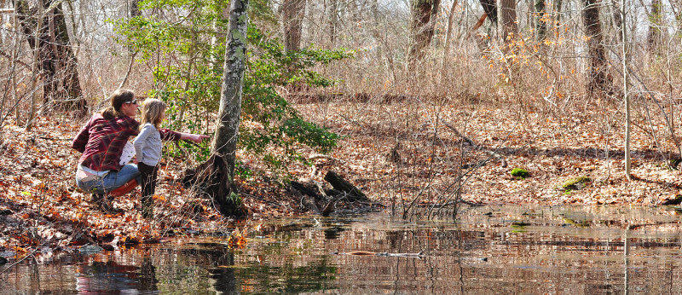
Anticipated Results
Newly defined layer showing potential vernal pools in the study area that builds on the potential vernal pool data created by the state in 2001
Habitat migration maps of study area within 100-ft zones and beyond
Statistics on amount of each habitat affected by disturbance
Source: https://www.savebuzzardsbay.org/news/20-places-around-buzzards-bay-to-discover-a-vernal-pool-this-spring/
Notes:
I anticipate some meaningful results from this project that expand on research done by others in Massachusetts regarding vernal pool identification. The first of which will be a newly defined layer showing potential vernal pools in the study area The potential vernal pool data which is the most readily available to the public in Massachusetts was created in 2001. As we are now 20 years beyond then, newer, better techniques have been developed, and I plan to use them to create hopefully a more accurate potential vernal pool layer. I will also be creating habitat migration maps throughout the study area which builds upon just locating and identifying the pools. Here we will be able to see areas that should be left undisturbed to promote healthy populations in these habitats. Statistics will then be a deliverable I plan to make part of this project in that they will show how disturbed these different zones are which will lead to some interesting discussion points regarding development on Cape Cod and the trade off to vernal pool habitat loss.

Slide 25
Timeline
Download and Preprocess Data
Phase 1 Generating Vernal Pool Polygons
Deliver Final Report
Phase 2 Upland Analysis
Present at Conference
Compile Results and Discussion
Notes:
Lastly, I wanted to show a brief timeline of how I expect things to go from here. I will start with downloading and analyzing the data a bit more before proceeding to preprocessing everything to make sure the data is compatible with each other. Then I will do the two phases of analysis before compiling results and discussion points. Then I plan to present at a conference such as the ASPRS Annual Conference. Finally, I will deliver the report after feedback from the conference.

Slide 26
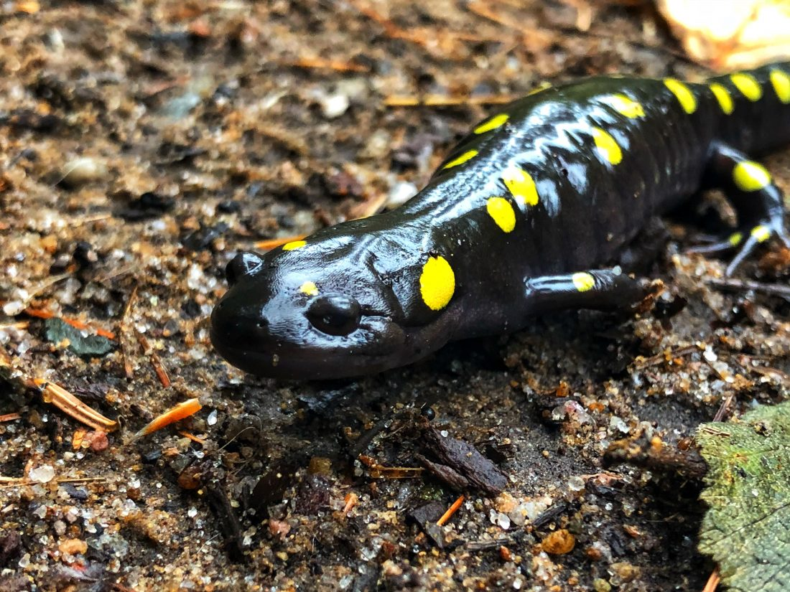
Thank you!
Source: https://www.adirondackdailyenterprise.com/news/local-news/2019/04/naturalist-leading-event-to-protect-yellow-spotted-salamander-migration/
Notes:
Thank you so much for listening to my proposal. I hope you enjoyed the presentation as much as this picture of a spotted salamander. I hope you see the value in a project like this going forward, and I will now take questions.

Slide 27
References
“310 CMR 10.00: Wetlands Protection.” Department of Environmental Protection, 24 October 2014, https://www.mass.gov/doc/310-cmr-1000-the-wetlands-protection-act/download.
Burne, Matthew R., “Massachusetts Aerial Photo Survey of Potential Vernal Pools.” Natural Heritage& Endangered Species Program, 2001.
Burne, Matthew R., “Vernal Pools: Regulatory Protection in Massachusetts.” Vernal Pool Association, https://6289ec42-117d-420b-8d6d-9372b556ab1a.filesusr.com/ugd/f08fdb_57b7f051dfae41628846184fb66dc1b8.pdf.
Calhoun, Aram J.K., and Michael W Klemens, “Best Development Practices: Conserving Pool-Breeding Amphibians in Residential and Commercial Developments in the Northeastern United States.” MCA Technical paper Series, vol. 5, 2002.
Calhoun, Aram J.K., and Phillip deMaynadier, “Forestry Habitat Management Guidelines for Vernal Pool Wildlife.” MCA Technical Paper, vol. 6, 2004.
“Guidelines for the Certification of Vernal Pool Habitat, March 2009.” Division of Fisheries & Wildlife, October 2020, https://www.mass.gov/doc/guidelines-for-the-certification-of-vernal-pool-habitat/download.
King, Jamie L., “Loss of Diversity as a Consequence of Habitat Destruction in California Vernal Pools.” Environmental Science, 1996, Pages 119-123.
“Protecting Vernal Pools: Buffer for Certified Vernal Pools in Jurisdictional Wetlands.” Vernal Pool Association, https://6289ec42-117d-420b-8d6d-9372b556ab1a.filesusr.com/ugd/f08fdb_6e3153ed68874ad4bebfa356a1138e8e.pdf.
Qiusheng, Wu, et al., “An Effective Method for Detecting Potential Woodland Vernal Pools Using High-Resolution LiDAR Data and Aerial Imagery.” Remote Sensing 2014, vol. 6, no. 11, 17 November 2014, Pages 11444-11467.
“Vernal Pools of Massachusetts.” Vernal Pool Association, 2019, https://www.vernalpool.org/vernal-pool-overview.

