Slide 1
Geog 596A: Blueprint for Creating an Open Source Web Map
Michelle Ballinger
Penn State
Masters of Geographic Information Systems
Advisor Frank Hardisty
Winter of 2010
Notes:
Hi my name is Michelle Ballinger. I would, first, like to thank everyone for attending the peer reviews of winter quarter. I am looking forward to hearing everyone else’s capstone ideas and receiving feedback on my idea. Next I would like to thank my advisor Frank for agreeing to work with me and being incredibly flexible this quarter as I worked a ton of overtime. My focus for my capstone project is a Blueprint for Creating Open Source Web Map.

Slide 2
Motivation: ease the adoption of open source web mapping
Notes:
Diving right in,
Make your organization stand out from the crowd with a web map. Open source programs tend not to be the first option that comes to mind to complete such a task in some organizations. To help change that mindset, I am creating a blueprint for the public’s use to create a web map using open source programs.
Part of the motivation to create a web map could be the ease of the adoption of open source programs.

Slide 3
How to do you create a web map?
Open Source
Mash Up
Notes:
How do you create a web map?
When thinking about creating a web map, there are 2 different avenues to consider, I will consider both for this project:
Open Source vs Mash Up
Each has its positives and negatives which we will consider throughout the slides
In the end, open source programs are the better option for many types of web maps. This is also how we will proceed in this project.

Slide 4
Why choose open source programs?
Free
Flexibility
Ability to control the end product
Notes:
The first question that pops into everyone’s head is why open source?
The software can be free which can help cut costs for a non-profit or city government or the like. Speaking from personal experience, the average workstation in my dept costs roughly $35,000 to $40,000 just to build, this includes the hardware and software but does not include the cost to keep the lights on or have an operator actually use the machine. Using an open source program to complete a given task instead of a commercial program in a given workflow can save an organization money. Considering the economy, this is a good idea.
Open Source Programs give you the Flexibility of choosing -
When change happens to the software, everything is well documented. You can adapt to the changes without having issues with your current code. Overall the change tends to occur more slowly. When something does change you will know what it is without having to revamp your work flow completely. Again from personal experience everytime, a new version of ESRI’s ArcMap comes out I must spend time looking for tools that we relay on to complete our workflows. Once I find the tools, I must retest them to ensure they still work in the same way without new issues. Overall I must spend a ton of man hours to revamp our work flows, rewrite documentation, and possibly retraining my team when the tools have changed for each new version.
With respect to open source programs, you can choose were or not to upgrade to new versions. If the currently version works for you then you do not have to upgrade. If the new version has a new feature that sounds interesting, you can upgrade. In general, all commercial programs, I work with do not give you the option of upgrading, you must upgrade to the new version for the program to keep working long term.
When working with open source programs, you do not have to rework your data so it can be used within different programs. All open source programs stay within the guidelines that are agreed upon. Everything has interoperability.
When you create your final web map, you can control how your data is displayed. This can be very important to a given organization. I will explore this topic farther in later slides.

Slide 5
Why not just use a mash up?
Mash up are great for certain situations, but not all.
Everyone has the ability to add to it.
Notes:
So instead of open source program, why not just use a mash up?
Mash ups are great for certain situations, depending what the goal of the project is.
But in general Mash ups can be constricting.
There are 3 types of mash ups: data, consumer, and enterprise. Each type has its own purpose. Data mash ups combine similar types of media and information from multiple sources into a single representation. Consumer mash ups combines different data types. The most common mash up is the consumer mash up which is aimed at the general public. Enterprise or business mash ups tend to combine the business’ resources, application and data with other external web services.
Mash ups are great for situations where you want input from the public and plan to combine that input into the final product. It is a positive for everyone to have the ability to add to it.
If you are trying to put out your information on a given topic, you do not necessarily want the public combining their information with yours. Then in this situation it is a negative for everyone to have the ability to add to it.
Once you put something on the internet as mash up, someone else has the ability to change the data, add their own, or delete it. If you want to put your best foot forward having someone else add negative information to your map, probably is not an ideal situation.
In a case of an organization trying to put out good spatial information about themselves, the better plan would be to create a web map using open source programs where they can control the end product.
Overall Mash ups are great for certain situations, but not all.

Slide 6
Who would want to use this blueprint?
City governments
School districts
Other organizations
Individuals
Notes:
Who would want to use this blueprint?
I designed this blueprint with city governments and non-profits in mind. As previously discussed, open source programs can be free which allows funding to be used for other purposes.
Why City governments? – most cities have websites which have lots of great information but not always in a format that makes sense. For example, the town I live in has just a pdf of downtown with the buildings numbered and legend naming the individual buildings by number, how much better would it be to have web map that the user can drive around, querying, linking to business’s websites, maybe even have an ortho photo as a background – this gives the user so much more information then just a pdf with numbered buildings.
Why School Districts? – most school districts have websites, wouldn’t it be great if a school district could have a web map of all of the school buildings with links to the schedule of events occurring at a given athletic field or a given building on any given day. This would be a great resource for anyone in the community.
There are countless other organizations who could benefit from having their own web map. They would be able to out great spatial information to the community about themselves.
Individuals could create their own web map of their favorite topic. Maybe you are avid bird watcher who wants to keep track on what trails you have seen a given bird and you want to share this information with the world or you are into mountain biking and you want to plot out based on your GPS unit where you have been biking and give those trails rates and share this information with the world.
The possibilities are endless.
In today’s world, people are sharing more of what they are doing and what they like more than ever. An open source web map is a good way to do that without having other people make comments or change your original idea.

Slide 7
Who is already doing this?
Friends of the Urban Forest and San Francisco's Department of Public Works have joined forces to create an open source web map of the trees in San Francisco
http://www.urbanforestmap.org/
Notes:
Is anyone already doing this?
I did find one example of San Francisco city government and Friends of the Urban Forest a nonprofit teaming up to create a web map that is a mixture between an open source and commercial technology. The project is mapping all of the trees within the city limits of San Francisco to create a base map. Then the public can upload pictures and information of the individual trees in their neighborhoods. The hope is this information would be used to help manage the trees, inventory of the species of trees, manage the health of the overall urban forest, and coordinating different agencies. I recently visited the site – it is set to launch April of 2010. I am really looking forward to see what the web map looks like and to see how residents take to the project. I hope this is a trend. I hope more cities create similar projects.
"City of San Francisco Plots its Urban Forest Using Open Source Mapping Technology; Together with Autodesk and Friends of the Urban Forest, San Francisco launches Web-based Urban Forest Mapping System for official and public use. " PR Newswire
8 March 2007 ABI/INFORM Dateline, ProQuest. Web. 3 Feb. 2010.

Slide 8
Where to get data?
Federal Geographic Data Committee’s Clearinghouse Network (http://gos2.geodata.gov/wps/portal/gos)
Libre Map Project (http://libremap.org/)
Many states have free data
Always can create your own
Notes:
The first step to creating any map is the data. Where can you get data?
Well that depends on what topic are you going to focus on. There are good options to get free data from the internet. This is just a short list of suggestions.
Federal Geographic Data Committee’s Clearinghouse Network (http://gos2.geodata.gov/wps/portal/gos) – this a great place to get all kinds of data like hydro files, boundary files, or base maps like usgs maps
Libre Map Project (http://libremap.org/) – another search engine that searches out free data, you will search by state then by feature type and even by county if you want
Many states have free data avaliable you just have to look for it – based on my MGIS classes, I know for sure that Pennsylvania has free data out on the internet for all to use.
When no other options for getting the needed data exist, there is always the option of create your own, I will be going in more detail on this idea on additional slides.
Depending on your topic, a combination of the above tends to be the best option.

Slide 9
What software to use?
Lots of options
Open Source:
uDig
GeoServer
Open Layers
Notepad++
Quantum GIS
Off the Shelf
- ESRI ArcMap
Notes:
What software to use?
There are lots of options on the internet.
Please note the websites for the open source programs – follow the directions listed on the websites for proper installs, depending your skill level you can either use the beta version or stable version, because of my limited programming experience I always use the stable version
uDig – Desktop GIS Program
GeoServer – Web Map Server
Open Layers – Web Map Client
Notepad++ – Text Editor
Quantum GIS – Desktop GIS Program – please note I do not have any steps involving Quantum GIS but I listed it because if you do not have a current ESRI license or if you do not want to use any off the shelf programs you could use Quantum GIS. It provides a viewer for either vector or raster data sets but the more importantly you can heads up digitize, or import GPS tracks. Lots of documentation and strong community to seek help from with Quantum GIS.
The off the shelf program used in this blueprint is ESRI’s ArcMap

Slide 10
Step by Step
Slides give an overview of how to create your own web map
Notes:
This is the whole point to the capstone projects to create a step by step set of instructions for anyone to sit down and create their own web map. I have already suggested multiple places to get existing data or to create your own. In many cases, the combination of using existing data and creating your own data will be the ideal solution. Also I have already suggested possible open source programs you may wish to use to create your web map. Next I am going to step you through an overview of the process using an example web map.

Slide 11
Example Web Map
The template is a web map that I created for Geog 585 of Jackson County, Missouri of farmers’ markets and breweries
Geared towards “buying local” movement
Notes:
To make the step by step process easier to follow, I will be walking you through the process using a web map that I created for Geog 585 Open Source Web Mapping, the web map I create is a map of Jackson County, Missouri’s of farmers’ markets and breweries
This web map was geared towards “buying local” movement, whether it is locally produced fruits, vegetables, meat or dairy. Environmentally conscious consumers are interested in this movement. Many just lack the basic knowledge of where to get these items if they are not readily available in the local supermarket. Part of the project’s focus is to help these consumers locate a farmers market or brewery near their homes.
Again using a real example to step people through the process of making an open source web map makes it easier to follow. Also it should be noted Geog 585 Open Source Web Mapping is the inspiration for my capstone project.

Slide 12
ESRI ArcMap
Tiger Census Data:
Roads
Cities
Area Water
Created Farmers’ Markets and Breweries
Notes:
Step One: ESRI ArcMap
Returning to the question of where to get data, I downloaded Tiger Census files of Jackson County, Missouri for the roads, cities and area water which was lakes and the Missouri river. I brought all shapefiles into ArcMap to prep the shapefiles for the following steps:
For the example map, I used Tiger Census data of road files but I added an additional field in ArcMap of Type so I symbolize major roads which were the interstate and state highways vs. minor roads which were everything else within the face of the web map. This comes more in play in the next step.
To get the user a reference point, I downloaded Tiger Census data for cities of Jackson County. This was a point feature. A polygon of the city boundaries probably would have worked better but sometimes you have to use the available existing data.
To get an additional reference point, I downloaded Tiger Census data for area water. In Kansas City, the Missouri River is a major landmark so it was important to have on my map face.
For the main feature of the web map, I created the farmers markets and breweries shape by hand. I used my local knowledge and internet searches to get exact addresses for the features.
I used ESRI’s ArcMap because it was available to me. If not, a program like Quantum GIS which also allows you to heads up digitize could be a good replacement program to create farmers’ markets and breweries layer. There are other similar programs that would also meet this requirement. A good starting place for looking for open source gis programs is freegis.org.
Once I have all my information into my shapefiles. I save them in ArcMap and close it down.

Slide 13
uDig
“User-friendly Desktop Internet GIS”
Creates Styled Layer Descriptor
http://udig.refractions.net/
Notes:
Step Two: uDig
Next I want to work with uDig. I brought all of the shapefiles in the program to start working on creating styled layer descriptor – this is a huge time saver especially for someone without a lot of programming experience like me
Styled layer descriptor is an XML format which can control how a web map server renders your map. So you are presetting the color of lines and fills on the polygons, size and type of symbol for points, any feature’s label’s position and font, and rules for all features to be displayed based on feature’s attributes or based on the feature type
Within uDig, I brought in all of my shapefiles into a single project to start working on setting up symbols that make sense. I also use this to set up the font and color for my labels on my highways, city names, names of my farmers markets and breweries. I also set up scale dependency for my minor roads so when the user is zoomed out past a given extent, the user can not see the minor roads. Overall you don’t want the map face to be too crowded.

Slide 14
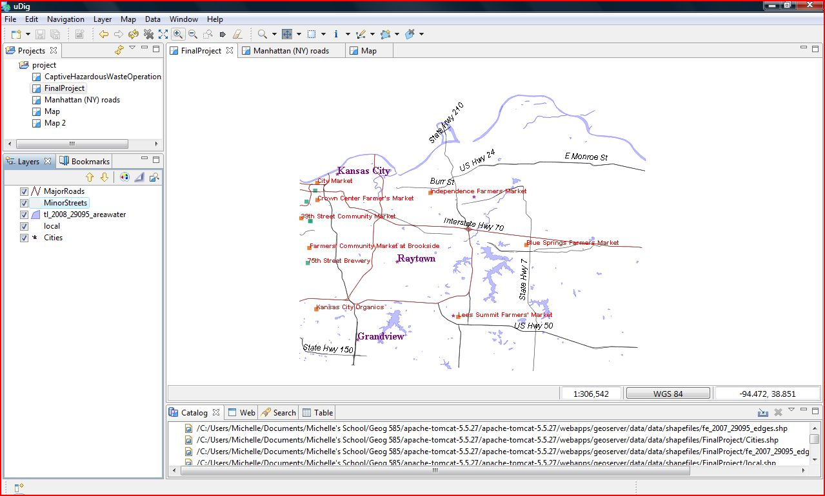
Notes:
This is a screen shot of my data in uDig.
There is where I am making choices of colors, testing what scale the minor roads should show up at, and how the overall map looks as a complete product. This is the point when you are thinking about how the multiple feature layers are working together. For example are the labels covering too much of overall map or does the color of the major roads just blend in too much. For anyone who has ever made hardcopy maps, this is a very important step. Spend as much time working on it as you need to ensure you are happy with it.
Once you are happy with the way the map face looks, you should start exporting the XML(s), one per layer. Go to the XML tab within the style editor, be sure to validate the code, click the export button, save and name as a Styled layer descriptor document for the feature layer.
Please note, for a given web map there will be different problems to think about and to address to create a quality product.

Slide 15
Geoserver
Written in Java
Web Map Server
Web Feature Server
http://geoserver.org
Notes:
Step Three: Geoserver
The next program I will be working with it is Geoserver. The basic information about geoserver is it is an open source software server written in Java that allows users to share and edit geospatial data. Geoserver can create maps in a variety of output formats.
It is also a web map server – provides a picture of a map for display by a web client. The creator will set the style and presentation of the data. The user of the web map server has limited ability to adjust the web map. This is a quick and safe way to display data on a server.
Web Feature Server – provides the map data to a web client.
I moved all of my shape files into Geoserver. Again by using geoserver the creator has control on how to display their data.

Slide 16
Open Layers
Written in Javascript
Web Feature Client
http://openlayers.org/
Notes:
Open Layers is a free mapping library that is integrated into Geoserver which helps the overall process of creating maps to be quick and easy. This is a great resource to look at for ideas on how to display data.
This is also written in Java script
Open Layers is considered a Web Feature Client is it provides a map data to a web client.

Slide 17
Other Options
There are many different web feature servers:
Mapbuilder
Degree
MapServer
Notes:
Like all previous steps, there are many different open source programs that could be use instead of the program I choose to outline. The two I previously discussed are just the ones I have experience with. Here I am just listing some alternate web feature servers. You could use a different one like Mapbuilder, Degree, or MapServer. Feel free to try them all until you find a personal favorite. Again there are many options out there to suit different needs and I just want to make you aware other programs exist.

Slide 18
Notepad++
Is a text editor
Written in C++
How to bring everything together
Creates the HTML
http://notepad-plus.sourceforge.net/uk/site.htm
Notes:
Step Four: Notepad++ - this is how to bring all the parts together
Notepad++ is written in C++
This is where you need to know a little code. This part can be a little tricky but with a little patient and following existing code as a guide, you can create the html for your web map.

Slide 19
How?
Building the final code using Notepad++
Notes:
How?
The oh so scary how. Building the final code in Notpad++, you will be setting up boundary box, refer to each style, call out each layer, the order to load the layers, set up controls, give the ability to query, create legend, create title, etc This is a huge step and probably your most time consuming, especially for someone like me who has little experience with programming.
This is really the guts of the web map. This is where mistakes can be made like having a comma in the wrong location can cause the entire web map not to work. I would suggest using Firefox as your internet browser and using an add on like firebug which can step through your code looking for issues.

Slide 20
What will this produce?
This template is designed as a thin client.
Notes:
Next what will these steps produce?
This template is designed as a thin client. There are a couple reasons to create a thin client like most computers have a web browser installed and most users know how to use a web browsers. You are able to keep people in their comfort zone when the web map behaves how they think it should.

Slide 21
Sample Code
Always can look at other web maps to find a good template for code
http://openlayers.org/dev/examples/
Notes:
Sample Code can be your friend.
You can always look at other web maps to find a good template for code. You can always right click on a web site, view source code to look at the guts of the web site. You will be surprised how quickly you start picking out what different lines of code mean.
There is also Sample Code out on the internet on Open Layers’ website, this is great resource for looking for sample code to perform functions that you would like your web map to perform
I have added some sample code to the following slides. These are some pretty common functions you would probably want for your web map.

Slide 22
Pan/Zoom
All interactive maps need this:
// setup controls and initial zooms map.addControl(new OpenLayers.Control.PanZoomBar()); map.addControl(new OpenLayers.Control.Navigation());
Notes:
Pan/Zoom – quite important to all interactive maps. This will behave just like the user would assume it would. Again it is helpful to be within the user’s comfort zone.

Slide 23
Querying
// support GetFeatureInfo
map.events.register('click', map, function (e) {
document.getElementById('nodelist').innerHTML = "Loading... please wait...";
var url = map.layers[2].getFullRequestString(
{
REQUEST: "GetFeatureInfo",
EXCEPTIONS: "application/vnd.ogc.se_xml",
BBOX: map.getExtent().toBBOX(),
X: e.xy.x,
Y: e.xy.y,
INFO_FORMAT: 'text/html',
QUERY_LAYERS: [map.layers[1].params.LAYERS,map.layers[2].params.LAYERS,map.layers[3].params.LAYERS,map.layers[4].params.LAYERS],
FEATURE_COUNT: 50,
WIDTH: map.size.w,
HEIGHT: map.size.h
},
Notes:
Query is a cool feature to have. This code is written so that once the user requests information from the server the following line pops up “Loading, please wait” – I believe it is important for the web map to acknowledge your request. This also allows the server a second to process your request. It also lists the queryable layers in the map. This code could probably be written a bit cleaner so it doesn’t return extra information that the user does not need or want. I plan to get all of my code to be cleaner before I complete my capstone project.

Slide 24
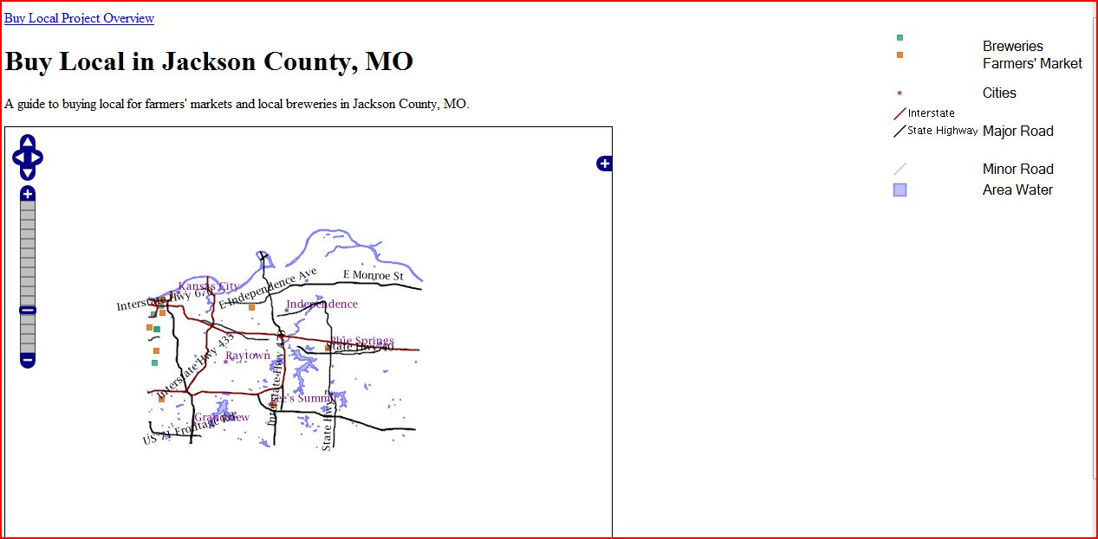
Post to the Web
Notes:
Last Step is the fun part. You are sharing your web map with the world.
We are looking at my example web map from my Geog 585 Open Source Web Mapping class.
Let’s Review the parts of website:
Title with short description of the web map
Pan/Zoom – this something users have seen before and understand how to use
Plus – allows users to turn off and on the layers of the map face
Legend – all maps need a legend to let you know what things are
The most important part of the map, the actual map face – note that all roads are not being shown because of the scale dependencies on the minor roads, note the labels are turned on at this point labeling the highways, the square blocks are the breweries and farmers markets whose labels only turn on when the user is zoomed in to a preset extent, and the area water is always displayed to provided a landmark for the users of the map
Given someone with better programming skills could probably make this a much prettier map but it does get my point across of where different farmers’ markets and breweries are located in Jackson County, Missouri.
Again this is just an example map. A web map can be anything that an user wants or needs to create.

Slide 25
Validation
The quality of the blueprint I am producing will be assured by having it approved by the relevant open source projects
Notes:
Validation: Overall to ensure that I have created a quality blueprint, I plan to post it out to the open source community like uDig, Open Layers, and Geoserver to get feedback from people who use the software quite a bit more than I do. The hope is by having them validate this project, I am able to create a great blueprint for creating a web map using open source programs for anyone to use.

Slide 26
Conclusion
Motivation: ease the adoption of open source web mapping
Limited only by your ideas
Lots of way to get to the same end product
Can be customized
Notes:
In conclusion, make your organization stand out from the crowd with a web map. Open source programs tend not to be the first option that comes to mind to complete such a task in some organizations. To help change that mindset, I am creating a blueprint for the public’s use to create a web map using open source programs.
The motivation for doing this can be as simple as the ease of the adoption of open source web mapping and the desire to get your spatial data out to the world.
Open Source web maps can be customized and they are only limited by your ideas. There are lots of options when considering what programs to use but in the end you will get to a great end product.
I offer the idea of using open source programs to create a web map up for consideration.

Slide 27
Questions?
Notes:
I wish to thank everyone for listening to my presentation. I look forward to any and all feedback you have for me to make my idea better. Does anyone have any questions for me?

Slide 28
References
"City of San Francisco Plots its Urban Forest Using Open Source Mapping Technology; Together with Autodesk and Friends of the Urban Forest, San Francisco launches Web-based Urban Forest Mapping System for official and public use. " PR Newswire
8 March 2007 ABI/INFORM Dateline, ProQuest. Web. 3 Feb. 2010.
Mitchell, Tyler. Web Mapping Illustrated. Sebastopol: O'Reilly Media, Inc., 2005.
Sherman, Gary E.. Desktop GIS Mapping the Planet with Open Source Tools. Raleigh: The Pragmatic Bookshelf, 2008.
Turton, Ian. Open Web Mapping. Penn State, World Campus. Winter 2009

