Slide 1
Capstone Proposal: Development of a Crowd Flow Model Coupled with Concentration Fields for Consequence Assessments
John Bambrick
Advisor: Frank Hardisty

Slide 2
Outline
What is Consequence Assessments
Models for Coupling
Proposed Model Development
Case Study
Journal Article
Notes:
In the presentation I’ll describe what CA is
Give a background of the Models to be coupled
Propose development of the coupled model
Describe a Case Study
and Journal Article

Slide 3
What is consequence Assessments (CA)?
Notes:
I’ll start with a brief overview of what the discipline of consequence assessments is.

Slide 4
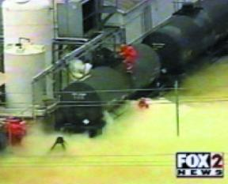
Analysis of Risk/Threat from Hazardous Atmospheric Releases
2002 Accidental Release of Chlorine Gas from a Railcar in Festus, MO.
http://www.aristatek.com/Newsletter/OCT07/OCT07ts.aspx
Notes:
Consequence Assessments is a multidiscipline study for analyzing the hazard and risk posed by releases of chemical, biological, and radiological hazards into the atmosphere
Models/Predicts dispersion of a hazardous cloud and effects upon a recipient population
Used by civil and military planners and emergency responders
Of interest for risk management, emergency planning, emergency response, homeland security, and force protection

Slide 5
Models for coupling
Notes:
Next I’ll introduce the models that will be coupled and illustrate an issue with CA this coupling will addressed

Slide 6
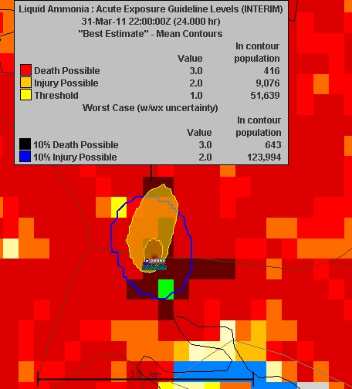
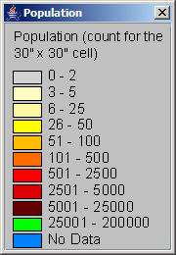
CA Models
HPAC
EpiSimS
ALOHA
CATS
QUIC
VLSTrack
HPAC
Is commonly used by civil government and military
Couples hazard plume with static population dataset for casualty estimate
Has potential for over prediction of casualties
Notes:
There are currently a number of modeling programs that perform CA in one manor or another
The Hazard Prediction Assessment Capability (HPAC), sponsored by DTRA, is available to US civil and military organizations is a widely used CA modeling program
HPAC applies concentration fields over a population dataset to predict casualties
The population dataset is static, thus predicts that the population stays in place as the hazard cloud passes over. There is no adjustment for the population evacuating or taking shelter.
The image on the right shows casualty estimates 24 hours after a release of material. But how much of that population will remain in the area for 24 hours?
By not accounting for evacuation the model can over predict casualties for long duration exposures.
To more accurately predict casualty levels a crowd flow model should be applied.

Slide 7
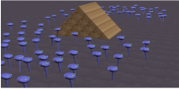
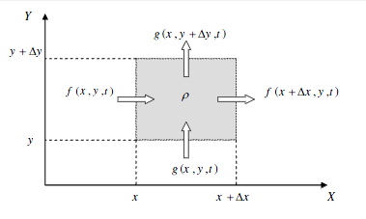
Crowd Flow Models (2 Categories)
Microscopic
Macroscopic
Simulates individuals
Discrete position
Computationally “heavy”
Applied within EpiSimS
Models density flow
1D and 2D cellular
Computationally “light”
Applied within ???
Simulated Individuals Moving Around an Obstacle
http://www.cs.virginia.edu/~gfx/pubs/group_behaviors_2/jar_herd.pdf
Cellar Flow of Density
http://scholar.lib.vt.edu/theses/available/etd-12152006-143454/unrestricted/NewCM.pdf
Notes:
Microscopic flow model
Models each individual reaction within a simulated environment
This may sound ideal but it is extremely complex and Computationally heavy
Used in EpiSim for biological CA
Macroscopic flow model
Models density flow instead of individuals
Many are 1D or 2D cellular based
Computationally light compared to microscopic
Key components are density and flow rates
Used with ?? for CA

Slide 8
Proposed Model Development
Notes:
Now that I’ve identified a need here what how I propose to do about it

Slide 9
Proposal
Develop a prototype macroscopic crowd flow model coupled with CA outputs to predict casualty estimates
Develop a 2D pedestrian flow model
Develop for specific scenario
Build in ArcGIS 9.3 with VBA
Couple HPAC outputs with 2D flow model
Document in journal submission
Notes:
This proposal if for the development of a prototype model for the coupling of a CA model concentration fields with a macroscopic crowd flow model to predict risk to a dynamically shifting population.
The purpose of my efforts will be to demonstrate the potential of this coupling and promote its use
The model will be develop at the proof of concept level and will not undergo Verification & Validation
Such models could be developed for a range of applications at various scales. This one will be for 2D pedestrian flow at a scale of a few city blocks.
Some aspects of flow will be specific to certain scenario types. The prototype model will be developed for a specific scenario
Modeling will be performed with ArcGIS 9.3 and coded in VBA
HPAC will be the source for concentration field while a 2D pedestrian flow model will be developed
Concepts of the model, development approach, and demonstration of use in a hypothetical case study will be documented and submitted for publication in a journal of risk management or homeland security

Slide 10
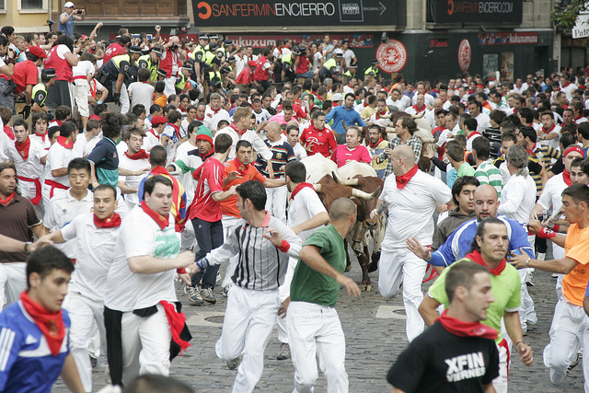
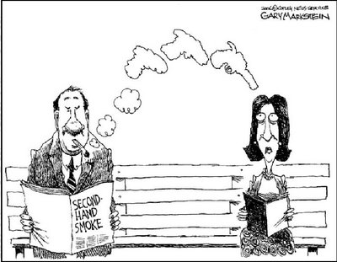
Concepts Behind Model
http://www.timtim.com/drawing/view/drawing_id/398
Running with the Bulls http://www.flickr.com/photos/mcmahon/4788415049/
http://www.theipinionsjournal.com/index.php/2006/07/its-official-second-hand-smoke-kills/
Notes:
People will flee from a recognized hazard
The level of feared danger or discomfort will correspond to the urgency of the individual’s plight
Individual’s rates are retarded by factors of flow resistance (such as congestion or obstacles)
Individual’s movement will be primarily driven to get away from the hazard and secondarily to best navigate through the environment.
In a crowd the environment is changing as others move simultaneously.
Unprotected individuals in the presence of a hazardous cloud will receive a dosage from the hazard.

Slide 11
Key Components
Concentration Fields
From HPAC
Environment
Crowd
Obstacles
Terrain
Egresses
Crowd Flow Model
Notes:
A series of concentration fields from an CA model for the entire temporal range of the model.
Elements of the environment
A crowd flow model.

Slide 12
Key Functions
Dosage calculation
Dosage = ∑ Concentration × Time Step
Crowd flow model
Primary flow driver
Recognize hazard
Determine directional flow based on hazard
Unique for differing hazard types
Secondary flow drivers
Model crowd density
Find path of least resistance
Find egress for escape from hazardous environment
Selection between primary and secondary flow factors
Notes:
Dosage calculation
Components of the Crowd flow model
Primary flow components in response to the hazard
Secondary flow components in response to the environment
Selection between primary and secondary flow directions or a product of the two

Slide 13
Quasi-Macroscopic
True Macroscopic
Quasi-Macroscopic
T₁
T₂
T₁
T₂
ρ=5
ρ=9
ρ=5
ρ=3
ρ=5
ρ=6
ρ=2
ρ=7
ρ=4
ρ=4
ρ=6
ρ=4
ρ=3
ρ=2
ρ=3
ρ=3
ρ=2
ρ=2
Moved out
Moved in
Stayed in
Concentrations
Model density flow
Know density but not who went where
No way to know who got what exposure
Model “individual” in flow
Track who went where
Track exposure of each “individual”
Notes:
In regards to the flow model…
For casualty estimates the model needs to account for dosage received by individuals but a macroscopic flow model pose a problem
A macroscopic model provides density shifting over time. As shown on the left, people are just components of a group totaling to some rho and history of dosage intake is lost as there is no real way to track who went where and received what amount.
Resolution is to make the model “quasi-”macroscopic by tracking individuals flowing in the model environment. This way the dosage history can be tracked.
Individuals? So why is it not microscopic? The simulation will be simple as all individuals’ “flow” would be determined based upon macroscopic flow principles

Slide 14
Primary vs. Secondary Flow Direction
Hazard
T₁
Fast
Primary
Flow Rate
Slow
Split Primary and Secondary
Primary Only
Secondary Only
Secondary
Secondary
T₂
Primary
Primary
Notes:
Primary and Secondary flow direction are another proposed break from macroscopic flow model provides an average mass movement through cells
Secondary flow direction offers options for individuals to “choose” alternative routes for ease of flow
Primary and secondary options will be weighted and then selected randomly for each individual at each time step
Example is shown on the slide: A cell has 10 people with the cell ahead in the primary direction also having 7 people, as shown on top.
The number of people causes congestion within the cell and slows each person’s potential travel rate.
An adjacent cell is empty and would allow for faster rates
If all 10 move to the empty cell the problem would persist
By weighting the options based on conditions it may be determined that a 6/4 split would provide a better flow
For each person a random number is generated with a 60% probability to take the secondary route, else remain in primary route

Slide 15
Data
Population shapefile
Point geometry
Attributes
Characteristics
Status
Variables
Concentration fields & aspect
Source: HPAC
Point geometry interpolated to raster
Environmental rasters
Density & aspect, slope
Distance from obstacles & aspect of slope
Terrain
Notes:
Back to the model…
Population data stored in a shapefile with point geometry for each person’s location
Attributes: characteristics (max speed - randomized on initialization), status (location, dosage), calculation variables (concentration, density, etc.)
Concentration fields
Environment rasters for like density, terrain and distance from obstacles and derivative rasters for calculations
Creating and storing data within the population shapefile will likely slow the process. Internal data storage would likely increase process speed but the files are desired for diagnostics of the model.

Slide 16
Data Flow
User:
Study Area Definitions
Input
Output
Crowd Flow Model
Population Data
Environment
Location, t_{n-1}, t_{n}
Integrated Exposure
Population Density
People Rate
Flow Direction
Secondary Flow:
Path of Least Resistance
Primary Flow:
Hazard Induced Flow Direction
Urgency:
Hazard Induced
HPAC
Concentration Field / Flow Driver
Notes:
Data in the model flows in an iterative process for each time step time step
Population responds to primary flow driver with a direction and level of urgency (for case study the concentration field – more later)
Population density and other environmental properties create levels of resistance. A secondary flow vector is created for finding paths of least resistance.
The urgency level, subject to resistance levels, determines flow rate
Vector of flow direction and flow rate are applied to original location to calculate new location
The product of concentration value at location and time step gives a time step intake
Integration of time step intakes for the duration of the run produces final dosage

Slide 17
Variable Sources for Primary and Secondary Flow (Conceptual)
Primary direction
Aspect (downward direction) of concentration
Secondary direction
Aspect of density (weighted by slope)
Perpendicular to aspect of the slope of distance to the obstacle (weighted by inverse of distance)
Rate
Urgency
Function of concentration above detectable levels but limited to individual’s max speed
Resistance
Function of density
Friction factor classified by terrain
Notes:
Current variables and processes are at this point conceptual and may be modified as a result of further research of crowd flow models and geoprocess
Primary flow direction will be determined from the downward direction of the aspect of the concentration field
For components of the secondary flow direction:
Downward direction of the aspect of density. This will be weighted by the slope for direction selection
For obstacle avoidance, perpendicular to the aspect of the slope of the distance raster. This will be weighted by the inverse of the distance.
Rate is a function of the urgency and resistance from congestion and terrain
Values fill be extracted from rasters for variables in flow calculations

Slide 18
Time Step Sequence
T_{n-1}
T_{n}
Slope
Slope
Flow Direction Calculation
Flow
Vector
Pop
X,Y
t_{n-1}
Kernel Density
Population Density
Aspect
Aspect
Rate Calculation
Pop
X,Y
t_{n}
Time
Step
Intake
Output
t_{n-1}
IDW
Conc.
Field
Aspect
Aspect
<<dependant on>>
HPAC
Output t_{n}
IDW
Conc.
Field
Constants
Obstacles
Distance
Distance
Aspect
Aspect
Point Data
Raster
Reclassify
Friction
Factor
Geoprocess
Terrain
Extract from Raster at Point
Internal Calculation
Notes:
To process flow in each time step data created from the previous time step will be used
Time T_{n} begins with the locations of people at T_{n-1} reacting to the concentration field at T_{n-1}.
Spatial data is created for the values required to calculate the flow vectors which are applied to locations from T_{n-1} to calculate locations for T_{n}.
New concentration fields are created for T_{n} from which values are extracted at locations of T_{n} for Time Step Intake total
Spatial constants used in the time steps will be generated prior to the time step iteration process

Slide 19
Development Priorities
Calculation of individual’s intakes from concentration fields at T_{n} location (Required)
Create individual’s primary flow vector at T_{n} and new location (Required)
Create secondary flow direction based on density and selection algorithm (Required)
Create secondary flow direction based on obstacle avoidance and selection algorithm (Optional - probable)
Apply terrain based friction factors to flow rate (Optional – possible)
Create secondary flow direction toward egresses and selection algorithm (Optional - doubtful)
Notes:
Not every potential component of such models is necessary for this proof of concept effort
Required components will be the individual dosage calculations, the primary flow elements and secondary flow influence of density
Optional development (in order of probability for development) will be the obstacle avoidance components, terrain based friction factors, and an escape function

Slide 20
Case Study
Notes:
A fictional case study will be performed to demonstrate the model’s capabilities

Slide 21
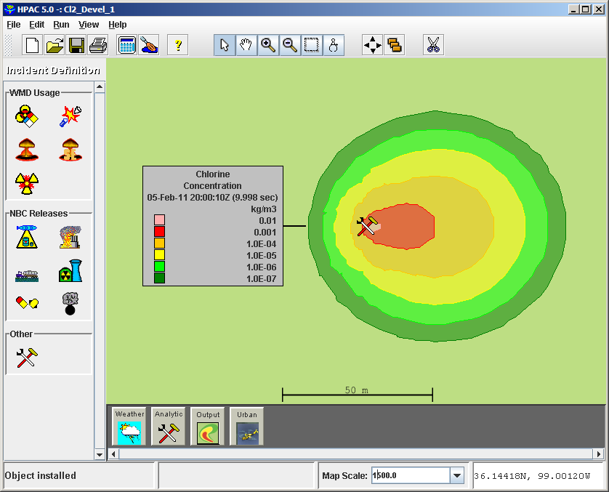
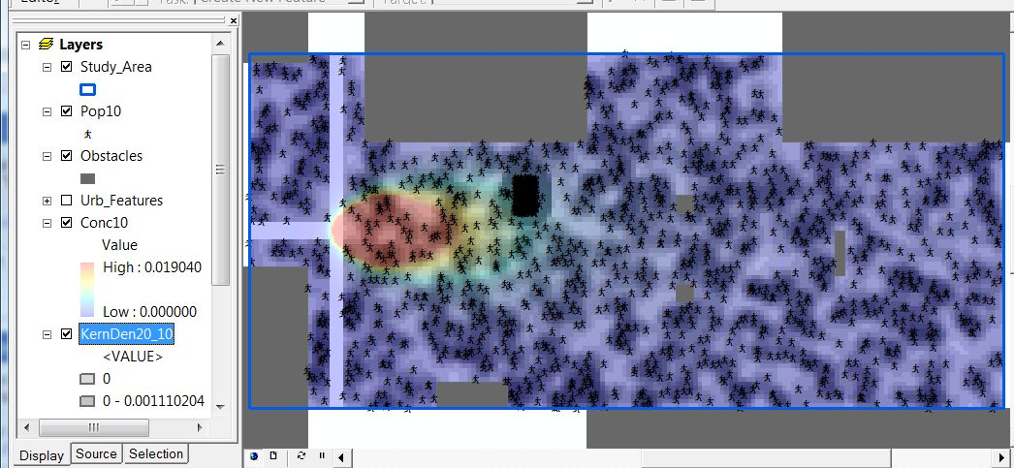
Case Study
Accident results in Cl₂ released near pedestrian mall
Cl₂
Visible and odorous
Irritation and harmful effects
Cl₂ acts as primary flow driver (crowd responds)
Flow from high to low concentrations
Urgency determined by concentration level
Notes:
An auto accident causes pressurized 50 lbs. gas cylinders, filled with chlorine, to fall from a truck with several tanks rupturing.
Winds blow the releasing gas towards a pedestrian mall
Chlorine gas has a greenish yellow hue, distinct odor, and may cause irritation or harmful effects. Thus individuals will respond to the developing cloud
The chlorine concentration field will act as the primary flow driver
Flow will be from high concentration to low concentration (aspect of concentration field)
Urgency will be a function of concentration level (higher concentrations correlates to greater urgency)

Slide 22
Expected Results
Dosage developing over time
Casualty estimates provided
Results comparatively different from a static population
Each run of model unique
Exploration of scale adaptability
Notes:
For each time step the model will produce a shapefile containing each individual’s accumulative dosage, with the last shapefile containing final results.
These dosage values may be used to summarize totals of individuals at risk of harmful effect, including death, base on various threshold levels
The results will differ to some degree from the intake by a static population data set (which will be created on the side for said purpose)
Due to randomized elements in the model each simulation should produce unique results. This will lend to Monte Carlo simulations of the model
Explore Adaptability: How will the model compare if number of people points are cut to 10% but each point represents 10 people

Slide 23
Journal Article
Notes:
The final product of this effort will be an article submitted for publication in a journal of risk management or homeland security

Slide 24
Article Submission
Purpose: To propose and promote the use of dynamic population flow models in consequence assessments
Contents
Present concepts of model
Demonstrate the working conceptual model
Suggest uses
Identify areas for future development
Candidate journals
Risk Management
Journal of Homeland Security
Journal of Homeland Security and Emergency Management
Notes:
The purpose of the article will be to propose and promote the concept of utilizing population flow models for improved CA estimates
Concepts of the model, development approach, and demonstration of use in the hypothetical case study will be documented in the article
Also included will be
Demonstrations of various components, like obstacle avoidance at work
Discussion of possible uses
Identification areas where future developments are required
Potential journals for submittal
Risk Management
Journal of Homeland Security
Journal of Homeland Security and Emergency Management

Slide 25
Questions?

