Slide 1
Swiss
Women’s
Suffrage
A study of how women’s suffrage spread throughout Swiss cantons over 30 years
By Danielle Barlow | Adviser Dr. Justine Blanford

Slide 2
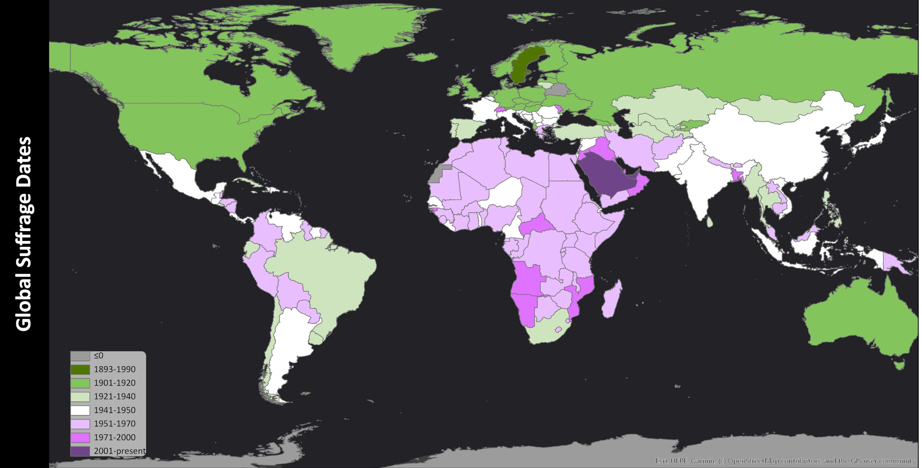
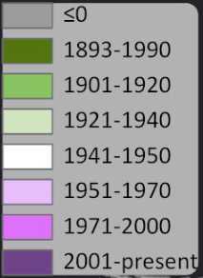
Background: Women’s Suffrage
Women’s suffrage is a movement that , for some countries, still carries on today; however, for many regions of the world, the 20th century was the era that launched the movement into the spotlight, revolutionizing a woman’s “place” in society.

Slide 3
Background: Women’s Suffrage
Cultural changes that led to women’s suffrage were often spurred on by a myriad of interconnected situations Most commonly, it wasr wars in which women were given the opportunity to demonstrate their independence and ability.

Slide 4
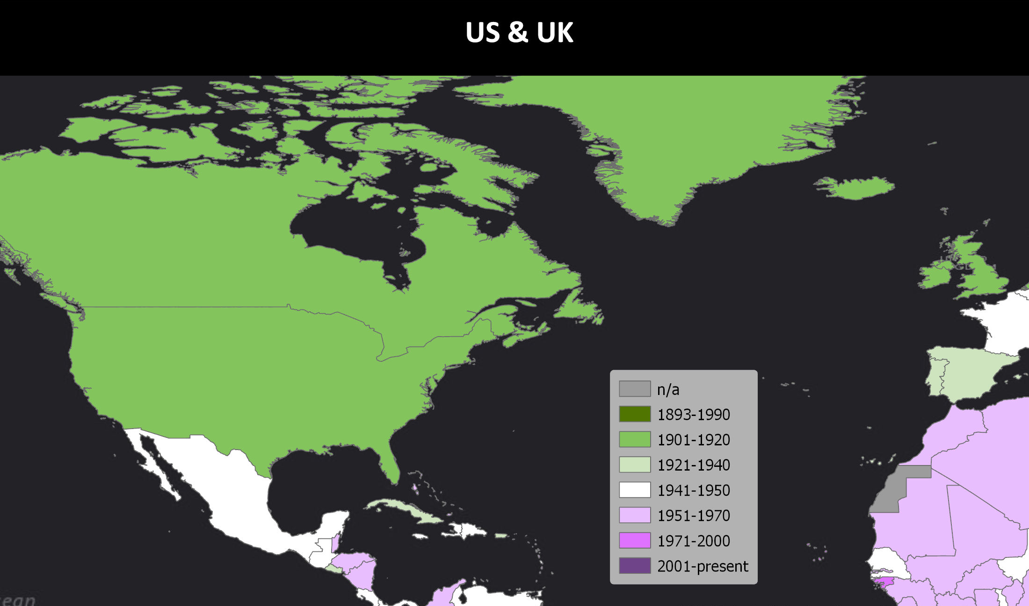
In the UK (1918) & US (1920) → WWI

Slide 5
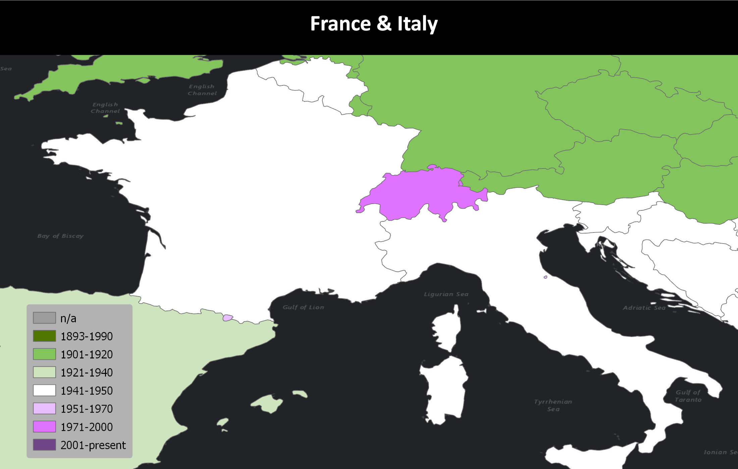
France (1944) & Italy (1945) → WWII

Slide 6
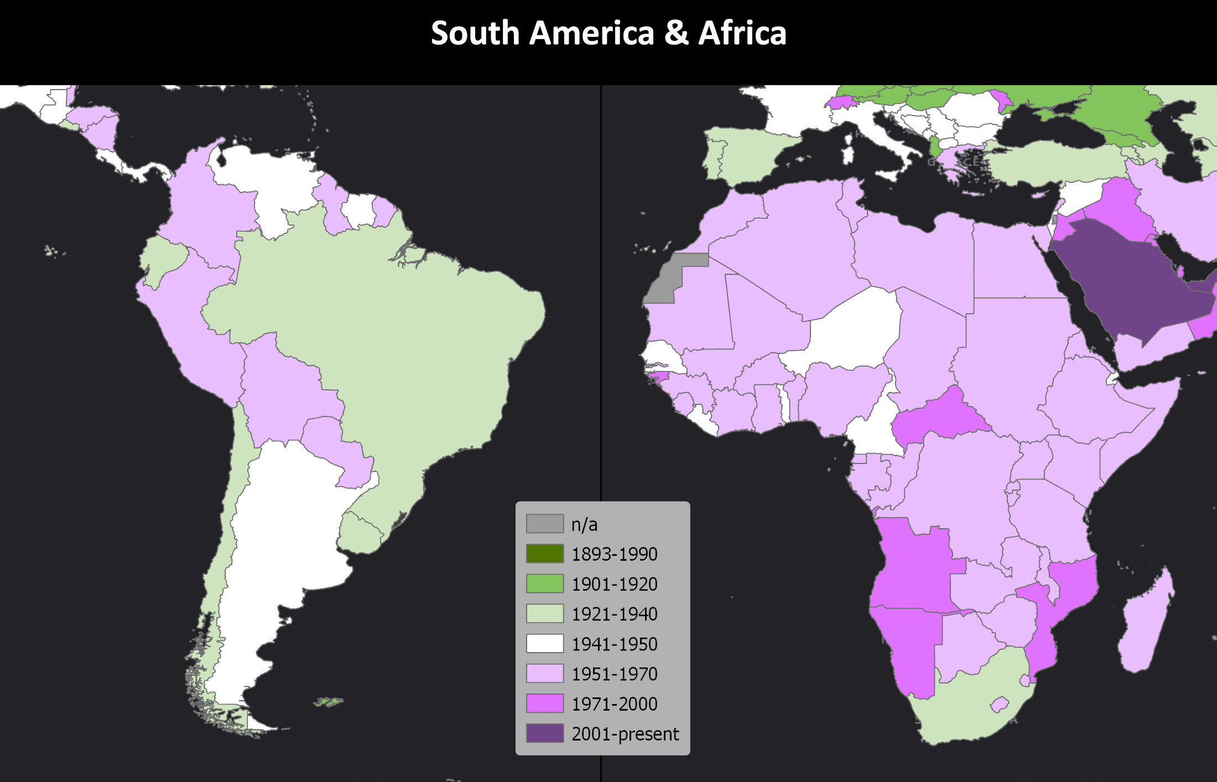
Many African & South American countries → their independence from European colonists

Slide 7
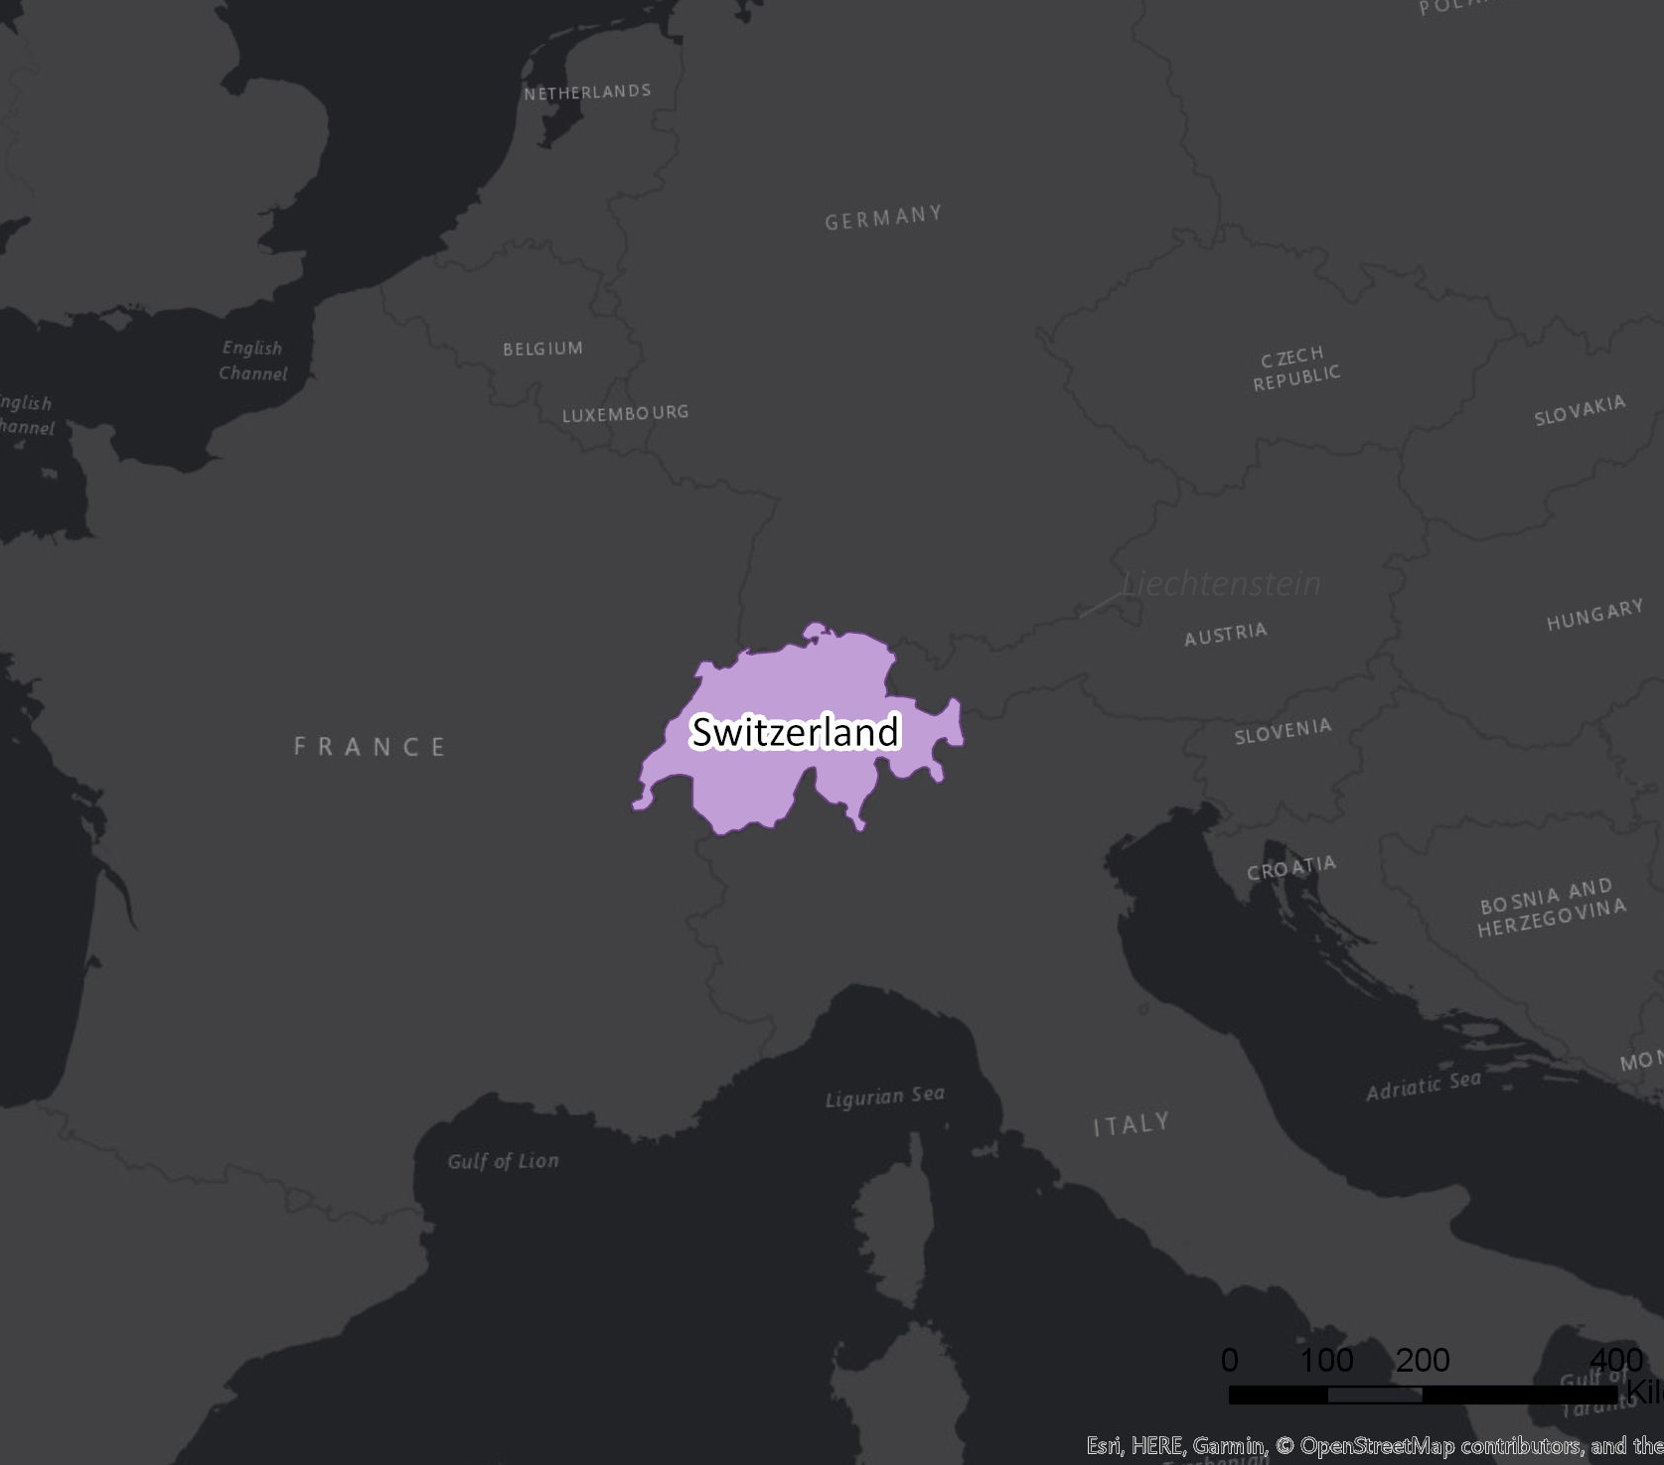
Background: Swiss Women’s Suffrage
Switzerland, as a notoriously peaceful country that remained neutral during the first world war and participated only minorly in the second, was much less impacted than the rest of Europe by these events. Switzerland did not have the same call to action from women refusing to return quietly to their pre-war existence.

Slide 8
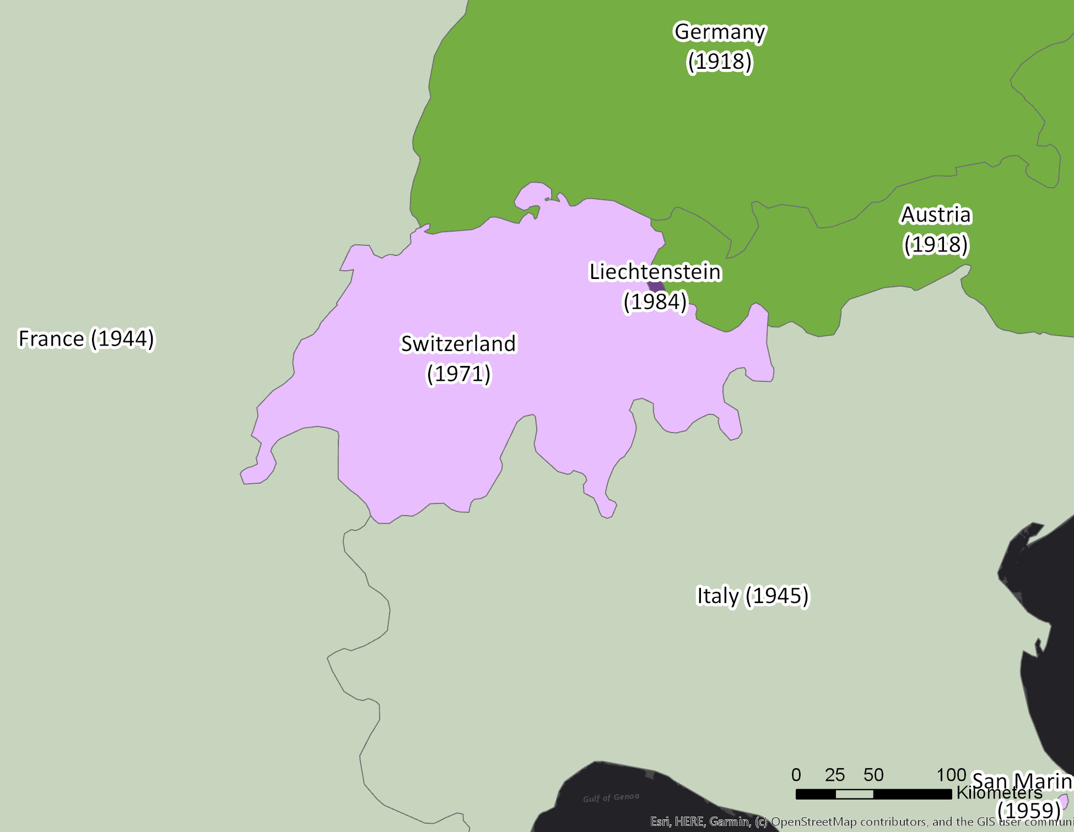
Background: Swiss Women’s Suffrage
Without the standard triggers that propelled the rest of Europe towards women’s suffrage, Switzerland’s path was influenced by its unique history.

Slide 9
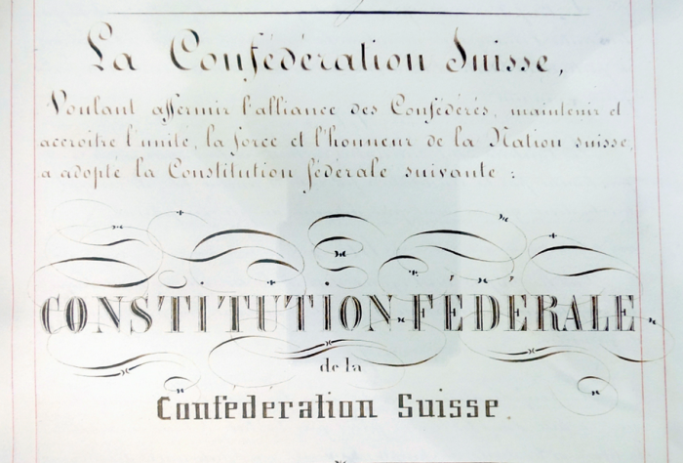
Democratic Legacy
First to declare universal suffrage for men
Semi-direct democracy
Notes:
https://forum-helveticum.ch/en/2016/12/die-schweizerische-verfassung-und-die-sprachen/

Slide 10
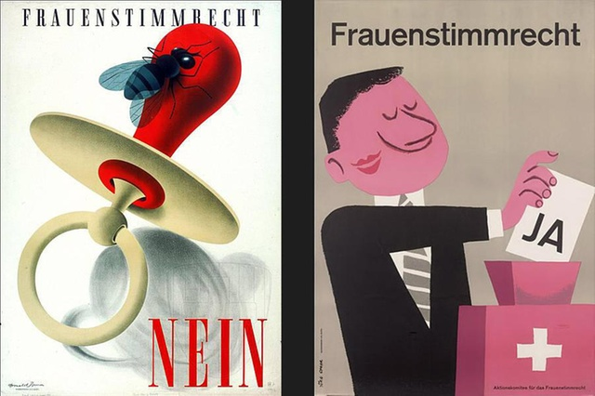
Approach to female enfranchisement
Swiss women’s approach to suffrage
Disjointed narrative
Notes:
https://www.swissinfo.ch/eng/inequality_the-march-for-women-s-suffrage-in-switzerland/44793282

Slide 11
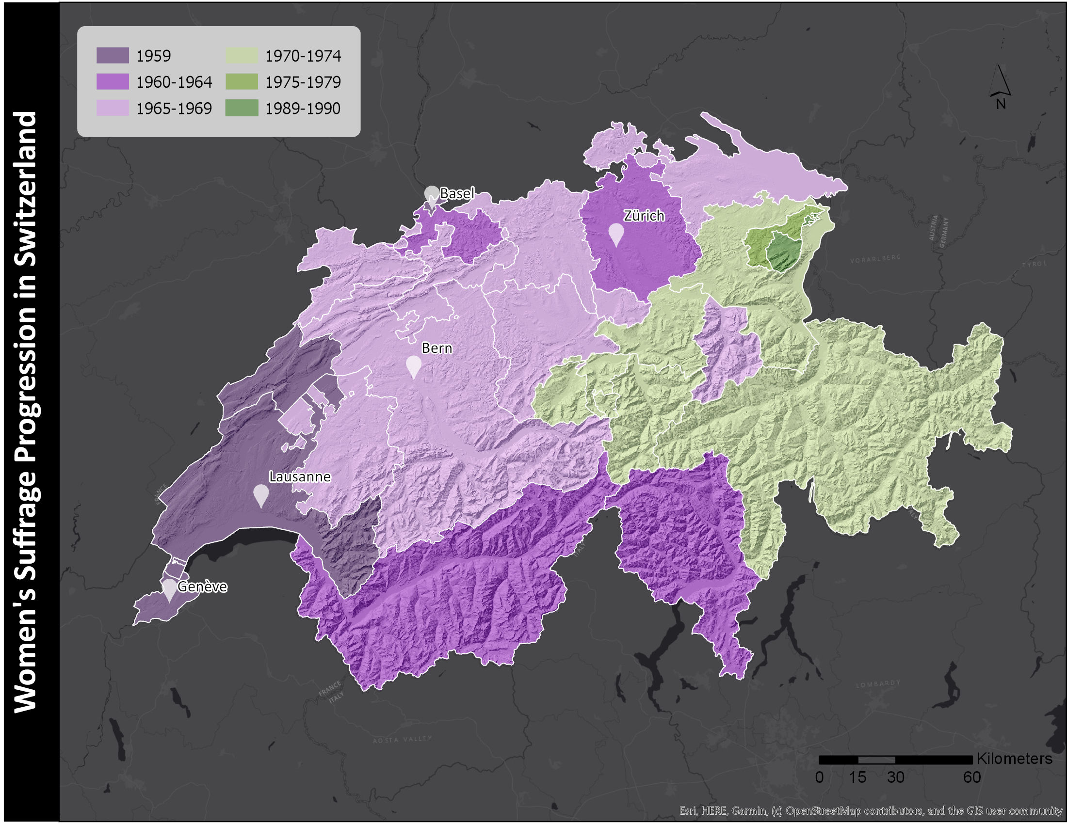
Preliminary Analysis: Cantonal Women’s Suffrage
The progression of female enfranchisement through the country on a cantonal level is a less-explained phenomena. While national suffrage was granted in 1971, some cantons remained without women’s suffrage on a regional level for decades more, creating the bizarre circumstance of some women being able to vote on national matters, but not cantonal ones.

Slide 12
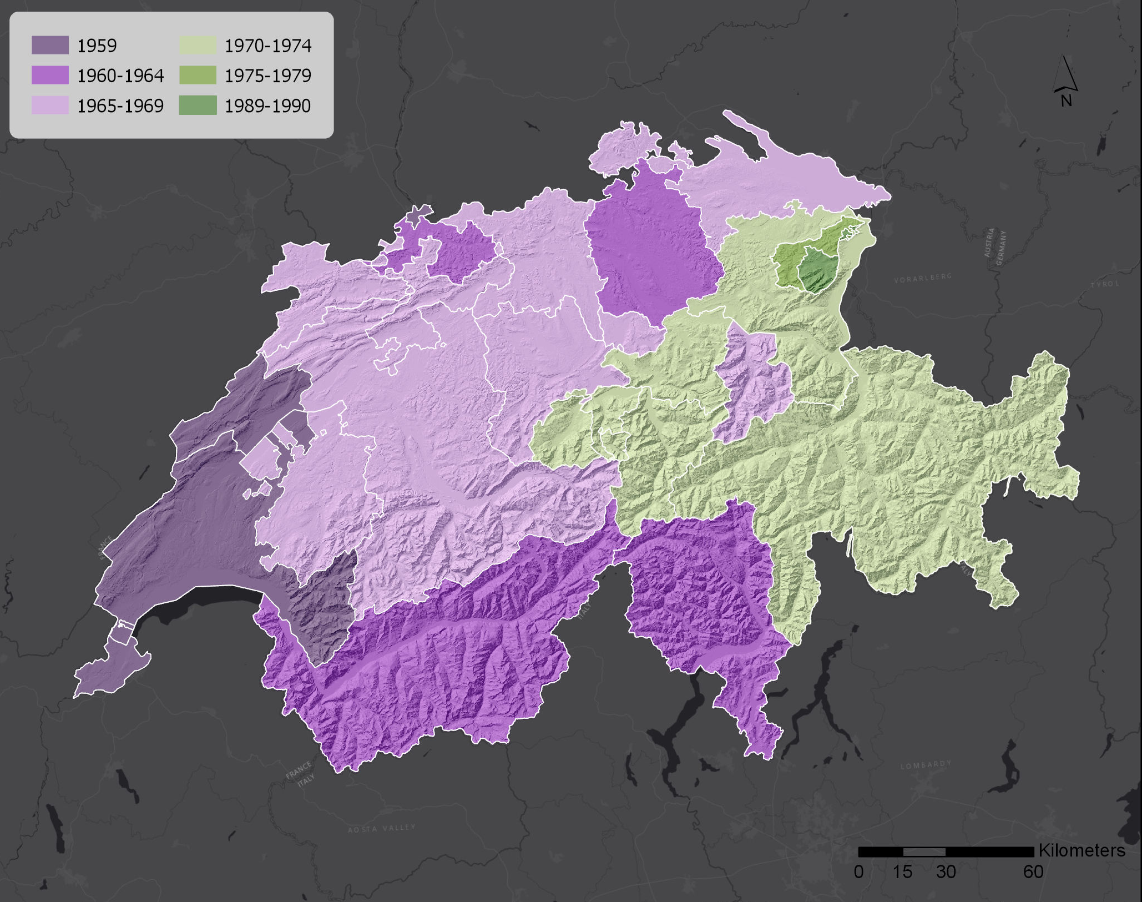
Additionally, this is progression is interesting as the path of women’s suffrage throughout the cantons does not reflect the relative suffrage dates of bordering countries.

Slide 13
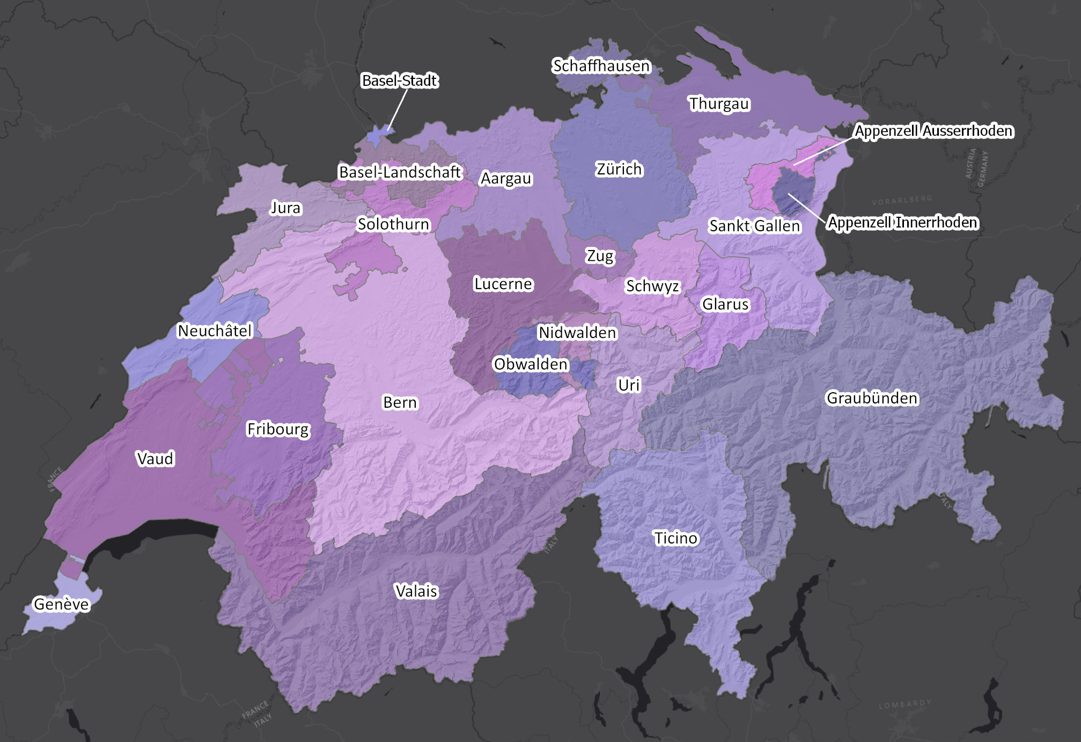
Objective
This study will look at the spread of women’s suffrage throughout Switzerland and examine elements that may have played a role in its progression. These elements include the population, the average income in the canton, the predominant religion in the canton and any significant geographic barriers (i.e. large mountain ranges or wide swaths of water). Using this data, along with the
suffrage year for each canton, this study will determine if a correlation exists between suffrage years and the identified elements.

Slide 14
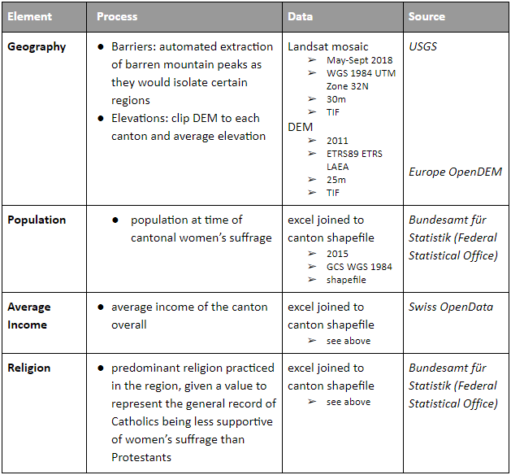
Data
Where possible, the data used in this analysis is sourced directly from Swiss governmental sources.
Data still expected: female population & dominant canton political party

Slide 15
Cantonal Analysis: Income
Canton | Avg Income | Canton | Avg Income | Canton | Avg Income
Neuchatel | 1,426 | Bern | 10,934 | Graubanden | 1,871
Vaud | 1,287 | Fribourg | 1,819 | Nidwalden | 316
Geneve | 3,303 | Glarus | 537 | Obwalden | 226
Basel-Stadt | 1,505 | Jura | n/a | Sankt Gallen | 4,111
Basel-Landschaft | 7,644 | Lucerne | 2,952 | Schwyz | 945
Ticino | 1,677 | Schaffhausen | 887 | Uri | 321
Valais | 2,106 | Solothurn | 2,600 | Appenzell Ausserrhoden | 966
Zurich | 16,196 | Thurgau | 2,047 | Appenzell Innerrhoden | 423
Aargau | 5,225 | Zug | 1,140
Average income of a canton can be a reflection of the proportion of women in the workforce. Taking into consideration the gap in pay between genders, a decline in “the median income of voters relative to their mean income” is only to be expected with the inclusion of women entering the workforce and living more independently.
Notes:
(Abrams et al, 1999).

Slide 16
Cantonal Analysis: Religion
The progress made between women’s organizations of differing religions marks an important shift that signaled the beginning of women’s suffrage in the country. In 1957, Catholic women’s organizations joined with Protestant and secular organizations to support the movement. With the first cantons declaring suffrage in 1959, it is possible that religion was as important to individual cantons as it was to the country as a whole.
Canton | Religion | Canton | Religion | Canton | Religion
Neuchatel | Protestant | Bern | Protestant | Graubanden | Neither
Vaud | Protestant | Fribourg | Catholic | Nidwalden | Catholic
Geneve | Neither | Glarus | Neither | Obwalden | Catholic
Basel-Stadt | Neither | Jura | Catholic | Sankt Gallen | Neither
Basel-Landschaft | Protestant | Lucerne | Catholic | Schwyz | Catholic
Ticino | Catholic | Schaffhausen | Protestant | Uri | Catholic
Valais | Catholic | Solothurn | Neither | Appenzell Ausserrhoden | Protestant
Zurich | Protestant | Thurgau | Protestant | Appenzell Innerrhoden | Catholic
Aargau | Neither | Zug | Neither

Slide 17
Cantonal Analysis: Geography
Eastern cantons, in more level, developed areas, declared suffrage long before the mountainous Appenzell region. With cantonal cultural and linguistic histories often being divided by the terrain, how isolated one canton is from its neighbors is an important factor impacting not only the population numbers and rate of development in cantons, but also the movement of ideas between them.

Slide 18
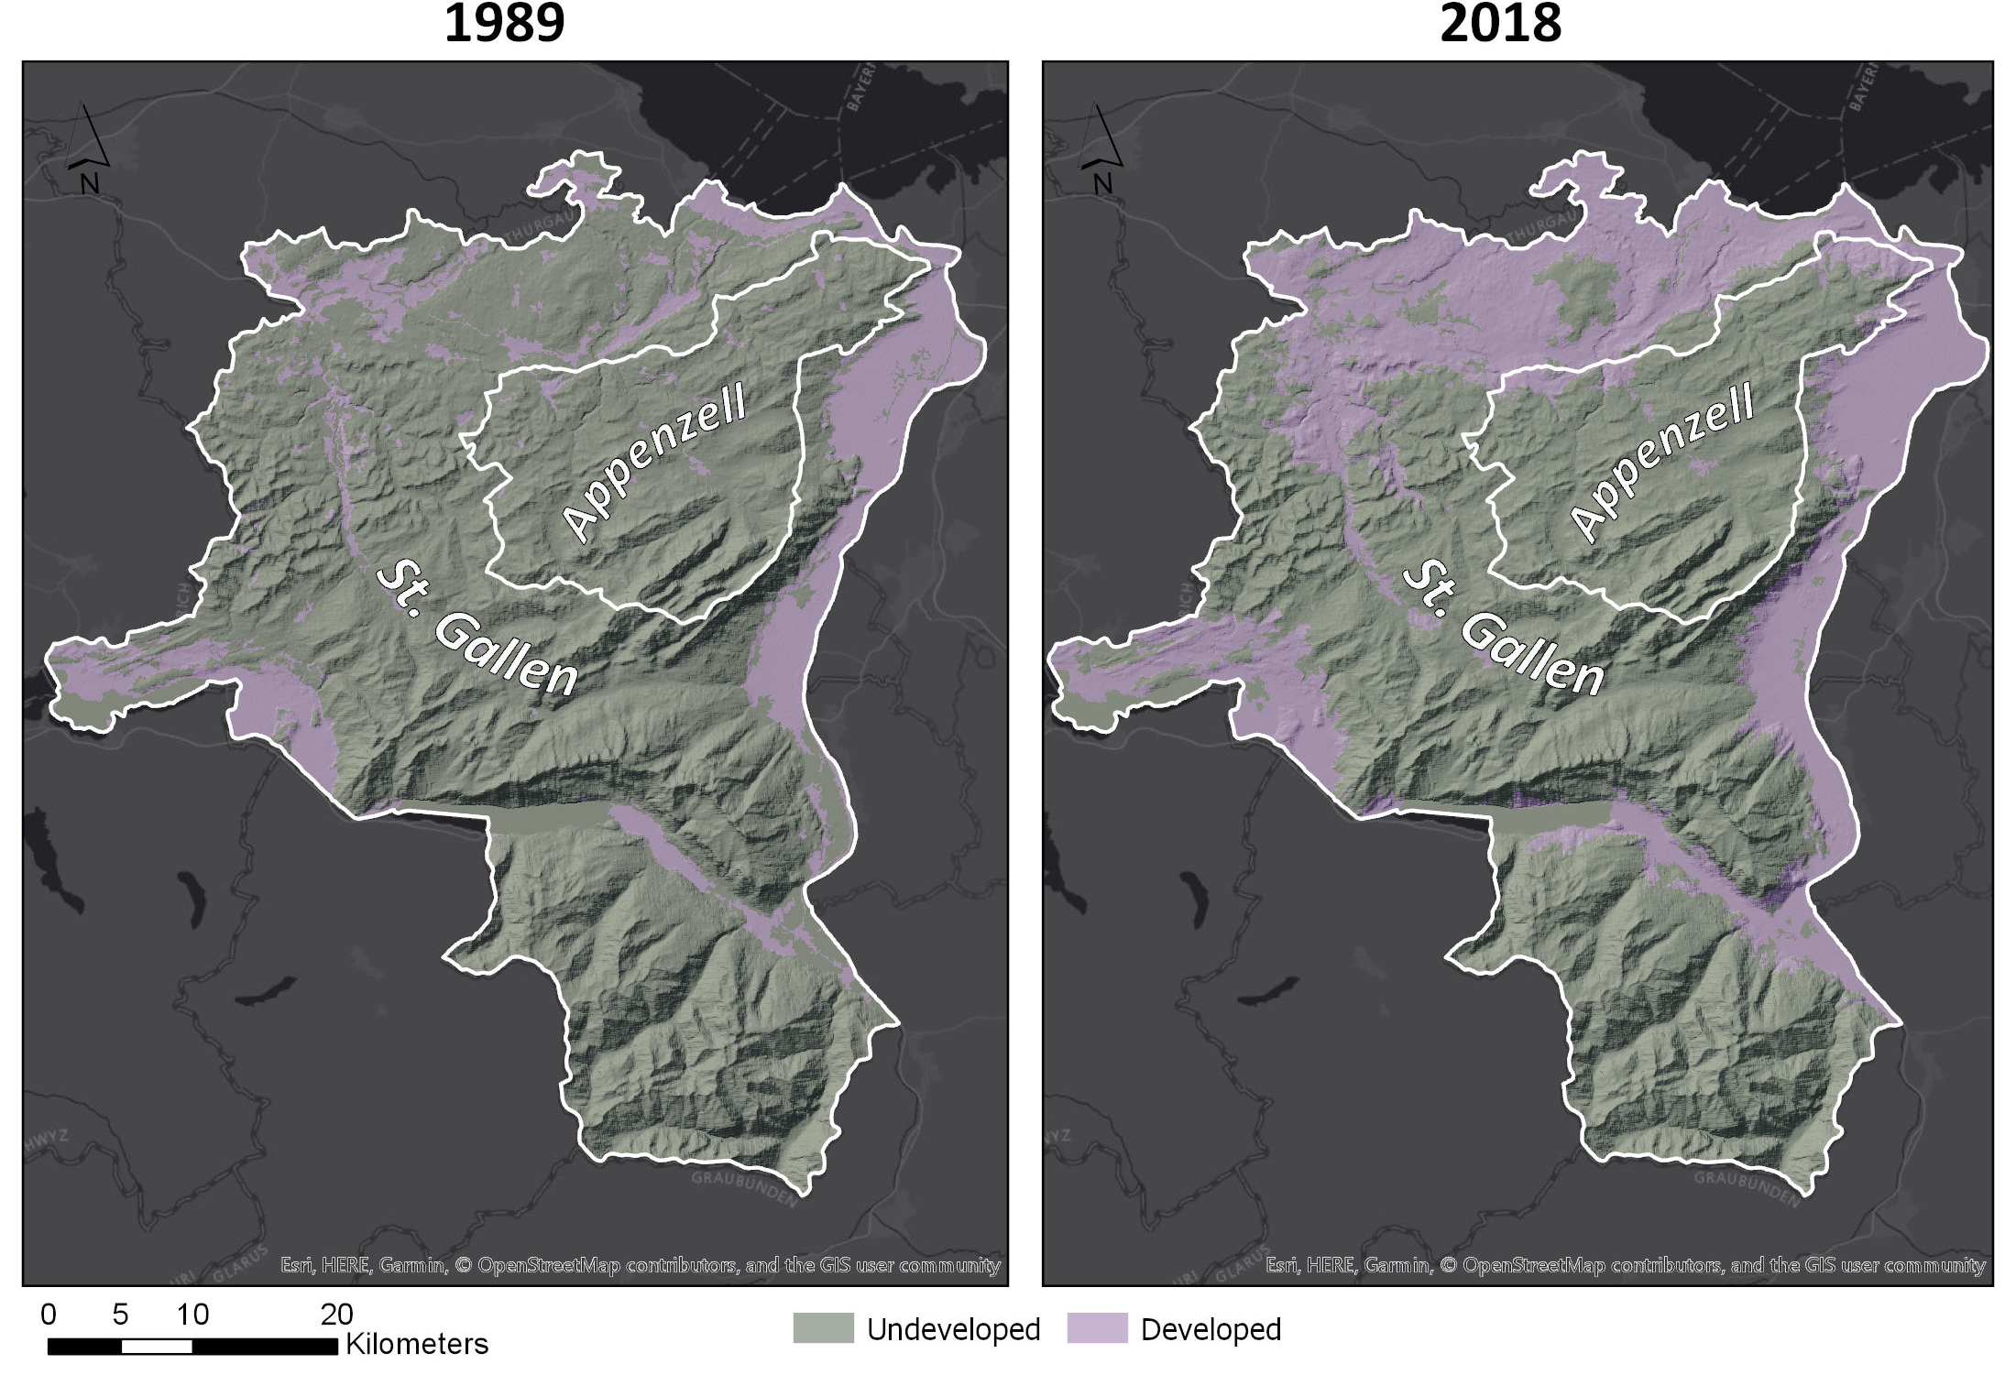
Canton Comparison
A preliminary study of the Appenzell region was undertaken to better identify how geography may impact the spread of ideas such as female enfranchisement. The last cantons to declare regional women’s suffrage, the Appenzell area was compared with the surrounding St. Gallen canton, which declared cantonal women’s suffrage in 1979, to find that the terrain of Switzerland potentially played an important hand in the path of female enfranchisement through the cantons.

Slide 19
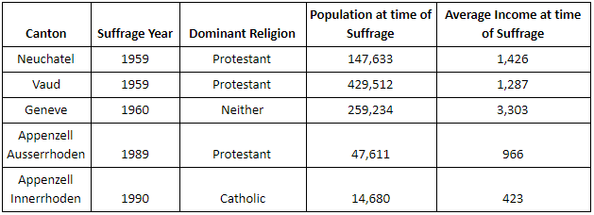
Comparison: Early and Late Women’s Suffrage Cantons
Two notable differences are apparent:
While all the early-adopting cantons are either protestant or religion-neutral, there is also a protestant canton as the penultimate adopter of cantonal women’s suffrage
Rather than a lower income representing more women in the workforce, the income seems to correlate with more populous areas leaning towards women’s suffrage earlier than less populated areas.

Slide 20
Expected Results
It is expected that the progression of female enfranchisement throughout the country will be most closely correlated with the geography and population density of the cantons. The wildcard element in this analysis is the dominant religion of each canton. Literature would indicate that Protestant cantons were more progressive in declaring Women’s suffrage, while Catholic cantons were less accepting of the movement; however, as seen in the table in the previous slide, this correlation may not be as straightforward as expected and does not account for religiously neutral cantons.

Slide 21
References: Data
Imagery
https://earthexplorer.usgs.gov/?
DEM
https://www.opendem.info/opendemeu_download_highres.html
Cantonal Fertility/Household Size
https://www.bfs.admin.ch/bfs/en/home.html
Cantonal Income
https://opendata.swiss/en/dataset/kantonale-volkseinkommen-nach-empfanger-auf-der-berechnungen-der-vgr-gemass-der-traditionellen-
Cantonal Language/Religion
TBD
Cantonal Suffrage Dates
Petrello Etter, M. (21 Oct 2012). Women’s Suffrage in Switzerland: The Journey. Retrieved from http://www.lexpose.ch/2012/10/womens-suffrage-switzerland/
Global Boundary Shapefiles
Ersi. (21 Jun 2015). Countries WGS84. ArcGIS Hub. Retrieved from https://hub.arcgis.com/datasets/a21fdb46d23e4ef896f31475217cbb08_1
Swiss Boundary Shapefiles
DIVA-GIS. (2015). Free Spatial Data [v7.5]. Retrieved from http://www.diva-gis.org/Data
Women’s Suffrage Dates
Women Suffrage and Beyond. (n.d.). Timeline. Retrieved from http://womensuffrage.org/?page_id=69
Women’s Suffrage Timeline
Wegner, T. (7 Mar 2018). The year Women became eligible to vote in each country. The Matador Network. Retrieved from https://matadornetwork.com/read/year-women-became-eligible-vote-country/?fbclid=IwAR2Ym4XUpzpEtqNS55vHPmwfl6JK2vPjal-4wlo1kr1C2a02myg70UYeBaQ

Slide 22
References: Literature
Abrams, B.A. & R.F. Settle. (1999). Women’s Suffrage and the Growth of the Welfare State. Public Choice; Vol. 100, No. 3/4. 289-300.
Aidt, T.S. & B. Dallal. (Mar 2008). Female Voting Power: The Contribution of Women’s Suffrage to the Growth of Social Spending in Western Europe (1869-1960). Public Choice; Vol. 134, No.3/4. 391-417.
Dando, C. (Deb 2010). “The Map Proves It”: Map Use by the American Women’s Suffrage Movement. University of Nebraska at Omaha.
Doepke, M., M.Tertilt, & A. Voena. (2012). The Economics and Politics of Women’s Rights. Annual Review of Economics; Vol. 4. 339-372.
Gatten, E. (25 Sept 2015). Swiss suffragettes were still fighting for the right to vote in 1971. Independent.
Kurt, Stephanie. (17 Nov 2016). Dangerous Women. DangerousWomenProject.org.
Miller, G. (Aug 2008). Women’s Suffrage, Political Responsiveness, and Child Survival in American History. Q J Econ; 123 (3), 1287-1327.
PBS-WHYY. (n.d.). “Margaret Sanger (1879-1966)”. The Pill. Retrieved from https://www.pbs.org/wgbh/americanexperience/features/pill-margaret-sanger-1879-1966/
PBS-WHYY. (n.d.). “The Pill and the Women’s Liberation Movement”. The Pill. retrieved from https://www.pbs.org/wgbh/americanexperience/features/pill-and-womens-liberation-movement/
Petrello Etter, M. (21 Oct 2012). Women’s Suffrage in Switzerland: The Journey. L’expose.
Schons, M. (21 Jan 2011). Woman Suffrage. National Geographic.
Studer, B. (2003). Universal Suffrage and Direct Democracy: The Swiss Case, 1848-1990. Political and Historical Encyclopedia of Women; 687-703. Retrieved from Gener Open Repositorium.
Women Suffrage and Beyond. (n.d.). Africa. Retrieved from http://womensuffrage.org/?page_id=203

