Slide 1
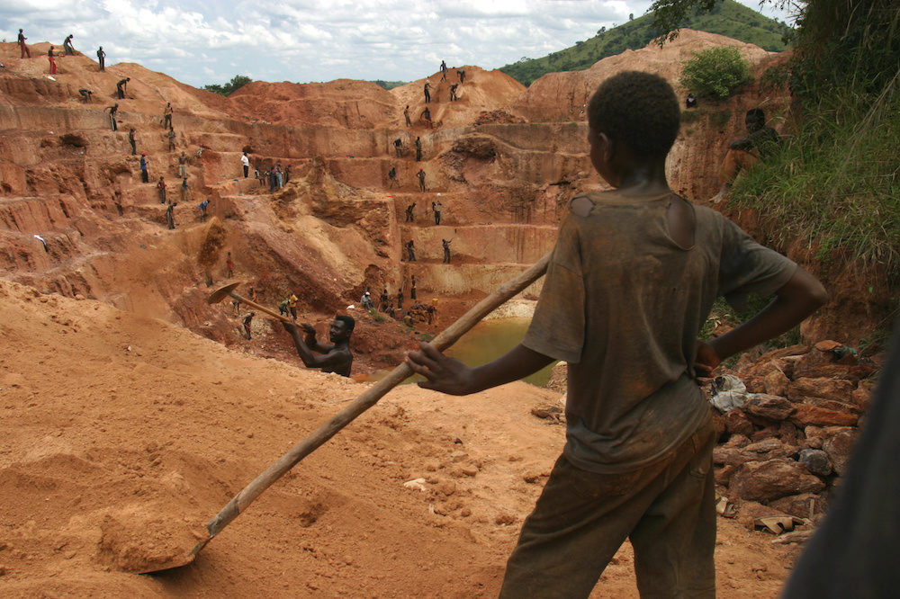
The Landscape of Modern Slavery
Combating Forced Labor in DRC Artisanal Cobalt Mining
with GIS and Machine Learning
Skyler Barlow

Slide 2
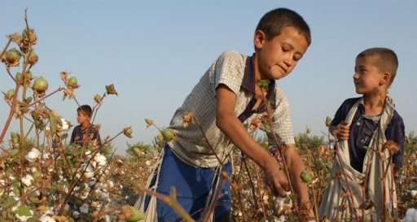
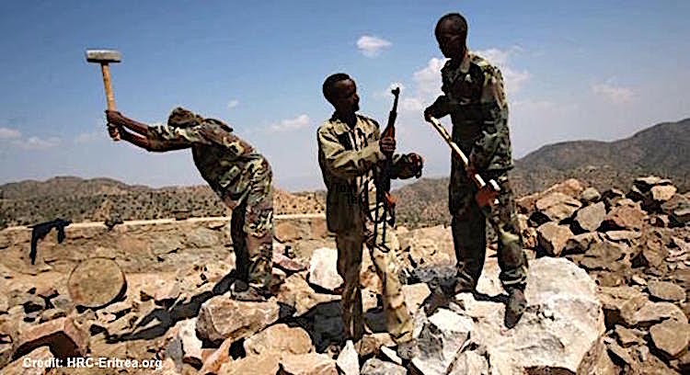
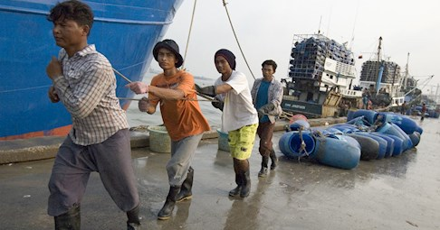
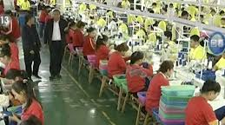
GIS in Combating Forced Labor
Forced Labor
Global Slavery Index:
…situations of exploitation that a person cannot refuse or leave because of threats, violence, coercion, abuse of power or deception
UN estimates 40 million people enslaved

Slide 3
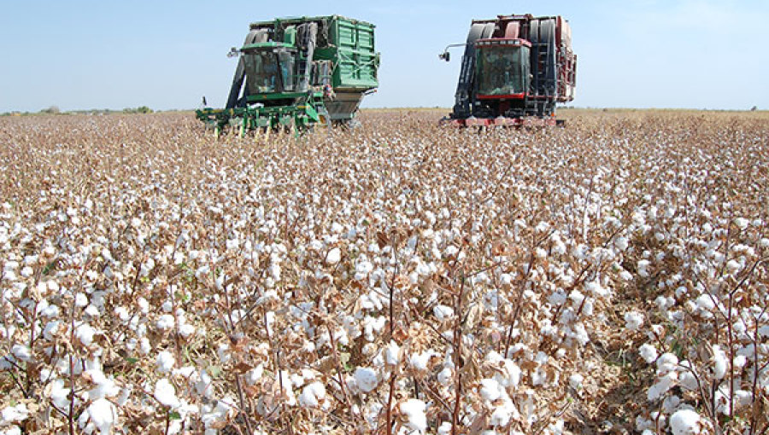
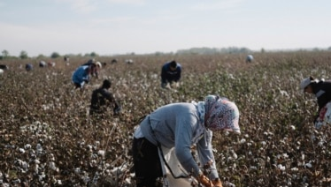
GIS in Combating Forced Labor
Highly Contextualized
Multidisciplinary
Examples:
Brick Kilns in India
Cotton Harvest in Turkmenistan

Slide 4
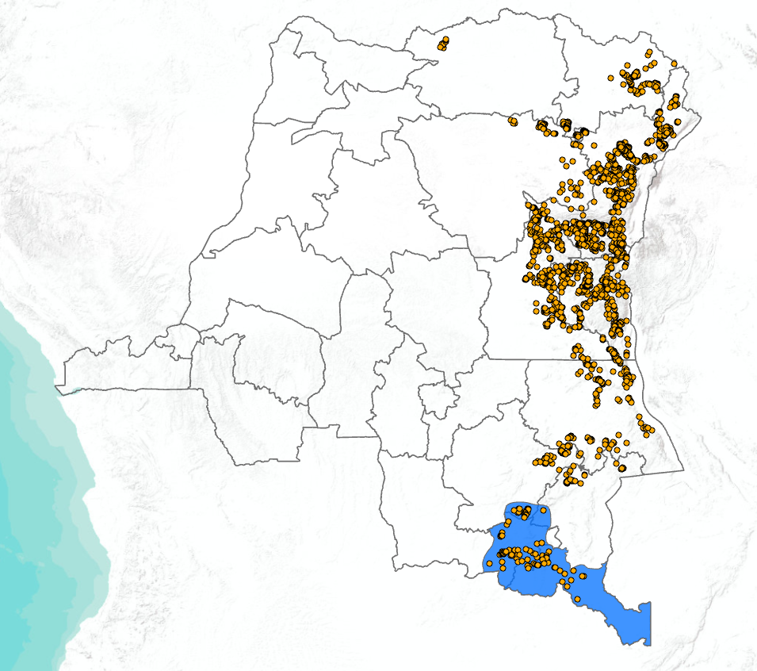
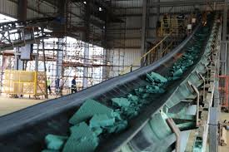
Cobalt and Artisanal Mining in the DRC
Cobalt
Ubiquitous in modern electronics
DRC Copperbelt
90,000 sqkm
85% of global cobalt supply

Slide 5
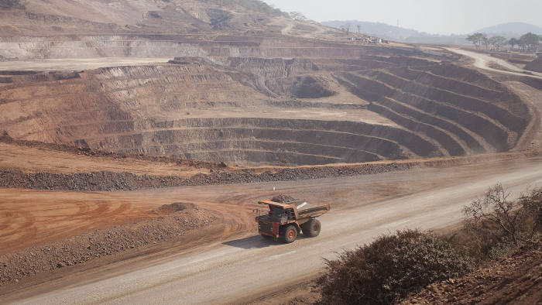
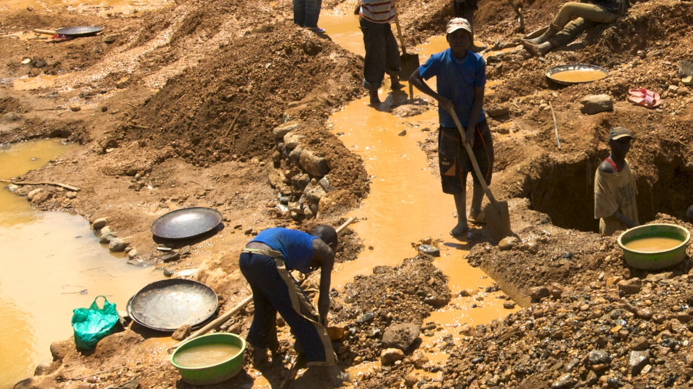
Artisanal Mining in the DRC
Large Scale Mining (LSM)
70-85% of mining output
Artisanal and Small Scale Mining (ASM)
14-17% of livelihoods
Blended output with LSM

Slide 6
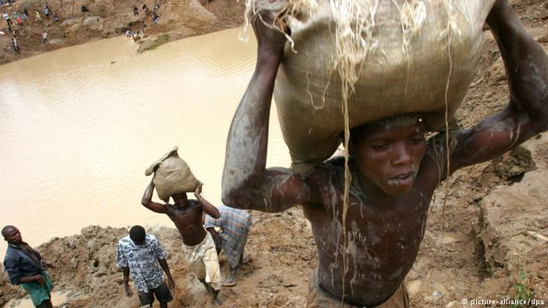
Artisanal Mining and Forced Labor
DRC Forced Labor
Physical insecurity
Debt Bondage
Human Trafficking
Estimated 35,000 children enslaved in Copperbelt mining activities

Slide 7
Proposed Capstone Project
Mine Identification
Probability of Forced Labor
Machine Learning Package
Mine Identification
Probability of Forced Labor
Machine Learning Package

Slide 8
Mine Identification
Tracking ASM Forced Labor in DRC

Slide 9
Mine Identification
2020 study in identifying ASM sites
Sentinel II
Differential Radar Interferometry
Found 215 mining sites
6000 sqkm study area
Measured surface movement
Dr Chloe Brown
Dr Siddharth Kara
Mine Identification
Probability of Forced Labor
Machine Learning Package

Slide 10
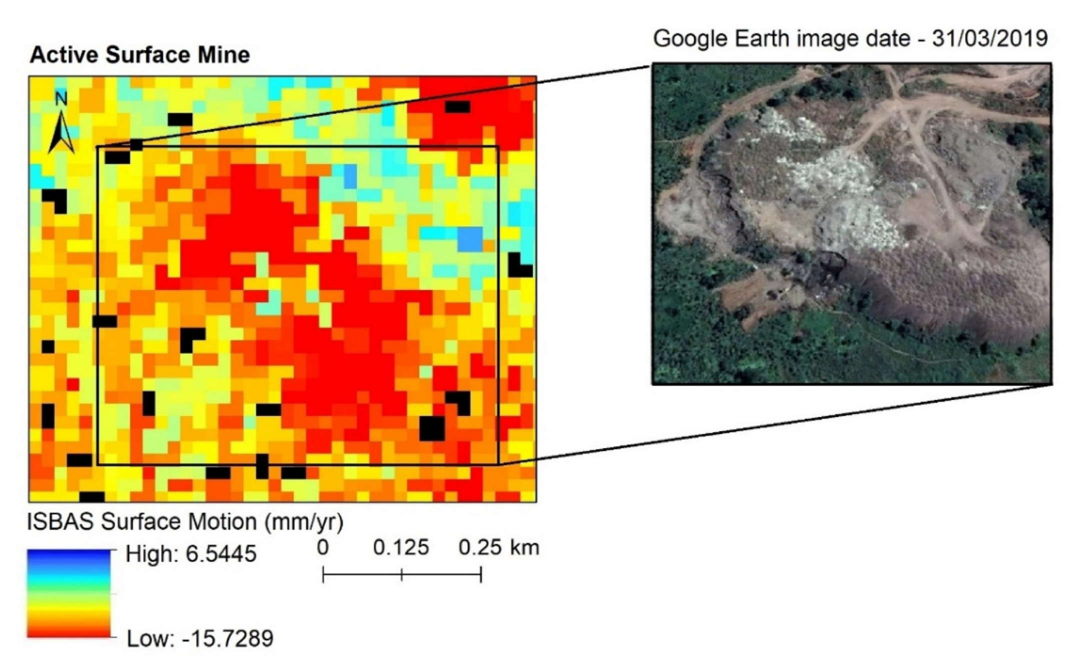
Mine Identification
2 time-lapsed radar images of an area
Negative values in the difference represent degradation of land
Statistical significance in ability to identify mining operations
Mine Identification
Probability of Forced Labor
Machine Learning Package

Slide 11
Mine Identification
Scalable study
Easily attainable data
Defined study area in Copperbelt
Opportunity for additional analyses
Maxar (Digital Globe) Partnership
InSAR interferometric radar data
Mine Identification
Probability of Forced Labor
Machine Learning Package

Slide 12
Probability of Forced Labor
Tracking ASM Forced Labor in DRC

Slide 13
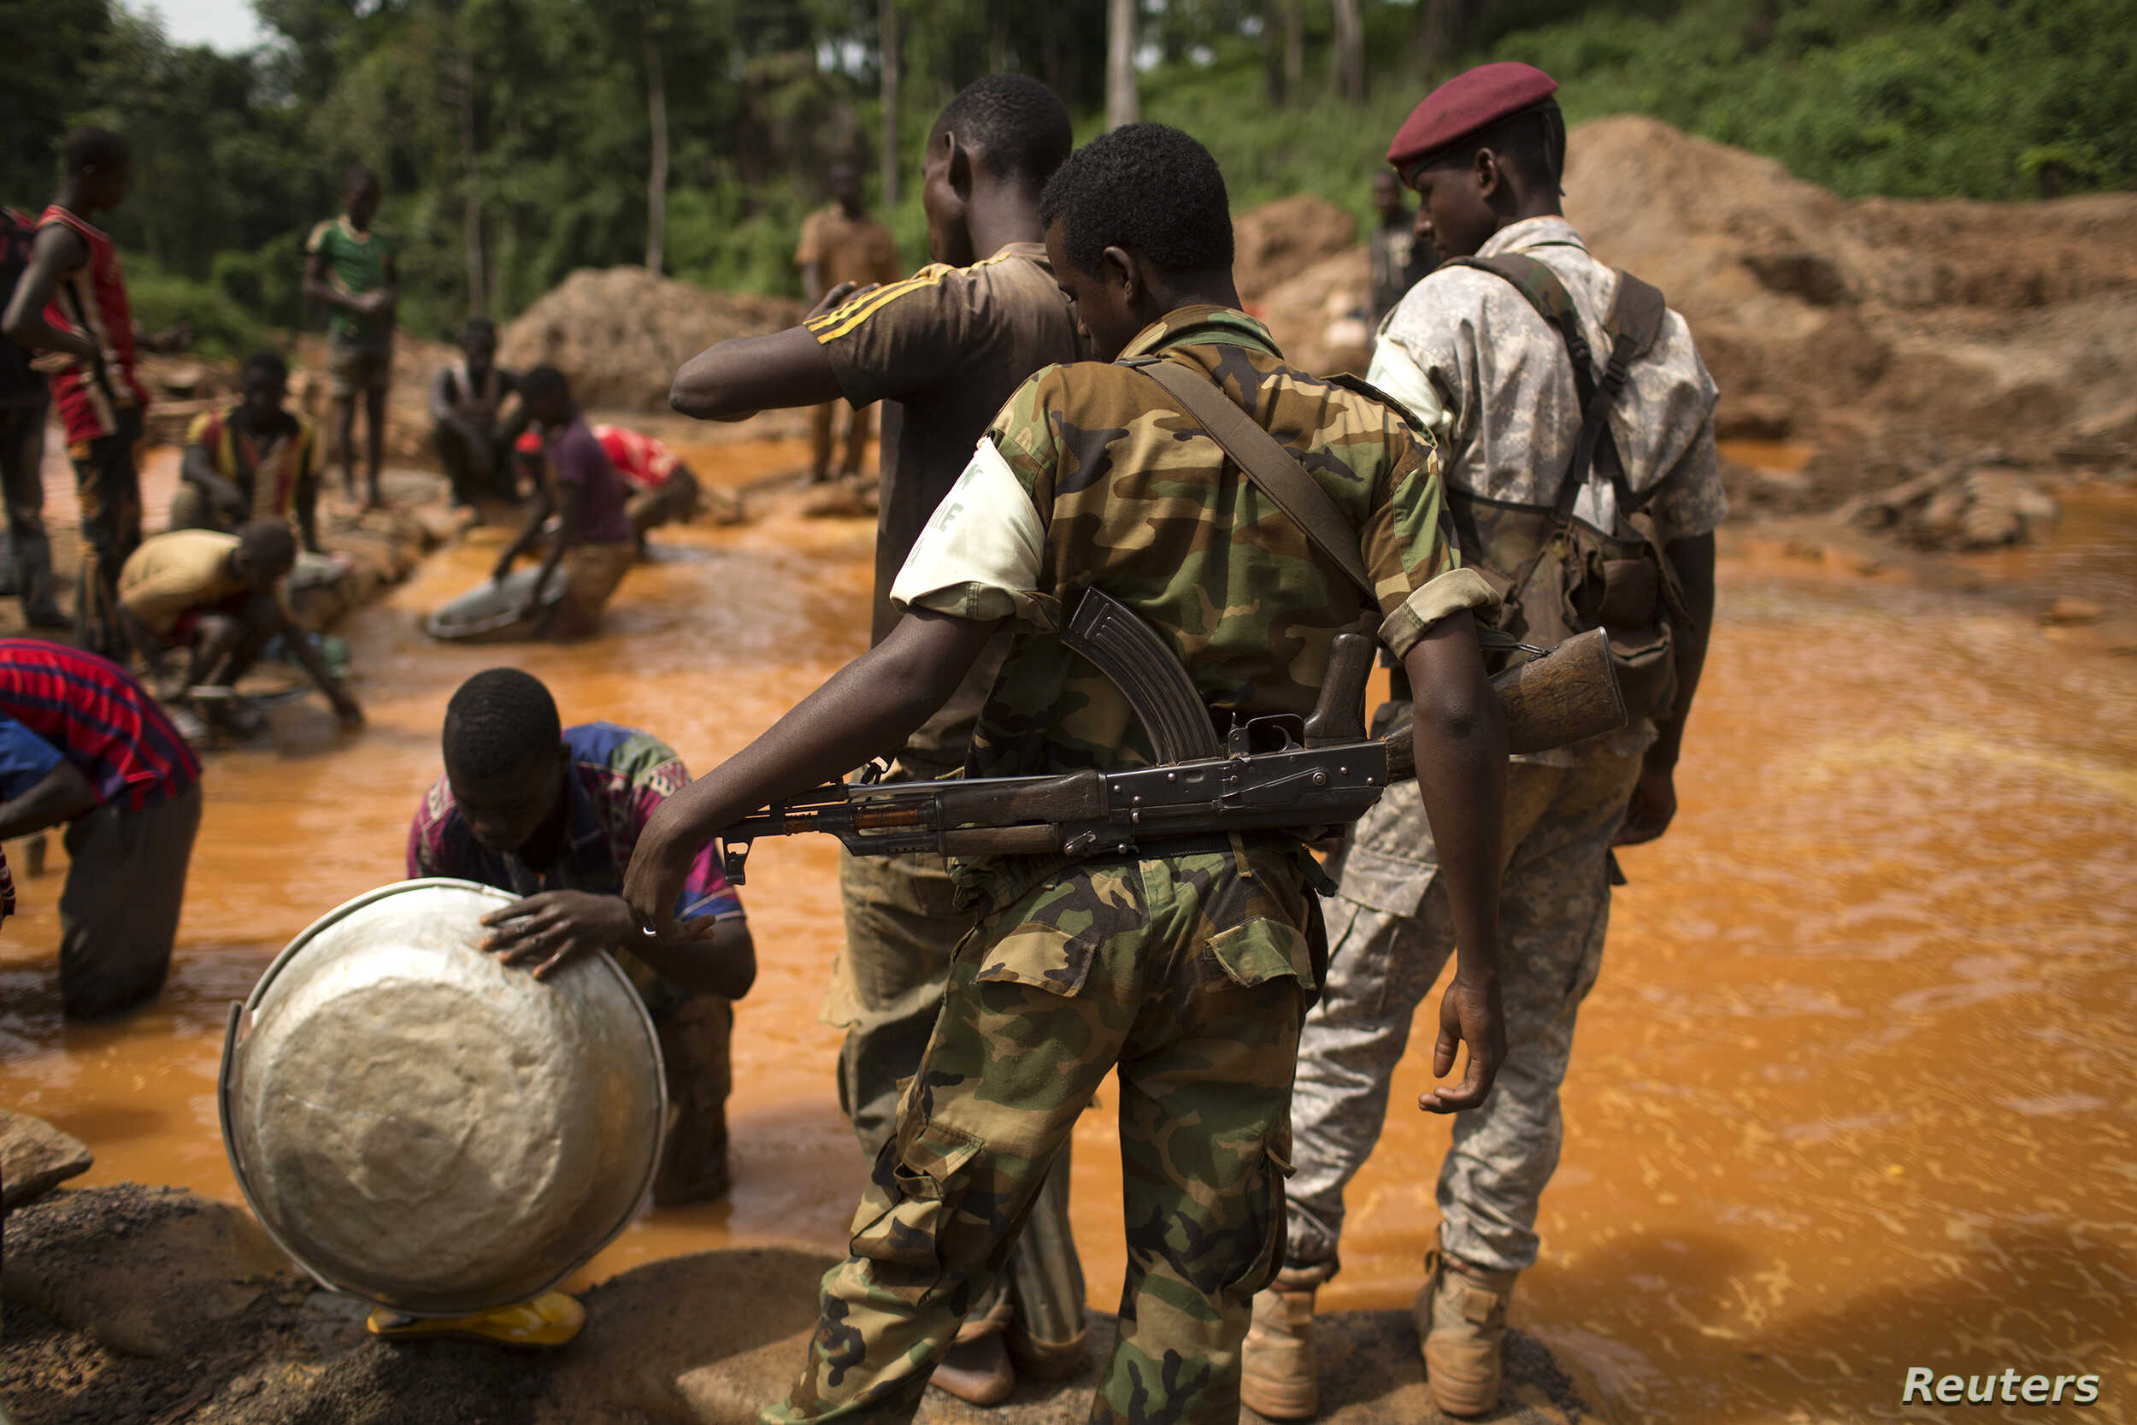
Probability of Forced Labor
Armed militia
Conflict data from Int’l Peace Information Service (IPIS)
ASM and Armed militia in eastern DRC
Mine Identification
Probability of Forced Labor
Machine Learning Package

Slide 14
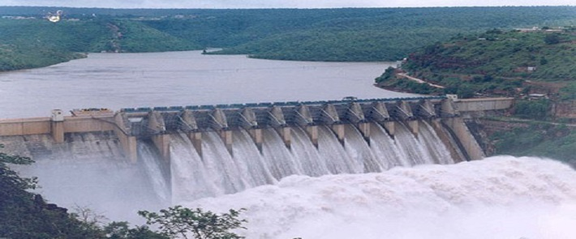
Probability of Forced Labor
Power Grid
2019 study on political control and power infrastructure
Shapefiles on SAPP power grid
Buffered shapefiles on Congo Hydroelectricity
Mine Identification
Probability of Forced Labor
Machine Learning Package

Slide 15
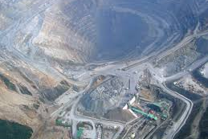
Probability of Forced Labor
Proximity to LSM
LSM data from IPIS and Gecamines
Mine Identification
Probability of Forced Labor
Machine Learning Package

Slide 16
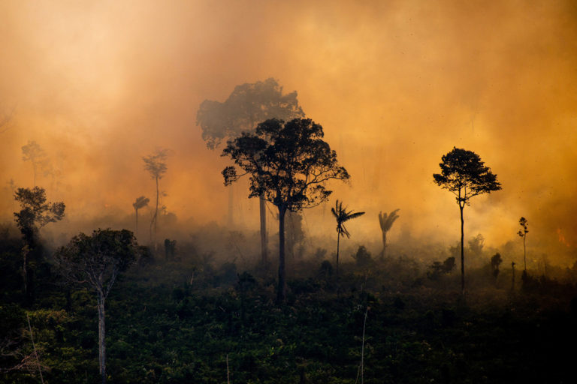
Probability of Forced Labor
Economic instability
Decreases in agricultural activity
Mine Identification
Probability of Forced Labor
Machine Learning Package

Slide 17
Probability of Forced Labor
Develop heat index based on selected indicators
Higher rating means higher likelihood of forced labor presence
Identification of forced labor presence offers anti-slavery NGOs investigative power
Mine Identification
Probability of Forced Labor
Machine Learning Package

Slide 18
Machine Learning Package
Tracking ASM Forced Labor in DRC

Slide 19
Machine Learning Package
ArcGIS Machine Learning Package
Acquire time-lapsed Maxar radar interferometry data
Apply Brown Method to entirety of Copperbelt using ArcGIS Deep Learning Tools
Export Training Data for Deep Learning
Train Deep Learning Model
Classify Objects Using Deep Learning
Mine Identification
Probability of Forced Labor
Machine Learning Package

Slide 20
Questions and Feedback
Mine Identification
Probability of Forced Labor
Machine Learning Package

Slide 21
Questions and Feedback
Mine Identification
Probability of Forced Labor
Machine Learning Package

Slide 22
THANK YOU
Skyler Barlow

