Slide 1

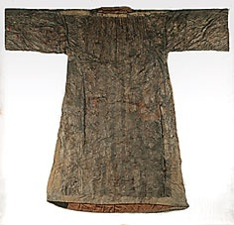

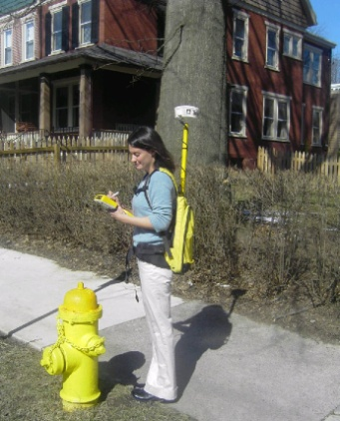

THE UNDIVIDED GARMENT: PLATS, PARCEL FABRIC, AND GIS
BRUCE BARROW
PENN STATE WORLD CAMPUS
LEGAL PRINCIPLES
LAND SURVEYING
GIS
GPS
Notes:
Hello. I’m Bruce Barrow, my advisor is Karen Schuckman, and this is The Undivided Garment: Plats, Parcel Fabric, and GIS. Land surveying is an ancient profession which has developed measurement technology, professional standards, and legal principles in society over thousands of years. In the United States, the relation of land surveyors, as measurement experts, to the courts that define property ownership is intimate and long-standing. Geographic Information Systems is a fifty year old technology that organizes and analyzes geographic information with computer programs. It is a major force in the modern digital age. There is a clash of cultures between the historic prerogatives of land surveying and the powerful innovations of GIS. The global perspective and new technologies of GIS challenge land surveyors to broaden their vision, and the established culture of land surveying in society challenges GIS to meet its standards. Environmental Systems Research Institute’s Parcel Fabric dataset may help to reconcile the conflicting cultures. Let’s explore together the parcel fabric creative process, its relationship to land surveying, and its potential advantages for government, land records professionals, and the public. We will consider the answers to two questions: Does the parcel fabric dataset provide an advanced method of land records management? Does the parcel fabric map rise to the level of a legal description of property?
See Slide 23 for graphic citations.

Slide 2
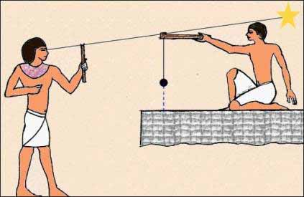
ANCIENT EGYPTIAN LAND SURVEYORS USING THE MERKHET CONSTRUCTION ALIGNMENT TOOL
Notes:
The ancient Egyptians used simple surveying tools, basic mathematics, and astronomical observation to perform both boundary and construction surveys. The Greeks absorbed the methods of Egyptian land surveying after Alexander the Great's conquest of Egypt in 332 B.C.
“Ancient Egyptian Land Suveyors” (Crystal, n.d.). ©1995-2013. All rights reserved. Reproduced here for educational purposes only.

Slide 3
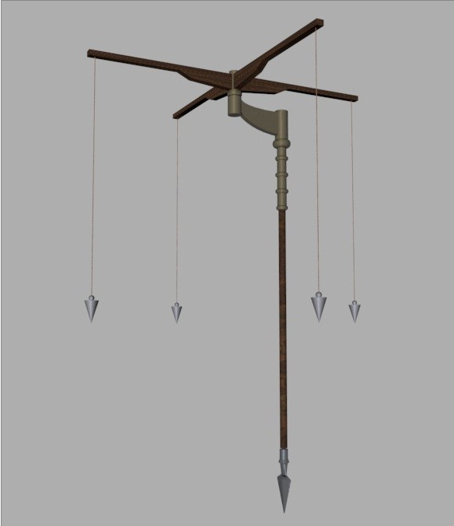
ROMAN GROMA SURVEYING TOOL
Notes:
Thus it was that the Romans learned the fundamentals of land surveying from the Greeks. The Romans used the groma, an instrument modeled on an Egyptian tool, to establish perpendicular axes with their origin at the center of a square.
“Groma” (SPAart&graphicdesign, n.d.). ©1999-2013 ZuccherodiKanna s.n.c. All rights reserved. Reproduced here for educational purposes only.

Slide 4
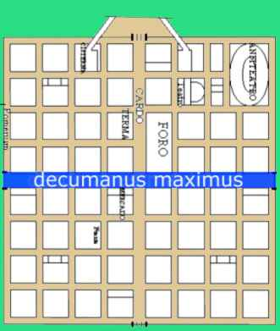
ROMAN CARDO AND DECUMANUS
Notes:
Each of the resulting quarters were then divided in the same manner for the desired number of single lots. The axes were called the cardo and the decimanus, which were incorporated as ways within the development. Earlier writers were not certain of their disposition with regard to north/south and east/west delineations (Rose, 1995). However, contemporary writers state with confidence that the cardo was the north/south or y axis and the decimanus was the east/west or x axis of a Roman military or civil development (Cardo, 2013). A chapel called the Lares Compitales was erected at the crossroads (compitum) of four lots to house the god (Lar) of each lot, and to be the focus of religious observance by each land owner to the particular god of his lot (Rose, 1995).
“Cardo and Decamanus” (Generalitat de Catalunya, n.d.). ©2013. All rights reserved. Reproduced here for educational purposes only.

Slide 5
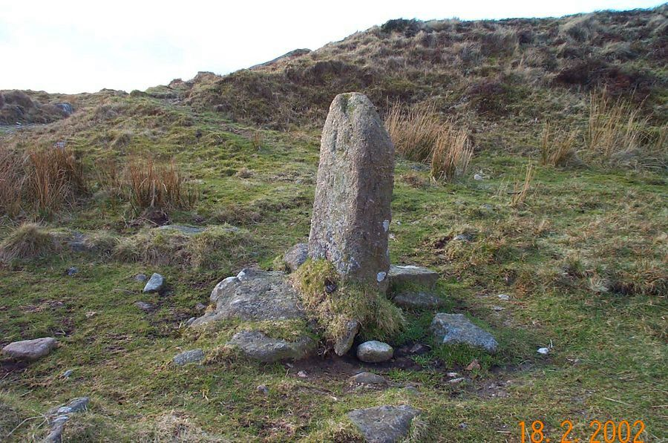
BOUNDARY STONE
Notes:
The ancient Roman land surveyor Siculus Flaccus describes the Roman reverence for boundary markers as follows:
They used to stand the stones themselves on the surface of the ground near the places where they meant to dig holes and fix them. The stones they would anoint, veil and garland. In the holes made for the stones to go into, when they had made sacrifice and burned the flesh of the slain victim on blazing sticks, they would, with their heads veiled, let some of the blood drip, and also throw in incense and grain. They would add honey-combs, wine, and other materials customary for the ritual of boundary-stones. When all the offering was burned, they would set the stones on top of the hot ashes and then fix them carefully. (as cited in Rose, 1995, p. 16)
With their simple tools and understanding of geometry, algebra, and trigonometry, the Romans translated their reverence for spatial distinctions into land management, civil engineering, and empire building ("Roman Surveying," n.d.).
“Boundary Stone” (Knights, n.d.). ©2013. All rights reserved. Reproduced here for educational purposes only.

Slide 6
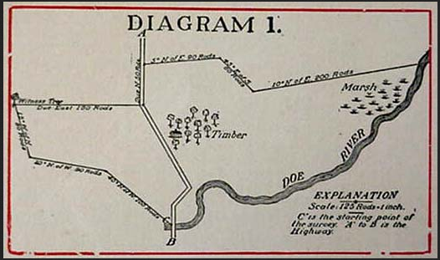
COLONIAL SURVEYING METES AND BOUNDS
Notes:
English immigrants to America brought the metes and bounds method of describing land ownership with them from England. Measurements of direction and distance were combined with references to physical features used to define boundaries on the ground, as shown in Diagram 1. Physical features called out in this descripiton include a stone, the highway, a large stump, the oak tree, and the Doe River.
Colonial surveying, and the descriptions associated with it, have improved with the use of sophisticated instruments and the development of professional standards for land surveying. However, it may be that the colonial system demands a special attention to detail and capacity for good judgment from professional land surveyors. The ability to discern another surveyor's intent from his plan, to compile information from plans with various, often assumed, coordinate systems, to assess the correspondence between field and plan data, and to arrive at the best solution to a given problem constitute the surveyor's art.
“Diagram 1” (Ingram – Hagen & Co., PLC, n.d.). ©2013. All rights reserved. Reproduced here for educational purposes only.

Slide 7
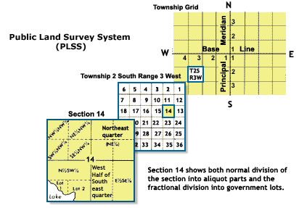
PUBLIC LAND SURVEY SYSTEM
Notes:
President Thomas Jefferson, a land surveyor, proposed the concept of the Public Land Survey System (PLSS) after the Revolutionary War, as a way for the new country to manage its public lands west of the original colonies. The PLSS divides the land into townships of 6 miles square in relation to a Principal Meridian and its perpendicular base line. The system consists of 37 Principal Meridians. One township is divided into 36 sections each of 1 mile square. Sections are divided into quarters and quarter-quarters. The United States Bureau of Land Management, created in 1946, is the government agency currently responsible for maintaining the 200 year old archive of PLSS land records, surveying new lots on public land, and preserving the monuments set by historic public land surveys. Survey monuments are an integral part of the PLSS cadastral system, providing accurate coordinate control points, and reinforcing legal descriptions of land on the ground (The Public Land, 2013).
The PLSS sections correspond to the square plots laid out by Roman surveyors with their groma. The American founding fathers looked to the Roman republic as an example of the kind of government they wanted to create. It may be that Thomas Jefferson was inspired by the Roman system of land management when he devised the original Public Land Survey System concept.
“Public Land Survey System” (United States Department of the Interior, 2013).

Slide 8
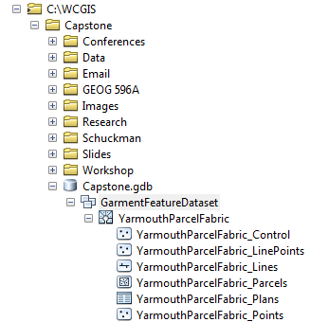
PARCEL FABRIC DATASET; PART OF A FEATURE DATASET; STORED IN A FILE GEODATABASE
FILE GEODATABASE
Notes:
Parcel Fabric is Environmental Systems Research Institute's (ESRI) current nomenclature for its system of managing land survey and records data in GIS. It was introduced with ArcGIS 10 in 2010, and includes the parcel data model, Parcel Editor toolbar, and Tax Parcel Editing template. The parcel fabric dataset, is part of a feature dataset, which is stored in a geodatabase. “A riddle wrapped in a mystery inside an enigma.” The parcel fabric stores and represents the data collected and generated by land surveyors, indicated by plats (plans) of land, and recited by deeds and descriptions of property. ESRI has developed a model and a method for uniting the specialized and highly skilled techniques of land measurement and land records professionals to the broader, but equally technical and conscientious, environment of geographic information systems.

Slide 9
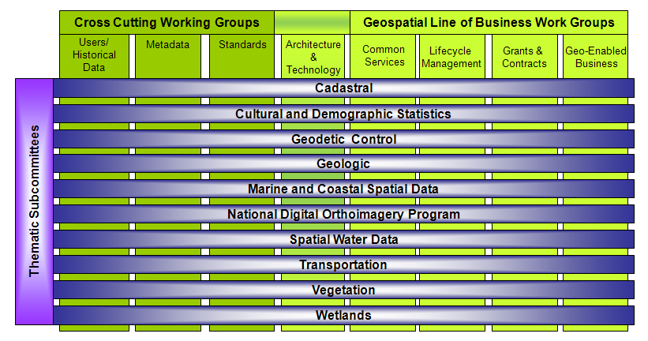
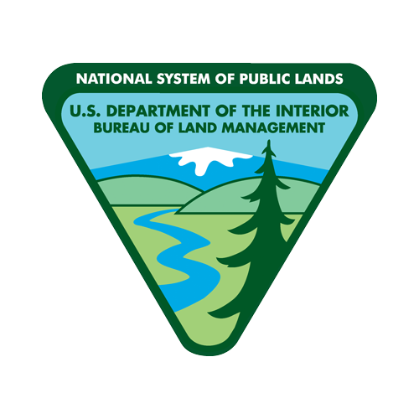

Federal Geographic Data Committee Subcommittees
Including the Cadastral Subcommittee
Notes:
"The Federal Geographic Data Committee (FGDC) . . . promotes the coordinated development, use, sharing, and dissemination of geospatial data on a national basis" (Federal Geographic Data Committee, 2013). The Cadastral Subcommittee of the FGDC is chaired by the Bureau of Land Management Cadastral Survey. One of BLM's primary responsibilities as Cadastral Subcommittee is "the construction, publication and maintenance of the national cadastre" (FGDC, 2012). ESRI began its work with fabrics in its association with the United States Bureau of Land Management (BLM) and the United States Forest Service (USFS) in 1999. "BLM contracted with ESRI Professional Services to design and implement the NILS enterprise GIS solution" (Land Records, 2006, p. 9). The National Integrated Land System (NILS) promised to deliver "a seamless national dataset" and a "national multipurpose cadastre" (Land Records, 2006, p. 10). In his 2008 POB magazine article about the NILS, Allen Hendrickson (2008) referred to the system's use of survey fabric, land description fabric, parcel fabric, and the national cadastre. Over time, ESRI simplified its model by adopting one parcel fabric, to which numerous methods, standards, templates, and workflows are applied in the land records and parcel maintenance design.
“FGDC Subcommittees” (Federal Geographic Data Committee, 2010).
“Bureau of Land Management” (Department of the Interior, 2013).
“US Forest Service” (Department of Agriculture, 2013).

Slide 10
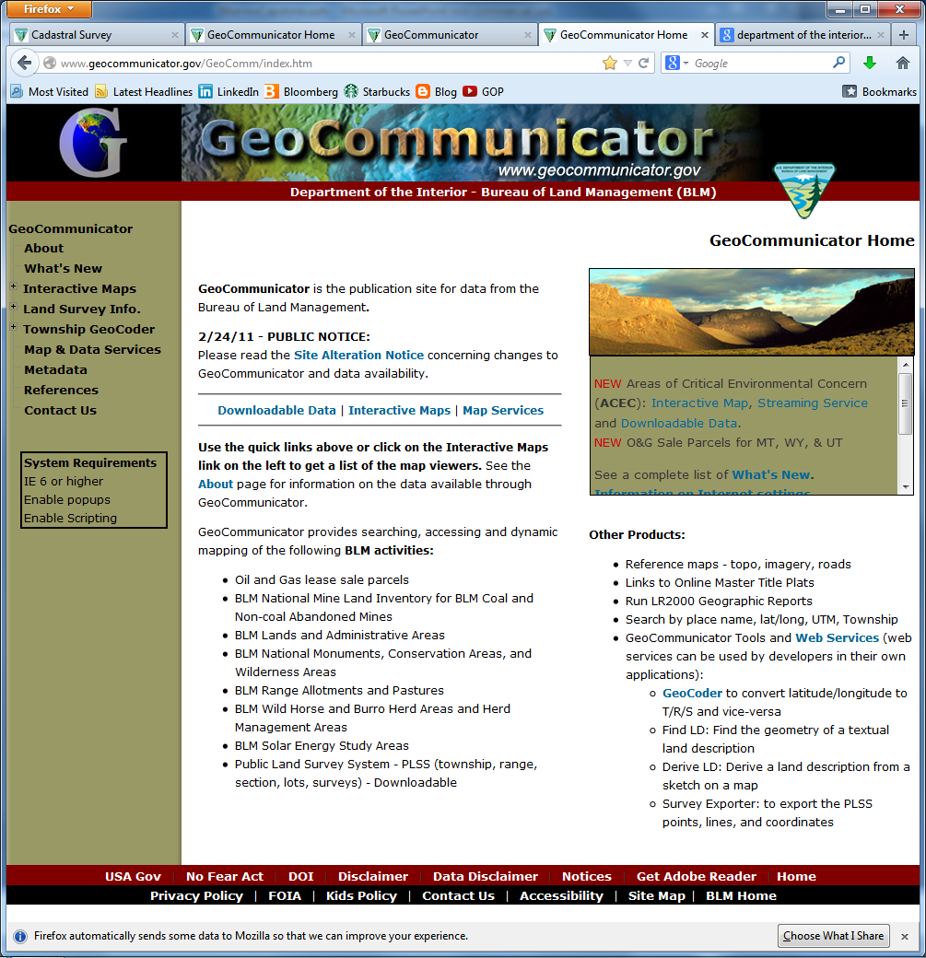
THE BUREAU OF LAND MANAGEMENT
GEOCOMMUNICATOR WEB PORTAL
Notes:
The Bureau of Land Management's National Integrated Land System is currently missing in action. If you go to BLM's GeoCommunicator website, which was its NILS information portal to the public, you will find the following notices:
On February 25, 2011 the BLM removed most of the data layers from the GeoCommunicator map viewers.
The data was removed over concerns of data quality. The Bureau is working to develop a means of supplying accurate data for the eliminated themes, but no time frames are available. As information becomes available we will post it on GeoCommunicator. ("What's New," 2011)
It appears that BLM will be fulfilling its Federal Geographic Data Committee mandate to develop a national cadastre without the National Integrated Land System ("Cadastral Subcommittee," 2012).
“GeoCommunicator” (Bureau of Land Management, 2011).

Slide 11
PARCEL DATA WORKFLOW
PLATS
(PLANS)
SURVEY MONUMENTS
LINE WORK
(AUTOCAD)
SURVEY SOLUTION
PARCEL FABRIC WORKFLOW
DATASET
CONTROL POINTS
MIGRATION
JOINING
LABELING
PRESENT
Notes:
ESRI designed the Tax Parcel Editing template, which includes the Local Government Information Model database schema, to help the most likely users of the Parcel Fabric data model to migrate their land records information into GIS. Municipal, county, registry, and state agencies are the local government entities that ESRI would like to serve with the Parcel Fabric model. I developed two workflows for this project to familiarize myself with the parcel fabric dataset and Parcel Editor tools. The parcel data workflow included plats, survey monuments, line work, and a survey solution. The parcel fabric workflow included the dataset, control points, migration, joining, labeling, and presentation.

Slide 12
“SUBDIVISION PLAN OF LAND IN YARMOUTH, MASS.”
Notes:
The parcel data workflow prepared high quality data for import into the parcel fabric. I chose a subdivision plan by Stanley Sweetser, prepared for Merchant and Cassidy of Yarmouth, Inc., in 1968, as the source of sample parcels to import into the parcel fabric.
“Subdivision Plan” (Sweetser, 1968). ©2013. All rights reserved. Reproduced here for educational purposes only.

Slide 13
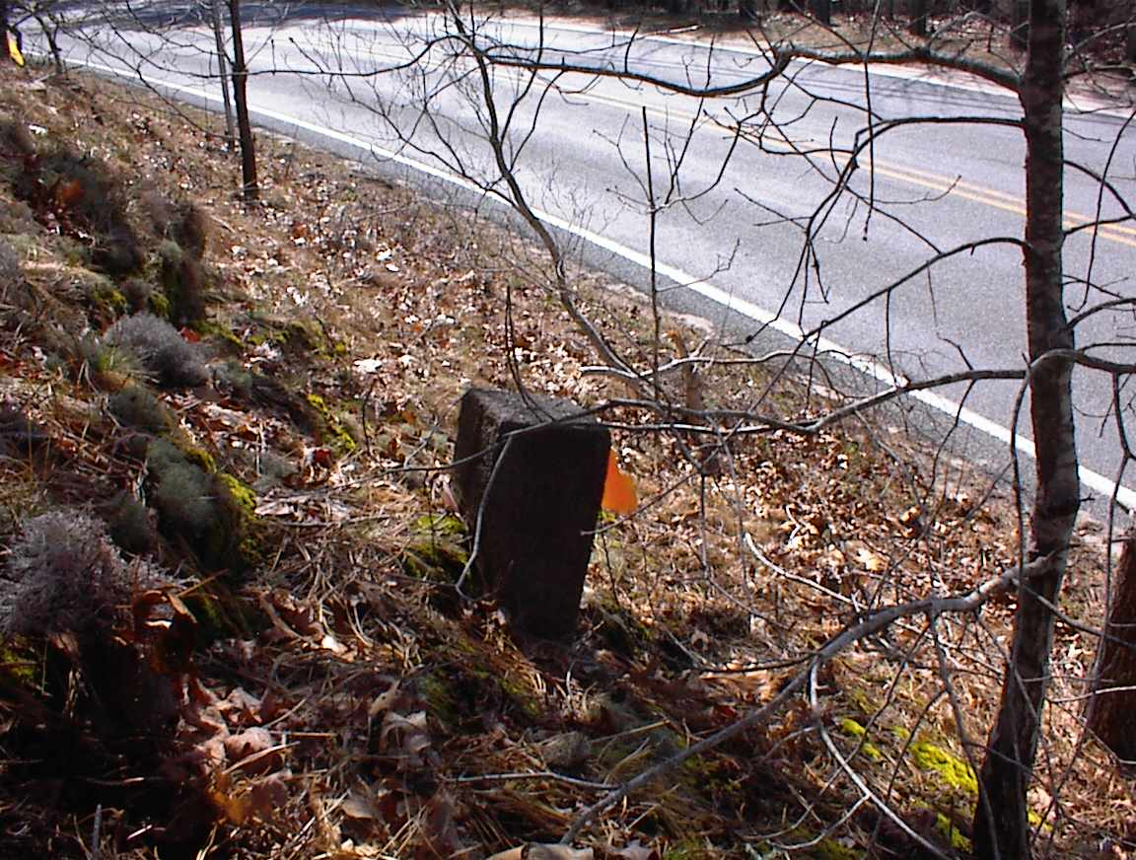
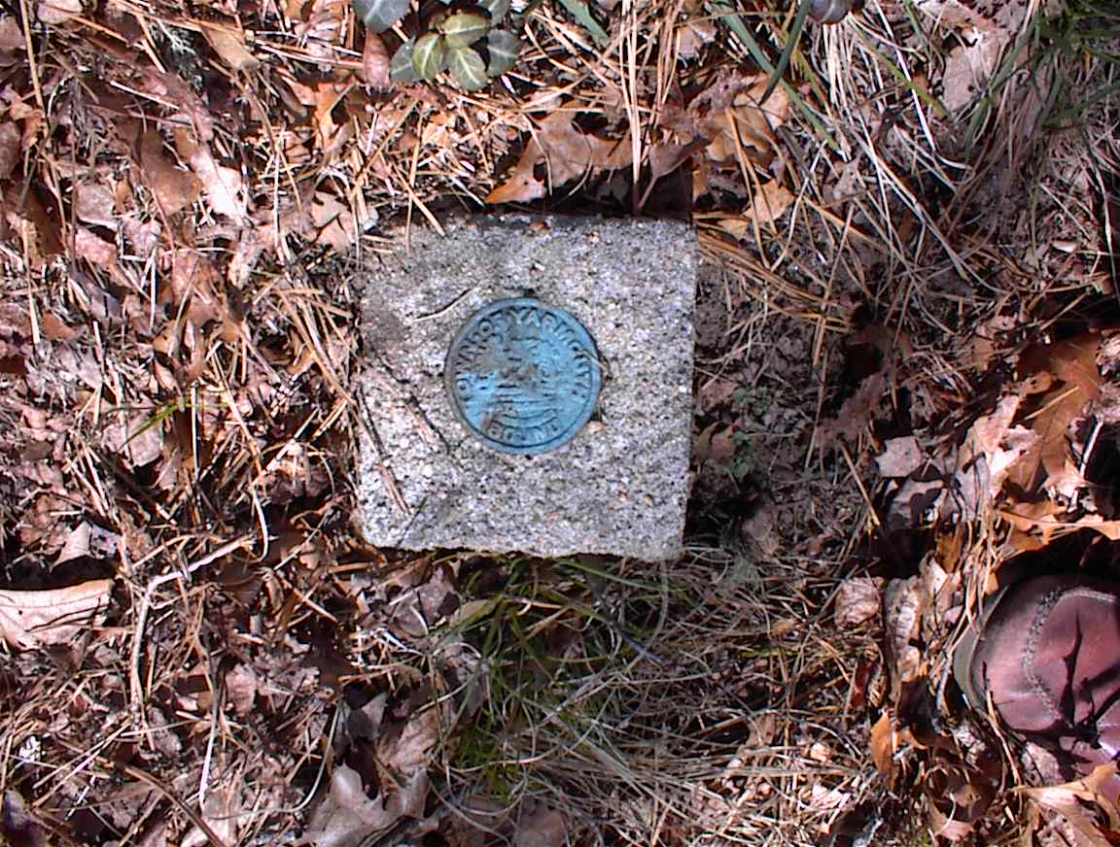
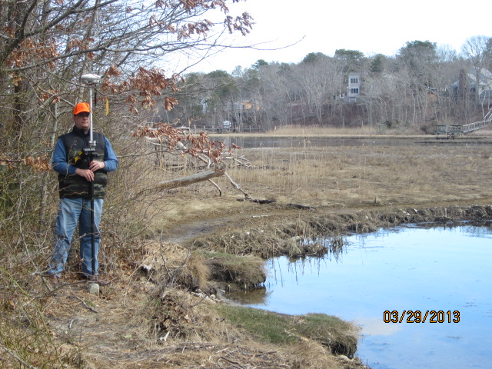
SURVEY MONUMENTS LOCATED WITH SUB-CENTIMETER ACCURACY GPS
Notes:
Fifteen monuments were found in the field, some of questionable provenance, others were angle point bounds in the county road, Yarmouth town bounds, and property bounds. The general condition of the bounds was good, but some were chipped or tipped. They were all located with sub-centimeter accuracy GPS, in the NAD83 Massachusetts Mainland State Plane Coordinate System (US feet).

Slide 14
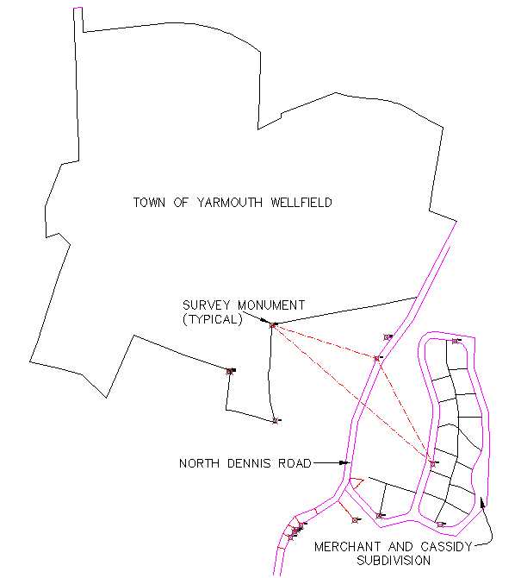
STUDY AREA IN AUTOCAD
Notes:
Line work for the Merchant Avenue subdivision, North Dennis Road layout, and several other recorded plans was combined in Autocad Civil 3D to cover an area of approximately 0.4 of a square mile. This large area was chosen to increase the selection of survey monuments for the project.

Slide 15
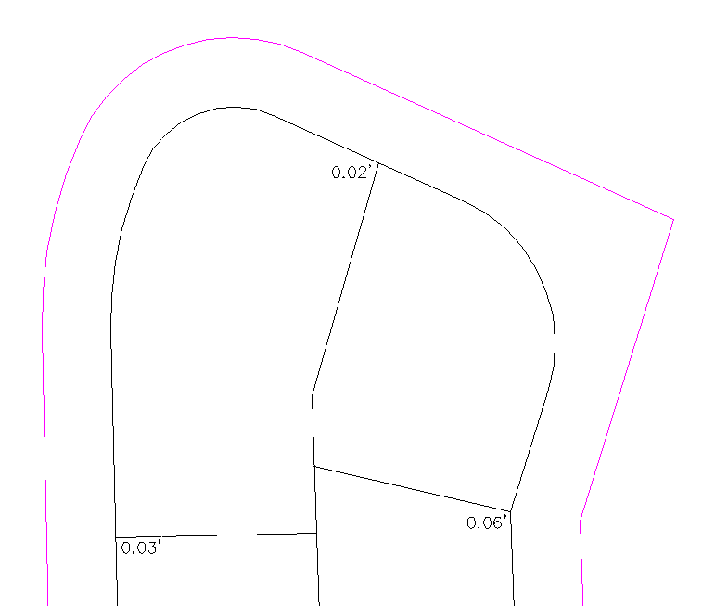
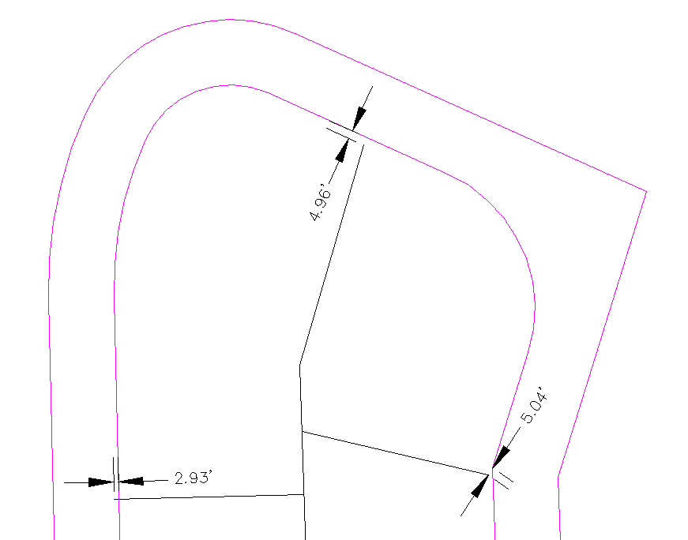
RENDERING THE PAPER PLAN IN AUTOCAD
WITH SURVEY CALCULATIONS
Notes:
Line work for fifteen parcels and the layout of Merchant Avenue was entered by bearing, distance, and curve data, as shown on the Merchant and Cassidy subdivision plan. My attempt to hold consistently the 40 foot width of Merchant Avenue, which was called out on the plan, resulted in numerous closure errors ranging from 2 to 5 feet for property lines. A different method of calculation closed the errors to invisible hundredths and revealed an anomalous width of 45 feet for a portion of the road layout, which was confirmed by scaling its distance from the paper plan.

Slide 16
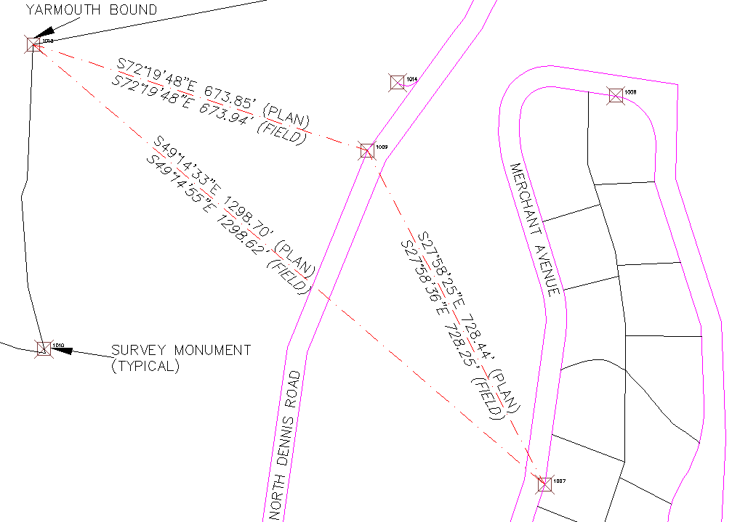
SURVEY SOLUTION IN AUTOCAD
Notes:
Analysis of plan data in relation to field data did not reveal a simple solution to the survey problem in this case. The discrepancies between some of the older monuments and their plan equivalents ranged from 0.5 to 0.9 of a foot. After consultation with three licensed professional land surveyors, I settled on a solution that included three monuments: a Town of Yarmouth bound, a North Dennis Road bound, and a Merchant Avenue bound. I held the Town of Yarmouth bound and rotated my plan onto the North Dennis Road bound 674 feet away. At this orientation the Dennis Road bound differed from the plan by 0.09 of a foot for length and the Merchant Avenue bound, which was 1,299 feet away from the Yarmouth bound, differed from the plan by 0.08 of a foot for length and 22 seconds for bearing. Given the purpose and parameters of the project, the availability of reliable monuments, and the disbursement of the three solution monuments over the project area, I believed that these numbers were acceptable.

Slide 17

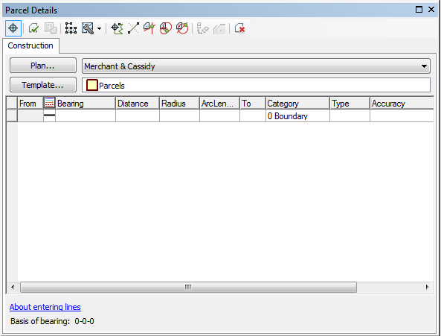
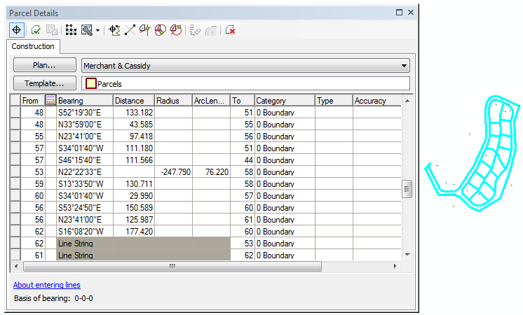
MIGRATION OF AUTOCAD LINES INTO THE PARCEL FABRIC (ARCGIS)
Notes:
I opened my Yarmouth Parcel Fabric in an ArcMap drawing, and imported my control points, which were derived from the GPS locations of field monuments. The parcel details construction grid was opened from the Parcel Editor toolbar. The parcel lines I had defined in Autocad were added as a polyline layer to ArcMap, selected, copied, and pasted into the empty construction grid. The grid was immediately populated with the bearing, distance, and curve data provided by the lines.

Slide 18
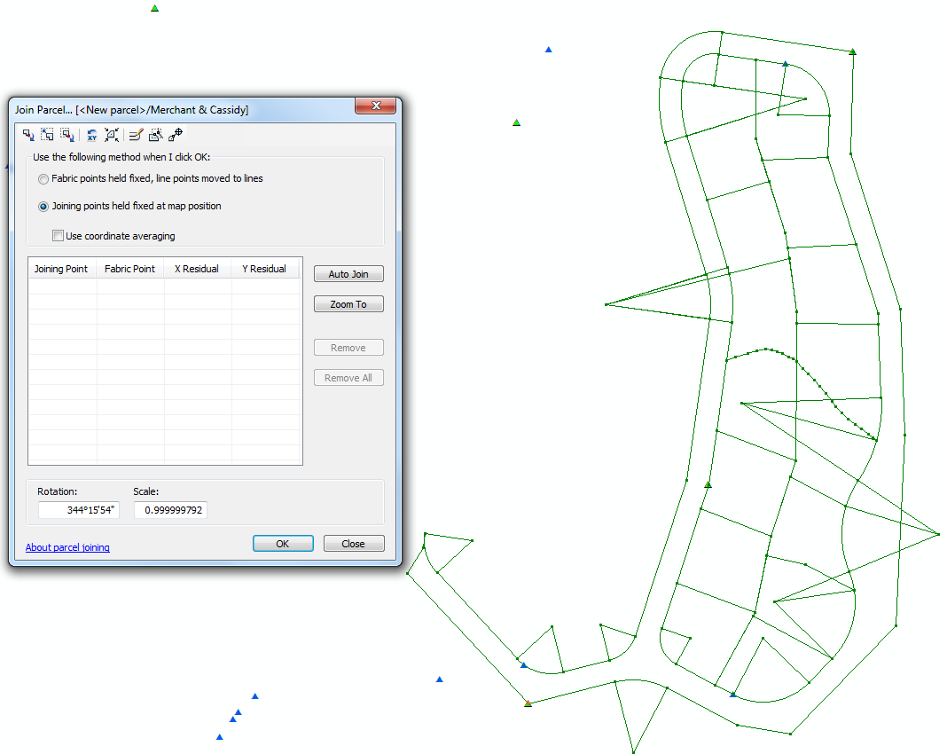

JOINING THE PARCELS TO THE FABRIC (ARCGIS)
Notes:
The Autocad lines were rendered as features in the map, from which parcels were built, georeferenced to control points, and joined to the parcel fabric, using the Join Parcel dialogue box tools.

Slide 19
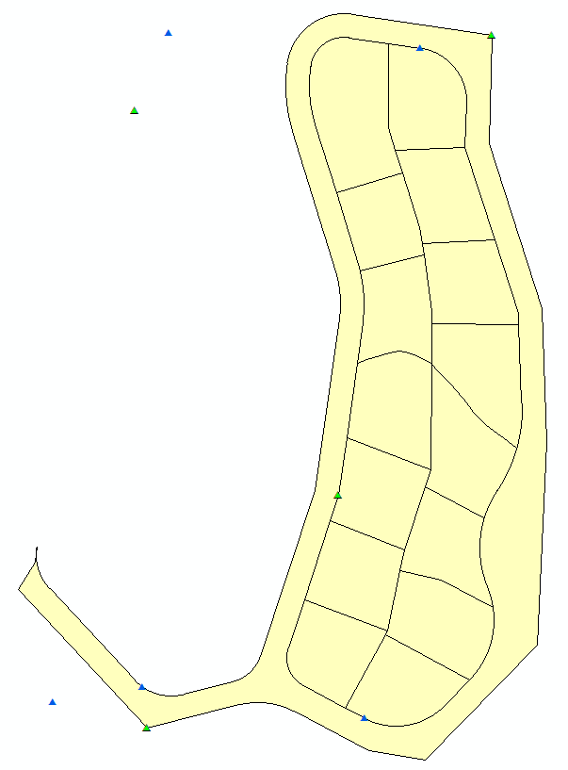
PARCEL FABRIC (ARCGIS)--JUST THE BEGINNING
Notes:
This is the newborn Yarmouth Parcel Fabric.

Slide 20
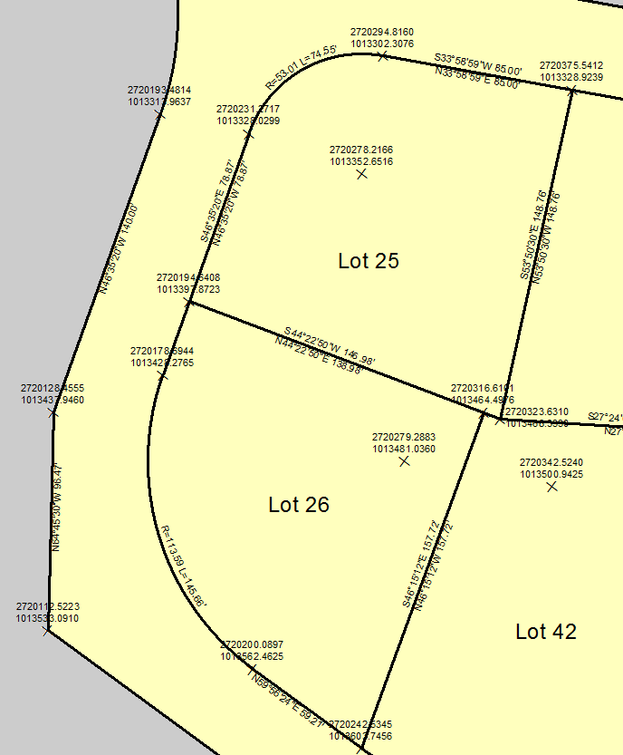
BEARINGS, DISTANCES, CURVES, AND COORDINATES
Notes:
The lines sublayer of the parcel fabric layer was labeled to show bearings, distances, radii and lengths of curves; the point sublayer was labeled to show State Plane coordinate values for the respective points; and parcels were labeled with the lot numbers assigned to them on the original paper plan. The line labels demonstrate that the parcel fabric retains the record plan dimensions even after the new parcels have been adjusted by joining to an existing parcel fabric, or existing parcels have been altered by a least squares adjustment of the parcel fabric. ESRI explains the emphasis on coordinates in the parcel fabric as follows:
Spatial accuracy in the parcel fabric is improved and maintained through a fabric least-squares adjustment. Control points are processed together with recorded dimensions to derive new, more accurate coordinates for parcel corners. Line dimensions are not changed, but fabric point coordinates are updated. The result is an accurate coordinate-based cadastral system. (ArcGIS 10.1 Help, 2012).
ESRI recommends the use of coordinates supported by high accuracy GPS surveys to define lot corners and property boundaries. In addition, the authority to accept least-squares adjustment should be restricted to qualified staff, who understand the method and what it says about the accuracy of coordinates in the organization's parcel fabric asset (ArcGIS 10.1 Help, 2012).

Slide 21
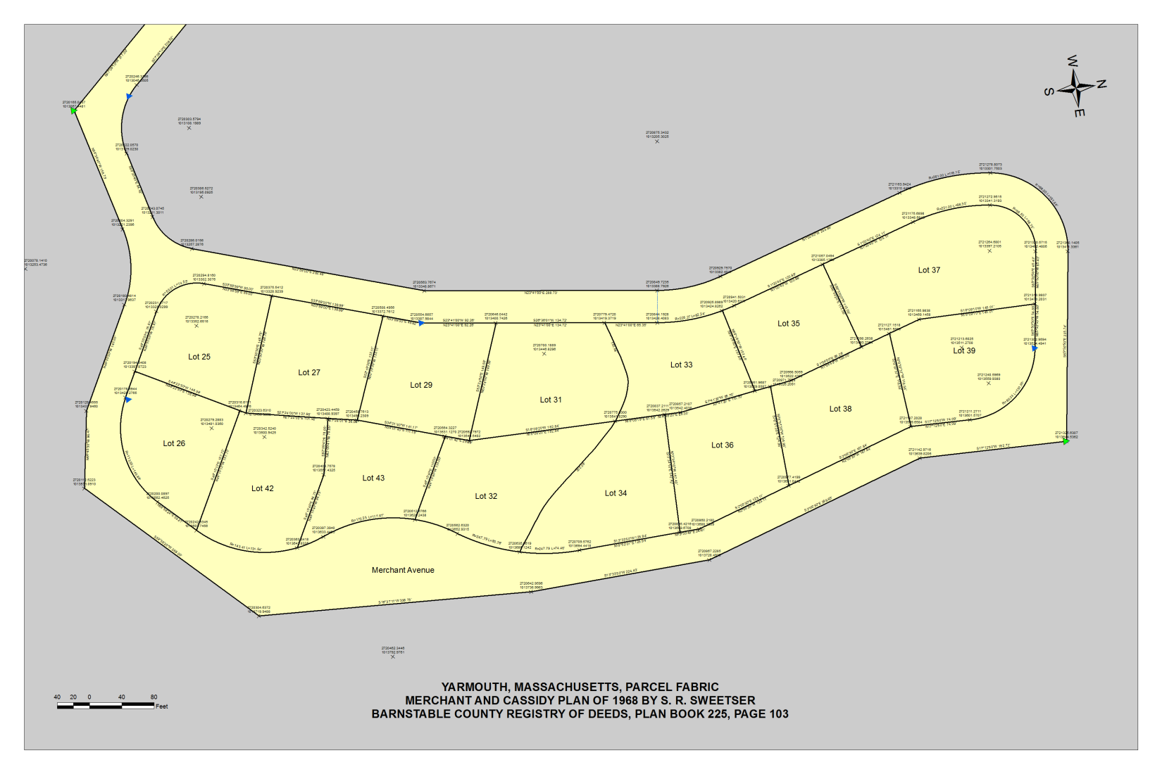
THE UNDIVIDED GARMENT: PLATS, PARCEL FABRIC, AND GIS
Bruce Barrow
Penn State World Campus
Notes:
The desire to consolidate land records and GIS information from local sources into regional datasets is apparent at the federal, state, and county levels of government. Parcel Fabric supports the implementation of this vision with its advanced method of land records management, which will make good information more readily available to consumers. Understanding something about Parcel Fabric and land surveying will help GIS professionals at all levels of government to participate in the national cadastre creative process, serve the public, and advance their careers.
The GIS profession needs the land records knowledge and expertise of licensed, professional land surveyors and experienced technicians as part of its Parcel Fabric endeavor. The participation of professionals who understand and adhere to the standards of land measurement and legal principles of land surveying can only improve the credibility and performance of the Parcel Fabric data model.
GIS is relevant to land surveying, and many surveyors decided years ago that it was, when they added GPS/GIS technology and terminology to their work. Land surveyors, as society’s authorized creators and retracers of boudary lines on the ground, will have an important role to play in helping the courts to determine the legal usefulness of GIS maps and land records. I believe that land surveyors will find that GIS and the Parcel Fabric dataset broaden their perspectives, enhance their expertise, and increase demand for their services. The courts in their respective jurisdictions will decree whether or not the parcel fabric map can be a legal record document of land ownership.

Slide 22
TIMELINE
MAY
JULY
SEPTEMBER
Incorporate peer reviews
Poll of land surveyors
Boundary Control and Legal Principles
Evidence and Procedures for Boundary Location
URISA Conference, Providence, Rhode Island
Revise and Submit final paper
JUNE
SaGES/FIG Conference, Tyler, Texas
AUGUST
Revision
Notes:
May – Apply peer review comments to the paper. Do a poll of public and private sector land surveyors to guage their awareness, use, and opinions of GIS and the Parcel Fabric dataset.
June – Present The Undivided Garment at the Surveying and Geomatics Educators Society conference in Tyler, Texas.
July – Study Brown’s Boundary Control and Legal Principles and Evidence and Procedures of Boundary Location, both classic land surveying and boundary law reference books by Robillard, Wilson, and Brown.
August – Revise the paper in light of what I learn from the poll and Robillard et al.
September – Present The Undivided Garment at the Urban and Regional Information Systems Association conference in Providence, Rhode Island. Do a final revision of the paper and submit it to Penn State.
Thank you.
See BBarrowFullNarrative.docx for script references.

Slide 23
Graphic Citations
Slide 1 – “GIS” (Google, 2013). ©2013. All rights reserved. Reproduced here for educational purposes only. “GPS” (County of Chester, PA, 2013). ©2013. All rights reserved. Reproduced here for educational purposes only. “Holy Robe of Christ” (Hayes, 2013). ©2013. All rights reserved. Reproduced here for educational purposes only. “Land Surveying” (Ingram – Hagen & Co., PLC, n.d.). ©2013. All rights reserved. Reproduced here for educational purposes only. “Legal Principles” (Rasmussen, 2013). ©2013. All rights reserved. Reproduced here for educational purposes only.
References
Ancient Egyptian land surveyors. Crystal, E. (n.d.). Retrieved May 11, 2013, from http://www.crystalinks.com/clocks.html
Boundary stone. Knights, R. (n.d.). Retrieved May 11, 2013, from http://www.richkni.co.uk/dartmoor/relics.htm
Bureau of land management. (2013). United States Department of the Interior. Retrieved May 11, 2013, from https://media.usajobs.gov/Spotlights/blm_logo_transparent2.png
Cardo and decamanus. (n.d.). Generalitat de Catalunya. Retrieved May 11, 2013, from http://www.xtec.cat/~malsius2/roma/art/imatges/decumanus.jpg
FGDC subcommittees. (2010). Federal Geographic Data Committee. Retrieved May 11, 2013, from http://www.fgdc.gov/participation/working-groups-subcommittees
GeoCommunicator. (2011). Bureau of Land Management. Retrieved May 11, 2013, from http://www.geocommunicator.gov/GeoComm/index.htm
GIS. (2013). US Dept of State Geographer. ©2013 Google. Data SIO, NOAA, U.S. Navy, NGA, GEBCO. ©2009 GeoBasis-DE/BKG. Retrieved May 7, 2013, from http://www.google.com/earth/index.html
GPS. (2013). County of Chester, PA. Retrieved May 7, 2013, from http://webapps.chesco.org/gis/cwp/view.asp?a=1577&q=615597
Groma. (n.d.). SPAart&graphicdesign. ©1999-2013 ZuccherodiKanna s.n.c. Retrieved May 11, 2013, from http://www.c4dzone.com/en/download/modelli-6/roman-groma-733.htm
Hayes, H. (2013). Holy robe of Christ. Retrieved May 11, 2013, from http://art-history-images.com/photo/30903

Slide 24
Ingram – Hagen & Co., PLC. (n.d.). Diagram 1. Retrieved May 11, 2013, from http://www.surveyhistory.org/metes_&_bounds_vs__public_lands.htm
Legal principles. Rasmussen, S. (2013). Retrieved May 7, 2013, from http://www.beaverdamlaw.com/bankruptcy.nxg
Sweetser, S. R. (1968). Subdivision plan of land in Yarmouth, Mass. (Plan Book 225, Page 103). Barnstable, MA: Barnstable County Regristry of Deeds.
United States Department of the Interior. (2013). Public land survey system. Retrieved May 11, 2013, from http://www.nationalatlas.gov/articles/boundaries/a_plss.html
US forest service. (2013). United States Department of Agriculture. Retrieved May 11, 2013, from http://www.alaskacenters.gov/images/USFS-logo-210x190.jpg

