Slide 1
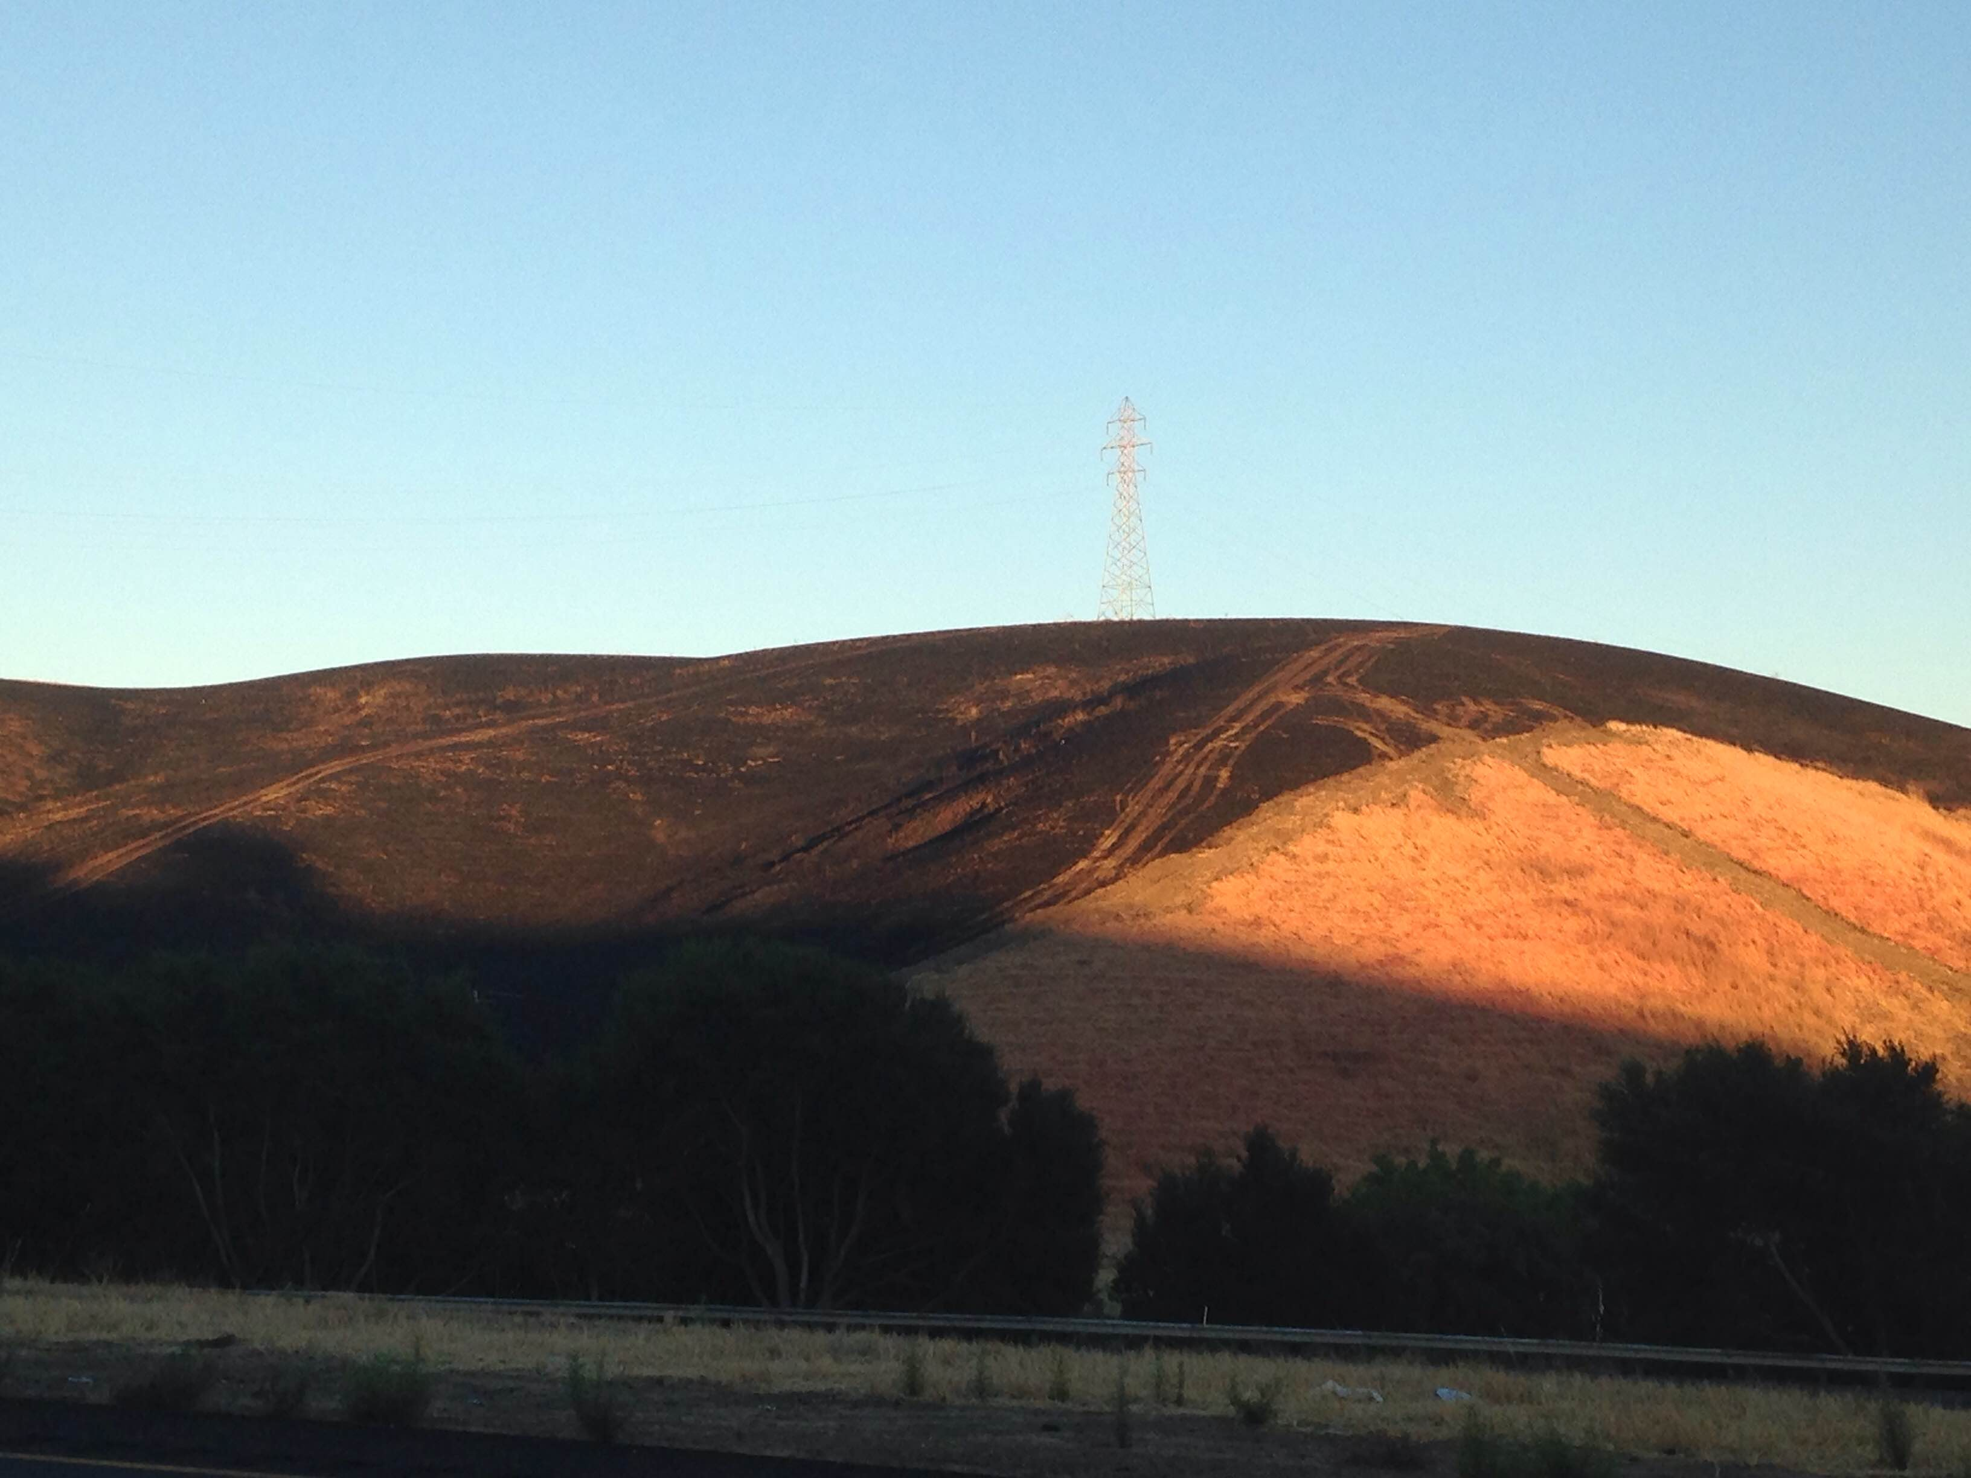
The Effect of Climate on Fire Activity in California’s Central Valley
MGIS Capstone Proposal
Anthony Bates
Advisor – Dr. Alan Taylor

Slide 2
Outline
Project Background
Study Area
Research Question
Literature Review
Goals and Objectives
Methods
Current Progress
Timeline
Notes:
In this presentation I will give some background information on my project, talk about the proposed study area, pose my research question and hypothesis, review some of the existing literature on fires in California, go over my goals and objectives, my methods, show some graphs of the work that I have done already, and then give my timeline for completing the project.

Slide 3
Background
There are 7 major railroads in the United States and Canada operating on over one hundred thousand miles of track
Fires are a major issue for railroads
Both caused by 3rd parties/weather or coming from the railroad
Railroads must maintain the vegetation growing along the right of way
Rural areas and major cities
Fires can be a huge liability for railroads
Service Disruptions are bad for the railroad and consumers
All of this is very expensive and time consuming
Notes:
There are 7 major railroads in the United States and Canada operating on over one hundred thousand miles of track. In California the main carriers are Union Pacific and Burlington Northern-Santa Fe. Along with UP and BN there are also many “short lines” that run over smaller areas, usually within a city. There are also commuter rails such as BART, the Bay Area Rapid Transit that runs through San Francisco and Oakland, or ACE, the Altamont Corridor Express, which runs from San Jose to Stockton but is also building to run through the rest of the Central Valley.
Railroads have to always be concerned about fires. A lot of things can cause fires along the rail. Weather, like lightning strikes, is a concern for railroads just as it is for anyone. There are also many 3rd party causes too. Transients like to camp out along railroads and under bridges because it is usually protected from the elements and very few people are there to disturb them. Occasionally they start warming fires that get out of hand and can quickly spread to the vegetation around the track. Another 3rd party cause is farmers doing controlled burns in their fields that spread to the track. Finally, railroads themselves can cause fires. Wheels and rails rubbing together, derailments, or engine fires can all cause sparks that can start a fire.
The most effective way for railroads to combat the number and damage done by fires is to take care of the vegetation around the track. There are even laws at different layers of government that dictate how far back the vegetation must be clear cut back from the track.
A major fire can be a huge liability for the railroad. The service disruptions that can result from a fire can set the delivery of goods back days and weeks. This is bad for the customer and consumers as well. A fire that takes out a critical bridge can cost millions of dollars and take several days to rebuild.

Slide 4
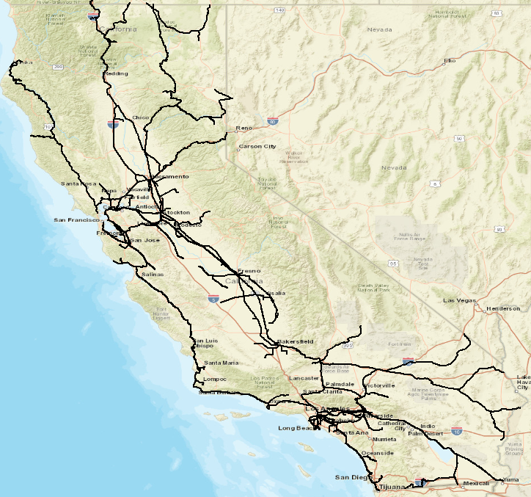
Background Cont.
California has over 6,800 miles of track running through urban areas, mountains, forests, plains, and deserts
More than 6.5 million carloads carrying over 156 million tons of goods
Commuter rails operate on the same tracks
Many of the fires that have been happening in California are near railroad tracks and/or other major transportation corridors
A fire that damages critical infrastructure such as a bridge can shut down a route for days

Slide 5
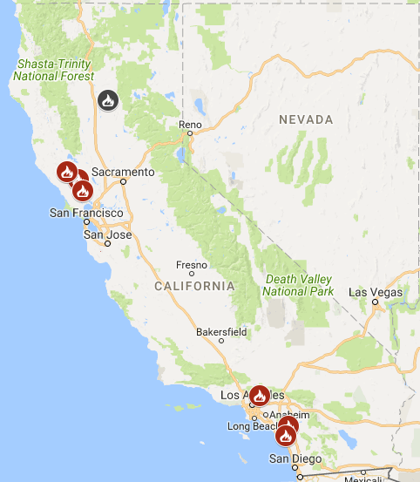
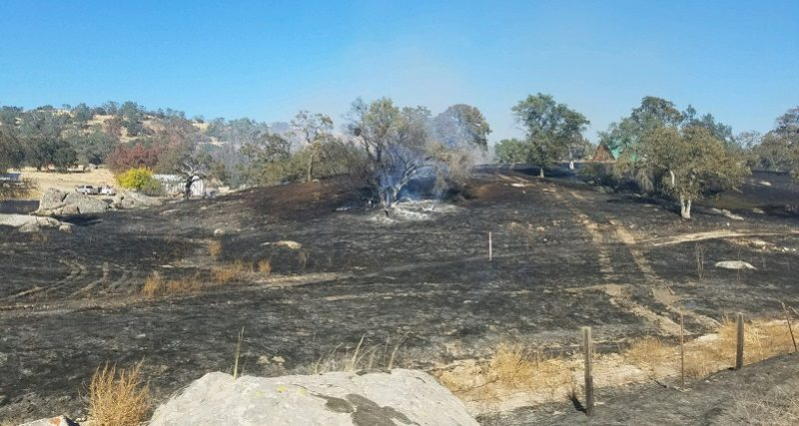
Background Cont.
There are currently 7 wildfires listed as active by CalFire
On October 27 a drunk driver getting stuck on a fence lit the dry grass in a field and burned 6 acres of land near Madera, CA

Slide 6
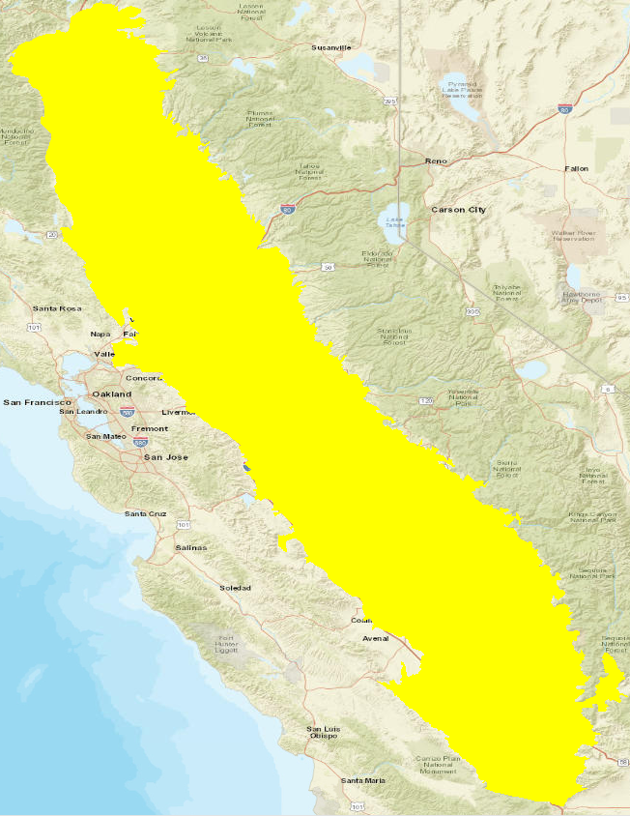
Study Area
The Central Valley in California
18,000 square miles with over 2,000 miles of rail
Between the Sierra Nevada to the east and the Coast Ranges to the west
Heavily agricultural but also has some large cities and woodlands
More than 7 million people
Wooded areas tend to still have a lot of grassy fuels

Slide 7
Why the Central Valley?
There have been many fire related studies done in the northern and southern parts of the state, but relatively few in the Central Valley
Few of these studies focus on grasslands. The majority are done on forests
It has been shown that fire management and suppression techniques can have an effect on the size and severity of fires in addition to that of climate
Pine forests that normally would have a fire every 5-15 years may go much longer between burns
This causes the amount of potential fuel to increase and even leads to changes in the dominant species of the area

Slide 8
Why the Central Valley?
Other studies have shown that more/larger fires occurred in forests during dry years,
At least one study showed that more fires occurred when dry years were preceded by one or more wet year.
Dry years give fuels more time and opportunity to dry out
Wet years can cause more plant growth, especially in grasses, which are primary fuels for fires
When followed by dry years causes more fuel than normal
Do other vegetation types, specifically grasslands, exhibit the same behavior?
Since grasses are fine fuels the wet-dry pattern may be more pronounced

Slide 9
Research Question and Hypothesis
RQ – What is the effect of climate on fire activity in the Central Valley of California?
Hypothesis – Years with more fires in the grasslands of the Central Valley since 1900 are primarily driven by climate variation

Slide 10
Project Goals and Objectives
Determine the relationship between temperature and precipitation (using the Palmer Drought Severity Index) and the number of fires occurring in areas of the Central Valley where the predominate vegetation type is grasslands or shrubs.

Slide 11
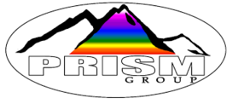
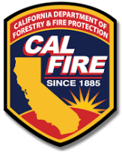
Data Sources

Slide 12
Literature Review
Evidence that the variation in the number of fires that occur in a year is linked to regional climatic variation such as the El Niño-Southern Oscillation (ENSO)
However, in years with more fires than normal temperatures were above average and precipitation was below average
Topology is largely similar across all grasslands in the Central Valley so it is unlikely to play a significant factor compared to climate

Slide 13
Literature Review Cont.
Many studies have shown or postulated that climate can have an effect on the occurrence of fires months or even years in advance
Wet years/seasons spur growth of grasses and other small plants which, when dry, are a primary source of fuel
ENSO is the main driver of the wet/dry cycles in California
These studies focused heavily on woodlands, but the proposed effects of the antecedent climate were on the grasses and other herbaceous vegetation growing on the forest floor

Slide 14
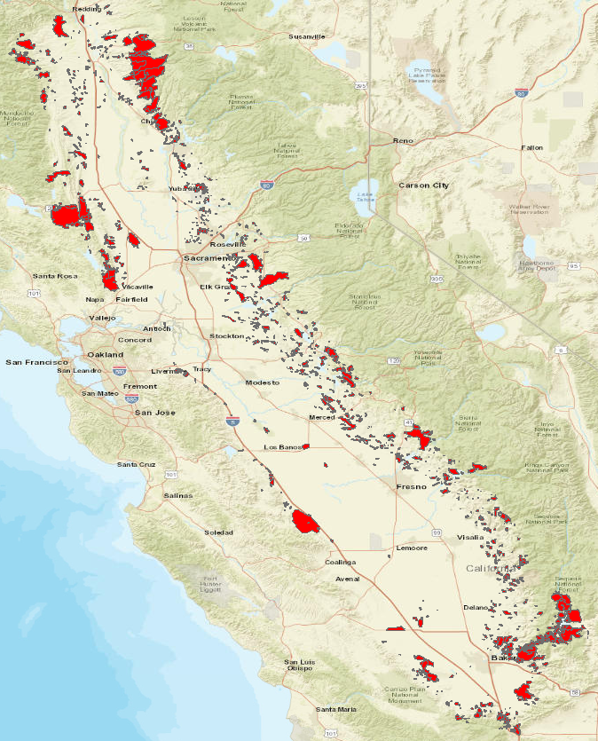
Methods
Gather fire data from Cal Fire’s Fire and Resource Assessment Program (FRAP)
Get climate data from PRISM and National Climate Data Center
Use GIS to filter fire data for the Central Valley and overlay fires with climate data

Slide 15
Methods
Use Superposed Epoch Analysis (SEA) and Cross Correlation Analysis to study the relationship between climate and fires
SEA –statistical method for evaluating the periodic relationship between two different types of events
Cross Correlation Analysis – compares two time series by examining the temporal difference from one to another

Slide 16
Current State
Notes:
Currently I have done some investigating of the data to get a better understanding of when the fires in the Central Valley occur. The first graph shows the number of fires that happened in shrub or grassland each year. You can see there are several clusters periods where the number of fires rises sharply. There are a few explanations for this. First, the population of California has risen steadily over this time period. In 1900 the population of California was about 1.5 million. In 1950 it had risen to 10 and a half million, and by 2010 it was over 37 million. Humans are a major cause of wildfire so as more people moved into California there were more chances to start fires. Second, as the population grew, there were more people to detect and report fires. Also, as technology has improved it is possible for entities like the Forest Service to use satellites to detect and track fires. It is possible that wildfires deep in the mountains would have gone undetected or reported in 1900 but now there is an accurate count at all times of where fires are burning. The third factor, and the one which I am studying, is climate. Even as the totals get higher and higher there are still years that have more and years that have fewer. It will be interesting to see how wet and dry years match up.

Slide 17
Current State
Notes:
The graphs on this page shows the count and cumulative area by week of all of the Central Valley fires since 1900, regardless of the vegetation type. What I found interesting about these graphs is that the rise in starts doesn’t match the rise in cumulative area burned. Starting around mid March to the beginning of April the number of fires begins to rise. To me this shows that conditions at up until this time are not favorable for fires to start. It is too cold and/or too wet. The cumulative area of fires doesn’t start to really go up until around Mid June and lasts until the end of September. So while there are generally fewer fires a week from June to September as compared to April to Mid June the fires later in the summer are much larger.
Week 25 – Mid June
Week 39 – End of Sept

Slide 18
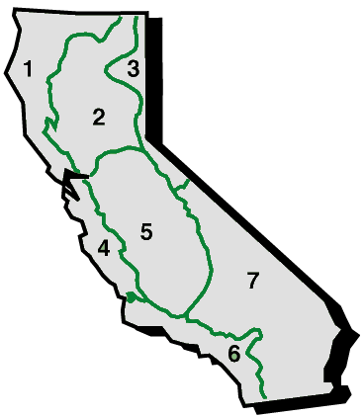
Current State
Monthly precipitation data for the state of California and Palmer Drought Severity Index (PDSI) data for the central valley for every year since 1900
PDSI data is based on drainage zones. The Central Valley lies in the Sacramento and San Joaquin drainages
I will run analyses separately for each zone
The precipitation data is from the PRISM Climate group and is raster data roughly 4x4 km that I have clipped to the state of California

Slide 19
Timeline
Peer Review Presentation
Capstone Presentation
Oct 31
Nov 7
June 15
Dec 20
2017
October
Nov
Dec
Jan
Feb
Mar
Apr
May
June
2018
6 days
Today
Complete Project
Nov 1 – May 31
18 days
GEOG 892
Feb 21 – May 2
24 days
16 days
25 days

Slide 20
Sources
California Department of Fish and Wildlife https://www.wildlife.ca.gov/Data/BIOS retrieved 8/24/2017
Cal Fire Fire and Resource Assessment Program (FRAP) http://frap.fire.ca.gov/ retrieved 8/23/2017
California Open Data Portal https://data.ca.gov/ retrieved 10/12/2017
Dillon, G. K., Z. A. Holden, P. Morgan, M. A. Crimmins, E. K. Heyerdahl, and C. H. Luce. (2011). Both topography and climate affected forest and woodland burn severity in two regions of the western US, 1984 to 2006. Ecosphere. 2(12):130. doi: 10.1890/ES11-00271.1
Grass Fire Image. http://martinezgazette.com/archives/26140 retrieved 10/25/2017

Slide 21
Sources
National Climate Data Center https://www.ncdc.noaa.gov/ retrieved 8/23/2017
Harris, L. & Taylor, A.H. (2015). Topography, fuels, and fire exclusion drive fire severity of the rim fire in an old-growth mixed-conifer forest, Yosemite National Park, USA. Ecosystems 18: 1192. https://doi.org/10.1007/s10021-015-9890-9
Sierra News Online. https://sierranewsonline.com/woman-arrested-for-suspicion-of-dui-after-crash-starts-fire/. Retrieved 10/30/2017
Swetnam, T. W., & Betancourt, J. L. (1998). Mesoscale disturbance and ecological response to decadal climatic variability in the american southwest. Journal of Climate, 11(12), 3128-3147. Retrieved from http://ezaccess.libraries.psu.edu/login?url=https://search-proquest-com.ezaccess.libraries.psu.edu/docview/222925543?accountid=13158
Taylor, A.H., & Beaty, R.M. (2005). Climatic influences on fire regimes in the northern Sierra Nevada Mountains, Lake Tahoe Basin, Nevada, USA. Journal of Biogeography. 32(3), 425-438
USDA Forest Service. https://fsapps.nwcg.gov/googleearth.php
Wikipedia. https://en.wikipedia.org/wiki/Central_Valley_(California). Retrieved 10/17/2017

