Slide 1
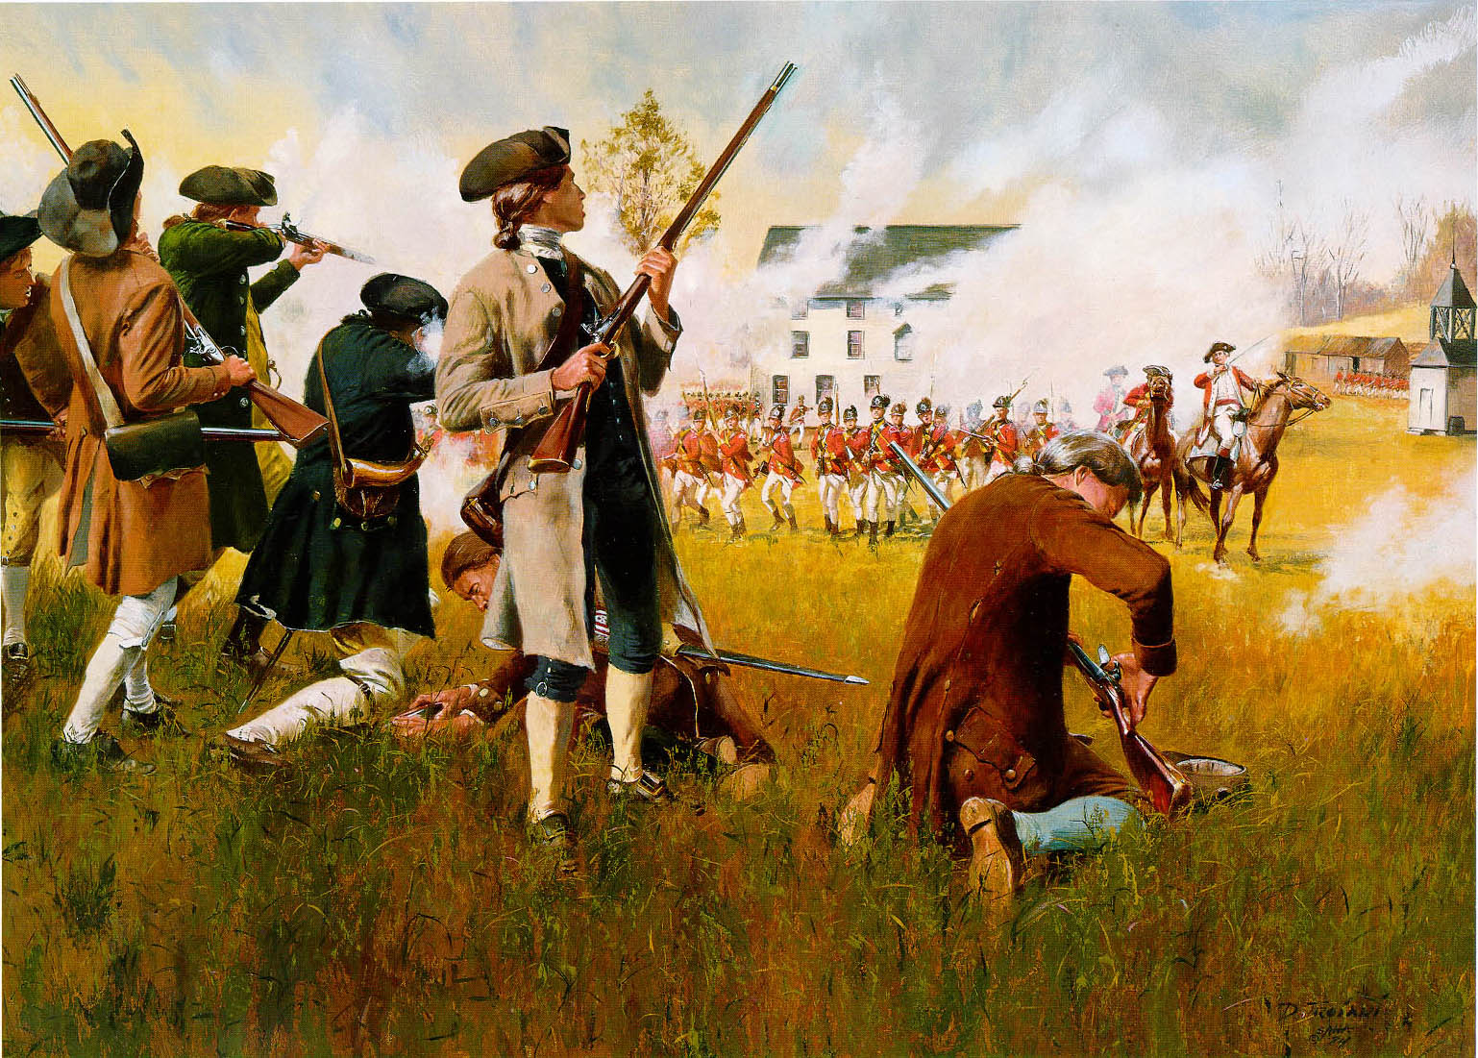
Modeling Small Arms Projectile Distribution on 18th and 19th Century Battlefields
Brandon Batt
Advisor: Dr. Todd Bacastow
GEOG 596A – Individual Studies - Peer Review
The Pennsylvania State University

Slide 2
Presentation Outline
Background
Overview of Previous Research
Model
Case Study: Battle of Ridgefield, Connecticut
Project Timeline

Slide 3
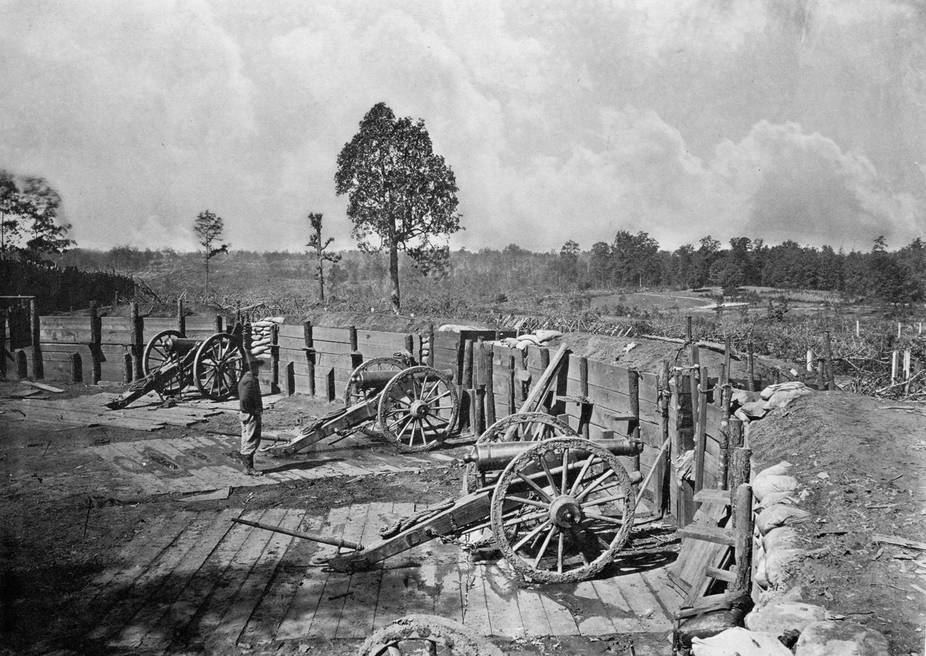
Background

Slide 4
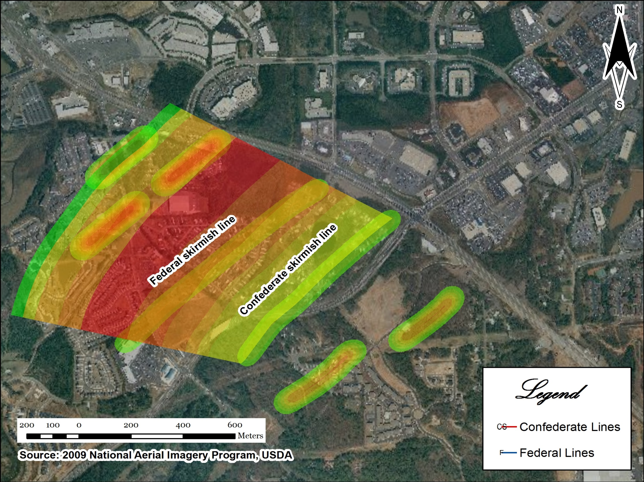
Background

Slide 5
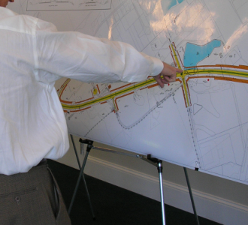
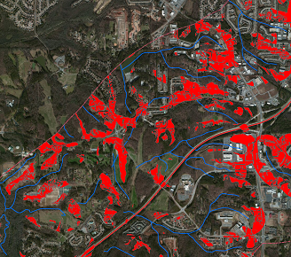
Background

Slide 6
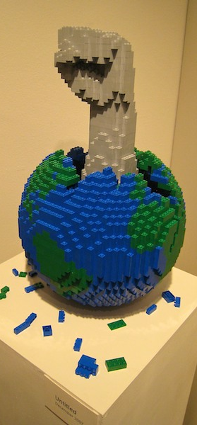
Background
Usable
Inexpensive
Distributable

Slide 7
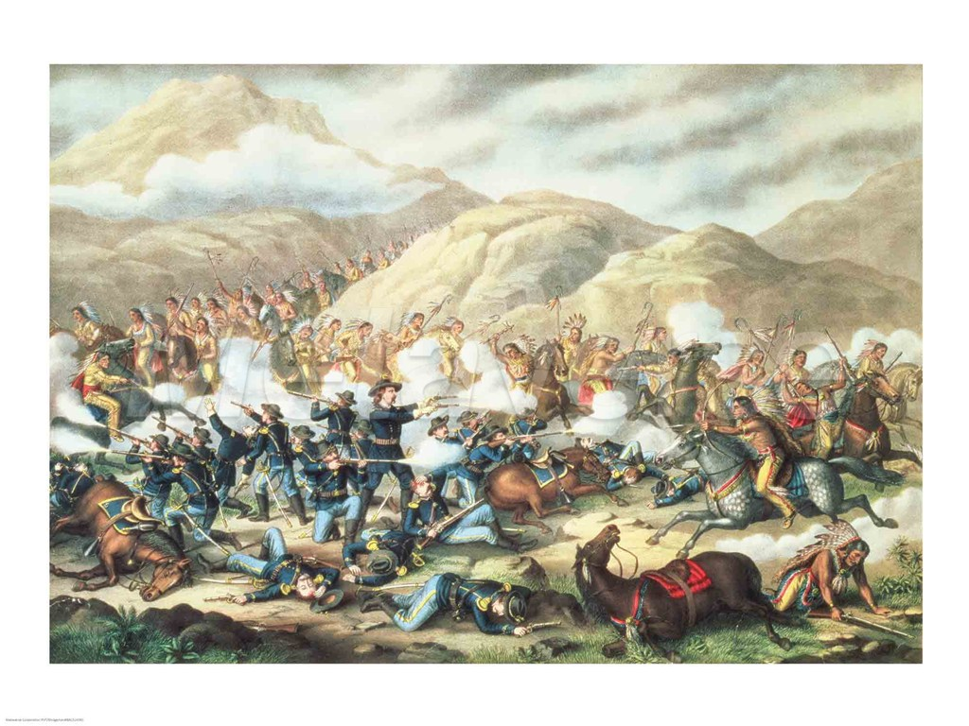
Research
Battle of Little Bighorn (Benson 2000)
Goal: Establish origin of five .40 caliber bullets
Methodology: Cumulative viewshed + effective weapon range

Slide 8
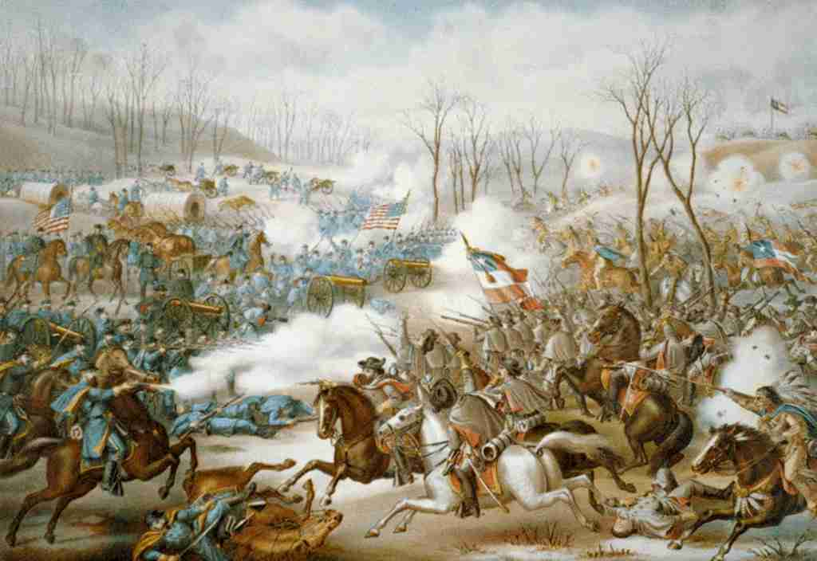
Research
Battle of Pea Ridge (Drexler 2004)
Goal: Model artillery capability from presumed locations
Methodology: Linear regression of artillery canister shot scatters (Hanson and Rowe 1985).

Slide 9
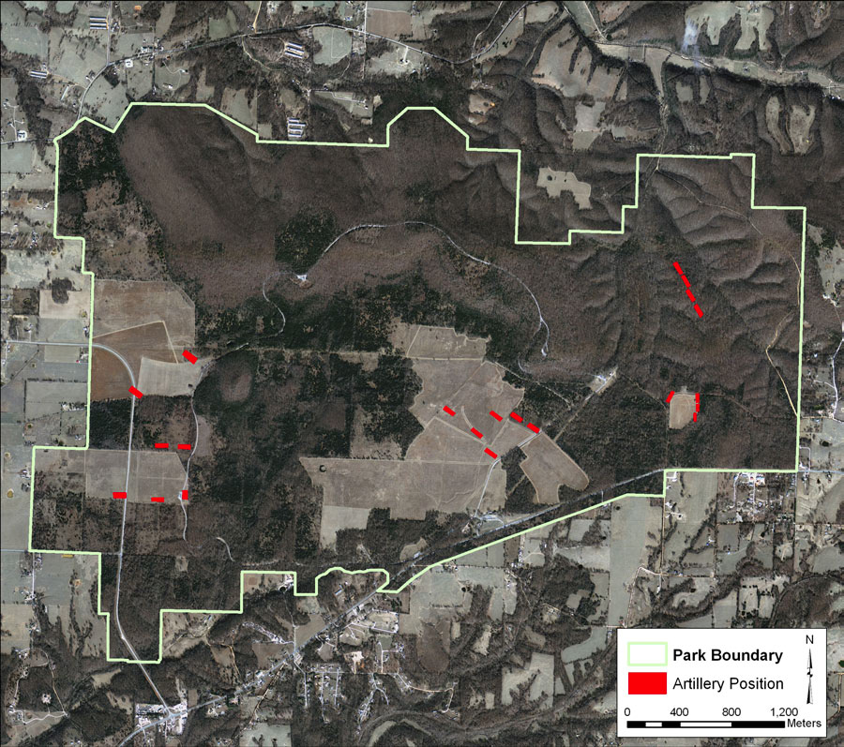
Research

Slide 10
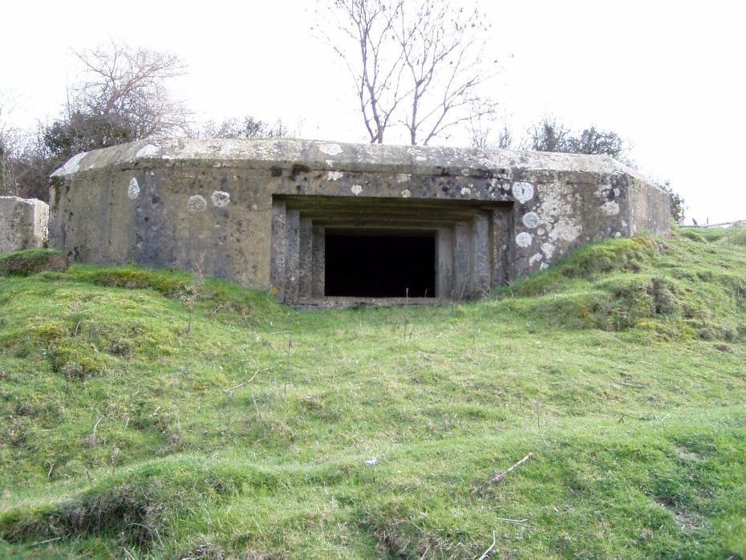
Research
Tuanton Stopline (Lacey 2003)
Goal: Model defensive capability from well known origin points (‘Fireshed’)
Methodology: Cumulative viewshed + innovative trajectory modeling

Slide 11
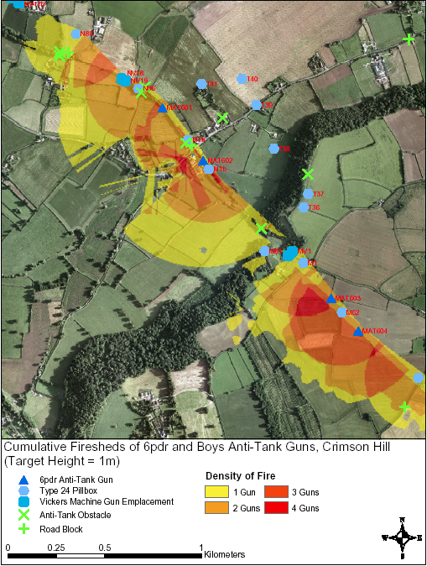
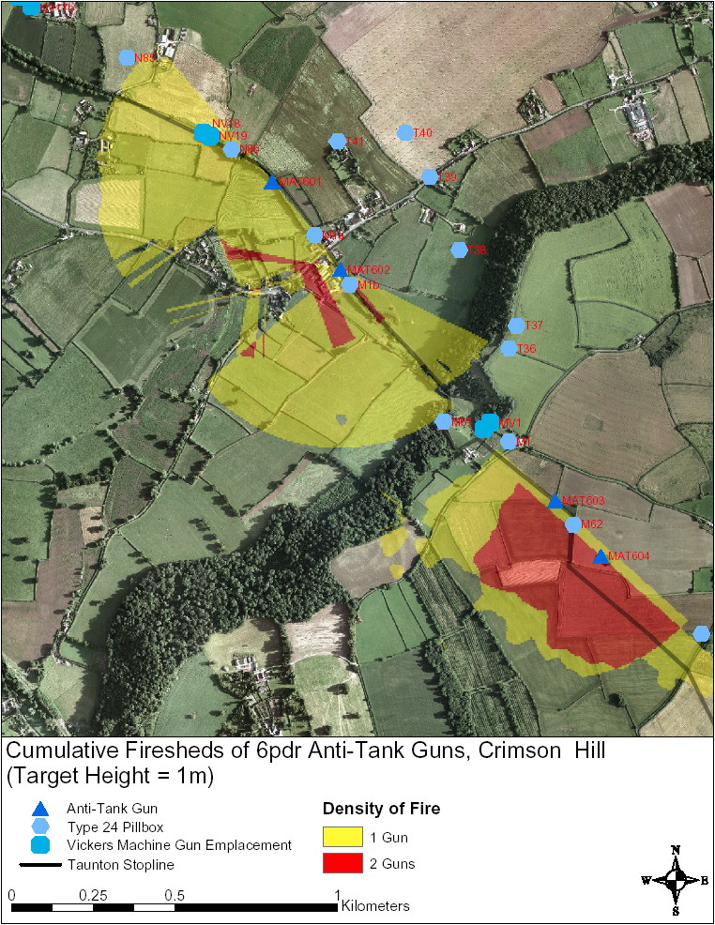
Research

Slide 12
Research
Greasy Grass Episode, Battle of Little Bighorn (1876)
Goal: Determine target and origin positions based on impact locations
Methodology: Extract feasible trajectories based on established criteria
Military ballistics engine (McTraj 4.1)
Cumulative viewshed from the Company C skirmish line, showing feasible trajectories from modeled firing points (Athanson 2006)

Slide 13
Research
User-Agent Model
Goal: Simulate an engagement to establish effective field work strategy
Methodology: Apply specific behaviors to discrete points (soldiers)
Requires a high-performance computing environment (Pandora and Cassandra)
Agent based model within Cassandra program
(Campillo et. al 2003)

Slide 14
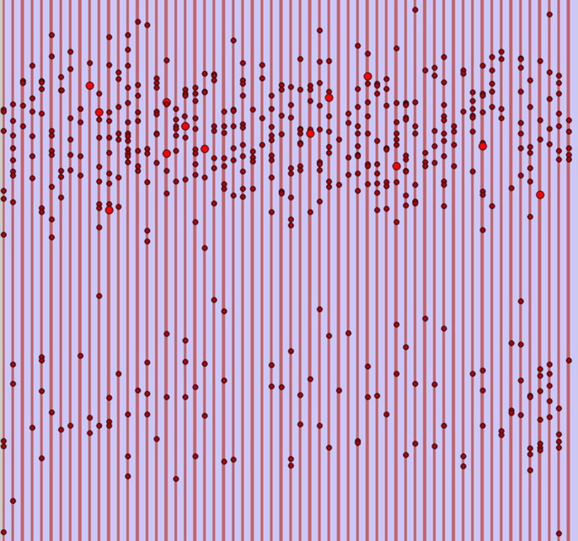
Research
User-Agent Model
Goal: Simulate an engagement to establish effective field work strategy
Methodology: Apply specific behaviors to discrete points (soldiers)
Requires a high-performance computing environment (Pandora and Cassandra)
Simulated excavation with 30% battlefield degradation, a distance of 5 m and parallel direction
(Campillo et. al 2003)

Slide 15
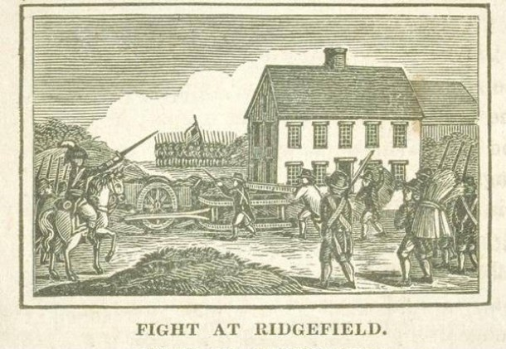
Battle of Ridgefield
April 27, 1777

Slide 16
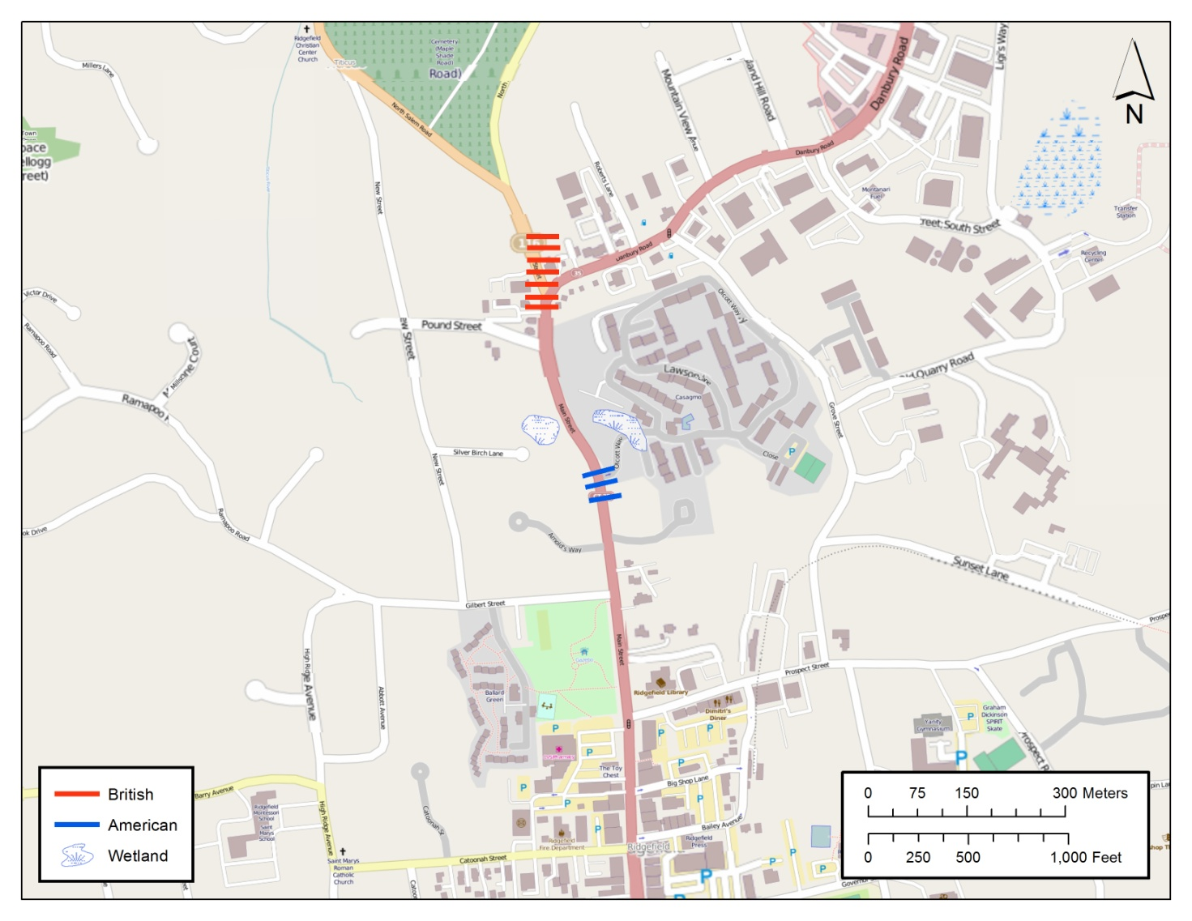
Battle of Ridgefield

Slide 17
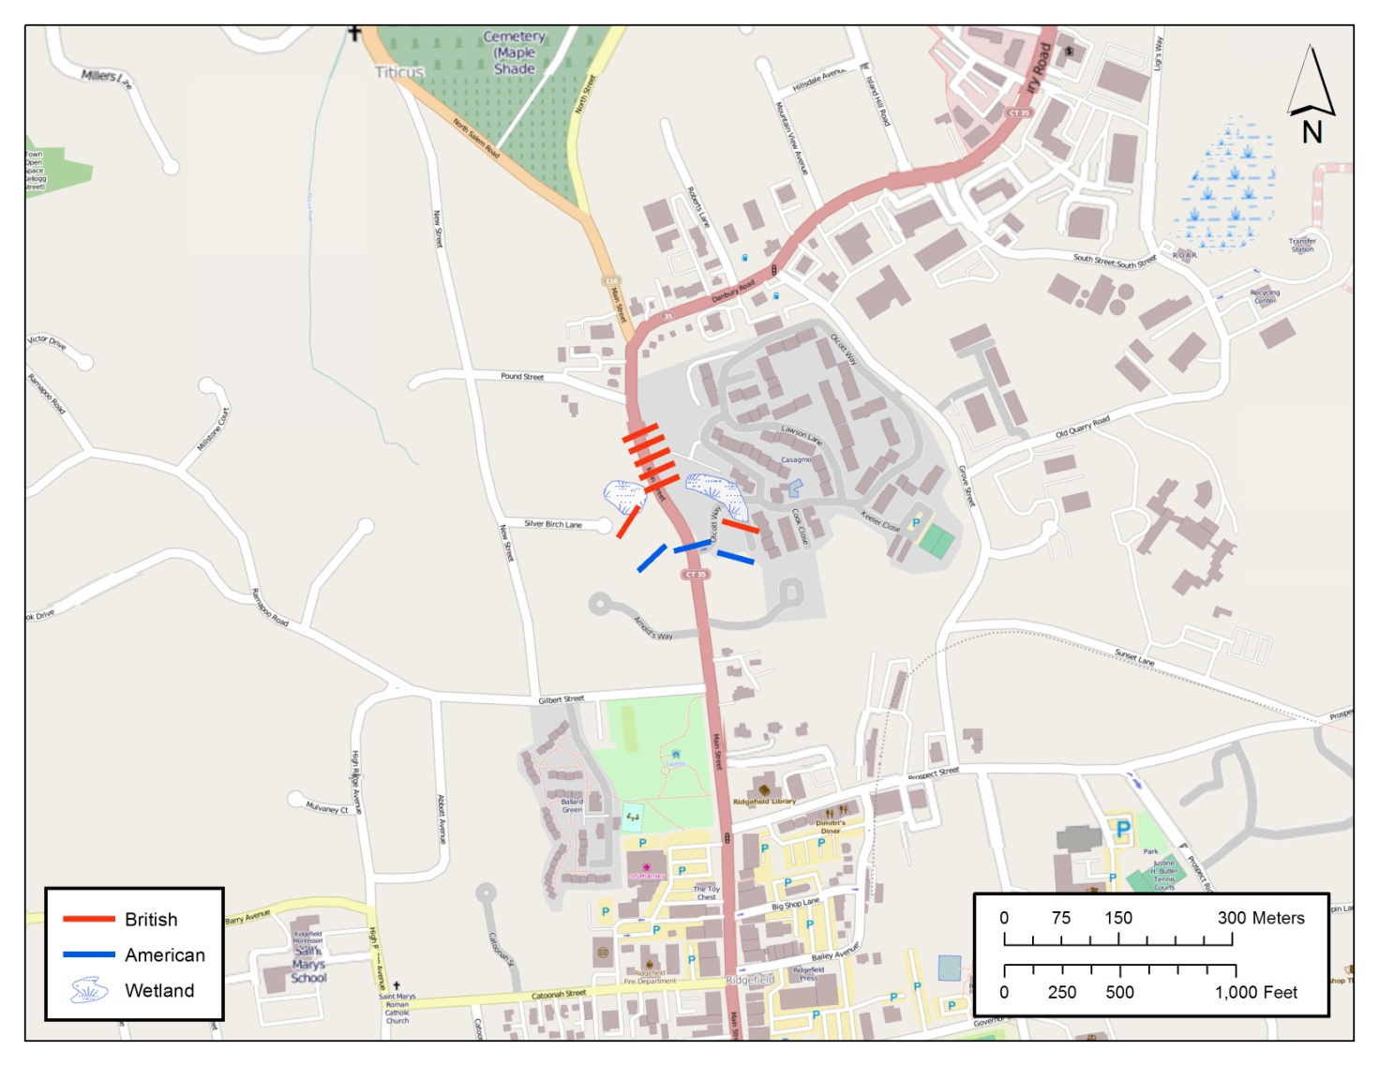
Battle of Ridgefield

Slide 18
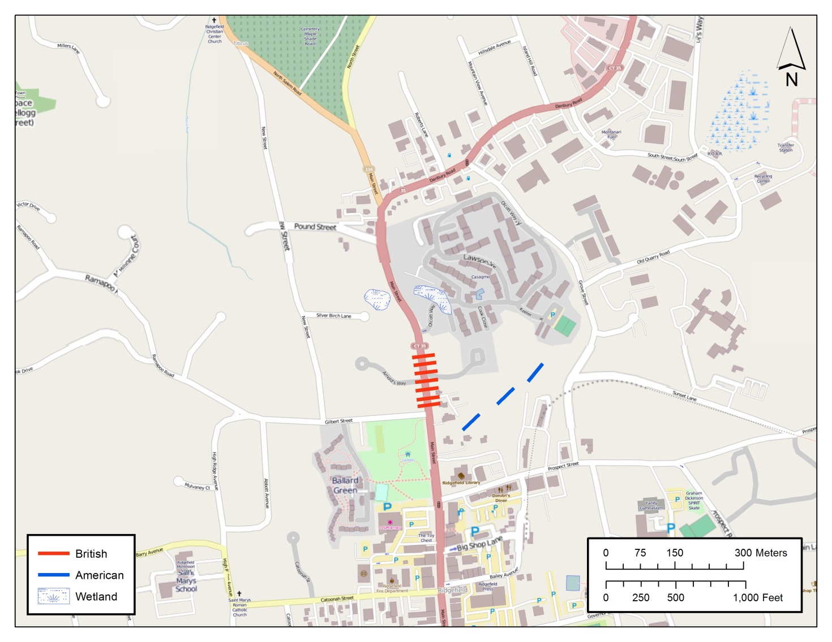
Battle of Ridgefield

Slide 19
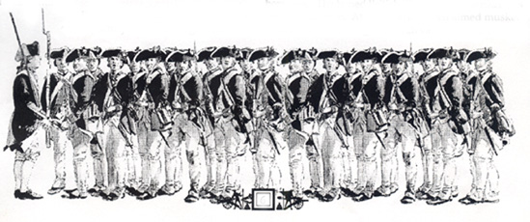
Model

Slide 20
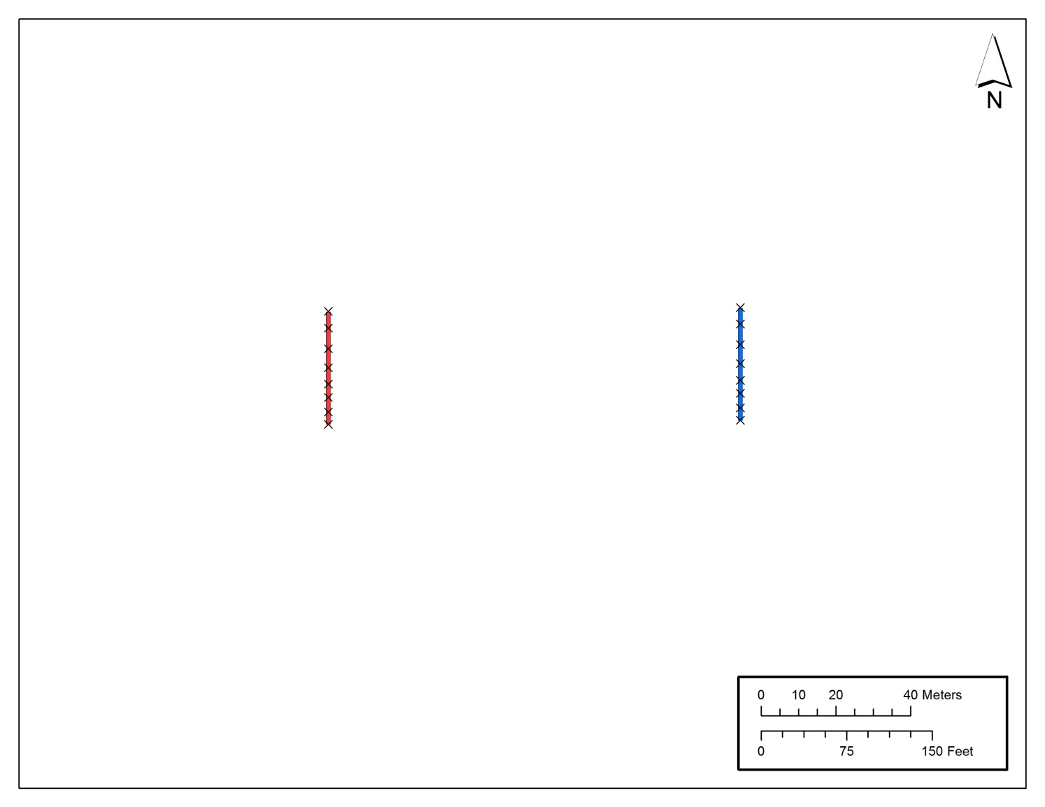
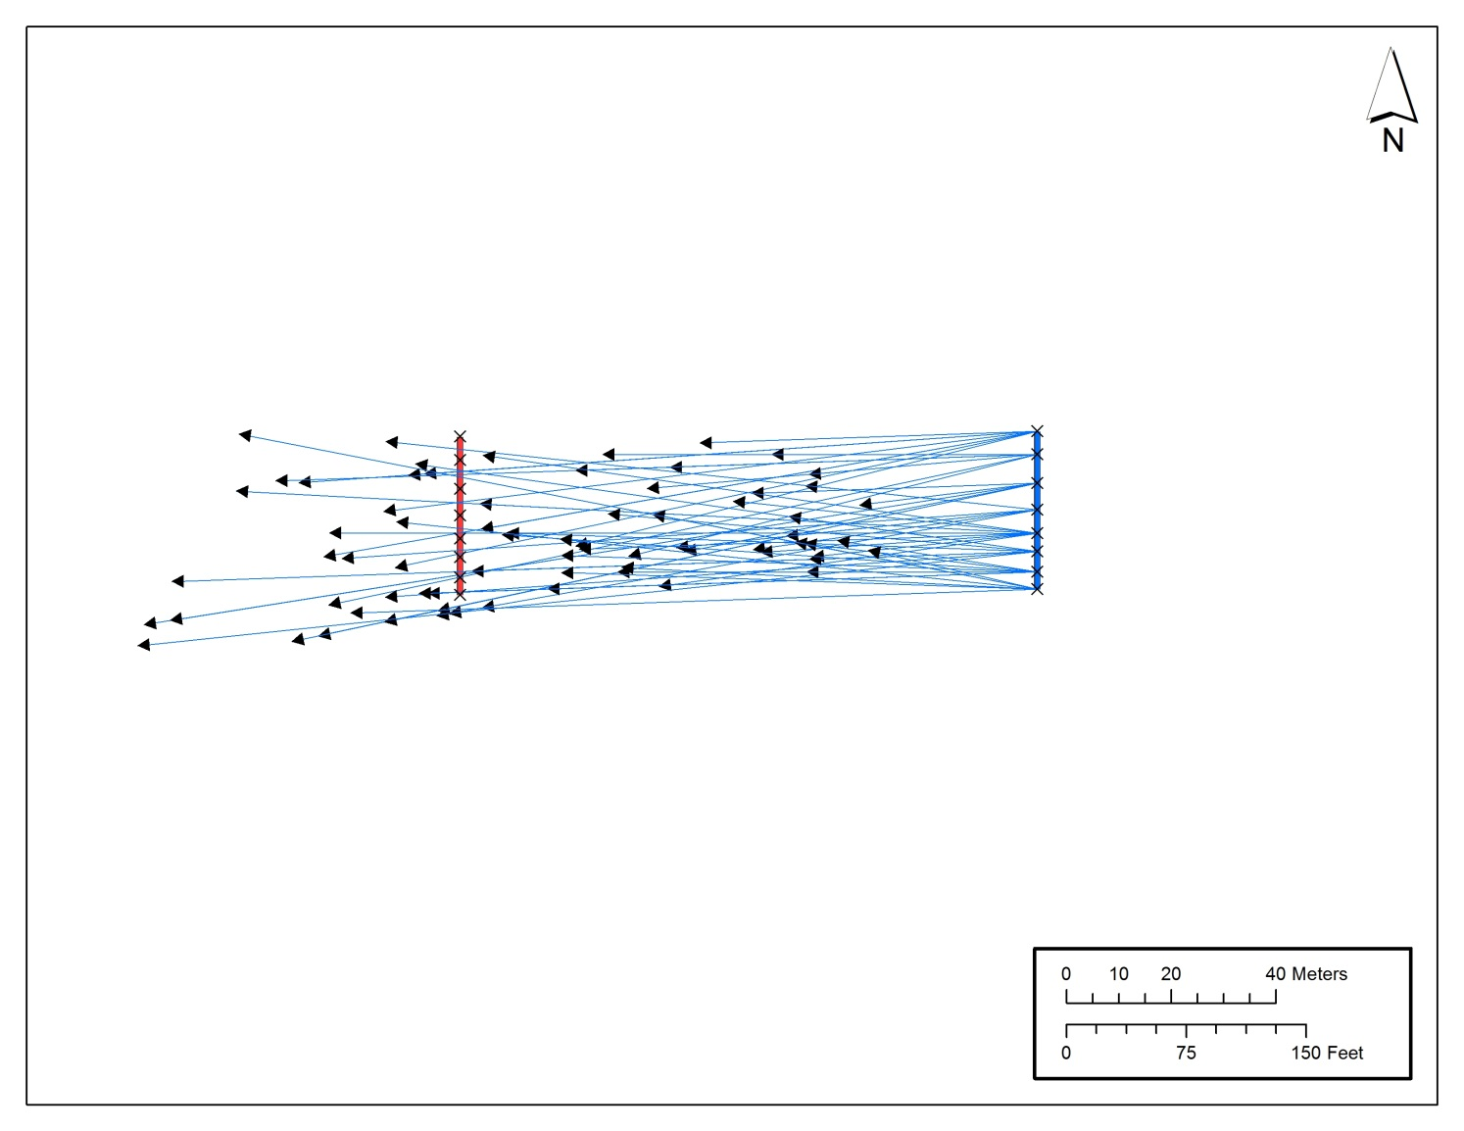
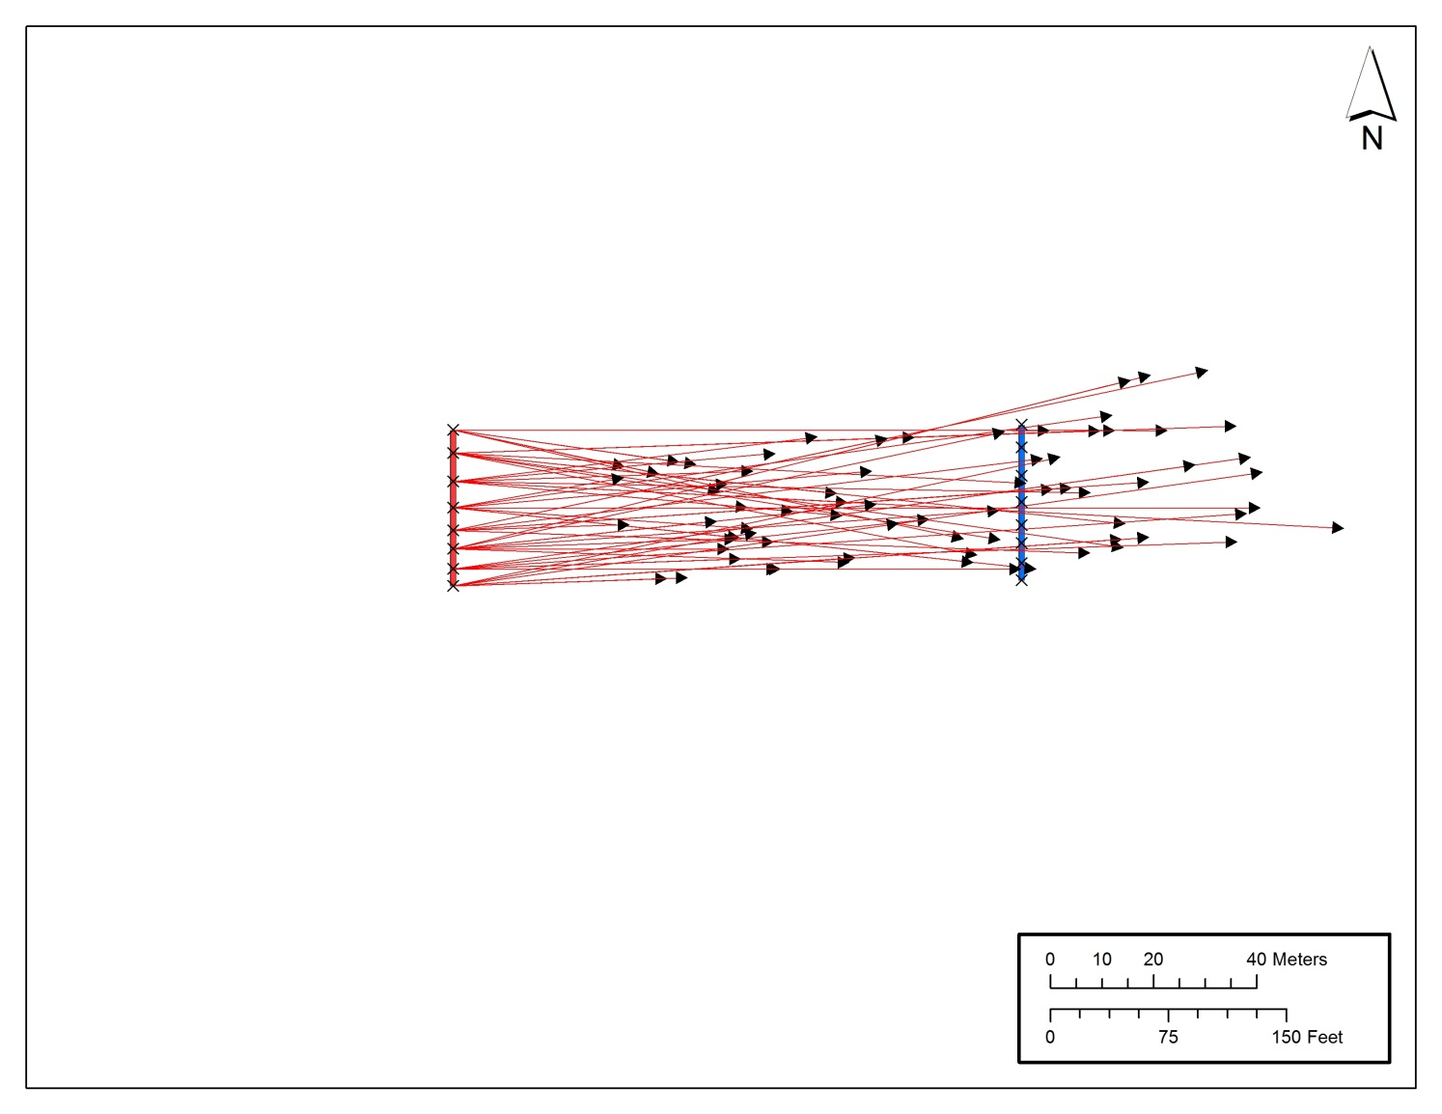
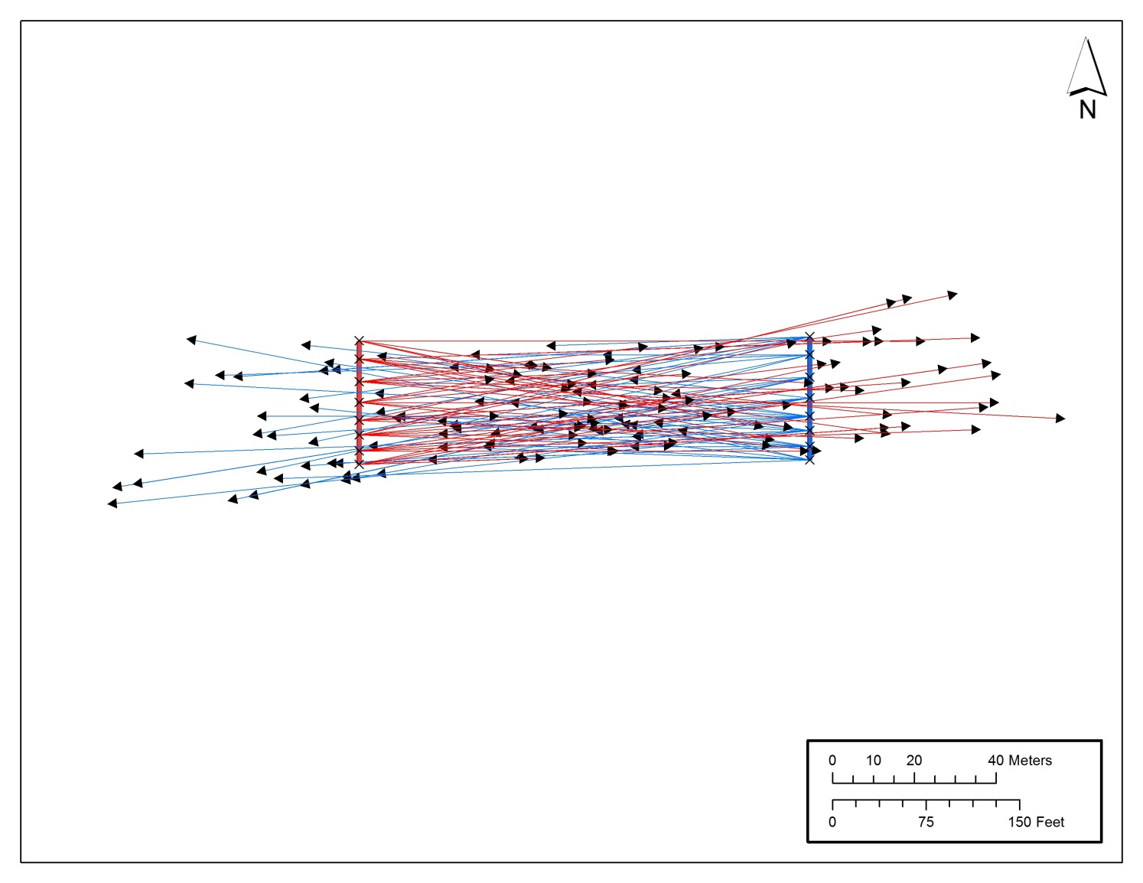
Model

Slide 21
Model
Origin + Target (Polyline features)
Once defined, each will know the location of the other
Polyline features with a number of discrete vertices
Calculate shots fired for each feature:
British forces: 3 rounds per minute
American forces: 2 rounds per minute
Length of engagement: 15 minutes
Soldiers per line: varies

Slide 22
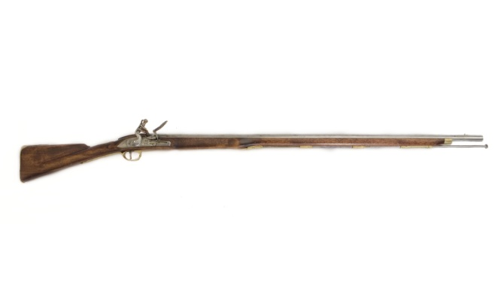
Model
Initial Muzzle Velocity
Vertical Angle of Fire
Horizontal Angle of Fire

Slide 23
Model
Initial Muzzle Velocity:
Defined as a range, dependent on weapon
Smooth bore muskets known for inconsistency
- Powder Consistency
- Barrel construction
- Escaping gases
Solution: Select random muzzle velocity from within range
Initial Muzzle Velocity

Slide 24
Model
.75 Caliber “Brown Bess” Musket

Slide 25
Model
Vertical Angle of Fire:
Consider proximity to target (~100 yards)
Consider target elevation relative to origin
Partial Solution: Extract origin and target point elevations and generate straight boreline to target point based on angle between coordinates
Vertical Angle of Fire

Slide 26
Model
Horizontal Angle of Fire:
Linear tactics: volleys at general target
Linear target versus single point
Solution: Generate target vector from random vertex in target
Horizontal Angle of Fire

Slide 27
Model
Calculating Trajectory Distances:
Assume “line-of-sight” is unimpeded
Based on well known equations (relatively simple in vacuum):
Incorporate projectile characteristics and air resistance (Euler’s Method or similar)
Drag coefficient for spherical projectiles based on experimental data (Pollard 2008)

Slide 28
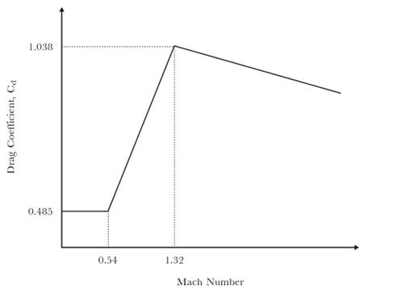
Model
Calculating Trajectory Distances:
Drag coefficient for spherical projectiles based on experimental data (Pollard 2008)

Slide 29
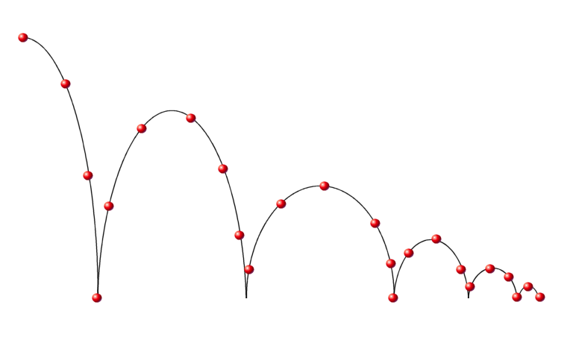
Model
Bounce and Roll

Slide 30
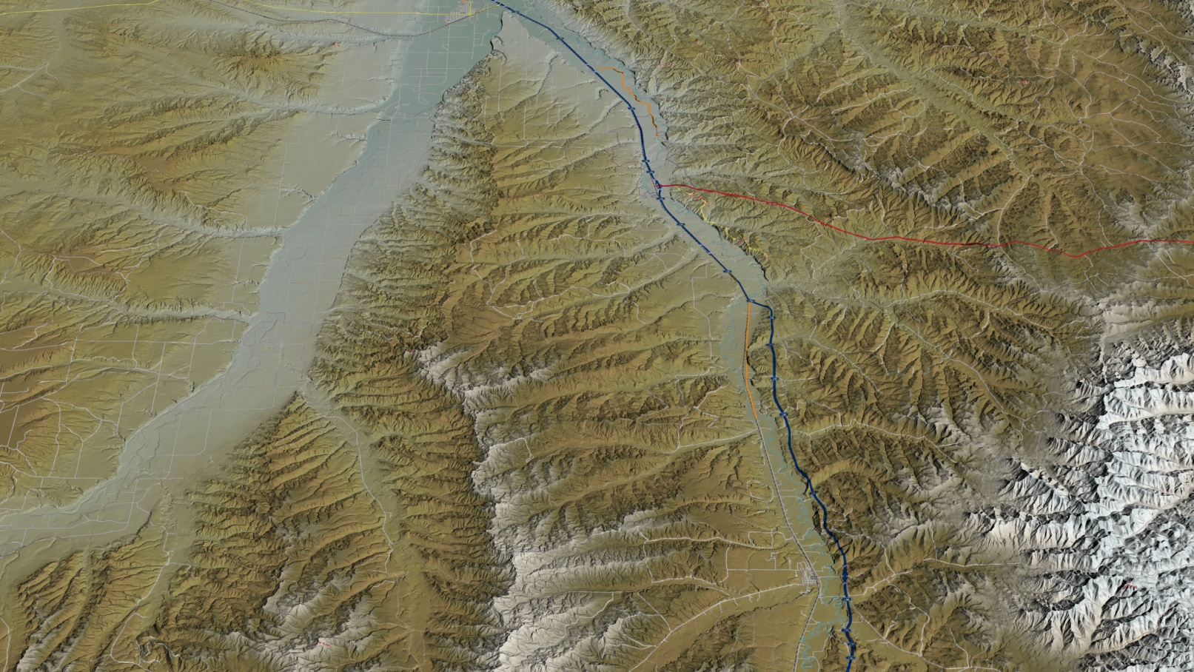
Model
Detailed Terrain Characteristics and Land Use

Slide 31
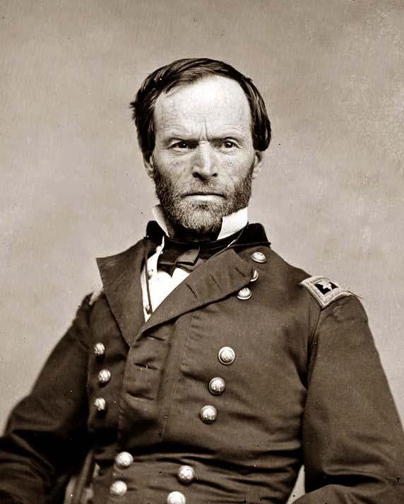
Assume “line-of-sight” is unimpeded
Based on well known equations (relatively simple in vacuum):
Model
“I am tired and sick of war. Its glory is all moonshine. It is only those who have neither fired a shot nor heard the shrieks and groans of the wounded who cry aloud for blood, for vengeance, for desolation. War is hell.”
- William Tecumseh Sherman, December 21, 1864

Slide 32
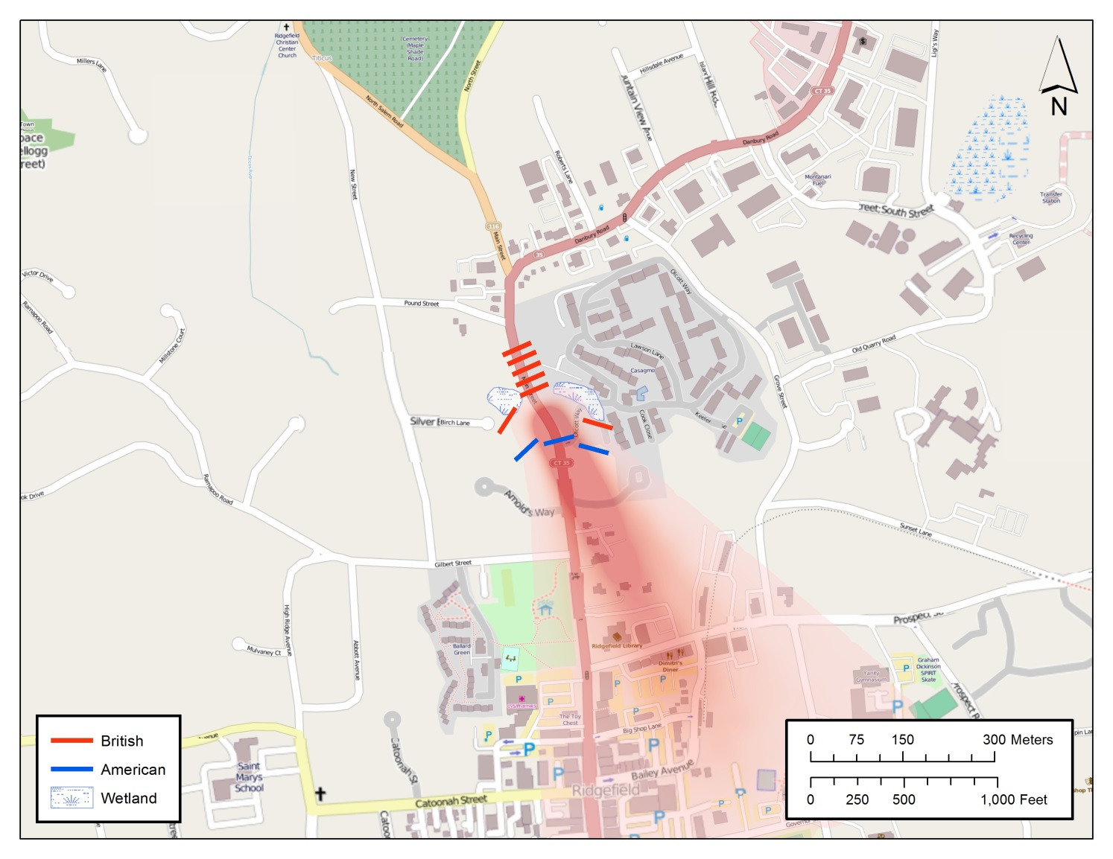
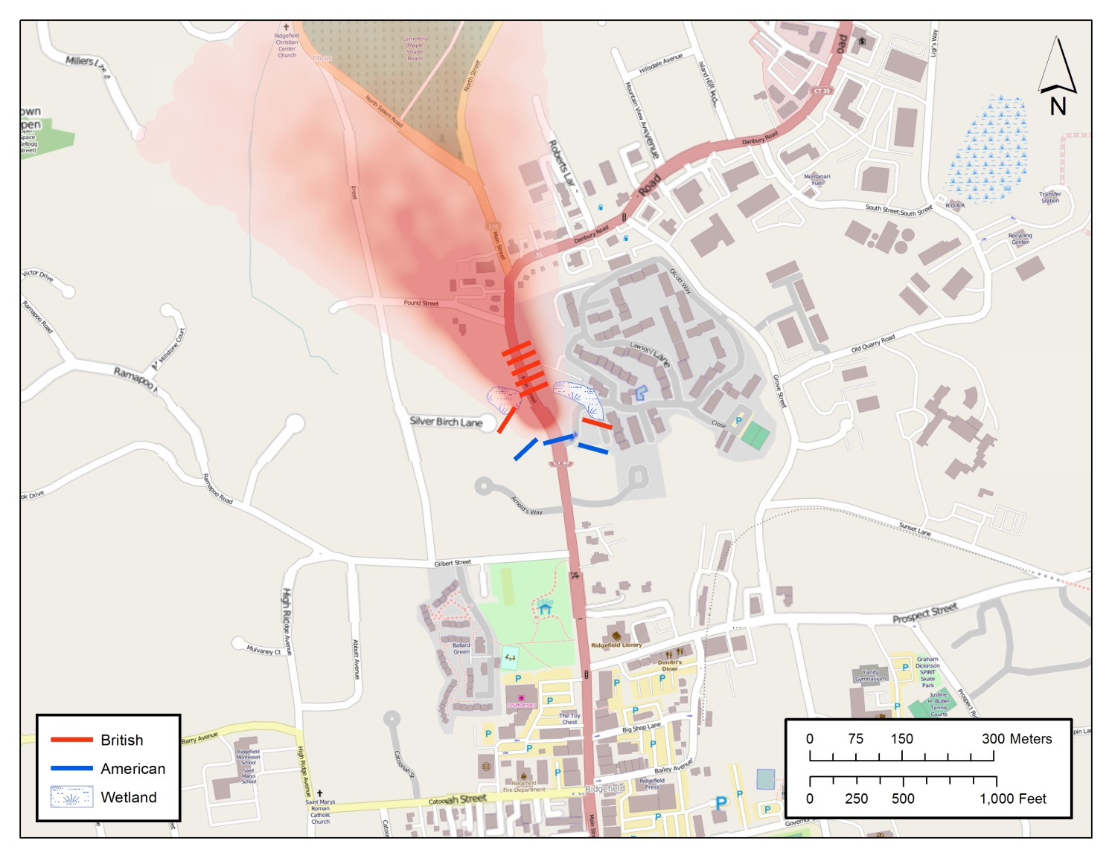
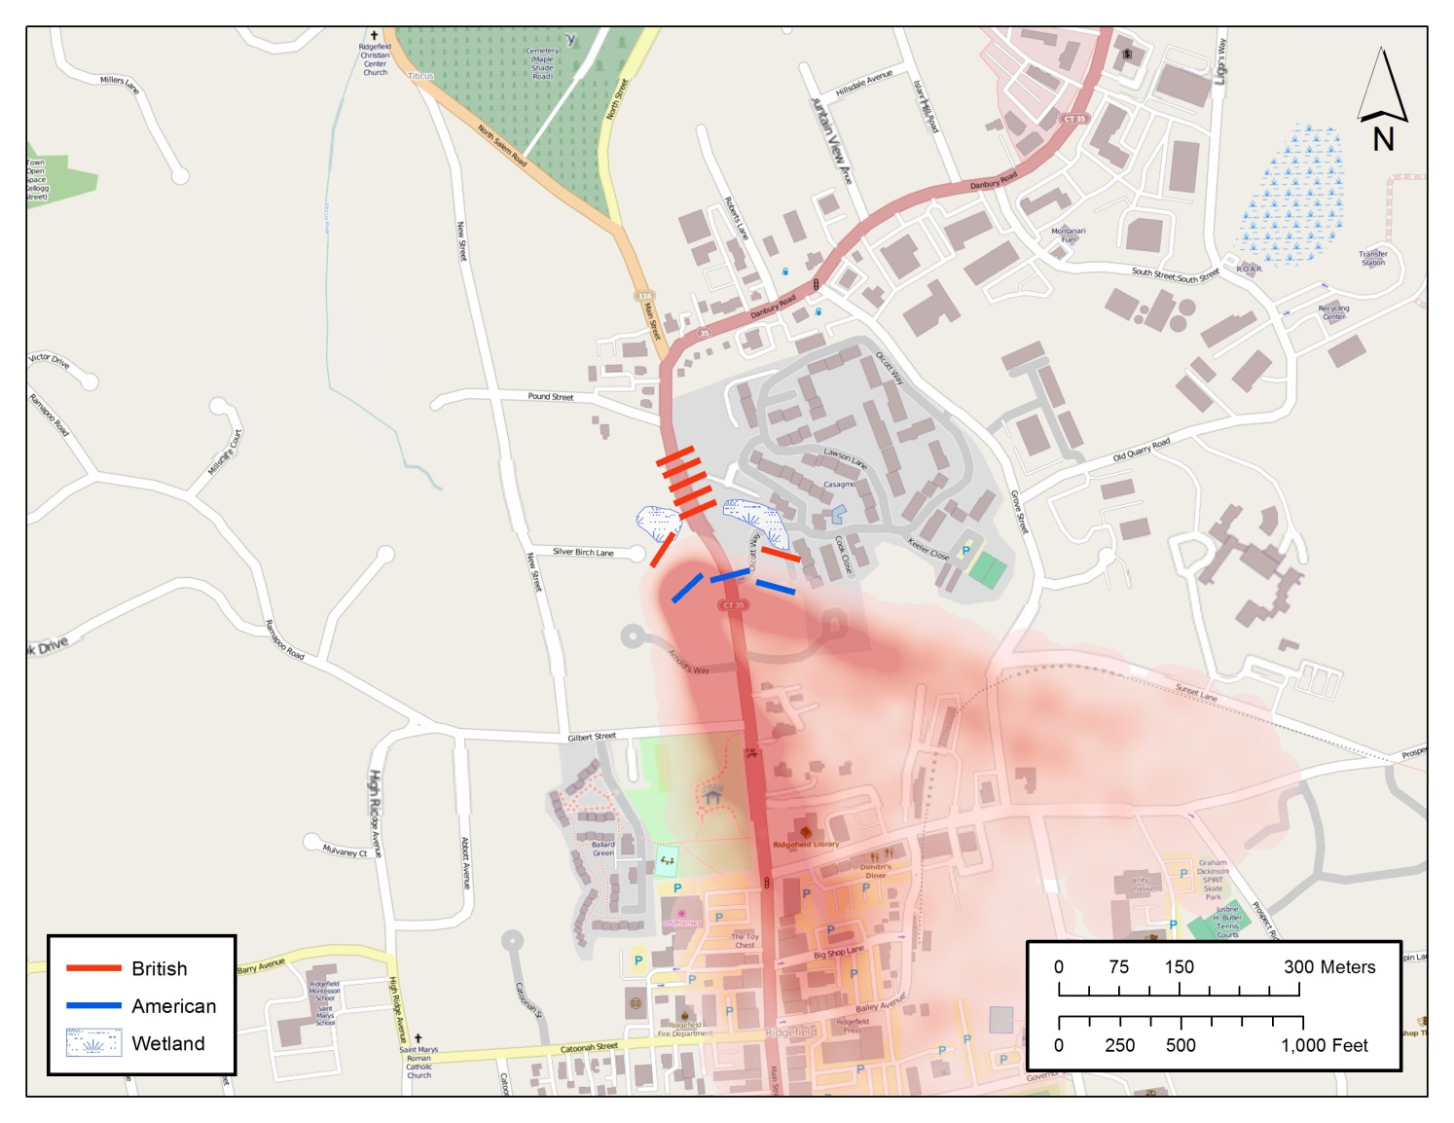
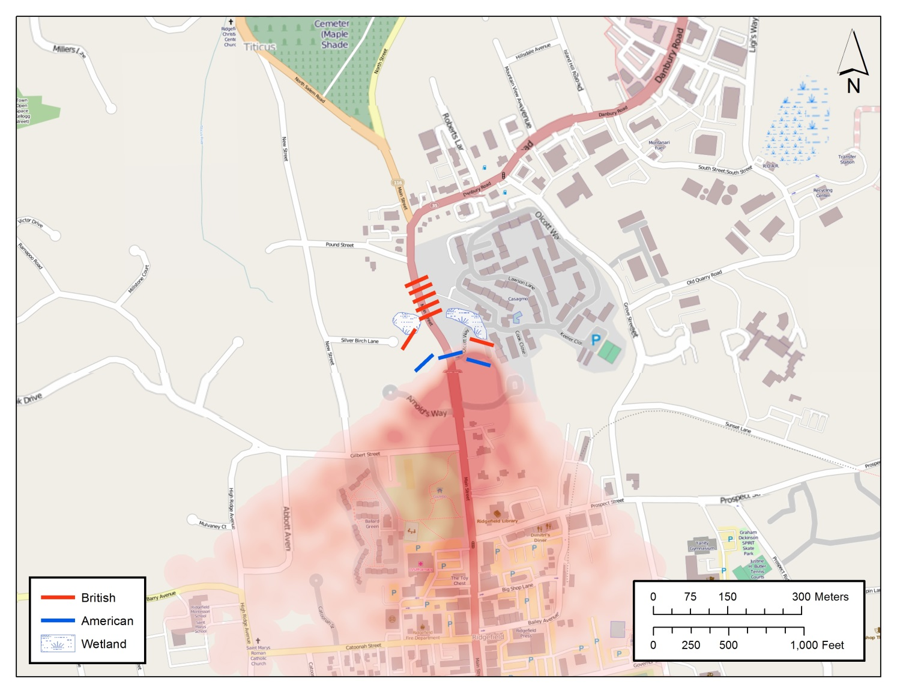
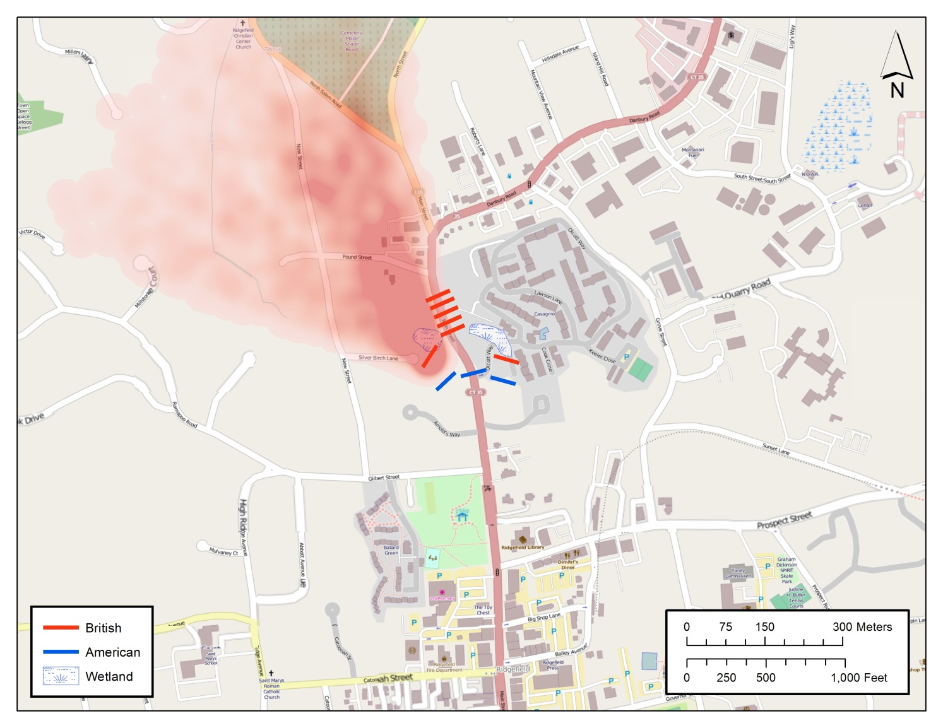
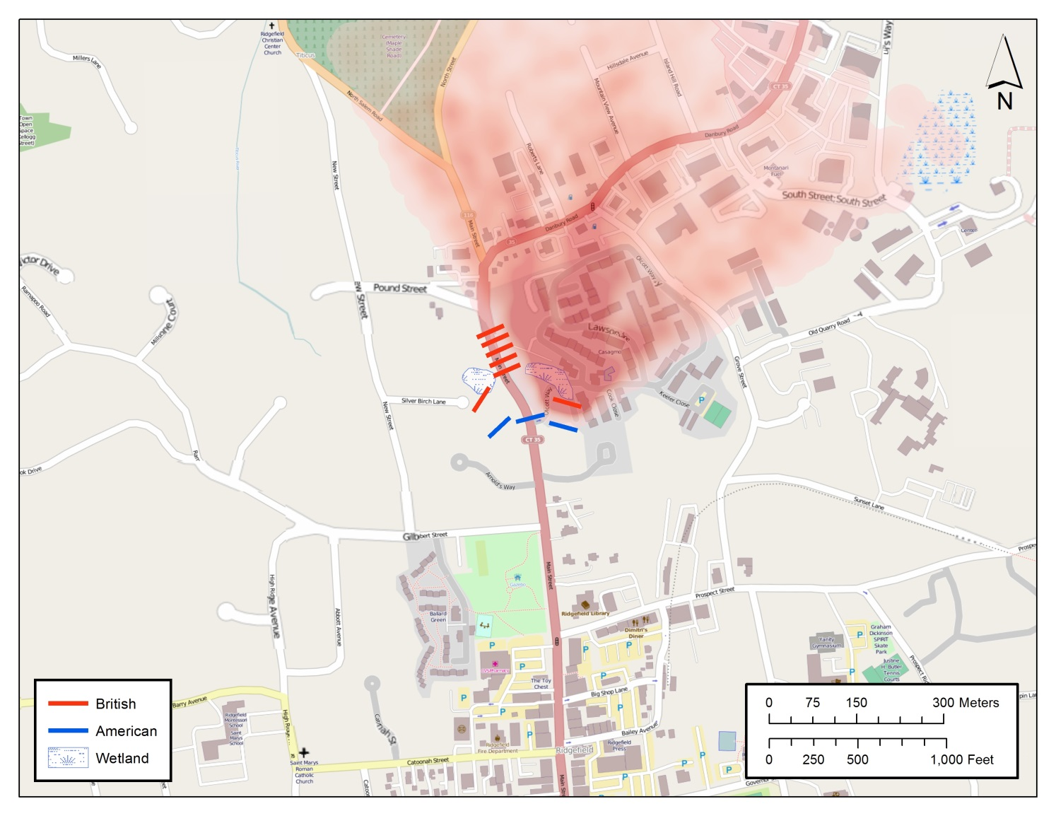
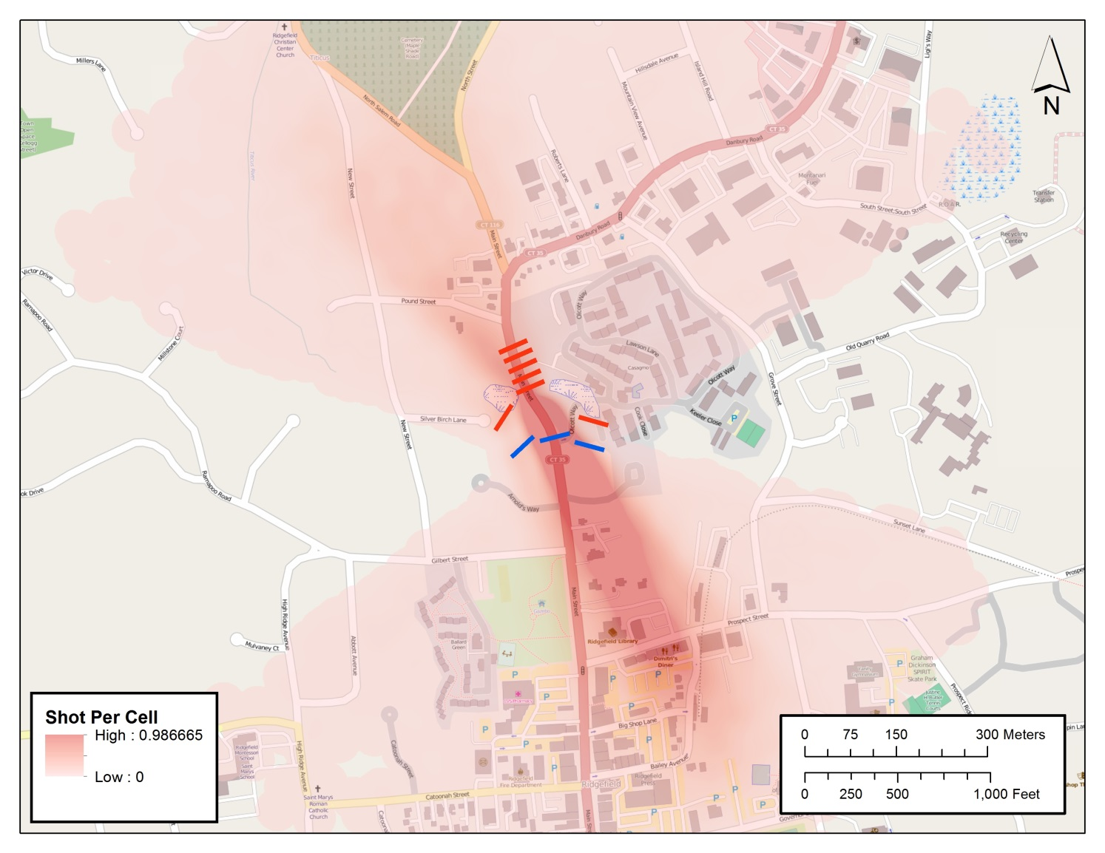
Initial Results

Slide 33
Timeline
Prepare Manuscript (July 2014)
Tool Available (August 2014)

Slide 34
References
Campillo, X. R., Cela, J. M., & Cardona, F. X. (2012, 12). Simulating archaeologists? Using agent-based modelling to improve battlefield excavations. Journal of Archaeological Science, 39(2), 347-356. doi: 10.1016/j.jas.2011.09.020
Kerr Jr, R. E. (1990). Wall of Fire -- the Rifle and Civil War Infantry Tactics. (Master’s Thesis). Available from the Defense Technical Information Center. (ADA227467)
Lacey, C. (2003). Fireshed: The Application of GIS Techniques to Historic Military Data. (Doctoral dissertation). Available from Scribd. (http://www.scribd.com/doc/49310003/Fireshed-The-Application-of-GIS-Techniques-to-Historic-Military-Data)
Lewis, B. R. (1956). Small arms and ammunition in the United States service. Washington: Smithsonian Institution.
Miller, D. P. (2010). Ballistics of 17th Century Muskets (Master’s Thesis). Available from the Cranfield Collection of E-Research. (http://dspace.lib.cranfield.ac.uk/handle/1826/4605)
Pollard, T., & Banks, I. (2008). Scorched earth: Studies in the archaeology of conflict. Leiden: Brill.
Rowe, W., & Hanson, S. (1985, 12). Range-of-fire estimates from regression analysis applied to the spreads of shotgun pellet patterns: Results of a blind study. Forensic Science International, 28(3-4), 239-250. doi: 10.1016/0379-0738(85)90134-3
Silliman, G. W. (2012). Management Summary of Archaeological Investigations at 593 Main Street, Ridgefield, Connecticut. Available from Terminus Archaeological Research, Atlanta, Georgia.
Wade, A. (2013, 12). Going Ballistic: Bullet Trajectories. Undergraduate Journal of Mathematical Modeling: One Two, 4(1). doi: 10.5038/2326-3652.4.1.5

Slide 35
Contact
Brandon Batt
bbatt@edwards-pitman.com
www.edwards-pitman.com
www.linkedin.com/in/bbatt/

