Slide 1
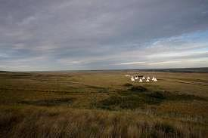
A GIS Model of Archaeological Site Distribution on the Northern Great Plains of Alberta
Tobi Baugh
Capstone Proposal Presentation.
December 18, 2012
Advisor – Tim Murtha

Slide 2
Outline
Introduction
Background
  Predictive Archaeological Models
  Cultural Resource Management
  Study Scope & Study Area
Archaeological Site Inventory of Alberta
Methodology
  Selection of Independent Variables
  Statistical Analysis
  Model Building
  Output Products
Projected Timeline
Anticipated Results
Acknowledgements
References

Slide 3
Introduction
Goal :
Use Geographic Information System (GIS) technology to investigate the potential for archaeological site distribution on the northern Great Plains of Alberta.
Objective:
To develop a dynamic spatial and temporal model that will uniquely combine significant regional landscape elements to provide an accurate context for the identification of yet unknown archaeological sites.

Slide 4
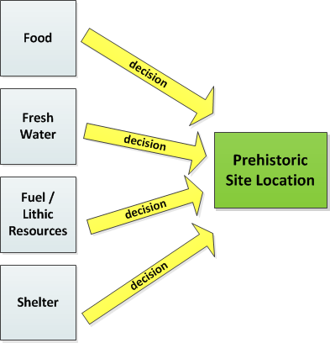
Predictive Archaeological Models
Predictive modeling is based on the assumption that all prehistoric communities made rational environmental decisions regarding site selection (Hudak 2002).
To survive, prehistoric people had to exploit their environment wisely and ensure that they had quick and easy access to the necessities of everyday life.

Slide 5
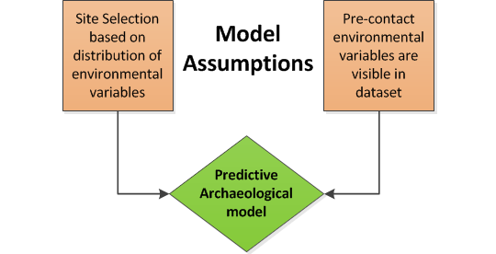
Model Limitations and Assumptions
The model assumptions are(Hudak 2002) :
  Spatial organization and site location prior to European contact was primarily determined by environmental variables.
  Environmental attributes present in the pre-contact period are still recognizable in current data sources
Because of the assumptions inherent in the predictive model, it is not intended to pinpoint the actual location of unknown archaeological sites
It can however, identify those areas with high archaeological site potential.

Slide 6
Cultural Resource Management (CRM)
Accounts for most archaeological activities in North America
The objective of is to protect archaeological and historical sites from loss or damage due to land development
Required by law in Canada and the US (Green et al 1998)
Predictive GIS models are valuable tools for CRM used in the early planning stages of land development to identify areas to be avoided

Slide 7
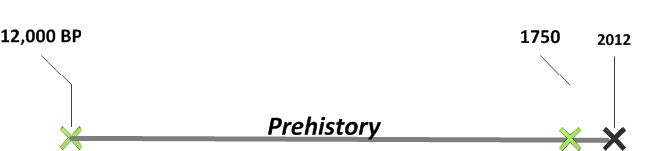
Study Scope
This predictive model will only be concerned with the analysis of pre-contact archaeological sites that occur prior to 1750.
European contact introduced new technologies – horses, guns and new ways of life - trading
After European contact, 250 years ago, the site selection process became more complex - based on non- environmental characteristics

Slide 8
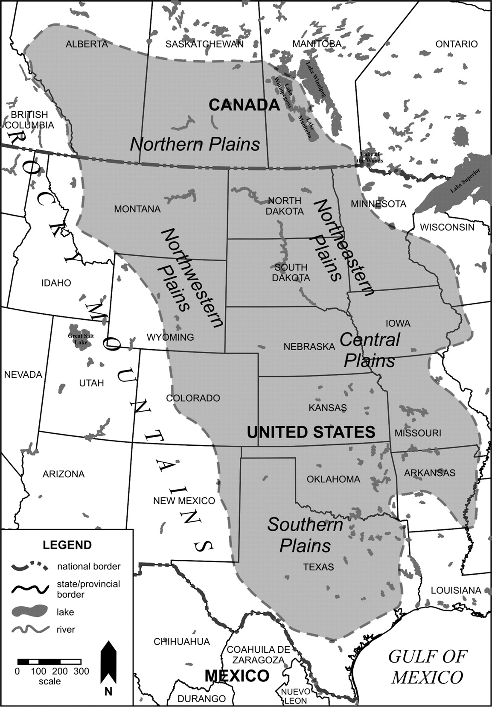
Study Area
The Great Plains region extends across the central grasslands of North America, from Texas to central Canada.
Each of the sub-regions of the Great Plains has unique environmental characteristics that resulted in similar prehistoric socio-economic adaptations.
(source: www.unl.edu)

Slide 9
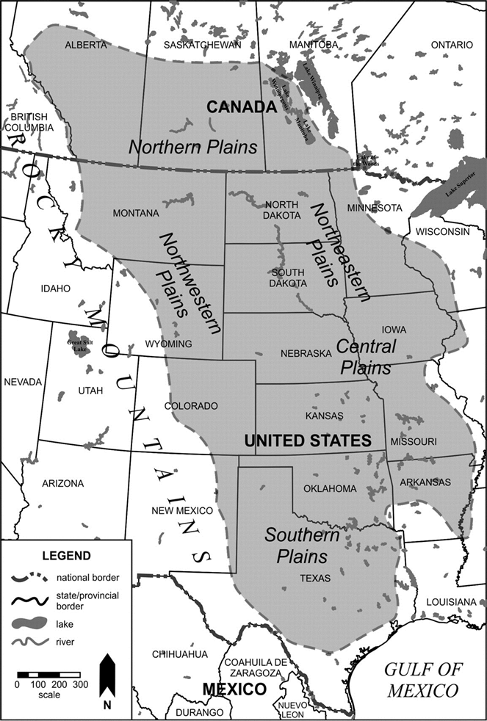
Northern Great Plains Region
The study area for this project is limited to the Northern Great Plains region located in the southeast corner of the Province of Alberta.
  to ensure that the analysis dataset contains evidence of similar locational decisions being made over time.
  limited to the province of Alberta to ensure archaeological data availability and consistency.
(source: www.unl.edu)

Slide 10
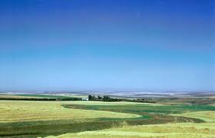
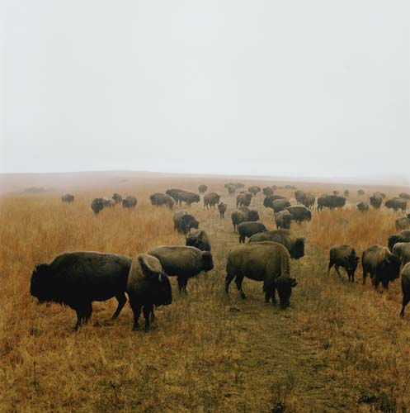
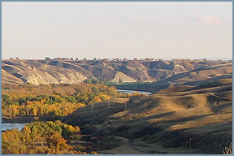
Environment of the
Northern Great Plains
Physical characteristics that combine to create this unique environment are:
  Landforms
  Climate
  Flora and fauna.
Demands of living in this environment created similar cultural / economic adaptations throughout the Northern Great Plains.
Image Source: Wikimedia Commons

Slide 11
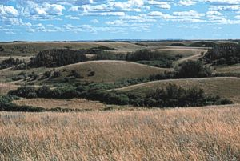
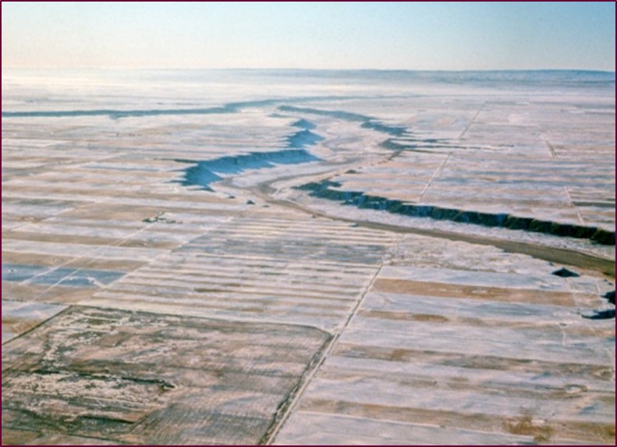
Landforms
Landscape is dominated by flat topography that is composed of thick, horizontal sedimentary layers and rise 2,000 – 3000 ft. above sea level
Localized topographical features break up the monotony of the flat prairie lands and are created by depositional & erosional processes.
Depositional landscapes are represented as low, rolling terrain (hummocky till plains)
Erosional landscapes are represented by coulees - deep channels that cut across the plains and offer some protection from the elements.
Image Source: Wikimedia Commons

Slide 12
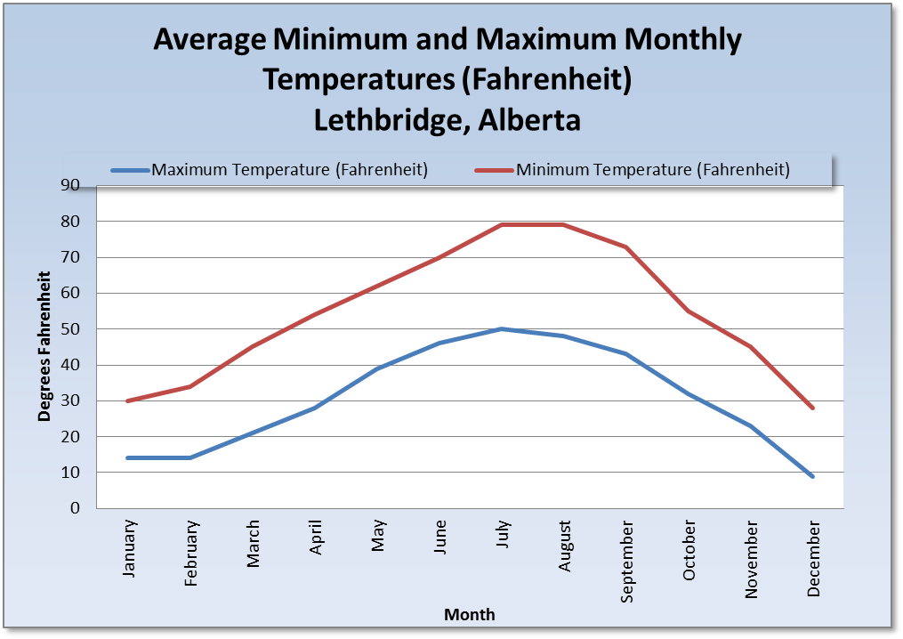
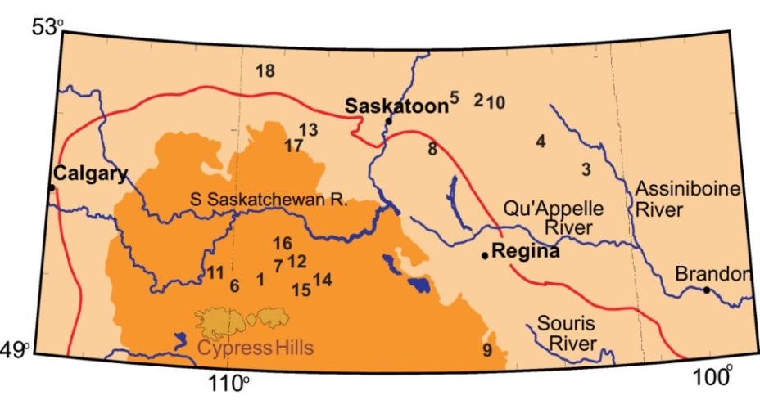
Climate
The climate is characterized by low precipitation, temperature extremes and short growing seasons
Cold winters are alleviated by an intermittent phenomenon known as the Chinook Winds, which are warming winds unique to this region that raise temperatures dramatically.
Situated within the Palliser's Triangle, the driest part of the Canadian prairies that are prone to drought and have an annual water deficit
Source: Environment Canada
Image Source: CPRC

Slide 13
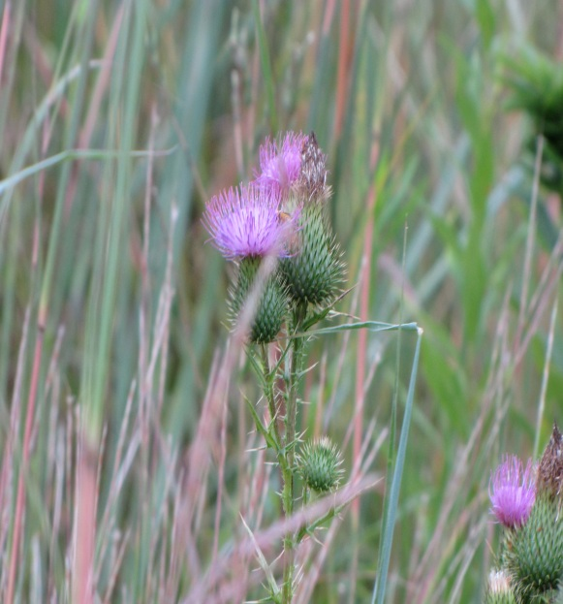
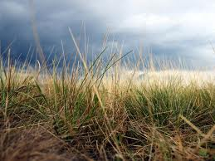
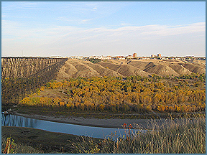
Flora
natural vegetation consists mainly of mixed prairie grasses
Fescue prairie is found in areas that have increased precipitation as a result of higher altitudes and
Xeric grasses are found in the drier southeast
Shrubs and trees such as willow and cottonwood are only found in moist, protected areas, such as river valleys
Image Source: Wikimedia Commons

Slide 14
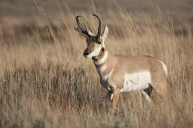
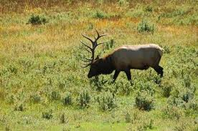
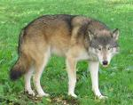
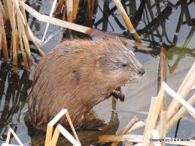
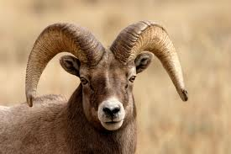

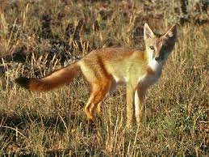
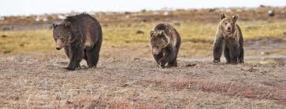
Fauna
Prior to European contact, the animal most numerous on the plains was the bison.
Other pre-contact fauna include the wapiti, deer, pronghorn , bear, coyote, swift fox, bobcat, beaver and muskrat
Image Source: Wikimedia Commons

Slide 15
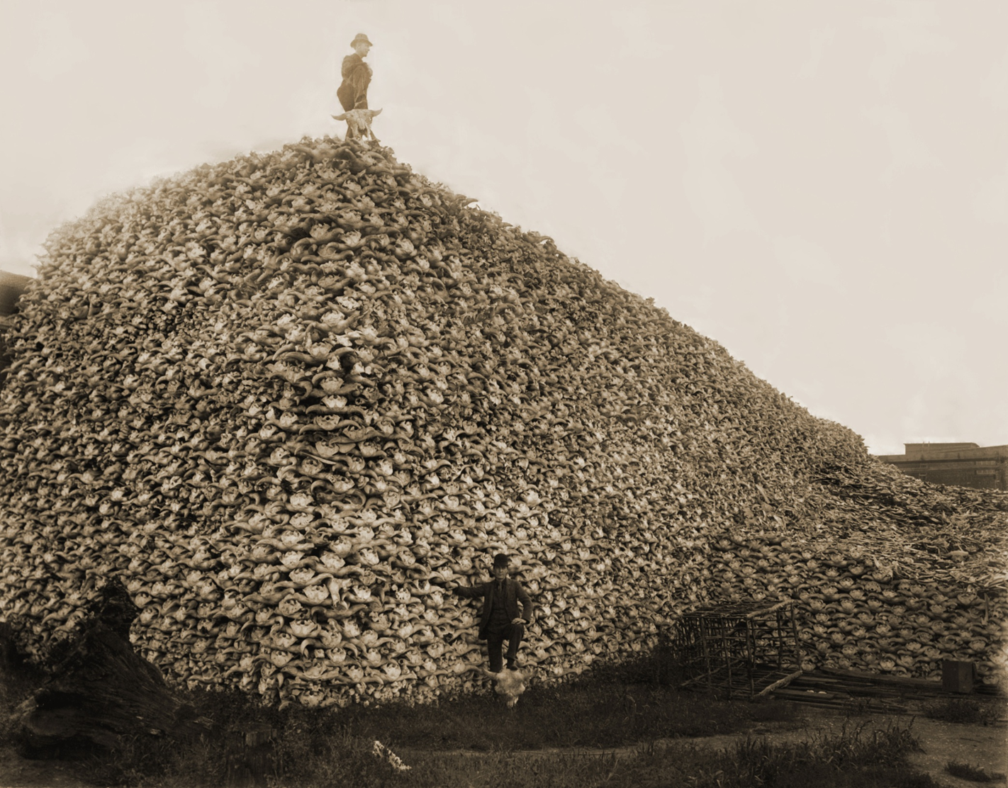
FAUNA
Prior to European contact, bison were estimated as high as 6 million (Indiana.edu)
Pile of bison skulls in 1876,
waiting to be ground for fertilizer.
Image Source: Wikimedia Commons

Slide 16
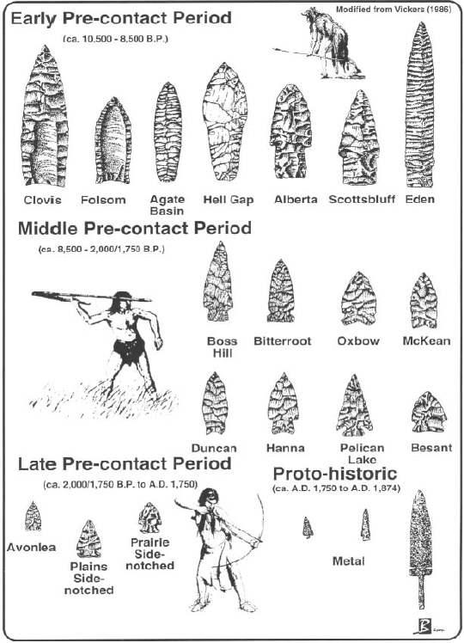
Prehistory
The prehistory of the Northern Great Plains region is organized according to the morphological changes in the projectile points through time.
In general, the change in form can be described as an alteration in use and style:
from spear to dart (using an atlatl) to arrow
Source: Peck 2011

Slide 17
Archaeological site inventory
The archeological record of Alberta contains over 30,000 site records that date back to the first archaeological excavations on the Great Plains in the 1950’s.
The database has grown rapidly since 1973 when Historical Resource Impact Assessments (HRIA) became mandatory .
The quality of the database is determined by the accuracy of many factors that are beyond control, such as the accurate initial recording, entry and management of the data.
Example of Alberta inventory records (with coordinates removed):
BORDEN_NO_ | SITE_CLASS | SITE_CONTENT | SITE_TYPE | FEATURES | CULTURE_AGE
DgOu-70 | prehistoric | surface, subsurface | campsite | hearth | undetermined
DgOu-71 | prehistoric | subsurface | campsite | hearth | undetermined
DgOu-72 | historic | surface | homestead | foundation | Historic
DgOu-73 | prehistoric | surface | isolated find |  | undetermined
DgOu-74 | prehistoric | surface | isolated find |  | undetermined
DgOu-75 | prehistoric | surface | stone feature | stone circle, stone arc | undetermined
DgOu-76 | prehistoric | surface | stone feature | stone circle, cairn | undetermined
DgOu-77 | prehistoric | surface | stone feature | stone circle | undetermined
DgOu-79 | prehistoric | surface | campsite |  | undetermined
DgOv-1 |  | surface | killsite | bison jump
DgOv-2 | prehistoric; historic | subsurface | rock art | pictograph; petroglyph; hearth | Middle Prehistoric; Middle Prehistoric
(Source: Alberta Culture)

Slide 18
Methodology

Slide 19
Methodology

Slide 20
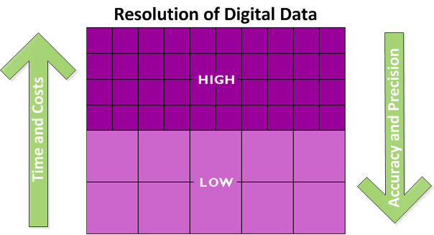
Land unit resolution
Procurement of datasets that will determine the size of the land unit of study.
In general, high resolution GIS models have parcel sizes less than 4 ha (10 acres) and low resolution models use parcels as large as 100 ha (250 acres), (Mn Model 200?).
There are advantages and disadvantages to both:
High resolution models are more expensive and time consuming but generate higher precision results
Low resolution models are quicker and less expensive but generate lower precisional accuracy.
(Adapted from: DiBiase 2012)

Slide 21
Land unit resolution
Currently, I have obtained the datasets at 30 metres (100 ft.) resolution

Slide 22
Acquire primary datasets
Determination of environmental variables based on the existing state of knowledge of settlement patterns in the prehistoric Northern Great Plains (determined by literature review),

Slide 23
Derive secondary datasets
Isolate prehistoric camp sites and buffer
}
Derived from DEM
Buffer zones
Surface soil types
Grasses vs. woodlands

Slide 24
Quantify relationship between sites & variables
Intersect the environmental variables and archaeological site data

Slide 25
Classification of environmental variables
Classify the environmental variables

Slide 26
Statistical analysis for Identification of Significant Variables and their classes
Perform a statistical analysis to identify the significant variable classes

Slide 27
regression analysis to calculate Weighting of Significant Variables
Conduct regression analysis to calculate weight of significant variable classes

Slide 28
Formula building - the weighted sum of significant variables
The model will be designed as a formula that will allow for the dynamic inclusion of new archaeological data, as it becomes available.
Static thematic maps can also be produced at any point in time to symbolize all lands within the region as having either: high, moderate or low archaeological site distribution potential.

Slide 29
Testing of model and
Re-iteration
Establishing Model Error with resampling methods will quantify uncertainty of the prediction
  Split sampling – withholds 50% of data available to measure predictive ability of the other 50%.
  Cross Validation, Jackknife sampling and Boot Strap sampling methods that use parts of the complete data set
  Obtain independent test data from recent compliance surveys and measure predictive ability of that. The shortcomings of independent data are survey sampling bias (see Verhagen article for more). (Verhagen, P 2007

Slide 30
Application of Formula and
creation of predictability surface

Slide 31
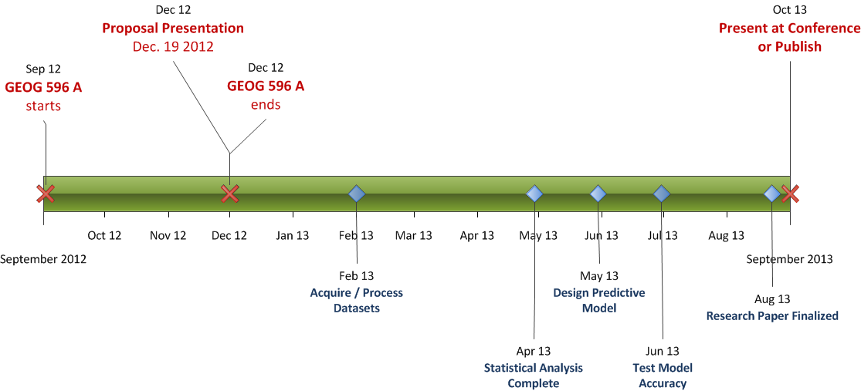
Projected Timeline

Slide 32
Anticipated Results
Based on the literature review its anticipated that the distance to fresh water, vegetation and local relief variables will have the highest correlation with known archaeological sites.
  The goal of predicting the distribution of prehistoric sites will be met to some degree and provide useful information for CRM projects, but will not be a substitute or eliminate the need for intensive archaeological survey

Slide 33
Acknowledgements
Thanks to Tim Murtha for all his advice and direction ☺
Thanks to Neil Mirau from Arrow Archaeology for his help in obtaining access to the archaeological database

Slide 34
References
CPRC – Canadian Plains Research Centre (2012) http://www.cprc.ca/
Environment Canada (2012) http://www.weatheroffice.gc.ca/city/pages/ab-30_metric_e.html
Green, W., & Doershuk, J. F. (1998). Cultural resource management and American archaeology. Journal of Archaeological Research, 6(2), 121-167.
Hudak, G. J. (2002). A Predictive Model of Precontact Archaeological Site Location for the State of Minnesota: Final Report. Minnesota Department of Transportation.
Peck, T. R. (2010). Light from Ancient Campfires: Archaeological Evidence for Native Lifeways on the Northern Plains. Athabasca University Press.
University of Nebraska – Lincoln (2012) Center for Great Plains Studies. Lincoln, NE 68588-0214 http://www.unl.edu/plains/about/map.shtml
Verhagen, P. (2008). Testing archaeological predictive models: a rough guide}. A. Posluschny/K. Lambers/I. Herzog (eds.), Layers of (2008).
Wikimedia Commons (accessed Nov 30, 2012) http://commons.wikimedia.org/wiki/File:Bison_skull_pile_edit.jpg

