Slide 1
A Spatial Analysis of Predictors of Different Types of Crime in Chicago Community Areas
Brett Beardsley
Pennsylvania State University MGIS Candidate
5/7/2014
Stephen A. Matthews
Faculty Advisor
Source: http://www.kgarner.com/blog/archives/2011/08/26/photo-238-chicago-skyline/
Source: http://www.personal.psu.edu/zul112/

Slide 2
Outline
Background
Research questions
Literature review
Characteristics of study
Regression analysis
Limitations and possible further studies

Slide 3
Background
Chicago is the third largest city in the United States with 2.7 million people
In 2011Chicago had 29% to 92% higher rates of crime per 100,000 people than all cities in the United States with more than 1 million people

Slide 4
Research Questions
Identify which Chicago Community Areas had the highest rates of specific crimes and indexed crime from 2007 to 2011
Identify predictors associated with total, property, and violent crime in Chicago Community Areas from 2007 to 2011
Identify the most influential predictors for each crime type in Chicago Community Areas from 2007 to 2011
Identify any patterns and relationships among the statistically significant predictors across crime type in Chicago Community Areas from 2007 to 2011

Slide 5
Literature Review
Spatial crime studies increasingly popular
Origins date back to 1820s in France
Data and methods have evolved
Focused on 5 Chicago studies from 1990-2009
All regression or modeling techniques
Numerous standard outcome and predictor variables

Slide 6
Previous Studies’ Conclusions
Surrounding areas have an affect on one another (i.e., Spatial dependence matters)
Traditional indicators of crime ring true (e.g. unemployment, poverty, population density)
Not every variation can be explained

Slide 7
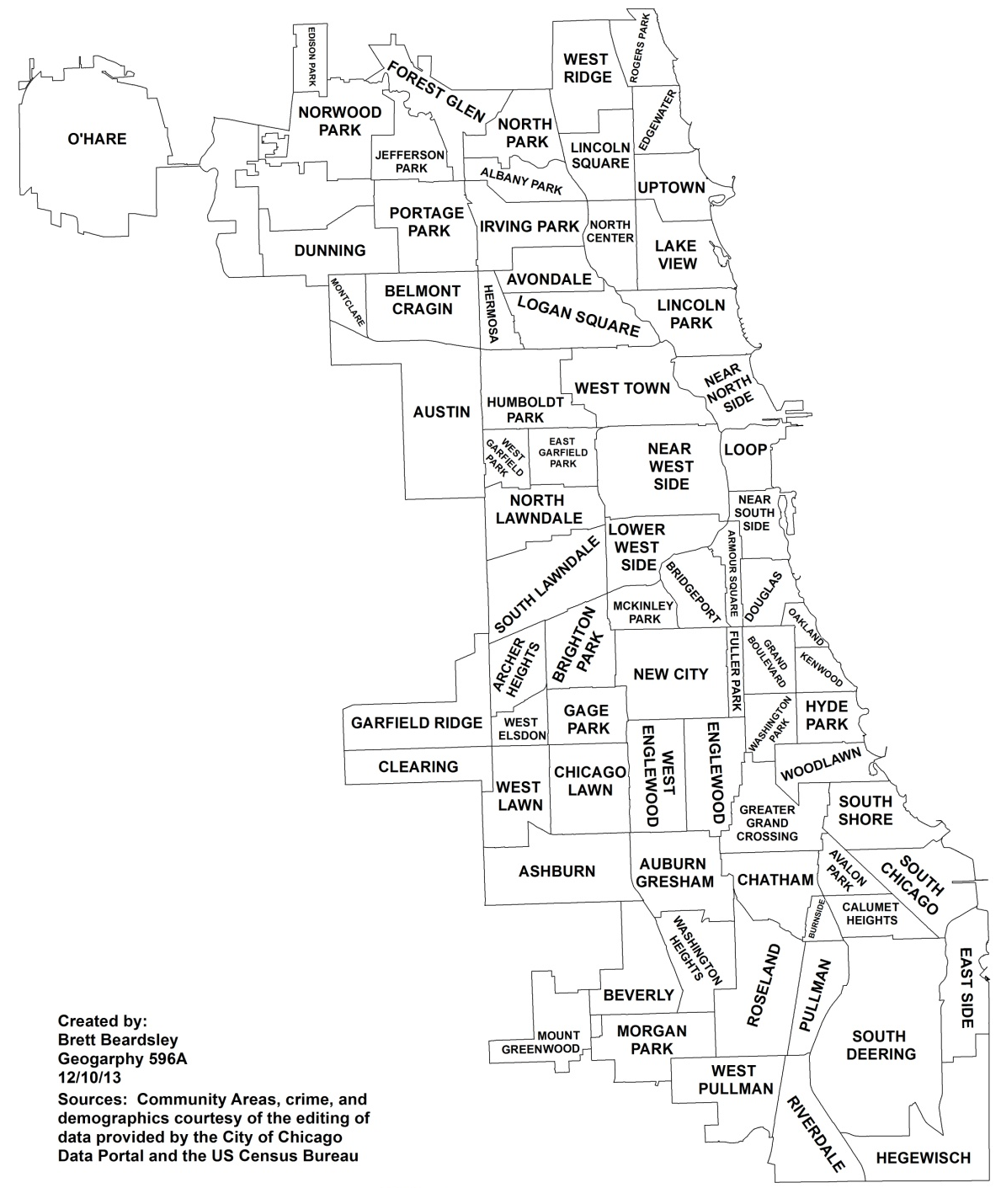
Time Frame, Sources, and Unit of Analysis
2007-2011
American Community
Survey
City of Chicago Data
Portal
77 Chicago Community
Areas

Slide 8
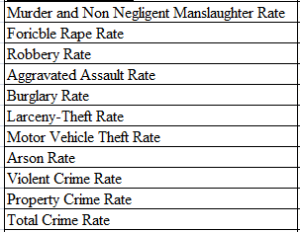
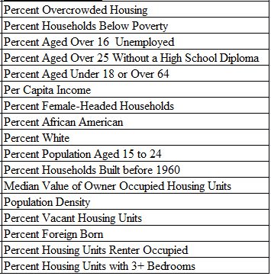
Original Variables
Potential Outcome Variables
Potential Predictor Variables
*rate per 100,000 people
Source: http://www.ucrdatatool.gov/

Slide 9
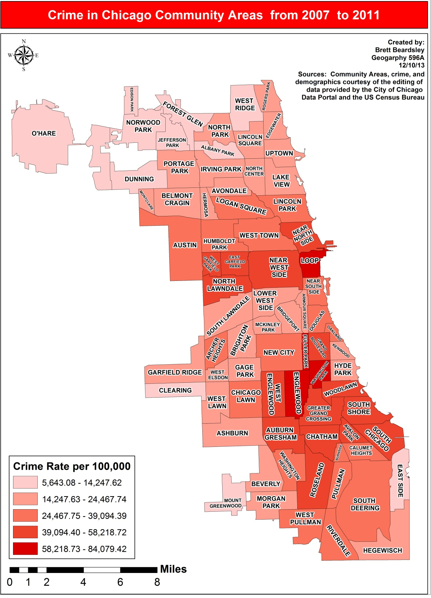
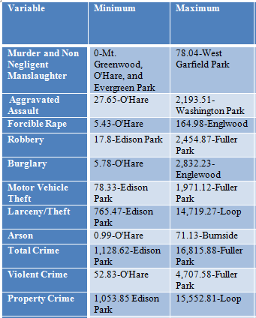
Preliminary Analysis
Outcome
Variable Map and Min/Max Statistics

Slide 10
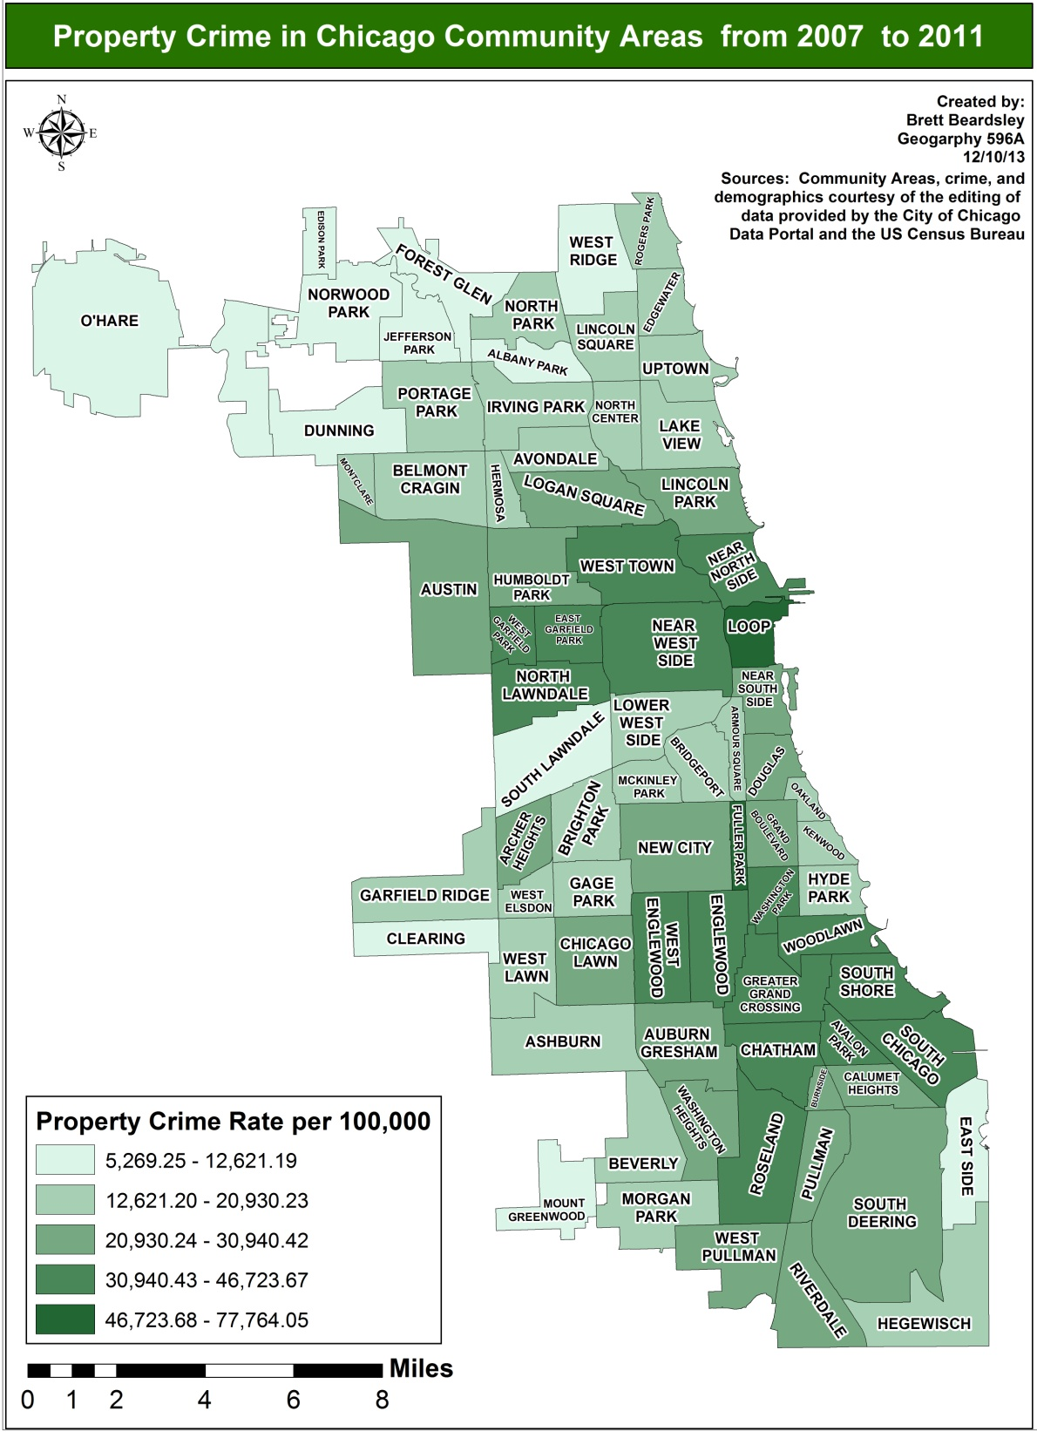
Preliminary
Analysis
Outcome
Variable Map

Slide 11
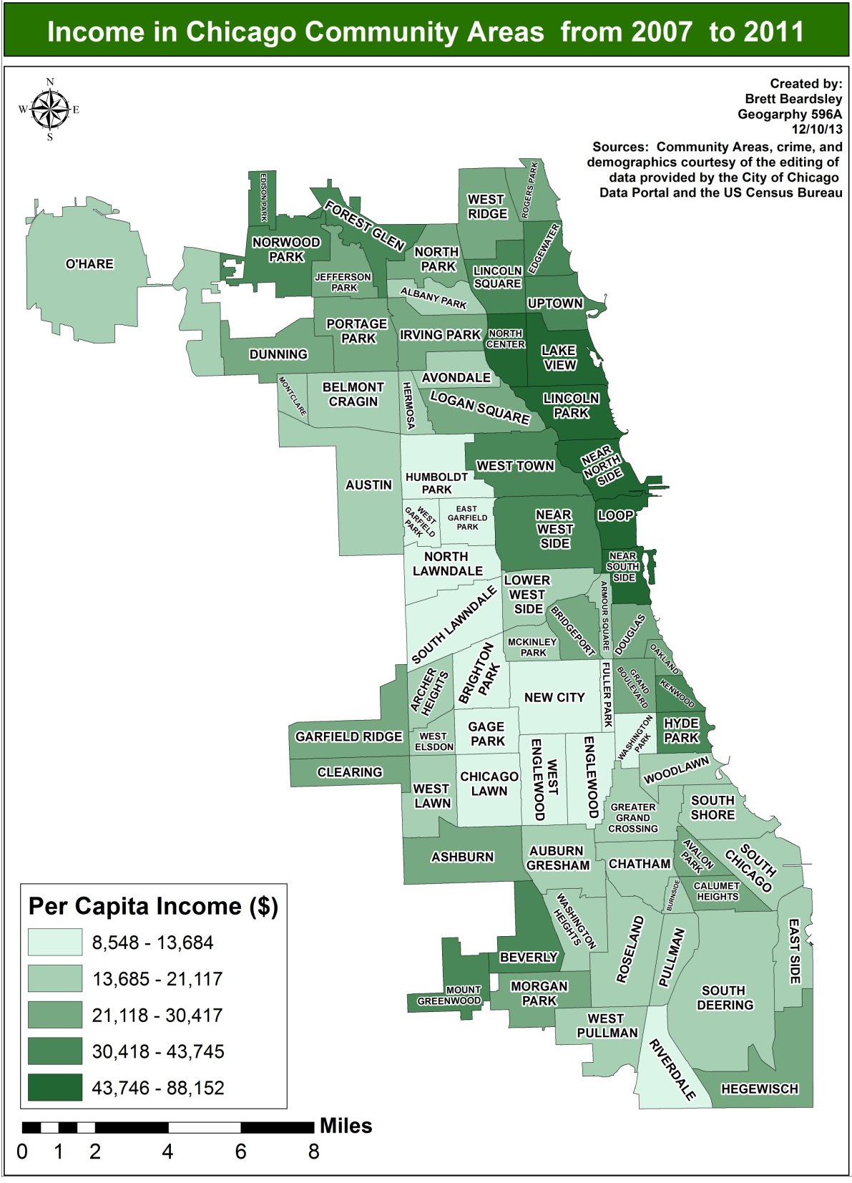
Preliminary
Analysis
Predictor
Variable Map

Slide 12
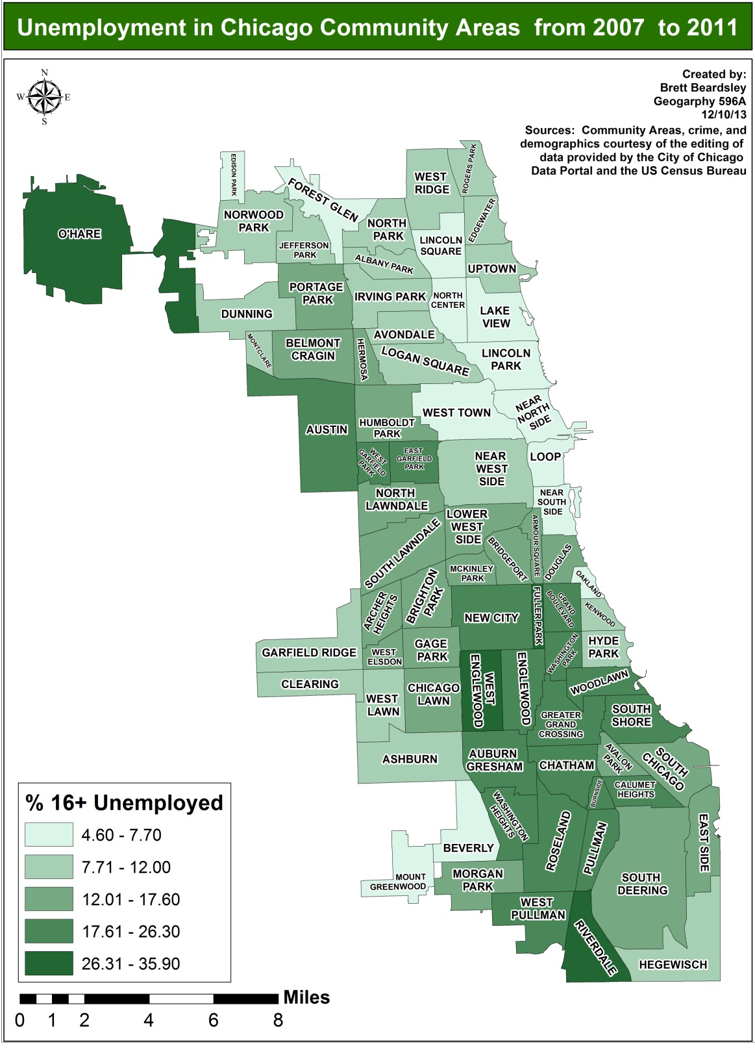
Preliminary
Analysis
Predictor
Variable Map

Slide 13
Variable Correlation
Used Correlation Matrices to test the strength and significance of the relationship among variables
Decided to use violent, property, and total crime rate only as outcome variables
Decided to use 16+ unemployed, 25+ no high school diploma, per capita income, white, aged 15 to 24, vacant housing units, foreign born, renter occupied housing units, and mean household value as predictor variables

Slide 14
Regression Analysis
Ordinary Least Squares (OLS) Regression can determine if a relationship exists between each crime type and the predictor variables
OLS diagnostics can also be used to reduce the variables in a model and to determine if a spatial regression model is needed
Through OLS and spatial regression final predictor variables for each outcome variable were determined.

Slide 15
Final Predictor Variables
Total Crime Rate-percent aged 15 to 24, per capita income, percent white, and percent vacant housing units
Violent Crime Rate-percent aged 15 to 24, per capita income, percent white, percent vacant housing units, and percent foreign born
Property Crime Rate-percent aged 15 to 24, per capita income, percent white, and percent vacant housing units

Slide 16
Regression Analysis of Total Crime Rate
OLS Regression
Spatial Lag
Diagnostic | Coefficient | Value/T-Statistic | Probability
Constant | 1,330.20 | 0.96 | 0.205
Per Capita Income | 0.09 | 5.00 | 0.000
Percent White | -60.23 | -6.01 | 0.000
Percent 15-24 | 91.00 | 1.08 | 0.285
Percent Vacant | 249.58 | 5.78 | 0.000
Multicollinearity Condition Number |  | 17.17
Log likelihood |  | -687.55
Akaike info criterion |  | 1,385.09
Schwarz criterion |  | 1,396.81
R-squared |  | 0.72
F-statistic |  | 46.45 | 3.07e-019
Moran’s I |  | 1.53 | 0.126
Lagrange Multiplier (lag) |  | 4.10 | 0.043
Robust LM (lag) |  | 3.75 | 0.053
Lagrange Multiplier (error) |  | 0.94 | 0.333
Robust LM (error) |  | 0.58 | 0.445
Diagnostic | Coefficient | Value/Z-Test | Probability
Constant | 231.36 | 0.17 | 0.864
Per Capita Income | 0.07 | 3.62 | 0.000
Percent White | -42.85 | -3.80 | 0.000
Percent 15-24 | 64.71 | 0.82 | 0.415
Percent Vacant | 215.45 | 5.24 | 0.000
Spatial lag term | 0.31 | 2.73 | 0.006
Log likelihood |  | -685.01
Akaike info criterion |  | 1,382.01
Schwarz criterion |  | 1,396.08
R-squared |  | 0.74

Slide 17
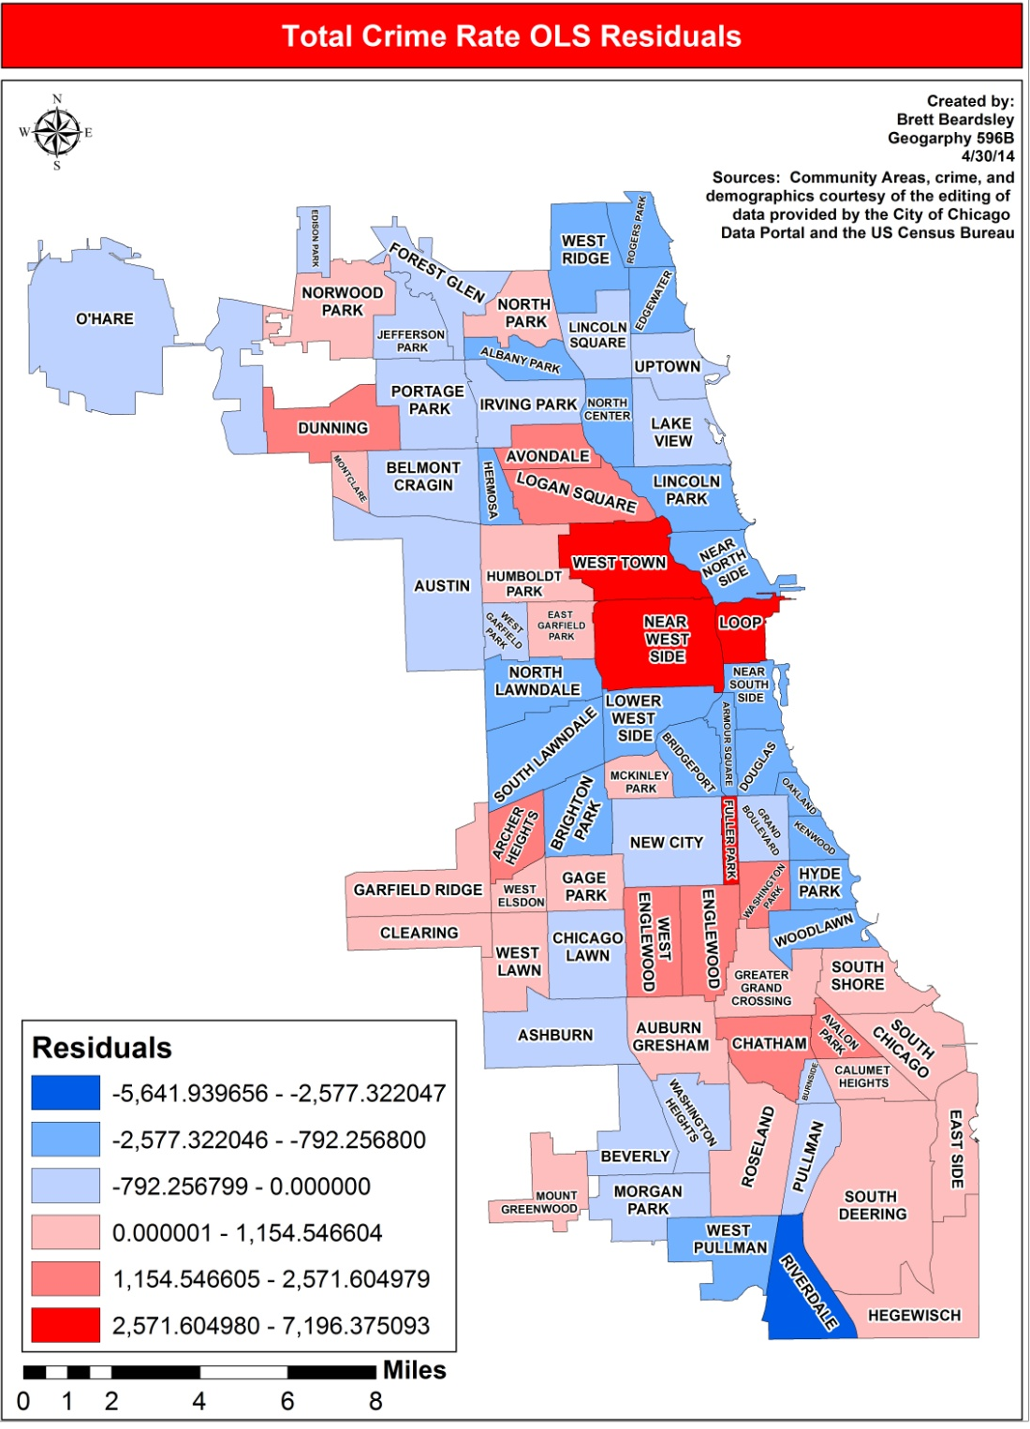
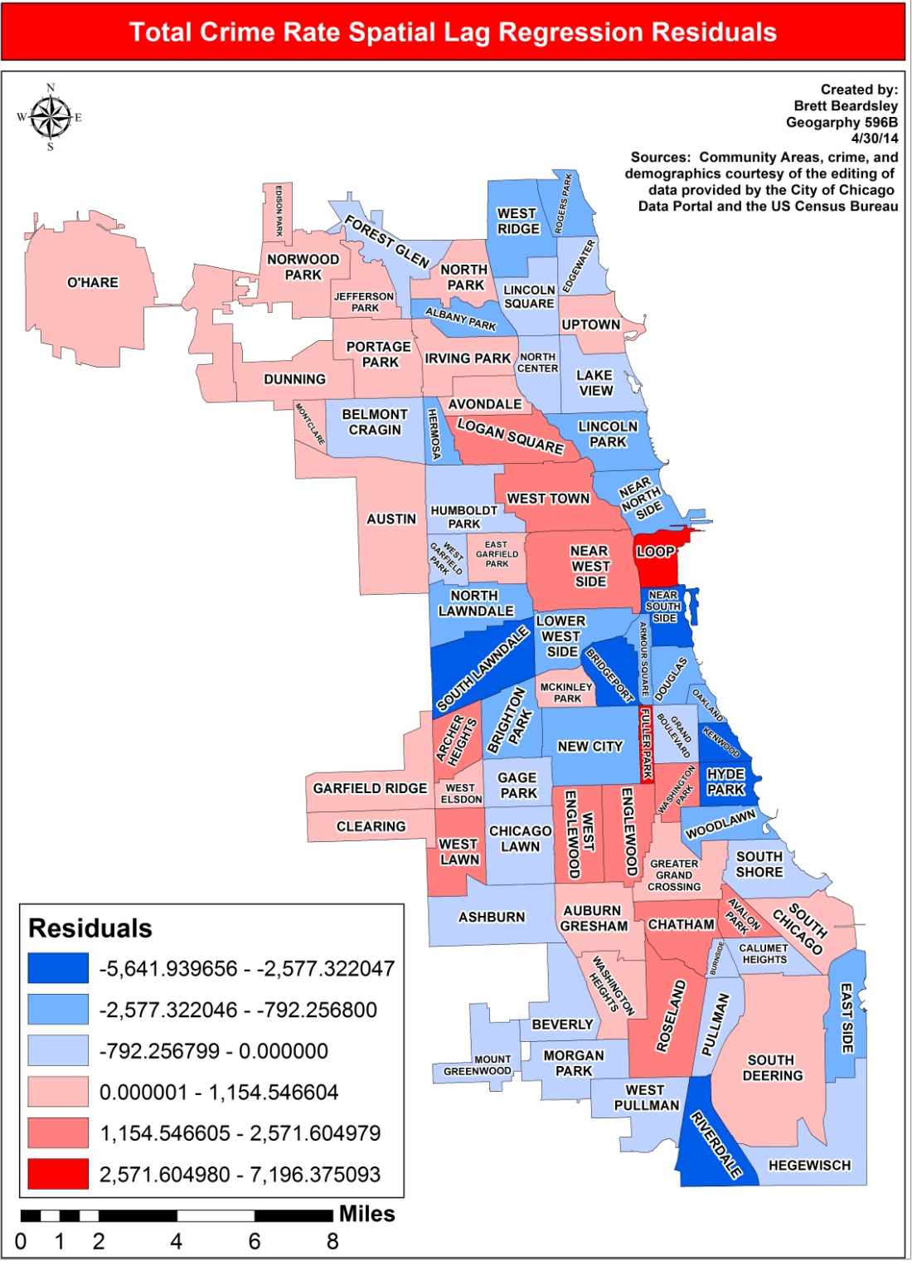
Total Crime Rate OLS and Lag Residual Maps

Slide 18
Regression Analysis of Violent Crime Rate
OLS Regression
Spatial Error
Diagnostic | Coefficient | Value/T-Statistic | Probability
Constant | 1,153.85 | 3.85 | 0.000
Per Capita Income | -0.01 | -2.17 | 0.033
Percent White | -11.67 | -4.59 | 0.000
Percent 15-24 | 10.07 | 0.54 | 0.588
Percent Vacant | 78.95 | 8.26 | 0.000
Percent Foreign | -19.68 | -4.68 | 0.000
Multicollinearity Condition Number |  | 18.45
Log likelihood |  | -567.88
Akaike info criterion |  | 1,147.77
Schawrz criterion |  | 1,161.83
R-squared |  | 0.89
F-statistic |  | 110.705 | 4.22e-32
Moran’s I |  | 4.29 | 0.000
Lagrange Multiplier (lag) |  | 2.29 | 0.130
Robust LM (lag) |  | 0.14 | 0.712
Lagrange Multiplier (error) |  | 11.67 | 0.000
Robust LM (error) |  | 9.51 | 0.002
Diagnostic | Coefficient | Value/Z-Test | Probability
Constant | 1,728.25 | 5.25 | 0.000
Per Capita Income | -0.02 | -2.97 | 0.003
Percent White | -12.59 | -4.50 | 0.000
Percent 15-24 | 11.49 | 0.81 | 0.415
Percent Vacant | 58.36 | 6.71 | 0.000
Percent Foreign | -26.02 | -5.76 | 0.000
Spatial error term | 0.69 | 7.41 | 0.000
Log likelihood |  | -559.81
Akaike info criterion |  | 1,131.62
Schwarz criterion |  | 1,145.68
R-squared |  | 0.92
Diagnostic | Coefficient | Value/T-Statistic | Probability
Constant | 1,153.85 | 3.85 | 0.000
Per Capita Income | -0.01 | -2.17 | 0.033
Percent White | -11.67 | -4.59 | 0.000
Percent 15-24 | 10.07 | 0.54 | 0.588
Percent Vacant | 78.95 | 8.26 | 0.000
Percent Foreign | -19.68 | -4.68 | 0.000
Multicollinearity Condition Number |  | 18.45
Log likelihood |  | -567.88
Akaike info criterion |  | 1,147.77
Schwarz criterion |  | 1,161.83
R-squared |  | 0.89
F-statistic |  | 110.705 | 4.22e-32
Moran’s I |  | 4.29 | 0.000
Lagrange Multiplier (lag) |  | 2.29 | 0.130
Robust LM (lag) |  | 0.14 | 0.712
Lagrange Multiplier (error) |  | 11.67 | 0.000
Robust LM (error) |  | 9.51 | 0.002

Slide 19
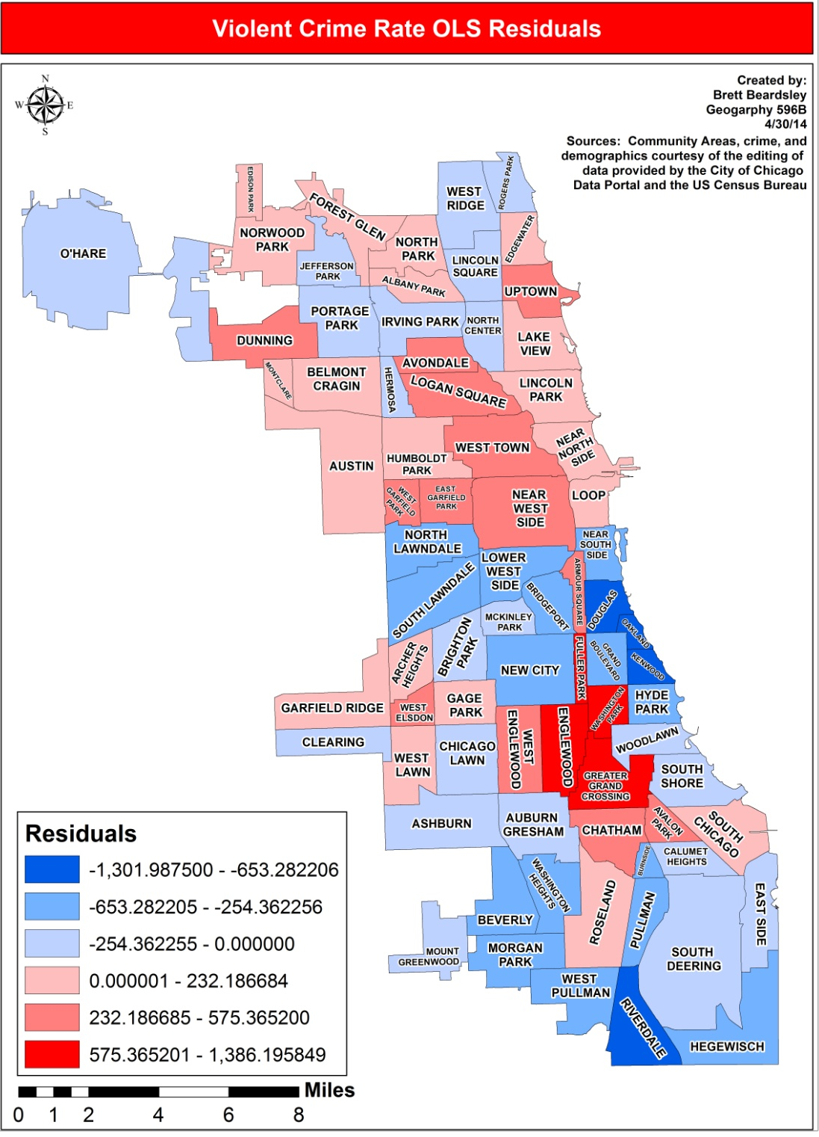
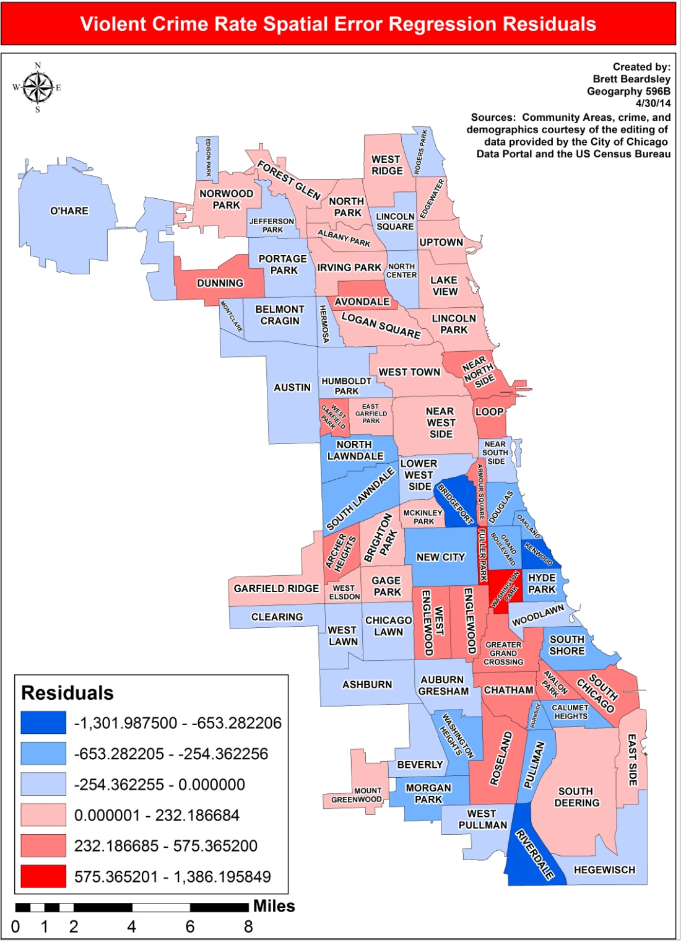
Violent Crime Rate OLS and Error Residual Maps

Slide 20
Regression Analysis of Property Crime Rate
OLS Regression
Spatial Lag
Diagnostic | Coefficient | Value/T-Statistic | Probability
Constant | 398.53 | 0.34 | 0.732
Per Capita Income | 0.09 | 6.00 | 0.000
Percent White | -42.09 | -5.03 | 0.000
Percent 15-24 | 100.74 | 1.43 | 0.158
Percent Vacant | 158.30 | 4.39 | 0.000
Multicollinearity Condition Number |  | 17.17
Log likelihood |  | -673.71
Akaike info criterion |  | 1,357.41
Schwarz criterion |  | 1,369.13
R-squared |  | 0.63
F-statistic |  | 30.90 | 5.63e-15
Moran’s I |  | 1.17 | 0.242
Lagrange Multiplier (lag) |  | 3.95 | 0.047
Robust LM (lag) |  | 0.40 | 0.012
Lagrange Multiplier (error) |  | 2.71 | 0.529
Robust LM (error) |  | 6.66 | 0.099
Diagnostic | Coefficient | Value/Z-Test | Probability
Constant | -378.66 | -0.34 | 0.734
Per Capita Income | 0.07 | 4.20 | 0.000
Percent White | -29.25 | -3.24 | 0.001
Percent 15-24 | 77.73 | 1.17 | 0.240
Percent Vacant | 131.76 | 3.86 | 0.000
Spatial lag term | 0.33 | 2.75 | 0.006
Log likelihood |  | -671.23
Akaike info criterion |  | 1,354.46
Schwarz criterion |  | 1,368.52
R-squared |  | 0.66

Slide 21
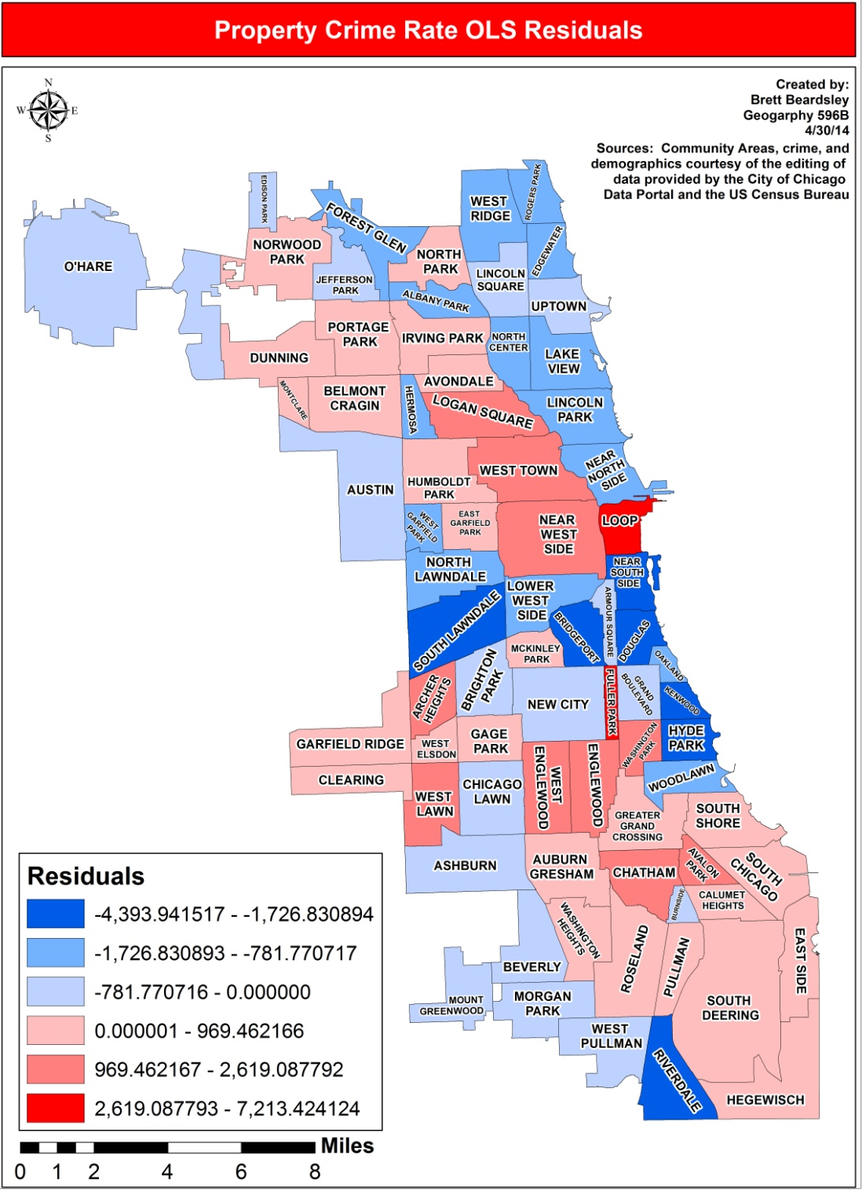
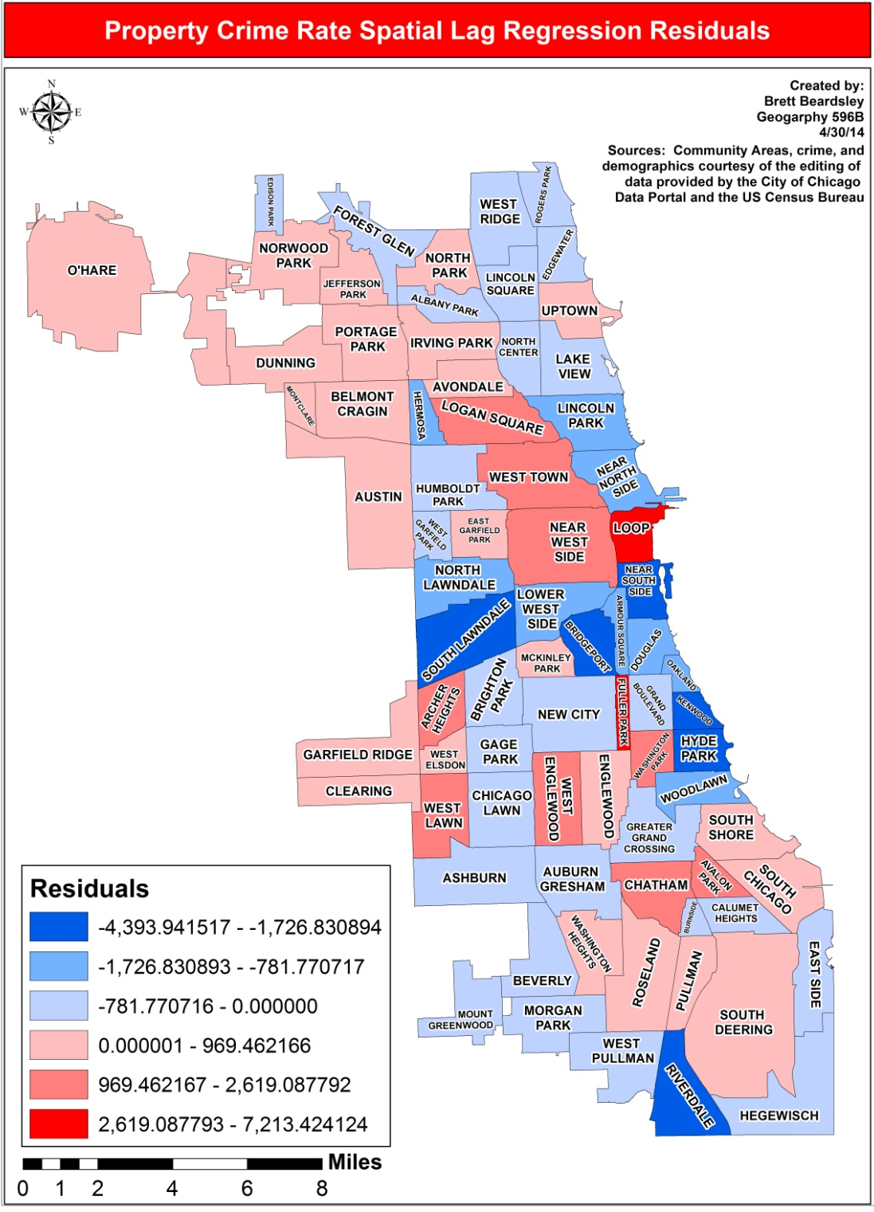
Property Crime Rate OLS and Lag Residual Maps

Slide 22
Significant Predictor Coefficients Across Crime Types

Slide 23
Limitations
Chicago Community Areas-Small number of observations for the unit of analysis (77)
American Community Survey is an estimate
Did not create an index for similar socioeconomic measures as was done in studies in literature review

Slide 24
Further Studies
Could use more up to date ACS data (2008-2012)
Create indices for certain socioeconomic data
Run study on census blocks and tracts for a more detailed analysis
Look into large residuals and what causes those Community Areas to be higher or lower than expected
Why does Fuller Park have so much crime?

Slide 25
Acknowledgements
Advisor-Stephen A. Matthews
Geography 586 Instructor-David O’Sullivan
Capstone Workshop-Pat Kennelly
Overall Guidance-Doug Miller and Beth King

Slide 26
References
Arnio, A. N. & Baumer, E. P. (2012). Demography, foreclosure, and crime: Assessing spatial heterogeneity in contemporary models of neighborhood crime rates. Demographic Research 26:18, 449-488.
Anselin, L. (2005). GeoDa Workbook. Retrieved 04 29, 2014 from GeoDa: https://geodacenter.asu.edu/system/files/geodaworkbook.pdf
Berg, M.T., Brunson, R.K., Stewart, E.A., & Simons, R.L (2011). Neighborhood Cultural Heterogeneity and Adolescent Violence. Journal of Quantitative Criminology 28, 411-435.
Boggs, S. (1965). Urban Crime Patterns. American Sociological Review 30:6. 899-908.
Bowers, K. & Hirschfield, A. (1999). Exploring links between crime and disadvantage in north-west England: an analysis using geographical information systems. International Journal of Geographical Information Science 13:2. 159-184.
Ceccato, V. (2005). Homicide in Sao Paulo, Brazil: Assessing spatial-temporal and weather variations. Journal of Environmental Psychology 25:3, 307-321.
Census. (2014). What is the American Community Survey. Retrieved 04 03, 2014 from Census.gov:. https://www.census.gov/acs/www/
City of Chicago. (2014). Data Portal. Retrieved 10 31, 2013, from data.cityofchicago.org: https://data.cityofchicago.org/Public-Safety/Crimes-2001-to-present/ijzp-q8t2
Earls, F., Morenoff, J.D, & Sampson, R.J. (1999). Beyond Social Capital: Spatial Dynamics of Collective Efficacy for Children. American Sociological Review 64:5, 633-660.
Graif, C. & Sampson, R. J. (2009). Spatial Heterogeneity in the Effects of Immigration and Diversity on Neighborhood Homicide Rates. Homicide Studies 13:3, 242-260.
Matthews, S.A., Yang T-C., Hayslett, K.L., & Ruback, R.B. (2010). Built environment and property crime in Seattle, 1998-2000: a Bayesian analysis. Environment and Planning 42:6, 1403-1420.
Morenoff, J.D. (2003). Neighborhood Mechanisms and the Spatial Dynamics of Birth Weight. American Journal of Sociology 108:5, 976-1017.
Raudenbush, S.W., Sampson, R.J., & Sharkey, P. (2008). Durable effects of concentrated disadvantage on verbal ability among African-American children. Proceedings of the National Academy of Sciences 105:3, 845-852.
Shaw, C.R. (1929). Delinquency Areas. Chicago: University of Chicago Press.
White, R.C. (1932). The Relation to Felonies to Environmental Factors in Indianapolis. Social Forces 10:4, 498-509.

Slide 27
Questions
Brett Beardsley
brett.a.beardsley@gmail.com

