Slide 1
Spatial Regression Explorer
A FOSS Web Tool for Spatial Regression Techniques
Spencer Bell
August 18, 2017

Slide 2
Project Goals & Motivation
Create a FOSS web tool that can run spatial regression
Use visual analytics techniques to present, explore, and disseminate results of spatial analysis
Investigate my bike share hypothesis

Slide 3
Bike Share Example
Hypotheses
Indego Bike Share Program
The more roads with bike lanes near a given bike station, the greater the chance the station will have high bike usage
Test the hypotheses using the Web Tool

Slide 4
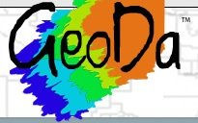
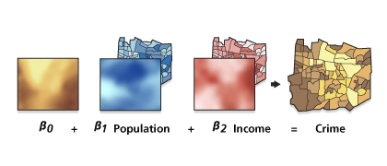
Existing Software in Spatial Regression
ArcGIS – Very expensive; not as much customization
Geoda – FOSS, Unable to run analysis on the web, no bivariate choropleth map
GWR4 – Very customizable; no visualization

Slide 5
Overview of Spatial Regression Analysis
Spatial Regression analysis helps answer the question WHY
Allows the user to model, examine, and explore spatial relationships
Assists in predictions and forecasting to help make better decisions

Slide 6
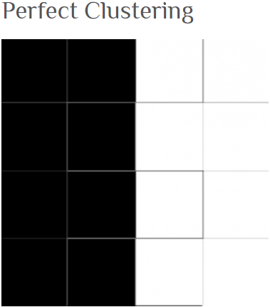
Ordinary Least Squares & Modeling Spatial Dependence
Models a dependent variable in terms of its relationship to a set of explanatory variables
Build a spatial weight matrix to test for spatial autocorrelation
Test residual values of OLS using Moran’s I

Slide 7
Geographically Weighted Regression (GWR) & & Choosing Bandwidths in Localized Models
Explore Spatial Non-Stationarity
GWR constructs a separate equation for each target feature
The features that fall within each feature’s separate equation is dependent upon the bandwidth

Slide 8
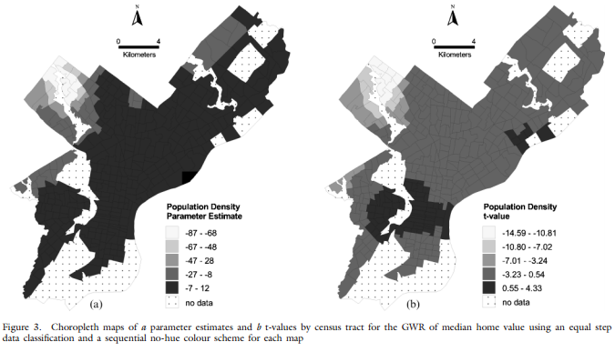
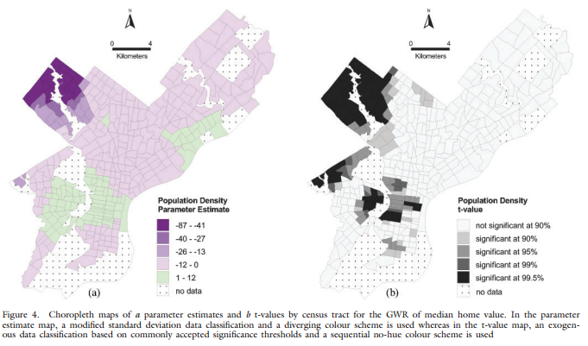
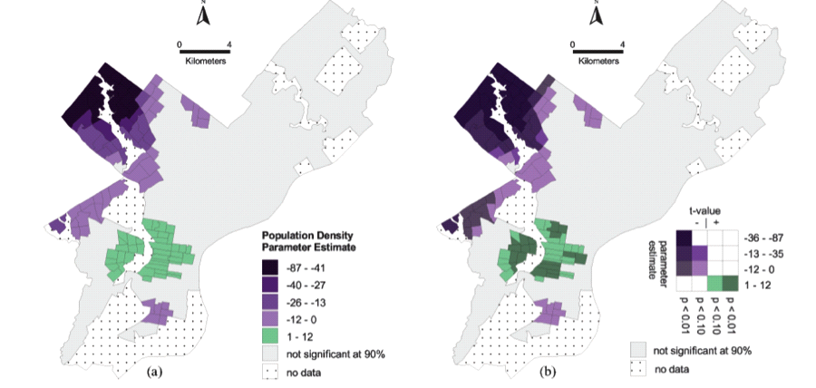
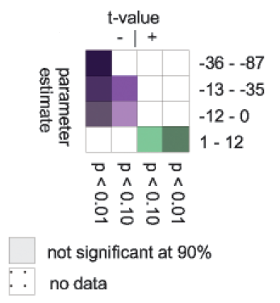
[4] Mennis, J.L. (2006). Mapping the results of geographically weighted regression. The Cartographic Journal 43(2): 171-179. doi:10.1179/000870406X114658.
Visualizing GWR [4]

Slide 9
FOSS Technology Overview
R
A powerful statistical language in which to build the web tool
Leaflet
Visualize, explore, and disseminate results
Shiny
Create interactivity for the user

Slide 10
R Spatial Overview
R is an integrated suite of software facilities for data manipulation, calculation and graphical display
R as a statistical system; an environment in which statistical techniques are implemented
R as a GIS – Numerous libraries to handle spatial data (leaflet, sf, mapview, sp, ggmap, etc.)

Slide 11
Leaflet
Lightweight open source JavaScript library
Leaflet package created and maintained by the Rstudio Team
Easily create a fully interactive web map with one line of code

Slide 12
Shiny
A web application framework for R
Free web deployment via shinyapps.io by Rstudio

Slide 13
Web Tool Workflow
User Input
Input Shapefile
View data in a simple leaflet map
Choose Regression Model
OLS
Analysis
Create & Compare Maps
GWR

Slide 14
Video

Slide 15
Results
Positive correlation in Center City and University City
Only one BG with negative correlation

Slide 16
Conclusion & Future Work
R/Shiny very easy to create a small projects; difficult trying to accommodate all types of user data
Improvements
Support for raster
Dynamic linking and brushing between maps/data
Increase options for current analysis tools and add new analysis tools
Available at https://github.com/spencerbell/SpatialRegExp

Slide 17
Literature List
[1] Anselin, L. 2007. Discrete Spatial Heterogeneity, and Continuous Spatial Heterogeneity. In Spatial Regression Analysis in R: A workbook. Pp. 102–115 and 116–130
[2] Fotheringham, A. Stewart, Chris Brunsdon, and Martin Charlton. 2002. Geographically Weighted Regression: The analysis of spatially varying relationships. Chichester, England: John Wiley.
[3] Matthews, Stephen A., and Tse-Chuan Yang. "Mapping the Results of Local Statistics." Demographic Research 26 (2012): 151-66. Web.
[4] Mennis, J.L. (2006). Mapping the results of geographically weighted regression. The Cartographic Journal 43(2): 171-179. doi:10.1179/000870406X114658.
[5] https://www.rideindego.com/about/data/ Retrieved November 15th, 2016.
[6] Sarmiento-Barbieri, Ignacio. “An Introduction to Spatial Econometrics in R”. http://www.econ.uiuc.edu/~lab/workshop/Spatial_in_R.html

Slide 18
Thank You!

