Slide 1
Predicting Pumice Raft Trajectories
South Pacific Oceans
Langley Research Center (LaRC)
Michael Bender, Pennsylvania State University
Advisor:
Dr. Jay Parrish, Pennsylvania State University
Notes:
SLIDE 1: Introduction
TRANSITION: Thank you all for attending and listening to my presentation.
DIALOG: Today I will be discussing how we might predict pumice raft trajectories.

Slide 2
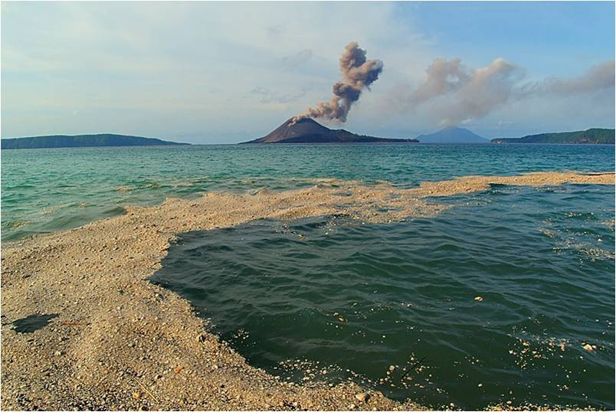
Outline
Community Concerns
Home Reef, Tonga
Havre Seamount, New Zealand
Project Objectives
Methodology
Earth Observations
Data Acquisition
Data Processing
Data Analysis
Timeline
Anticipated Results & Discussion
Questions
Acknowledgements & References
Notes:
SLIDE 2: Outline
TRANSITION: Before we get into the specifics, let’s outline our approach.
DIALOG: I will, of course, start out with a brief explanation of what a pumice raft is, for those that don’t know. I will also try to explain why we should care and include a couple of examples for illustration. Once done, I will explain the objectives of my project followed by my methodology. Next, I will provide a general timeline for when I expect to have the project complete and the results I anticipate, along a few items for discussion. I will finish by trying to answer any questions you may have, and acknowledge those without who’s help and expertise I would not have gotten even this far.

Slide 3
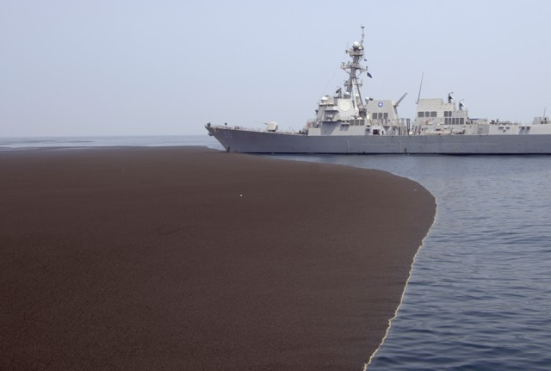
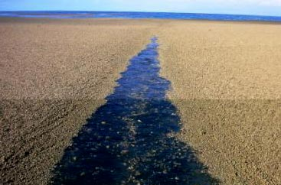
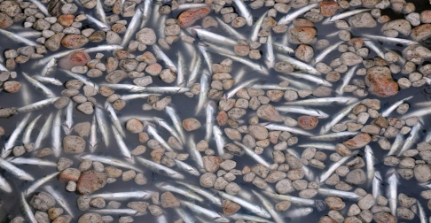
Community Concerns
Pumice Rafts
Masses of volcanic rock
Magma from large volcanic eruptions
Subsurface
Near-ocean
rapid cooling/depressurization
Have been known to reach tens of kilometers across and several feet deep
Can create a host of hazards:
Crossing established shipping lanes
Risk to navigation and sea life
Can block seawater intake valves, affecting engine cooling systems.
Notes:
SLIDE 3: Community Concerns
TRANSITION: Now, with your indulgence, we will start with the background.
DIALOG: You are probably already aware of what a pumice rock is. They are used commonly as mild abrasives in cleaners, for removal of dry skin, and as decorative landscaping rock. Its light but durable nature makes it perfect for all of these applications, but it also presents some problems as well. Pumice is naturally formed when hot magma from a volcanic eruption comes into contact with cool air or, in some cases, water. Rapid cooling and de-pressurization of the molten rock traps air bubbles creating the pumice stone. Of course, this most often occurs when volcanoes are near a shoreline, on an island, or even subsurface. Because of their porous nature and low density, these rocks tend to float on water. The resulting raft’s size is dependent on the amount of, and speed at which, molten rock is ejected and how quickly it cools, but a single raft has been known to reach tens of kilometers across and several feet deep (Chojnacki, 2011).
Obviously, an object of this size floating around the ocean presents a host of hazards. Although typically considered a low frequency event, surveys have revealed that pumice rafts have been observed in all of the major oceans over the last 200 years and are particularly abundant in the Pacific Ocean (Bryan, 2012). When they do occur, local fishing and shipping are greatly affected. The photograph on the lower left of the slide, taken by associated press photographer Carlos Succo, shows how Pumice rock can choke nearby waterways, killing indigenous marine life and endangering manmade structures such as dams (Succo, 2011). More to the purpose of this project, as harbors and shipping lanes are blocked by the debris; the pumice obstructs maritime shipping and travel. Pumice rock can also cause problems for ships that attempt to pass through the rafts by clogging the seawater intakes and causing the engine cooling system to fail, thus overheating the engines (Chojnacki, 2011).

Slide 4
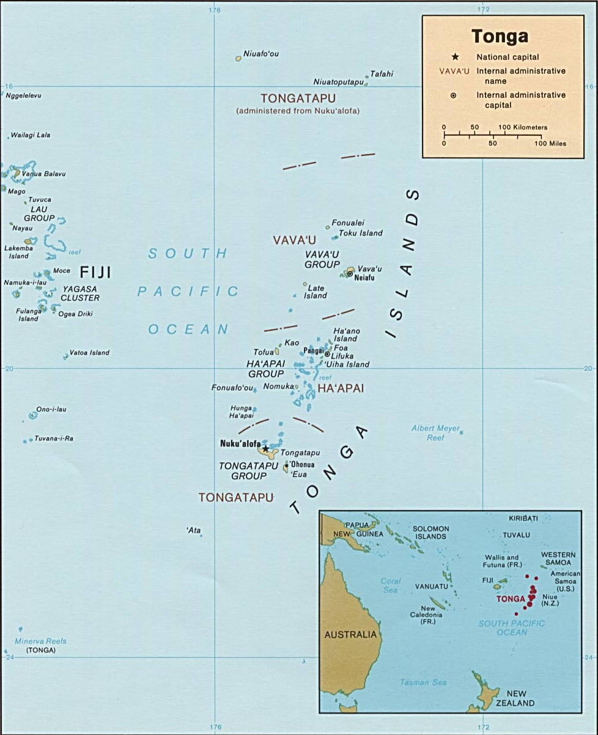
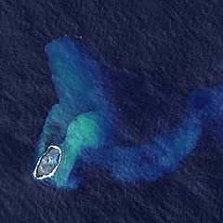
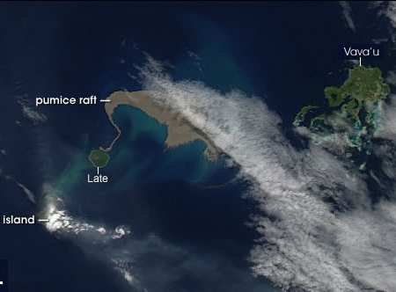
Home Reef, Tonga
Coordinates: 18°59′28″S 174°45′47″W
Eruption started: August 8, 2006
Visibly forming an island by August 12th
Pumice traveled both N and S around Fiji's Lau Group.
Water travel around the nearby islands was nearly brought to a standstill.
Notes:
SLIDE 4: Home Reef, Tonga
TRANSITION: Based on the availability of collected data, I have chosen two specific events as the test subjects for this project.
DIALOG: The first is Home Reef, Tonga, located between Metis Shoal and Late Island in the Tonga Islands. In August of 2006, an eruption occurred forming a transitory island, or pumice cone, which was subsequently eroded by wave action over the following eight months. Pumice rafts produced by the initial eruption, and subsequent airborne cooling, covered over 440 square kilometers, moving towards the Vava’u Islands before turning westward and arriving in Fiji and Vanuatu around mid-September. Local sea travel around the islands of Fiji was nearly brought to a standstill. Soon after, the pumice raft dispersed into tendrils measuring tens to hundreds of kilometers long, covering an ocean area of approximately 1,600 square kilometers. They eventually reached Australian waters by March 2007, seven months after the original eruption (Bryan, 2012).

Slide 5
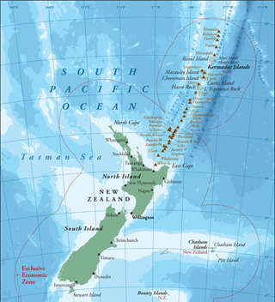
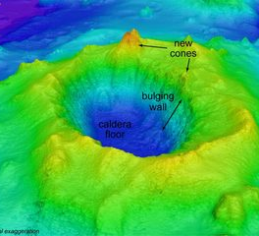
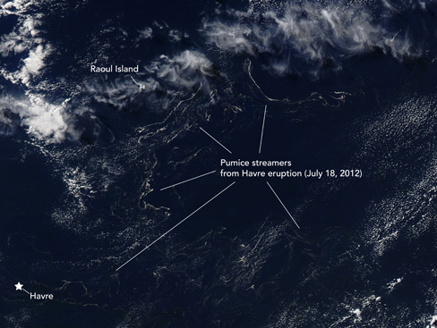
Havre Seamount, New Zealand
Coordinates: 31°07′13″S 178°59′07″W
Eruption started: July 18, 2012
Produced ash plume breaching the ocean surface from a depth of at least 700m.
By August 13th, winds & currents spread the pumice into twisted strands over an approx. 450x250 km area.
Notes:
SLIDE 5: Havre Seamount, New Zealand
TRANSITION: My second test subject occurred more recently and initially provided a bit of a mystery to researchers and scientists.
DIALOG: On August 9th, 2012, a naval vessel belonging to the Royal New Zealand Navy came across what was described as a floating pumice island measuring 482 kilometers long and 48 km wide. A lieutenant aboard ship was quoted as saying, “The rock looked to be sitting two feet above the surface of the waves, and lit up a brilliant white color in the spotlight. It looked exactly like the edge of an ice shelf." Using imagery obtained by NASA's Moderate Resolution Imaging Spectro-radiometer (MODIS), it was determined that this pumice raft originated from Havre Seamount, located near the L'Esperance and L'Havre Rocks in the Kermadec Islands of New Zealand (Bryner, 2012). Unnoticed, this subsurface volcano, from an estimated 700 to 1,100 meters below the surface of the ocean, erupted around July 18th, 2012. This eruption created a pumice raft estimated at 450 by 250 kilometers by August 13th, then dispersing over an area of 270,000 square kilometers by August 19th. It likely stayed afloat for months traveling to wherever the currents took it (Havre Seamount, 2012).

Slide 6
Project Objectives
Project Objectives
Build and verify two predictive maps for the pumice rafts produced by the Home Reef and Havre Seamount volcanic eruptions of 2006 and 2012.
Develop and document a methodology for predictive mapping that can be applied to other near-sea or subsurface volcanoes around the world.
Apply predictive maps to commercial shipping lanes to identify high risk areas that may provide a hazard for ship and crew.
Notes:
SLIDE 6: Project Objectives
TRANSITION: As you can see, pumice rafts can present a fairly distinctive problem set to scientists and local populations alike. This project will attempt to begin the process of making that problem more manageable.
DIALOG: This project builds on work done previously by NASA’s DEVELOP National Program and constructs a framework for future projects, which I will discuss briefly later on in this presentation. The previous project utilized multispectral imagery to develop spectral signatures for the phenomena, and this project will utilize those signatures to complete its three objectives. First, utilizing current and wind data, predictive mapping will be created for the two previously discussed events. These maps will be compared to the actual routes taken by the pumice rafts described earlier. Discrepancies will be identified and, if possible, corrected; and when not possible, limitations to the predictive mapping will be identified and documented. Finally, the predictive maps created by the first two objectives will be compared to established shipping lanes in order to identify potential risk areas for commercial shipping.

Slide 7
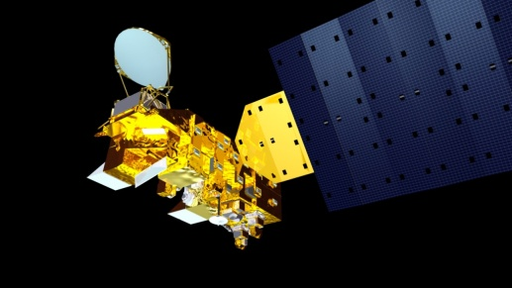
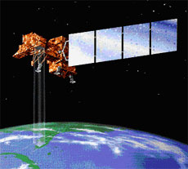
Methodology
Earth Observations
MODIS (Moderate Resolution Imaging Spectroradiometer)
Atmospheric, land, and ocean imaging in a single instrument
On Terra (EOS AM) and Aqua (EOS PM) satellites
36 spectral bands
1,000m, 500m, and 250m resolution
Landsat (Land Remote-Sensing Satellite)
The longest continuous global record of the Earth's surface
Encompasses eight satellite missions since 1972
8 spectral bands (Landsat 7 ETM+)
60m, 30m, and 15m resolution
Notes:
SLIDE 7: Methodology (Earth Observations)
TRANSITION: NASA’s DEVELOP National Program strives to “bridge the gap between NASA Earth Science and society” (About DEVELOP, 2012). As such, several of NASA’s Earth observation sensors will be used as keystones in this project, so before going any further, I would like to introduce them and explain how they will be used.
DIALOG: The first two are Multispectral imaging sensors, each with their benefits and limitations. MODIS provides 36 spectral bands, allowing for more coverage of the electromagnetic spectrum, and thus a more refined spectral signature than Landsat. However, Landsat’s higher resolution allows for a more detailed analysis of the subject area. These two sensors will be used in conjunction to identify and track the pumice rafts from Home Reef and Havre Seamount.

Slide 8
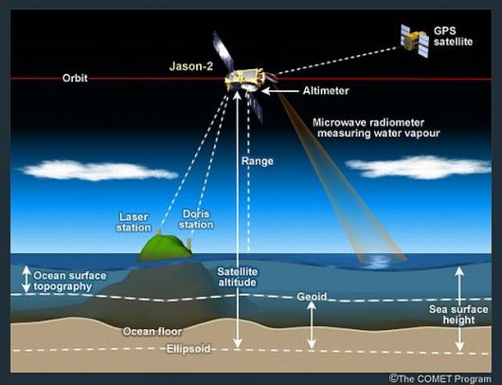
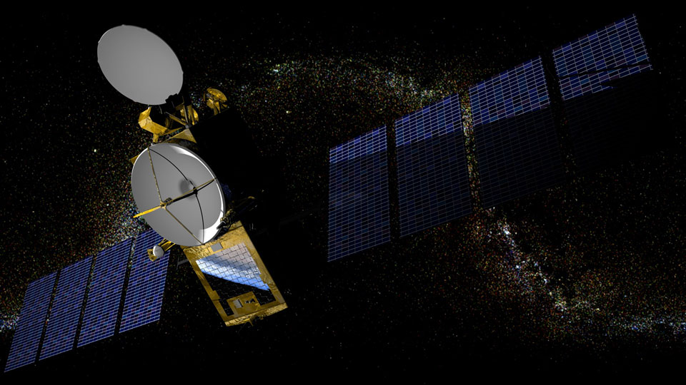
Methodology
Earth Observations
Poseidon Radar Altimeter
Precisely measures sea surface height and topography
Aboard Jason-1 and Jason-2 satellites
Emits pulses at 2 freq, 13.6 GHz (Ku-band)/5.3 GHz (C-band)
Analyzes the return signal reflected by the surface.
Notes:
SLIDE 8: Methodology (Earth Observations)
TRANSITION: The next Earth observation sensor is NASA’s Poseidon Radar Altimeter.
DIALOG: Poseidon is part of the Ocean Surface Topography Mission (OSTM) and uses high-precision ocean altimetry to measure the distance between the satellite and the ocean surface to within a few centimeters. This information provides speed and direction of ocean currents as well as heat stored in the ocean. The current information will be one of two influences utilized in our prediction model.

Slide 9
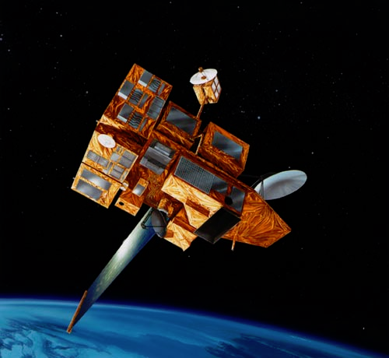
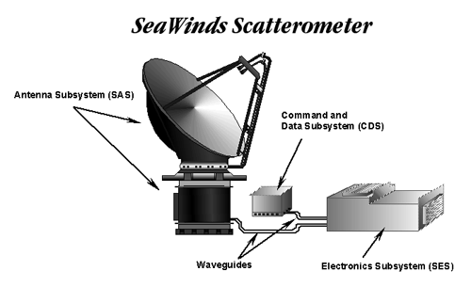
Methodology
Earth Observations
SeaWinds Scatterometer
Measures near-surface wind velocity over Earth's oceans
Aboard QuikSCAT and ADEOS II satellites
A specialized microwave radar (13.4 gigahertz)
Analyzes speed & direction in all weather & cloud conditions
Notes:
SLIDE 9: Methodology (Earth Observations)
TRANSITION: The last Earth observation sensor I will introduce is NASA’s SeaWinds Scatterometer.
DIALOG: Seawinds is a specialized microwave radar antenna which measures near-surface wind velocity over Earth's oceans. Analyzing speed and direction of ocean winds, it will (in conjunction with Poseidon’s current data) allow us to predict, within a limited degree of certainty, where a pumice raft will travel from the point of eruption.

Slide 10
Methodology
Sea Shipping Lanes
Raster product with values ranging from 0 to 1,158
Data collected from October 2004 to October 2005
Collected as part of the World Meteorological Organization Voluntary Observing Ships Scheme
All stationary and single point ship data removed
Connected all mobile ship data
Removed those crossing land
Buffered tracks to 1km
Summed overlapping ship tracks
Notes:
SLIDE 10: Methodology (Sea Shipping Lanes)
TRANSITION: As you can see, there is a volume of Earth observation data to sift through, but there is one last data set that is necessary to complete the project. The final piece of the puzzle is the commercial shipping lanes.
DIALOG: Luckily, the National Center for Ecological Analysis and Synthesis (NCEAS) has already solved this problem. Ships from all over the world collect meteorological data as part of a voluntary program with the World Meteorological Organization (WMO). Included with the weather information the ships provide is their locational data. The NCEAS collected this data from October 2004 to October 2005 and created shipping tracks for approximately 3,374 commercial and research vessels. The tracks were then converted to a raster product containing one square kilometer cells with values ranging from 0 to 1,158 indicating the volume of ships that occupied that square. It almost certainty does not account for every ship on the sea (NCEAS estimates that it is around 11%), but for the purpose of this project, it provides an adequate depiction of shipping lanes around the world.

Slide 11
Methodology
Data Acquisition
Sea Shipping Lanes
http://www.nceas.ucsb.edu/GlobalMarine/impacts
MODIS
http://ladsweb.nascom.nasa.gov/
Landsat
http://landsatlook.usgs.gov/
http://earthexplorer.usgs.gov/
http://glovis.usgs.gov/
Poseidon/Seawinds
Physical Oceanography Distributed Active Archive Center (PODAAC) http://podaac.jpl.nasa.gov/
Ocean Surface Current Analysis – Real time (OSCAR) http://www.oscar.noaa.gov/
Notes:
SLIDE 11: Methodology (Data Acquisition)
TRANSITION: Now that we have discussed what datasets are needed for this project, where do we get them?
DIALOG: All of the Earth observation data as well as the shipping lanes can be found through open source at the websites listed on this slide. NCEAS hosts their own data, while NASA, the U.S. Geological Survey (USGS), and the National Oceanic and Atmospheric Administration (NOAA) all provide for the various Earth observation data.

Slide 12
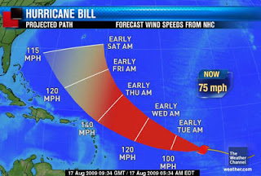
Methodology
Data Processing
MODIS/Landsat
Utilize previously derived spectral signature of pumice
Identify pumice spread over duration following eruption
Create a binary classification raster for each volcano where each pixel represents the presence or absence of the subject pumice raft over time
Poseidon/Seawinds
Utilize pre-existing algorithm to determine currents from collected altimeter data
Process to determine currents and winds in the area of subject volcanoes
Create predictive raster indicating direction and spread of pumice from eruption (may resemble hurricane map)
Notes:
SLIDE 12: Methodology (Data Processing)
TRANSITION: So, once the data is obtained, what do we do with it?
DIALOG: The MODIS and Landsat data will comprise the first part of the project. After obtaining all usable imagery covering the two subject pumice raft events, the imagery will analyzed, pixel by pixel, for the presence of pumice. As mentioned previously, a DEVELOP project that was performed two summers ago did an outstanding job of producing a well defined spectral signature for pumice. That signature will now be used to create binary classification raster images depicting the presence or absence of pumice in each pixel. These raster products can then be merged to produce a single product each which will portray the main spread of the pumice from both Home Reef and Havre Seamount.
The second part of the project can, and probably will, happen concurrently with the first. This part involves processing the Poseidon and Seawinds data to obtain current and wind data. During the processing, the two datasets will be merged to create a raster product depicting direction of flow within the subject areas. This will allow us to predict a pattern of movement from a given point of origin, i.e. the eruption point. I am anticipating that the final product will somewhat resemble a hurricane map such as the one shown on this slide. This will indicate the areas at risk from the pumice raft.

Slide 13
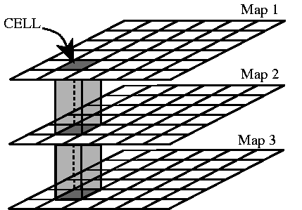
Methodology
Data Processing
Document processes used to build and prepare the datasets
Provide step-by-step methodology to repeat process for worldwide risk areas
Identify and document best-practices, limitations, and lessons-learned in the process as they occur
Incorporate sea shipping lanes
Only minor processing should be required
Ensure that this raster file lines up correctly with all others in the project
Shipping
Lanes
Cell
Currents
& Winds
Pumice
Rafts
Notes:
SLIDE 13: Methodology (Data Processing)
TRANSITION: Those two efforts represent the bulk of the information to process, but before we move on to the analysis, there are two other steps that are crucial to the success of this project.
DIALOG: From the beginning, it will be critical that every step in this process is recorded with the foresight that the validation for this project is its capability to reproduce credible results for any potential risk area in the world. Also, although the shipping lane dataset is mostly ready-to-use, we must make sure that it, along with all of the other raster products in the project aligns with necessary geographic precision.
Once we have completed our data processing we will have three raster types, a total of five files, on which to perform our analysis: two binary classifications recording the actual pumice spread for each of our two subject events; two dispersal maps showing cumulative current and wind direction in each area, and the worldwide sea shipping lanes file.

Slide 14
Methodology
Data Analysis
Analyze predictive pumice dispersal map against binary classification raster
Determine accuracy of predictive map
Identify contributing influences to errors and correct if possible
Four Possible outcomes:
Pumice | Predicted | Not Predicted
Observed | Positive Outcome | Negative Outcome
Not Observed | Negative Outcome | Positive Outcome
Notes:
SLIDE 14: Methodology (Data Analysis)
TRANSITION: With these five files complete and properly aligned, it will be time to perform the analysis, and build the products that will answer the three objectives stated earlier in this brief.
DIALOG: The first objective was to build and verify two predictive maps for the pumice raft events at Home Reef and Havre Seamount. Building the maps will involve analyzing the current and wind raster product to trace the path from the eruption site. Once complete, it will be verified against the binary classifications of the actual events. The final product will be a raster where each cell represents one of four possibilities: no pumice predicted or observed; pumice predicted and observed; pumice predicted but not observed; and pumice not predicted, but observed. Negative outcomes will be reviewed and analyzed in an attempt to ascertain a reason. If the negative outcomes are extensive enough to warrant, the data will be reprocessed and analyzed to incorporate the findings from the previous attempt.

Slide 15
Methodology
Data Analysis
Document and weigh processes used for predictive analysis
Identify limitations and best practices
Provide defined methodology for universal application
Analyze predictive pumice dispersal map against sea shipping lanes
Identify shipping lanes affected and resulting ports
Provide final product identifying “at-risk” areas.
Notes:
SLIDE 15: Methodology (Data Analysis)
TRANSITION: (No Transition)
DIALOG: The second objective was to develop and document a methodology for predictive mapping for worldwide application. This document will be completed and made available through DEVELOP National Program and its partners. It will include all of the technical aspects of the project, limitations and best practices, and step-by-step instructions for worldwide application. As time and resources permit, additional at-risk areas will be identified and the methodology will be applied to verify its relevance and accuracy.
Finally, the third objective was to apply the predictive maps to commercial shipping lanes. All predictive models produced by this project will be analyzed against the shipping lane raster file. A final map product (or products), identifying areas where the shipping lanes intersect with at-risk areas, will be produced.

Slide 16
Timeline
NASA DEVELOP National Program
Summer 2013 term: June 3rd to August 9th
Week 3: Project Summary Rough Draft
Week 4: VPS Submission Wave 1 (Storyboard & project details)*
Week 5: Tech Paper Rough Draft
Week 6: PPT Rough Draft
Week 7: Poster Rough Draft
Week 8: Project Summary Final Draft*
Week 9: VPS Submission Wave 2 (Video & Full Transcript)*
Week 9: Final Poster *
Week 9: Final PPT Presentation w/Speaker Notes *
Week 10: Tech Paper Final Draft *
Week 10: Brochure Deliverables *
Summer Close-out presentations: August 8th
*Deliverables
Notes:
SLIDE 16: Timeline
TRANSITION: Each of the three products discussed will address one of our objectives. Now let’s look at the timeline for completing this project.
DIALOG: Because I am completing this project as part of the NASA DEVELOP National Program’s summer term, they have a very structured schedule to follow. They also require several deliverables beyond the presentation required by the University. The main effort of the project will be completed over a ten-week period from June 3rd to August 9th, with the milestones and deliverable shown on the slide here and the final presentation on August 8th at Langley Research Center in Hampton, Virginia.

Slide 17
Anticipated Results & Discussion
Anticipated Results
An understanding of the influences of currents on ocean surface debris and the effects on surrounding populations
Discussion
Information can be used to predict where pumice rafts might have the greatest impact, and what areas of the world might be at risk from future volcanic raft formations
Future work
Refine predictions by identifying other possible influences
Incorporate timelines and speed of travel
Develop variable probability profile as distance increases from source
Automate near real-time alerts and monitoring based on most current data
Notes:
SLIDE 17: Anticipated Results & Discussion
TRANSITION: The final topic I would like to share with you before taking your questions addresses my anticipated results and some final discussion items.
DIALOG: Beyond the three products previously identified, I feel that this project will result in an improved capability to predict the impact of pumice raft events on local populations and commercial sea travel. I do not anticipate one hundred percent accuracy in this model, but I believe that it will be within the realm of acceptable error, and will provide a strong basis for further evolution. I am certain that DEVELOP will take this work and continue it on in future terms. With this in mind, I offer some suggestions for future work, shown here.

Slide 18
Questions?
Notes:
SLIDE 18: Questions
TRANSITION: This concludes my presentation. Before I recognize those who have helped me thus far through my endeavor, I would like take any questions you may have and try to answer them.
DIALOG: (Question and answer session)

Slide 19
Acknowledgements & References
Thanks to Dr. Jay Parrish for his advice and direction!
Thanks to everyone with NASA DEVELOP National Program at Langley Research Center for sponsoring me, letting me bounce ideas of them, and just letting me hang out.
Mike Ruiz, DEVELOP Program Manager
Lindsay Rogers, Assistant Program Manager
Dr. Kenton Ross, National Science Advisor
Lauren Childs, National Lead
Jamie Favors, Deputy National Lead
Kelsey Rooks, Langley Center Lead
Quinten Geddes, Assistant Center Lead
The Spring 2013 Oregon Health and Air Quality Team
Notes:
SLIDE 19, 20, & 21: Acknowledgements & References
TRANSITION: Thank you again, but before I let you go, I would like to recognize some others.
DIALOG: Dr. Parrish for his guidance; Everyone at DEVELOP for their support; and everyone listed in my references whose work allowed me to build a foundation for my own. Thank you.

Slide 20
Acknowledgements & References
"About DEVELOP." DEVELOP National Program Office. NASA Langley Research Center, 26 Sept. 2012. Web. 15 Nov. 2012. <http://develop.larc.nasa.gov/IE/aboutIE.html>.
Bryan, Scott E., Alex G. Cook, Jason P. Evans, Kerry Hebden, Lucy Hurrey, Peter Colls, John S. Jell, Dion Weatherley, and Jennifer Firn. "Rapid, Long-Distance Dispersal by Pumice Rafting." PLoS ONE. N.p., July 2012. Web. 14 Apr. 2013. <http://www.plosone.org/article/info:doi/10.1371/journal.pone. 0040583?imageURI=info:doi/10.1371/>.
Bryner, Jeanna. "Source of Mysterious Pumice 'Raft' in Pacific Found, NASA Says." Yahoo! News. Yahoo!, 14 Aug. 2012. Web. 14 Apr. 2013. <http://news.yahoo.com/source-mysterious-pumice-raft-pacific-found-nasa-says-061029144.html>.
Childs, L. M., P. R. Chojnacki, C. Coady, Q. Geddes, L. B. Honaker, W. Lyddane, J. McGilloway, and J. Scott. "Pacific Ocean Disasters - Enhanced Detection and Monitoring of Pumice Rafts Using NASA EOS." The Smithsonian/NASA Astrophysics Data System. Smithsonian Astrophysical Observatory, Fall 2011. Web. 15 Nov. 2012. <http://adsabs.harvard.edu/abs/2011AGUFM.V44C..04C>.
Childs, Lauren, and Lindsey B. Honaker. "Remote Sensing Monitoring of Pumice Rafts in the Pacific Ocean." National Institute of Aerospace, 2011. Web. <http://www.nianet.org/NIA/media/photo-gallery/Remote-Sensing-Monitoring-of-Pumice-Rafts-in-the-Pacific-Ocean.pdf>.
Chojnacki, Paula, William Lyddane, Jason McGilloway, Quinten Geddes, Lindsay Honaker, Conor Coady, and Josh Scott. "Implementing NASA Remote Sensing to Protect and Monitor Our Waterways." Earthzine. Shane & Peter, Inc., 10 Aug. 2011. Web. 15 Nov. 2012. <http://www.earthzine.org/2011/08/10/implementing-nasa-remote-sensing-to-protect-and-monitor-our-waterways/>.

Slide 21
Acknowledgements & References
"Floating Pumice (Tonga)." Global Volcanism Program. Smithsonian Institution, Sept. 2011. Web. 15 Nov. 2012. <http://www.volcano.si.edu/world/vol_extra.cfm?name=Tonga_Pumice>.
"Havre Seamount." Global Volcanism Program. Smithsonian Institute, Sept. 2012. Web. 14 Apr. 2013. <http://www.volcano.si.edu/world/volcano.cfm?vnum=0402-005>.
Klemetti, Erik. "NASA Satellites Pinpoint Volcanic Eruption." The Earth Observatory. EOS Project Science Office, 14 Aug. 2012. Web. 15 Nov. 2012. <http://earthobservatory.nasa.gov/IOTD/view.php?id=78849>.
"Ocean Surface Topography Mission (OSTM)/Jason-2." NASA. N.p., n.d. Web. 14 Apr. 2013. <http://www.nasa.gov/mission_pages/ostm/overview/index.html>.
"Pumice Raft." Wikipedia. Wikimedia Foundation, 11 Dec. 2012. Web. 15 Nov. 2012. <http://en.wikipedia.org/wiki/Pumice_raft>.
"SeaWinds on ADEOS II." WINDS: Missions: SeaWinds on ADEOS II. NASA, n.d. Web. 14 Apr. 2013. <http://winds.jpl.nasa.gov/missions/seawinds/index.cfm>.
Succo, Carlos. Potograph 10. 2011. Photograph. Volcanic Ash and Pumice From Puyehue, Puyehue-Cordon Caulle, Chile. The Atlantic. 17 June 2011. Web. 14 Apr. 2013. <http://www.theatlantic.com/infocus/2011/06/volcanic-ash-and-pumice-from-puyehue/100088/>.

