Slide 1
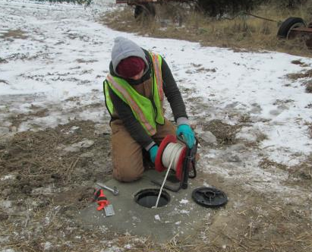
The Effects of Changing Precipitation Patterns on Mid-Atlantic Groundwater Supplies
Lara Bennett
May 14, 2017
Penn State MGIS Program
Advisor: Dr. Tess Russo
GEOG 596A - Spring 2017

Slide 2
Personal Background
Background in hydrogeology
Worked as an environmental consultant & state government contractor for 7+ years
Chesapeake GeoSciences, Inc.
Maryland Department of the Environment
Specialized in monitoring and management of contaminated groundwater via Petroleum LNAPL and Chlorinated Solvents
Completed PSU GIS certificate in Spring 2016 & began MGIS program

Slide 3
Overview
I. Project Background
A. Groundwater as a Resource
B. The Connection between Climate & Groundwater
II. Project Framework
A. Objectives & Key Research Questions
B. Study Area
C. Data Sources
D. Methodology
E. Evaluation
F. Example Analysis
G. Challenges
III. Result Applications

Slide 4
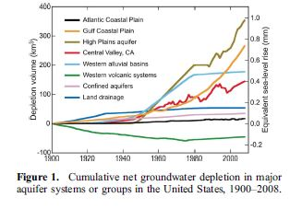
Groundwater: A Key Resource
Groundwater accounts for more than 30% of the freshwater on Earth but makes up 94% of usable freshwater when excluding glaciers
Globally, groundwater is utilized as the primary source of potable water for over 1.5 billion people
In the United States, more than 50% of the population use groundwater as a drinking water source
Irrigation makes up 70% of groundwater use
Multiple studies show widespread groundwater storage decline across the United States in the last 3 decades
(USGS Groundwater Resources Program, 2011)
Source: (Konikow, 2011)

Slide 5
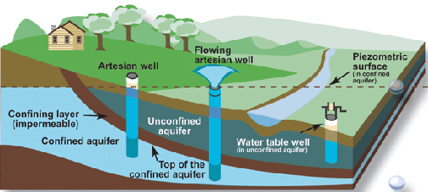
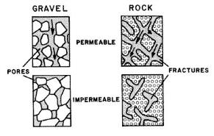
How Do We Obtain & Monitor Groundwater?
Groundwater wells
Often sourced from confined aquifers
Aquifer capacity is dependent on soil porosity & permeability
Groundwater is depleted when more water is discharged than recharged within an aquifer
Source: (USGS, 2014)
Source: (USGS, 2014)

Slide 6
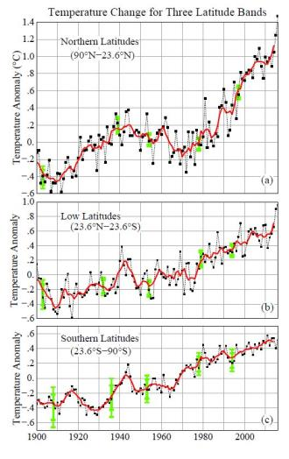
The Connection Between Climate & Groundwater
Climate change directly impacts annual temperature, precipitation patterns, and evapotranspiration cycle
Results in impact to aquifer recharge rates over time
Consequences include:
Drought
Waterlogging Resulting in Flooding
Seawater Intrusion
Groundwater Pollution
Source: (Hansen, 2010)

Slide 7
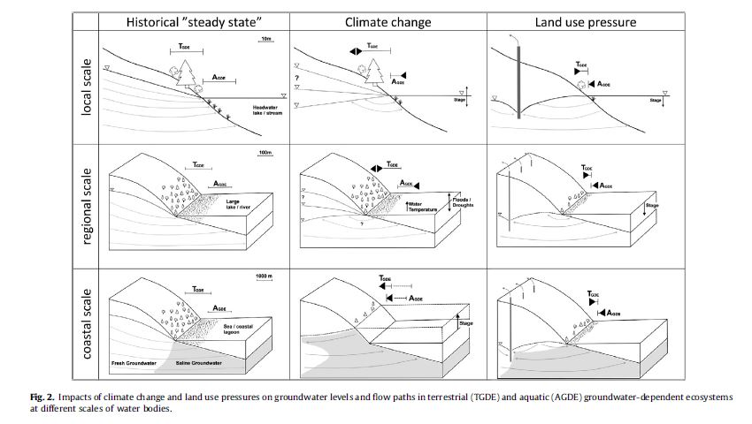
The Connection Between Climate & Groundwater
Paper published by Klove & al. in 2013 shows the correlation between changes in precipitation patterns, land use, and the effects they have on groundwater storage levels
Source: (Klove, 2013)

Slide 8
Project Objectives & Key Research Questions
What areas within the Northern Coastal Plain Aquifer have exhibited the most consistent correlation between groundwater elevations and precipitation patterns?
Are there specific correlations between:
Certain topographic features?
Soil types?
Land use types (i.e. agricultural, rural residential, urban)?
What are the incrementally measured changes in groundwater elevation for shallow unconfined vs. deep confined local aquifers from dry to wet years (and visa versa)?
Can a statistical coefficient be applied to measured changes to aid in predicting future impacts to groundwater supplies?
Notes:
Overall Objective:
To assess and categorize the impact of historically changing precipitation patterns on the groundwater elevations in the Northern Coastal Plain aquifer along the Atlantic coast from 1950 - 2010
To answer these questions I will:
-Examine years of extreme dry and wet periods to identify study control points in high irrigation and domestic well land use areas
-Analyze the influence soil type & porosity, topography, and land use have on groundwater elevations
-Utilize historic correlation control points to estimate future trends based on possible seasonal changes in precipitation

Slide 9
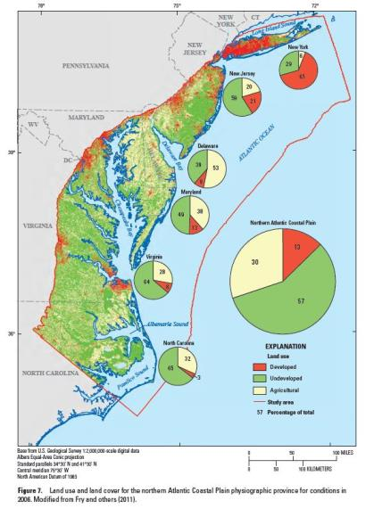
Anticipated Results
Areas of shallow unconfined aquifers, low topography, & high porosity soils respond quickest to climate changes
Areas of high irrigation & domestic well water use require shorter timescales to respond to precipitation variability
Deep aquifers respond to extreme changes in precipitation at a slower rate, often responding to drastic changes in precipitation patterns over months rather than days
Source: (Materson, 2016)
Notes:
i.e. my hypotheses for this project based on my literature review

Slide 10
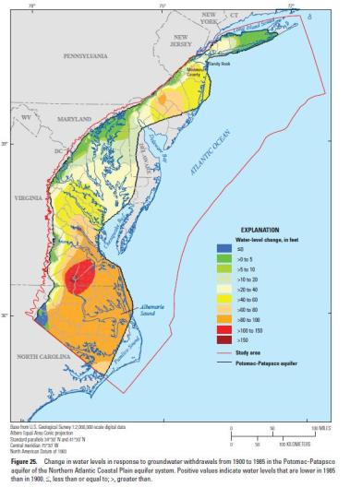
Why Focus on the Mid-Atlantic?
Many US studies conducted in agriculture rich areas [the High Plains (Ogallala) Aquifer & the Gulf Coastal Plain] and areas of severe droughts [Central Valley in California & Western Alluvial Basins]
Few if any direct studies on Mid-Atlantic region
Highly populated area & growing
Unique mixed water use
Drastically changing groundwater levels over the last century
Source: (USGS, 2011)

Slide 11
GIS Data Sources
USGS Groundwater Historical Instantaneous Monitoring Well Depth to Water Level (~1950 – 2010)
Maurer Gridded Observed Meteorological Data (Annual Precipitation Rasters)
USGS 1 Meter DEMs
USDA SSURGO Soil Type Shapefiles
USGS National Land Cover Database (NLCD) Rasters
ACWI National Groundwater Monitoring Network Aquifer Shapefiles

Slide 12
Proposed Methodology
Point Pattern Analysis
Time Series & Trend Analysis
Applications
Map & Graph Ground-water Elevation Gradients
Overlay Analysis & Evaluation
Average Daily Precipitation per Year
Groundwater Elevation Gradients
Soil Map
NLCD Maps
Yearly Average Groundwater Elevations
Years of Extreme Drought
Years of Extreme Flooding
Years of High Precipitation
Identify Control MW Points Grouped by Topography
Research Regression Models
Develop Correlation Coefficients
Utilization of regression model for assignment of groundwater protection area & decision making
DEM

Slide 13
Analysis Methods
Point Pattern Analysis on Depth to Groundwater Levels for Years of Interest
Kriging
IDW
Nearest Neighbor Distance
Map Groundwater Elevation Gradients for Years of Interest
DEM
Create polygon layers to distinguish between different groundwater elevation zones
Overlay Analysis
For each year of interest overlay precipitation averages, soil types, & land use rasters onto groundwater elevation zones
Identify & subcategorize areas based on types of soil, land use, and precipitation impacts
Time Series & Trend Analysis of Temporal Datasets
Compare significant yearly results from overlay analysis in each decade from ~1950-2010
Define areas of significance (i.e. areas that show significant response to precipitation patterns in years of high and low precipitation)
Select key spatial control points within areas of significance
Graph groundwater elevation changes for each control point over each decade
(Tripathi, 2006)

Slide 14
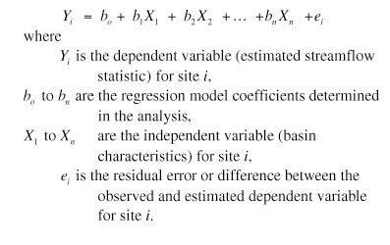
Evaluation
Define historical trends for various types of parameters & map high risk areas
Unconfined vs. confined aquifers
Agricultural land use
Urban land use
High elevation topography
Low elevation topography
Soil types
If time permits, calculating coefficients for prediction
Regression Analysis (Risley, 2008)
Multiple Regression vs. Geographically Weighted Regression (GWR)
Control Point Groundwater Elevations = Dependent Variable
Source: (Bayramov, 2011)
Source: (Risley, 2008)
Notes:
If I have time, I would like to create a multivariate regression model. The multivariate regression model will predict groundwater elevation using a number of independent variables.

Slide 15
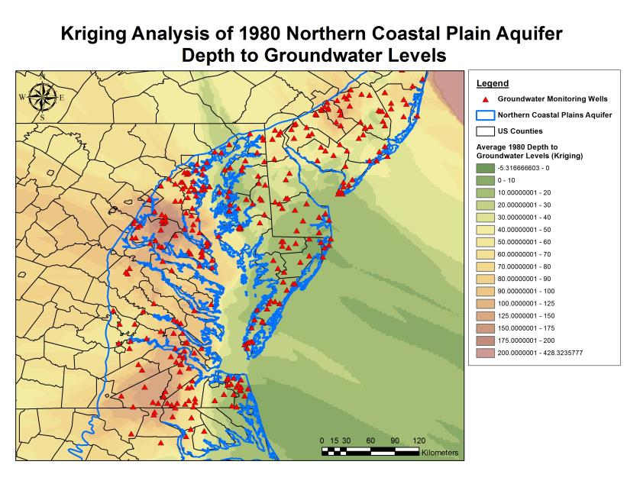
Example Kriging Analysis
1980 (Intense Drought Year)

Slide 16
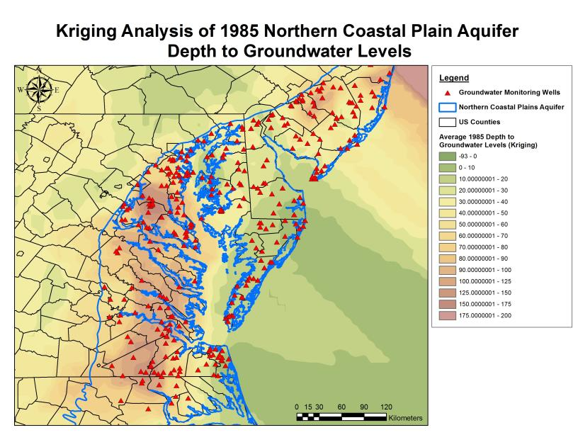
Example Kriging Analysis
1985 (High Precipitation Year)

Slide 17
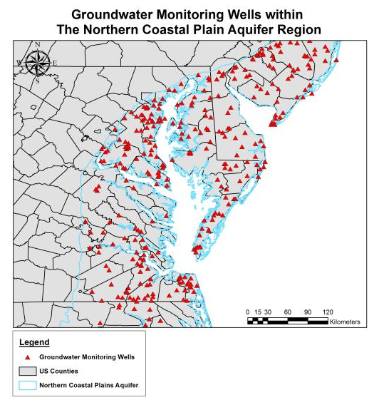
Challenges
Data Resolution
Spatial Gaps & Localization of Data
Incomplete & Spotty Groundwater Elevation Data
Data Collection Errors

Slide 18
Result Applications
Utilize historical findings to map areas at high risk of flooding and/or drought
Implement notification system for high risk areas
Create web application for assisting with predicting impacts to localized aquifers
Users: Hydrologist, Farmers, Urban Planners
Apply findings to further studies of localized aquifer yields via incorporation of pumping and discharge rates of irrigation and domestic well use

Slide 19
Capstone Timeline
Fall 2017
January 2018
February 2018
March 2018
April 2018
Summer 2017
Prepare & Finalize Presentation
Present at American Association of Geographers (AAG) Conference April 10-14, 2018
Data Collection & Processing
Finish Data Analysis
May 2017
Peer Review Presentation on 5/14/17
Edit & Revise Based on Feedback by Beginning of June
Evaluation of Results
Submit Abstract by 11/17/2017
Application of Regression Model
Research Regression Models
Data Analysis

Slide 20
References
Bayramov, E., Buchroithner, M., and McGurty, E. “Determination of main climate and ground factors controlling vegetation cover regrowth along oil and gas pipelines using multiple, spatial and geographically weighted regression procedures.” Environmental Earth Science, July 27, 2011: 2047-2062.
Hansen, J., Ruedy, R., Glascoe, J., and Sato, M. “GISS Analysis of Surface Temperature Change.” Journal of Geophysical Research, 1999 (Updated 2010): 104, 30997-31022.
Klove, B., Ala-Aho, P., Bertrand, G., Gurdak, J., Kupfersberger, H., et al. "Climate Change Impacts on Groundwater and Dependent Ecosystems." Journal of Hydrology, June 27, 2013: 250-266.
Konikow, Leonard. "Contribution of global groundwater depletion since 1900 to sea-level rise." Geophysical Research Letters, September 2, 2011.
Materson, J., Pope, J., Fienen, M., Monti, J., Nardi, M. and Finkelstein, J. Assessment of Groundwater Availability in the Northern Atlantic Coastal Plan Aquifer System from Long Island, New York, to North Carolina. Reston, VA: USGS Science Publishing Network, May 31, 2016.
Risley, J., Stonewall, A., and Haluska, T. Estimating Flow-Duration and Low-Flow Frequency Statistics for Unregulated Streams in Oregon. USGS Scientific Investigation Report, 2008.
Russo, T., Alfredo, K., and Fisher, J. "Sustainable Water Management in Urban, Agricultural, and Natural Systems." Water, December 12, 2014: 3934-3956.
Russo, T., and Lall, U. "Depletion and response of deep groundwater to climate-induced pumping variability." Nature Geoscience (Macmillan Publishers Limited, part of Springer Nature) 10 (January 23, 2017): 105-110.
Tripathi, S., Srinivas, V., and Nanjundiah, R. "Downscaling of precipitation for climate change scenarios: A support vector machine approach." Journal of Hydrology, April 14, 2006: 621-640.
USGS. "Groundwater Basics." USGS. January 2, 2014. https://pubs.usgs.gov/of/1993/ofr93-643/ (accessed April 29, 2017).
USGS Groundwater Resources Program. Assessing Groundwater Availability in the Northern Atlantic Coastal Plain Aquifer System. USGS, February 2011.
USGS Office of Global Change. Effects of CLimate Variability and Change on Groundwater Resources of the United States. Idaho Falls, Idaho: USGS, September 2009.

Slide 21
Questions?
Email: lqb5349@psu.edu / Phone: (314) 570-3551

