Slide 1
Utilizing Esri’s ModelBuilder for a Risk-Based Approach for Stormwater Asset Management and Maintenance
Tim Black
GEOG 596A

Slide 2
Personal Background
Currently employed as a GIS Analyst at a global engineering firm
Previous role at company involved field location of stormwater assets using GPS
Primary work projects involve asset inventory and inspection
Concentration in stormwater assets, however have experience in sanitary sewer, water meter, and roadway projects as well

Slide 3
Project Purpose
Use Esri’s ModelBuilder to construct a model to help prioritize and optimize stormwater asset management and maintenance for the Georgia Department of Transportation (GDOT)
Output will be a tool that can be used to help schedule work, plan for the future, and begin to outline potential budgetary costs
Initial target audience: Maintenance Group at GDOT

Slide 4
Project Background
1972 Clean Water Act – regulates discharges and potential pollution to surface water
National Pollutant Discharge Elimination System (NPDES) permit – program to regulate these discharges
Municipal Separate Storm Sewer Systems (MS4s) – evolution of legislation required these areas to obtain permitting
Inventory and Inspection programs are necessary for permit compliance, but also reveal maintenance needs
Part of a team assisting GDOT with their MS4 program

Slide 5
Literature Review: Research
Initial focus on GIS Asset Management
Various topics; agency approaches vary
Narrowed to Risk Assessment and Modeling
Similar risk-based approach, but asset and/or agency specific criteria
Searched for incorporation of Esri’s ModelBuilder
2015 Esri User Conference examples
Discussions with colleagues at work
Water distribution network modeling; complex formulas and algorithms

Slide 6
Literature Review: Discoveries
General Asset Management principles are well documented
GIS integration appears to be relatively recent (approx. within last 10 years)
2015 User Conference Presentations suggest ModelBuilder is being utilized by some agencies for some asset classes
Examples: Sewer Condition Assessment (Biedenbender & Hamm), CIP Budget Allocation (Smith & Baldwin), and Environmental Impact Study (Powell)
General Risk Matrix structure appears to be common, but criteria, scoring and application of results vary greatly
“Garbage in, Garbage out”
Model should be a tool for the decision maker, not the decision maker itself

Slide 7
Risk Matrix Terminology
Likelihood of Failure (LOF) – indication of the condition of an asset and an approximation of the remaining useful life
Consequence of Failure (COF) – impact of a scenario where the asset fails
Overall Risk Score = LOF x COF

Slide 8
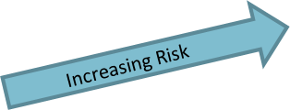
Risk Matrix Example

Slide 9
LOF Criteria (Preliminary)
Remaining Useful Life – how much life does the asset have left before it fails?
Observed Condition – what is the current condition of the asset?
Surface Damage/Erosion – is there any surface damage or erosion that either indicates a larger problem or would contribute to future failure?
Flow Limitations (Blockage/Water Level) – what percentage of the infrastructure is obstructed?
Note: The LOF criteria, while captured in a GIS database, do not require a GIS model to calculate and compile (table level calculations).

Slide 10
COF Criteria (Preliminary) part 1
Impact to Impaired Stream – does system flow to an impaired stream? (From 303(d) of CWA – too polluted to meet water quality standards)
Distance to National Wetlands Inventory (NWI) – does system flow to a wetland?
Distance to Outfall/Discharge Point – how far is asset from an outfall/discharge point in the system?
Route Priority – what is the route classification, and what would be the level of disruption? (Example Factors: Interstate/State Route, AADT, Freight or Evacuation Corridor, Speed Limit)

Slide 11
COF Criteria (Preliminary) part 2
Population – how many people living in the vicinity would be impacted?
Critical Facility Impact – how many critical facilities (hospitals, police, fire stations, schools) would be disrupted?
Pipe Under Road – does the system flow underneath a road?
Cost Estimate of Replacement – what would it cost to replace the infrastructure?
Note: All of the COF criteria are spatially related, thus the advantage of a GIS model to automate the scoring.

Slide 12
Criteria Scoring
All criteria will be scored on a 5 point scale
LOF Criteria will use “Max Grade” approach
Highest score amongst criteria will be used as LOF score for final calculations
COF Criteria will use a balanced, weighted approach
Example:
Quick word on preliminary weight construction and future adjustments
Consequence of Failure |  | Weighting
"Environmental" | Flows to Impaired Stream (w/POC) | 30% | 10%
 | Distance to NWI |  | 10%
 | Distance to Outfall\Discharge Point |  | 10%
"Socio-economic" | Route Priority | 40% | 30%
 | Population (Census Block Groups) |  | 5%
 | Critical Facility Impact |  | 5%
"Economic" | Pipe Under Road? | 30% | 10%
 | Cost Estimate for Replacement |  | 20%

Slide 13
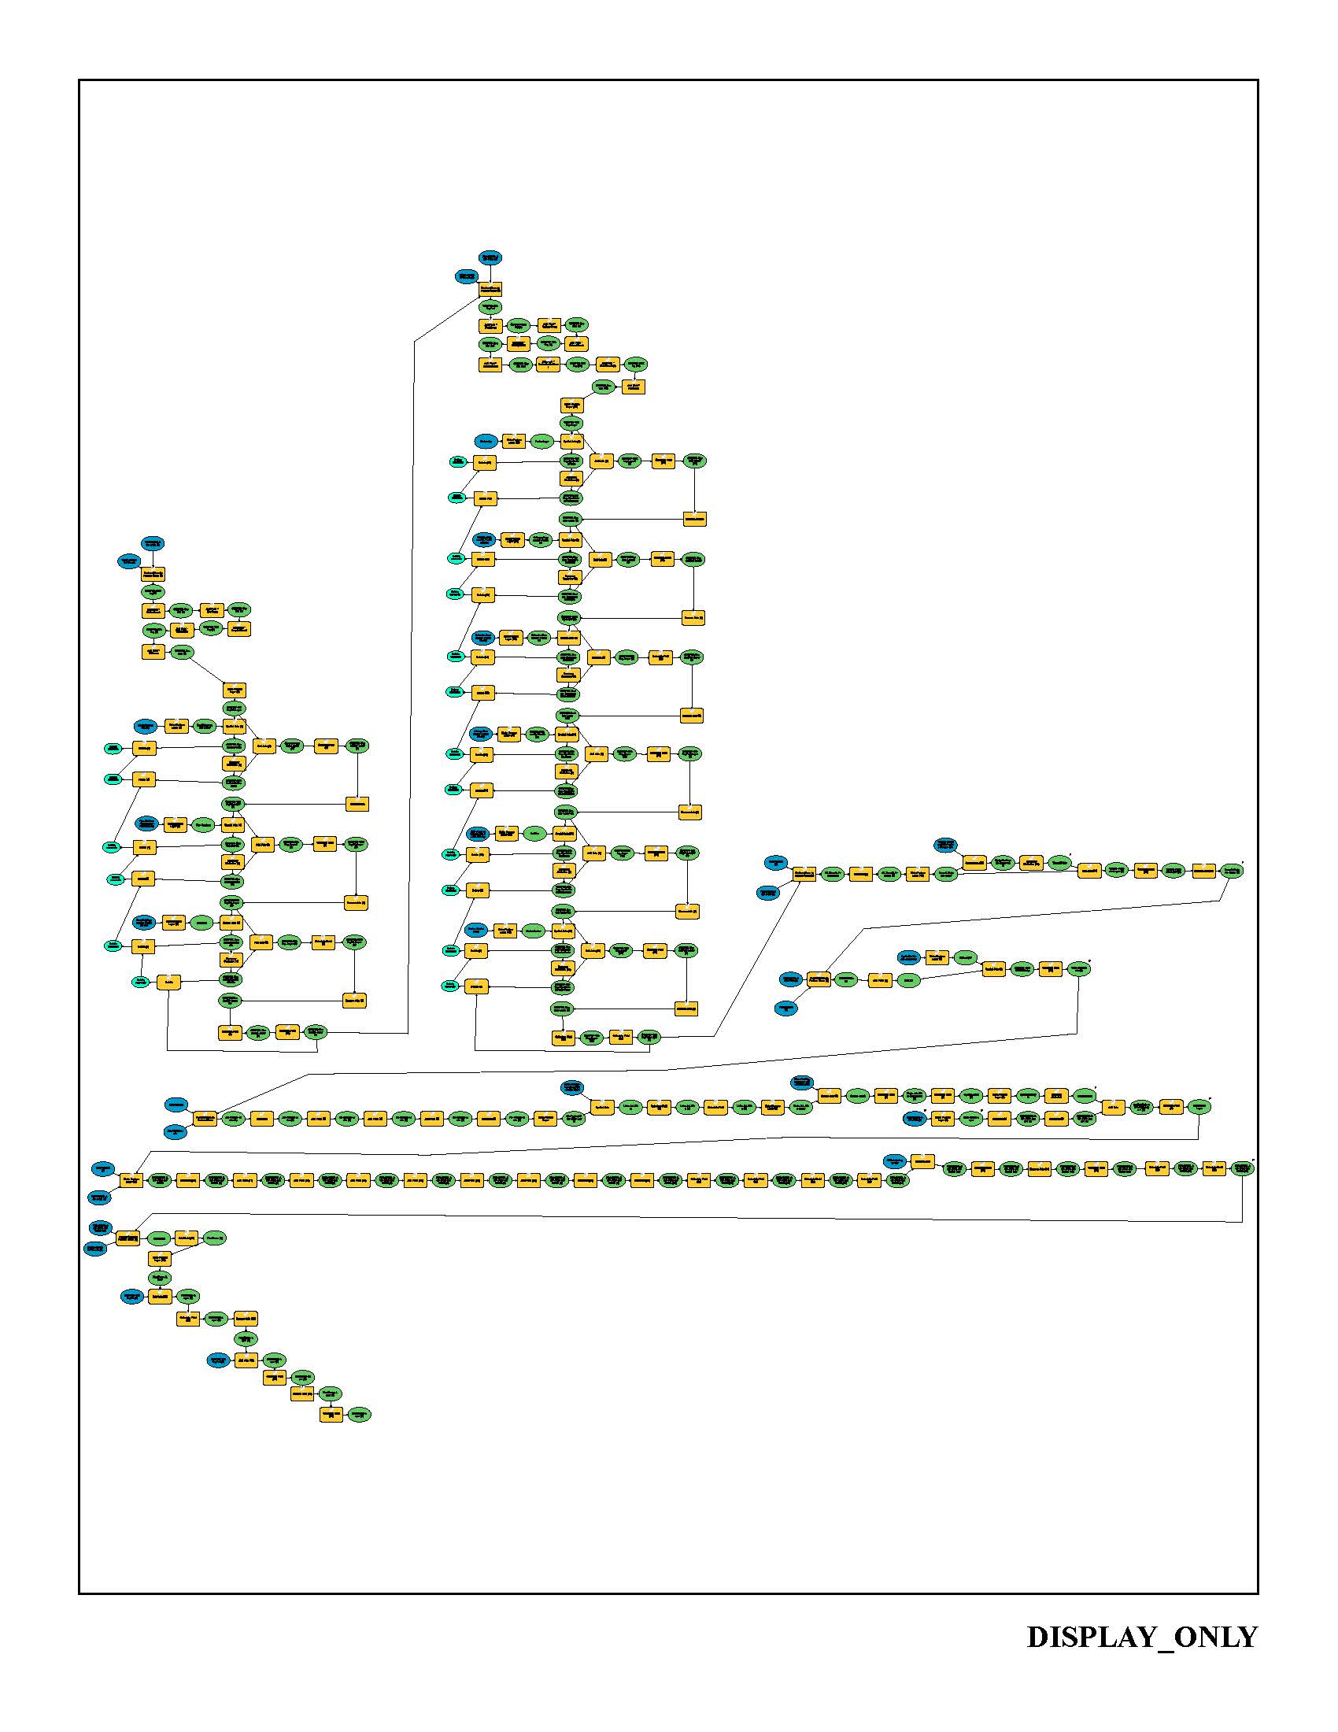
Building a Model
String together tools for automation
Modular creation technique
Embedded scripts

Slide 14
Expectations
Demonstrate logical, defensible prioritization method
Demonstrate that Esri’s ModelBuilder is a viable out-of-the-box solution for this type of analysis
Demonstrate a flexible and repeatable methodology that can be applied to other asset classes and jurisdictions
Demonstrate that the end product is user-friendly

Slide 15
Potential Presentation Locations
Any GIS related conference in Georgia
Esri User Conference
Water/Stormwater Conference

Slide 16
References
Biedenbender, Jerry and Jordan Hamm. Determining Consequence of Failure Using ModelBuilder. Presentation. 2015 Esri International User Conference. Online. Retrieved from http://proceedings.esri.com/library/userconf/proc15/index.html on October 11, 2015.
Powell, Luke. GIS Modelling as a Unifying Tool in Environmental Impact Assessments. Presentation. 2015 Esri International User Conference. Online. Retrieved from http://proceedings.esri.com/library/userconf/proc15/index.html on October 11, 2015.
Smith, Erin and Andy Baldwin. Using ModelBuilder to Evaluate Risk and Prioritize Sewer Upgrades. Presentation. 2015 Esri International User Conference. Online. Retrieved from http://proceedings.esri.com/library/userconf/proc15/index.html on October 11, 2015.

Slide 17
Questions?

