Slide 1
Developing a Web Mapping Application for Collaborative Database Management
Travis Bock
GEOG 596A - Summer 2016

Slide 2
Travis Bock
Geospatial Developer, Innovate, Inc.
Contractor for Local, Territorial and Federal Governments and private organizations
Build End-user solutions to collect/manage geospatial data and help answer questions.
Notes:
Intro… mention American Samoa?

Slide 3
Intro
GIS should be an integral part to an organization's day to day activities
Better data organization
Increase collaboration
This approach can apply to many different databases
For this application I focused on Geographic Response Planning for the EPA
Notes:
I have run into a lot of data that has a spatial component but it is often managed elsewhere
This cause data to be disorganized and out of sync
By creating this tool we will also enhance people’s ability to contribute

Slide 4
What is a Geographic Response Plan?
Plan covering loosely defined geographic area
Used for early stage response to oil, chemical or any spill that could cause serious harm to sensitive sites.
Comprised of Sensitive Sites (points), Booms (lines), Incident Action Plans (polygons) and various related tables

Slide 5
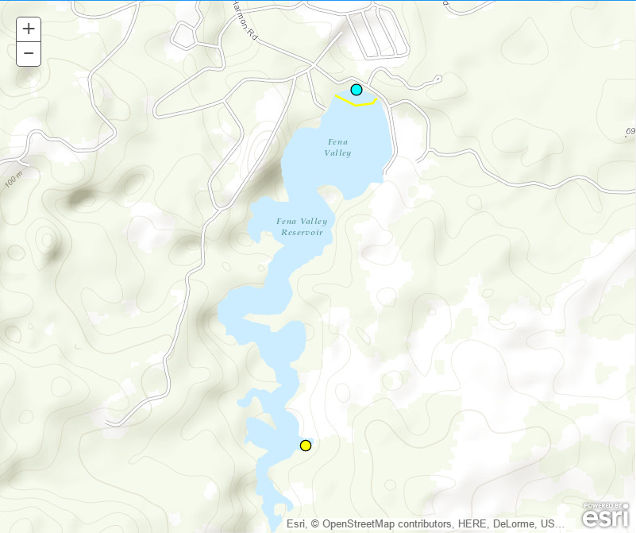
Sensitive Sites with Strategies and Booms
Environmental
Economical
Historical
Cultural
Archeological
Notes:
What is a sensitive site… talk at some length about what these are

Slide 6
Incident Action Plan
Early response coordination
Fire, Police and Medical resources
Spill response resources
Local, Regional and National contacts
Notes:
Give directions based on organization, collection of documents, includes organizational structure for the response.

Slide 7
Who creates these plans?
EPA Emergency Response
First Responders
Environmental Scientist
Local/Regional Experts
Various subject matter experts
Notes:
Mostly obvious
Talk about subject matter experts based on geographic location and the site type

Slide 8
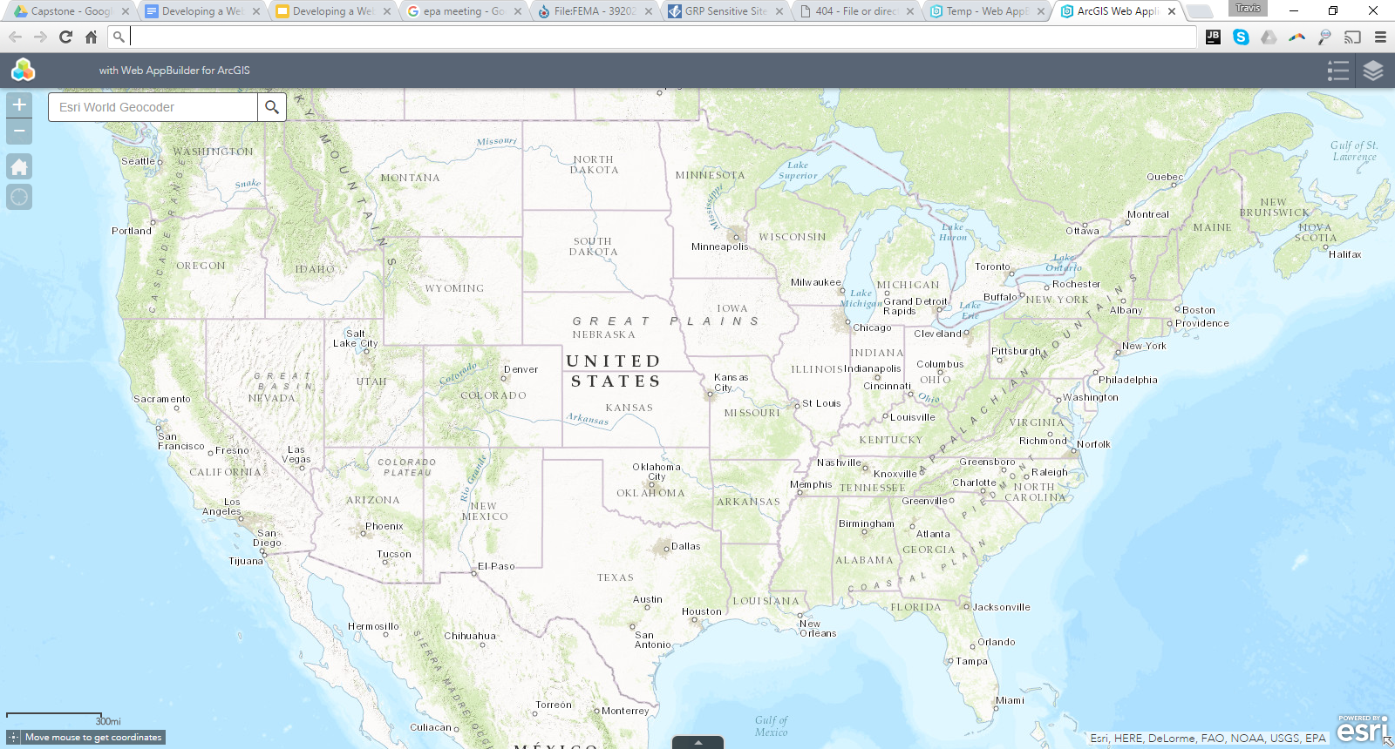
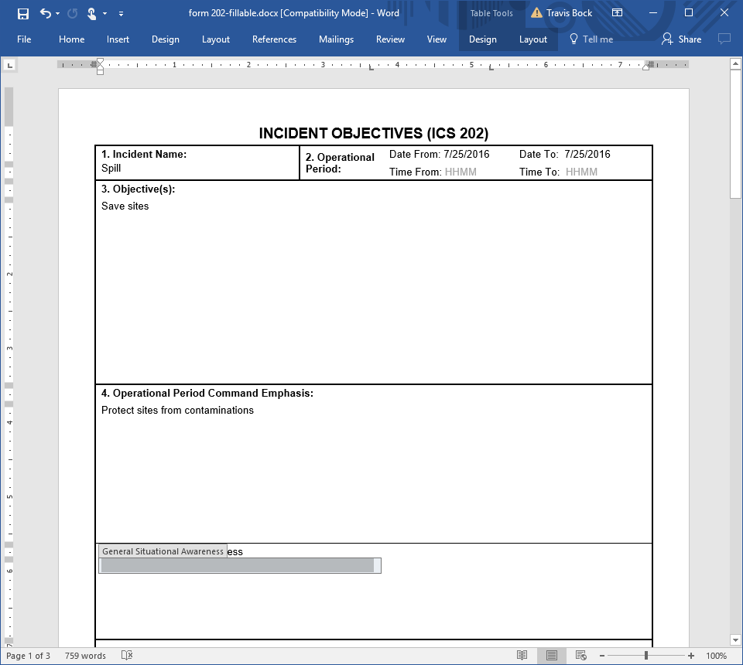
Current tools
Email
Microsoft Word
ESRI Web AppBuilder
Notes:
Be sure to make sure to make the point that this is disconnected, word/pdfs are not directly connected to geospatial data

Slide 9
Current database
Single flat table
Attributes are repeated
Relationship is 1:7 instead of 1:Many
Missing lots of information

Slide 10
Whats wrong with that?
Spatially enabled in a disconnected manner
Lack of access controls
Not centralized (many version could exist)
Difficult to collaborate
Poor quality data model
Notes:
AppBuilder UI doesn't lend itself to editing many attributes
While spatial data isn’t static appbuilder is barely used to edit anything b/c of the tedious nature of it.
Collaboration needs to be enabled but controlled so people at editing the correct things.
80-90% solutions out of box.

Slide 11
How can we do better?
User requirements gathering
New data model
Create custom user interface

Slide 12
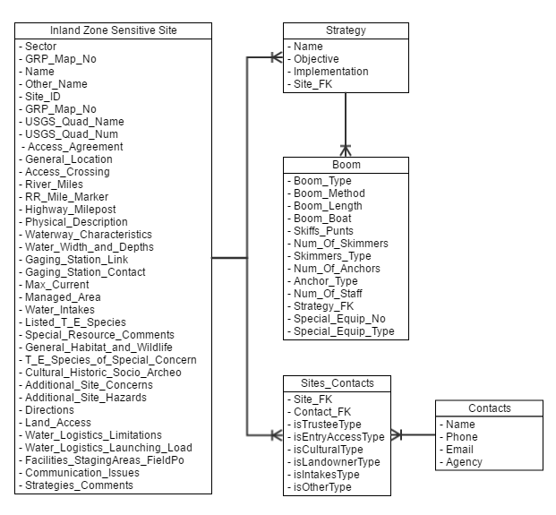
New Data Model
Actual 1:Many relationships
All relevant information is stored in a single place
Notes:
Could also talk about attachments (not pictured)

Slide 13
What will this look like
Start from scratch?
Frameworks
Use graphic designer

Slide 14
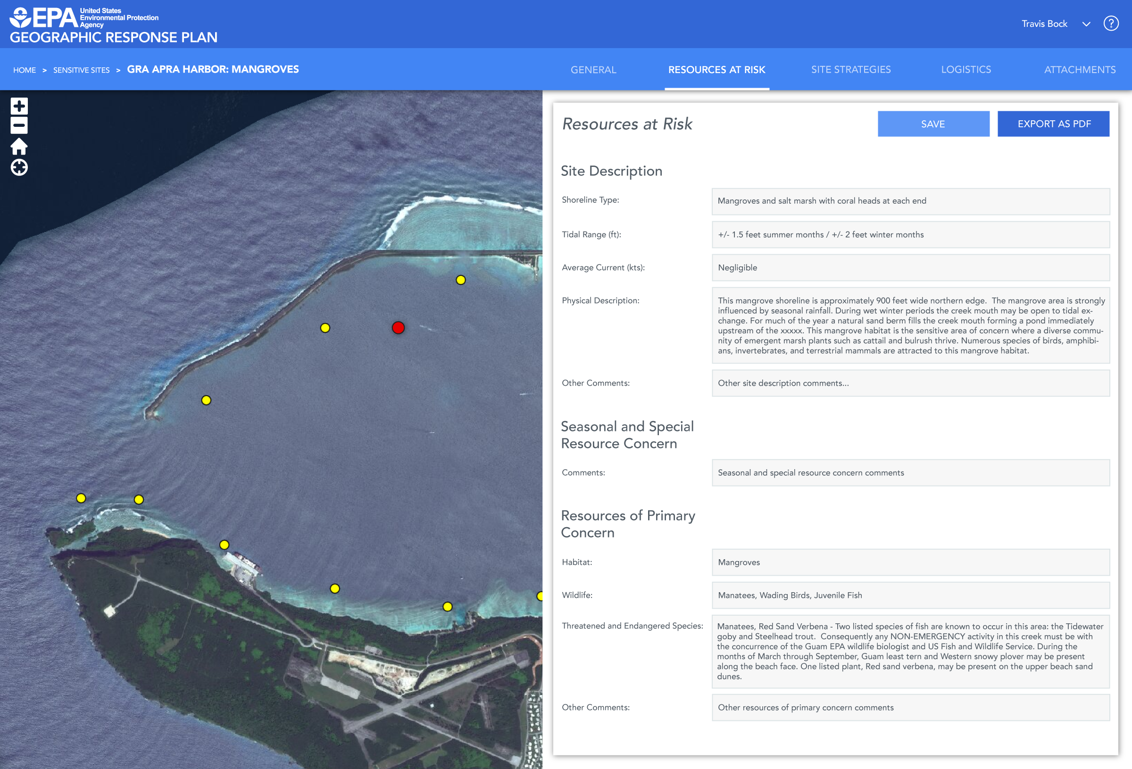
Graphic Designers!
User requirements
Data structure
Create static mockup to present to end users for feedback
Starting point for developing UI

Slide 15
How to build
Ajax
Client-side
HTML
CSS
JavaScript
API’s
Frameworks

Slide 16
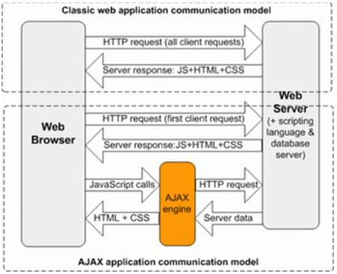
Asynchronous JavaScript and XML (Ajax)
Asynchronous is the key
Restful API
XML = JSON
http://stackoverflow.com/questions/1510011/how-does-ajax-work

Slide 17
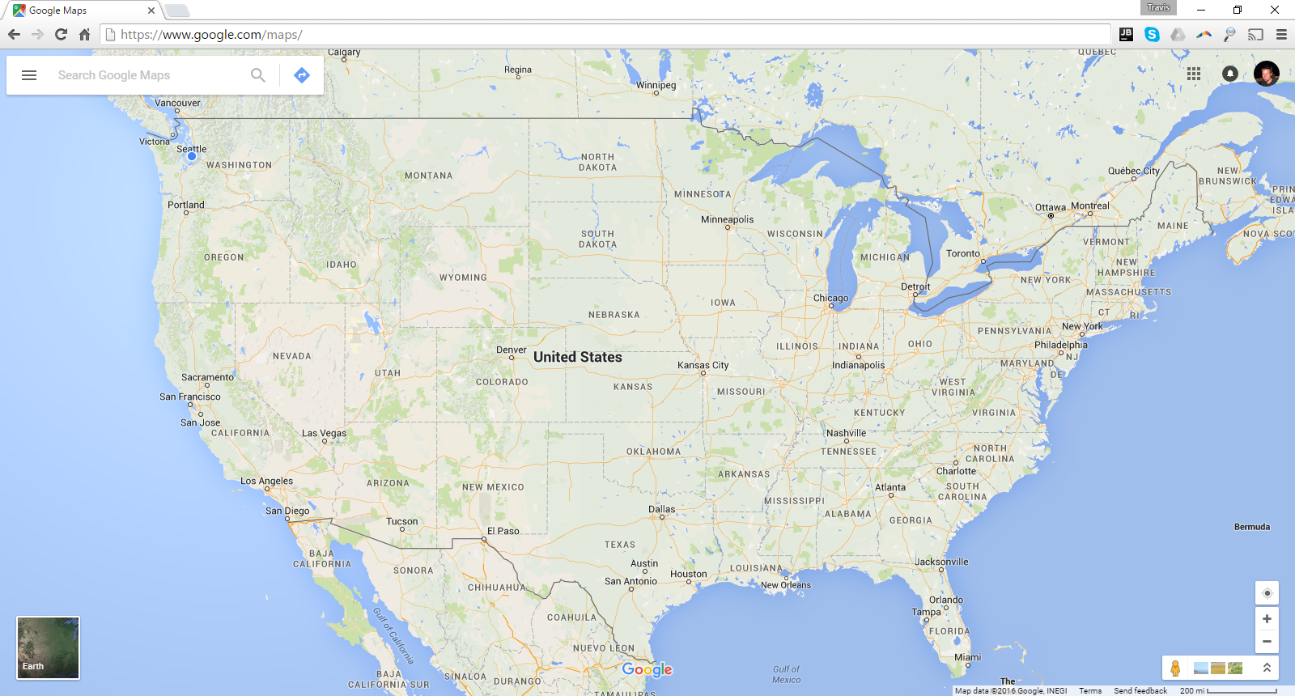
Slippy Maps
Fast
Responsive
Not possible without Ajax

Slide 18
Building Blocks
HTML5
CSS3
JavaScript
ArcGIS JS API 3.x
AngularJS 1.x
Angular Material 1.x
ArcGIS Server/Online

Slide 19
But what about ESRI Web AppBuilder?
Built using Ajax technology
Custom Widgets
Good for visualization
Bad for data entry

Slide 20
User Interface Frameworks
Faster than starting from scratch
Angular Material
Dojo
Bootstrap
Other

Slide 21
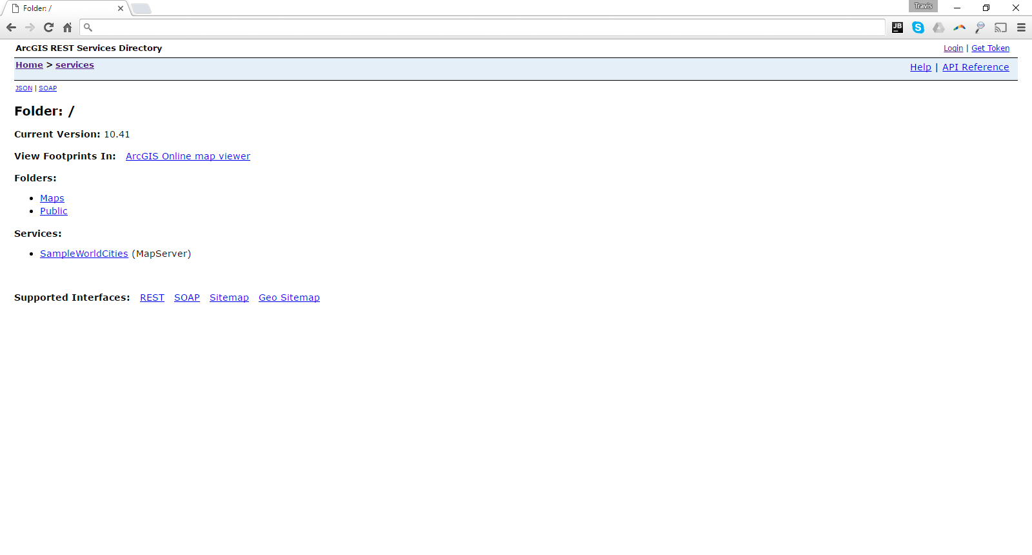
Still need that server!
ArcGIS Server
Others?
JSON (ESRI JSON vs GeoJSON)

Slide 22
Cloud Based ArcGIS Server
Amazon Web Services
Microsoft Azure

Slide 23
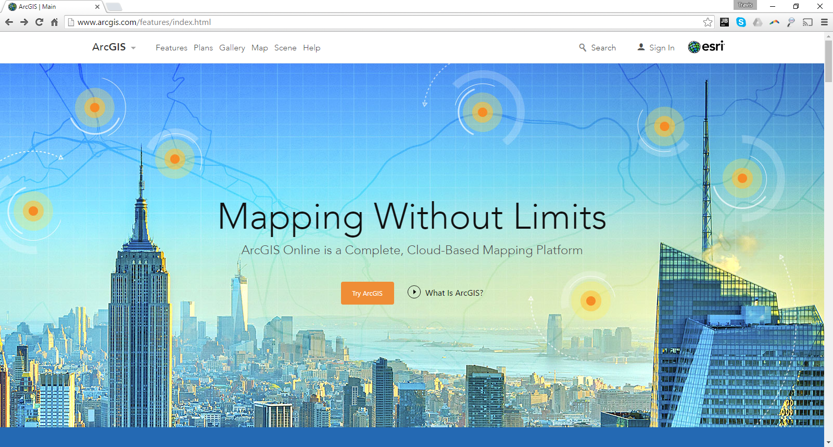
Software as a Service
ArcGIS Online

Slide 24
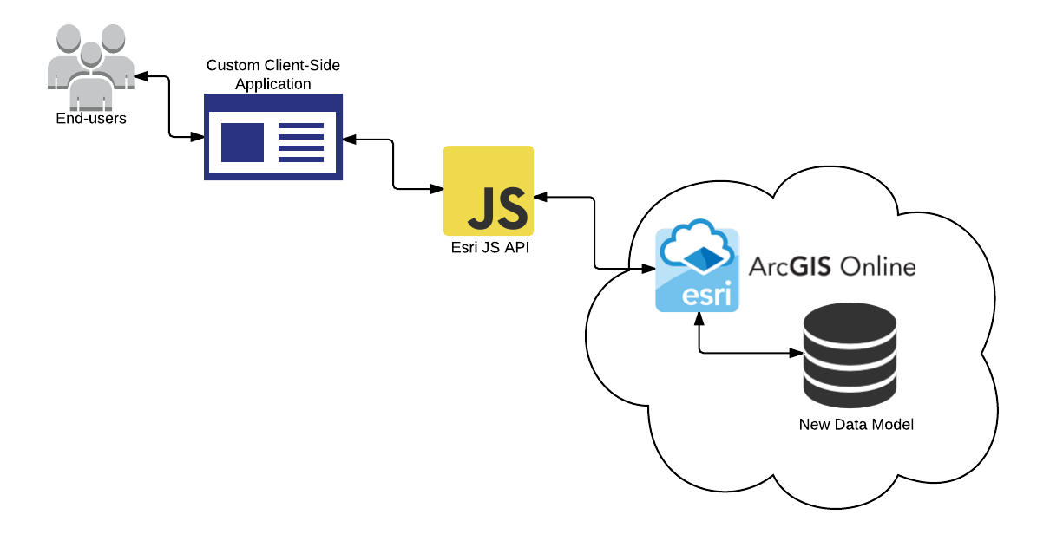
Big Picture

Slide 25
Conclusion
Web based spatially enabled tools will increase planning participation and collaboration
Collaboration increases the quality of information in the plan
Always available applications will increase the likelihood of having current information
Web base client side applications backed by cloud based services insures data will always be available.

