Slide 1
An Object-Based Image Analysis of Pipeline Well Head Vegetation
MGIS Capstone Project Proposal
Michael M. Bowser
Advisor: Jarlath O'Neil-Dunne
December 13, 2018

Slide 2
Introduction

Slide 3
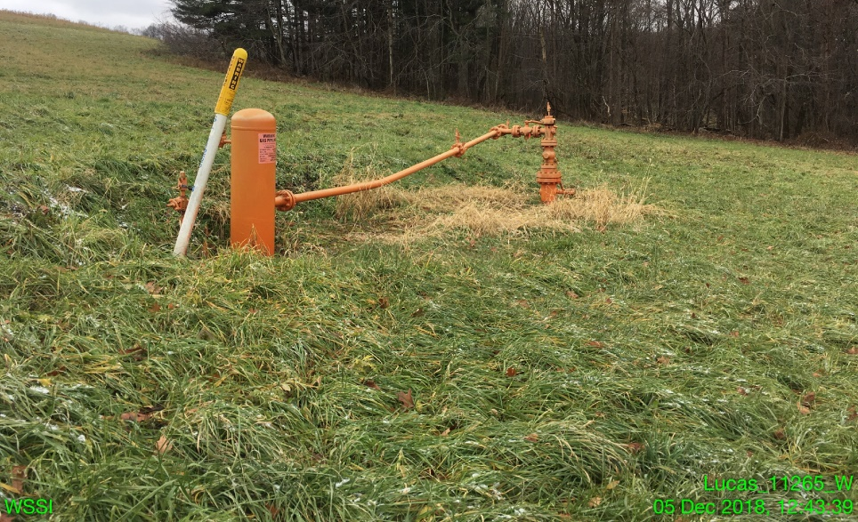
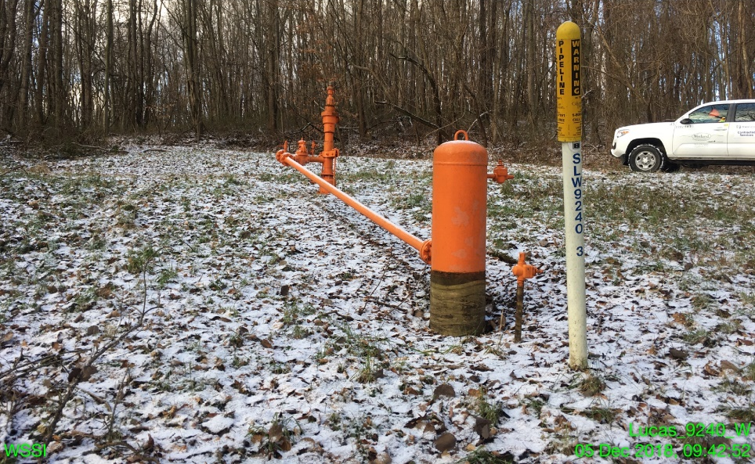
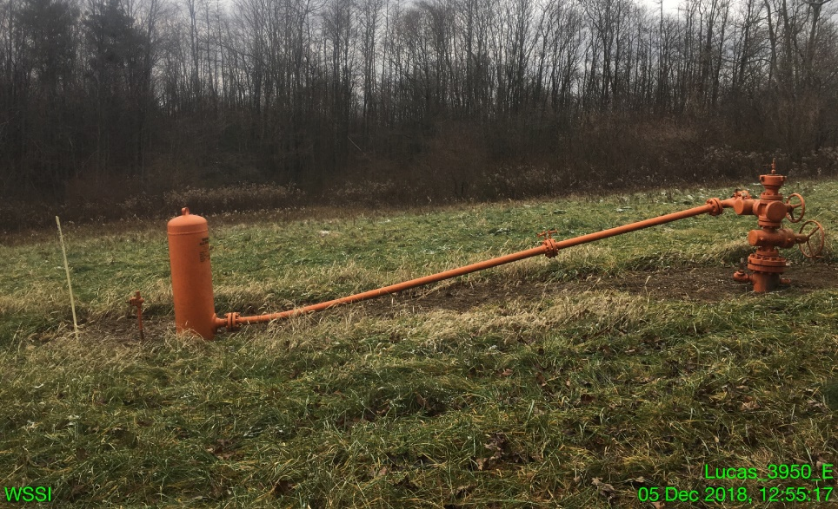
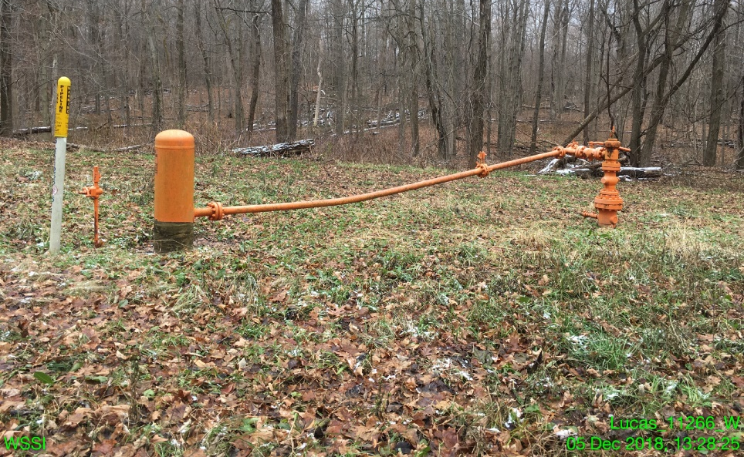
Ideal Wellhead Vegetation

Slide 4
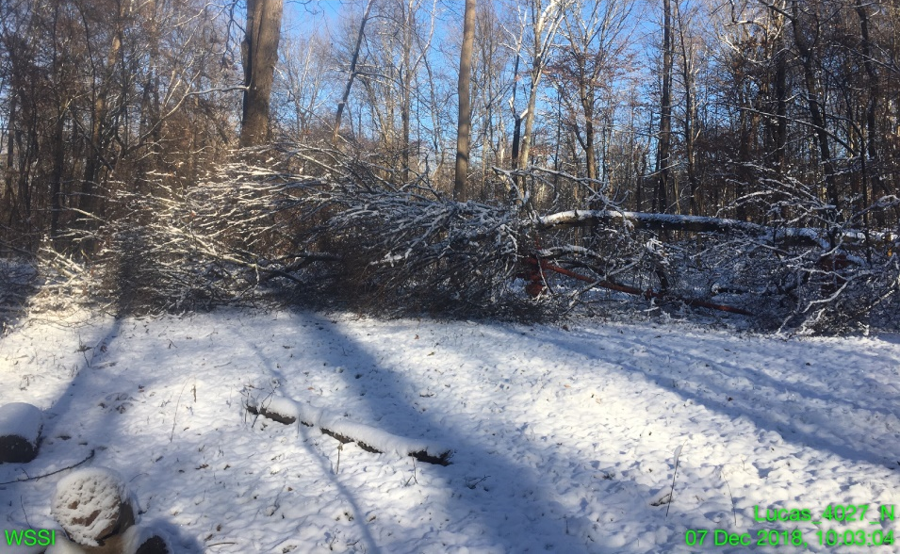
The Importance of Wellhead Vegetation Management

Slide 5
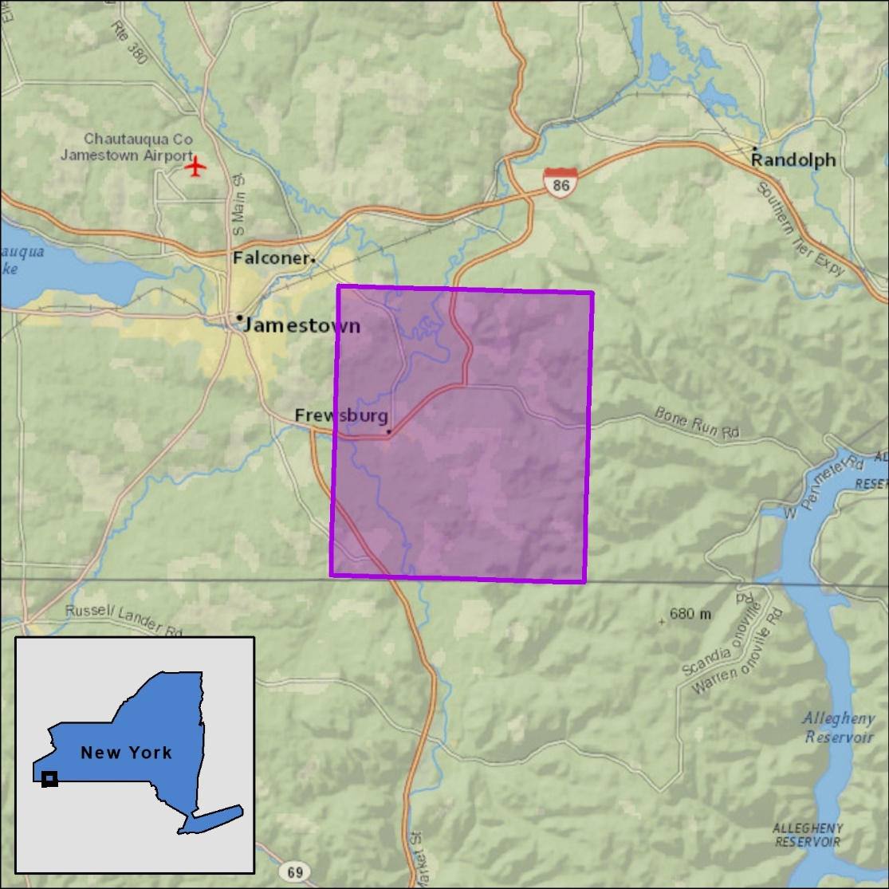
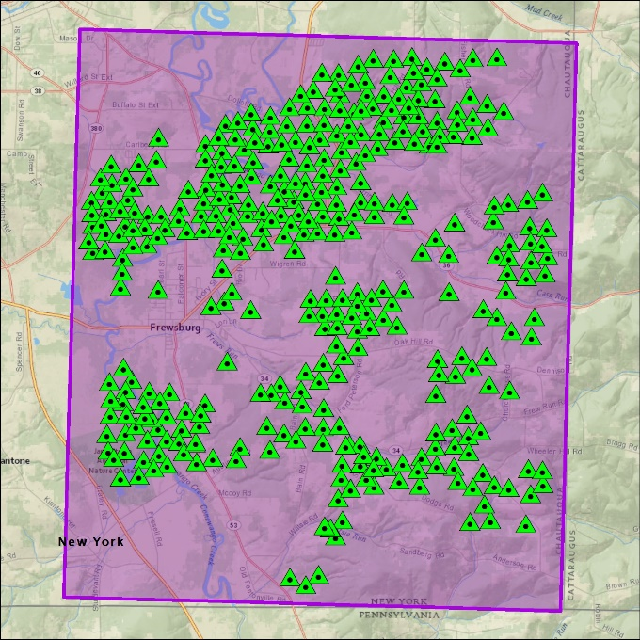
The Project Location
Western New York
422 Wellheads

Slide 6
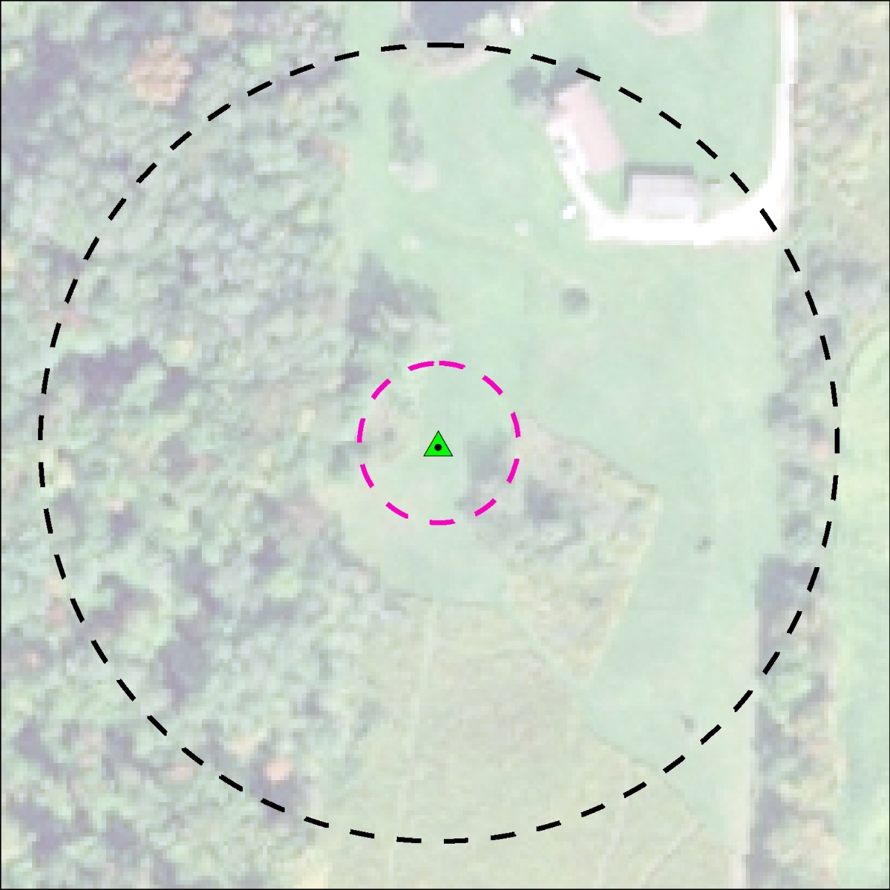
The Project Location
Wellhead Buffers
300’ Buffer
60’ Buffer: Wellhead conditions
300’ Buffer: Surrounding conditions/ Access constraints
60’ Buffer

Slide 7
Project Workflow

Slide 8
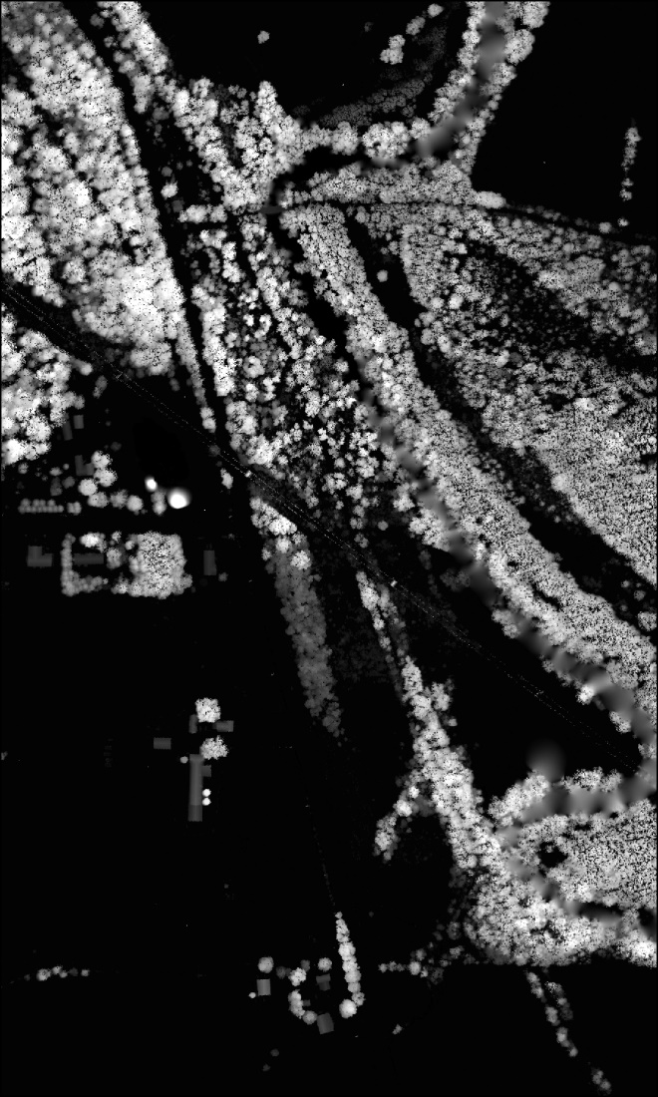
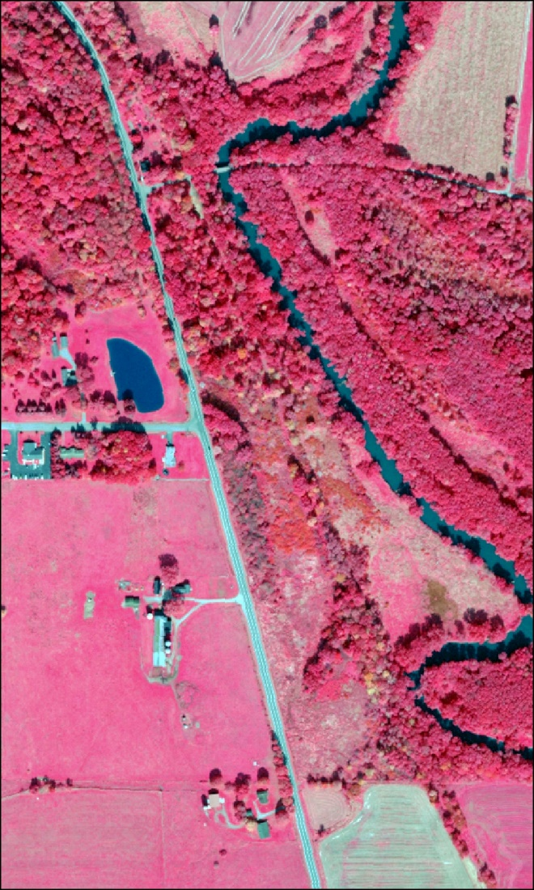
Data Acquisition
2017 Spring
Southwest NY Lidar
2017 4-Band
Imagery (NAIP)

Slide 9
Preprocessing
Data processing will be broken into three phases:
Spectral
Spatial
LiDAR

Slide 10
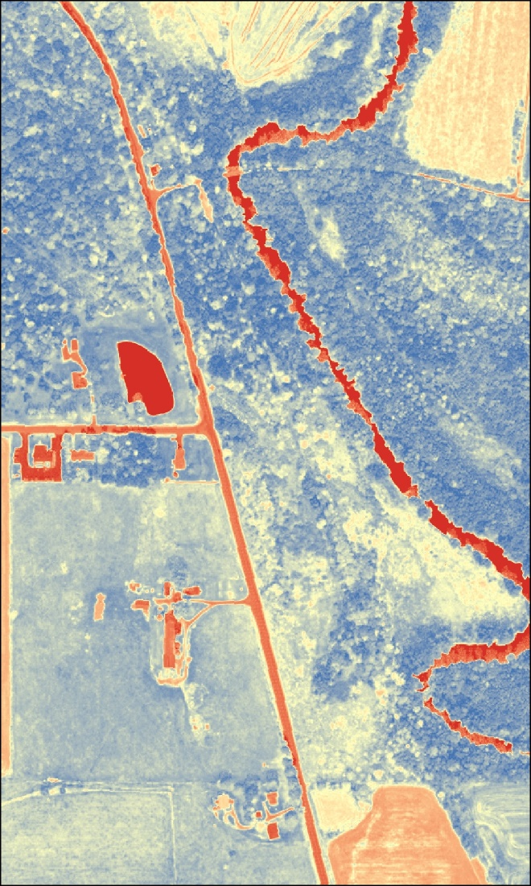
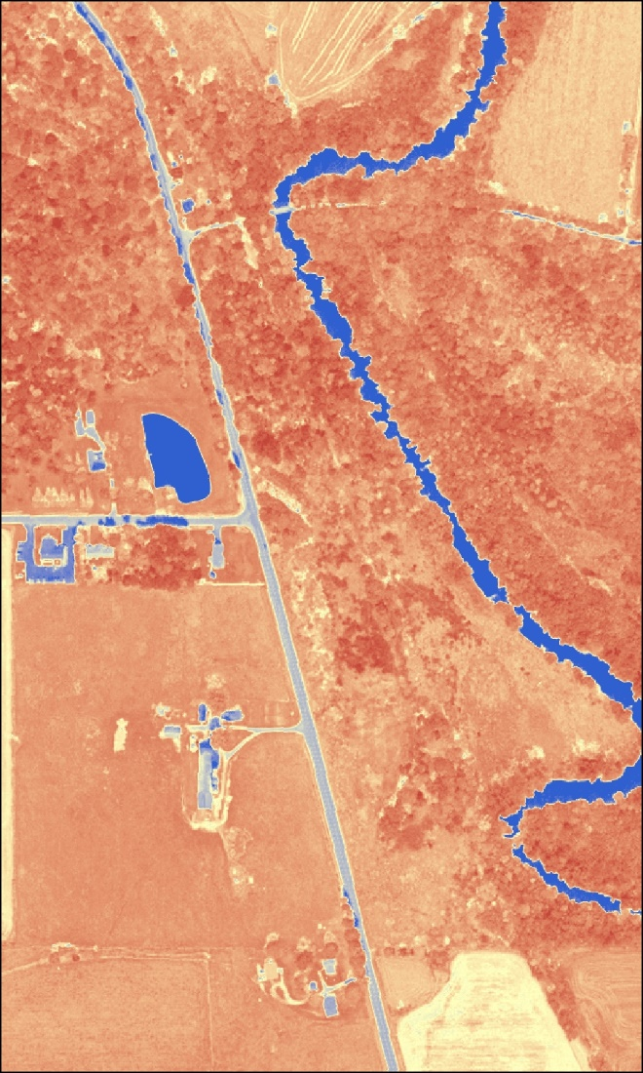
Preprocessing – Spectral
Normalized Difference Vegetation Index (NDVI)
Normalized Difference Water Index (NDWI)

Slide 11
Preprocessing – Spatial
Projecting all data to NY State Plane coordinate system
Mosaic imagery to single raster dataset
Clip imagery to study area to reduce the amount of processing.

Slide 12
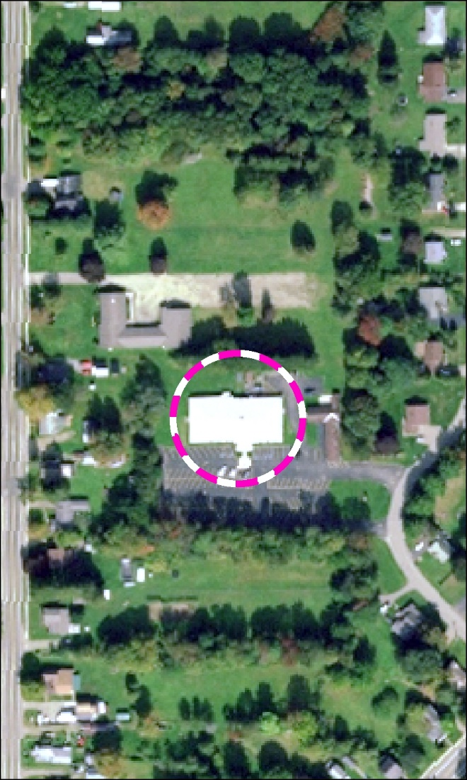
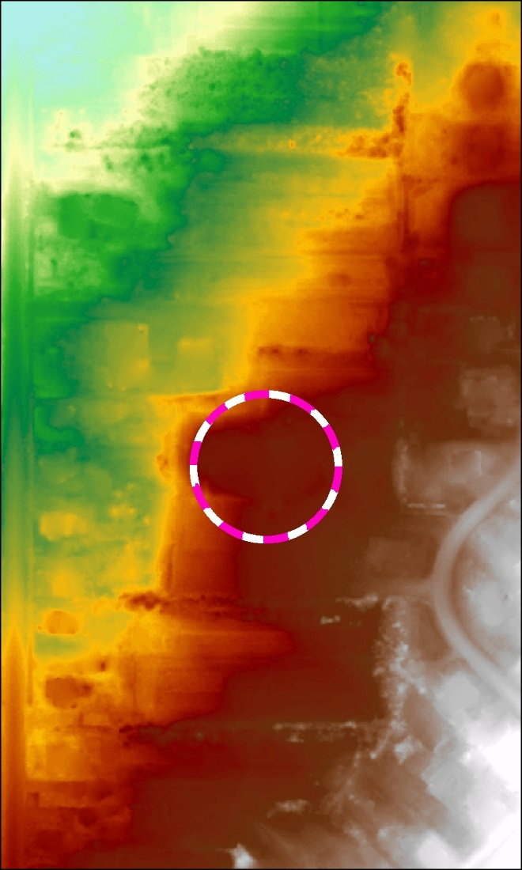
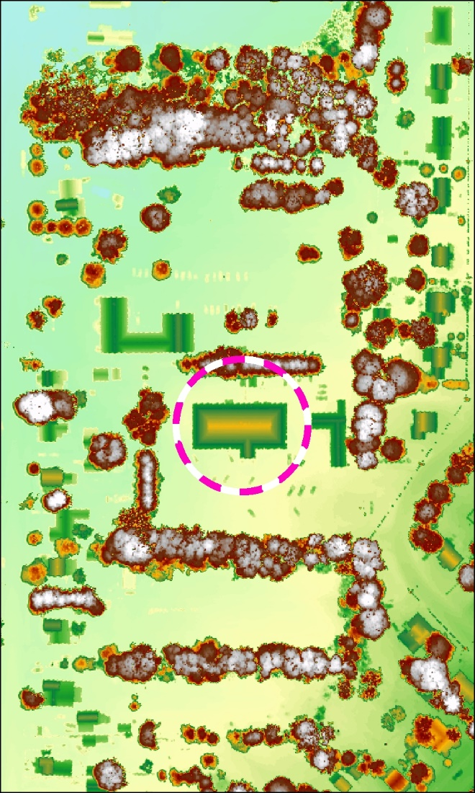
Preprocessing – LiDAR
Digital Elevation Model
(DEM) – 395 meters
Digital Surface Model
(DSM) – 403 meters
Aerial

Slide 13
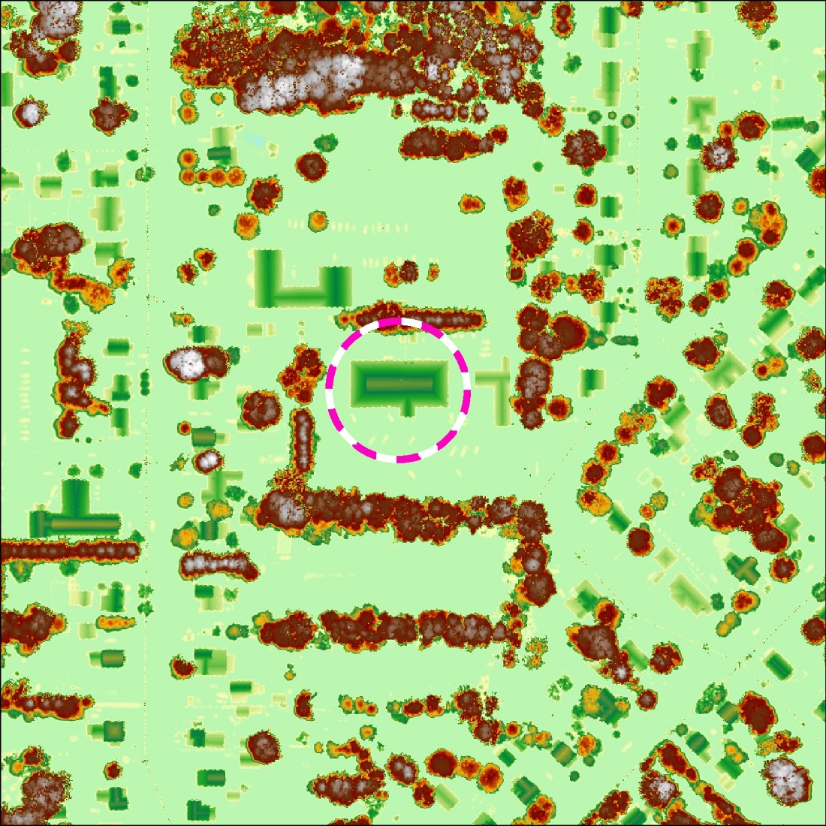
Preprocessing – LiDAR
Normalized Digital Surface Model (nDSM) – 8 meters

Slide 14
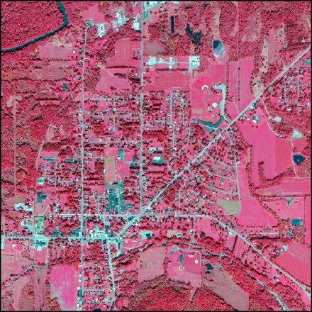
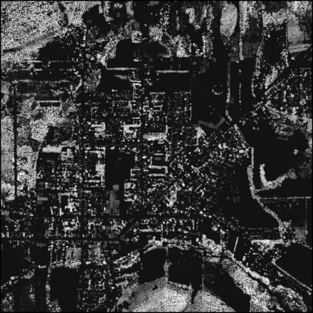
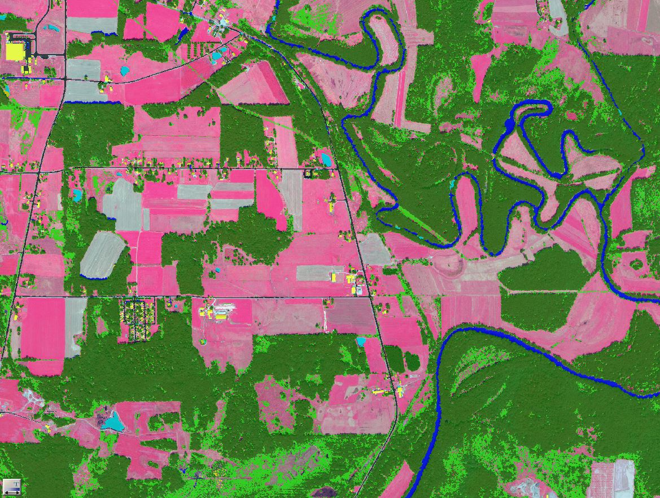
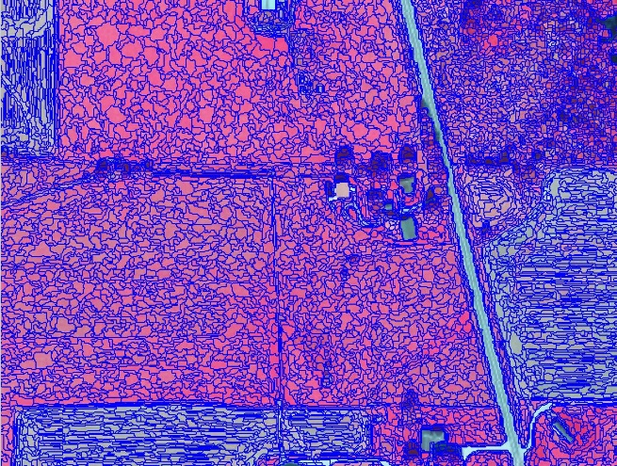
Object Based Image Analysis
Input Datasets
Classification
Segmentation

Slide 15
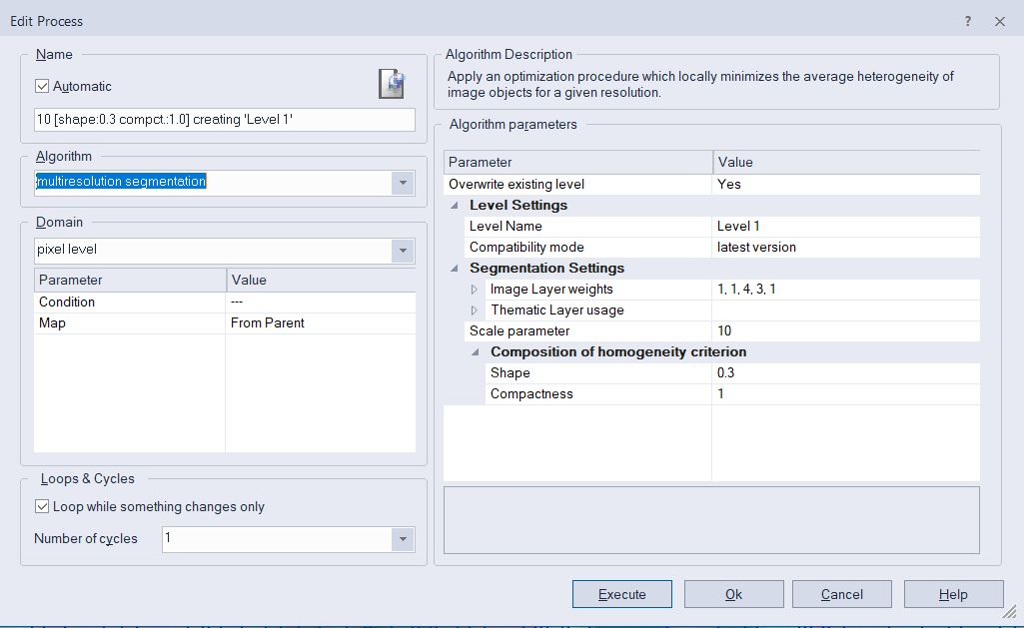
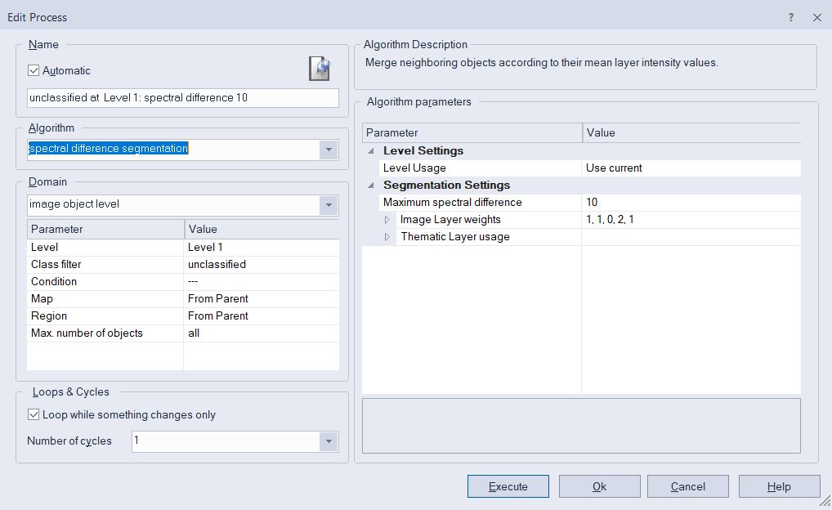
Object Based Image Analysis - Segmentation
Two segmentations will be used.
Multiresolution segmentation
  scale, shape, and compactness
Spectral difference segmentation
  Neighboring objects are merged.

Slide 16
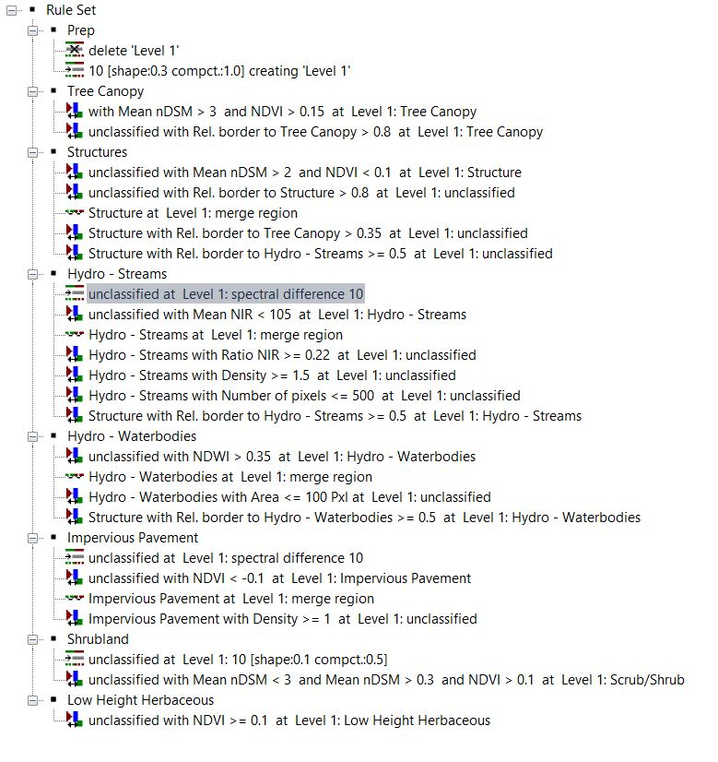
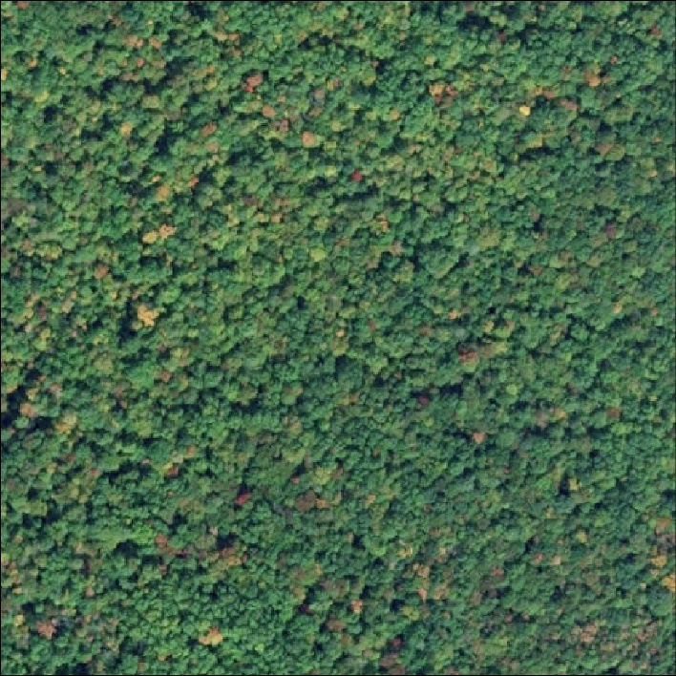
Object Based Image Analysis - Classification
Tree Canopy
Tall objects
High NDVI values
Coarse/Rough objects

Slide 17
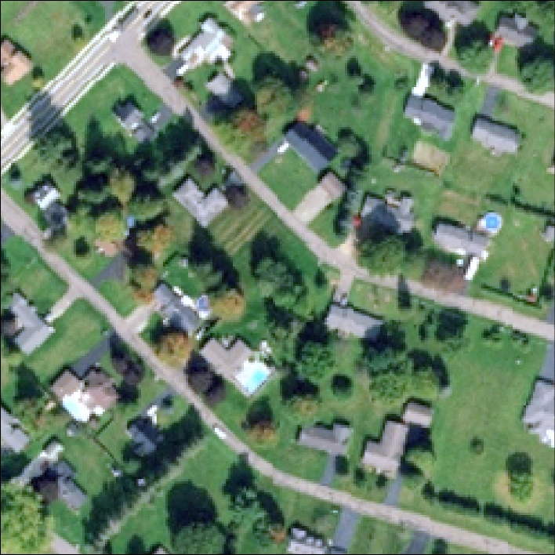
Object Based Image Analysis - Classification
Structures
Tall objects
Low NDVI values

Slide 18
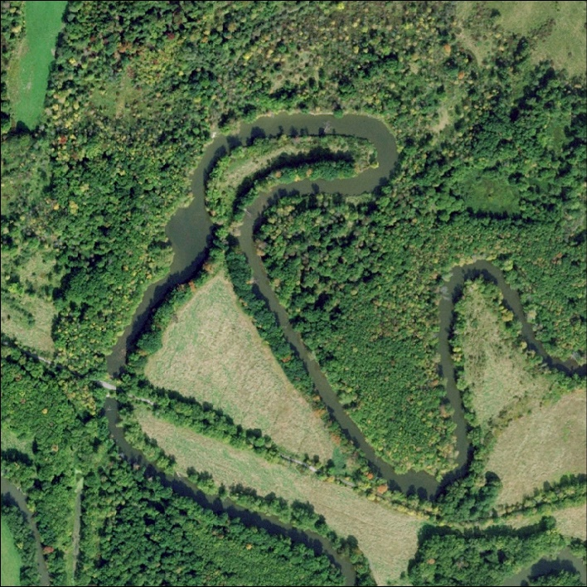
Object Based Image Analysis - Classification
Water
Low near infrared values
Low density values
High NDWI values

Slide 19
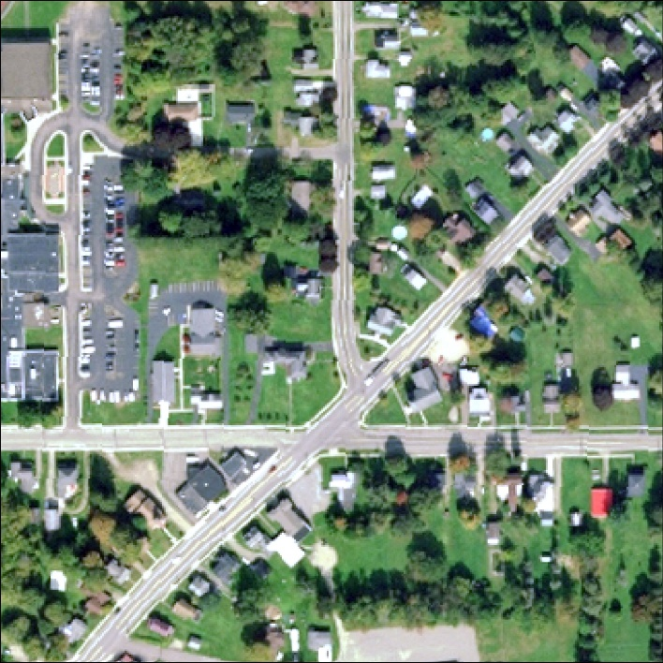
Object Based Image Analysis - Classification
Pavement
Low density values
Low NDVI values
Smooth objects

Slide 20
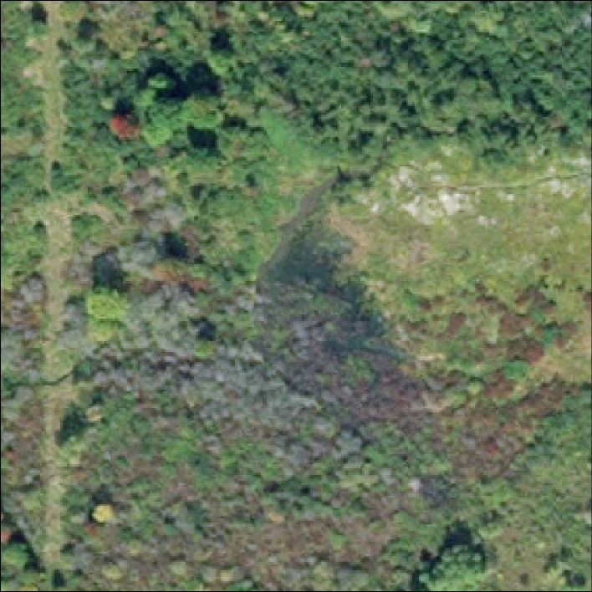
Object Based Image Analysis - Classification
Shrubland
Medium height objects
High NDVI values

Slide 21
Final Products
Land Cover Geodatabase
Final Report
Accuracy Assessment

Slide 22

Final Products - Accuracy Assessment
User Accuracy
Producer Accuracy
Goal of 90% overall Accuracy

Slide 23

Project Timeline
Proposal Presentation – December 13, 2018
Continue work independently – December 2018 – April 2019
EnerGIS Conference – April 25-26

Slide 24

Questions?

