Slide 1
Archaeology.Geo-Wiki
Prehistory, Crowdsourcing, and Freely Available High-Resolution Spaceborne Imagery
By Matthew Boyter
Advisor: Frank Hardisty
Notes:
Good evening everyone. I would like to thank you all for attending my presentation tonight. I’m really excited about this project as it joins two fields I’m passionate about, archaeology and GIS.

Slide 2
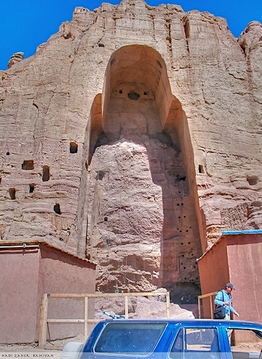
Archaeology.Geo-Wiki
Niche of the Buddha of Bamiyan بت بامیان. Source: Flickr, photo used under Creative Commons from Hadi Zaher
Introduction Problem Definition Approach and Methodologies Q&A
Notes:
Archaeological sites are in a constant state of destruction, be it from natural processes such as erosion and time, or man-made processes such as looting or destruction for other means. The picture here shows the niche that formally held the Buddha of Bamiyan, a sixth century statue of a standing buddha that was destroyed by the Taliban in 2001. The preservation of the scarce historical and pre-historical records of human civilization requires the participation of all of us. This project will create a path for the interested layperson to assist professional archaeologists in the discovery and preservation of our shared cultural heritage.

Slide 3
Archaeology.Geo-Wiki
Introduction
Research Problem Definition
Research Approach and Methodologies
Q&A
Introduction Problem Definition Approach and Methodologies Q&A
Notes:
My talk today will be done in 4 parts: Introduction, Research Problem Definition, Research Approach and Methodologies, and ending with Q&A session.

Slide 4
Introduction
Freely Available High-Resolution Spaceborne Imagery (HRSI)
Archaeological Site Exploration
Volunteered Geographic Information
Crowdsourcing
Introduction Problem Definition Approach and Methodologies Q&A
Notes:
My project focuses on the use of publically available high resolution spaceborne imagery (HRSI) and its uses within the field of archaeology. HRSI has been used in the discovery of unidentified archaeological sites, monitoring of existing sites to guard against and evaluate the extent of looting, and in predictive modeling to determine where sites may be located. What differentiates my research from others (Myers, Ur, Kennedy, Conroy, Vega, Contreras) is that I hope to crowdsource the time consuming direct discovery method of scanning large areas for visual identification of archaeological remains to volunteers via a web mapping application.

Slide 5
Problem Definition
Cost of acquisition.
Learning curve associated with technology.
Automated site identification not yet possible.
Manual direct discovery of sites requires large investment of people-hours.
Introduction Problem Definition Approach and Methodologies Q&A
Notes:
I have identified four problems associated with the use of HRSI in the field of archaeology. These problems exist in other fields, such as paleontology, but will not be discussed in this project. The problems identified are: Cost of acquisition, Learning curve associated with technology, Automated site identification not yet possible, and the Manual direct discovery of sites requires a large investment of time.

Slide 6
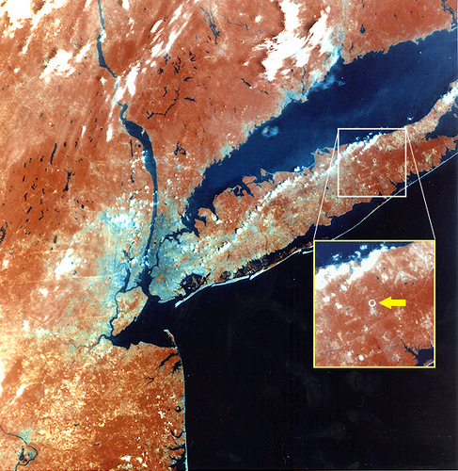
Remote Sensed Data and Archaeology
Source: Flickr, photo used under Creative Commons from Farther Along
Source: Flickr, photo used under Creative Commons from Brookhaven National Laboratory
Source: Flickr, photo used under Creative Commons from Fylkestinget i Nord-Trøndelag
Introduction Problem Definition Approach and Methodologies Q&A
Notes:
Archaeologists have long recognized the utility of remote sensed data and have used it in many of its forms; ground penetrating radar (GPR), multispectral scanners, hyperspectral scanners, and LiDAR. Due to the cost of acquisition and the steep learning curve associated with manipulating remotely sensed imagery though, remotely sensed imagery has not been utilized to its fullest extent in archaeology (Conroy, 2008; Vanderwalker, 2011). New technologies have reduced the cost of acquiring remotely sensed imagery, have increased the efficiency and speed of analysis, and have reduced the learning curve associated with the technology (Conroy, 2008). One of the new tools in remote sensing and GIS is Google Earth.

Slide 7
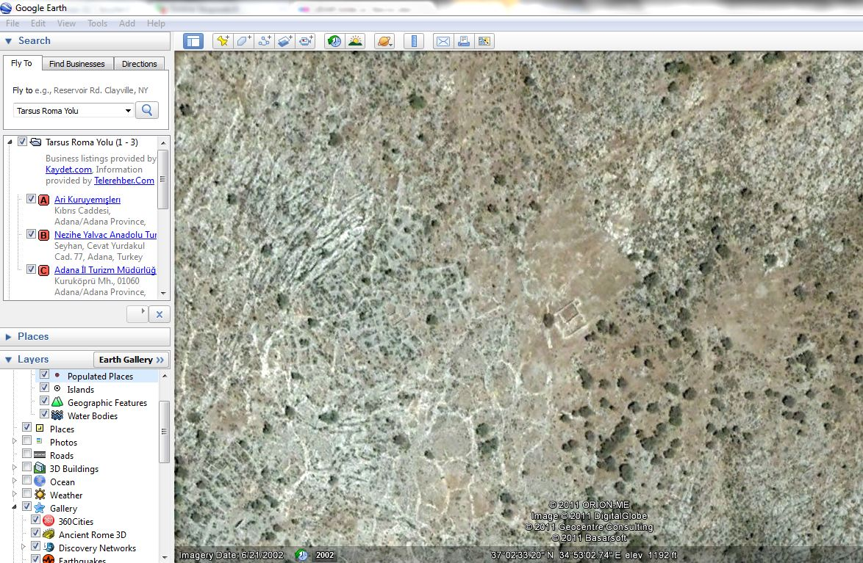
Google Earth
Tarsus, Mersin, Turkey, 2011. Source: Google Earth
Introduction Problem Definition Approach and Methodologies Q&A
Notes:
Google Earth is a free GIS program released by Google in 2005 that now has over 400 million downloads (GeoWeb, 2008; Google, 2005). This screenshot of Google Earth that I took of Tarsus Turkey, my current home, shows an archaeological structure. GE includes basic GIS functionality, such as panning, zooming, searching, and navigation. GE also has grown to include 3D buildings and 3D terrain based upon layering HRSI over digital terrain models. GE comes in three different packages, the standard installation, which is free, and Google Earth Plus and Google Earth Pro, which add additional functionality at a cost (Google, 2005). GE has taken the complex, intimidating, and expensive world of GIS and remote sensed multi-specteral spaceborne imagery and scaled it down to a free, user-accessible format that is available to everyone and simple enough to be used by laypeople. (Show where structure is).

Slide 8
Google Earth and Archaeology
“Fieldwork in the age of Digital Reproduction: A Review for the potential and limitations of Google Earth in Archaeology” by Adrian Myers
“Google Earth and Archaeology” by Jason Ur
“Google earth and the archaeology of Saudi Arabia. A case study from the Jeddah area” by David Kennedy and M.C. Bishop
“Ground truthing of remotely identified fortifications on the Central Coast of Perú” by Nathan Craig et al.
“The Utility of Publicly Available Satellite Imagery for Looting” by Neil Brodie and Daniel Contreras
“Field Expedition: Mongolia” National Graphic, Dr. Albert Yu-Min Lin
Introduction Problem Definition Approach and Methodologies Q&A
Notes:
Many archaeologists (and other scientists) are now incorporating GE into their research (Ur, 2006; Conroy, 2008; Myers, 2010; Kennedy 2011; Craig 2011; Thomas et al. 2008). The uses vary from using the imagery as a supplement to other data, using it as a teaching device (Ur, 2006), and using it as a method of identifying possible archaeological features to be ground truthed in future expeditions, such as the National Geographic Field Expedition Mongolia (Craig, 2011).

Slide 9
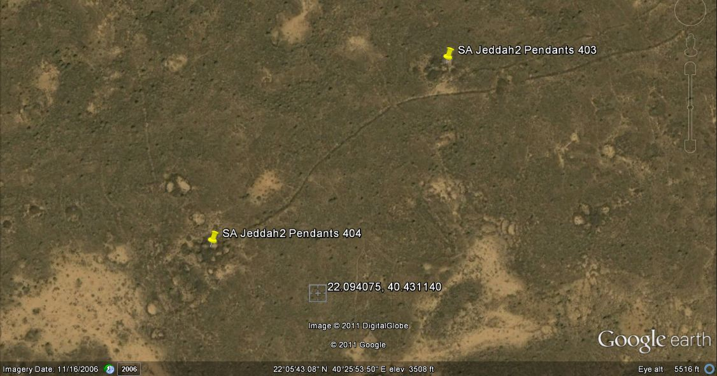
Google Earth and Archaeology
SA Jeddah2 Pendants 404 and 403, Saudi Arabia. Source: Google Earth
Introduction Problem Definition Approach and Methodologies Q&A
Notes:
The research done by Nathan Craig et al (2011) and David Kennedy and M.C. Bishop (2011) have shown that GE provides sufficient spatial and spectral resolution to locate and identify archaeological sites. This image shows a site that Craig and Bishop identified using Google Earth. The methodologies used though amount to little more the high-tech prospecting (Vanderwalker, 2011), by that, we mean the scanning large areas of interest in hopes of finding anomalies (Craig, 2011).

Slide 10
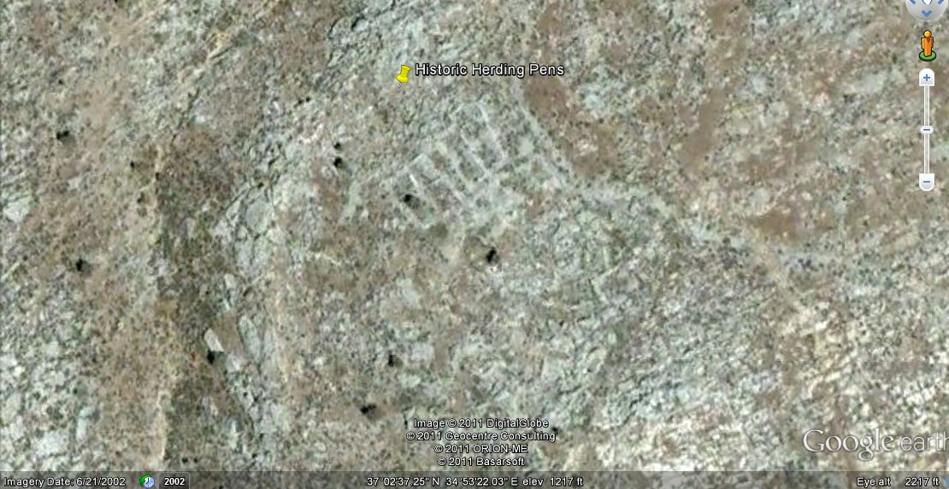
Site Identification
Automated identification of archaeological sites not yet possible
Tarsus, Mersin, Turkey, 2011. Source: Google Earth
Introduction Problem Definition Approach and Methodologies Q&A
Notes:
Research has been done on identifying automated procedures for extracting archaeological features from remote sensed imagery, but so far, those methods have shown to be ineffective, and the authors currently recommend visual interpretation of the imagery (ADD McCoy and Siart, Paulissen, 2007). Part of the difficulty in creating algorithms to identify sites, is that most sites are constructed from local materials, thus giving them a similar spectral response to the background. (Point out pens in middle of image).

Slide 11
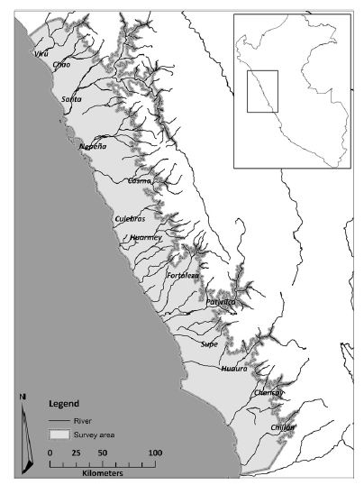
Site Identification
Manual direct discovery is very time consuming.
Craig et al used Google Earth to review their 25,000 km² project area.
Sample study area for archaeological research project. Source: Craig, N (07/01/2011). "Ground truthing of remotely identified fortifications on the Central Coast of Peru". Journal of archaeological science (0305-4403), 38 (7), p. 1680.
Introduction Problem Definition Approach and Methodologies Q&A
Notes:
Depending on the size of the area and the intensity of visual scan of the imagery, the manual direct discovery process can consume countless person-hours. Shown here is the project area used by Craig et al in their search for Peruvian archaeological sites. Their project area covers 25,000 sq km.

Slide 12
Problem Definition
Cost of acquisition.
Learning curve associated with technology.
Automated site identification not yet possible.
Manual direct discovery of sites requires large investment of people-hours.
Introduction Problem Definition Approach and Methodologies Q&A
Notes:
The release of Google Earth and the increase of free HRSI available has provided a solution to the first two problems outlined earlier. With automated extraction not yet possible and visual interpretation currently the most effective method in locating the sites within the HRSI, I propose that a structured volunteer crowdsourcing effort can be assembled to scan study areas and identify potential sites. The volunteers will handle the time consuming manual inspection, freeing the professional archaeologists to perform analysis.

Slide 13
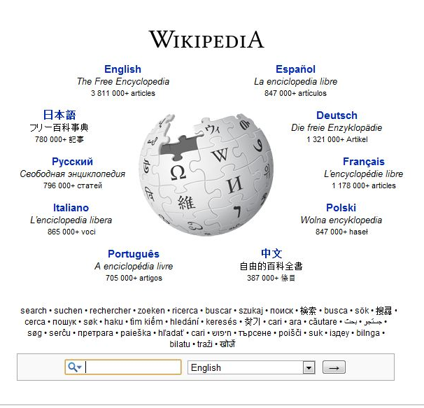
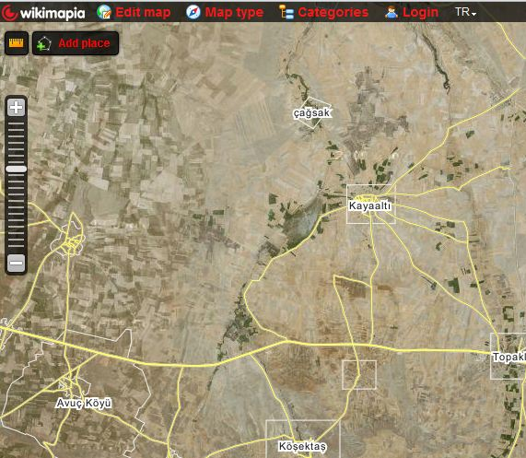
The Crowdsourcing Solution
Netflix Prize, Source: www.netflixprize.com
Wikipedia, Source: www.wikipedia.org
Wikimapia, Source: www.wikimapia.org
Introduction Problem Definition Approach and Methodologies Q&A
Notes:
Crowdsourcing will be used to create a volunteer effort to identify archaeological sites with Google Earth. Gorassi stated that crowdsourcing relies on “a network of interested parties who decide, based on their own interests and their own time, whether they want to help an organization with its problem.” (Gorassi, 2009). Crowdsourcing can allow for organizations to tap into a larger network of workers to complete a task without having to take those workers on as employees or staff. Crowdsourcing has been used successfully in a wide variety of business models, including Wikipedia, Wikimapia, the Human Genome Project, and Netfilx, the online movie rental company.
Netflix delved into crowdsourcing by offering one million dollars to any group that could best their recommendation selection algorithm by 10% (Lohr, 2009). This project allowed for them to gain the knowledge of countless statisticians, programmers, and computer engineers, while only having to pay the one team that succeeded.

Slide 14
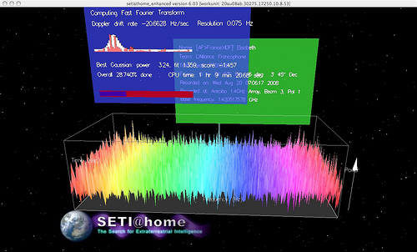
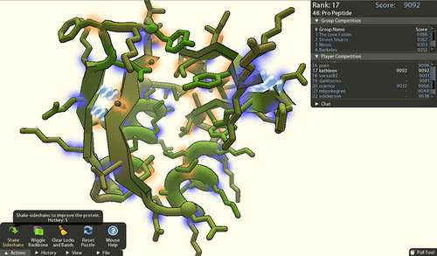
Crowdsourcing and Citizen Science
FoldIt, Source: Flickr, photo used under Creative Commons from billmcclair
SETI@Home, Source: Flickr, photo used under Creative Commons from FRSeti
Introduction Problem Definition Approach and Methodologies Q&A
Notes:
Within the overall genre of Crowdsourcing, there has risen a section known as Citizen Science. One of the first major Citizen Science projects was SETI@home from the University of California at Berkley. This project took advantage of unused computer power of volunteers to process radio telescope data. Eric Hand in the August 2010 edition of Nature Magazine talks about current Citizen Science projects that have moved beyond simply using volunteers computers and rely on human abilities not yet matched by machines, such as our “highly evolved talent for spatial manipulation” and where computers must process the countless degrees of freedom to find the correct answer humans have the ability to “see the solution intuitively”.
Two Citizen Science projects discussed in the article are Stardust@home and Foldit. These projects require volunteers to either visually scan numerous images to find traces of cosmic dust or to manipulate digital peptides and proteins to find the best solution to untangling the molecules. One hurdle that both projects had to overcome was how to motivate volunteers to preform the tasks, without having to resort to paying them. So far, giving the volunteers naming rights on the particles found, listing the volunteers as co-authors, and, in the case of Foldit, providing a competitive interface for volunteers to compete with each other, has been sufficient.

Slide 15
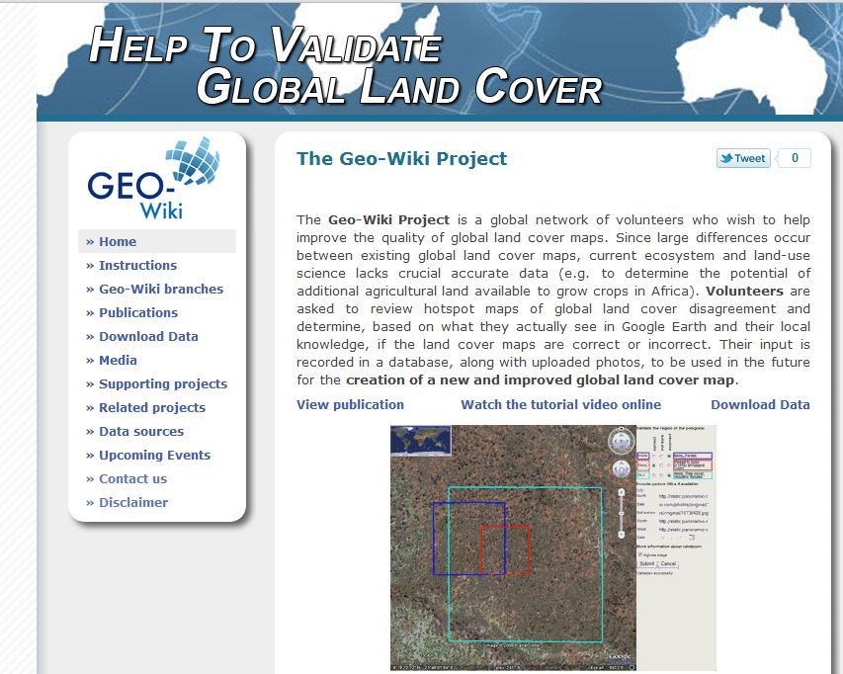
Geo-Wiki.Org
Geo-Wiki.org Home Page, Source: www.Geo-Wiki.org
Introduction Problem Definition Approach and Methodologies Q&A
Notes:
Another Citizen Science project not discussed in the article is Geo-Wiki.org. Geo-Wiki.org uses directed volunteer geographic analysis to identify land cover and create an updated terrestrial land cover map. This type of directed volunteer geographic analysis has been labeled “facilitated volunteered geographic information” or (F-VGI). Geo-Wiki.org was created by Drs. Steffen Fritz and Ian McCallum et al. in 2009 (McCallum, 2009). Dr. Fritz’ team created a website which hosted a web application based off of the Google Earth API. Users login to their account and identify land cover classes for preselected locations. My project will use a similar interface as the Geo-Wiki Land Cover site.

Slide 16
Archaeology.Geo-Wiki
Identify
Volunteers visually scan study areas.
Add placemarks over potential sites, complete simple attributes
Review
Vote on others placemarks.
Ground Truth
Professionals and amateurs physically inspect locations.
Update attributes if prehistoric remains are present.
Introduction Problem Definition Approach and Methodologies Q&A
Notes:
The planned procedure for identifying archaeological sites will be to have volunteers identify sites using a visual inspection of the study areas in what is known as “direct discovery” and add placemarks over potential sites (Kvamme, 2006). Online volunteers will review the proposed selections of their peers and rate them. Volunteers and professional archaeologists will next ground truth the potential sites. Finally, the attribute data of the potential sites will be updated to show if the location was or was not pre-historical.

Slide 17
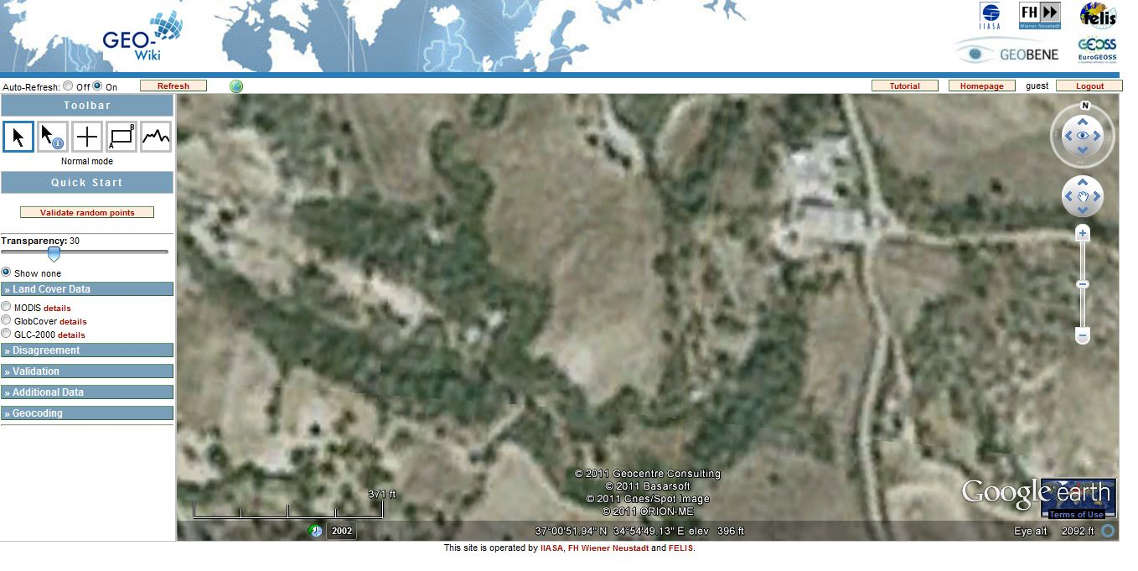
Visualizing Data
Geo-Wiki Web Map Viewer Page, Source: www.Geo-Wiki.org
Introduction Problem Definition Approach and Methodologies Q&A
Notes:
A geospatial web application will be designed and hosted on a dedicated website and presented to the user through their web browser. The application will combine basemap data from Google Earth and operational layers hosted on a private web map server (Go into details, what server, REST-stop, all web map details, etc.). The basemap data will be high resolution spaceborne imagery, road layers, and city layers. Potentially other free imagery, such as is available on ArcGIS.com will be made available. The operational layers will include the proposed archaeological site layer, layers delineating study areas, query results and analysis results. The application will dynamically create maps requested by the user and store the users’ proposed site location inputs. The potential site location layer will be stored using point geometry with the ability for the user to select limited attributes from drop-down lists.
The site will require users to register before they will be able to add locations or rate other users’ locations. Although excessive malicious behavior is not predicted, having users register will allow a method of tracking the behavior of individuals and potentially easily removing malicious entries.

Slide 18
Training
Archaeological Visual Interpretation
Attributes | Archaeological Description
Tone | Tonal differences in soil may indicate buried structures
Texture | Different vegetation textures may indicate buried features
Shape | Foreknowledge of shapes of archaeological features can assist with determining whether a feature can be considered as archaeological or not
Size | The dimensions of the feature are also important in order to regard the feature as archaeologically significant or not
Spatial patterns | If the feature is of an extensive size, the spatial patterns within the feature could represent an ancient settlement
Orientation | Some archaeological features are consistently oriented in a certain direction
Shadows | Positive archaeological features appear in imagery through the shadows they cast
Spatial relationships | Some ruins which have been abandoned for hundreds or thousands of years are sometimes located in isolated areas. However, some excavated sites have modern roads leading to them for public access. Depending on the state of the ruins, they may still be associated with other nearby ancient features
Archaeological Visual Interpretation, Source: High “Resolution Satellite Imagery for Archaeological Application” by Lefki Pavildis
Introduction Problem Definition Approach and Methodologies Q&A
Notes:
Although the average user will not be trained in archaeology, cartography, or any related fields, the web application will provide examples and training to impart the volunteers with the skills and knowledge needed to identify prospective sites.
Upon first signing up to the archaeological geo-wiki, users will be prompted to complete the online training. This training will briefly touch upon the application interface, but the majority of the training will be on what tell-tale signs are associated with archaeological sites.
As mentioned earlier, archaeological sites are often difficult to distinguish from the surrounding landscape as they are normally constructed using local materials, thus have similar spectral signatures as the landscape (ADD TO THESIS Siart). Also, archaeological features vary in shape, size, and color making extraction difficult (add to thesis: Paulissenn). The same characteristics that impede automated extraction of archaeological features from HRSI also impedes manual, direct discovery. Fortunately much work has been done to help in the classification of archaeological sites from aerial and satellite imagery (add to thesis: Pavlidis)
In the 1920s, OGS Crawford, one of the pioneers of aerial archaeology, formulated a set of site classifications for determining archaeological features in aerial photographs, his classification focused on shadows, moisture differences and crop markings.
More recently, Lefki Pavilidis has created a visual interpretation attribute list to be used with 1m spatial resolution HSRI that builds upon Crawford’s. As the imagery used in this project is similar to that Pavildis used, his “Archaeological Visual Interpretation” attributes will be used as a training guide for the volunteers (Pavilidis). His list is shown here in this slide.

Slide 19
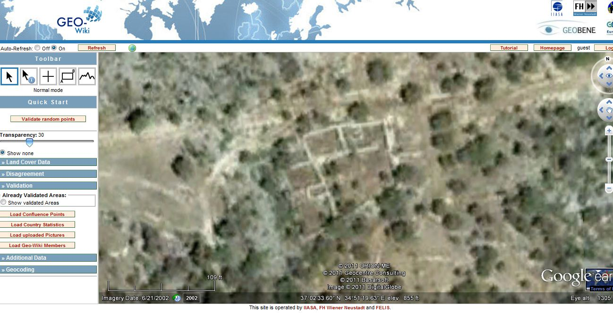
Direct Discovery
Site Description
Structure Type:
Site Description:
Geo-Wiki Web Map Viewer Page, Source: www.Geo-Wiki.org
Introduction Problem Definition Approach and Methodologies Q&A
Notes:
After logging in to the site, volunteers will be directed to study areas selected by image quality and the need for research. The application interface will allow volunteers to zoom, pan, select which layers are visible, select potential sites, and evaluate other volunteers’ selections. If available, volunteers will also be able to view geocoded photography provided by other web services, such as Panoramio.
As this project intends to use a modified version of the application developed by Dr. Fritz and his team, some functionality will be identical, such as the selection status changing from red to green based upon zoom (McCallum, 2009, 350). Since the tool was originally developed using AJAX, customization will be done to create tools specific for archaeological selection.
To identify sites, the user will click with their mouse over the area in question. This will bring up a pop-up window containing the fields to be populated. The database will also track the login of the user that created the entry for future statistical analysis and to identify any potential abuse of the tool.

Slide 20
Peer Review
Site Verification
Is this a prehistoric site?
Confidence of assessment?
Geo-Wiki Web Map Viewer Page, Source: www.Geo-Wiki.org
Introduction Problem Definition Approach and Methodologies Q&A
Notes:
Volunteers will also have the ability to review the selections of others. A tool will be created that will allow volunteers to navigate directly to the potential site locations created by others. Via a pop-up window, users will have the ability to rate the potential site location as “high likelihood”, “moderate likelihood”, “low likelihood” or not vote. This tool will also track the user and their vote and will be used for future analysis

Slide 21
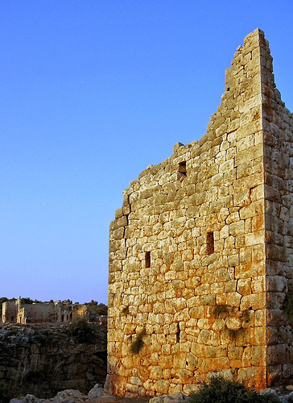
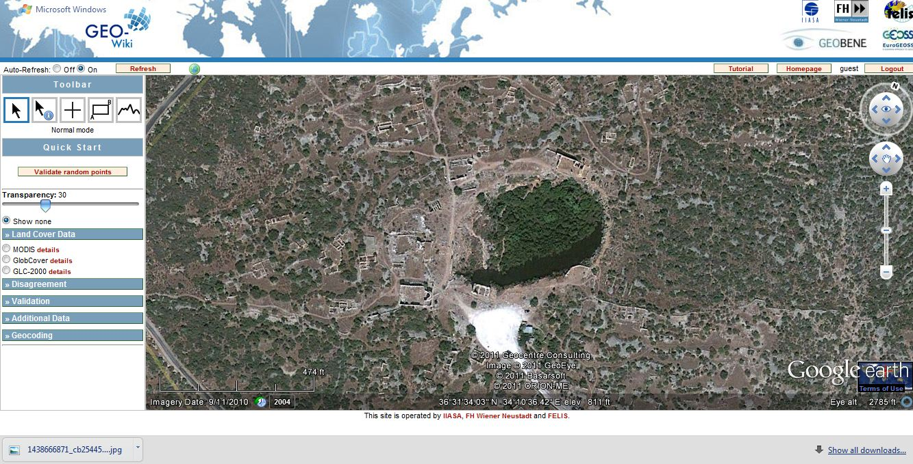
Ground Truthing
Ground Truthed
Is this a prehistoric site?
Upload Photo?
Geo-Wiki Web Map Viewer Page, Source: www.Geo-Wiki.org
Source: Flickr, photo used under Creative Commons from Happy Jumper ()
Introduction Problem Definition Approach and Methodologies Q&A
Notes:
After image interpretation is completed for a specific study area, ground truthing will occur, “[i]mage interpretation and ground truthing are at the core of any prospecting” (Ladefoged, 2009, p. 270). Until the locations are ground truthed, the accuracy of the user generated content cannot be calculated, therefore we hope to have volunteers and professional archaeologists go into the field and ground truth the findings.
A tool will be created to export location coordinates in GPX format for use with commercial GPS units. Volunteers will then go to sites, photograph the sites, and upload the photographs to the application. They will then be able to change the attribute of the locations as being a positive, negative, or unsure identification of archaeological remains. Other users will then be able to review the status updates and photographs, and vote on the classification.

Slide 22
Study Areas
Suitability
Professional Interest
Impact Assessment
Community Interest
Image Quality
Introduction Problem Definition Approach and Methodologies Q&A
Notes:
Although users can potentially look for sites anywhere in the world, study areas will be defined to focus the volunteers on areas that are deemed important. The criteria for defining study areas are as follows:
Suitability: Depending on the types of artifacts created by different prehistoric populations, some locations are less likely to have produced structures or geomorphic forms identifiable by HRSI.
Professional interest: Interest by professional archaeologists that specific areas be surveyed, as long as those areas meet the suitability requirement.
Impact Assessment: Locations that meet the suitability criteria and are, or will be, under threat of being damaged, destroyed, or otherwise negatively impacted by any activity, human or otherwise, a study area may be created to facilitate potential sites’ protection.
Community Interest: As a F-VGI project, if sufficient user interest exists in a specific location, and said location meets the suitability requirement, a study area may be created.
Image quality: Availability of HRSI of sufficient spatial resolution is a prerequisite for study areas.
Other criteria may be added as needed
The purpose of creating study areas is to focus the survey effort in those areas that will potentially yield findings and where those findings may contribute to the archaeological record.

Slide 23
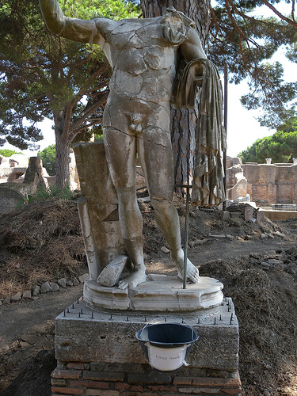
Conclusion
Source: Flickr, photo used under Creative Commons from Hembo Pagi
Introduction Problem Definition Approach and Methodologies Q&A
Notes:
Like many environmental scientists, archaeologists are often working within tight budget restraints. Having an existing application will help departments incorporate HRSI into their projects.
Google Earth v5.0 includes archived imagery, which allows for an area to be observed over time (Contreras). This will allow volunteers to notice if sites are actively being looted and to measure the extent of the looting. We hope to create a feature that the user can use to alert us of potential looting. The same tool can also be used to determine if a site is being negatively impacted by erosion or other factors.
In addition to finding new sites and monitoring looting, I hope to use this data to assist in predictive site modeling (McCoy). By marrying the predictive modeling functionality of GISs with the inherent, highly-evolved talent that humans have for spatial recognition, we hope to contribute to the development of better modeling algorithms. Using exploratory data analysis (EDA, McCoy), verified site locations will be used as inputs to define future study areas (ADD TO THESIS).

Slide 24
Q&A
Archaeology.Geo-Wiki: Prehistory, Crowdsourcing, and Freely Available High-Resolution Spaceborne Imagery.
By Matthew Boyter
Advisor: Frank Hardisty
Introduction Problem Definition Approach and Methodologies Q&A
Notes:
This concludes my presentation. I would like to thank Frank for his guidance and assistance with this project, he has been a great help and has provided constant support. I will now answer any questions.

