Slide 1
Integrating & Displaying a Launch Range Schedule System with GIS
Penn State University GEOG 596A
Alexander J Brown
Advisor: Jim Detwiler

Slide 2
Agenda
Background
Range Schedule
Resources
ROMS & Primary Keys
RSS Feed
Literature Review
Development Methodology
What’s next?
Proposed Workflow & Timeline

Slide 3
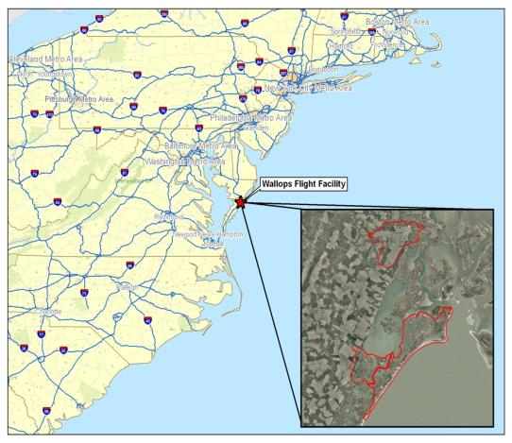
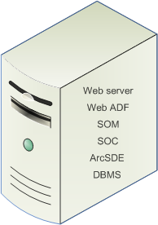
Background
Launch Range
NASA Wallops Flight Facility (WFF)
WFF Missions
Test Director
GIS System
Spatial Services
ArcGIS Server
DBMS
Single Machine Deployment

Slide 4
Project Background
Range Space Management “Rspace”
Joint Project scheduled for 2014
Various Directorates
Phase 1: Integrate scheduled resource information from Range Schedule and display in rSpace.
Project Goal: Integrate scheduled resource information from the Range Schedule and display in an intranet GIS application

Slide 5
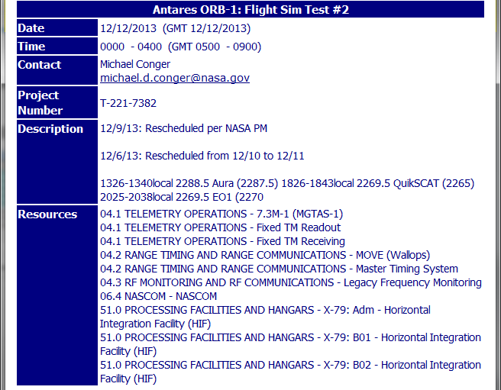
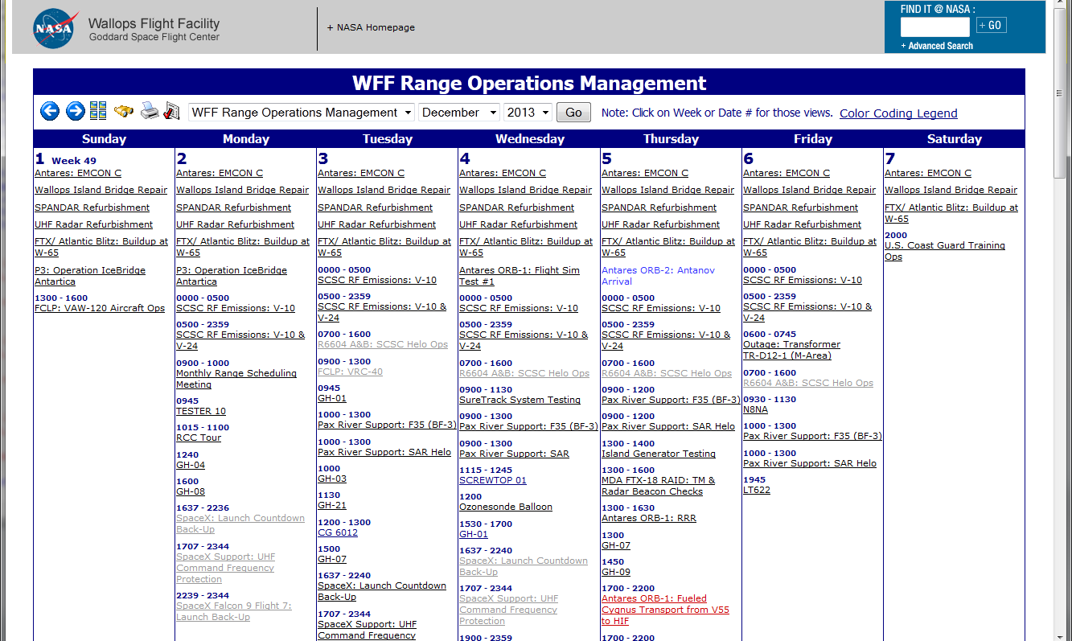
Range Schedule
Connect Daily Software
MH Software Inc.
Events/Resources

Slide 6
Asset/Resource?
What are they?
Various Categories
Range Control Center
Tracking Radars
Payload Processing Facility
ARC Launcher

Slide 7
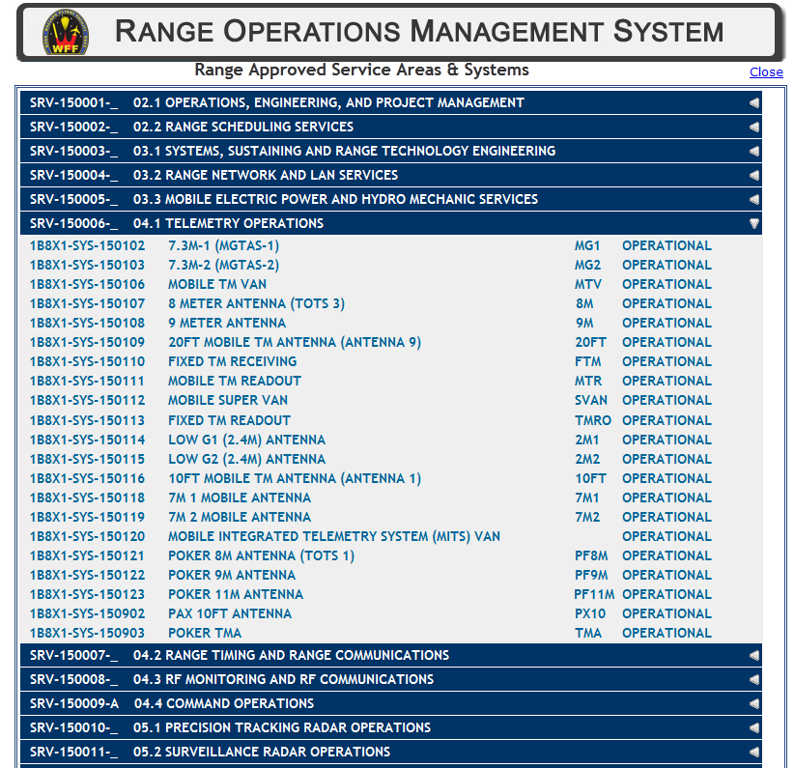
ROMS & Primary Keys
Resource master list
Critical – Primary Keys
Additional resources?

Slide 8
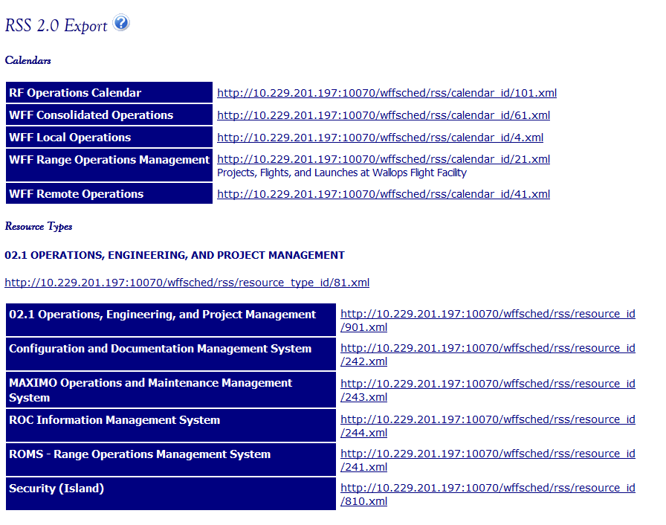
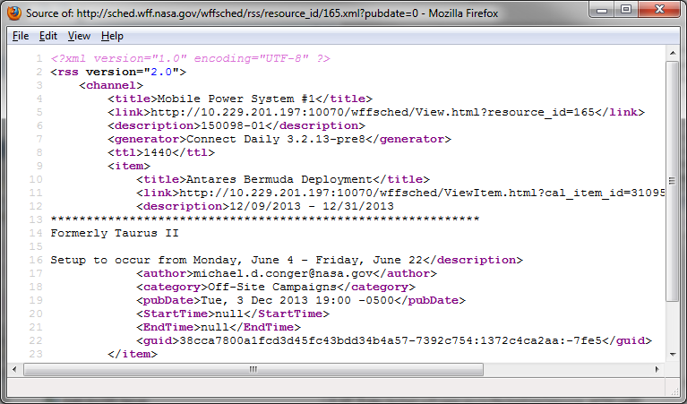
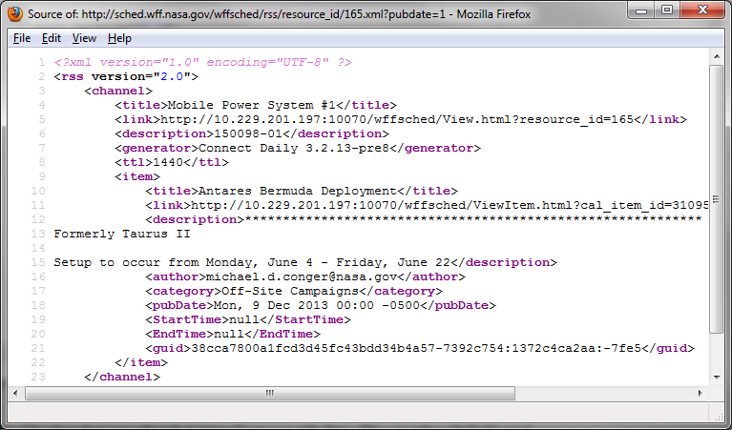
RSS Feed
Export Options
iCal
RSS
Pubdate method
?pubdate=0
?pubdate=1
Accessibility
URL Transformation
http://calendar.yourhost.name/[your path/]rss/[by method]/[id].xml

Slide 9
Literature Review
Specific scenario?
Asset Management
Construction Schedule Planning
Space Scheduling
Python
ArcObjects

Slide 10
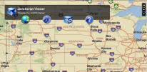
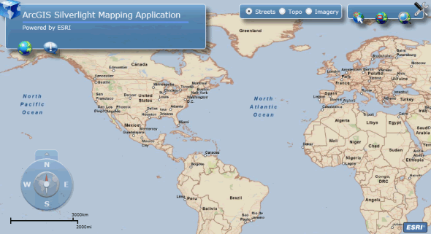
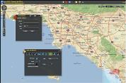
Development Overview
GIS Data
Subset of Range Resources
Compile from existing datasets or create new?
ArcSDE
Geodatabase
+
SQL
ArcMap
Front End Intranet Viewer
ArcGIS Server

Slide 11
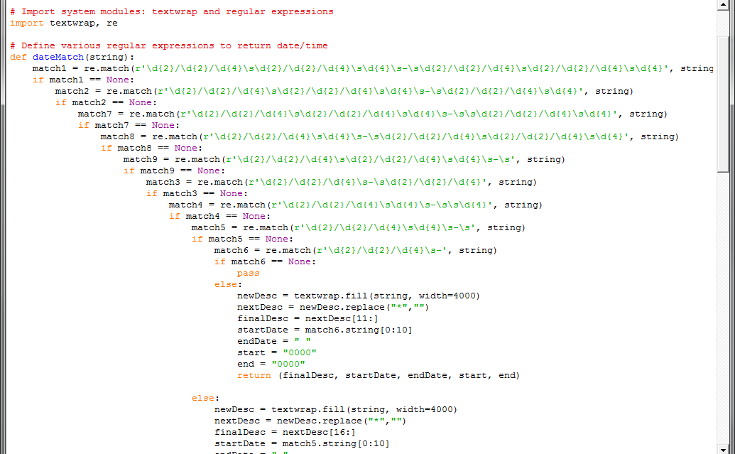
Python Function
Determines proper date & time designations
Regular Expressions = matching formats
i.e. (r’\d{2}/\d{2}/\d{4}) = (00/00/0000)
re.match()
\d = Decimal Digit
0 to 9
\s = Whitespace
Returns properly formatted data
http://docs.python.org/2/library/re.html

Slide 12
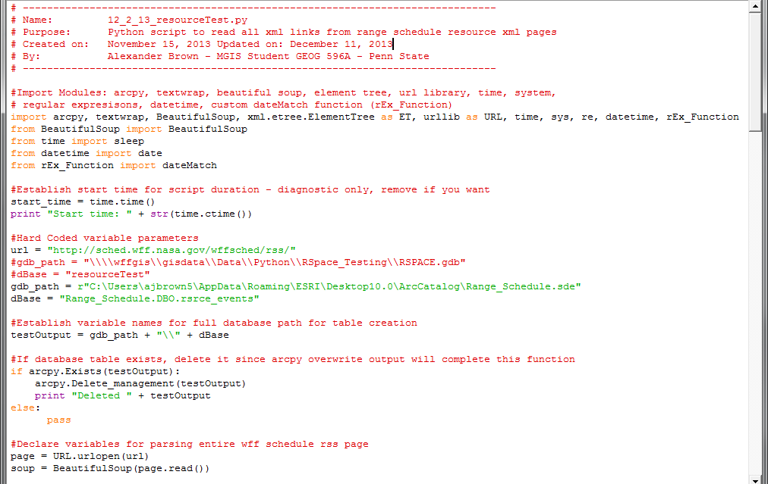
Python Script

Slide 13
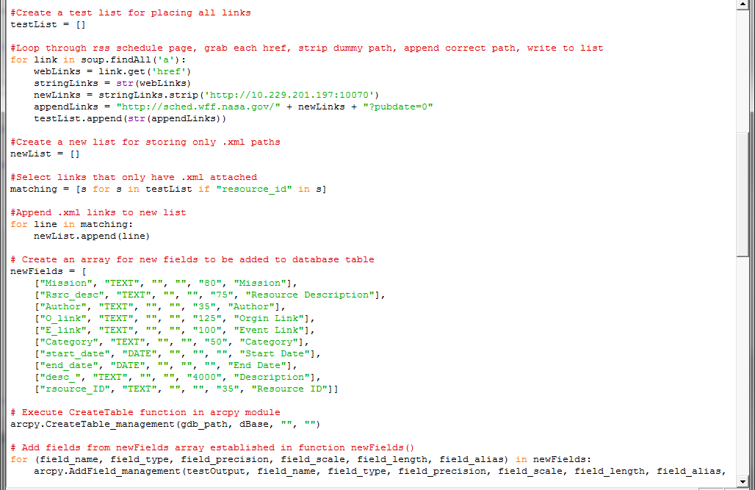
Python Script (cont.)

Slide 14
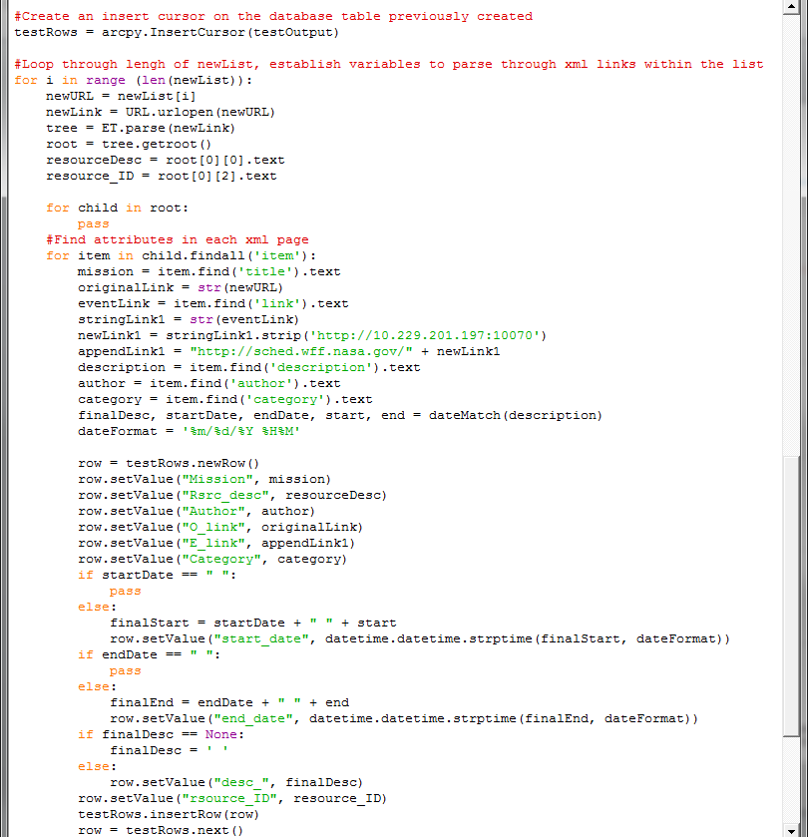
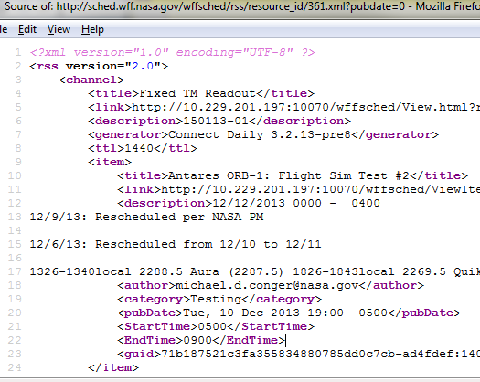
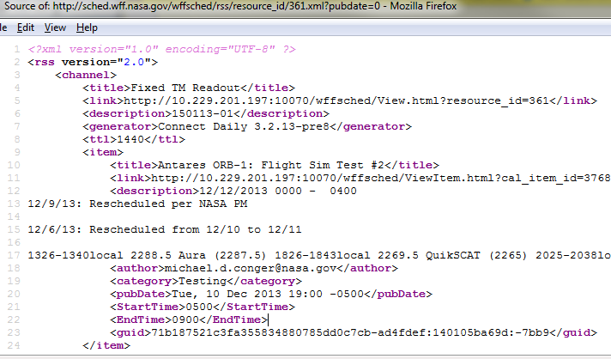
Python Script (cont.)

Slide 15
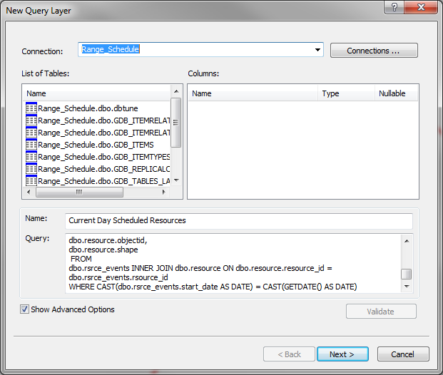
Query Layers
ArcMap (Add Query Layer)
SQL Query from SDE
Data Storage Migration
SDE Binary to ST_Geometry
Shape.STArea()
Shape.STLength()
SELECT
dbo.rsrce_events.rsource_ID, dbo.rsrce_events.author, dbo.rsrce_events.mission,
dbo.rsrce_events.rsrc_desc AS Title, dbo.rsrce_events.category, dbo.rsrce_events.start_date,
dbo.rsrce_events.end_date, dbo.rsrce_events.E_link,
dbo.rsrce_events.O_link, dbo.rsrce_events.desc_ AS Description, dbo.resource.objectid, dbo.resource.shape
FROM
dbo.rsrce_events INNER JOIN dbo.resource ON dbo.resource.resource_id = dbo.rsrce_events.rsource_id
WHERE CAST(dbo.rsrce_events.start_date AS DATE) = CAST(GETDATE() AS DATE)

Slide 16
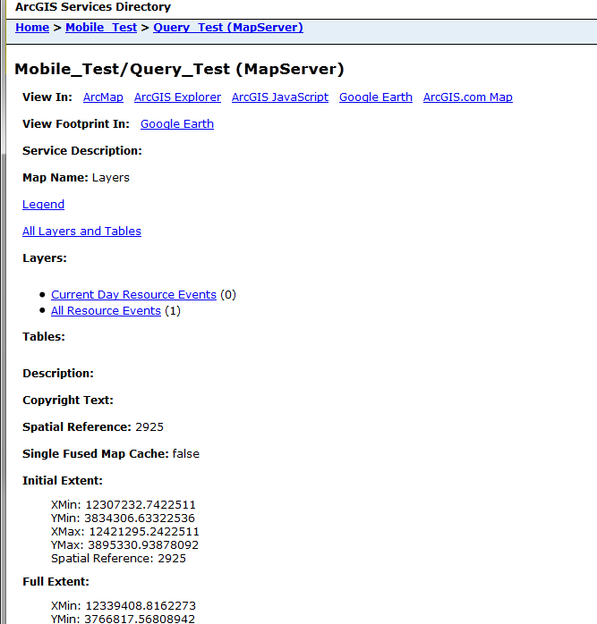
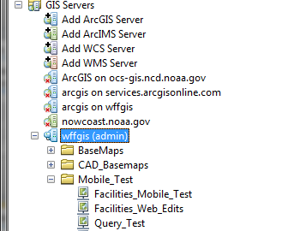
Publish to the Web
ArcMap => ArcGIS Server
Map Service
REST

Slide 17
Event Example
Antares Orbital Launch – Flight Simulation Event

Slide 18
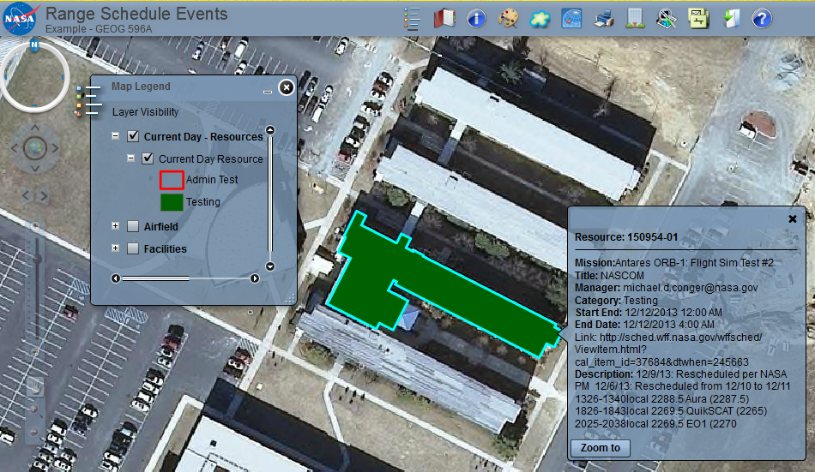
Event Example – Web Mapping

Slide 19
What’s Next?
Continue GIS Data Development
Query Categories/Refinement
Map Service Symbology
Extend Python
Front-End Application Development

Slide 20
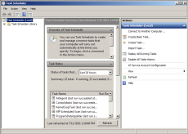
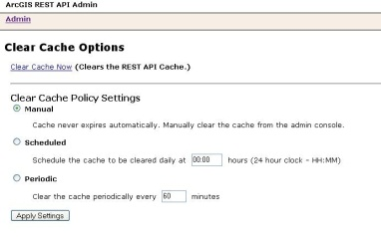
Proposed Workflow
Executes
Task Scheduler
+
Restart Map Services
Clear Server REST Cache
Updates Reflected on Front End Application

Slide 21
Timeline
December
Finish GIS Data Development
Extend Python Scripts
January
Application Development
Finish Query Categories
Map Symbology
February
Finish Application Development
Begin Finalizing Presentation
March
Finalize Presentation
March 10-13: Presentation ESRI International Developer Summit

Slide 22
Acknowledgements
Special Thanks to Jim Detwiler
Penn State University MGIS Program
NASA WFF
Range and Mission Management Office
Applied Engineering and Technology Directorate
Facilities Management Branch

Slide 23
References
Bansal, V. K. (2011). Use of GIS and Topology in the Identification and Resolution of Space Conflicts. Journal of Computing in Civil Engineering, 25(2), 159-171. http://dx.doi.org/10.1061/(ASCE)CP.1943-5487.0000075
Bansal, V.K., & Pal, M. (2007). Geographic Information Systems in Evaluation and Visualization of Construction Schedule. 2007 ESRI Asia-Pacific User Conference, 1-10. Retrieved from http://arxiv.org/abs/0803.3515v1
Dobesova, Z. (2011). Programming language Python for data processing. Electrical and Control Engineering (ICECE), 2011 International Conference, 4866-4869. doi: 10.1109/ICECENG.2011.6057428
ESRI. (2013, August 19). Data migration from one storage type to another. Retrieved from http://help.arcgis.com/en/arcgisdesktop/10.0/help/index.html#//002n00000076000000
ESRI. (2012, August 2). What is a Query Layer?. Retrieved from http://help.arcgis.com/en%20/arcgisdesktop/10.0/help/index.html#//00s50000000n000000
Guler, H., Akad, M., & Ergun, M. (2004). Railway Asset Management System in Turkey: A GIS Application International Federation of Surveyors – Working Week 2004, 1-11. Available from http://www.fig.net/pub/athens/papers/ts20/ts20_3_guler_et_al.pdf
Python Software Foundation. (2013, December 12). Regular Expression Operations. Retrieved from http://docs.python.org/2/library/re.html
MH Software Inc. (2013). Connect Daily. Retrieved from http://www.mhsoftware.com/connectdaily.htm
Newman, G., & Reck, N. (2009). GIS Application Support of Operations-Based Programs at NJ Transit [PowerPoint slides]. Retrieved from http://www.transitgis.org/download/conference/2009- presentations/BAquila.pdf
RSS Advisory Board (2009, March 30). RSS 2.0 Specification. Retrieved from http://www.rssboard.org/rss-specification

