Slide 1
Using Volunteered Geographic Information to Track Invasive Fish in Delaware
Lori Mae Brown
Pennsylvania State University – MGIS Capstone Proposal
May 7, 2020
Advisor: Jim Detwiler
Notes:
Hi everyone. Thanks for taking the time to listen to our Capstone proposal presentations today. I’m going to be talking about using Volunteered Geographic Information to track Invasive Fish in Delaware. I would like to acknowledge my advisor Jim Detwiler as well as collogues from Delaware Division of Fish and Wildlife, Delaware Invasive Species Council, Delaware SeaGrant, and my coworkers in the Division of Watershed Stewardship for encouraging me to take on this project and giving me lots of great ideas.

Slide 2
Overview
Background
Project Objectives
Methodology
Considerations
Anticipated Results
Timeline
Questions
Notes:
Jumping into things, I am going to be giving you some background about why I’m doing this project, what the project objectives are, my planned methodology, issues that need to be considered, anticipated results, my timeline, and then I’ll open it up for questions.

Slide 3
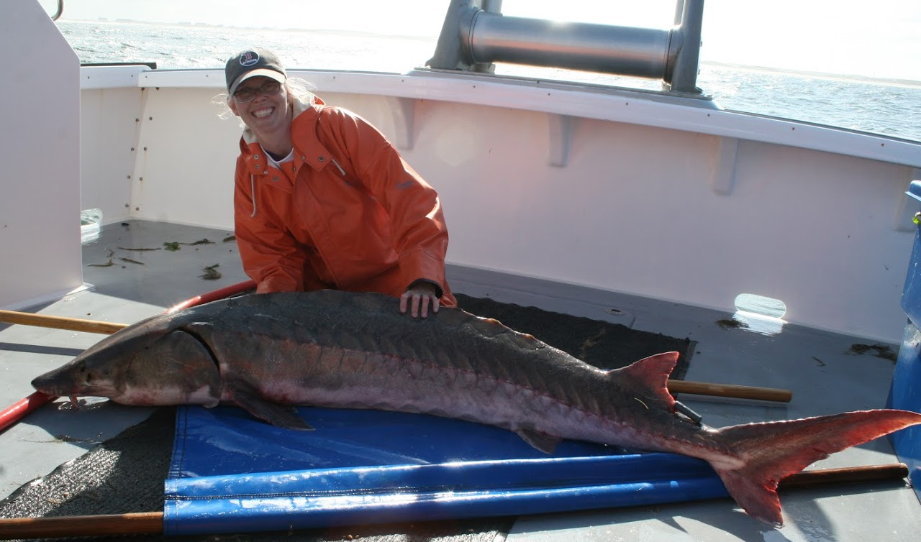
About Me
Environmental Scientist at Delaware Department of Natural Resources and Environmental Control (DNREC)
Watershed Assessment and Management Section
Research Technician at Delaware State University
Fisheries Biology and Aquaculture
Undergraduate degrees in Biology and Environmental Science
Marine Science, Fisheries and Aquaculture, and Ecology
NOAA – National Marine Fisheries Service
Permit No. 16507-01
Notes:
This project is probably a little different than other you have seen so to understand my interest, it might help to know a little bit about me. I’m a former fisheries biologist that is now working in the world of water quality standards, and pollution control. As you can see, I clearly enjoyed working with fish – that is an Atlantic Sturgeon, if you aren’t familiar. I am always looking for an excuse to keep my feet wet, so when I was asked by collogues if it was possible to make a tool to report invasive fish, I was eager to help – it was incorporating my love of fish and fisheries science and my GIS skills! Many people I work with get anxious when they hear GIS, so I’m always looking for opportunities to help people feel more comfortable using spatial data.

Slide 4
What are Invasive Species?
Any living organism not originally from an area whose introduction does or is likely to cause economic or ecological harm or harm to human health Executive Order 13112 (1999)
Approximately 42% of threatened and endangered species are at increased risk due to invasive species Pimentel et al., 2005
Mapping the global state of invasive alien species: patterns of invasion and policy responses by Turbelin, Malamud and Francis, 2017.
Notes:
I’m sure everyone has heard about invasive species, but I wanted to provide you with a quick overview. According to US Executive Order 13112, an invasive species can be defined as any living organism not originally from an area whose introduction causes or is likely to cause economic or ecological harm or harm to human health. The map on this slide is from a 2017 paper by Turbelin, Malamud, and Francis. It shows the number of known invasive species by country and as you can see red indicates the highest number of documented species, so the US is unfortunately a leader. We have seen an increase of invasive species on a world-wide scale due to increased international trade and relative ease of international travel. In a 2005 paper by Pimentel et al, it was calculated that 42% of threatened and endangered species were being put at increased risk due to invasive species and while I couldn’t find any updates to this number, it can be assumed that the risk has only continued to grow.

Slide 5
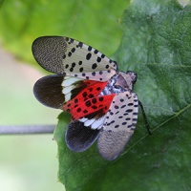
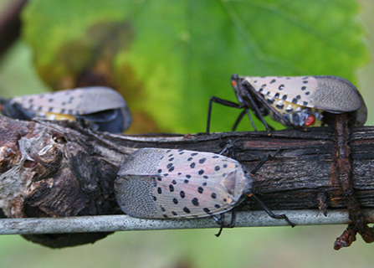
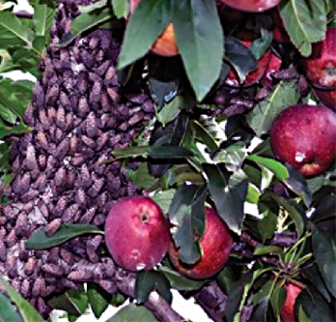
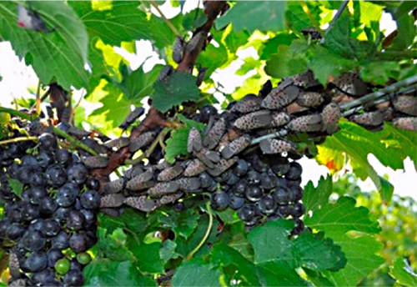
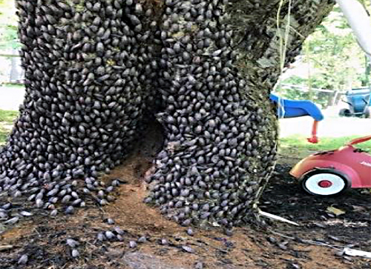
So What?
Invasive Species:
Reduce native diversity
Predation
Compete for resources such as nutrients and space
Disrupt natural communities
Change habitat structure for other organisms
Potential to hybridize with native species
Jeopardize economies
Damage crops
Utilize needed resources
Spread disease
All images from Cornell College of Ag & Life Science
Notes:
When an invasive species is introduced to an area, there are usually no natural checks in place so they can quickly begin to impact the native species, environments, crops, and communities through competition, predation, and the spread of disease. Spotted lanternfly is a timely example that you may have heard of. They are believed to have arrived from Asia as egg masses on a stone shipment in 2012. The first infestation was documented in 2014 in Berks County, PA and since then they have spread throughout Pennsylvania to New York, New Jersey, Maryland, Virginia, and Delaware. These images show the spotted lanternfly as both an economic and lifestyle pest, causing issues for residents, businesses, tourism, forestry, and agriculture. The lower images show an apple tree, grape vine, and a backyard tree completely infested.

Slide 6
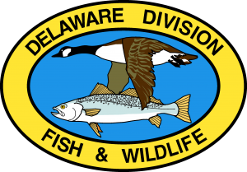
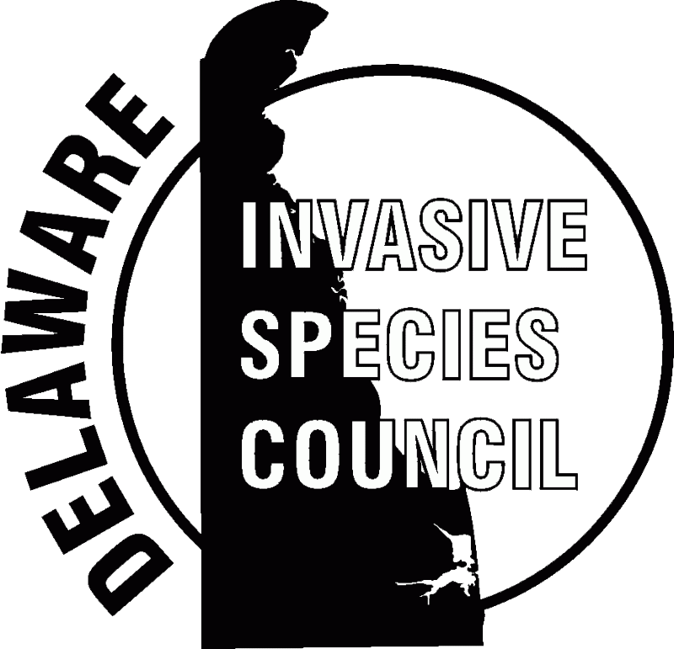
Project Objective - What can we do?
Gather more information about invasive species without having to invest in additional sampling efforts
Develop an invasive species reporting tool
Verify the reported information
Incorporate existing and new information into a single database so it can be accessed and analyzed together
Visualize the reported data so stakeholder can utilize it
Educate the public on the importance of reporting invasive species
Notes:
Now that we have an overview of the potential impacts of invasive species, what can we do in Delaware to try and gain a better understanding about the problem? Because there are many types of invasive species found in a wide variety of habitats, I knew I couldn’t just create something to report any and all invasive species – it would just be too unwieldy. It was important to initially focus on species that would be recognizable and relatively easy to identify, are encountered by the public, and have the potential to impact native species, habitat, and ecology. I met with stakeholders from the Division of Fish and Wildlife, the Delaware Invasive Species Council and Delaware SeaGrant to determine what they thought would be a beneficial project through a needs assessment process. To be frank, they wanted to be able to do more with less – a moto for this day and age. They hoped to be able to use to public to find out where invasive species were being found and not necessarily have to increase their own efforts. They wanted to be able to incorporate any existing data they already had and they wanted to be able to visualize the data. We picked three fish to focus on based on the criteria I just mentioned, Flathead Catfish, Blue Catfish, and Northern Snakehead, and I will give you a little background on each of them.

Slide 7
Focus Species Flathead Catfish – Pylodictis olivaris
Native to the US, but not the Mid Atlantic region
Quickly establishes in areas they are introduced
Can reach up to 5 ft in length
Preys on native fish and crustaceans
First reported in DE in 2018
Illustrated by Duane Raver, Jr.
Notes:
Flathead Catfish is a freshwater species native to the United States, but not the Mid Atlantic region. Its native range is the lower Great Lakes and Mississippi River Basins. This species has been found to quickly establish itself in the locations it has been introduced. It is fast growing can reach up to 5 feet in length and preys heavily on the native fish and crustacean populations, outcompeting and devastating communities.

Slide 8
Focus Species Blue Catfish – Ictalurus furcatus
Native to the US, but not the Mid Atlantic region
Primarily freshwater, but can inhabit higher saline
Voracious appetites
Can grow up to 5.5 ft and 110 lbs
Introduced to Virginia in the 1970s and spread to surrounding states
Illustrated by Duane Raver, Jr.
Notes:
The Blue Catfish is another species native to the United States, but not the Mid Atlantic Region. It’s native range is the Mississippi, Missouri, and Ohio River Basins as well as Gulf Coast streams from Alabama, south into Mexico. This catfish is primarily freshwater, but has a high salinity tolerance allowing it to establish itself in a wide variety of habitat types. This is a highly fecund and long-lived species. It can reach lengths of 5.5 feet and weigh up to 110 lbs. In the 1970s and 80s this fish was stocked for recreational fishing in Virginia and soon spread to surrounding states. Thanks Virginia!

Slide 9
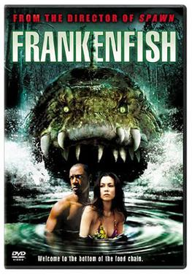
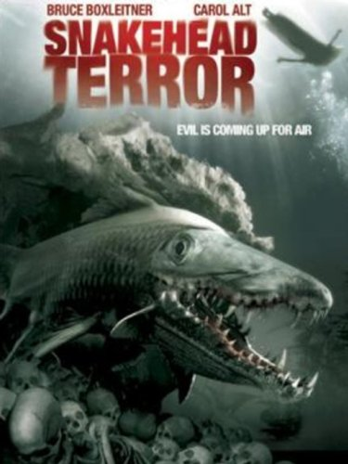
Focus Species Northern Snakehead – Channa argus
Indigenous to Russia, China, and Korea
Average length 33 inches
Voracious appetite
Can survive several days out of water
Believed to be intentionally introduced
First reported in DE in 2010
Illustrated by Susan Trammel-USGS
(2004)
(2004)
Notes:
The last species I’m are going to focus on is the Northern Snakehead also known as Frankenfish, and for good reason. This fish is native to Russia, China, and Korea. It averages 33 inches in length and has a voracious appetite. It is tolerant of cold temperatures, can survive out of water for up to 4 days and juvenile Northern Snakeheads have been know to “walk” between adjacent waterbodies. It was brought to the US for the live fish market trade and is believed to have been intentionally released – quickly establishing itself and becoming the stuff of SyFy Original Movies.

Slide 10
Project Objective - What can we do?
Notes:
I created this diagram to walk stakeholders through my idea of how this project would work based on the needs assessment. You will note that this design is very Esri-specific. The State of Delaware has a license agreement with Esri and we are encouraged to utilize their products. I did look at other options in my literature review, but I will be focusing on Esri products for my capstone. All of the data collected will be stored in a hosted feature layer thought the state’s ArcGIS Online Organization.
To start the prosses - someone out fishing would catch an invasive fish – they would used the reporting app on their smartphone, tablet, or computer to send in a completed form with a picture and location of the fish they caught – the submission would trigger an email notification to the reviewers – a reviewer would verify the accuracy of the report - that verified information would be made available to stakeholders for analysis, reporting, and outreach efforts – information would also be made available to the public in a separate tool. I will explain my plans for these various tools as we continue.

Slide 11
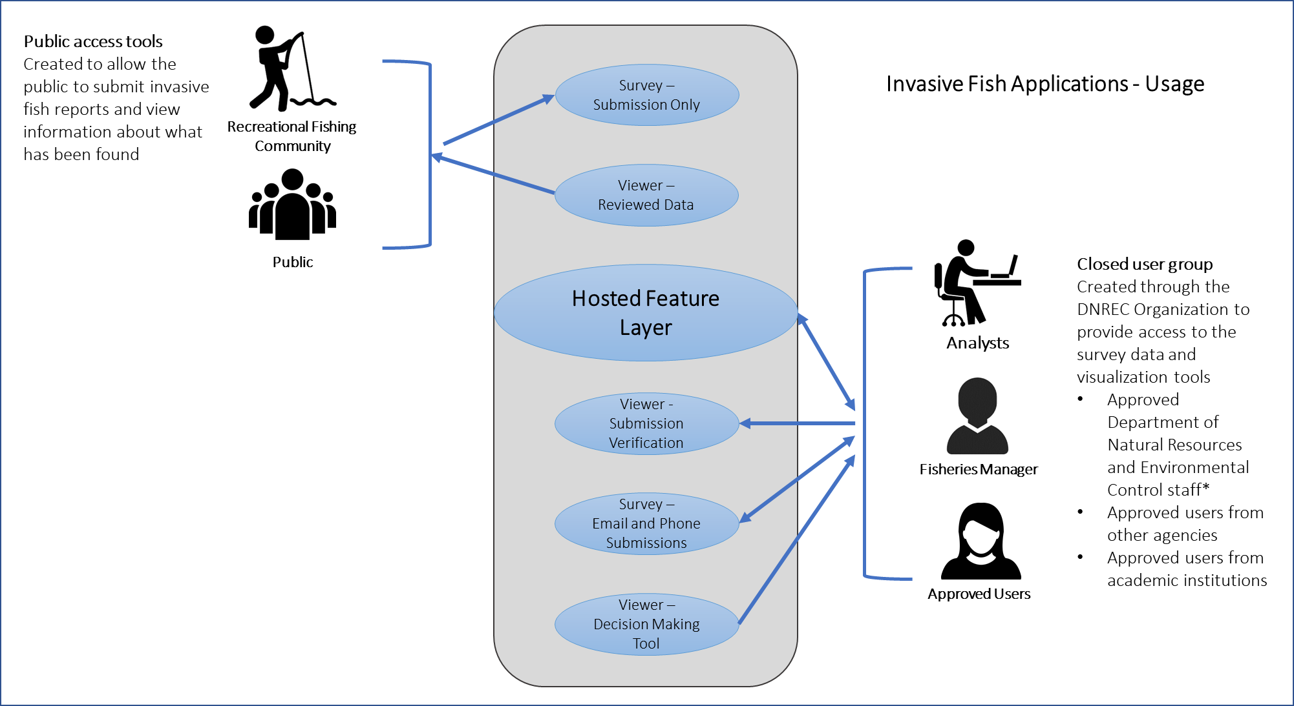
Project Components & Usage
Notes:
This diagram breaks down the components of the project. Each component will be explained in more detail later.
The public will be able to submit reports of invasive species using a Survey123 reporting app. They will also be able to view reported data through a web tool.
Analysts, managers and other approved stakeholders would have greater access to the actual hosted feature layer if needed. They will be able to use an app to review submissions and verify accuracy before approving the data for use. They will also be able to add data that is submitted through methods other than the public reporting app and they will have tools for visualizing and analyzing the data received.

Slide 12
Ideas From Others
Organization | Project | Website
Cooperative Agricultural Pest Survey | Invasive Pest Survey and Site Visit | https://solutions.arcgis.com/state-government/help/invasive-pest-surveys/
USDA – Forest Service | Hazard Tree Assessment | https://www.fs.usda.gov/detail/r2/forest-grasslandhealth/?cid=fsbdev3_041670
Delaware Department of Agriculture | Spotted Lanternfly Sighting Survey | https://agriculture.delaware.gov/plant-industries/spotted-lanternfly/
The Lake Environmental Association | Nonpoint Source – Stormwater Survey | https://mainelakes.org/lake-health/stormwater_survey/
Glacier National Park | Common Loon Citizen Science Project | https://www.nps.gov/articles/survey123.htm
The River Mile Network | Water Quality, Animal and Plant Inventories, and Crayfish Study | https://therivermile.org/network-projects/data-collection-submission/
Prince George’s County, MD | Tracking Litter Cleanup | https://www.princegeorgescountymd.gov/DocumentCenter/View/16263/PGCLitterTRAK-user-manual?bidId=
Washington Stormwater Center | Inspection Templates | https://www.wastormwatercenter.org/stormwater-construction-site-inspection-resources
FEMA | Preliminary Damage Assessment | https://www.fema.gov/media-library/assets/images/180952
Integrated Monarch Monitoring Program | Monarch, Site, Milkweed, Observation Surveys | https://monarchjointventure.org/images/uploads/documents/Survey123Instructions2019.pdf
Vassar Farm and Ecological Preserve | Bird Survey | https://farm.vassar.edu/research/citizen-science-projects/
Wisconsin Department of Natural Resources | Deer Hunter Wildlife Survey | https://dnr.wi.gov/topic/wildlifehabitat/wlsurvey.html
Arizona Department of Environmental Quality | Arizona Water Watch | http://www.azdeq.gov/programs/azww
Survey123 has become a popular tool
Notes:
During my literature review, I looked at a whole lot of existing survey/reporting tools. Here is a handful of Survey123 tools specifically. Some of the overall benefits that were noted in these various projects were Survey123 provides a straightforward way to pose questions that will hopefully aid in informed decisions based on results. Being able to collect images makes it easier to verify accuracy and potentially collect additional information. Little training is needed to use the apps. Data can be accessed and edited through ArcGIS Online and ArcGIS Pro.

Slide 13
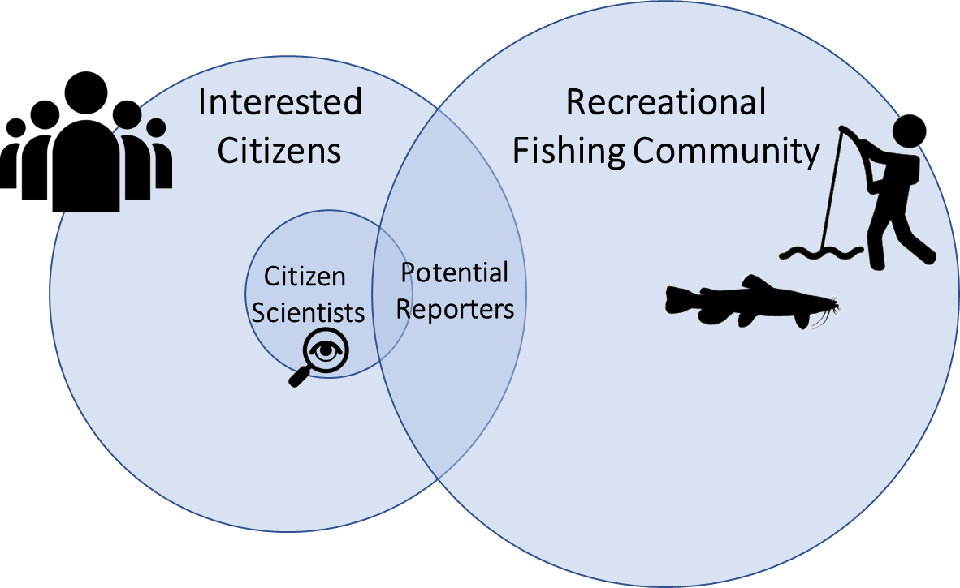
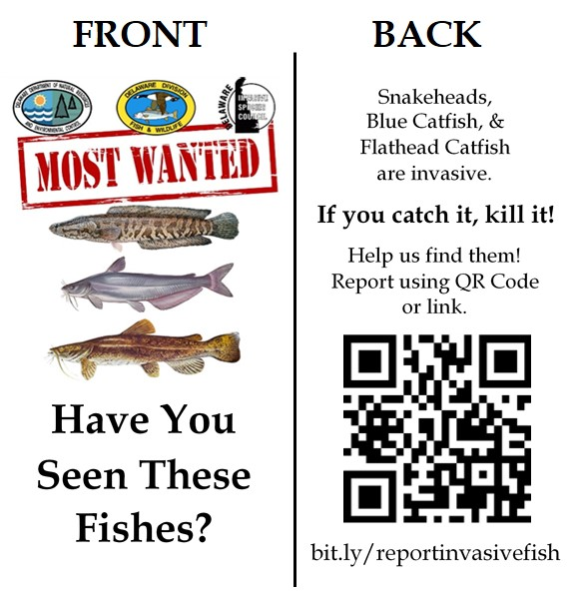
Working with the Recreational Fishing Community Reporting App
Get information from the public
Volunteered Geographic Information
Develop a reporting app
Easy to use/understand
Can be accessed on a variety of devices
Collects an image
Collects a location
Easy to update and modify
Publicize the reporting app
Notes:
The public submitting reports is key to the success of this project. Michael Goodchild called this type of reported information Volunteered Geographic Information. According to Goodchild, Volunteered Geographic Information is based on “the widespread engagement of large numbers of private citizens, often with little in the way of formal qualifications, in the creation of geographic information. They are largely untrained and their actions are almost always voluntary, and the results may or may not be accurate.”
Citizen science focuses this volunteer effort for scientific projects. We are targeting these engages individuals that are also a part of the recreational fishing community.
I know that “If you build it, they will come” only works in baseball fields in Iowa, so I can’t assume, just because I make a app, it will get used - it is important to spread the word. Information about the reporting app has already been included in the State’s Annual Fishing Guide, and Division of Fish and Wildlife’s website. I have also created business cards with the fish images, QR code, and link to the reporting form to hand out. Other efforts will include invasive species rack cards, flyer at fishing areas, and social media posts.
A tool geared towards public must be easy to use and understand. It has to be accessible from a variety of devices and it needs to gather the required information. The next series of slides show the prototype app I created in Survey123 Connect.

Slide 14
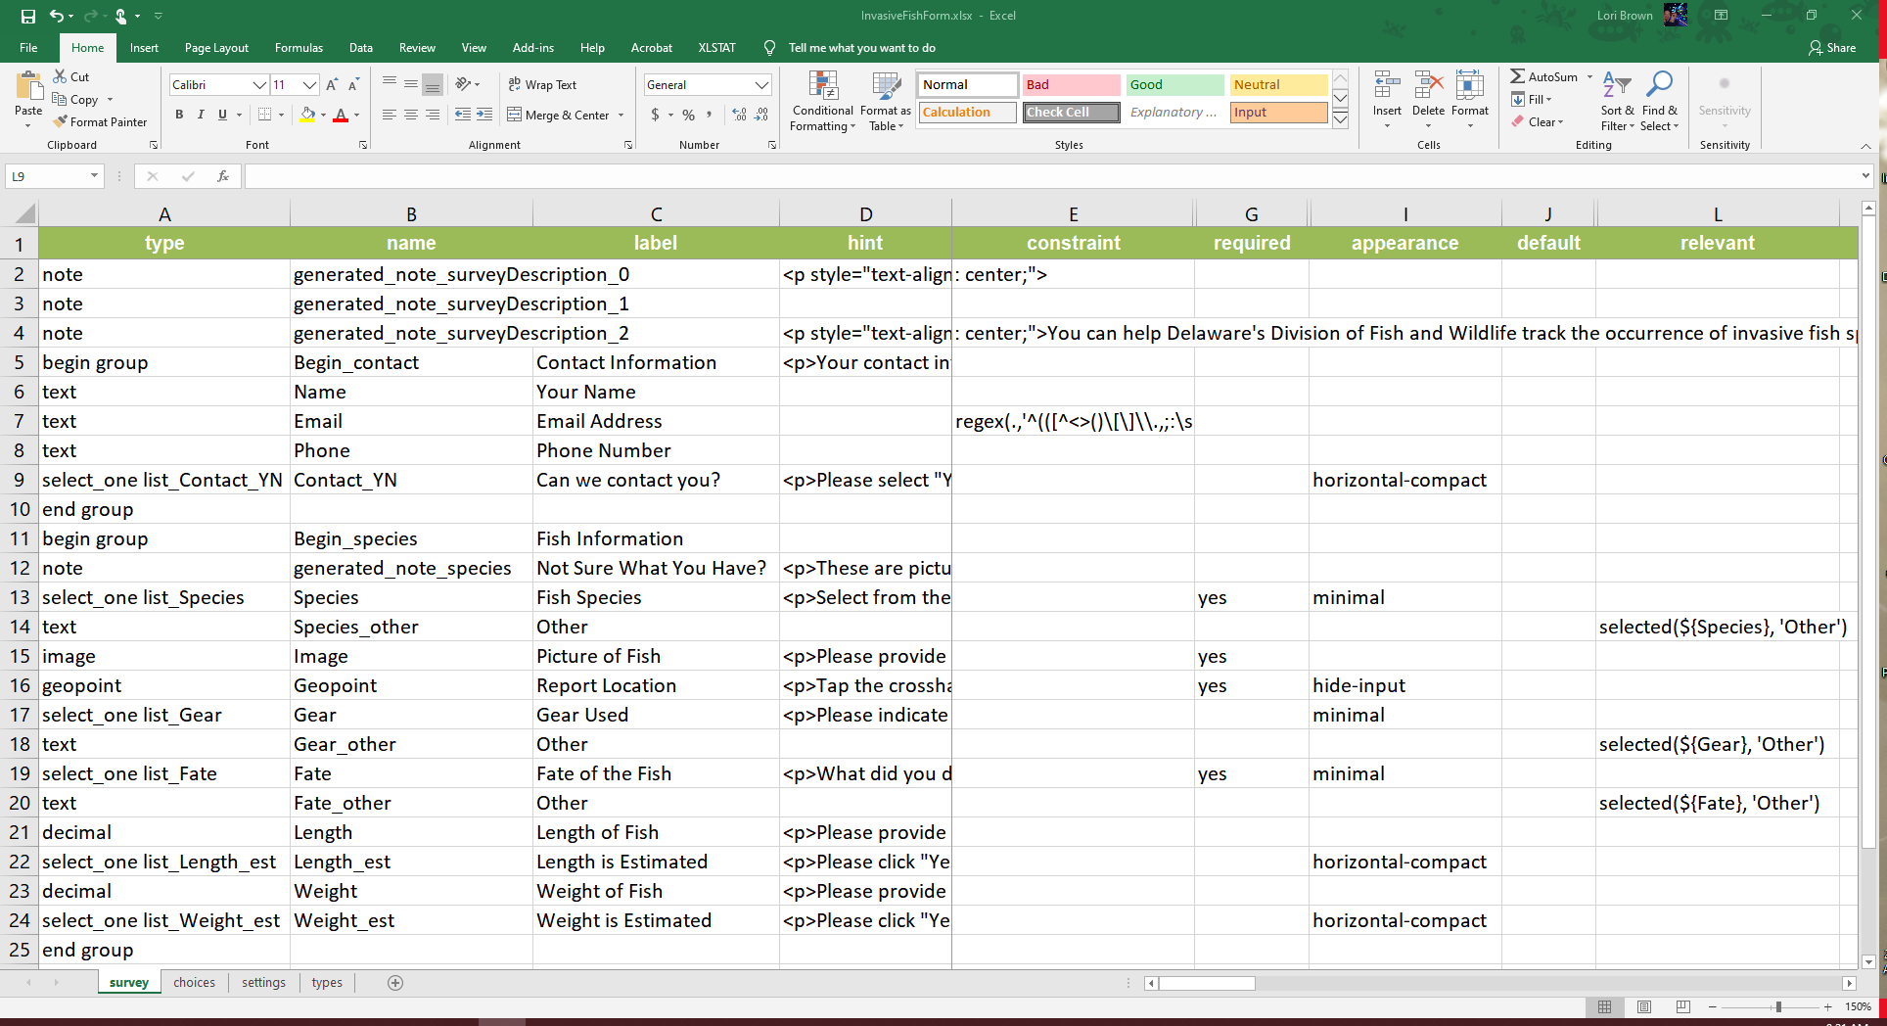
Working with the Recreational Fishing Community Reporting Tool
https://xlsform.org
Notes:
In case you haven’t working with Survey123, its is a form-centric user-friendly app developer and Survey123 Connect is a desktop tool for customization of the forms using XLSForm. XLSForm is a standard for authoring smart forms in excel sheets. This is a little piece of my spreadsheet form, to give you an idea of what it looks like. Here you can set question types, create pick lists, constrain answers with regular expressions, control flow based on previous answers, and much more.

Slide 15
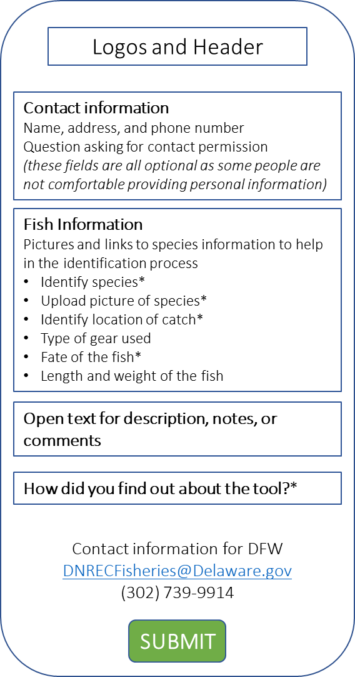
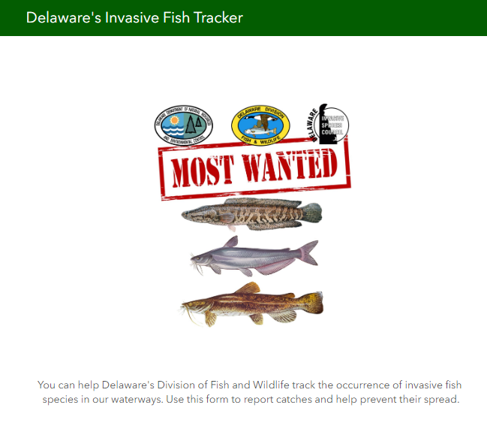
Working with the Recreational Fishing Community Reporting Tool
Notes:
The wireframe on the left show the overview of my prototype app based on the information in the spreadsheet and will remain on the slide as we walk through the sections. The right side will show the sections in the prototype.

Slide 16
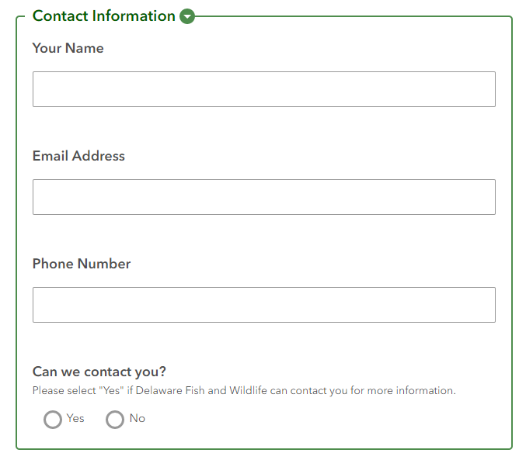
Working with the Recreational Fishing Community Reporting Tool
Notes:
The first section to fill out is contact information and a question about being contacted. Submitters are not required to complete this information and Survey123 does not require login or contact information to use the web app. We have seen that often the public refrains from reporting if they are required to provide personal information – this could be do to a variety of factors including fishing without the correct licenses, in illegal locations, or just not trusting the government. We would rather receive anonymous reports to no reports.

Slide 17
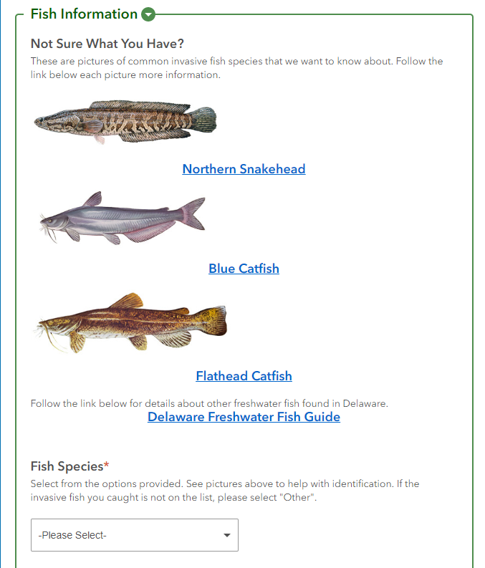
Working with the Recreational Fishing Community Reporting Tool
Notes:
We have information to help the public identify their fish – pictures and links to species details and the fishing guide. Selection of a species is required.

Slide 18
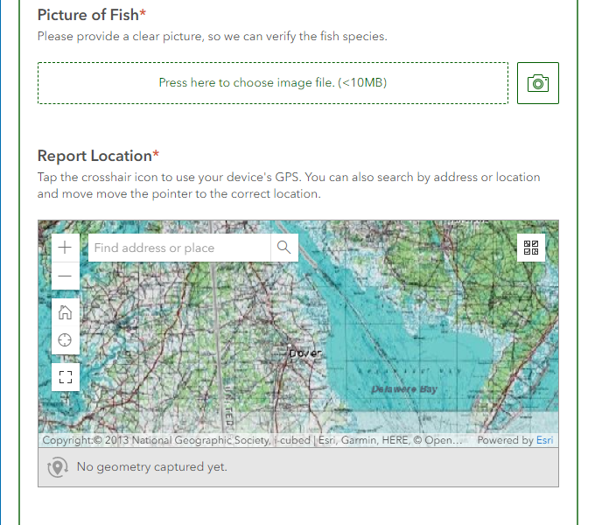
Working with the Recreational Fishing Community Reporting Tool
Notes:
Here is the image upload and catch location section, both of these fields are required. The submitter can use their phone’s GPS, type an address, or manually zoom to a location.

Slide 19
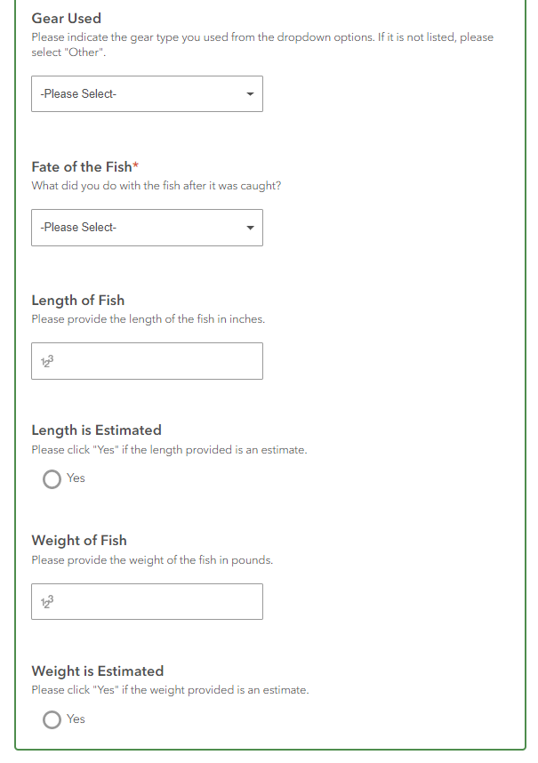
Working with the Recreational Fishing Community Reporting Tool
Notes:
Next is information about the gear used, the length and weight of the fish and if the fish will killed or released. The state advocates for no release of invasive fish.

Slide 20
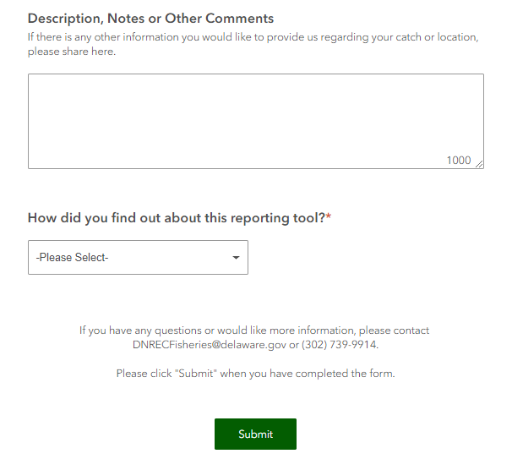
Working with the Recreational Fishing Community Reporting Tool
Notes:
Finally we have free text area where submitters can provide any other information they feel would be useful. We also have a question about how they heard about the reporting tool.

Slide 21
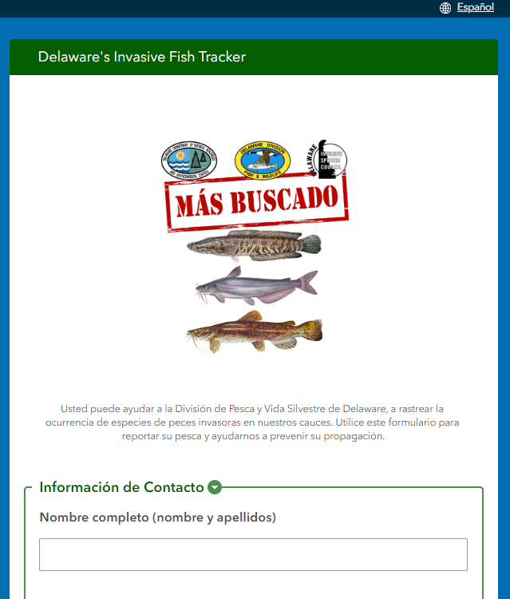
Working with the Recreational Fishing Community Reporting Tool
Notes:
Survey123 Connect can support translations, so I worked with a coworker to translate the form into Spanish. According to July 2019 census estimates, 9.5% of Delaware’s population is Hispanic and Spanish is spoken in 6.9% of Delaware households. This coupled with qualitative observations of active fishing, leads me to hope having a language option will increase usage.

Slide 22
Working with Stakeholders Verification
Before reported data can be used, it must be verified for accuracy
Survey123 offers some standardized options to reduce potential errors
Required fields, lists, selections, validation using regular expressions
Only authorized experts can verify the data
Information seems “real”
Location seems reasonable
Species ID is accurate
Picture is not a stock photo
Experts will receive email notification as reports are submitted to speed up the process
Notes:
Now we have a tool and are hopefully getting reports submitted. The submitted information needs to be verified for accuracy before it can be used. Survey123 has some built-in options to help reduce submission errors which can simplify verification – these include required fields, utilizing lists and selections rather than requiring typing, and having validations like email, phone numbers, text only or number only fields all reduce possible entry errors. Only experts familiar with the species of interest will review and verify the data. Reviewers need to know if the information submitted appears reasonable and if the species identification is accurate. To make sure reviews happen in a timely manner, reviewers will be notified via email when a report is submitted. I have utilized Integromat to set up a webhook for this process.

Slide 23
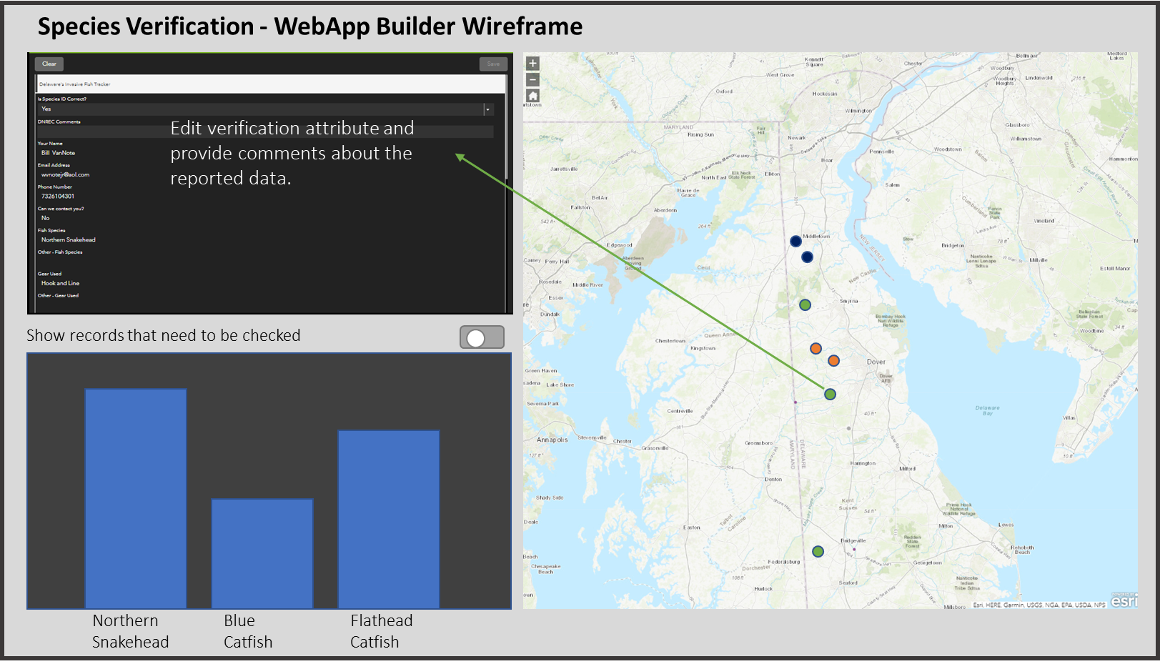
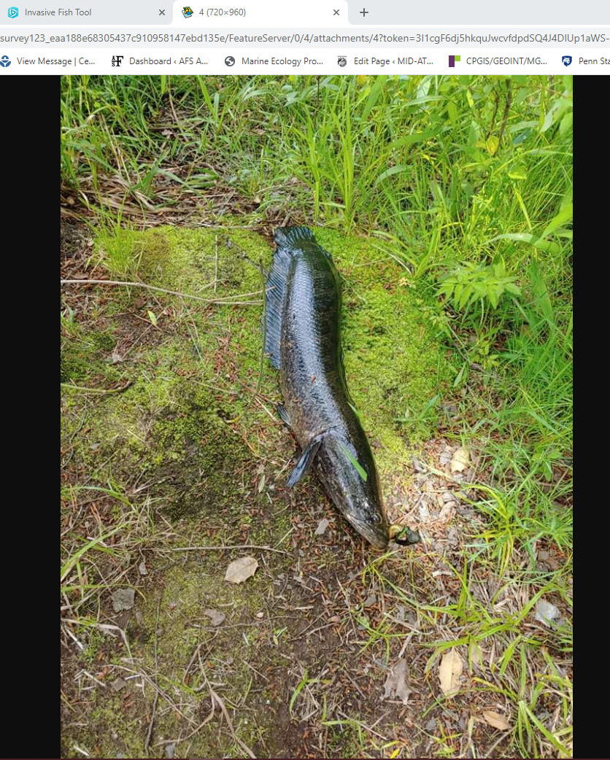
Working with Stakeholders Verification
View image of reported fish
Notes:
This is a mockup based on Esri’s Web AppBuilder for a verification tool. Web AppBuilder is based on widgets, allowing for some flexibility on the information presented in an app. Using the SmartEdit widget, you can select attributes that can be edited. This protects from the reviewer accidental editing or deleting information. When the reviewer clicks on a point, the attributes are displayed in the table to the left and selected fields are open to edit – these fields are a question field “is the species identification correct?” and comments field. When submissions come in, the “is the species identification correct?” question has a default answer of “check” and the data will not be incorporated into the usable dataset unless the answer is “yes.” This widget also allows the submitted image to be opened in a new window so it can be reviewed. I also plan to include a summary bar graph to show the count of each species reported to date and a switch button to filter by all records, records that need to be checked, or records that have been checked. As data is filtered information will change on the map and bar graph accordingly.

Slide 24
Working with Stakeholders Other Data
Incorporate existing data and data reported though other means and indicate where the data came from (reporting tool, phone call, email, conversation)
Fish and Wildlife staff have received phone calls and emails to report invasive fish that is currently stored in annual Excel spreadsheets
Formatted can be appended to the hosted feature layer using ArcGIS Pro
Other methods of reporting will continue and data needs to be incorporated as received
Staff Survey123 tool
Notes:
The Division of Fish and Wildlife has been receiving reports about snakeheads since 2011 and it is important to them that this data is incorporated with the new data we hope to get with the reporting app. Once the existing data is formatted appropriately it will get appended to the hosted feature layer using ArcGIS Pro. I intend to include a field to distinguish the reporting types (public reporting app, phone, email, personal communications). I realize that it is not realistic to expect the public to just use the reporting app, so I plan to create a tool for Fish and Wildlife staff to add new information as they receive it.

Slide 25
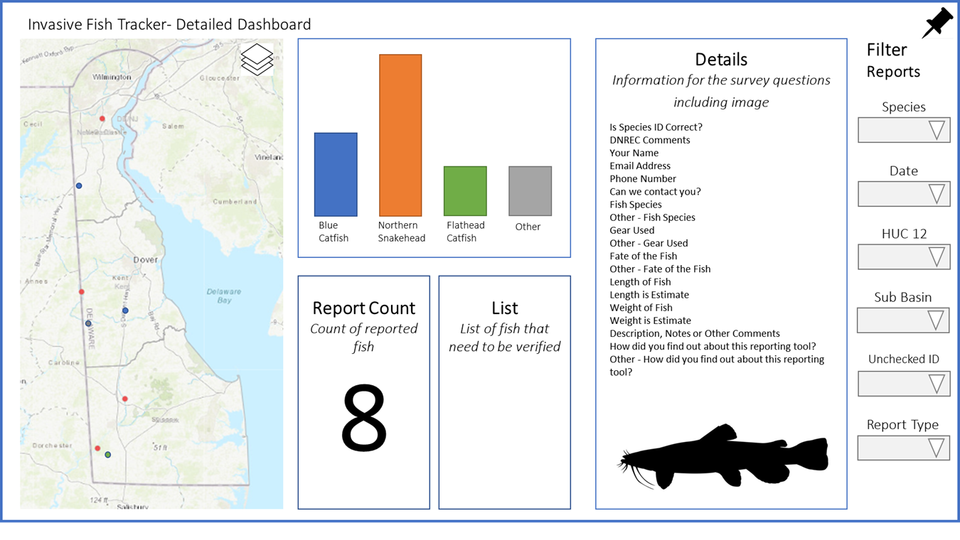
Working with Stakeholders Visualization and Analysis
Tool(s) to visualize reported data spatially
Show individual submission details
Filter
Summarize
Graph
Create printable reports
Notes:
A web-based app will be developed to meet the visualization and analysis needs of the stakeholders. Both ArcGIS Dashboard – previously called Operations Dashboard - and Web AppBuilder have useful features. ArcGIS Dashboard provides detailed lists and extensive filtering options for visualizing data as mocked up here. All data visualizations change as filters are turned on and off. Graphs and summaries can also be incorporated into the dashboard. Web AppBuilder also has filtering and graphing capabilities as I have already shown. It also has a print widget, that could be useful for directly printing or saving maps to PDF format for incorporation into other documents.

Slide 26
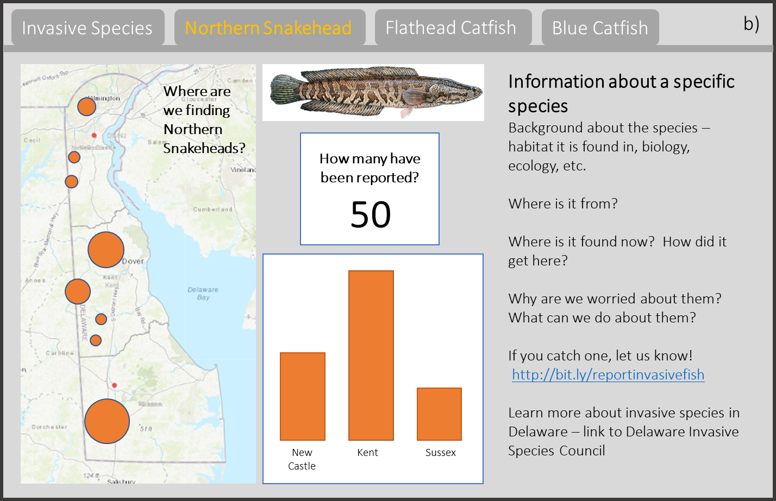
Helping the Public Understand
Provide mapcentric data in an aggregated/summarized format
Provide narrative information to educate them on the dangers of invasive species and the importance of reporting them
Notes:
Finally, I want to provide the public with information about this project. Here is a mockup of a potential informational public app. Using a platform like Esri’s Story Map or Experience Builder, I hope to develop an app that will provide both mapcentric data and narrative information. I want to be able to provide the public with an overview of invasive species and then focus on our three species of interest. I plan to provide summarized data rather than raw point data for clearer visualization and general information about species themselves. I want to public to understand the issues and realize the value of reporting efforts.

Slide 27
Considerations
Public
If the public doesn’t use the tool, we won’t get data
If there is poor cell service, it may be hard to submit data
Data only comes from where the recreational fishing community is catching the fish of interest
Notes:
It is important to identify potential challenges with my project. I’ve already mentioned that a tool is only good if it is being used, so it is important to reach as many people as possible.
Because this app relies on cloud services, network connectivity is a concern. If the app doesn’t work because of bad cell service we may not get accurate data. A 2019 RootMetric report stated the overall performance of all four major cell phone networks in Delaware was above 84% with data performance over 87%, While this is not perfect, it is pretty strong coverage. If submitters have issues with their phone, they can always report later from a computer or tablet
It is important to remember what the data being collected is and isn’t - Volunteering Geographic Information is data from where things are found, so there is no accounting for where thing are not found. This is the nature of these types of sampling efforts. This data supplements other efforts and provides valuable information when full scientific surveys cannot occur.

Slide 28
Considerations
Stakeholders
Data and products are stored in a cloud-based service leading to potential access issues
Experts need to verify submissions for them to be usable
The analysis and visualization tools need to be useful
Notes:
There are also several concerns on the stakeholder side that should be addressed. Data is being stored in a cloud environment and that tends to make people nervous. No one wants to lose their data. To deal with this situation, I think it is important to periodically backup data to have a on-premise copy incase there are issues. This kind of backup can be done easily with ArcGIS Pro.
Much like the public needing to use the reporting app so we get data, our experts need to verify the data to make it available. It is important to make sure they are comfortable with the verification process. The stakeholders must also feel comfortable with visualization and analysis tool. It needs to be user-friendly and provide useful information.

Slide 29
Anticipated Results
Collect useful, spatially referenced data that can enhance the current understanding of Flathead Catfish, Blue Catfish, and Northern Snakehead in Delaware
Allow individuals and organizations that do not regularly use GIS technology to better utilize spatial data for management and outreach efforts
Educate the recreational fishing community and the general public about dangers of invasive species and the importance of reporting them
Notes:
As you can see, this is a multifaceted project composed of many working parts. Invasive species are a challenging issue world-wide and I hope this project collects useful, spatially referenced data that can enhance Delaware’s current understanding of Flathead Catfish, Blue Catfish, and Northern Snakehead. I hope that through the tools I develop, individuals and organizations that do not regularly use GIS technologies will become more comfortable and begin to utilize spatial data for management and outreach efforts. Finally, I hope this project will educate the recreational fishing community and the general public about the dangers of invasive species and the importance of reporting them. If we can get reporting to become a standard practice, we may be able to better control the spread of invasive species.

Slide 30
Timeline
Task | Spring 2019 | Fall 2019 | ≠ | Mar 2020 | Apr 2020 | May 2020 | Jun 2020 | Jul 2020 | Aug 2020 | Sep 2020 | Oct 2020* | Nov 2020* | Dec 2020
Needs Assessment
Recreational Fishing Reporting Tool
Proposal
Verification Tool
Existing Data Tool
Visualization -Stakeholders
Visualization – Public
Finalize Project Formatting
Presentation*
Complete Report
*Meetings I am considering do not have their final details available yet. Two options are the Delaware Invasive Species Council Annual Meeting October 20th in Marydel, DE or the Mid Atlantic Chapter of the American Fisheries Society conference tentatively scheduled for November 9th - 10th in Asbury Park, NJ.
Notes:
Here is my project timeline. As you have heard, I have already started working on some aspects of the project, so over the next few months, I will make any needed modification to the survey123 public reporting tool, I will finish the verification tool and incorporate existing data in the hosted feature layer. I will then work on the stakeholder’s visualization and analysis tool and a tool to incorporate data submitted via calls and emails. Later this summer, I will work on the public visualization tool. In October I will finalize my project and I hope to present at one of two regional conferences. These are the Delaware Invasive Species Annual Meeting at the end of October or the Mid Atlantic Chapter of the American Fisheries Society Meeting in early November. I will then complete my final report by December.

Slide 31
References
American Association of Geographers. (n.d.). About ArcGIS Online. Retrieved April 20, 2020, from http://www.aag.org/cs/geomentors/prepare/about_arcgis_online
Arias de Reyna, M., & Simoes, J. (2016). Empowering citizen science through free and open source GIS. Open Geospatial Data, Software and Standards, 1, 7. https://doi.org/10.1186/s40965-016-0008-x
Crall, A. W., Newman, G. J., Jarnevich, C. S., Stohlgren, T. J., Waller, D. M., & Graham, J. (2010). Improving and integrating data on invasive species collected by citizen scientists. Biological Invasions, 12(10), 3419–3428. https://doi.org/10.1007/s10530-010-9740-9
Crall, A. W., Newman, G. J., Stohlgren, T. J., Holfelder, K. A., Graham, J., & Waller, D. M. (2011). Assessing citizen science data quality: An invasive species case study. Conservation Letters, 4(6), 433–442. https://doi.org/10.1111/j.1755-263X.2011.00196.x
Crick, W., & Colville, J. (2017). The Power of Apps. In Christian Harder and Clint Brown (Ed.), The ArcGIS Book (2nd ed.). https://learn.arcgis.com/en/arcgis-book/chapter7/
Croswell, P. L. (2009). The GIS Management Handbook. Kessey Dewitt Publications.
Delaware Department of Agriculture. (n.d.). Spotted Lanternfly - Delaware Department of Agriculture - State of Delaware. Retrieved March 3, 2020, from https://agriculture.delaware.gov/plant-industries/spotted-lanternfly/
Delaware Fish and Wildlife. (n.d.-a). Blue catfish. http://www.dnrec.delaware.gov/fw/Fisheries/Documents/Invasive Species/Blue Catfish-Fact Sheet 2018.pdf
Delaware Fish and Wildlife. (n.d.-b). Snakeheads. Retrieved April 7, 2020, from http://www.dnrec.delaware.gov/fw/Fisheries/Pages/Snakeheads.aspx
Esri. (n.d.-a). ArcGIS Experience Builder | Build & Deploy Web Apps. Retrieved March 3, 2020, from https://www.esri.com/en-us/arcgis/products/arcgis-experience-builder/overview
Esri. (n.d.-b). Hosted layers—ArcGIS Online Help | Documentation. Retrieved April 14, 2020, from https://doc.arcgis.com/en/arcgis-online/manage-data/hosted-web-layers.htm
Esri. (n.d.-c). Invasive Pest Surveys | ArcGIS Solutions for State Government. Retrieved March 2, 2020, from https://solutions.arcgis.com/state-government/help/invasive-pest-surveys/
Esri. (n.d.-d). QR Code Frequently Asked Questions. Retrieved April 14, 2020, from https://www.esri.com/~/media/Files/Pdfs/events/user-conference/pdfs/QR Code FAQs
Esri. (n.d.-e). Quick reference—Survey123 for ArcGIS | Documentation. Retrieved March 5, 2020, from https://doc.arcgis.com/en/survey123/desktop/create-surveys/quickreferencecreatesurveys.htm
Esri. (n.d.-f). Survey123 for ArcGIS | Create Smart Surveys & Forms for Data Collection. Retrieved March 2, 2020, from https://www.esri.com/en-us/arcgis/products/survey123/overview
Esri. (n.d.-g). Web maps—ArcGIS Online Help | Documentation. Retrieved April 14, 2020, from https://doc.arcgis.com/en/arcgis-online/reference/what-is-web-map.htm
Esri. (n.d.-h). Webhooks—Survey123 for ArcGIS | Documentation. Retrieved March 31, 2020, from https://doc.arcgis.com/en/survey123/browser/create-surveys/webhooks.htm
Esri. (2012). Get Up and Running with ArcGIS Online for Organizations. https://www.esri.com/news/arcuser/1012/get-up-and-running-with-arcgis-online-for-organizations.html
Esri. (2019a). ArcGIS Experience Builder | GeoNet, The Esri Community | GIS and Geospatial Professional Community. https://community.esri.com/thread/235216-arcgis-experience-builder
Esri. (2019b). Determine your app/map pattern—ArcGIS Runtime SDK for Android | ArcGIS for Developers. https://developers.arcgis.com/android/10-2/guide/determine-your-app-map-pattern.htm
Esri. (2019c). Environmental Management Dashboards | GeoNet, The Esri Community | GIS and Geospatial Professional Community. https://community.esri.com/thread/232901-environmental-management-dashboards
Esri. (2019d). What is a dashboard—Operations Dashboard for ArcGIS | Documentation. https://doc.arcgis.com/en/operations-dashboard/help/what-is-a-dashboard.htm
Esri. (2019e). What is Web AppBuilder for ArcGIS?—Web AppBuilder for ArcGIS | Documentation. https://doc.arcgis.com/en/web-appbuilder/create-apps/what-is-web-appbuilder.htm
Executive Order 13112 - Invasive Species. (1999). https://www.invasivespeciesinfo.gov/executive-order-13112
Fuller, P., M. Neilson, and R. S. (2020). Flathead Catfish (Pylodictis olivaris) - Species Profile. https://nas.er.usgs.gov/queries/FactSheet.aspx?speciesID=750
Fuller, P., & Neilson, M. (2020). Blue Catfish (Ictalurus furcatus) - Species Profile. U.S. Geological Survey, Nonindigenous Aquatic Species Database. https://nas.er.usgs.gov/queries/FactSheet.aspx?SpeciesID=740
Goodchild, M. F. (2007). Citizens as Sensors: The World of Volunteered Geography. GeoJournal, 69, 211–221. http://www.ncgia.ucsb.edu/projects/vgi/docs/position/Goodchild_VGI2007.pdf
Goodchild, M. F., & Li, L. (2012). Assuring the quality of volunteered geographic information. Spatial Statistics, 1, 110–120. https://doi.org/10.1016/j.spasta.2012.03.002
Haklay, M. (2013). Citizen Science and Volunteered Geographic Information: Overview and Typology of Participation. In D. Sui, S. Elwood, & M. Goodchild (Eds.), Crowdsourcing Geographic Knowledge: Volunteered Geographic Information (VGI) in Theory and Practice (pp. 105–122). Springer Netherlands. https://doi.org/10.1007/978-94-007-4587-2_7
iMapInvasives Network. (n.d.). iMapInvasives Network. Retrieved March 2, 2020, from https://www.imapinvasives.org/
iNaturalist. (2019). A Community for Naturalists · iNaturalist. https://www.inaturalist.org/
Invasive Species Specialist Group. (2015a). FULL ACCOUNT FOR: Channa argus. http://www.iucngisd.org/gisd/speciesname/Channa+argus
Invasive Species Specialist Group. (2015b). FULL ACCOUNT FOR: Pylodictis olivaris. http://www.iucngisd.org/gisd/species.php?sc=331
Lamoureux, Z., & Fast, V. (2019). The tools of citizen science: An evaluation of map-based crowdsourcing platforms. CEUR Workshop Proceedings, 2323(4). http://ceur-ws.org/Vol-2323/SKI-Canada-2019-7-4-1.pdf?utm_source=Digest&utm_campaign=be59e213de-RSS_EMAIL_CAMPAIGN&utm_medium=email&utm_term=0_d90a01c7ff-be59e213de-87770417
Law, D. (2017). 5 Reasons to Use Survey123 for ArcGIS. https://www.esri.com/about/newsroom/arcuser/5-reasons-to-use-survey123-for-arcgis/
Lovell, S. J., & Stone, S. F. (2005). The Economic Impacts of Aquatic Invasive Species: A Review of the Literature Working Paper Series. http://www.epa.gov/economics
Morse, L., Randall, J., Brenton, N., Hiebert, R., & Lu, S. (2004). An Invasive Species Assessment Protocol: Evaluating Non-Native Plants for Their Impact on Biodiversity. Version 1. www.invasive.org.
Oren, C., Pratt, A., Holme, C., Grey, K., Levasseur, E., & Chagrasulis, T. (2018). Smartphone Surveying Guide With a Step-by-step Instruction for Creating a Survey with Esri’s Survey123 Written by. www.horizonfoundation.org
Pimentel, D., Zuniga, R., & Morrison, D. (2005). Update on the environmental and economic costs associated with alien-invasive species in the United States. Ecological Economics, 52(3 SPEC. ISS.), 273–288. https://doi.org/10.1016/j.ecolecon.2004.10.002
Pratt, M. (2018). Using GIS to Bring Citizens and Scientists Together. ArcUser, 68–69. https://www.esri.com/about/newsroom/arcuser/using-gis-to-bring-citizens-and-scientists-together/
Rawlins, K.A., R.D. Wallace, D.J. Moorhead, C.T. Bargeron, and S. J. S. (2018). EDDMapS: Identifying and Mapping Invasives. https://bugwoodcloud.org/CDN/eddmaps/tools/EDDmapS_Handbook022118.pdf
RootMetrics. (2019). State RootScore Report - Delaware. https://www.rootmetrics.com/en-US/rootscore/map/state/delaware/2019/2H
Schmidt, S., Specialist, E., Mclane, C., Specialist, P. S., Invasive, A., & Bureau, S. (2018). Aquatic Invasive Species Early Detection and Monitoring Program.
See, L., Mooney, P., Foody, G., Bastin, L., Comber, A., Estima, J., Fritz, S., Kerle, N., Jiang, B., Laakso, M., Liu, H. Y., Milèinski, G., Nikšieč, M., Painho, M., Podör, A., Olteanu-Raimond, A. M. R., & Rutzinger, M. (2016). Crowdsourcing, citizen science or volunteered geographic information? The current state of crowdsourced geographic information. ISPRS International Journal of Geo-Information, 5(5). https://doi.org/10.3390/ijgi5050055
Turbelin, A. J., Malamud, B. D., & Francis, R. A. (2017). Mapping the global state of invasive alien species: patterns of invasion and policy responses. Global Ecology and Biogeography, 26(1), 78–92. https://doi.org/10.1111/geb.12517
U.S. Census Bureau. (n.d.). QuickFacts: Delaware. Retrieved April 13, 2020, from https://www.census.gov/quickfacts/DE
US Congress - Office of Technology Assessment. (1993). Harmful Non-Indigenous Species in the United States.
US Department of Agriculture. (n.d.). Region 2 - Forest & Grassland Health. Retrieved March 8, 2020, from https://www.fs.usda.gov/detail/r2/forest-grasslandhealth/?cid=fsbdev3_041670
US Fish and Wildlife Service. (2014). Blue Catfish (Ictalurus furcatus) Ecological Risk Screening Summary. August, 1–70.
US Geological Survey. (n.d.). Nonindigenous Aquatic Species. Retrieved March 3, 2020, from https://nas.er.usgs.gov/SightingReport.aspx
Wold, N. (2019). The Survey123 App: Enhancing the Citizen Science Experience (U.S. National Park Service). https://www.nps.gov/articles/survey123.htm
Notes:
Here are my references that no one can read, but I promise they are all real.

Slide 32
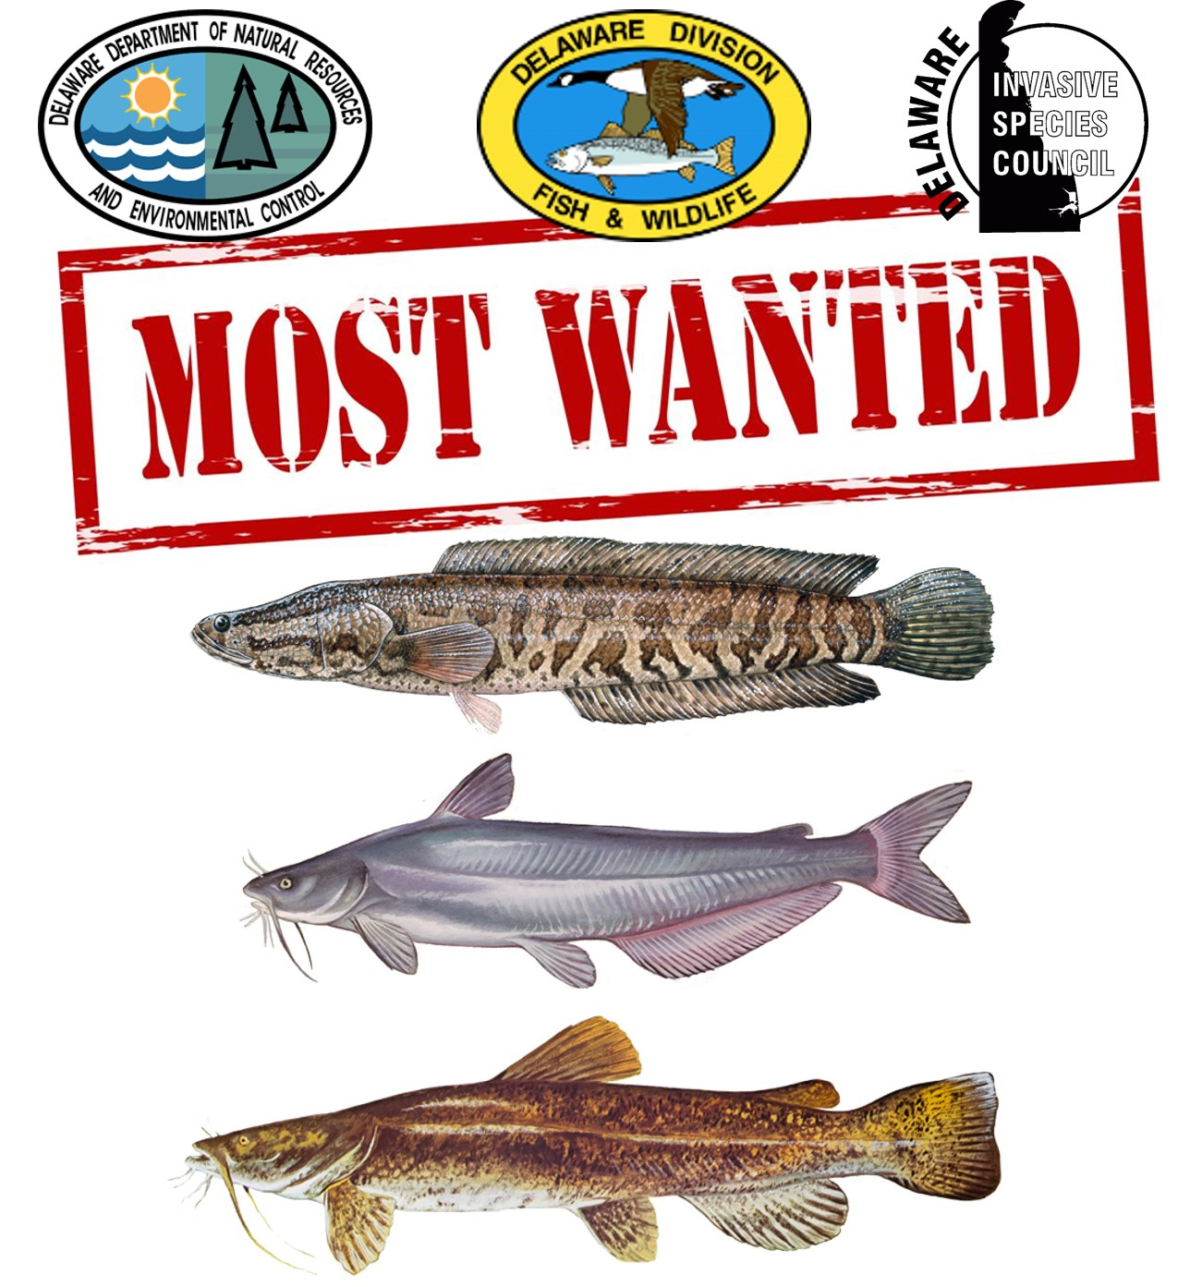
Thank You
Snake-Head Swamp (2014)
Notes:
And with that I would like to thank you and take any questions.

