Slide 1
Productivity vs. Performance in the Context of ArcGIS Server 10
Brendan Collins
MGIS Capstone Project Presentation
Advisor Prof. Frank Hardisty

Slide 2
Anatomy of the Web Map
Client Application
(Web Browser)
Spatial
Data / Operations
Mapping Server
(ArcGIS Server)
Application Server
(IIS / Apache)
Flash / JS / HTML
client-side
server-side

Slide 3
Demo Time

Slide 4
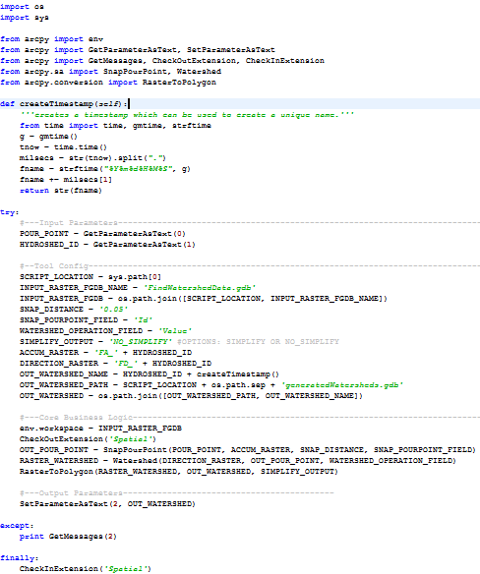
Watershed Delineation Python

Slide 5
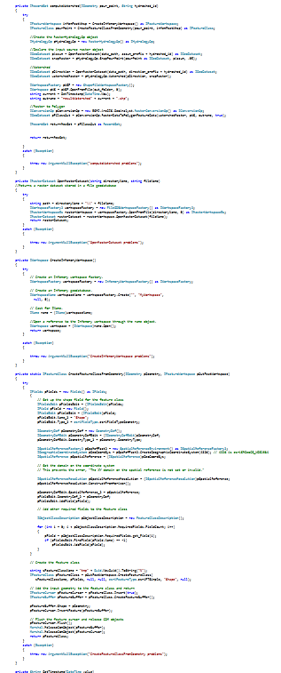
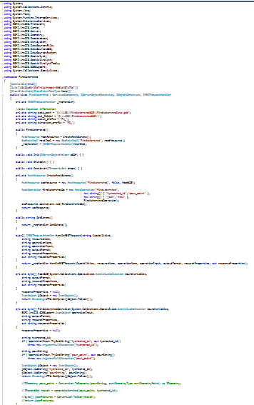
Watershed Delineation C#

Slide 6
$feasibility α \frac{1}{Latency}$
Fundamental Formulas for Developers
(triple constraint)
$$\$≠∞$$
$1day=24hrs=1440mins$

Slide 7
The Services
Raster Services
Vector Services
Server Utilities
Categorized by types of data handled in core business logic of service

Slide 8
Raster Services
Watershed Delineation
Input: Pour Point (x, y)
Computes geographic area containing water which flows into supplied point
Output: Watershed Polygon
Zonal Statistics
Input: User defined Polygon
Outputs average precipitation for each month
(12 operations in total)

Slide 9
Vector Services
Server-side point clustering
Input current extent and zoom level
Returns aggregated point locations
Data Extraction (Clip, Zip, Ship)
Input user defined extent
Outputs link for downloading extracted features

Slide 10
Server Utility Services
KML HTTP Proxy
Makes requests on behalf of client application
Necessary for sites with cross-domain restrictions
Database Connectivity
Access database through ArcGIS Server
MongoDB (non-relational document database)
Opens possibility for additional feature geometry caching, and application architecture simplification

Slide 11
Measuring Outcomes
Performance
Latency
Automated requests for repeatable testing
Reliability
Percent of successful responses
Ease of Development
Lines of Code
Qualitative account of deployment
Controlling for Bandwidth
Throttling bandwidth using Charles HTTP Proxy

Slide 12
Multi-Mechanize
Web performance and load testing framework
Open-source written in Python
Automates requests
Logs Responses
Outputs statistics including graphs

Slide 13
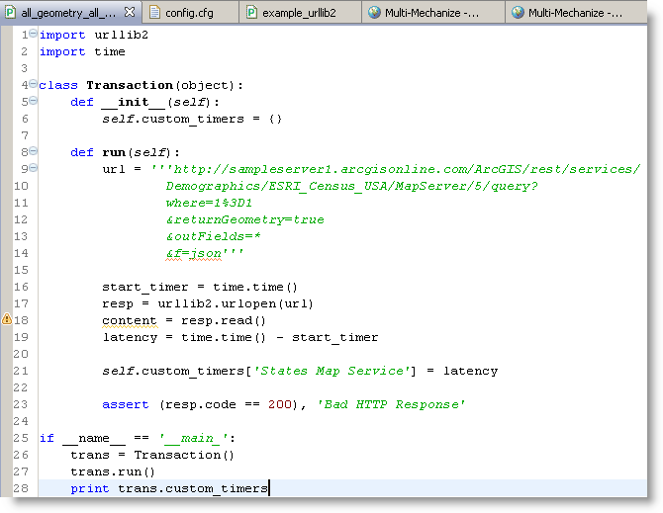

Slide 14
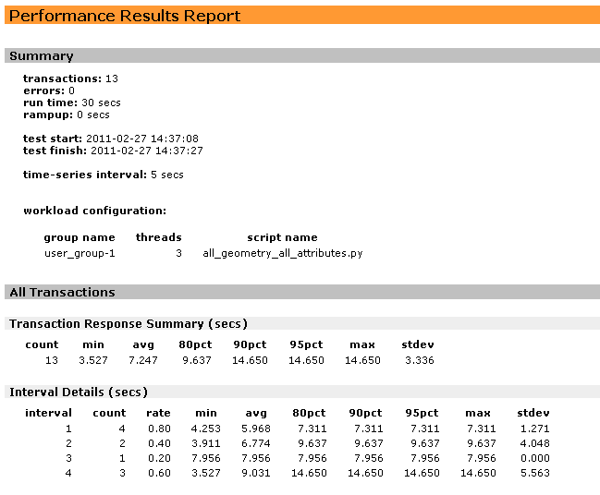

Slide 15
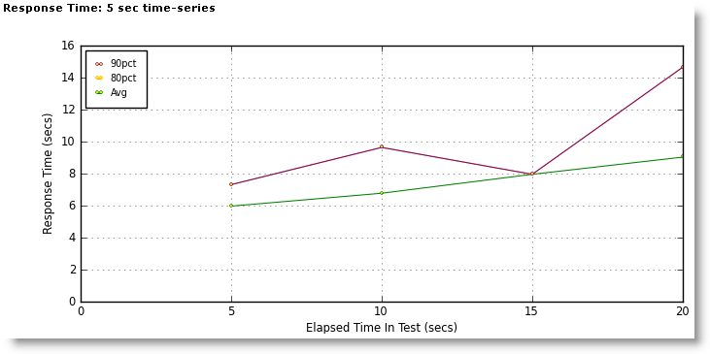

Slide 16
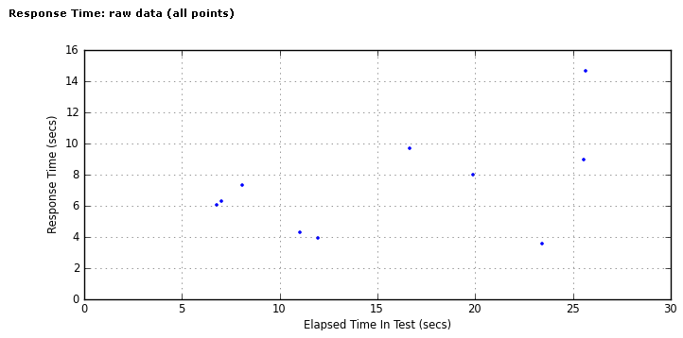

Slide 17
Conclusion
The goal is not to suggest that one language is inferior to the other.
The goal is understand when use of one tool over another is appropriate

