Slide 1
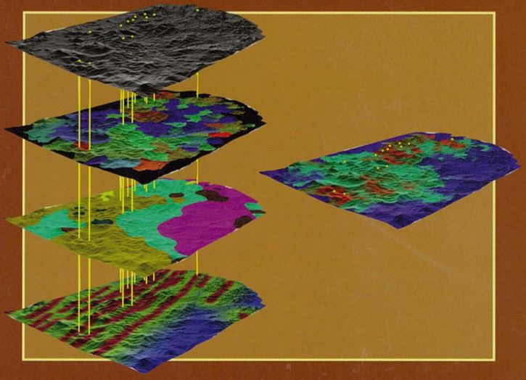
Copper Potential by Nadia Caira
Modeling
Source: Carranza (2008)
Modeling Copper Potential - Using a Desktop GIS and Esri’s Web GIS Suitability Modeler widget: An Example from the Southwest Porphyry Copper Province of the United States and México
Advisor : Ryan E. Baxter

Slide 2
Presentation Outline
Results and Conclusions
Introduction/Background
Modeling Approach
Mineral Potential Mapping (what, why?)
Overlay Analysis Tools
Model (s) Evaluation
State of
Research
Multi-Criteria
Index Overlay
Expected Outcomes
Study Area
Project Workflow
Desktop-GIS (WRO)
Limitations
Copper Model
Data-sets
Web-GIS (WRO)
Future Work

Slide 3
Stages in Mineral Exploration
Project Focus
Resource/Reserve Evaluation
Area Selection
Target Generation
Mineral sought
Regional-scale to a Local-scale
Estimation of grade and tonnage
Geological model
Geoscience data-sets integrated
Systematic drilling
Decision to mine
Permissive regions
Anomaly definition
Mineral resource classification
Knowledge of an area
Significant anomalies
Ore reserve classification

Slide 4
Why Map Copper Potential ?
Global population IS growing
Mineral consumption IS increasing (hybrid electric)
HEV’s (85 lbs Cu), PHEV’s (132 lbs Cu), BEV’s (183 lbs)
Third world countries DO rely on their mineral resources to sustain economic development
To guide mineral exploration teams, stakeholders
To enhance discoverability worldwide

Slide 5
Mineral Potential Mapping Scenario
Mineral Deposits
Remote Sensing
Geochem
Gravity
Magnetics
Mineral Potential Map
Structure
Integration of features
Multi-source data-sets
Choose predictive criteria
Weight predictive criteria
Combine data-driven or knowledge-driven approach
Input data-sets
Source: Google maps

Slide 6
Mineral Potential GIS Layer Input
Prospective
Mineral deposit location (point)
Lithology distribution (polygon)
Structural features (polyline)
(d) Copper element anomalies (polygon)
(e) Pathfinder element anomaly (polygon)
(f) Hydrothermal alteration (polygon)
(g) Aeromagnetic-inferred structures (polyline)
(h) Aeromagnetic anomaly (polygon)
(i) Mineral potential map
(Li et al., 2018)
New exploration targets

Slide 7
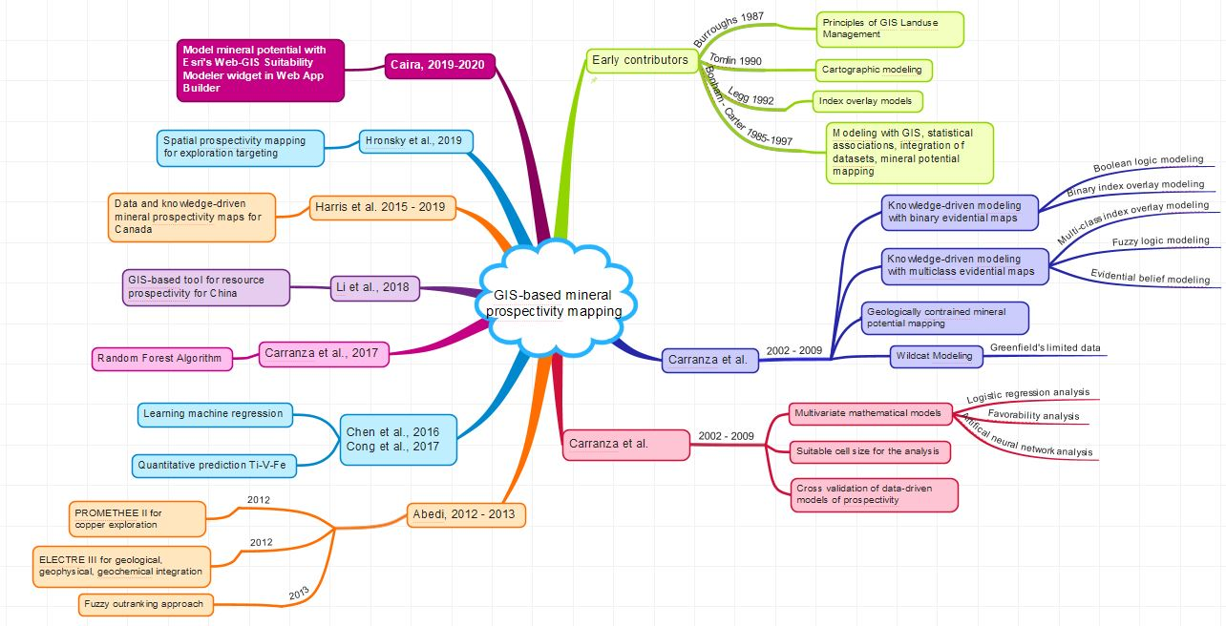
State of Mineral Potential Mapping

Slide 8
What is a Porphyry Copper Model ?
Most sought-after-target
Found along subduction zones
SW. USA-N. Mex, Chile-Peru
Copper found in porphyry belts
Density fifteen per 100,000 km²
At unique fault intersections
Porphyry magma rises (6 km)
Erosion level in study area
Source: Sillitoe, 2010

Slide 9
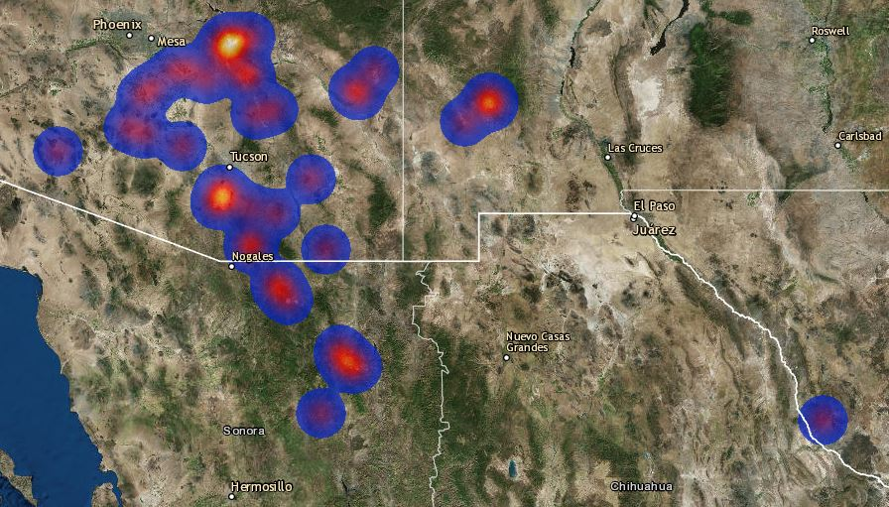
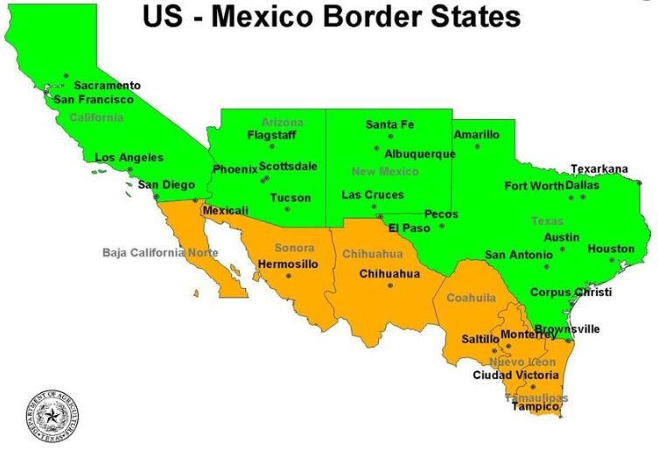
The Study Area (1 million square km)
Source: Esri’s Web AppBuilder (imported zipped shapefile of world copper deposits USGS)

Slide 10
Project Workflow
Define Project
Project Definition
Define the Problem
Data Management
Selection
DB Import
Desktop-GIS
WRO tool
Model Design
Model
Evaluation(s)
User Interface Design/Build
Implement Model (WRO)
Curation
Clean-up
Content, Method, Expected Results
Assess
Trial + Error
Re-calibrate
Re-run model
Re-calibrate
Re-run model
Final Presentation
Configure Widgets (SMW)
Implement Model (WRO)
Web-GIS
Build App
Evaluation
Field visit
(subset study)
Web App Use-case scenario

Slide 11
Data Modeling Techniques
Bivariate, Multivariate, Deduction, Predictive, Deduction, Deterministic, Empirical, Heuristic, Mathematical, Mechanistic, Probabilistic, Qualitative, Quantitative, Statistical, Theoretical, and as well as
Data-driven and Knowledge-driven

Slide 12
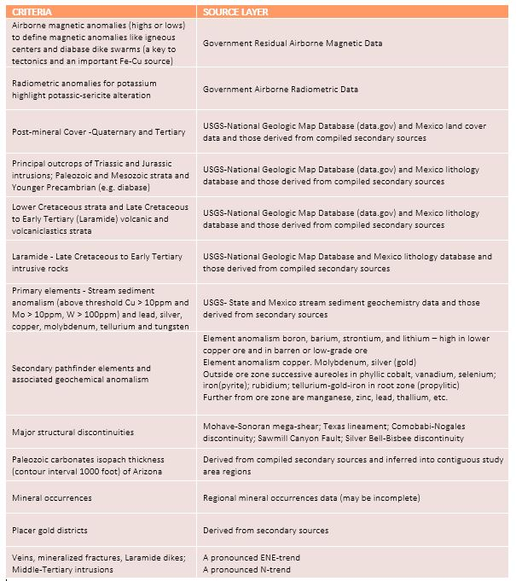
Data Integration
Data extent
Spatial resolution
Quality and accuracy
Temporal resolution
Privacy

Slide 13
Model Environment - A Desktop GIS
Access to many spatial analyst tool-sets
Create complex analytical models
Data-driven tools: deep learning, training data, random tree classifier, max likelihood
Knowledge-driven tools: interpolation, overlay
What are the Overlay Analysis tools ?

Slide 14
Overlay Analysis Tools Desktop GIS
Multi-criteria spatial modeling problem solving
Fuzzy membership (math), binary (scale 0-1)
Fuzzy raster overlay tool (combine FMR)
Weighted raster sum tool (no evaluation scale)
Weighted raster overlay tool (reclass to a common evaluation scale) for a rated output

Slide 15
Model Environment- Build Web GIS app
Extends reach desktop-GIS in shareability (apps)
Web AppBuilder, build apps, no programming
Access information, lower cost, no expertise
Cross platforms (desktop and mobile browsers)
Create your app to suit your model need
Configurable widgets in a designer platform
+30 ready widgets, new are downloadable (e.g. Suitability Modeler widget WRO)

Slide 16
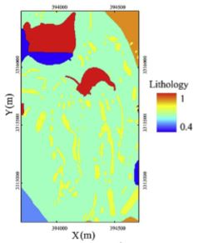
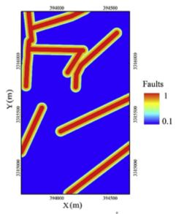
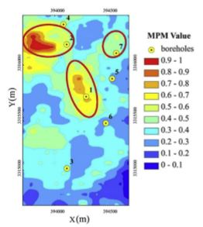
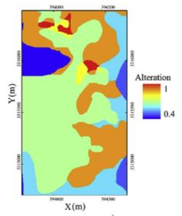
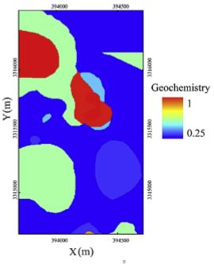
Weighted Raster Overlay Desktop-GIS
Define model criteria
Define ranges/values
Use ‘No-Data’ scale value
Reclassify raster cell values
Use common scale (1 to 10)
10 is 2x as prospective as 5
Weight (%) by importance
Input criteria * weights are added together
MODEL VALIDATION
Rated Cu prospectivity map
using a common prospectivity scale
Source: Abedi et al.,2017

Slide 17
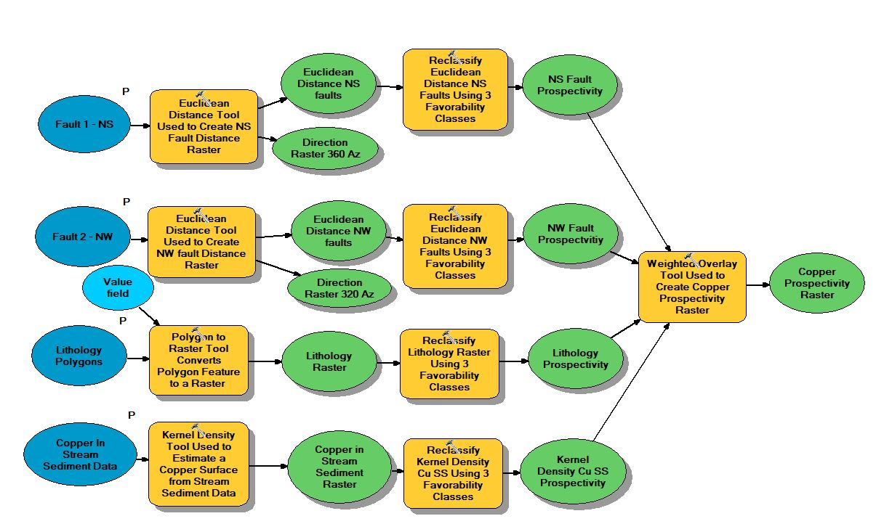
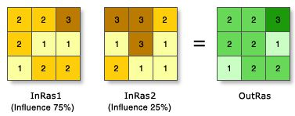
Copper Prospectivity Inputs
Processing Tools
Raster Outputs
Reclassified Evaluation Scale
Raster Inputs for WRO
Weighted Overlay Model
Source: Esri, ArcGIS
Weighted by importance
Single rated output map
Source: Caira, GEOG586

Slide 18
Web-App Key Requirements
User interface design (intuitive, easy to use)
Stores and manages data in spatial database
Accommodate variety of data types/formats
Access to variety of linked visualization tools
Color consideration for visualizations
Adjust cell values + weight % (SMW)
Web Browser and display settings support
Supports a variety of configurable widgets

Slide 19
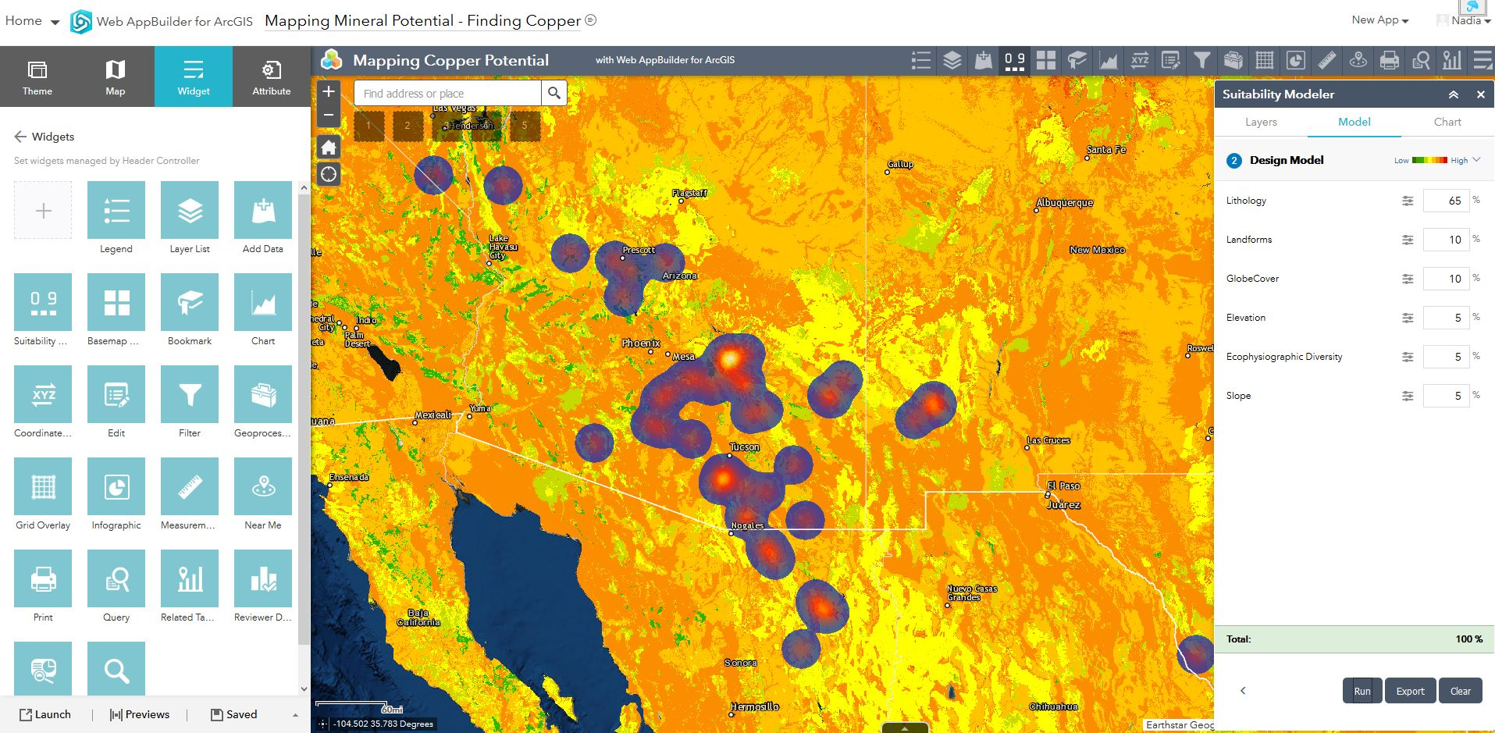
Rendered Mineral Potential Model
Types of widgets

Slide 20
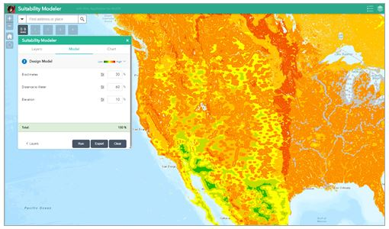
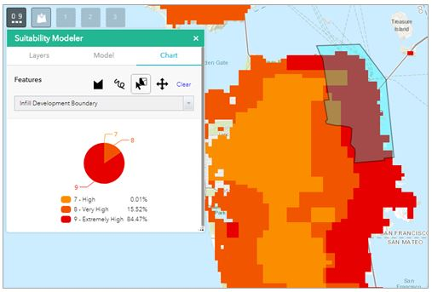
A Successful SMW-WRO Model
Uses a weighted raster overlay
Three layers in this model
Assign a weight (%) by importance
Use chart widget to analyze an attribute
Red to green according to suitability

Slide 21
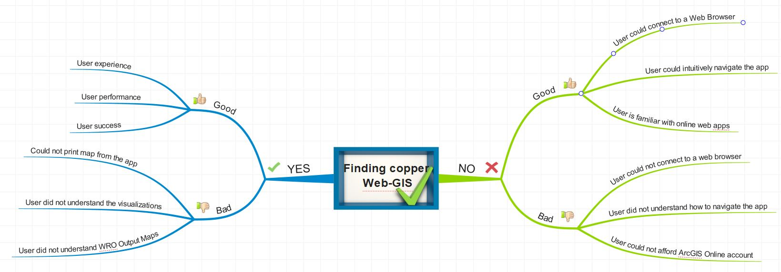
Use-Case Scenario Web App Tool

Slide 22
Desktop-GIS vs Web-GIS
Desktop-GIS
NEW targets identified, new information extraction
AREA calculation of new copper prospectivity tracts
ACCURACY of new copper targets (field visit or other)
Web-GIS
NEW targets identified, new information extracted
AREA of new copper prospectivity tracts
ACCURACY of new copper targets (field visit or other)

Slide 23
Expected Results in a Desktop-GIS
Advantages
Access to many other spatial analysis tools as check
Easier to adjust the model
Can accommodate more data types/formats
Disadvantages
Limited map shareability
GIS expertise required
More time consuming
FUTURE-test with Fuzzy Logic or Weighted SUM method

Slide 24
Expected Results - Web App
Advantages
Global reach and shareability web apps and maps
Better cross-platform capability, flexibility
Ready maps, layers, analytics
Disadvantages
Single analysis method (WRO)
Limited data types and formats
Web Browser access required
FUTURE-build a tool for Copper Potential Mapping

Slide 25
Project Workflow Timeline (2019)
Project Management
Project Definition
Define the Problem
Data Management
Selection
DB Import
Desktop-GIS
WRO tool
Model Design
Model
Evaluation(s)
User Interface Design/Build
Implement Model (WRO)
Curation
Clean-up
Content, Method, Expected Results
Assess
Trial + Error
Re-calibrate
Re-run model
Re-calibrate
Re-run model
Final Presentation
Configure Widgets
Implement Model (WRO)
Web-GIS
Build App
Evaluation-Success?
Field visit
(subset study)
Web App Use-case scenario
Completed
June -July
July-August
September
October

Slide 26
Abstract Submittals - Fall 2019
Esri’s User’s GIS Conf.
Ottawa, ON
October
16th, 2019
Esri’s User’s GIS Conf.
Vancouver
October
22nd, 2019
Thank you!
Questions?
Esri’s User’s GIS Conf.
Regina, SK
November 14th, 2019
Esri’s User’s GIS Conf.
Halifax, NS
November
5th, 2019

