Slide 1
GIS Enabled Resource Estimation for Obstacle Effects Planning
Meredith Caram GEOG 596A

Slide 2
Agenda
Introduction
Background
Literature Review
Methodology
Anticipated Challenges
Anticipated Results
Anticipated Timeline
References
Questions

Slide 3
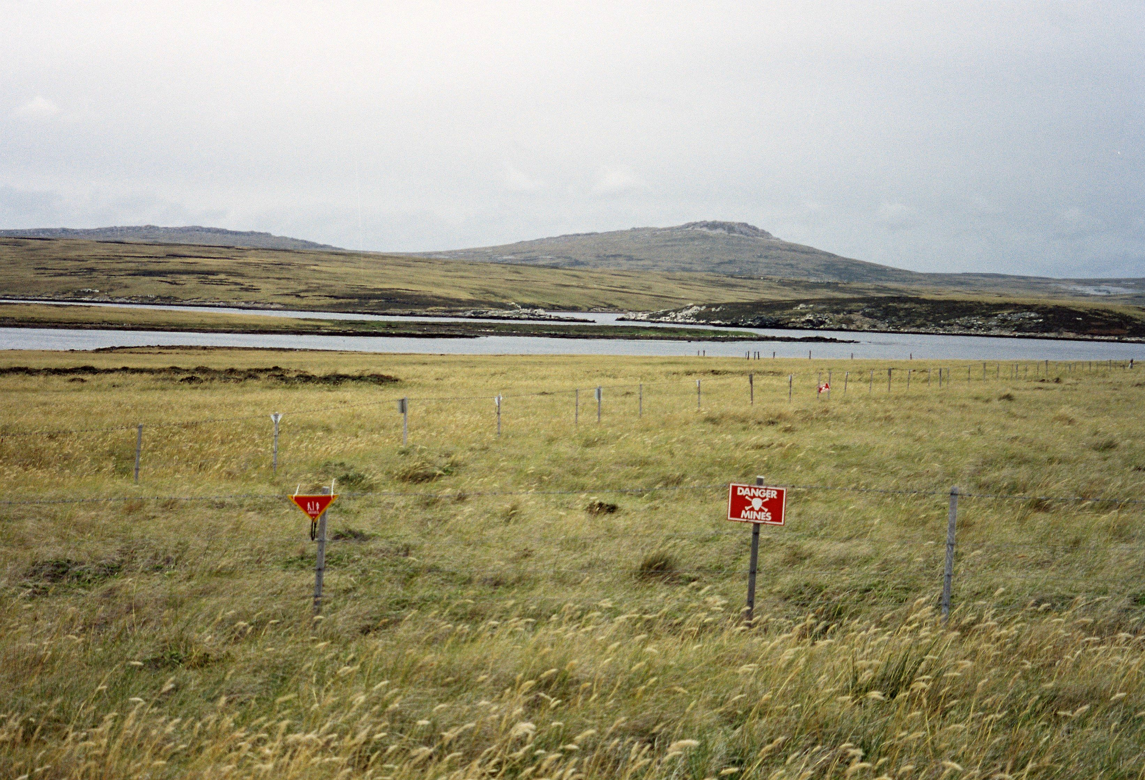
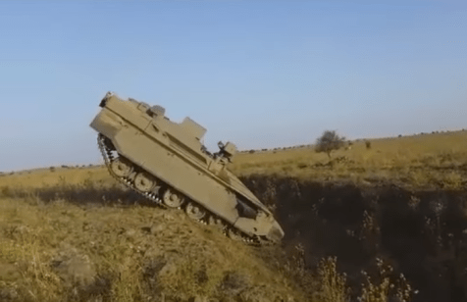
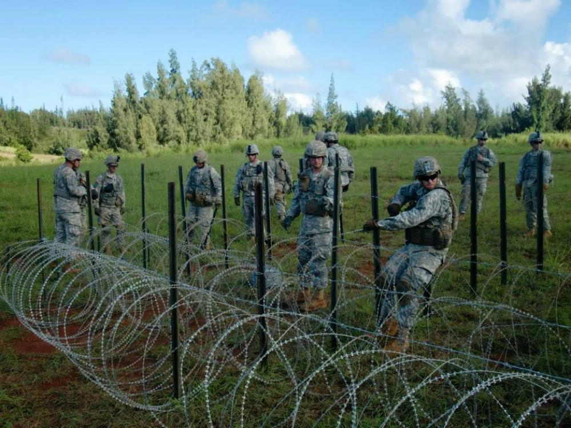
Introduction
This project will hone in on the obstacle estimation process and translate those analog functions into a geographic information system (GIS) environment to increase efficiency in obstacle planning as well as deliver digital products in a more interoperable format.

Slide 4
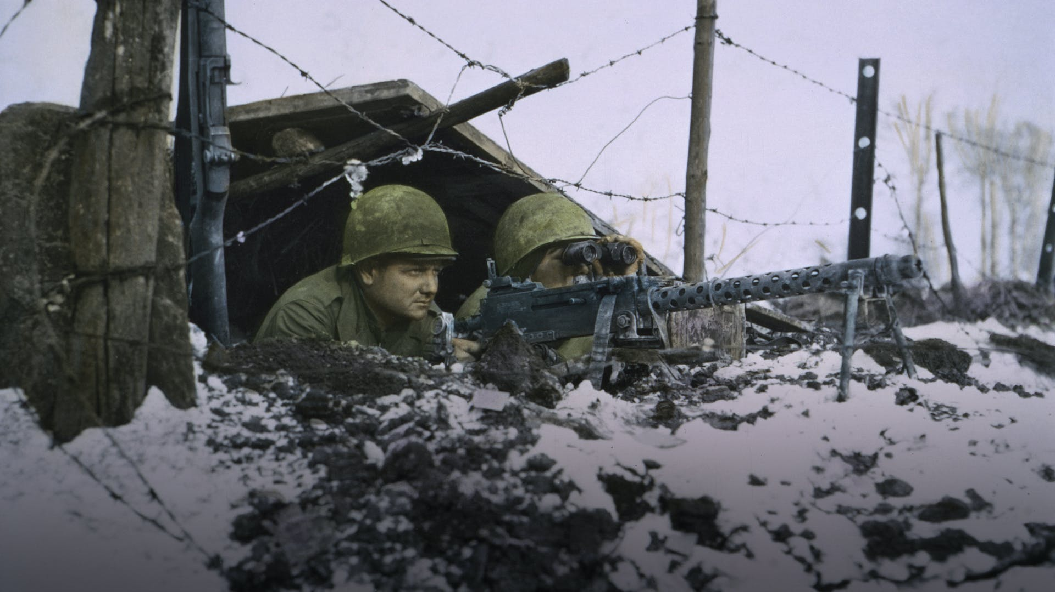
Background
Engineer obstacle efforts during the Battle of the Bulge in WWII were essential in stalling the advance of the German counter offensive. Without the dogged efforts of American engineers and their extensive use of defensive obstacles like road blocks, ditches, and minefields, the Germans might have penetrated into the Allied logistical zone. Without access to supplies, many would have been forced to surrender.

Slide 5
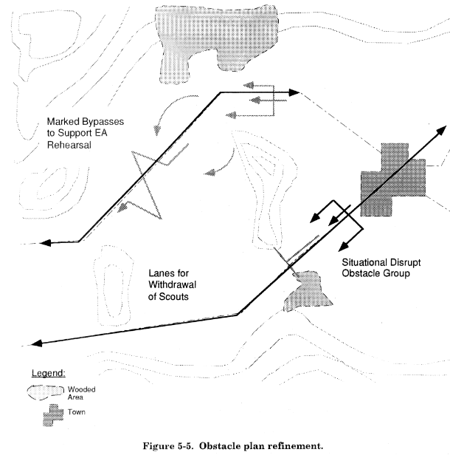
Background
Obstacle effects planning for defensive operation is typically carried out via an analog process.
GIS capabilities exist in the formation.
Analog processes are time intensive and can be made more efficient by leveraging the GIS to aid in the obstacle planning process.

Slide 6
Literature Review
Guiding Questions:
Who are the targeted end-user that will find the deliverable most useful?
What are the parameters required to ensure that the information generated by the tool is accurate?
How can the tool be best developed to ensure that the end-user is both able and incentivized to use the tool?

Slide 7
Literature Review
Who are the targeted end-user that will find the deliverable most useful?
The Assistant Brigade Engineer (ABE)
Geospatial Engineers

Slide 8
Literature Review
What are the parameters required to ensure that the information generated by the tool is accurate?
Doctrinal Heuristics
Accepted Standard Operating Procedures

Slide 9
Literature Review
How can the tool be best developed to ensure that the end-user is both able and incentivized to use the tool?
Scenario-based Design
Card Sorting/Sketching
Prototyping

Slide 10
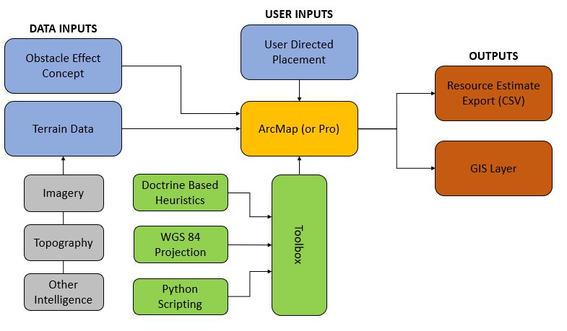
Methodology

Slide 11
Methodology
Initial Design
Collaberative development with select end-users
Engineer Officer
Senior Geospatial Technicians
Geospatial Instructors
Scenario-based Narrative
Gain feedback from end-users
End-user Sketches/Card Sorting Exercises
How do end-users envision using the tool?
What similarities are there?

Slide 12
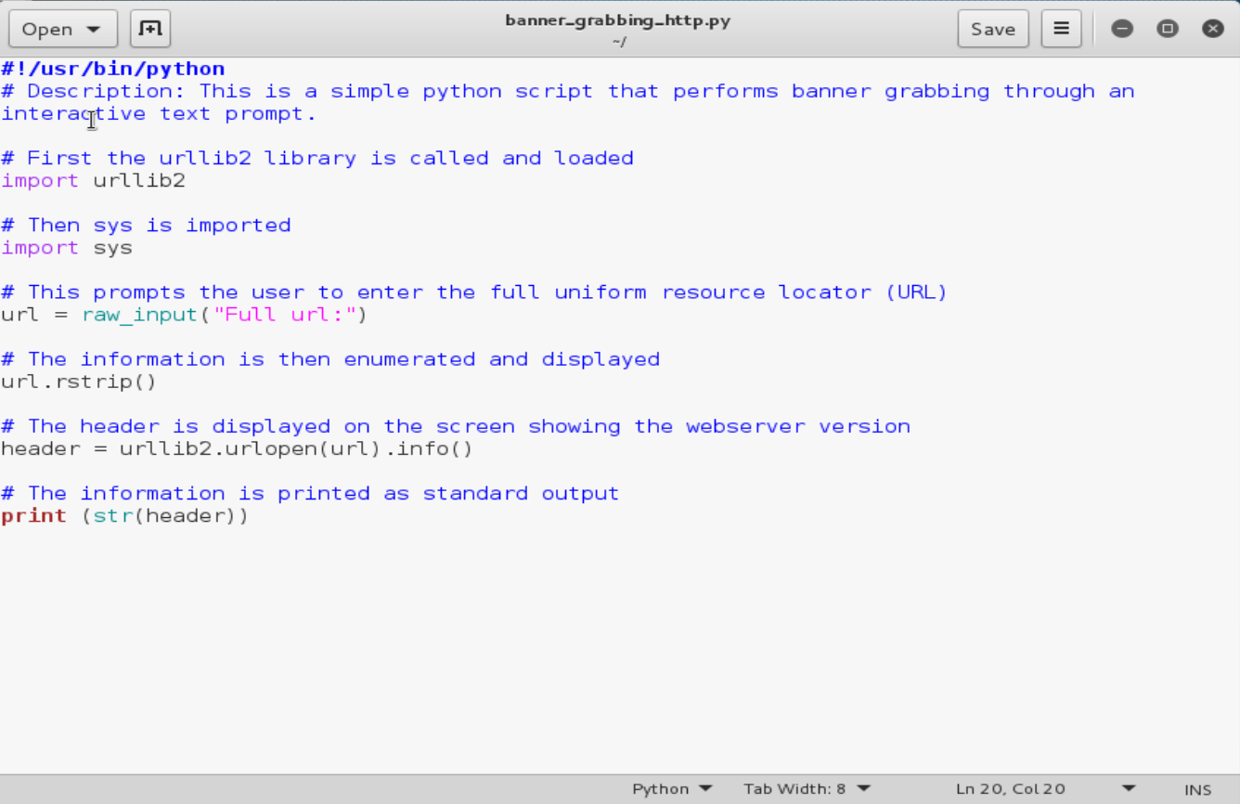
Methodology
Constructing Digital Prototype
Python scripting
ArcGIS compatible toolbox
Incorporate Heuristics
Doctrinal Army graphics

Slide 13
Methodology
Additional Testing
User feedback
Broader Test Group
Less-experienced end-users
Simplicity
Possible integration beyond of tools into existing systems

Slide 14
Anticipated Challenges
More thought must be given on the manner in which user feedback will be captured and weighted to generate an application with broad appeal.
The nature of the iterative process with collaboration amongst several end-users means that scope creep is a distinct possibility.
Given the nature of administrative rights in Army networks, there may be some difficulty in identifying test users that are able to run the toolbox without first gaining approval. The potential for versioning conflicts or differences in licensing are also pitfalls that may arise.

Slide 15
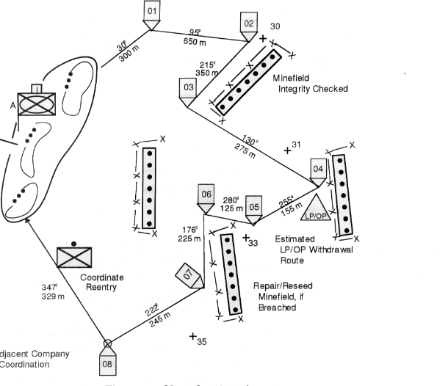
Anticipated Results
The toolbox will read areal parameters of user placed polygons and return a filled obstacle resource requirement worksheet in a tabular CSV format. The user will be able to share the output across staff sections to enable enhanced coordination and planning. The tool should be made operationally viable by its simplicity, requiring minimal training to be able to operate effectively while also integrating seamlessly with existing terrain analysis and other GIS planning tools already in use at the staff level.

Slide 16
Anticipated Results

Slide 17
References
Ahmad, B., & Kharal, A. (2009). Fuzzy Sets, Fuzzy S-Open and S-Closed Mappings. Advances in Fuzzy Systems, 9, 1-5.
Dobesova, Z. (2012). Visual Programming for Novice Programmers in Geoinformatics. In 12th International Multidisciplinary Scientific GeoConference (Vol. 3, pp. 433-440). Sofia, Bulgaria: STEF92 Technology.
Gori, R., Chen, P., & Pozgay, A. (2004). Model-Based Military Scenario Management for Defence Capability. Canberra, Australia: Department of Defence Air Force Office.
Lloyd, D., Dykes, J., & Radburn, R. (2008). Mediating geovisualization to potential users and prototyping a geovisualization application. School of Informatics, City University, Northampton, London.
Rosson, M., & Carroll, J. M. (2002). Scenario-Based Design. In Human-Computer Interaction Handbook: Fundamentals, Evolving Technologies and Emerging Applications (pp. 1032-1050). Lawrence Erlbaum Associates.
United States Department of the Army. (2014). ATP 3-90.8 Combined Arms Countermobility Operations. Fort Eustice, VA: Army Publishing Directorate.

Slide 18
Questions?

