Slide 1
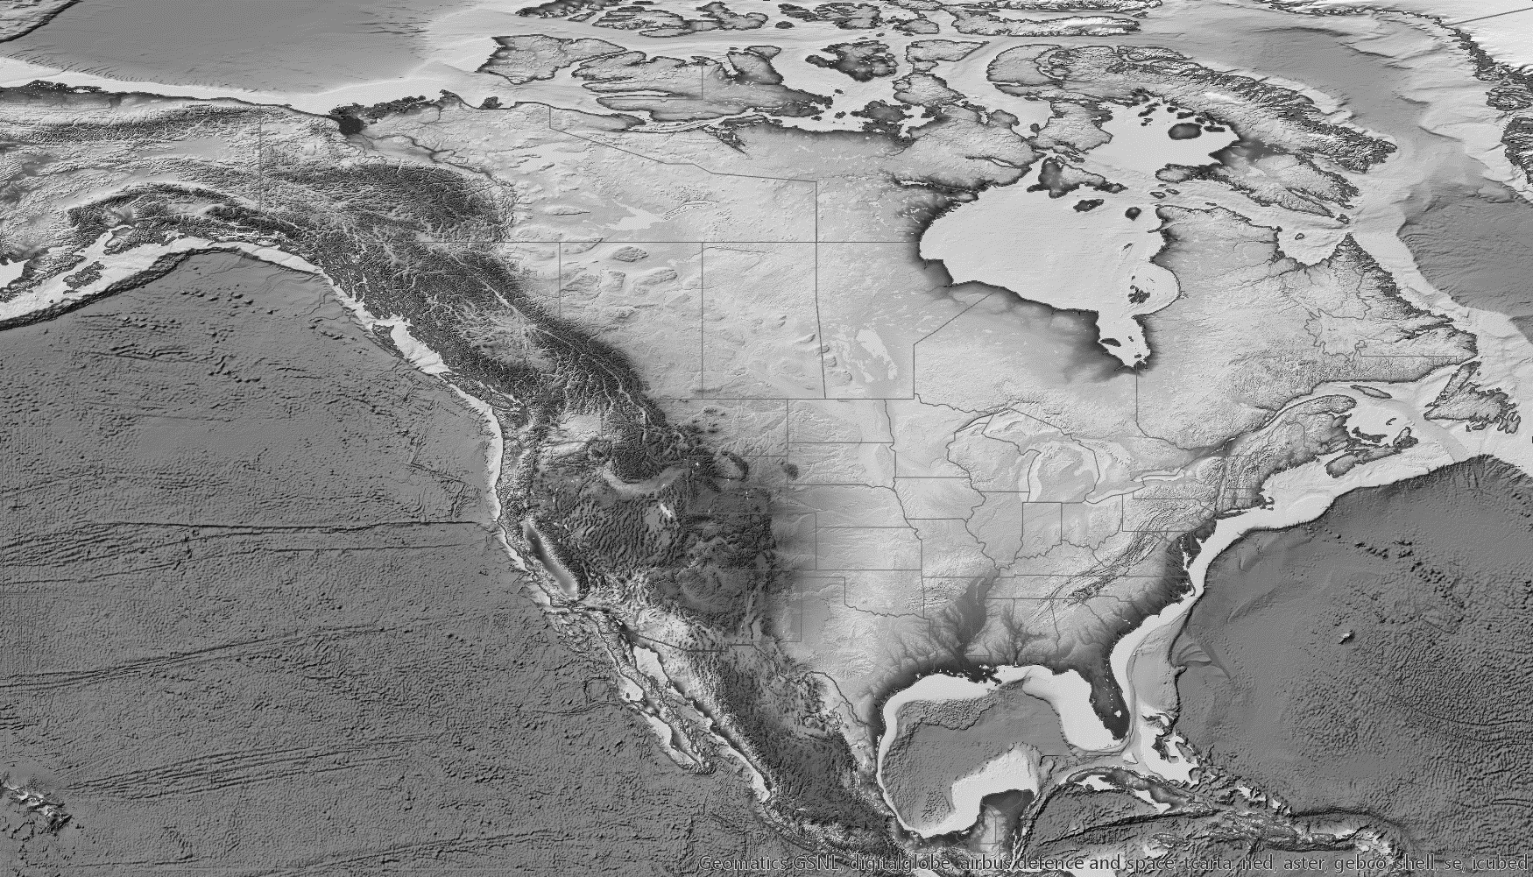
A Comparative Analysis On Spatial Interpolation Methods and Data Resolution For an Accurate Representation of Earth’s Topography
Monica Casso
GEOG596A, Fall 2019

Slide 2
Analytic Question
What is the impact of the different interpolation methods with respect to getting an accurate representation of the Earth’s topography? How much spatial resolution is truly needed to increase that accuracy?

Slide 3
Outline
Background
Topography
What is Interpolation?
Methodologies Available
Data Resolution
Why is it important?
Methodology
Site Selection
Data Preparation
Data Evaluation
Anticipated Results
Timeline
Proposed Schedule
Proposed Venue
Q&A

Slide 4
Background
Topography
Topography is a map that gives information about the Earth Surface, the information being elevation data.
The surface is known to be irregular, representing geologic features such as hills and valleys.

Slide 5
Background
Topography – why is it important?
Topography is used for a variety of development applications such as:
Pipeline route planning
Transportation network planning (Highways and minor roads)
Industrial site planning
Planning communications facilities

Slide 6
Background
Topography – why is it important?
It has an implication on:
Economics (more difficult terrains, irregularity can increase the costs)
Feasibility:
Communications facilities site selection require unobstructed locations to be able to transmit and receive signals.
Site selection feasibility for development may change depending on the terrain. Correct mapping of hazards such as flood zones or areas prone to Earthquake due to faulting.

Slide 7
Background
Data Resolution
It would be very costly and time consuming to get sample points at every location of an area of interest to get a precise topographic representation.
To avoid the high costs and times delays in data acquisition, the data resolution is then compromised and a framework of sample points that controls density and its spacing need to be established.
The points in between must then be interpolated to produce a representation of the topography.

Slide 8
Background
Interpolation
The process in which an estimate is made between a given set of point values to fill the gaps in between. There are multiple interpolation methods available. Some of the common methods offered by Esri are Inverse Distance Weighted, Kriging, and Spline.
These methodologies produce different output products that may or may not get you an accurate representation of topography.
From Esri’s ArcUser July-September 2004

Slide 9
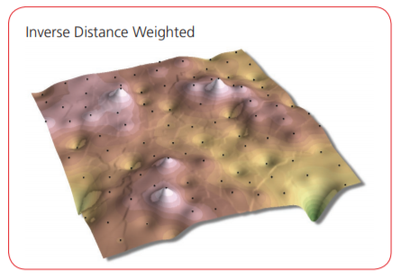
Background
Interpolation
Inverse Distance Weighted (IDW)
Esri’s IDW interpolation uses a linear-weighted approach to determine cell values. The weight is a function of a sample point location where the further away the point, the less influence it has on the interpolated output value.
From Esri’s ArcUser July-September 2004

Slide 10
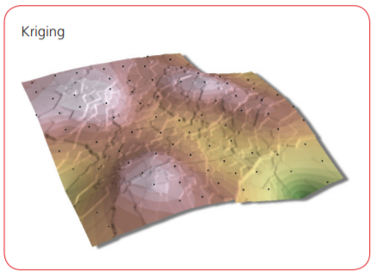
Background
Interpolation
Kriging
Esri defines it’s kriging interpolation to assume that “distance or direction between sample points reflects a spatial correlation that can be used to explain variation in the surface”.
It is ideal for use in areas where there is a
spatial correlation over distance or
directional bias.
From Esri’s ArcUser July-September 2004

Slide 11
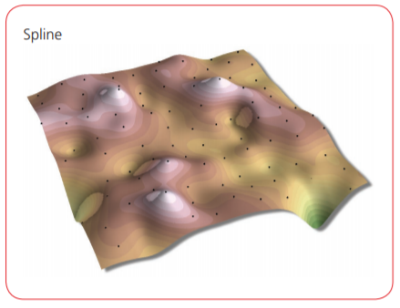
Background
Interpolation
Spline
Esri’s spline interpolation, “estimates values using a mathematical function that minimize overall surface curvature”.
This method instead of making sharp edges at truncations will try and smooth the transition.
From Esri’s ArcUser July-September 2004

Slide 12
Background
Interpolation & Data Resolution
These two factors go hand in hand when trying to achieve an accurate representation of topography from a limited set of data points.
The best chance at achieving accuracy is a thorough understanding of the area you are sampling is needed. This analysis will attempt to prove or disprove this statement.
From Esri’s ArcUser July-September 2004

Slide 13
Methodology
Site Selection
Because the Earth’s topography varies from geologic settings. One interpolation likely does not fit all. To test how well or how poorly the interpolation methods work, we will test three different terrain types.

Slide 14
Methodology
Site Selection – Terrain types Criteria
Flat Terrain
Little to no changes in amounts of variation in elevation changes
Channelized Terrain
Gradual changes in amounts of variation in elevation changes
Mountainous Terrain
Rapid changes in amounts of variation in elevation changes

Slide 15
Methodology
Site Selection – Dataset Criteria:
Must be publicly available data
Must cover terrain selection types
Must have a potential for use if not already in use
Must be available in latest High Resolution USGS standards 1-meter

Slide 16
Methodology
Dataset | Description of Dataset
1-meter DEM itation: Citation_Information: Originator: U.S. Geological Survey Publication_Date: 20181018 Title: USGS NED one meter x73y438 CO Central Western 2016 IMG 2018 Geospatial_Data_Presentation_Form: raster digital data Publication_Information: Publication_Place: Reston, VA Publisher: U.S. Geological Survey Online_Linkage: http://nationalmap.gov/elevation.html Online_Linkage: http://nationalmap.gov/viewer.html | AOI Garflied Colorado Spatial_Reference_Information: Horizontal_Coordinate_System_Definition: Planar: Grid_Coordinate_System_Name: Transverse_Mercator Universal_Transverse_Mercator: UTM_Zone_Number: 30 Transverse_Mercator: Scale_Factor_at_Central_Meridian: 0.9996 Longitude_of_Central_Meridian: 0.0 Latitude_of_Projection_Origin: 0.0 False_Easting: 500000.0 False_Northing: 0.0
1-meter DEM Citation: Citation_Information: Originator: U.S. Geological Survey Publication_Date: 20190816 Title: USGS NED one meter x78y332 LA UpperDeltaPlain 2017 IMG 2019 Geospatial_Data_Presentation_Form: raster digital data Publication_Information: Publication_Place: Reston, VA Publisher: U.S. Geological Survey Online_Linkage: http://nationalmap.gov/elevation.html Online_Linkage: http://nationalmap.gov/viewer.html | AOI Mississippi River Over Plaquemine, White Castle, Carville, St. Gabriel Spatial_Reference_Information: Horizontal_Coordinate_System_Definition: Planar: Grid_Coordinate_System_Name: Transverse_Mercator Universal_Transverse_Mercator: UTM_Zone_Number: 30 Transverse_Mercator: Scale_Factor_at_Central_Meridian: 0.9996 Longitude_of_Central_Meridian: 0.0 Latitude_of_Projection_Origin: 0.0 False_Easting: 500000.0 False_Northing: 0.0
1-meter DEM Citation: Citation_Information: Originator: U.S. Geological Survey Publication_Date: 20191018 Title: USGS NED one meter x23y353 TX West Central B7 2018 IMG 2019 Geospatial_Data_Presentation_Form: raster digital data Publication_Information: Publication_Place: Reston, VA Publisher: U.S. Geological Survey Online_Linkage: http://nationalmap.gov/elevation.html Online_Linkage: http://nationalmap.gov/viewer.html | AOI West Texas (Near Midland and Odessa) Spatial_Reference_Information: Horizontal_Coordinate_System_Definition: Planar: Grid_Coordinate_System_Name: Transverse_Mercator Universal_Transverse_Mercator: UTM_Zone_Number: 30 Transverse_Mercator: Scale_Factor_at_Central_Meridian: 0.9996 Longitude_of_Central_Meridian: 0.0 Latitude_of_Projection_Origin: 0.0 False_Easting: 500000.0 False_Northing: 0.0
Site Selection –
Datasets Selected

Slide 17
Methodology
Data Preparation
In order to perform an accuracy assessment/comparison a ground truth dataset is needed.
The ground truth dataset will be a Digital Elevation Model (DEM) retrieved from the USGS database, one for each of the three terrain types.

Slide 18
Methodology
Data Preparation
The ground truth DEMs will be down sampled to three different resolutions to test how data resolution affects your end product of interpolation.

Slide 19
Methodology
Data Preparation- Data Resolution spacing
According to the USGS, high-resolution data is considered between
1 to 5 – meter spacing.
Two spatial resolutions tests will be ran at the high resolution spacing:
1x1m
5x5m
And the other at slightly less than high resolution:
7x7m

Slide 20
Methodology
Data Preparation- Data Resolution spacing
Why test at slightly less than high resolution?
This will give an indication if a company would need to splurge for a higher confidence dataset in their area of interest or whether they can have some potential savings in selecting a larger spatial resolution spacing.

Slide 21
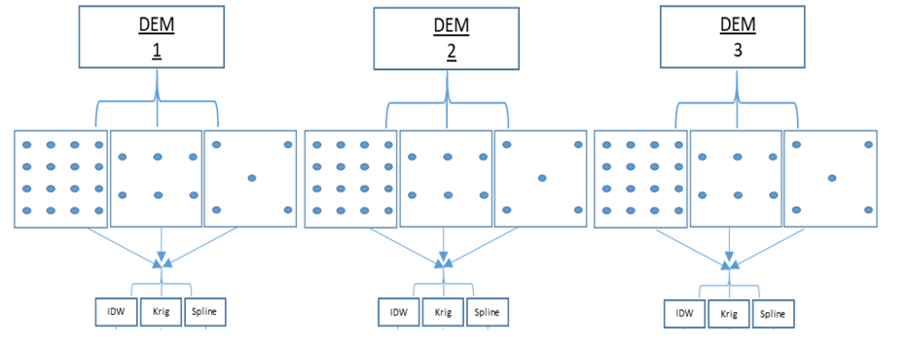
Methodology
Data Preparation
These down sampled datasets will then be interpolated using IDW, Kriging, and Spline in ArcGIS Pro.

Slide 22
Methodology
Data Evaluation
The resulting DEMs will then be compared back to the original DEM by use of difference map and scatter plot analysis.
The difference map should give a visual idea of where spatially the interpolation methods struggle.
As for the scatter plot, each DEM dataset Z values will be compared by predicted vs. expected values. A one to one correlation would indicate an exact match/a perfect interpolation.

Slide 23
Anticipated Results
It is expected that the point sets interpolated with higher resolution will result in a closer match to the original input as there are more data to keep fidelity to.
More points would be less likely to produce an artificial bullseye effect that would be more commonly seen in more sparse datasets.
As for data interpolation, kriging tends to be a commonly used method when it comes to geology as spatially correlated distances/ directional bias are often a key player in this discipline.

Slide 24
Proposed Timeline
October 2nd – November 26th | November 26th – Jan 22nd | Jan 23rd – Feb 5th | Feb 6th – Feb 12th | Feb 12th – 21st
Develop Project Idea/ Literature Review/ Methodology Selection/ Anticipated Results | Data Selection/ Preparation/ Processing | Data Analysis/ Evaluation | Final Write-Up/ Report Out | Final Poster Updates

Slide 25
Proposed Venue
Possible presentation venue
Proposed Location: American Association of Geographers Annual Meeting 2020
Type: Poster Session
Possible Dates: April 6th-10th, 2020

Slide 26
References
P. V. Arun (2013) A terrain-based hybrid approach towards DEM interpolation, Annals of GIS, 19:4, 245-252, DOI: 10.1080/19475683.2013.843590
USGS. What Are Digital Elevation Models (DEMs)?, www.usgs.gov/faqs/what-are-digital-elevation-models-dems.
U.S. Government Printing Office (1980). Topographic maps: Tools for planning. [online] Washington, D.C.: USGS Publications Warehouse. Available at: http://pubs.er.usgs.gov/publication/70039402.
Florinsky, Igor V. “Digital Elevation Models.” Digital Elevation Models - an Overview | ScienceDirect Topics, 2012, www.sciencedirect.com/topics/earth-and-planetary-sciences/digital-elevation-models.
Samantha T Arundel, Christy-AnnMArchuleta, Lori A Phillips, Brittany L Roche, and Eric W Constance. 2015. 1-Meter Digital Elevation Model specification. Technical Report. US Geological Survey.
Childs, Colin. 2004. “Interpolating Surfaces in ArcGIS Spatial Analyst.” ArcUser. Redlands, CA: ESRI Press.

Slide 27
Q&A

