Slide 1
Applying Statistical Analysis on Geospatial Natural Hazard Raster Data
Jason Catelli
MGIS Candidate
GEOG 596A
Dr. Patrick Kennelly – Advisor
May 8, 2014

Slide 2
Presentation Overview
Background
General
Data
Project
Statistics
What has been done?
Objective
Methodology
Timeline
Future Adaptations

Slide 3
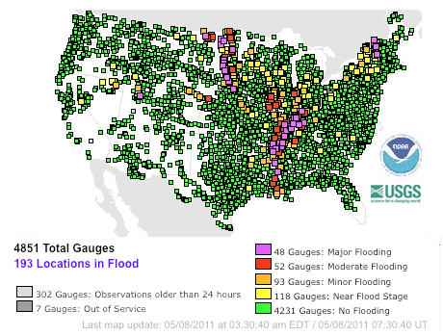
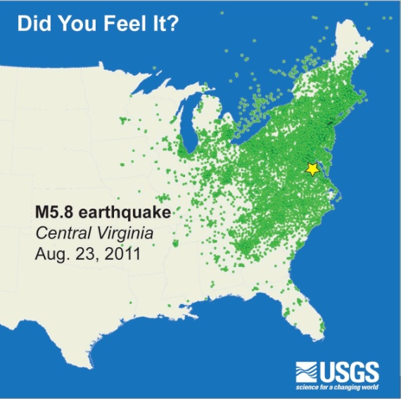
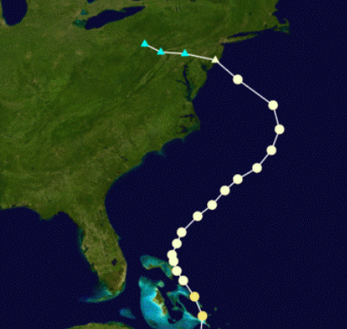
Background: General
2011 Lower Mississippi River Flooding
Arkansas, Illinois, Kentucky, Louisiana, Mississippi, Missouri, and Tennessee
21,000 homes and businesses impacted
Damaged many levee systems
~ $3 Billion in damages
2011 Virginia Earthquake
5.8 Magnitude
Felt across the East Coast
Largest east of the Rockies since 1897
2012 Superstorm Sandy
Westward “Right-turn” path
Lowest barometric pressure ever recorded for an Atlantic storm to make landfall north of Cape Hatteras, NC (940mb)
Extreme storm surge
13.88 feet at Battery Park in NYC
32.5 foot wave measured by buoy in New York Harbor

Slide 4
Background: General
Return periods or recurrence intervals
The % chance of exceeding a certain threshold over 1 year
100-yr flood event is a 1 in 100 chance or 1% chance over 1 year
500-yr magnitude earthquake is a 1 in 500 chance or 0.2% chance over 1 year
1000-yr storm surge flooding refers to 1 in 1000 chance or 0.1% chance over 1 year
How are these numbers used?
Insurance companies and public entities use return periods to understand the risk and prepare for catastrophic extremes
Policies and pricing can be set based on the chance of events with respect to a geographic region
Catastrophe models simulate events and can produce return periods based on historical and simulated results
Protection structures are built to heights based on values of a particular return period

Slide 5
Background: General
So how rare were these events?
2011 Lower Mississippi River Flooding
~75-200-yr event (AIR Worldwide, 2011)
2011 Virginia Earthquake
1000-1300-yr event (Chapman, 2012)
2012 Superstorm Sandy
Westward “Right-turn” path (Hall, 2013)
700-yr event
Extreme storm surge (Sweet, 2013)
~300-yr Sandy Hook, NJ
~1500-yr The Battery, Lower Manhattan

Slide 6
Background: Data
Natural hazard analysis is typically best implemented using gridded data
Data is usually natively in a raster format
Uniform point data can be easily converted to grid data
Point data can be interpolated to a grid
Many overlay functions are simple to perform using raster data
Utilizing Map Algebra
Concept is very similar to mathematical algebra
Operators and functions can be applied to grid values to produce new values (raster grids)
Performed on individual or collection of rasters

Slide 7
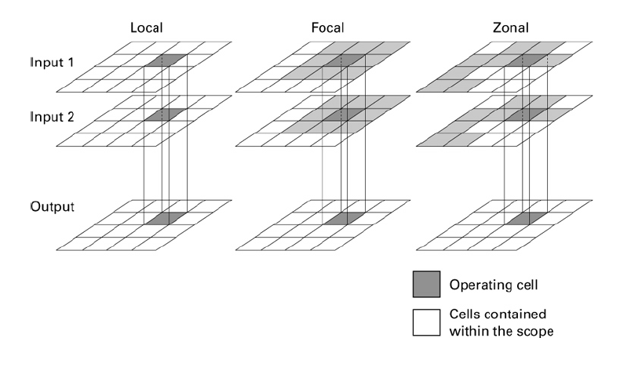
Background: Data
Types of raster analysis
Local – works on a cell by cell basis
Focal (neighborhood) – uses surrounding cells
Zonal – uses defined zone input layer
(Albrecht, 2007, p. 57)

Slide 8
Background: Project
US Gulf and East Coast storm surge dataset development
Goal of project to create two raster datasets representing 100-yr and 500-yr storm surge flood elevations
Current process involves simulating thousands of synthetic storm surge events across the project area utilizing SLOSH (Sea, Lake, and Overland Surges from Hurricanes) model data
Based on results derived from the SLOSH model, a series of interpolations were performed at both the SLOSH basin level as well as the event level
Final result for each event consists of several rasters representing two iterations of interpolations along with their respective variance
All results tied to a project-wide raster with unique cell IDs

Slide 9
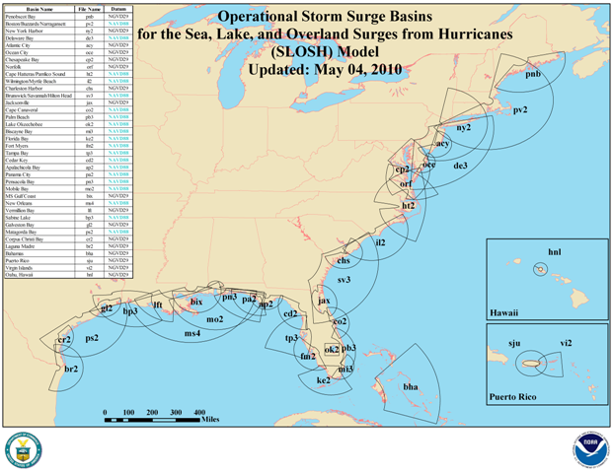
Background: Project
SLOSH Basin Coverage (NOAA)

Slide 10
Background: Project
US Gulf and East Coast storm surge dataset development
Goal of project to create two raster datasets representing 100-yr and 500-yr storm surge flood elevations
Current process involves simulating thousands of synthetic storm surge events across the project area utilizing SLOSH (Sea, Lake, and Overland Surges from Hurricanes) model data
Based on results derived from the SLOSH model, a series of interpolations were performed at both the SLOSH basin level as well as the event level
Final result for each event consists of several rasters representing two iterations of interpolations along with their respective variance
All results tied to a project-wide raster with unique cell IDs

Slide 11
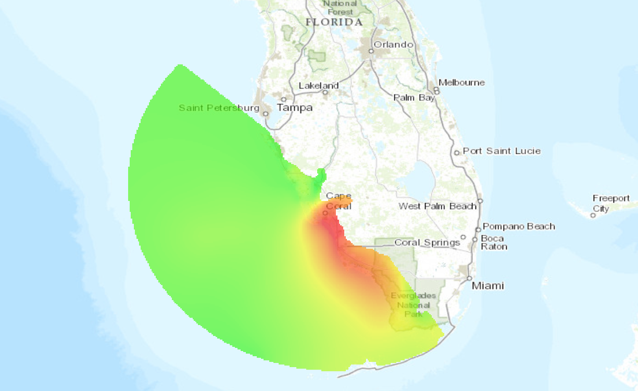
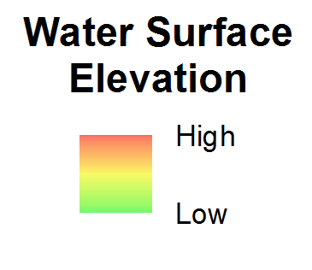
Background: Project
Interpolation at SLOSH Basin level

Slide 12
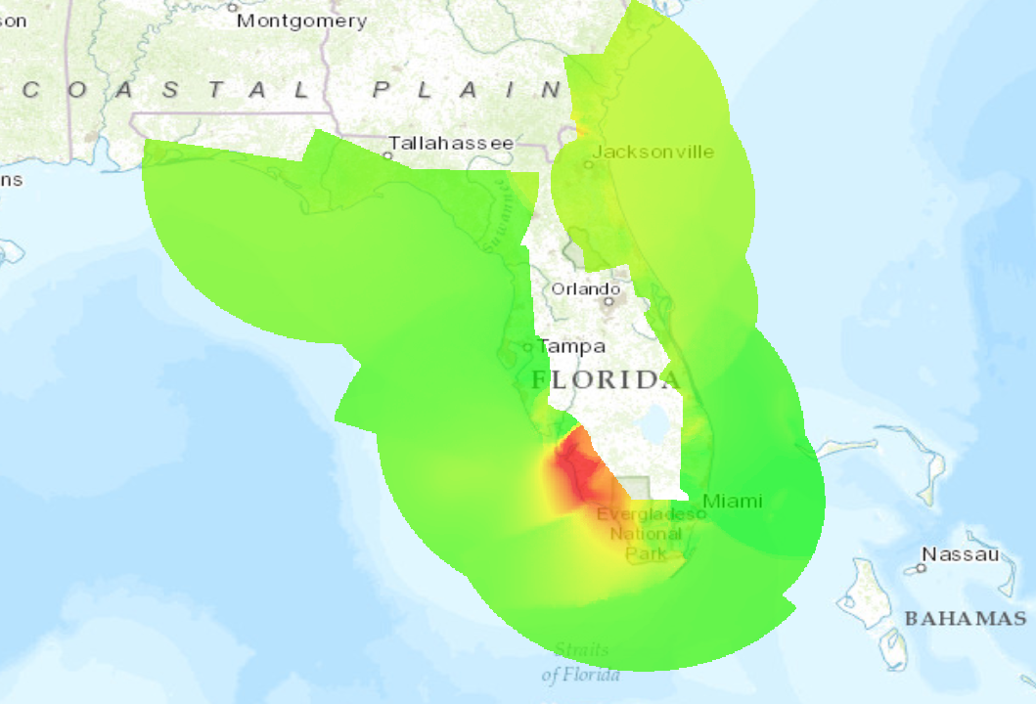
Background: Project
Interpolation at Event level

Slide 13
Background: Project
US Gulf and East Coast storm surge dataset development
Goal of project to create two raster datasets representing 100-yr and 500-yr storm surge flood elevations
Current process involves simulating thousands of synthetic storm surge events across the project area utilizing SLOSH (Sea, Lake, and Overland Surges from Hurricanes) model data
Based on results derived from the SLOSH model, a series of interpolations were performed at both the SLOSH basin level as well as the event level
Final result for each event consists of several rasters representing two iterations of interpolations along with their respective variance
All results tied to a project-wide raster with unique cell IDs

Slide 14
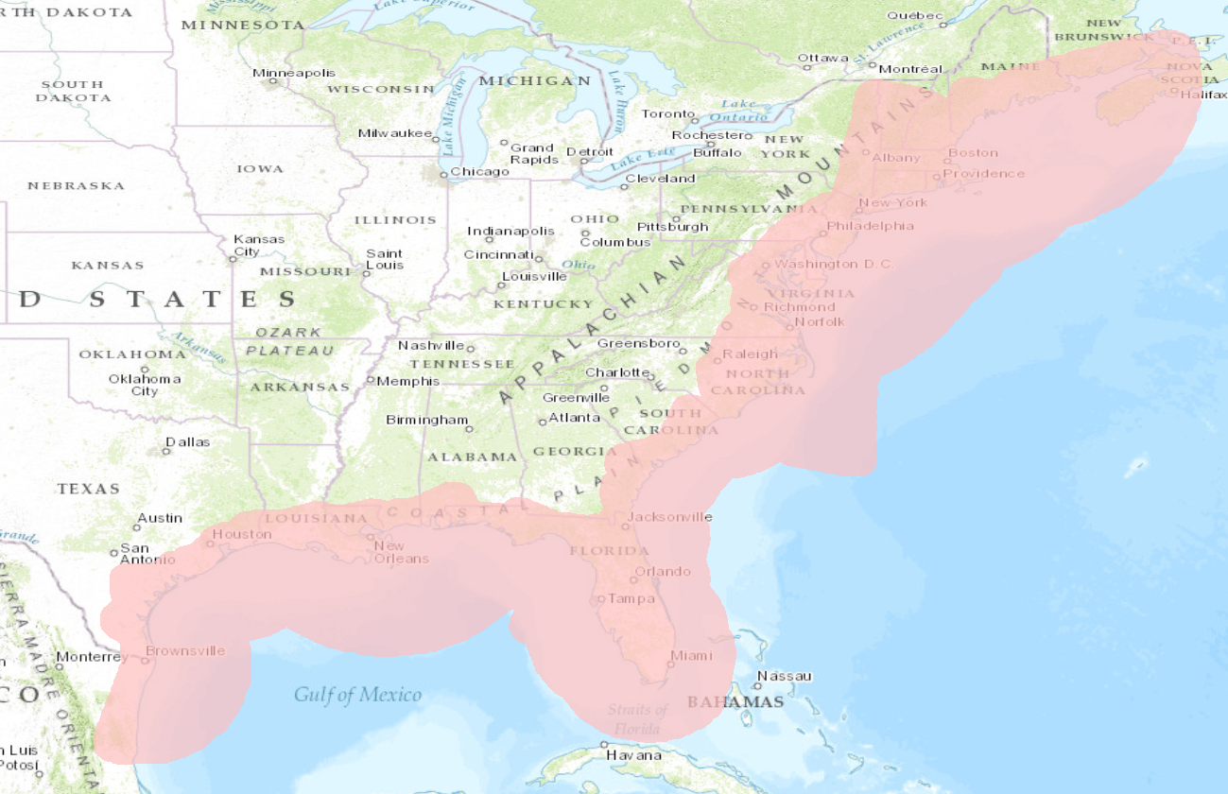
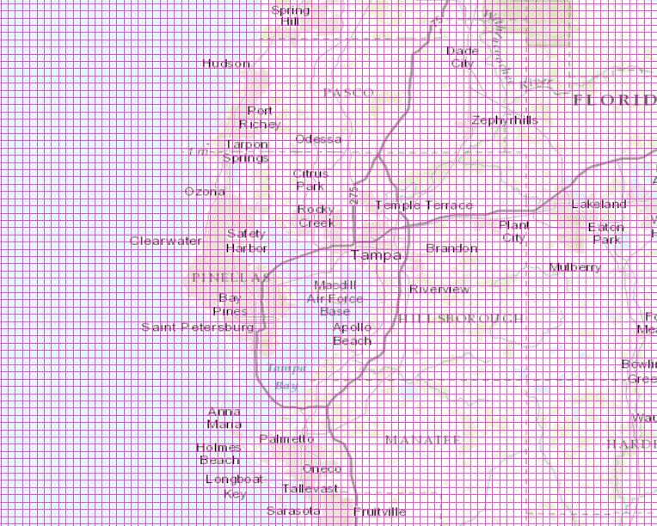
Background: Project
Project Grid

Slide 15
Background: Project
US Gulf and East Coast storm surge dataset development (continued)
Process written in Python and utilizes Arc Advanced, Spatial Analyst, and Geostatistical Analyst.
Entire project to this point (with the exception of the SLOSH work) has been accomplished utilizing GIS
Final code output places the results for each event into a text file with cell ID on global grid and corresponding values
Current plan is for a colleague to create a code to read each event text file and for each project-wide grid cell determine each participating event for that cell and value
Final goal to then apply extreme value theory to determine 100-yr and 500-yr values for each cell within global grid

Slide 16
Background: Statistics
Extreme Value Theory
“Techniques and models for describing the unusual rather than the usual” (Coles, 2001, p. vii)
Goal of EVT to quantify stochastic or random behavior of processes or phenomena at a very large or very small scale
Involves predicting extreme values beyond what has already been observed
Levee example – determine the height to build to for 500-yr protection

Slide 17
Background: Statistics
Extreme Value Theory - Block Maxima/Minima Technique
Divide data into equal sized time intervals/blocks (i.e. by month)
Determine the maximum value for each block
Estimate Generalized Extreme Value (GEV) distribution fitted to block maxima
Calculate return value function and uncertainty
https://www.isse.ucar.edu/extremevalues/back.html

Slide 18
Background: Statistics
Extreme Value Theory - Peak Over Threshold Technique
Select a threshold
Extract exceedances from data
Fit exceedances to General Pareto (GP) Distribution (conditional distribution)
Estimate unconditional distribution and return values
https://www.isse.ucar.edu/extremevalues/back.html

Slide 19
What has already been done?
Risk Assessment of Hurricane Storm Surge for New York City (Lin et al., 2010)
Simulated large number of synthetic hurricane events
Storm surge values based on SLOSH model data
Used peaks-over-threshold method with the generalized Pareto distribution to generate return periods

Slide 20
What has already been done?
Drought Risk Assessment (Tonini, 2013)
Used extreme value analysis to calculate maximum monthly temperatures contributing to drought conditions
GIS-based analysis
Custom Python script and toolbox created utilizing calls to R statistical package
Block maxima technique only

Slide 21
Objective
To apply statistical analysis to geospatial raster data to calculate values for desired return periods on natural hazard data.
How will this be achieved?
Explore existing methodologies to determine which (if any) techniques would fit current project
Formulate a series of methods to perform statistical analysis on geospatial raster data in an advanced statistical package utilizing the Python programming language.

Slide 22
Methodology
Evaluate current code
Move rasters to array structures utilizing SciPy’s NumPy library
Evaluate functions offered by SciPy
Evaluate functions offered by outside statistical packages as pertains to extreme value theory
Develop new code to connect array structure to statistics offered by SciPy and/or through an outside statistical package
Produce sample output and compare to results derived by colleague’s process

Slide 23
Methodology
SciPy - www.scipy.org
Python-based open-source software for mathematics, science, and engineering
NumPy library – fundamental library for numerical computing
Numerical (multi-dimensional) arrays and matrix types
Key piece to the project – moving raster data out of ArcGIS into this format for optimized processing
RasterToNumPyArray / NumPyArrayToRaster
SciPy.stats
Large number of probability distributions
Library of statistical functions

Slide 24
Methodology
Evaluate current code
Move rasters to array structures utilizing SciPy’s NumPy library
Evaluate functions offered by SciPy
Evaluate functions offered by outside statistical packages as pertains to extreme value theory
Develop new code to connect array structure to statistics offered by SciPy and/or through an outside statistical package
Produce sample output and compare to results derived by colleague’s process

Slide 25
Methodology
R - http://www.r-project.org/
Free software environment for statistical computing and graphics
Wide variety of statistical and graphical techniques
Highly extensible
Contains suite of operators to perform calculations on arrays and matrices
Large collection of intermediate tools for data analysis
Well developed, simple, programming language

Slide 26
Methodology
Evaluate current code
Move rasters to array structures utilizing SciPy’s NumPy library
Evaluate functions offered by SciPy
Evaluate functions offered by outside statistical packages as pertains to extreme value theory
Develop new code to connect array structure to statistics offered by SciPy and/or through an outside statistical package
Produce sample output and compare to results derived by colleague’s process

Slide 27
Timeline
Summer 2014
Research
Evaluate current code
Investigate SciPy and utilization of NumPy arrays
Investigate outside statistical packages
Determine connection between Python and statistical packages
Code Changes
Fall 2014
Code improvements
Complete report
Late Fall 2014/ Spring 2015
American Geophysical Union Conference?
American Association of Geographers Conference?

Slide 28
Future Adaptations
Utilizing Extreme Value Theory for other hazards
Flood modeling
Wind events
Earthquakes
Additional statistical analysis beyond Extreme Value Theory
Ability to move from ArcGIS to outside statistical package
Utilization of SciPy to improve code performance by tapping into multi-dimensional arrays

Slide 29
Acknowledgements
Dr. Patrick Kennelly - Advisor
Dr. Shangyao Nong - Colleague

Slide 30
Sources
AIR Worldwide. “Alert Worldwide: Mississippi River Flooding.” Last modified May 13, 2011. http://alert.air-worldwide.com/EventSummary.aspx?e=554&tp=54&c=1.
Albrecht, Jochen. Key Concepts and Techniques in GIS. London: SAGE Publications Ltd., 2007.
Chang, Kang-Tsung. Introduction to Geographic Information Systems. Texas: McGraw-Hill, 2003.
Coles, Stuart. An Introduction to Statistical Modeling of Extreme Values. London: Springer-Verlag, 2001.
Chapman, Martin. “The August 23, 2011 Earthquake in the Central Virginia Seismic Zone.” Presentation at the USGS National Seismic Hazard Mapping Workshop, Memphis, Tennessee, February 22-23, 2012.
Hall, T. M., and A. H. Sobel. “On the impact angle of Hurricane Sandy's New Jersey landfall” Geophysical Research Letters. May 28, 2013: 2312–2315.
Lin, N., K. A. Emauel, J. A. Smith, and E. Vanmarcke. “Risk Assessement of Hurricance Storm Surge for New York City.” Journal of Geophysical Research. September 25, 2010.
Nong, Shangyao, Jeffrey McCollum, Liming Xu, Michael Scheffler, and Hosam Ali. “Probabilistic Storm Surge Heights for the US Using Full Stochastic Events.” Paper presented at the AMS 29th Conference on Hurricanes and Tropical Meteorology, Tucson, Arizona, May 10-14, 2010.
O’Sullivan, David, and David J. Unwin. Geographic Information Analysis. New York: Wiley, 2010.
Sweet, William, Chris Zervas, Stephen Gill and Joseph Park. “Hurricane Sandy Inundation Probabilities Today and Tomorrow.” Bulletin of the American Meteorological Society. September 2013: 517-20.
Tonini, Francesco. “Drought Risk Assessment – A Customized Toolbox.” Presentation at the ESRI International User Conference, San Diego, California, July 8-12, 2013.
Walton, Todd L. “Distributions for Storm Surge Extremes.” Ocean Engineering. December 2000: 1279-1293.

