Slide 1
Designing and Developing a Road Condition Database and Application for Belize
GEOG 596 A
Marion Cayetano

Slide 2
Presentation Outline
Background
Capstone Project Objectives
Proposed Methodology
Anticipated Results
Project Timeline
Acknowledgements

Slide 3
Background

Slide 4
The Heartbeat of the Caribbean in Central America
Belize is the only English speaking country in Central America
It is located in northeastern Central America, bounded by Mexico to the north, Guatemala to the west and south, and the Caribbean sea to the east
It has the smallest population in Central America and the only country with smaller land area is El Salvador
Belize is fondly referred to as the heartbeat of the Caribbean in Central America
Source: http://www.worldatlas.com/webimage/countrys/camerica.htm

Slide 5
About Belize
Population: 379,909 (April 2016)
Surface area: 22,970.0 sq. km. (8,867 sq. miles)
Country dimensions: 280 km. (174 miles) by 109 KM (68 miles)
About 200 villages and ten urban areas spread across the country
The primary, secondary and tertiary roads that connect the towns and villages together makes up about 3,281 km
Belize’s road network is one of the country’s most expensive assets
Replacement cost of the road network was estimated to be US $3.3 billion in 2013
Sources: Statistical Institute of Belize; McNish and Granada 2013

Slide 6
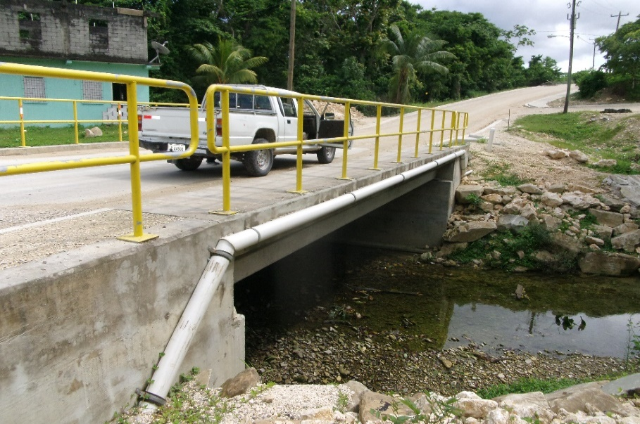
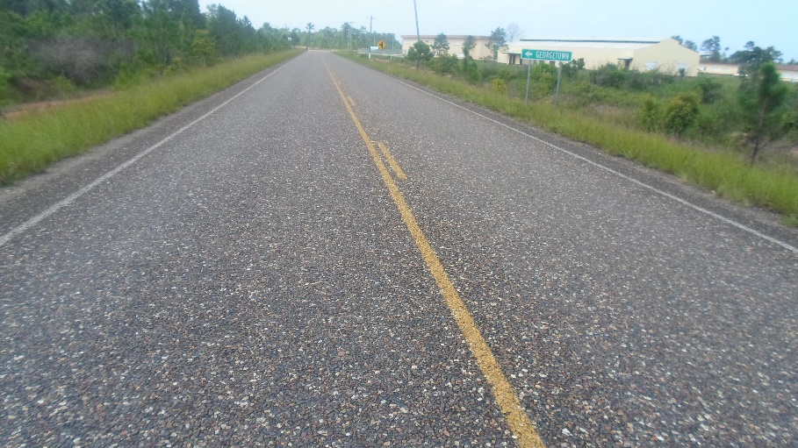
Public Works Department, Belize
Resides within the Ministry of Works, Transport, and National Emergency Management
Has primary responsibility for road asset management, and for maintenance and upgrade of the primary, secondary and tertiary roads
Is also responsible for village roads
Town and city roads are the responsibility of the respective town and city councils

Slide 7
Challenges Faced by the Public Works Department
Does not currently have a road asset management plan
Does not have a fully functioning road asset inventory and condition database that can be used to support operations planning
Does not have in-house database management skills
Is under-resourced so does not schedule routine condition surveys of the road network

Slide 8
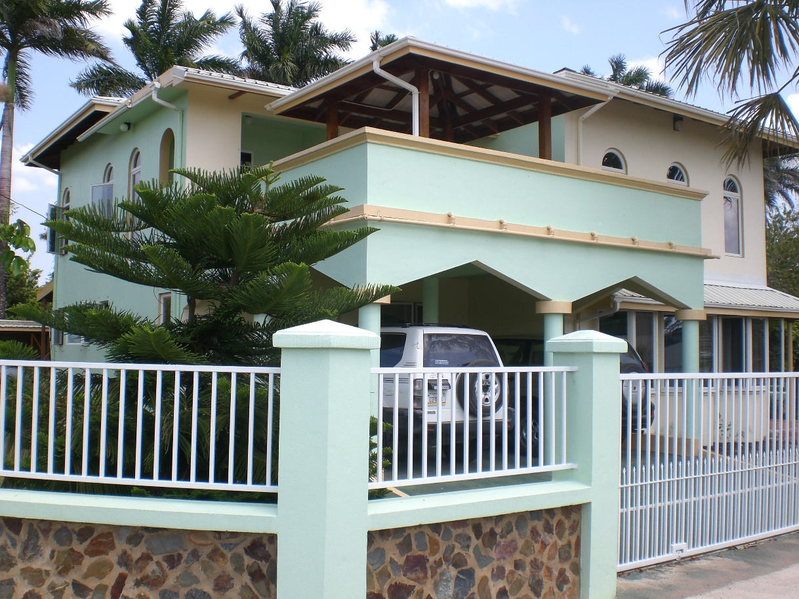
My Relationship with Belize
Since 2012 about half of my consulting work each year has been as a short term consultant for the World Bank working on issues related to Belize. In that capacity, I have:
Supervised a one-time process to collect condition data for the primary and secondary roads in Belize using visual inspection methods
Collaborated in the use of a multi-criteria evaluation process to prioritize road segments for rehabilitation
Collaborated in the preparation of a Climate Resilience Investment Plan for Belize

Slide 9
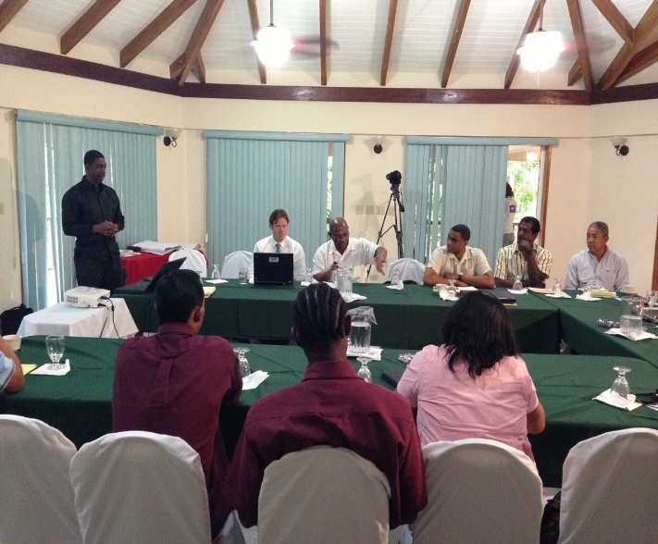
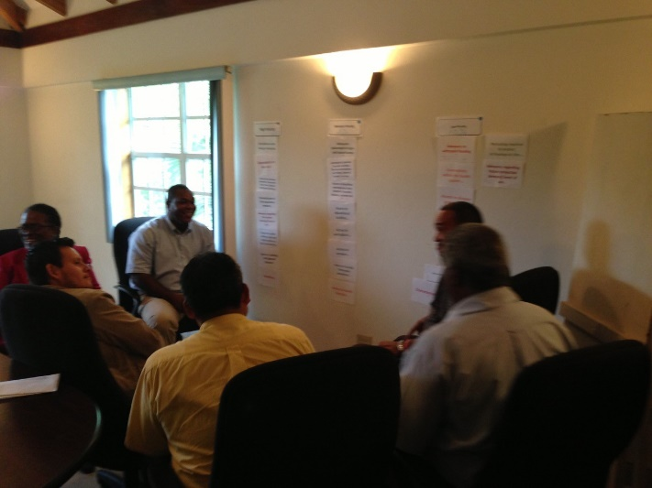
My Relationship with the Ministry of Works
I hold frequent discussions with the Chief Executive Officer of the Ministry about challenges with data management
I hold frequent discussions with the Chief Engineer about challenges with asset management and operations planning
I maintain a good working relationship with the engineers who manage operations
I am not a member of staff of the Ministry of Works, Transport and Emergency Management

Slide 10
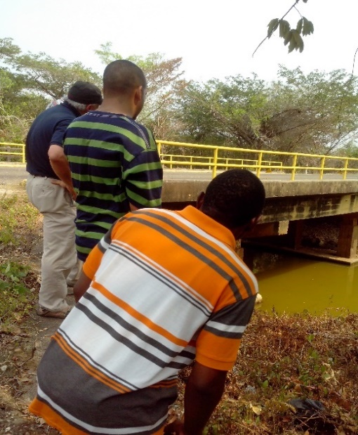
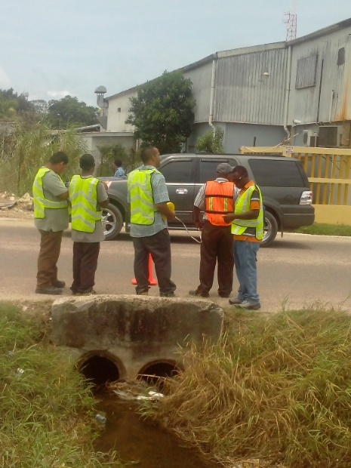
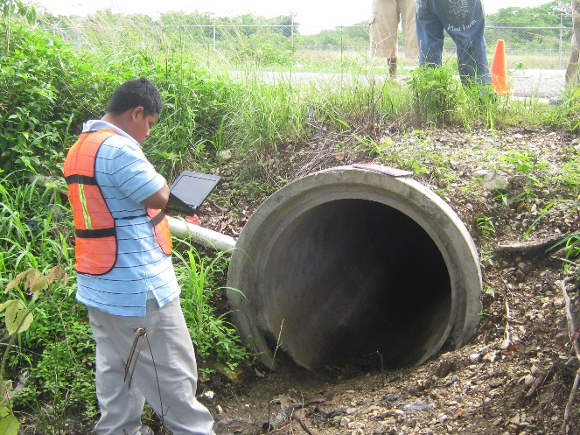
What is Road Condition Assessment?
Describes the level of distress of roads and appurtenances
Describes the extent to which roads, culverts, bridges and road appurtenances are serving their intended functions
May be based on visual inspection by professionals, or may be done using equipment to measure characteristics of the roads, bridges and culverts etc.
Usually carried out through scheduled surveys

Slide 11
Uses of Condition Data
Provide a snapshot of the state/condition of the road network assets
Plan maintenance activities for roads, bridges, culverts and appurtenances
Plan asset upgrades and refurbishments
Estimate resource requirements to restore/refurbish the network or selected parts of it to some preapproved standard
Source: Bennett et al (2007)

Slide 12
General Practice for Collection of Condition Data
Surveys
Road inventory: one-off followed by updates when changes occur
Pavement/surface condition data
Primary and secondary roads: every 1 – 2 years
Tertiary roads: every 2 - 5 years
Bridge condition
Regular condition survey: 1 – 2 year intervals
Intensive investigation: every 5 years
Road traffic
Permanent traffic count stations
Supplemental short term counts (7 days) in other location
Source: Bennett et al. 2007; OECD, 2001

Slide 13
Belize Road Condition Survey
In 2013 the Government of Belize and the World Bank conducted a condition survey for the primary and secondary roads of Belize
The condition survey visually inspected road, bridges, culverts, guardrails, and other appurtenances
This is not a routine practice, and unfortunately, is not likely to occur again in the near future though the importance of a knowledge of road condition is recognized

Slide 14
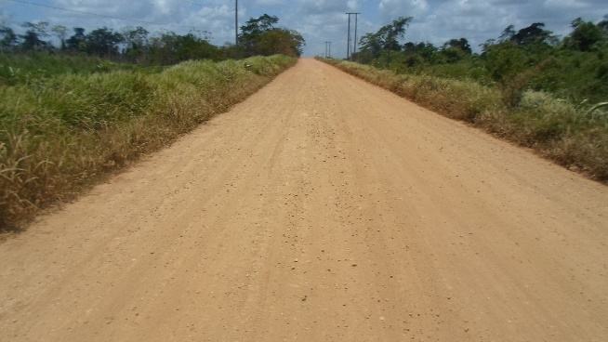
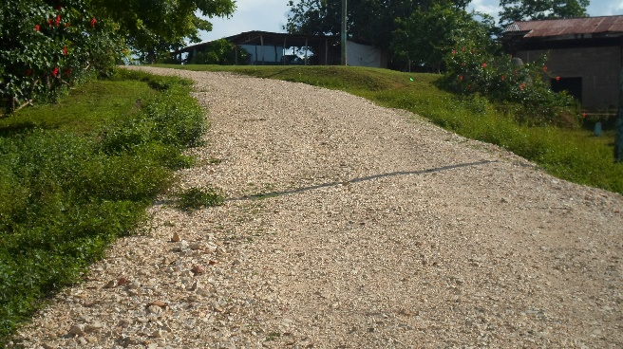
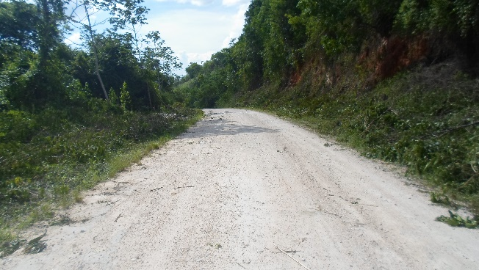
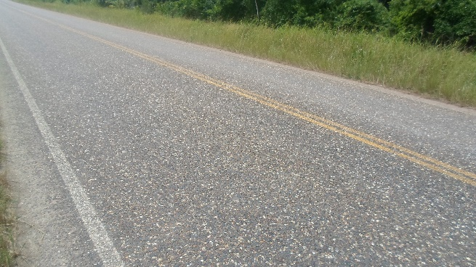
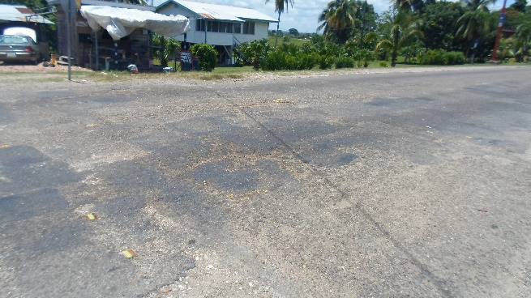
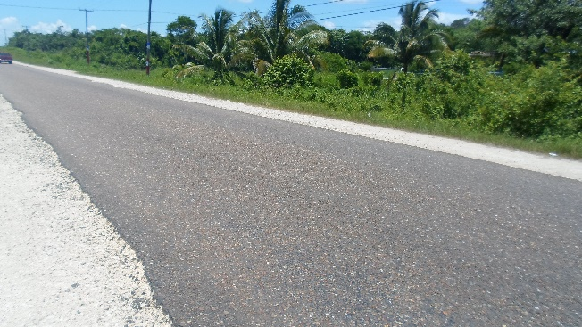
Sample of Paved and Unpaved Roads in Belize
Unpaved Roads
Paved Roads
Photos taken in 2013 during Belize road condition survey

Slide 15
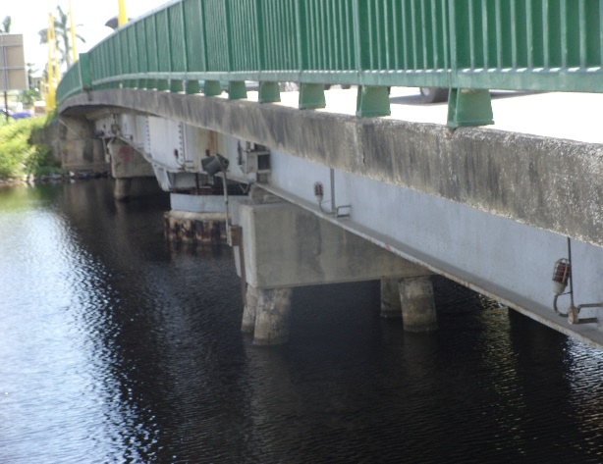
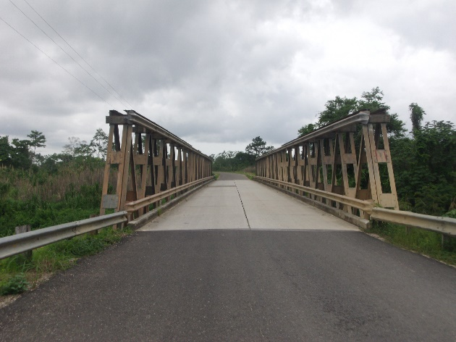
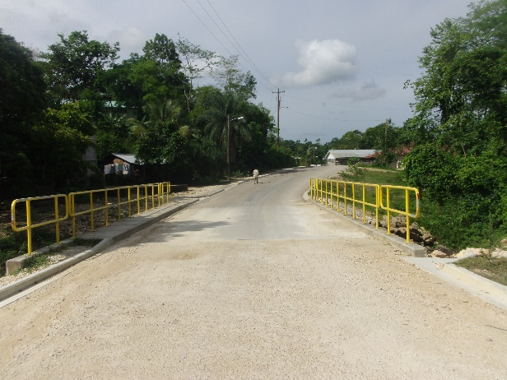
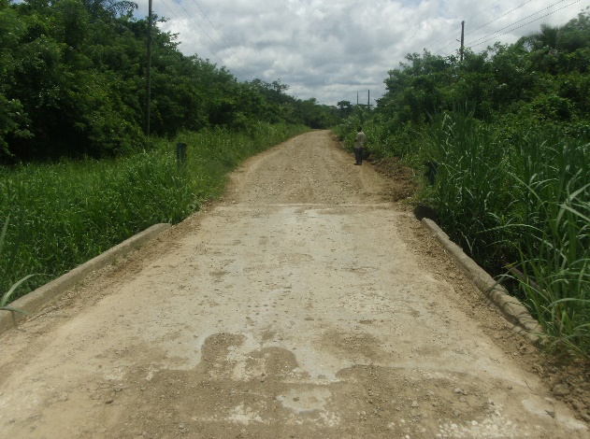
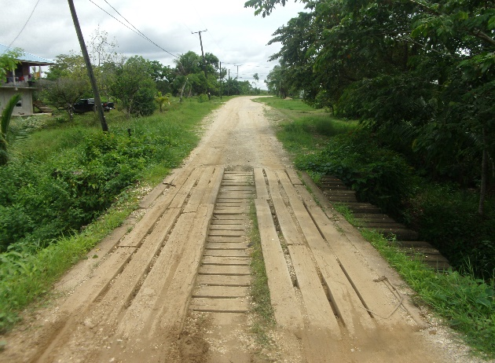
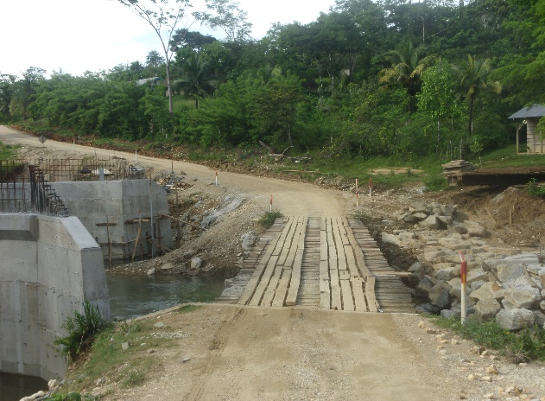
Various Bridges on Belize’s Road Network
Bridges in Good Condition
Precarious Bridges
Photos taken in 2013 during Belize condition survey

Slide 16
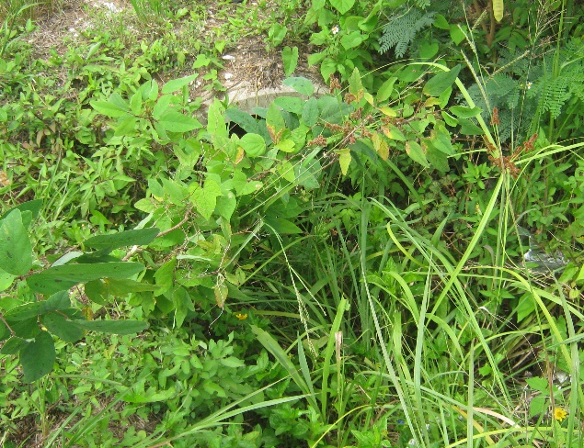
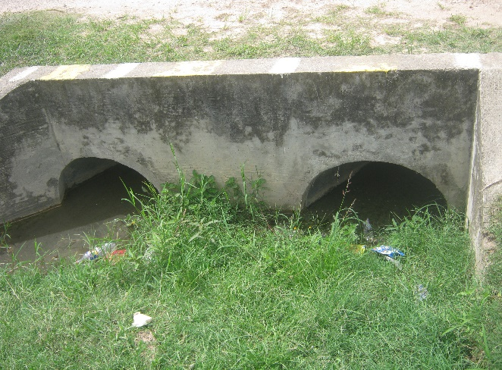
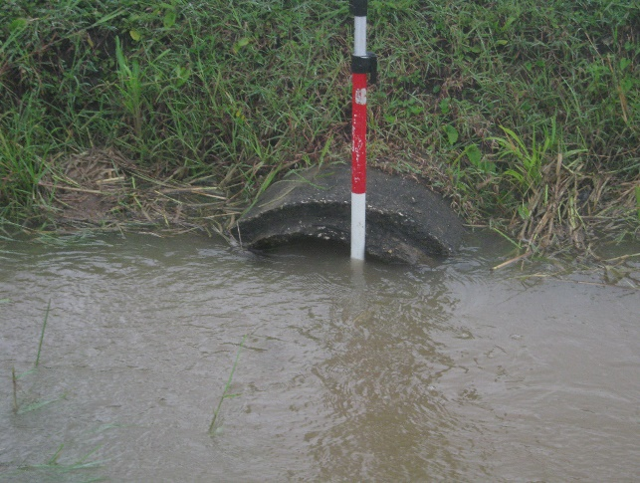
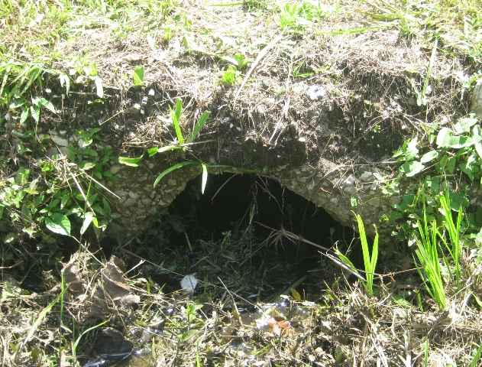
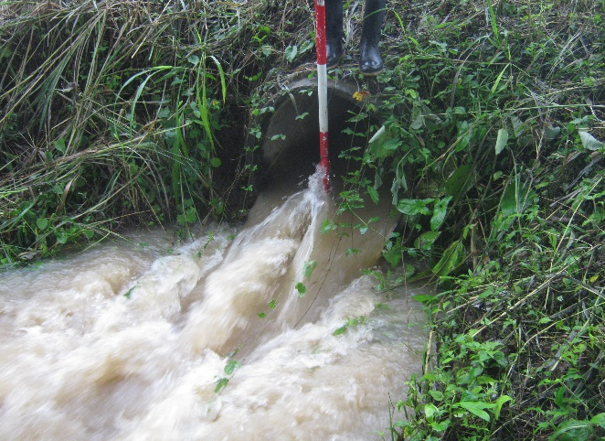
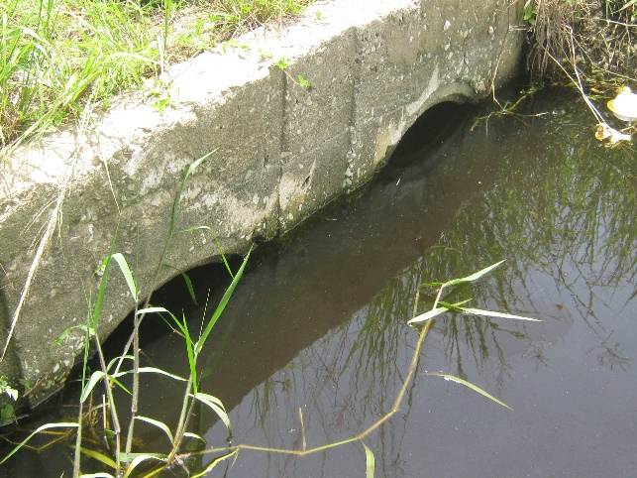
Collage of Culverts in Poor Condition
Photos taken in 2013 during Belize road condition survey

Slide 17
The Case for a Condition Database and Mobile App
The poor condition of several road assets emphasizes the need for better documentation of condition
There is a need for tools that enable one time data entry

Slide 18
Capstone Project Objectives

Slide 19
Objective of the Capstone Project
Given the challenges that Belize’s Public Works Department faces, the objectives of the Capstone Project are:
Develop a road network inventory and condition database that can manage spatial and a-spatial data about Belize’s road network and the condition of its features
Develop an easy to use mobile application that existing field teams of the Public Works Department can use to collect and update data about the condition of road network features

Slide 20
Methodology

Slide 21
Methods
Analyze and document the current operations and processes of the Public Works Department that are related to road asset management
Identify the data currently collected, and the data needed to carry out pertinent road asset management tasks and operational decision making about the road network
Notes:
Analyze and document the current operations and processes of the Public Works Department that are related to road asset management
Interview key people in the Public Works Department
Document the current workflows
Check that the documentation reflect the reality
Identify the data currently collected and the data needed to carry out pertinent asset management tasks
Initiate the preparation of a master data list (including tables, fields and relationships)
Describe the data that is currently generated and how it is generated
Identify the features and their properties that need to be captured in a database

Slide 22
Methods
Conceptual database design
Define the database tables and their relationships
Develop and implement the database in a relational database management system (RDBMS)
Prepare and test mockups of the user interface for field data collection application
Create a prototype of the application and carry out testing
Develop the data collection application
Notes:
Analyze and document the current operations and processes of the Public Works Department that are related to road asset management
Interview key people in the Public Works Department
Document the current workflows
Check that the documentation reflect the reality
Identify the data currently collected and the data needed to carry out pertinent asset management tasks
Initiate the preparation of a master data list (including tables, fields and relationships)
Describe the data that is currently generated and how it is generated
Identify the features and their properties that need to be captured in a database

Slide 23
Database Design and Development

Slide 24
Data Collection Application Development

Slide 25
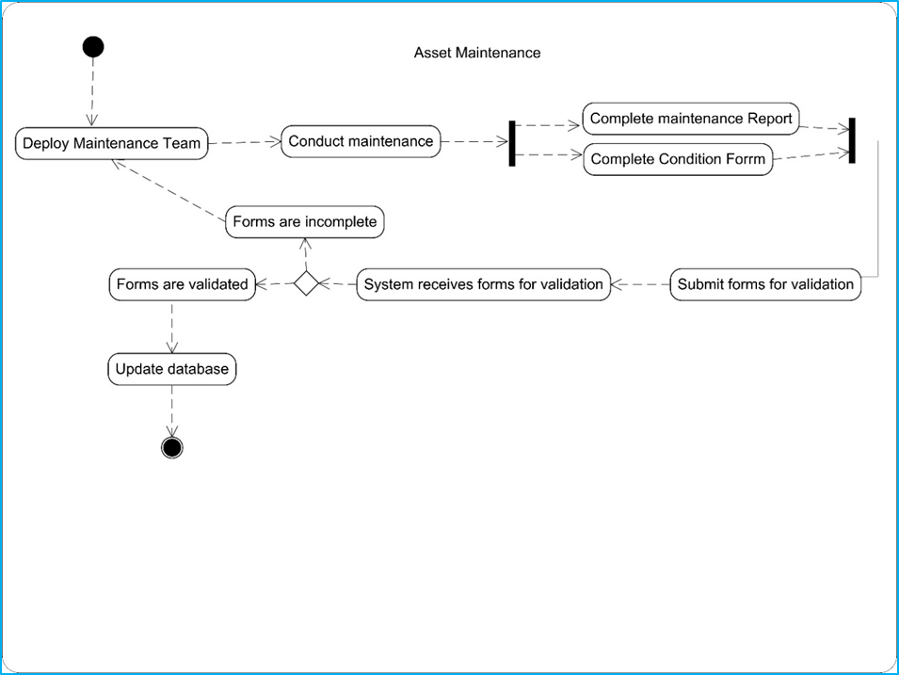
Sample UML Activity Diagrams

Slide 26
Sample Data Entry Form (Road Search)

Slide 27
Sample Data Entry Form (Road Point)

Slide 28
Anticipated Results

Slide 29
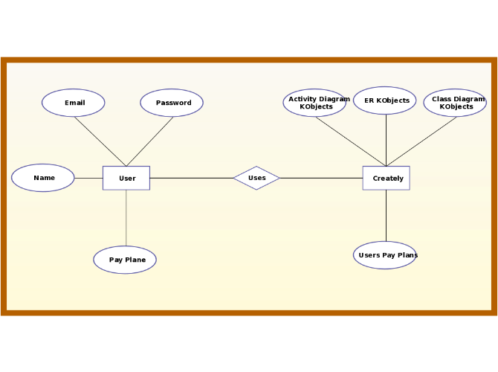
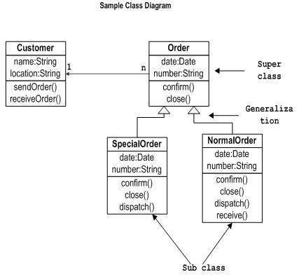
Fully Developed Database Design (Conceptual, Logical and Physical Design)
Entity-Relationship Diagram is vetted and approved
UML Class Diagram is vetted and approved
Relational database management system is selected
The relational database is built and tested
Example of an E-R Diagram
Example of a Class Diagram

Slide 30
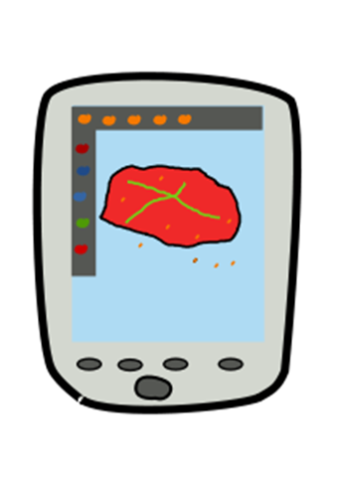
Mobile Application for Data Collection is Built
UML Activity Diagrams are vetted and approved
Functionality table is prepared
User interface is designed
User interface is tested
The application is prototyped
The revised application is presented

Slide 31
Project Timeline

Slide 32
Project Timeline
Activity | Target Date
Register for GEOG 596 B | August for Fall 2
Carry out requirements analysis | August 2016
Design the database | Late August 2016
Application development and usability testing | September and October 2016
Present the results | Late November 2016
Submit the written report | Mid December 2016

Slide 33
Acknowledgements
Professor Patrick Kennelly, Capstone Advisor
Beth King, Assistant Program Manager, Online Geospatial Education
Dr. Justine Blanford, Instructor on record for GEOG 596 A
Claudina Cayetano, my beloved wife
Colleagues at the World Bank and at the Belize Ministry of Works, Transport and National Emergency Management
Course mates throughout the program

Slide 34
References
Asian Development Bank (2013) Recent trends in road asset management and case studies: Workshop proceedings [Online] Available from: http://www.lpcb.org/index.php/documents/road-management/rms-reports/25236-2013-adb-recent-trends-in-road-asset-management-workshop/file Accessed: 14 July 2016
Bennett C.R., Chamorro A., Chen C., de Solminihac, H., Flintsch G.W. (2007) Data Collection Technologies for Road Management Washington DC, World Bank [Online] Available from: From: http://siteresources.worldbank.org/INTTRANSPORT/Resources/07-02-12DataCollectionTechnologiesReport-v20.pdf Accessed 16 July 2016
Central Intelligence Agency (CIA) The world fact book [Website] Available from: https://www.cia.gov/library/publications/the-world-factbook/geos/bh.html Accessed 18 July, 2016
McNish, B. and Granada, I. (2013) Transport Sector in Belize: IDB Technical Note 607 Washington DC IDB [Online] Available from: https://publications.iadb.org/bitstream/handle/11319/6022/Transport%20Sector%20in%20Belize.pdf;sequence=1 Accessed 14 July 2016
Organization for Economic Co-operation and Development (OECD) (2001) Asset management for the roads sector [Online] Available from: http://www.itf-oecd.org/sites/default/files/docs/01assete.pdf Accessed 18 July, 2016
Robertson S., and Robertson J. (2012) Mastering the Requirements Process: Getting requirements right 3rd Ed. Addison-Wesley
Statistical Institute of Belize (2016) Statistics of the nation [Website] Available from: http://www.sib.org.bz/ Accessed 18 July, 2016
The University of Birmingham/Transit New Zealand Road asset management principles (2002) [Online] Available from: http://www.worldbank.org/transport/training/birmingham-un/Week3/Week3-Day1.pdf Accessed 16 July 2016
United Kingdom Policy: Road Network and Traffic [Website] Available From: https://www.gov.uk/government/policies/road-network-and-traffic Accessed 14 July 2016
World Bank World Development Report 1994: Infrastructure for Development (1994) Available from: https://openknowledge.worldbank.org/bitstream/handle/10986/5977/WDR%201994%20-%20English.pdf?sequence=2&isAllowed=y Accessed 14 July 2016

Slide 35
Questions?

