Slide 1
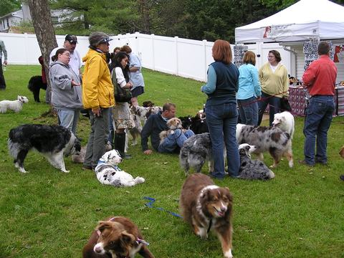
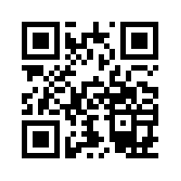
Applying GIS to Dog Rescue
Developing GIS Data for New Spirit 4 Aussie Rescue in Order to Visualize Trends and Aid in Daily Operations
K. M. Chaney
MGIS Candidate
May 7, 2013
Faculty Advisor – Beth King
www.ns4ar.org

Slide 2
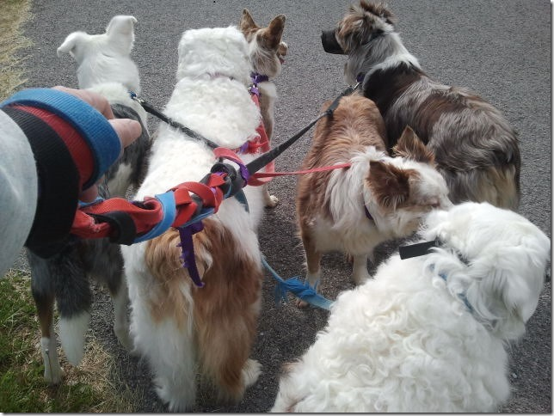
Agenda
Reality of Rescue
Objectives
Methods
Schema
Deliverables
www.ns4ar.org

Slide 3
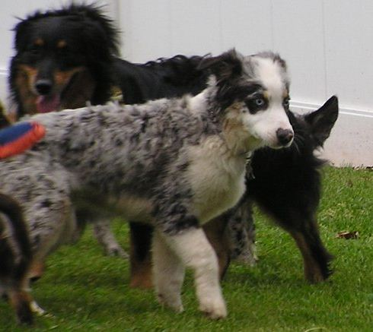
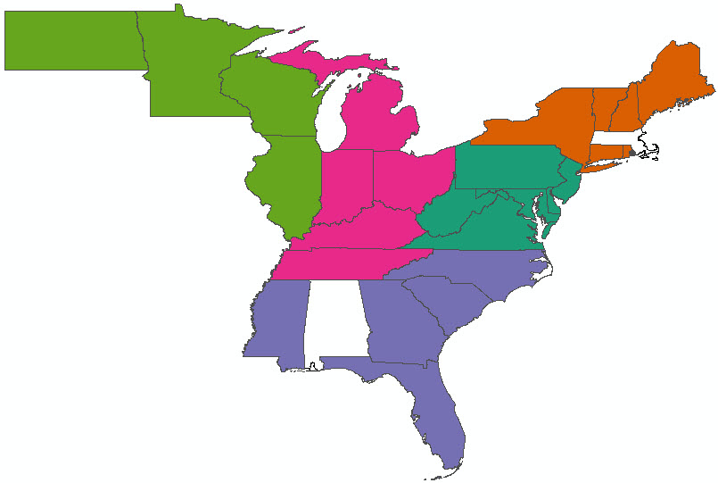
New Spirit 4 Aussie Rescue
Operates in five regions
- North East
- Mid Atlantic
- South East
- Heartland
- Upper Mid West
500+ Volunteers
1,800+ Australian Shepherds (Aussies), Aussie mixes, and honorary “Aussies”
www.ns4ar.org

Slide 4
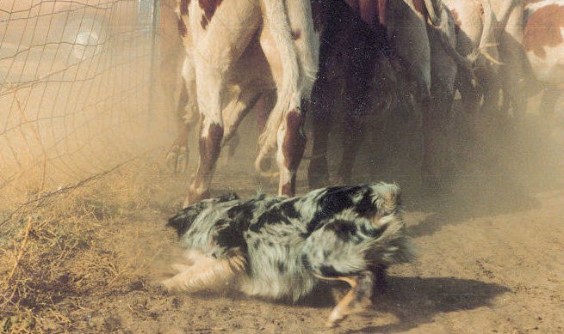
The Tale of the Tailless Dog
A general purpose stock and farm dog created in the American West.
The Australian Shepherd Club of America (ASCA )Breed Standard:
GENERAL APPEARANCE- He is attentive and animated, showing strength and stamina combined with unusual agility.
CHARACTER- Primarily a working dog of strong herding and guardian instincts. He is an exceptional companion. He is versatile and easily trained, performing his assigned tasks with great style and enthusiasm. He is reserved with strangers but does not exhibit shyness. Although an aggressive, authoritative worker, viciousness toward people or animals is intolerable."
www.ns4ar.org

Slide 5
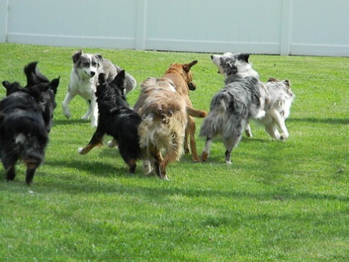
NS4AR Meet GIS, GIS Meet NS4AR
(If dog is man’s best friend, maybe GIS can be dog’s best friend)
Large enough geographic area to warrant the use of GIS
Small, easily managed database
Incremental updates
Project expansion possibilities
www.ns4ar.org

Slide 6
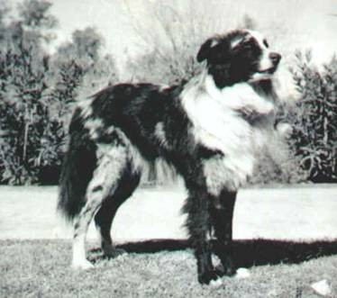
Objectives
(If dog is man’s best friend, maybe GIS can be dog’s best friend)
New Spirit 4 Aussie Rescue geodatabase
Visualization of trend
www.ns4ar.org

Slide 7
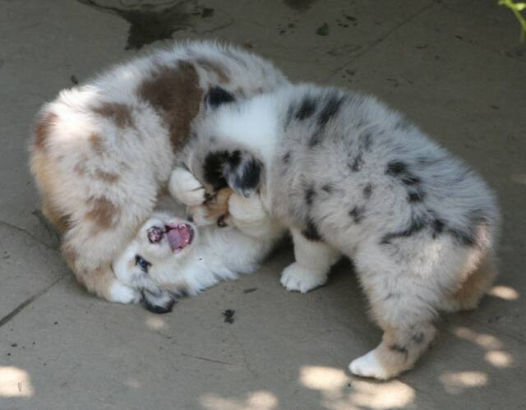
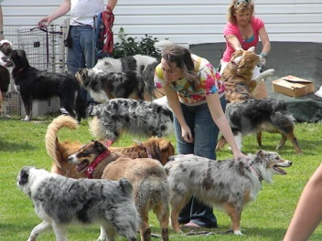
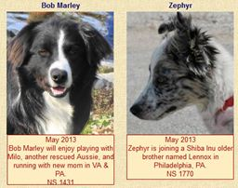
The NS4AR Geodatabase
Volunteers
Dogs
www.ns4ar.org

Slide 8
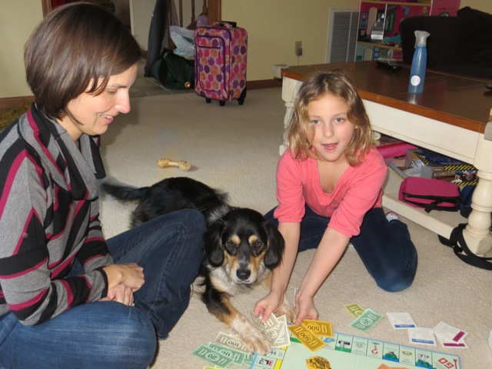
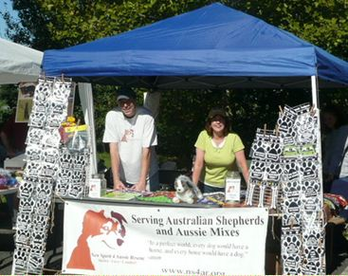
The NS4AR Geodatabase
Adopters
Events
www.ns4ar.org

Slide 9
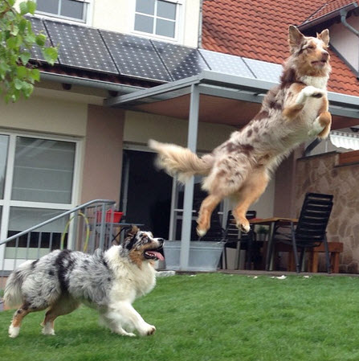
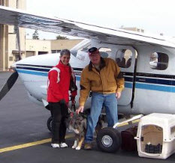
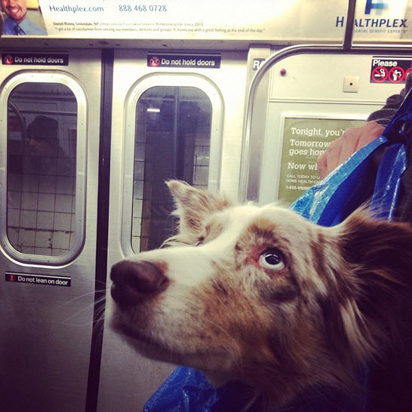
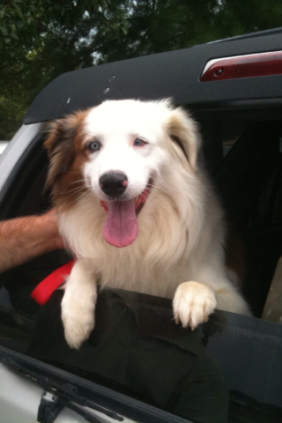
The NS4AR Geodatabase
Cooperating Shelters
Transportation
www.ns4ar.org
Notes:
O

Slide 10
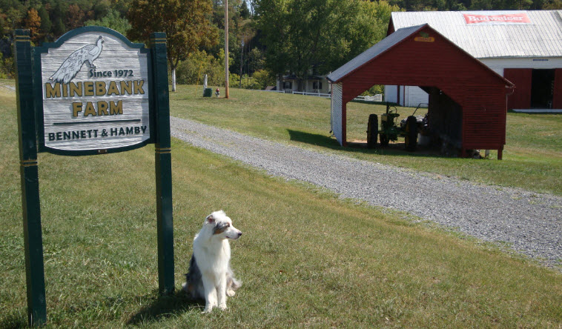
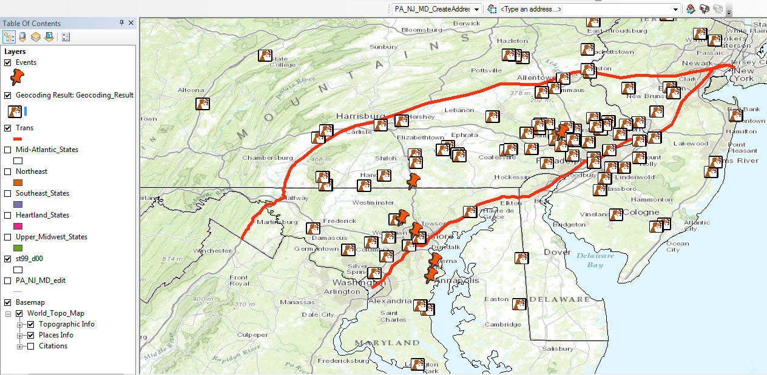
www.ns4ar.org

Slide 11
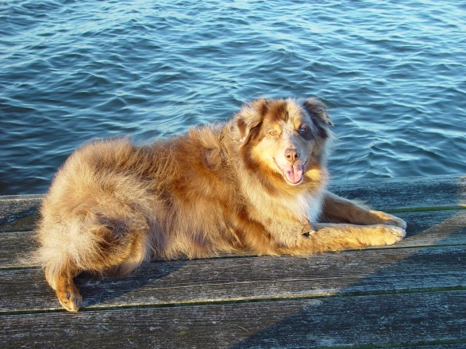
Methods
Identify operational needs
Define objectives
Determine data requirements
Acquire data
Database design
Populate database
Define update process
www.ns4ar.org

Slide 12
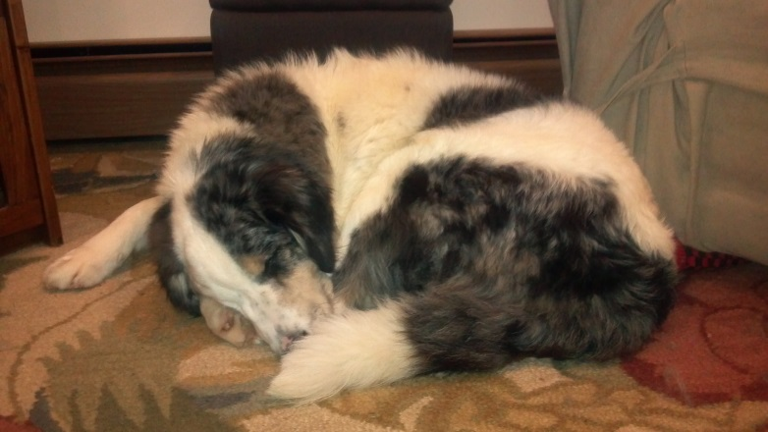
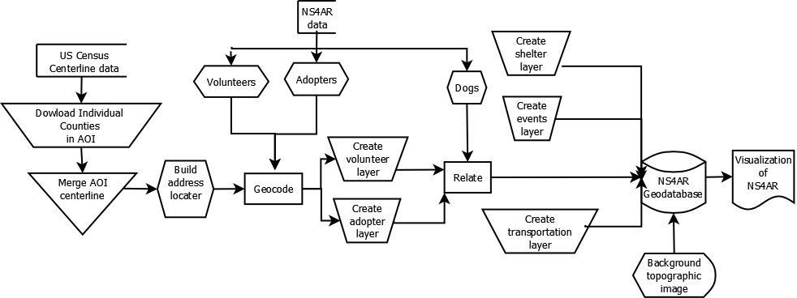
Workflow
www.ns4ar.org

Slide 13
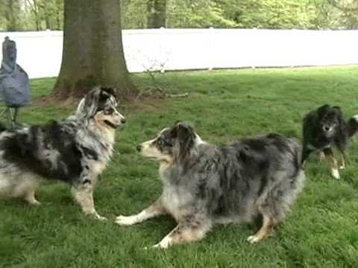
Data Resources
Australian Shepherd Club of America, Inc. http://www.asca.org/aboutaussies
ESRI ArcGIS Online, Map Services
http://www.esri.com/software/arcgis/arcgisonline/services/map-services
New Spirit 4 Aussie Rescue data http://pets.groups.yahoo.com/group/NewSpirit4AussieRescue/
US Census Bureau for centerline data
http://www.census.gov/cgi-bin/geo/shapefiles2010/main
www.ns4ar.org

Slide 14
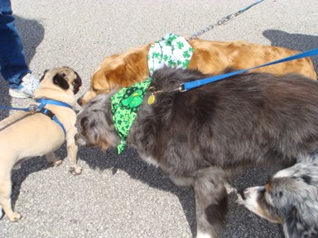
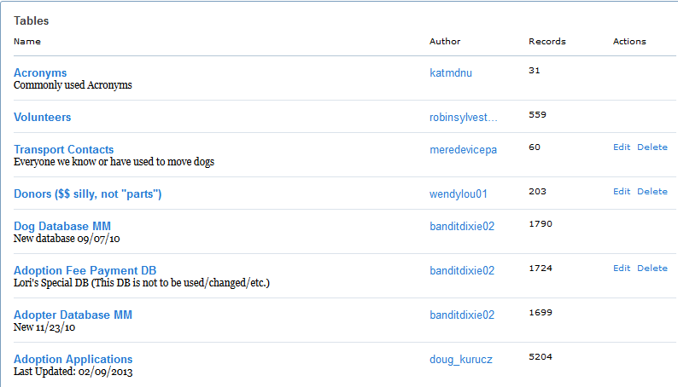
NS4AR Data
www.ns4ar.org

Slide 15
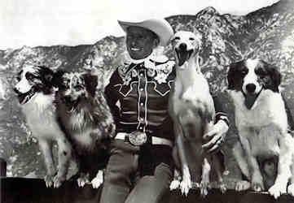
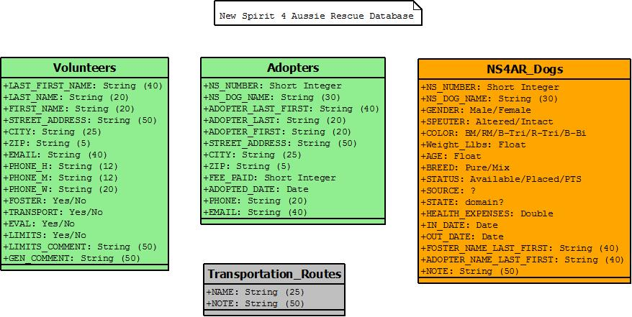
Schema
www.ns4ar.org

Slide 16
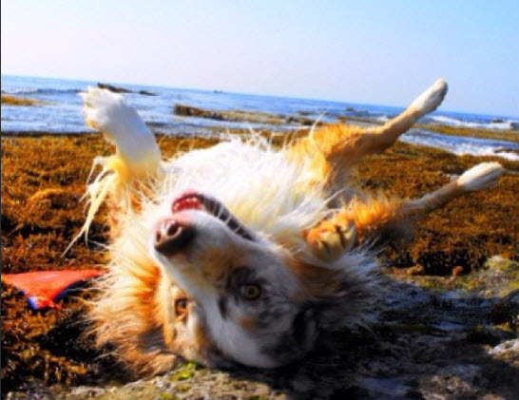
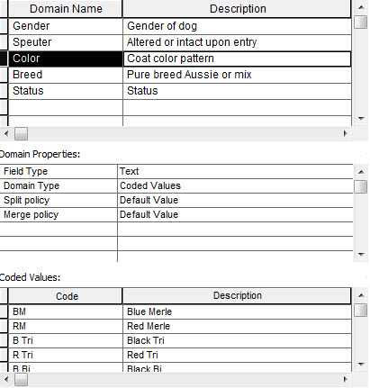
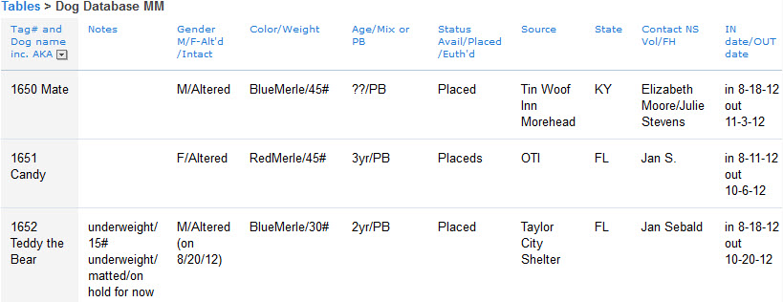
Database Conversion
www.ns4ar.org
Notes:
“Automate it as best I can.” Example of the short comings of the Yahoo! Groups (only 10 fields) and how that complicates automating the attributes
Show a field with multiple data types and how that will be resolved in the database.

Slide 17
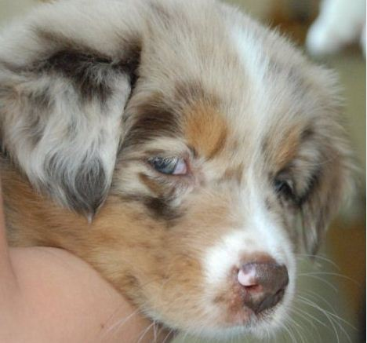
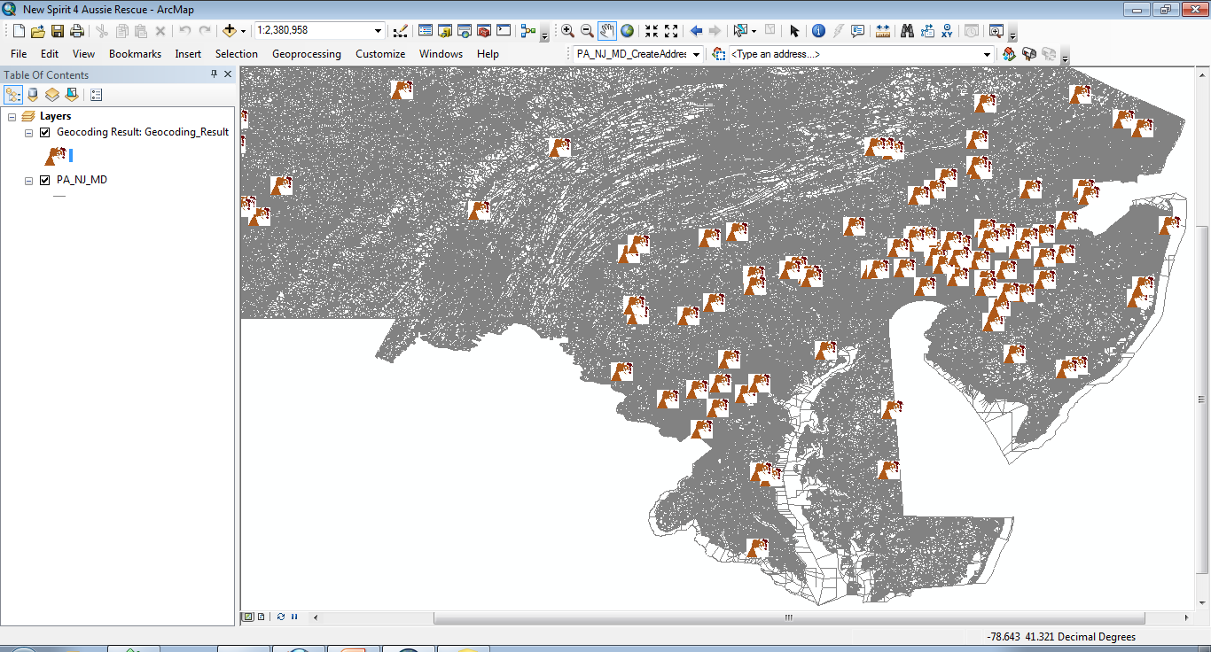
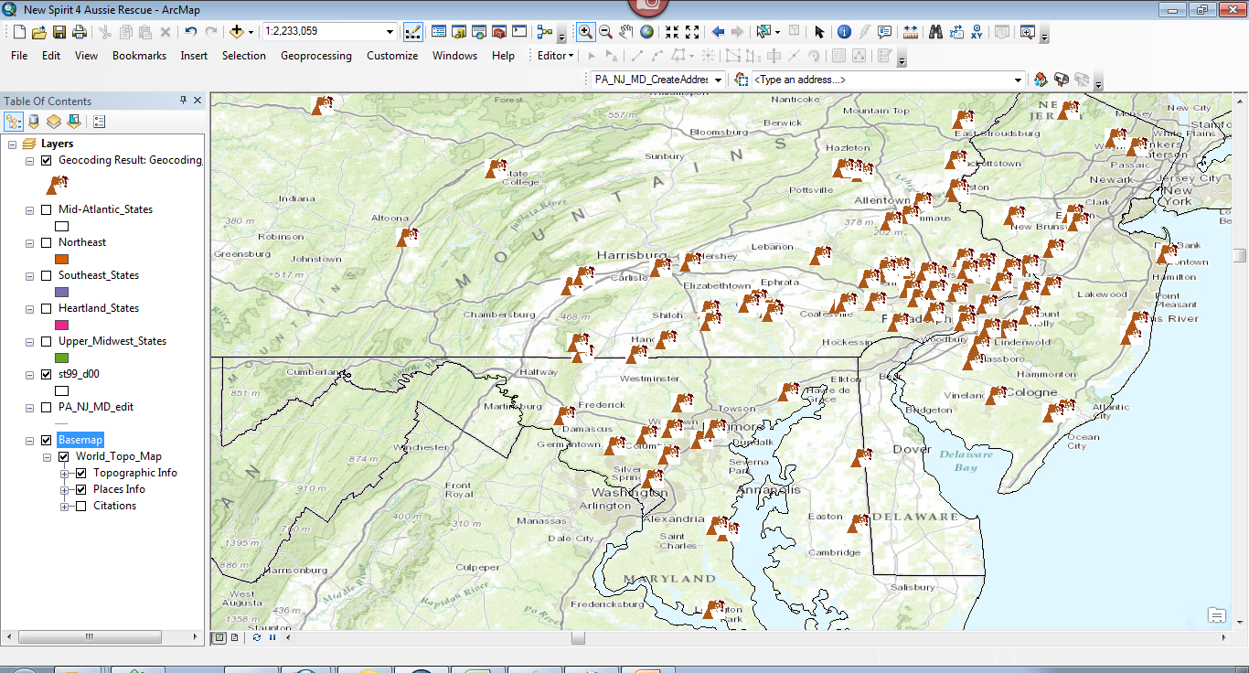
Geospatially Enabling the Data
www.ns4ar.org

Slide 18
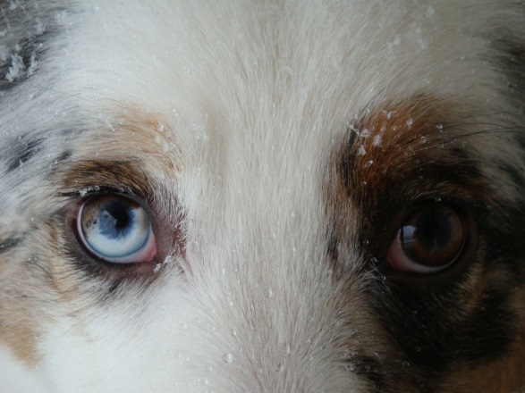
Challenges & Limitations
Geocoding – Some addresses are not amendable to the way U.S. Census (TIGER data) centerline data is entered (e.g. Illinois sample data)
Inconsistent data (e.g. attributes)
Returning NS4AR dogs
www.ns4ar.org

Slide 19
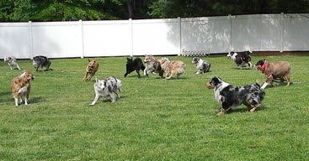
Deliverables
Consistent and transferable data model for NS4AR
Geospatially enabled database for NS4AR
Enabling geospatial visualization of the distribution and movement of animals and volunteers
www.ns4ar.org

Slide 20
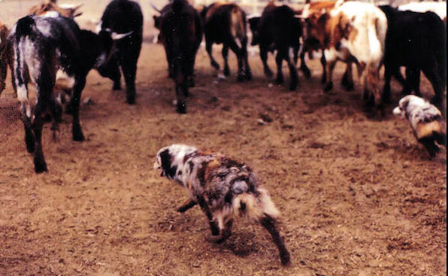
Herding Volunteers & Other Resources
(Nice map, but how does this help?)
Quickly identify volunteers in close proximity to dogs, transportation routes, events, and adopters
Data presentation for grant proposals
Identify gaps in NS4AR coverage
www.ns4ar.org
Notes:
Add a bulleted list to show how this will improve the organizations process (close the loop on this) 1. ID vols. opposed to general cattle call

Slide 21
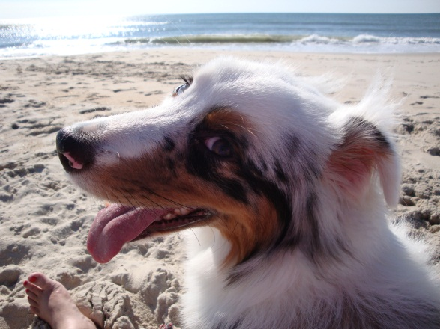
Questions?
Outside of a dog, a book is man’s best friend. Inside of a dog, it is too dark to read. – Groucho Marx
Computing is not about computers any more. It is about living. – Nicholas Negroponte
www.ns4ar.org

