Slide 1
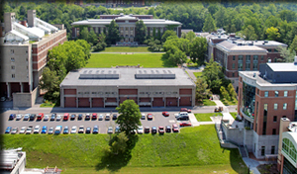
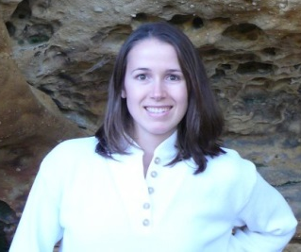
Developing and Populating a GIS Repository of Local Data
www.esf.edu
Jessica Clemons
@clemonsJess
jclemons@esf.edu
Notes:
Talk about myself a little bit, who I am, where I am

Slide 2
Objectives
Provide some background on GIS repositories and libraries
Mention specific roles of libraries
Discuss options to achieve the project goals
Review challenges to accomplishing the goals
Determine the next steps in the process

Slide 3
General background
Geospatial data is in high use and high demand especially in academic institutions
Management of data is required by many funding agencies
Geospatial data management is particularly complicated
Sharing data is important to advance science
Good examples: Google Earth, USGS

Slide 4
Library background
Some libraries are already partners for data management requirements
GIS data a natural extension of this?
Librarians are used to dealing with data, adding metadata, and helping people find information
There are professional library organizations who are actively engaged in these initiatives

Slide 5
Spatial data cycle
Hartter, J., Ryan, S. J., MacKenzie, C. A., Parker, J. N., & Strasser, C. A. (2013). Spatially Explicit Data: Stewardship and Ethical Challenges in Science. PLoS Biology, 11(9).

Slide 6
Description
Metadata
Added within the files themselves
remember the exercise GEOG 484 in ArcCatalog?
FGDC, OCG, others have guidelines
Not necessarily followed
Qualitative data can be more difficult to find a “home” for
Notes:
Possibly change this into 2 slides?

Slide 7
Standard metadata
http://gis.ny.gov/gisdata/

Slide 8
“Librarian enhanced” metadata
http://cugir.mannlib.cornell.edu/

Slide 9
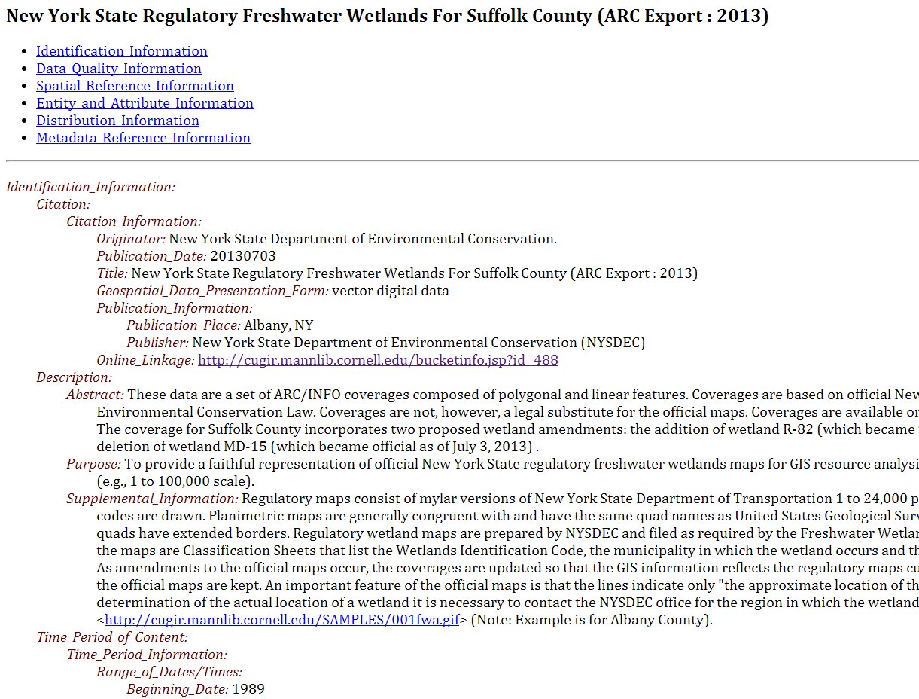
Another view of CUGIR metadata

Slide 10
Preservation and storage
Many decisions to make, for example:
Platform/location
File type
NDIPP is an excellent resource
File formats are a big concern
Cloud computing is an attractive option
Requires training, money, more staff, more infrastructure…
Not the answer for this initiative

Slide 11
Local option for metadata

Slide 12
Collection building process

Slide 13
Discoverability
Also known as “findability”
Metadata really helps with this
Searching data full-text is not necessarily helpful
Weigh benefits of creating yet another database to search with local control
Include this in discovery layers, institutional repositories, or known platforms for data

Slide 14
Example of a finding aid
http://researchguides.library.syr.edu/GIS

Slide 15
Why bother?
New and emerging role for libraries
Add a “citable unit” for faculty research
Highlight and stimulate research on campus
Help advance research and teaching
Even in a small way
Notes:
Change to full sentences, change title

Slide 16
Challenges
Hard getting to data
Exactly why this project is important
Repository upgrades
Taking an entire month
Can’t add new data
Time
Support from colleagues, institution, etc.
Notes:
This one okay for no sentences

Slide 17
Next steps
Find data (possibly find other data on campus)
Wait for Dspace to be upgraded
Begin pursuing collaborations with CUGIR librarians
Establish connections with faculty on campus who are using GIS

Slide 18
References
Bishop, B. W., Grubesic, T. H., & Prasertong, S. (2013). Digital Curation and the GeoWeb: An Emerging Role for Geographic Information Librarians. Journal of Map & Geography Libraries, 9(3), 296–312.
Bose, R., & Reitsma, F. (2006). Advancing Geospatial Data Curation. Retrieved from http://www.era.lib.ed.ac.uk/handle/1842/1074
Boxall, J. C. (2007). Advances and Trends in Geospatial Information Accessibility—Part II. Journal of Map & Geography Libraries, 3(1), 57–78.
Data Sharing Cooprative. (n.d.). NYS GIS Clearinghouse - Coordination Program. Retrieved October 29, 2013, from http://gis.ny.gov/co-op/
Dietrich, D., Adamus, T., Miner, A., & Steinhart, G. (2012). De-mystifying the data management requirements of research funders. Issues in Science and Technology Librarianship, 70(1). Retrieved from http://www.istl.org/12-summer/refereed1.html?a_aid=3598aabf
Erwin, T., & Sweetkind-Singer, J. (2009). The National Geospatial Digital Archive: A Collaborative Project to Archive Geospatial Data. Journal of Map & Geography Libraries, 6(1), 6–25.
Faniel, I. M., & Zimmerman, A. (2011). Beyond the Data Deluge: A Research Agenda for Large-Scale Data Sharing and Reuse. International Journal of Digital Curation, 6(1), 58–69.
Foundyller, C. (2011). GIS/Geospatial Sales Up 10.3% to US$4.4 Billion Growth Forecast to Top 8.3% in 2011. Cambridge, MA: Daratech.
Hartter, J., Ryan, S. J., MacKenzie, C. A., Parker, J. N., & Strasser, C. A. (2013). Spatially Explicit Data: Stewardship and Ethical Challenges in Science. PLoS Biology, 11(9).
Hoebelheinrich, N. J. (2012). An Aid to Analyzing the Sustainability of Commonly Used Geospatial Formats: The Library of Congress Sustainability Website. Journal of Map & Geography Libraries, 8(3), 242–263. doi:10.1080/15420353.2012.700301
Kollen, C., Dietz, C., Suh, J., & Lee, A. (2013). Geospatial Data Catalogs: Approaches by Academic Libraries. Journal of Map & Geography Libraries, 9(3), 276–295.
Metadata Ad Hoc Working Group. (2012). Federal Geographic Data Committee endorsed standards. Standards publications. Retrieved November 13, 2013, from http://www.fgdc.gov/standards/standards_publications/
Morris, S. P. (2009). The North Carolina Geospatial Data Archiving Project: Challenges and Initial Outcomes. Journal of Map & Geography Libraries, 6(1), 26–44.
National Institutes of Health. (2003, February 26). Final NIH statement on sharing research data. NIH Guide Notice. Retrieved October 28, 2013, from http://grants1.nih.gov/grants/guide/notice-files/NOT-OD-03-032.html
National Science Foundation. (2013, January 1). NSF Data Management Plan Requirements. Dissemination and Sharing of Research Results. Retrieved October 28, 2013, from http://www.nsf.gov/bfa/dias/policy/dmp.jsp
Olson, J. A. (2010). Data as a service: Are we in the clouds? Journal of Map and Geography Libraries, 6(1), 76–78.
Open Geospatial Consortium Standards and Supporting Documents. (2013). Open Geospatial Consortium. Retrieved November 13, 2013, from http://www.opengeospatial.org/standards
Reilly, S. (2012). The role of libraries in supporting data exchange. Presented at the International Federation of Library Associations, Helsinki.
Notes:
Add bit.ly link

Slide 19
Questions?
Jessica Clemons
@clemonsJess
jclemons@esf.edu
Thank you to:
Linda Musser (advisor)
Beth King
Notes:
Add ESF image,

