Slide 1
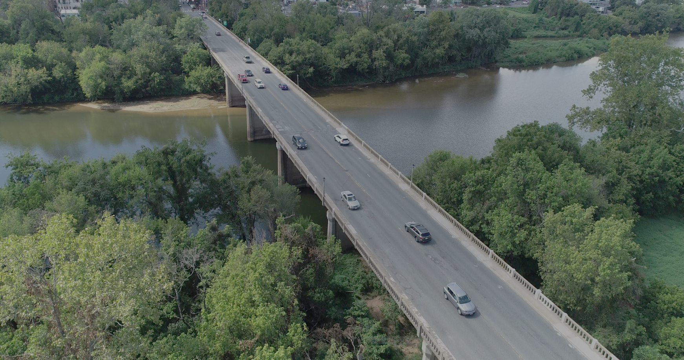
Stafford County, Virginia Transportation
A GIS Retrospective and Predictive review of the Stafford County Comprehensive Plan and the Factors Influencing Transportation
April 28, 2022
Student: Dustin Coburn
Advisor: Dr. Stephen Matthews
Notes:
Image Source: https://www.virginiadot.org/Projects/Fredericksburg/asset_upload_file294_135519.png

Slide 2
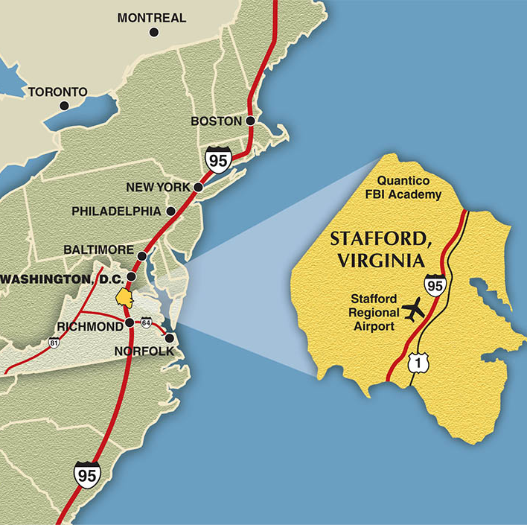
Overview
Why Stafford County?
Factors Influencing Transportation
Data Sources
Data Analysis
Timeline
Additional Considerations
Anticipated Results
References
Notes:
Map Source: https://www.gostaffordva.com/where-is-stafford-virginia/

Slide 3
Why Stafford County?
Located between Washington DC and Richmond, VA
Directly adjacent to Interstate 95
County commitment to economic growth
Population of 156,000 and growing
Birthplace of George Washington
Private and Public employers
Amazon
Geico
US Department of Defense
Federal Bureau of Investigation
Notes:
Image Sources:
https://www.potomaclocal.com/2021/11/10/amazon-to-build-second-larger-hub-in-stafford-county/
https://www.madd.org/new-york/sponsors/geico-logo/

Slide 4
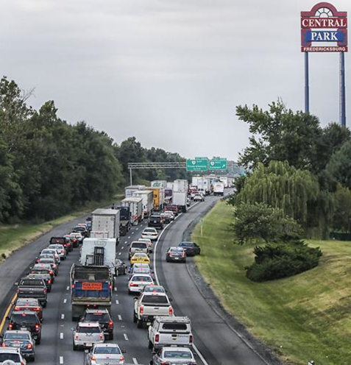
Factors Influencing Transportation
Changes in land use
Population growth
Economic climate growth
Revenue and funding
Technology advancements
Multi-model facilities (public transit, bicycle, and pedestrian)
Federal, regional, and local transportation improvements
Notes:
Image Source: https://fredericksburg.com/news/transportation/d-c--to-stafford-stretch-of-i-95-tabbed-worst-traffic-hotspot-in-u/article_b094fa03-527a-5826-bba5-de7e24810b69.html

Slide 5
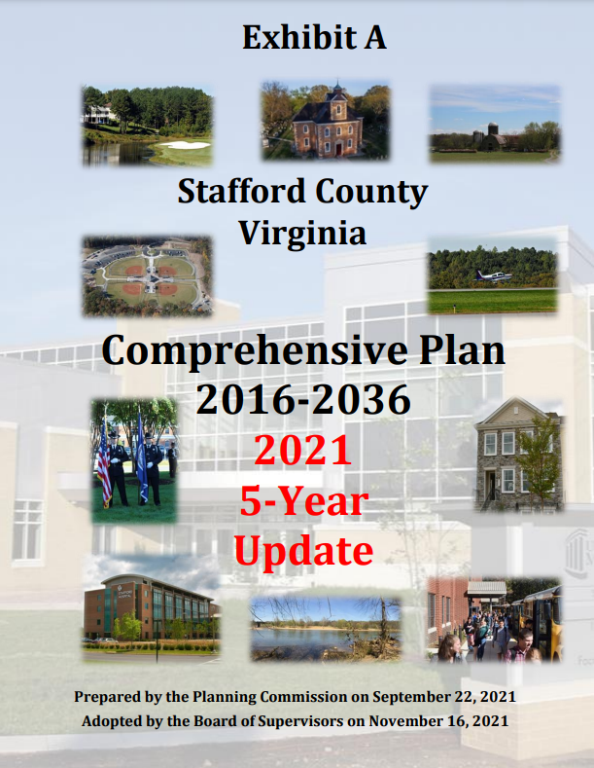
Primary Data Sources
Stafford County Virginia Comprehensive Plan 2016-2036
Stafford County GIS Portal
Virginia Department of Transportation GIS Portal
Virginia Open Data Portal
Bureau of Transportation Statistics
US Census ACS
University of Virginia Weldon Cooper Center for Public Service
Notes:
Image Source: https://cdn.staffordcountyva.gov/Planning%20and%20Zoning/Comp%20Plan%202016-2036%20Updated%2011162021/COMP%20PLAN%202021_11_16%20FINAL%20ENTIRE%20DOCUMENT.pdf

Slide 6
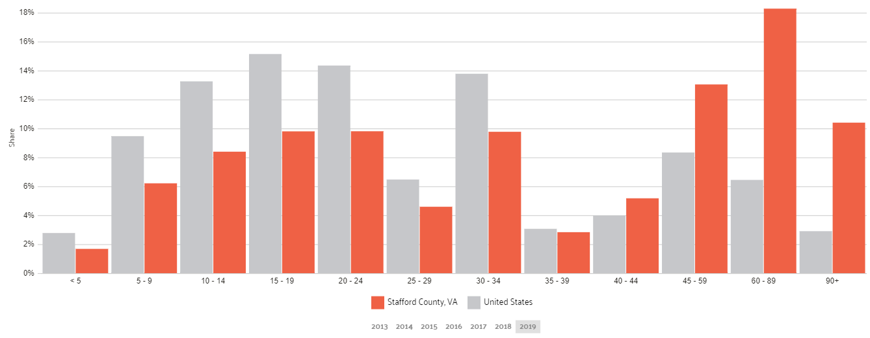
Data Analysis (2000, 2010, 2020)
Historic, Current and Projected
Transportation data
Economic data
Land Use and property Value
Demographics
Educational institutions
Commuting trends (to and from Stafford County)
Public transportation use and planned improvements
Notes:
Graph Source: https://datausa.io/profile/geo/stafford-county-va

Slide 7
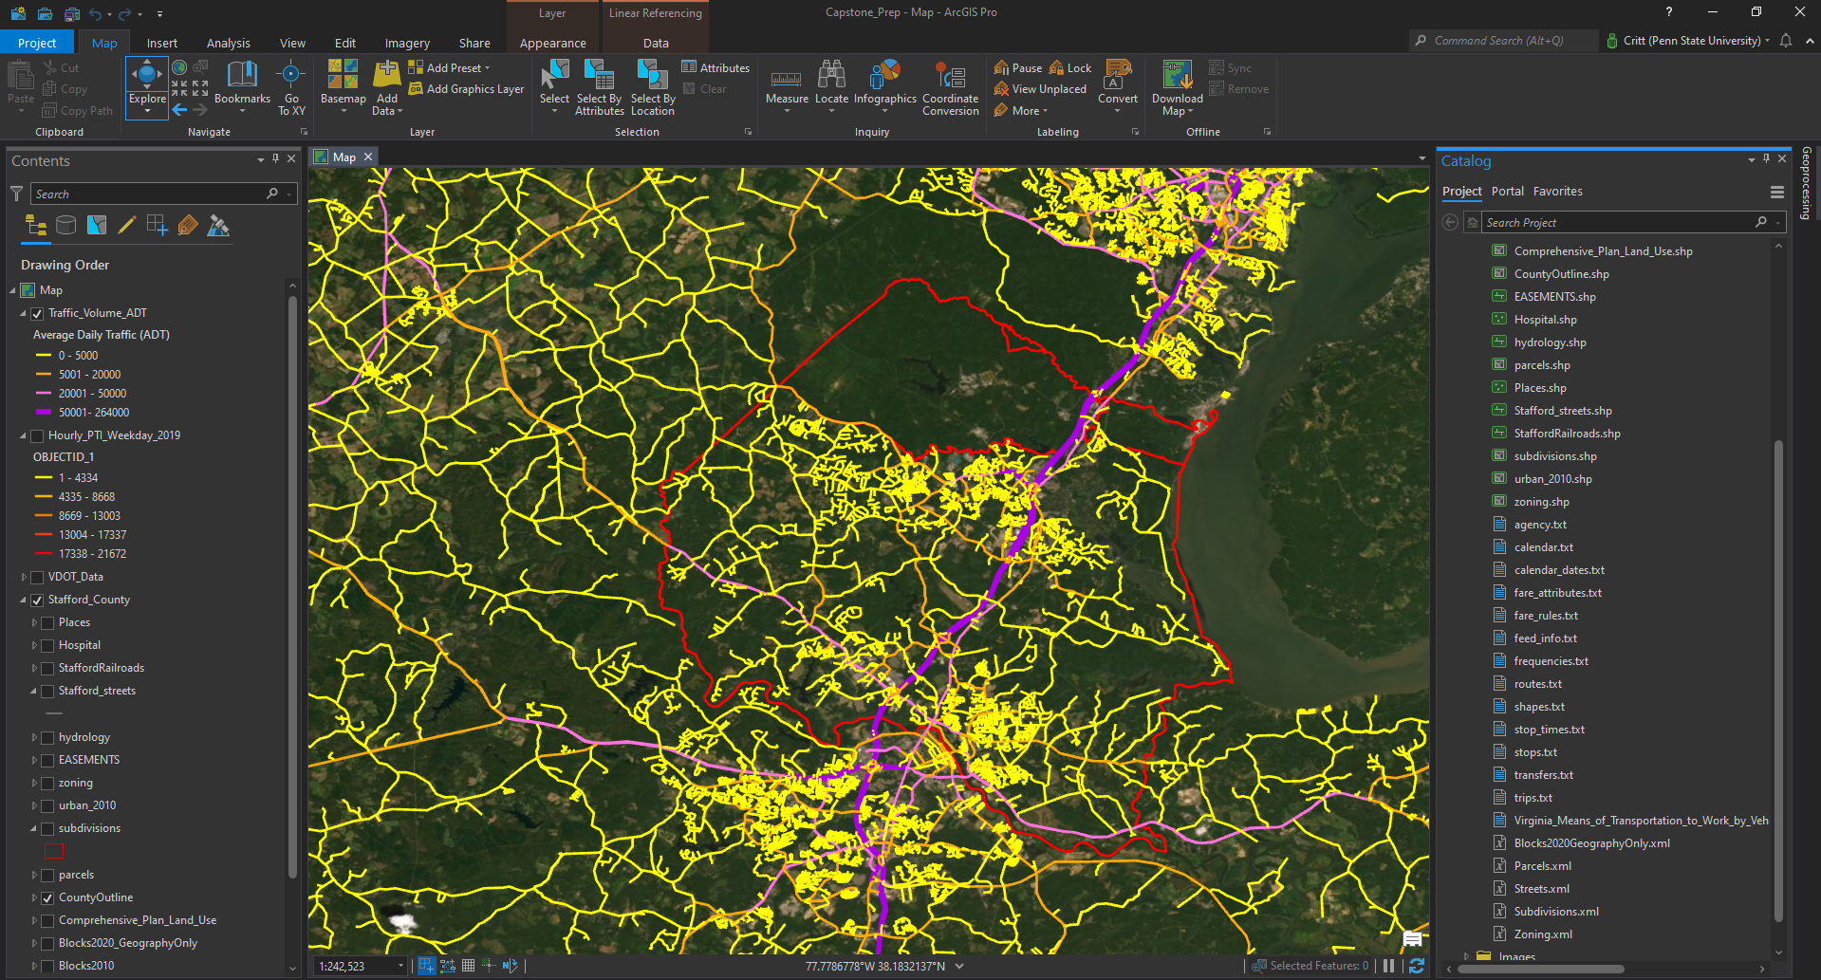
Data Analysis (2000, 2010, 2020)
Review data at ten-year intervals beginning in 2000
Create overview products geographically depicting data using ArcGIS Pro
Compare data and identify growth using Tableau to create charts for display
Geographically depict and compare growth, transportation and infrastructure expansion using ArcGIS Pro
Identify results and create projection graphics
Notes:
Historic transportation data – Transportation data includes traffic patterns and trends, road and infrastructure improvement projects, and
Commerce/economic data – Commerce directly related to Stafford County, economic growth during study, and projected economic growth as part of the Stafford County strategic plan, how will economic growth bring more commuters into Stafford and how will commercial traffic require additional infrastructure investment
Land use/property value – Adjustments in land use over time, identification of newly established subdivisions, effects of rising property values and home costs in relation to improvements in transportation infrastructure
Demographics – backgrounds of Stafford's residents, identify changes during study period
Educational institutions – Public and private schools, enrollment trends in relation to available transportation, future plans for more schools as the county expands
Commuting trends (to and from Stafford County) – Identify where residents of Stafford County are commuting to, major metropolitan areas or neighboring counties? Who is commuting in to Stafford County, what industries are they working in.
Public transportation availability and future plans – Stafford County strategic plan includes public transportation in addition to existing public transportation, will the COVID-19 pandemic change this plan? Should Stafford County continue the plan of investing in public transportation

Slide 8
Project Timeline
February 2022 – Begin GEOG 596A and develop project plan
April 2022 – Present project plan
May – July 2022 – Initial data review and analysis, build report and graphic templates
August 2022 – Begin GEOG 586 (Geographic Information Analysis)
August 2022 – Implement improved techniques gained in GEOG 586
September – October 2022 – Complete data analysis
November 2022 – Report and geographic products preparations
December 2022 – Present full capstone project
Notes:
Image Source: https://brand.psu.edu/visual-identity-standards/university-mark-and-shield

Slide 9
Additional Considerations
Differentiate Interstate 95 local traffic from through traffic
Quantico Marine Corps Base is within Stafford County, should this be included in the analysis?
What is the significance of surrounding areas, specifically Fredericksburg VA, an independent city
How will the COVID-19 pandemic shift Stafford Counties goals and plans
Notes:
Image Source: https://www.mountvernon.org/plan-your-visit/calendar/events/livestream-reflections-on-washington-s-farewell-address/

Slide 10
Anticipated Results
Stafford County will continue upward economic and population growth
Additional businesses entering Stafford County will cause the county to increase investment in transportation infrastructure
Stafford County will continue to invest in public transit and multi model facilities
The county will see a minor decrease in commuters due to an increase in remote work brought on by the COVID-19 pandemic
Stafford County will use the goals set forth in the comprehensive plan with minor adjustments as needed
Notes:
Image Source: https://news.sportslogos.net/2019/10/05/introducing-the-frednats-by-george/

Slide 11
References
Stafford County Virginia Comprehensive Plan 2016-2036 - https://staffordcountyva.gov/government/departments_p-z/planning_and_zoning/long_range/comprehensive_plan/comprehensive_plan_2016-2036.php
Stafford County GIS Portal - https://staffordcountyva.gov/government/departments_f-o/gis_(maps)/index.php
Virginia Department of Transportation GIS Portal - https://vdot.maps.arcgis.com/home/index.html
Virginia Open Data Portal - https://data.virginia.gov/
Bureau of Transportation Statistics - https://www.bts.gov/
US Census ACS - https://www.census.gov/programs-surveys/acs
University of Virginia Weldon Cooper Center for Public Service - https://demographics.coopercenter.org/
Why Stafford County, Virginia? - https://www.gostaffordva.com/
National Historic GIS - https://www.nhgis.org/

