Slide 1
Investigating Spatial Relationships ……………………………………………………………………………………… Short-Term Rentals &Criminal Activity
Class
Geog 596A
Presenter Clayton cockerham
Advisor Amy Griffin
Notes:
Good evening everyone.
My name is Clayton Cockerham and the subject of my presentation is the investigation of spatial relationships between short-term rentals and criminal activity.
Amy Griffin is my advisor for this project, and I’d like to thank her for all the guidance she has provided me thus far.
And with that, let’s just jump right in…..

Slide 2
So what’s the problem?
“The complaints we receive
include loud, late-night parties,
trash in the neighborhood,
parking problems, and crowds
gathering in the street in the
way of traffic.”
Las Vegas Review Journal – February 6, 2020
“[Nashville] police received 647 calls at short-term rentals
in the roughly 22 months. The Tennessean - March 12, 2017
"Noise, broken glass, throwing up in
the driveway, throwing up on the porch,“
The Buffalo News – February 20, 2020
“When police responded, a large party was occurring … with an estimated 60 people inside” The Denver Post - December 23, 2019
“They’ve [Residents] told horror stories of backyard sex parties.
The Tennessean - January 23, 2018
“By the time offensive conduct and disturbances end, the guests have left without Code Compliance officers ever having observed anything.“
Fort Worth Star-Telegram - May 13, 2019
"They're up late, they drink a lot, there’s
been drug activity, lots of trash throwing.“
The Courier Journal – April 23, 2016
Notes:
Across the United States and abroad, a growing number of municipalities and government bodies, have enacted legislation to regulate, limit, or ban Short-Term Rentals.
Neighborhood groups have described escalating levels of community disruption most often associated with unsupervised short-term rental properties.
In interviews with local media, residents recounted tales of drunken debauchery, vandalism, drug use, and persistent noise violations.
Some properties were described as “party houses” where dozens of attendees would gather for raucous occasions leading to outbreaks of violence, resulting both injuries and deaths.
Common amongst all these reports is the absence of on-site hosts or property owners to supervise and curtail such behavior.
These Non-Owner Occupied Short-Term Rentals are typically targeted in new legislation and generally receive the strongest restrictions.

Slide 3
Key Terms
Short-Term Rental (STR)
A furnished property rented for less than 30 consecutive days at a time.
Owner Occupied STR
A Short-Term Rental that serves as a primary residence and acts as a supplemental income source.
Non-Owner Occupied STR
An investment property not used as a primary residence that is solely profit driven. Used as a primary income source.
Professional Host
A user who rents out single or multiple units on a full-time basis, excluding users who rent spare rooms to supplement income.
$
Notes:
Before going any further it is important to clarify some of the terminology used in this presentation.
Some of these are industry or legal terms, while others are presentation specific.
First is “Short-Term Rental”……which is an industry and legal term that describes a furnished property, rented for less than 30 consecutive days at a time. This is essentially an umbrella term that encompasses all rental sub-types, including shared rooms, private rooms, entire homes, and vacation rentals. Exact time limits vary from jurisdiction to jurisdiction, but generally equate to approximately a month.
The next is “Owner Occupied Short-Term Rental”……. which is a presentation specific term that describes when a homeowner rents out an unused space for additional income. A 2019 study by Han and Wang refer to this type of short-term rental as “Authentic Home Sharing.” This is the rental type that has become synonymous with the Airbnb platform and is generally the most recognizable type. This property type typically serves as the owner's primary residence and they are usually present throughout the duration of the stay.
The term “Non-Owner Occupied Short-Term Rental” is often used in legislation to describe commercial short-term rentals. Han and Wang refer to this rental type as “Commercial Home Sharing”. This does not mean “commercial” in the sense of zoning or store fronts, but in the notion that the entire property itself is commoditized and used strictly for profit. A property of this type does not serve as the owner’s primary residence and the host is often an intermediary representing the owner. Generally interactions between the guest and host are limited.
The final term is “Professional Host” which describes a user that rents out single or multiple commercial short-term rentals on a full-time basis. While they act as host, they may or may not be the property owner. It is common for a Professional Host to manage multiple properties for multiple owners.
All of these term are in fact interrelated……a Short-Term Rental falls into either one of two categories Owner Occupied or Non Owner Occupied, the latter of which is managed by a Professional Host.

Slide 4
Short-term rental Categories
Owner Occupied STR
(Authentic Home sharing)
Non-owner occupied STR
(Commercial Home Sharing)
Host is present on-site
Host uses the property as a primary residence
Supplemental source of income
Primary function of the property is a permanent residence (Residence)
Host is NOT present on-site
Host does NOT use the property as a primary residence
Primary source of income
Primary function of the property is Short-Term Rental (Investment)
Considered a Professionally Hosted Property
Notes:
Professional Hosting is essentially an industry unto itself, with practices and priorities that are substantially different from non-professional hosting.
Because they function as an investment, Professional Hosted properties are marketed and managed in manner that prioritizes increased profits and reduced expenditures.
Professional Hosts often manage multiple properties and may employee third party services and management tools to increase efficiency.
Properties managed in this fashion generally lack the on-site supervision which is commonplace in Owner Occupied types.
This management style produces unique on-site conditions that may in turn have an influence on criminal activity.

Slide 5
Timeline
Airbnb Expands to apartments, houses, and vacation rentals
Period of Rapid Growth begins for Airbnb
Airbnb Sues San Francisco to block STR ordinance
Airbnb introduces Professional Host Tools
2008
2011
2014
2016
2018
2020
Airbnb Launches as a room sharing site
New York
passes Multiple Dwelling Law
San Francisco passes
Residential Unit Conversion Ordinance
Los Angeles introduces the Home Sharing Ordinance
Boston, New Orleans, Los Angles, Denver, and 16+ municipalities vote to regulate STRs
Notes:
Since its launch in 2008 Airbnb has contended with legislation restricting short-term rental operations.
Until 2016, much of that legislation was limited to densely populated urban areas, the focus of which was primarily housing availability and area rental rates.
However……between 2016-2018 a wave of municipalities including Boston, New Orleans, Los Angeles, and Denver began crafting and implementing legislation specifically targeting commercial short-term rentals.
Much of this legislation did not go into effect until 2019 due to litigation initiated by Airbnb.
It was also during this time period that Airbnb introduced tools specifically tailored to Professional Hosts.
When combined these factors indicate that Professional Hosting likely reached a critical point of growth and exposure sometime between 2016 and 2019 where conditions were sufficient to generate enough voter support to implement new regulations and restrictions.

Slide 6
What we Know
Xu, Kim and Pennington-Gray 2017
Positive relationship between densities of Airbnb and all crimes
Han and Wang 2019
Commercial (Non-Owner Occupied) home sharing has a positive association with rates of both violent and non-violent crime
Authentic (Owner-Occupied) home sharing had only a minor impact on crime rates, specifically weapons and drug crime types
Positive relationship between densities of Airbnb and property crime and a negative relationship with violent crime.
Spatially varying relationship between densities of Airbnb and all crimes
Relationships are altered by crime categorization and Airbnb listing type (Shared Room, Private Room, Entire Home)
Notes:
Few studies have examined the relationship between short-term rentals and criminal activity. The most directly relatable studies are by Xu, Kim, and Pennington-Gray in 2017 and Han and Wang in 2019.
These studies indicate a positive relationship exists between densities of short-term rentals and overall crime rates, with commercial short-term rentals having the strongest relationship.
Less clear are the relationships between short-term rentals and individual crime types.
The Xu, Kim, and Pennington-Gray study found a positive relationship with property crimes and a negative relationship with violent crimes while the Han and Wang study indicates there should be a positive relationship with both.
Such discrepancies may result from differences in the selection of individual crimes types used to populate the crime categories…..Property and Violent Crime categories in Xu, Kim, and Pennington Gray study and Violent and Non-Violent categories in for the Han and Wang study.
Han and Wang determined that variations in crime category selection alters relationship results, a fact which supports the prior assertion about discrepancies.

Slide 7
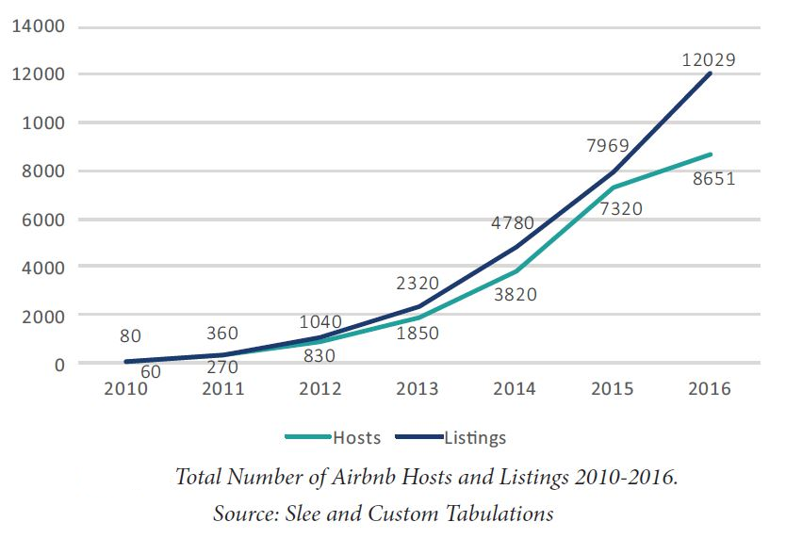
Why is this study necessary?
Image 1
Few studies directly address Short-Term Rentals and Criminal Activity
Most studies do not differentiate between Owner and Non-Owner Occupied
Professionally Hosted listings have grown to hold a sizable market share
Image 1: Richter, F. (2020) New Years' Peak Illustrates Airbnb’s Growing Stature. Statista [Digital Image] https://www.statista.com/chart/20386/guests-staying-at-airbnb-appartments-on-new-years-eve/
Image 2: Wieditz, T. (2017) Squeezed Out: Airbnb’s Commercialization of Home-Sharing in Toronto. FAIRBNB.CA Coalition. [Technical Report] March 2017, p. 13 https://www.researchgate.net/publication/319207035_Squeezed_Out_Airbnb%27s_Commercialization_of_Home-Sharing_in_Toronto
Image 2
Notes:
So why then is this study necessary? Well firstly……
(Click Slide)
The 2017 Xu, Kim, and Pennington-Gray study and the 2019 Hang and Wang study are really the only two available studies that directly focus on the relationship between Short-Term Rentals and Criminal Activity. There are other studies that tangentially look at this subject matter, but do not drill down into the nuances of different crime types and categories.
(Click Slide)
Furthermore, studies of Short-Term Rentals rarely distinguish between Owner and Non-Owner Occupied properties, choosing instead to focus on Airbnb rental designations such as Shared Rooms, Private Rooms, Entire Homes, and Vacation Rentals.
This is problematic because while professionally hosted properties are generally Entire Homes or Vacation Rentals, Entire Home rentals are not always Professionally Hosted. An owner may rent their entire home for only a few days a year, which would not qualify it as Professionally Hosted. This means even if a study focuses on Entire Home rentals, the data may not correlate with commercial short-term rentals unless the study accounts for duration of stay.
The lack of studies may also relate to the fact that the concept of the Professional Host has only recently emerged. While commercial short-term rentals have existed since the beginning of the industry, Airbnb only began promoting the Professional Host concept in 2018.
(Click Slide)
Professionally Hosted properties now represent a substantial portion of the overall Short-Term Rental Market.
The graph in the lower right-hand corner indicates the number of worldwide Airbnb guests on New Year Eve over the last decade. This New Years Eve metric is often used to exemplify yearly grow in the quantity of Airbnb guests. It shows a sustained growth trend from 2009 to present.
The graph in the upper right-hand corner is from a 2017 study of Commercial Airbnbs in the City of Toronto.
In 2015 the number of Airbnb hosts (shown in green) begins to plateau while the number of listings (shown in blue) continues to increase. This trend indicates an increase in the number of Professional Hosts with multiple listings.
This data indicates that Non-Owner Occupied listings are now growing at a faster rate than Owner Occupied listings.
This sharp increase in Professionally Hosted listings corresponds with the wave short-term rental legislation describe in the timeline earlier
Such as substantial change in the growth pattern of an industry that is still experiencing sustained overall growth is significant and warrants additional investigation.

Slide 8
Crime theory keystones
Routine Activity Theory
Convergence of motivated offenders, suitable targets, and an absence of suitable guardians
Crime Pattern Theory
Absence of controls, intimate handlers, guardians, and place managers
Rational Choice Theory
Offenders first consider if anticipated punishments outweigh anticipated results.
Increases likelihood of criminal activity.
Increases likelihood of predatory criminal activity.
Favorable conditions increase likelihood of criminal activity.
Notes:
Three criminological theories underpin this study.
The first, Routine Activity Theory, posits that the convergence of three factors, motivated offenders, suitable targets, and the absence of guardians creates conditions favorable for criminal activity.
The substance of these factors is as described. When a criminal with sufficient motivation encounters a vulnerable target within an unguarded environment, the possibility of a crime occurring increase exponentially. Basically, this means if predator and prey are placed together in a space with no controls they will act according to their nature.
Further expanding on this concept is Crime Pattern Theory which introduces into the mix three influencing factors…..intimate handlers, guardians, and place managers.
An intimate handler is a person who has some connection with the motivated offender and can influence their actions to reduce criminal behavior. This could be a family member, friend, or even an acquaintance.
A guardian is someone who protects a target, though they need not be a trained officer or security guard. They must simply be a person who’s presence serves as a deterrent and who’s influence reduces the suitability of potential targets. This can also be a family member, friend, or an acquaintance.
A place manager is a person who regulates behavior in the locations they control. They influence the actions of both offender and target by controlling environmental conditions and may or may not be directly acquainted.
Lastly is Rational Choice Theory which simply states that a criminal will weight the pros and cons when considering a crime and act if the reward outweighs the risk.
In the context of a short-term rentals these theories offer clear implications…….. (Click Slide)

Slide 9
Crime Theory Application
A host can act as all three control types: Intimate Handler, Guardian, and Place Manager.
Non-Owner Occupied Short-Term Rentals may lack all the three control types with no host or owner present.
High occupancy rates, regular tenant turnover, and a lack of assured controls creates a high risk of criminal activity
Notes:
The Crime Pattern Theory control types only require a person to wield some level of influence.
In the case of Short-Term Rentals, the person with the most influence should be the host.
At Owner-Occupied properties, a host assess guests before booking, greets guests upon arrival, imparts rules and instructions directly, and serves as a local primary point of contact. These interactions coupled with the host’s physical presence gives them direct influence over offenders, targets and the environment.
Removing the on-site host at Non-Owner Occupied Short-Term Rental removes the assured presence all control types, which all but guarantees that one of the three Routine Activity Theory factors, absence of suitable guardians, is consistently met.
The absence of controls coupled with sustained occupancy, and turnover rates, increase the chance of a convergence of all three Routine Activity Factors: motivated offenders, suitable targets, and the absence of suitable guardians.

Slide 10
Study Intention and Goals
Investigate potential spatial relationships between Non-Owner Occupied Short-Term Rental density and Criminal Activity
Notes:
The broad scope of this project is to investigate relationships between short term rentals and criminal activity.
More specifically this study will analyze the relationship between Non-Owner Occupied Short-Term Rentals and individual crime types.
Now let’s look at the methodology…..

Slide 11
Methodology
Notes:
This study will utilize the Difference-In-Differences technique previously used by Han and Wang in 2019.
Han and Wang’s stated intention was “to add to the understanding of the nature of the sharing economy, and the phenomenon of commoditization and institutionalization on sharing platforms.”
This study will build upon their preliminary work, while seeking to reconciling potential weaknesses from previous studies.

Slide 12
Han and Wang 2019
Potential Weaknesses
Study Area Comparability
Difference in neighborhood composition (Demographics, Housing Types)
Different approaches to short-term rental regulation (Proactive vs. Reactive)
Applicability
Significant socioeconomic event potentially contaminated result in at one study site
Legislation addressed in the study pertains to enforcement of existing law, not overall legality
Notes:
Critical improvements depend on the selection of viable data and study locations. Han and Wang made a temporal comparison of two study sites, New York and San Francisco, before and after the passage of short-term rental legislation. Being a comparative analysis, it required that the areas of study have equitable characteristics.
While New York and San Francisco are both densely populated urban areas, they have distinctly different housing conditions. New York is synonymous with high rise apartments and multistory brownstones, while San Francisco is synonymous with Victorian style homes and low-rise apartment buildings, due to long standing building height restrictions.
With so many densely populated buildings, New York has long taken a proactive approach to regulating housing, as evidenced by the early adoption of short-term rental codes in 2011. San Francisco’s 2015 regulatory efforts were a reaction to an ongoing housing shortage that began in 2012.
This socioeconomic event was driven by an influx of well-paid professionals seeking to capitalize on a booming Silicon Valley economy. This event caused a gentrifying effect that led to both a shortage of long-term housing and a steep increase in rental rates, which in turn led to evictions of low-income residents. With so many housing factors at play there is no way to be reasonably certain that short-term rental guests during the study period correlate to the type of guests under normal conditions.
Furthermore, the legislation cited in the Han and Wang study was meant to improve enforcement capabilities, not determine the legality of short-term rental types. It is likely that many of the commercial short-term rentals that shut down following the enactment of the new regulations had been knowingly operating in violation of the law. Such actions speak to the integrity of the hosts at these locations and calls into question the nominal operational state of the properties assumed by the study.
To reduce the influence of such factors, choosing a satisfactory study area is of critical importance and starts with an assessment of available datasets.

Slide 13
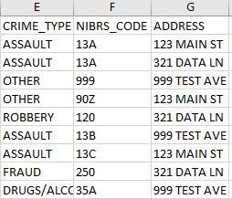
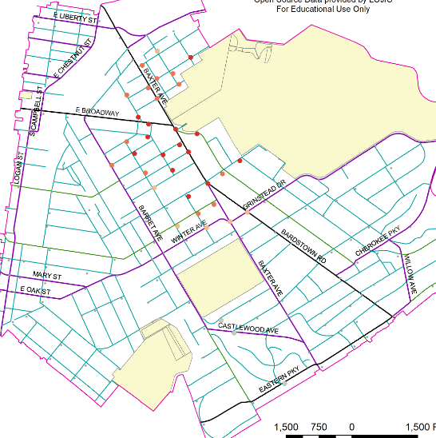
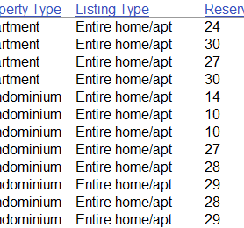
Data Specifications
Crime Data
Incident point locations must be precise and not approximations (City Blocks, Neighborhoods, etc.)
Date of occurrence
Crime Type designations in NIBRS format
Short- Term Rental Data
Incident point locations must be precise and not approximations (City Blocks, Neighborhoods, etc.)
Dates and durations of stays
Number of available days
Listing Type - Shared Rm, Private Rm, Entire Home
Notes:
Crime data is generally available in the form of yearly, CSV format reports published by local police departments. While readily available, the reports often vary in complexity, accuracy, and usability.
To be viable for this study…..
The report must contain geocodable point location data. These points need to represent the true physical locations of incidents, not city blocks or neighborhoods. Previous tests indicate that generalized location data, by city block or neighborhood, results in a large amount of incident overlap, which is likely more attributable to reporting practices than actual criminal activity. Lat/Long coordinates or city style addresses are both acceptable formats.
Crime types should be assigned code designations compatible with the Federal Bureau of Investigation’s National Incident-Based Reporting System. This system divides crimes into two categories based on severity. Prior studies did not utilize an officially recognized system for grouping crimes in categories such as Violent, Non-Violent or Property. This study will use NIBRS standards to increase the comparability of results and reduce relationship variation.
Short-Term Rental data will be acquired via scraping services such as InsideAirbnb or AirDNA and further supplemented with any available data from area permit services.
The accuracy of point location data from scrapping services varies greatly from area to area. This a result of platforms, such as Airbnb, giving users the option to display an actual property address or a generalization. If they choose not to show the address, Airbnb will display the area within 500m of the property to ensure guests understand where they are booking stays. Scraping services distinguish between true locations and false locations making filtering possible, but an abundance of false locations will adversely affect result accuracy.
With supplementary local permit data it may be possible to cross-reference false locations to make the data useable, but the availability permit data is not guaranteed.
Additionally, stay durations, available days, and listing types will help to verify if a property is truly Non-Owner Occupied, by identifying any occasional Owner-Occupied Entire Home Rentals.

Slide 14
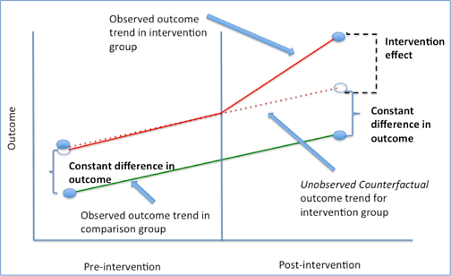
Difference in Differences
Define the period of study and intervening event date.
Group analysis units by similarity
Select control and experimental points to avoid contaminated results
Analyze the conditions before and after the intervening event in both groups
Image Source: Difference-in-Difference estimation, graphical explanation [Digital Image] Difference-in Difference Estimation. Columbia University Mailman School of Public Health (2019) https://www.mailman.columbia.edu/research/population-health-methods/difference-difference-estimation
Notes:
Difference in Differences is a form of regression analysis that involves defining control and experimental groups, then analyzing the difference in change that occurs between the two groups, following an intervening event. For the analysis to be viable both groups must be comparable in composition and the intervening event must be clearly defined.
The control group will consist of private properties that do not contain any short-term rentals, rendering them unaffected by any legislation.
Units of analysis will be grouped together by similarity using a combination of Census demographic data and observations of neighborhood composition, such as primary housing types. Control and experimental points will be selected in a manner that avoids contamination of influence. Requirements to avoid contamination by proximity of influence will be study area specific, but will likely involve utilizing buffer zones.
The intervening event will be legislation regulating Short-Term Rentals. This does not necessarily mean a ban, but the legislation must be clear, enforceable, and not delayed by litigation. The intent is to avoid the gray areas present in previous studies where illegal short-term rentals were operating in open violation of the law due to ambiguous ordinances or lack of enforcement provisions.
Conditions before and after the intervening event will then be analyzed in both groups to determine what, if any, changes occurred and what difference exists between the groups.

Slide 15
Project Process
Data Assessment
Assess availability of crime data and rental data
Site Selection
Check site list for areas matching neighborhood composition and demographics.
Analysis
Produce list of sites with acceptable data
Qualify data using required specifications
Check for strength of legislation and potential contaminating events
Prepare control and experimental groups
Perform difference in differences regression analysis of selected site
Notes:
This study is currently in the data assessment phase, focusing on the availability, quantity, and quality of both crime reports and short-term rental data.
Following the data assessment phase, the project will move into site selection. Research will be conducted on sites identified in the prior phase to determine if they meet conditional and legislative qualifications. Tests will also be conducted to determine if control and experimental groups can be established using existing statistical or legal boundaries as units of analysis.
Once selected, control and experimental groups will be established, and the Difference in Differences analysis will take place.
Whereas Han and Wang utilized two different municipalities as the control and experimental groups, this study aims to use a single subdivided municipality.
This action should help reduce differences in law application, neighborhood composition, and demographics observed in the Han and Wang study.
If this concept proves untenable due to limitations in the quantity or quality of available data, the study will shift to a comparison using multiple municipalities selected from the list of previously qualified sites.

Slide 16
Questions

Slide 17
Resources:
Airbnb. (2020a) Fast Facts. Retrieved on 03/21/2020 from https://news.airbnb.com/fast-facts/
Bailey, P. (2016). Airbnb rules rip neighbors apart. The Courier Journal [Louisville], 24 April 2016, Digital Article. Retrieved on 3/10/2020 from https://www.courier-journal.com/story/news/local/2016/04/23/airbnb-rules-rip-neighbors-apart/82800926/
Difference-in-Difference estimation, graphical explanation [Digital Image] Difference-in Difference Estimation. Columbia University Mailman School of Public Health (2019) Retrieved on 5/4/2020 from https://www.mailman.columbia.edu/research/population-health-methods/difference-difference-estimation
Han, W & Wang, X 2020, Does home sharing impact crime rate? A tale of two cities. in 40th International Conference on Information Systems, ICIS 2019. 40th International Conference on Information Systems, ICIS 2019, Association for Information Systems, 40th International Conference on Information Systems, ICIS 2019, Munich, Germany, 12/15/19
Garrison, J. (2018) Nashville council approves Airbnb phase-out bill for residential neighborhoods. The Tennessean [Nashville] 23 January, 2018. Digital Article. Retrieved on 5/1/2020 from https://www.tennessean.com/story/news/2018/01/23/ashville-council-approves-airbnb-phase-out-bill-residential-neighborhoods/1057718001/
McShea, K. (2020) Neighbors: South Buffalo home where man was killed is Airbnb with many parties. The Buffalo News [Buffalo] 20 February 2020 Digital Article. Retrieved on 5/1/2020 from https://buffalonews.com/2020/02/20/19-year-old-man-shot-killed-inside-home-in-south-buffalo/
Ranker, L. (2019) As Airbnb spread, some wonder if Fort Worth is doing enough to control ‘party houses.’ Fort Worth Star-Telegram [Fort Worth] 13 May, 2019. Digital Article. Retrieved on 5/1/2020 from https://www.star-telegram.com/latest-news/article230211789.html
Reicher, M. (2018) Complaints shed new light on short-term rental fight. The Tennessean [Nashville] 19 January, 2018. Digital Article. Retrieved on 5/1/2018 from https://www.tennessean.com/story/news/politics/2017/03/12/complaints-shed-new-light-nashvilles-airbnb-fight/98910284/
Richter, F. (2020) New Years' Peak Illustrates Airbnb’s Growing Stature. Statista [Digital Image] Retrieved on 5/4/2020 from https://www.statista.com/chart/20386/guests-staying-at-airbnb-appartments-on-new-years-eve/
Schultz, B. (2020) Airbnb, short-term rentals see continued growth in Clark County. Las Vegas Review Journal [Las Vegas], 06 February 2020, Digital Article. Retrieved on 5/1/2020 from https://www.reviewjournal.com/business/tourism/airbnb-short-term-rentals-see-continued-growth-in-clark-county-1951979/
Simmons, A. Short-Term Rental Laws in Major U.S. Cities. 2nd Address Research, 02/05/2020, Digital Article. Retrieved on 3/21/2020 from https://www.2ndaddress.com/research/short-term-rental-laws/
Swanson, C. (2019) A new city rule is tested as 2 Denver property owners must defend their short-term rental licenses. Denver Post [Denver] 23 December, 2019 Digital Article. Retrieved on 5/1/2020 from https://www.denverpost.com/2019/12/23/denver-short-term-rentals-airbnb/
Wieditz, T. (2017) Squeezed Out: Airbnb’s Commercialization of Home-Sharing in Toronto. FAIRBNB.CA Coalition. [Technical Report] March 2017 Retrieved on 5/4/2020 from https://www.researchgate.net/publication/319207035_Squeezed_Out_Airbnb%27s_Commercialization_of_Home-Sharing_in_Toronto
Wilhelm, A. (2020) Airbnb’s New Year’s Eve guest volume shows its falling growth rate. Tech Crunch [Digital Article] Retrieved on 4/28/2020 from https://techcrunch.com/2020/01/01/airbnbs-new-years-eve-guest-volume-shows-its-falling-growth-rate/
Xu, Yu-Hua; Kim, Jin-won; and Pennington-Gray, Lori, "Explore the Spatial Relationship between Airbnb Rental and Crime" (2017).Travel and Tourism Research Association: Advancing Tourism Research Globally. 5. https://scholarworks.umass.edu/ttra/2017/Grad_Student_Workshop/5

