Slide 1
Where to Next?
Using scenario-based design and task analysis to assess web-GIS functionality for travel planning
Brookelynn Constant
Geography 596A
Pennsylvania State University
Adviser: Anthony Robinson

Slide 2
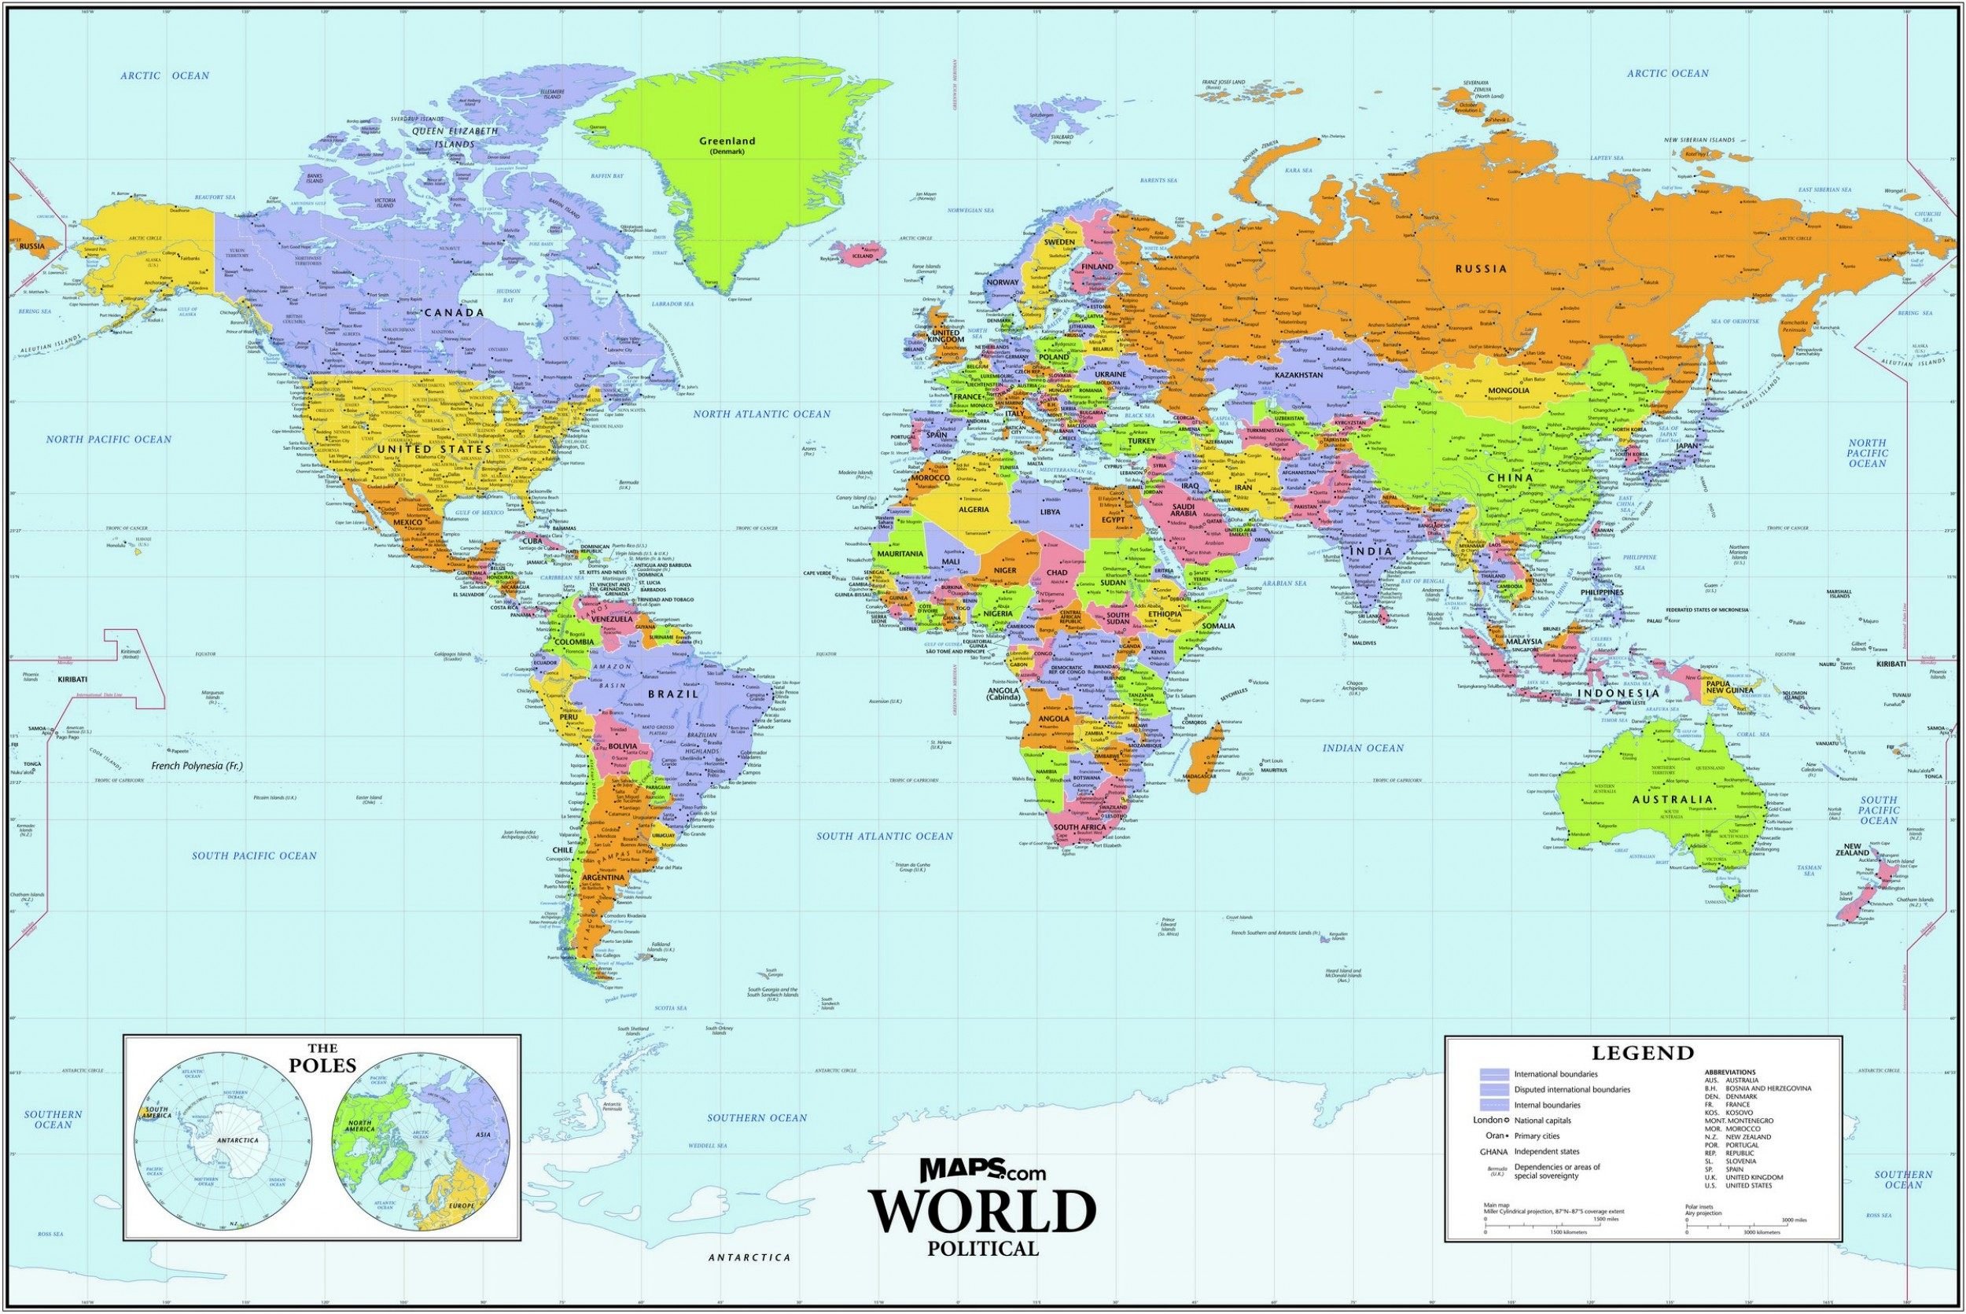
Overview
Research Question
Research/Design Influence
Web-map vs web-GIS
Motivation
Methodology
Significance/Limitations
Where to Next?

Slide 3
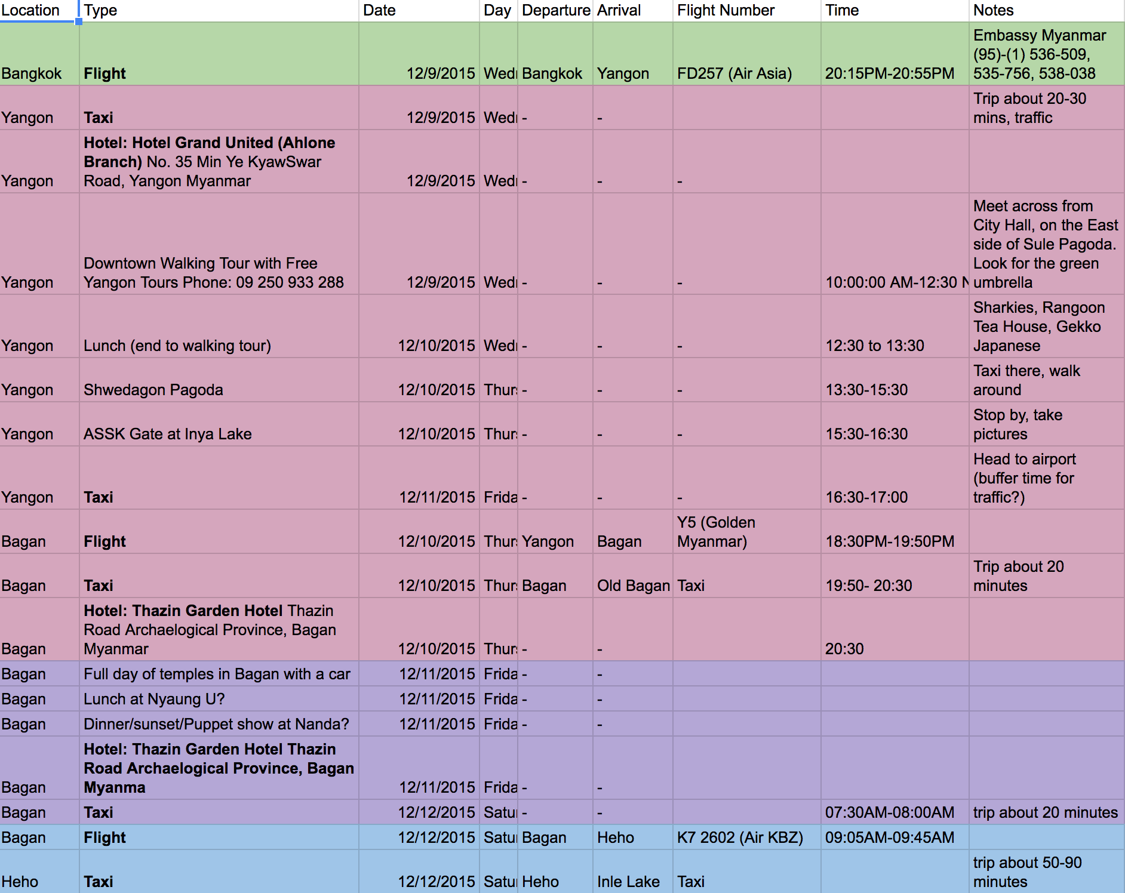
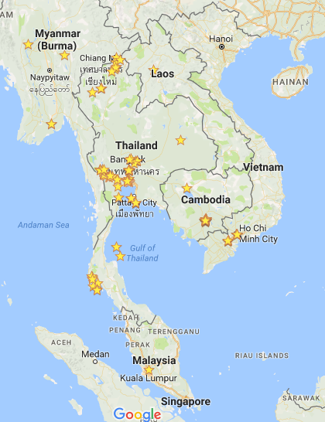
Research Question
How can a web-GIS’ functionality be tailored for recreational purposes or reflection on past experiences?
What specific tasks are most important to this user?

Slide 4
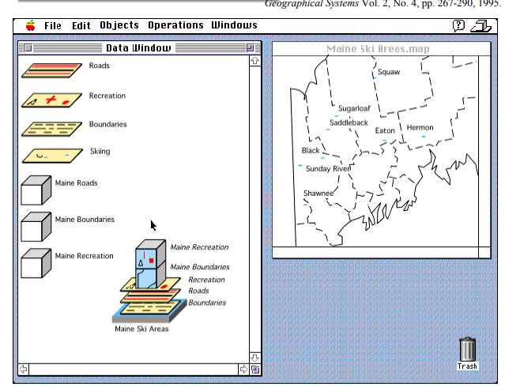
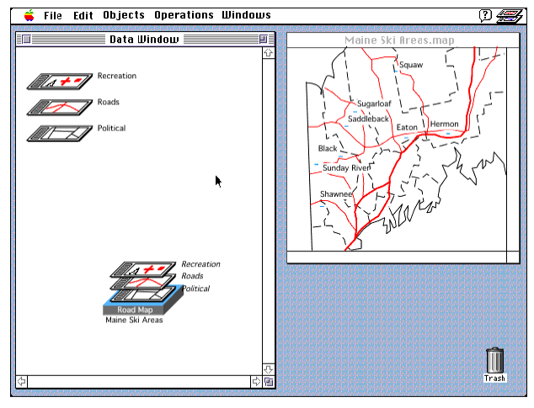
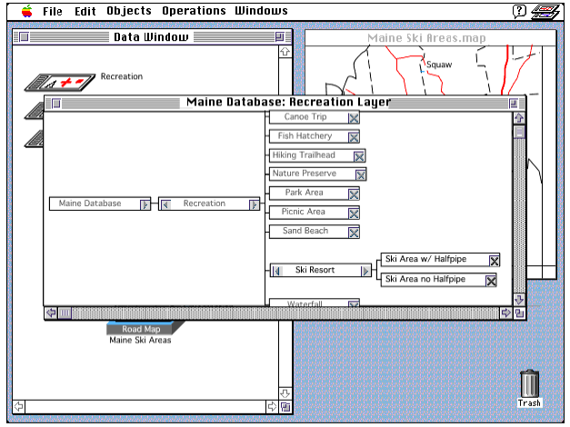
GIS User Interface and Tasks
Identifies what a user would do and how they would achieve the desired outcome.
Which interface resulted in fewer clicks? Which was more intuitive? Why?
Assumptions, actions, and error.

Slide 5
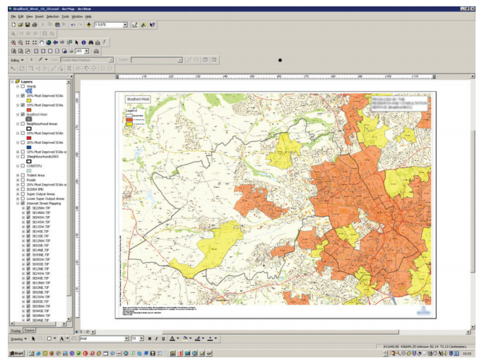
GIS Design Influence
Screen shot assessment.
What toolbars are active? How large is the map area compared with other interface items?
Measured “Effectiveness of the Interface.”

Slide 6
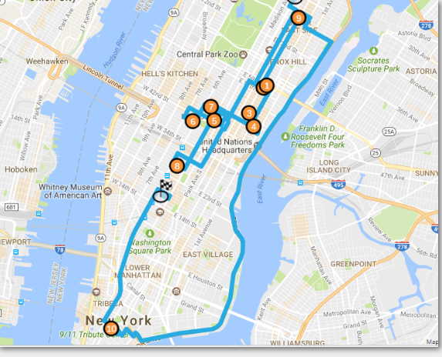
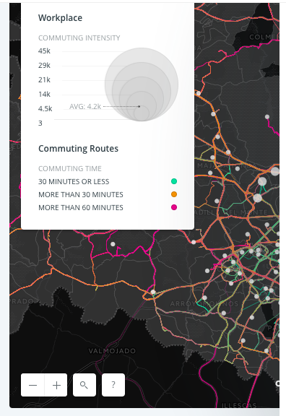
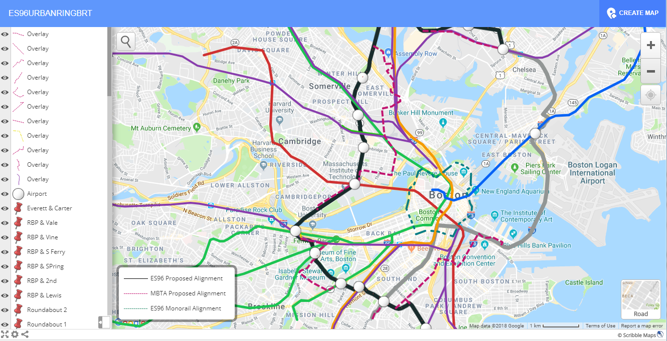
Relevant Web-based Tools
A web-map versus a web-GIS?
Web-Map (Visualization) | Web-GIS (Analytic Component)
Google Maps, My Maps | ArcGIS Online
Open Street Map Viewer | CartoDB
MapBox* | Scribble Maps
 | eSpatial
* Can be modified/enabled as a GIS with TurfJS

Slide 7
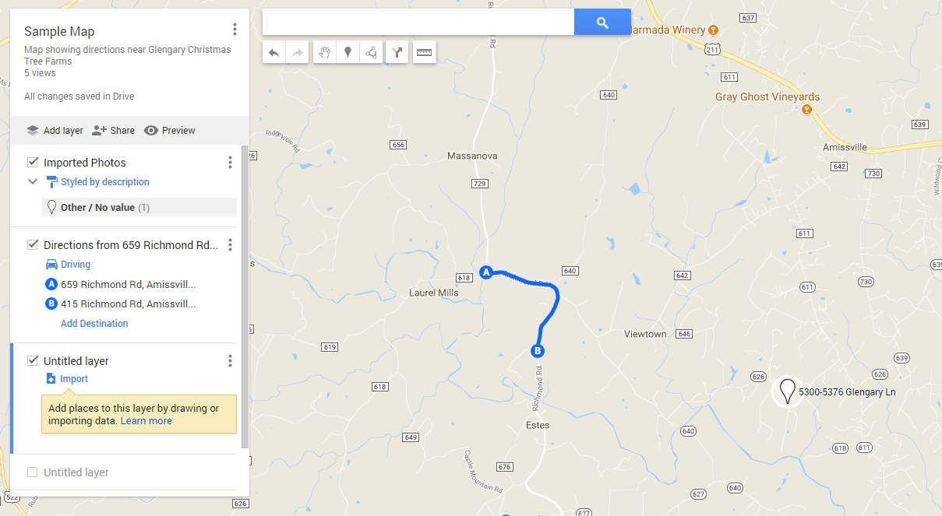
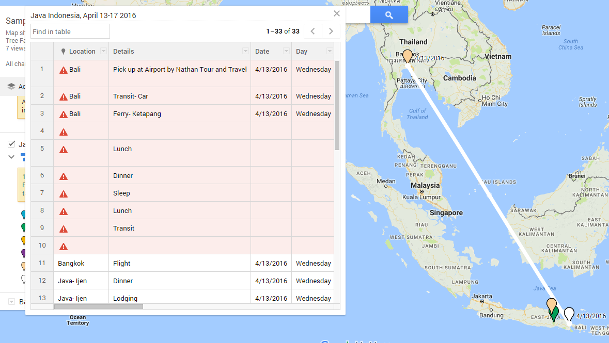
Google MyMaps Review
Flexible symbology, imports, map sharing.
Difficult to customize
What fields are needed prior to importing?
Not fully interoperable with saved places.

Slide 8
Motivation For This Research
How can a user generate spatial information that can be easily visualized and shareable?
What functionality do users want to have when working with this interface (i.e. anecdotal: ‘I wish it would…’)?
Are there specific functions that users want (ex.: Drop a pin, add a label)?
What type of design choices help a user achieve these tasks more intuitively or faster?

Slide 9
Methodology
Consultations and heuristic development
Use cognitive walk-throughs to identify tasks/subtasks. Generate wireframes.
Initiating
Consultations with colleagues/friends.
Capture initial task requirements.
Identify and outline specific tasks (Cognitive walkthroughs).
Design & Development
Design prototype wireframes.
Develop a persona.
Develop scenario(s) that address user needs.
Identify tasks.
Modify wireframes
Persona, scenario, and wireframe development
Test task completion using wireframes
Assess results
Review cognitive walkthroughs of tasks and collect additional heuristic measures
Present findings

Slide 10
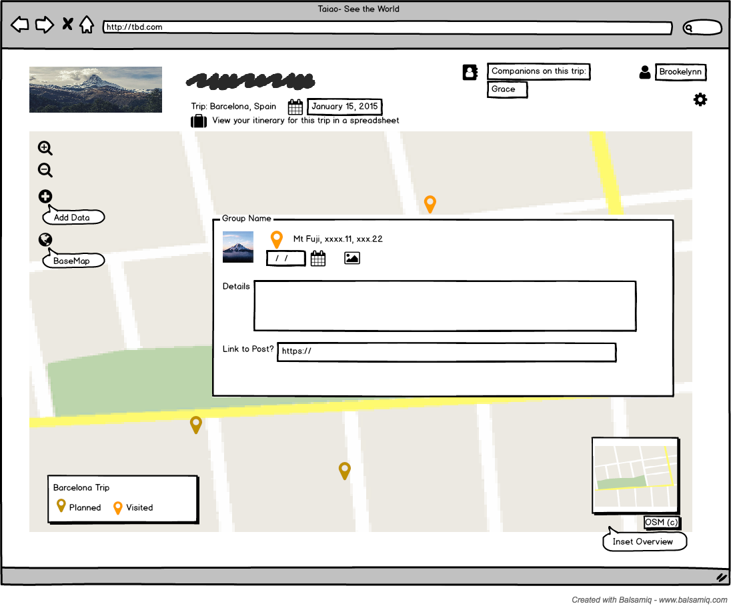
Wireframe Design
From the perspective of the user, what capabilities must be present?
Add a point, a photo, free-form text details, date, time, etc.
Designed by Brookelynn Constant using Balsamiq

Slide 11
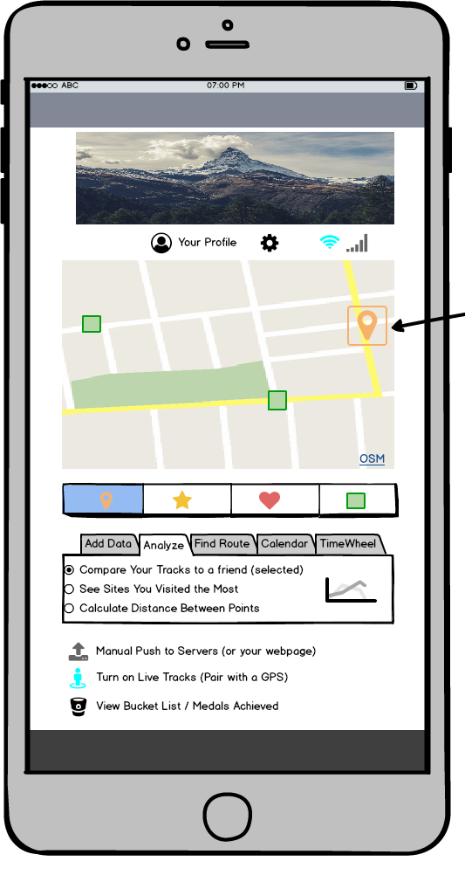
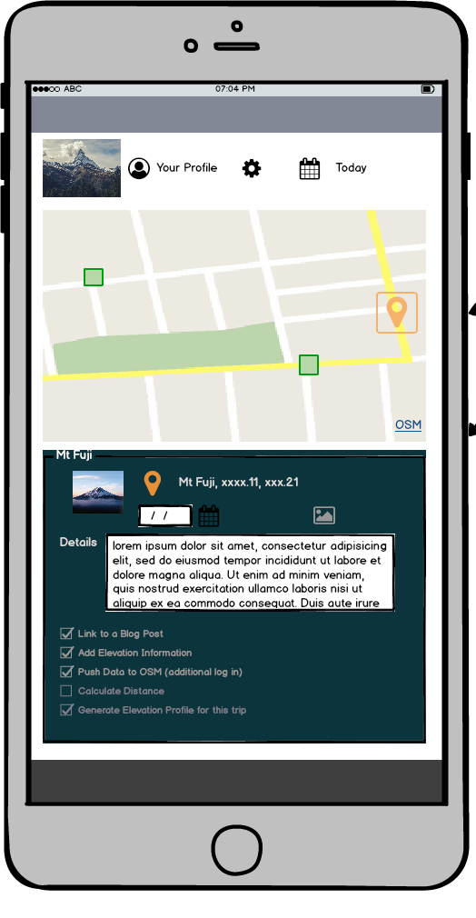
Sample Task
Edit an existing point and add details about your visit.
View map data in calendar form.
Choose the tool to find distance between points.
Designed by Brookelynn Constant using Balsamiq

Slide 12
Methodology, Continued
Data collection
Upload wireframes to a click-test app, like Chalkmark
Share System Usability Survey.
Analysis
Assessment: Did the user perform the task correctly? Were errors made in response to the design features or misunderstanding the task?
How long did tasks take? Where did users click the most? What errors were observed?
Monitoring/Evaluation
Revisit cognitive walkthroughs
Asses usability feedback.
Closure
Consolidate overall findings.

Slide 13
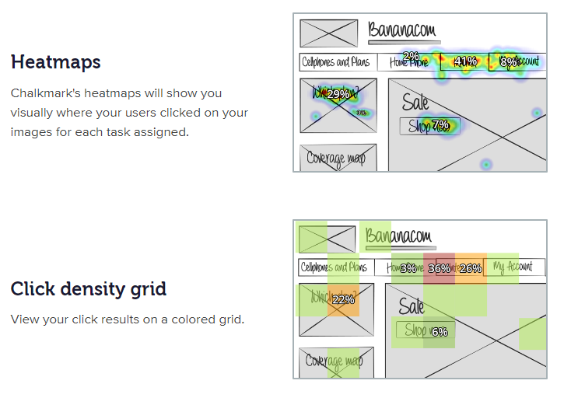
Chalkmark
Can test a user’s first impression of a site.
Upload tasks and associated wireframes.
Heatmaps, density grids.
Accessed via Chalkmark.com Live Demo at https://bananacom.optimalworkshop.com/chalkmark/bananacom-demo-survey

Slide 14
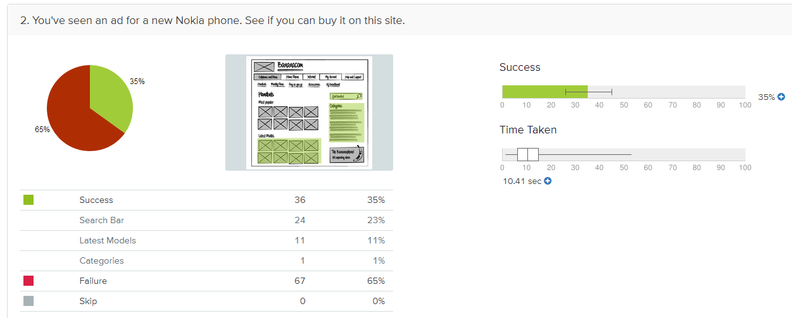
Chalkmark
Sample task analysis.
Recruit participants through Chalkmark.
Accessed via Chalkmark.com Live Demo at: https://www.optimalworkshop.com/chalkmark/bananacom/bananacom-demo-results/shared-results#/t/analysisTools/taskResults

Slide 15
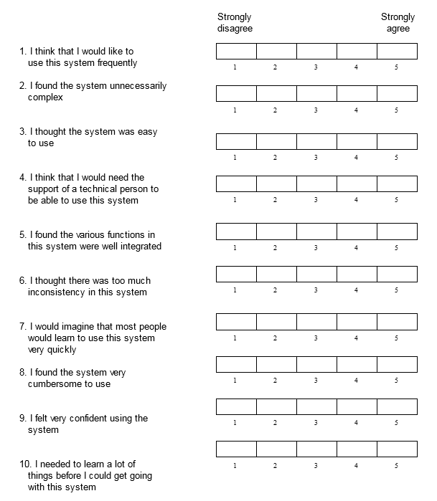
The System Usability Scale
General and low-cost measure of system usability.
Usability is defined by the context in which it is used.
Digital Equipment Corporation, 1986 ©

Slide 16
Significance & Limitations
What design features of a web-GIS are most useful when visualizing a trip?
Potential applications for web-GIS design in other industries, like healthcare.
Doesn’t automate selection of locations in an itinerary.
Not a live-demo.
Doesn’t capture all possible design features or tasks.
Sample size.

Slide 17
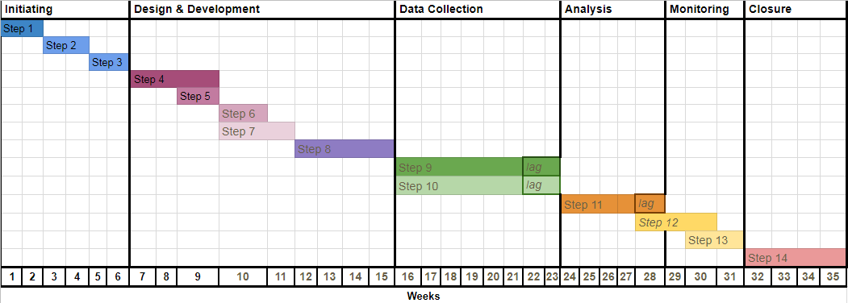
Project Timeline and Proposed Conferences
FOSS4G Fall ‘19, Bucharest
FOSS4G Spring ‘19, North America
AAG April Spring ‘19, Washington DC
HCI International, Summer ‘18
ACM Symposium on User Interface Software and Technology (UIST) Fall ‘18

Slide 18
Where to Next?
Finalize proposed methodology.
Develop the scenario(s) and associated tasks.
Design/finalize wireframes.
Launch Chalkmark assessment.
Select the presentation venue.

Slide 19
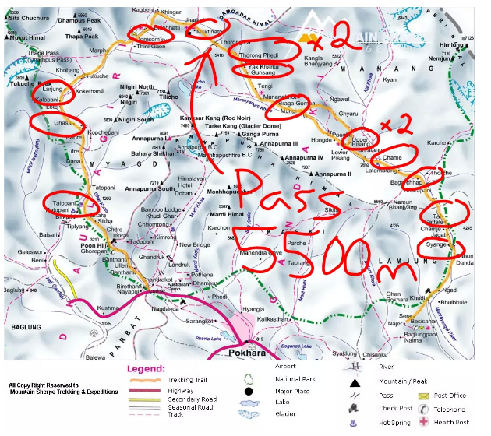
Conclusion
User-oriented approach to assessing the functionality of a web-GIS informs design and development.
What can be streamlined in the design process to enhance how users accomplish travel-related tasks in the future?
Image retrieved 2018 from: http://bsbs.ca/travelling/nepal/annapurna-circuit/
Notes:
http://bsbs.ca/travelling/nepal/annapurna-circuit/

Slide 20
References
Haklay, Mordechai (Muki), Antigoni Zafiri. 2008. “Usability Engineering for GIS: Learning from a Screenshot.” The Cartographic Journal Vol. 45 No. 2. Accessed from: http://discovery.ucl.ac.uk/7902/1/7902.pdf
Richards, James and Max Egenhofer. 1995. “Comparison of Two Direct-Manipulation GIS User Interfaces for Map Overlay.” Geographical Systems. Vol 2, No. 4. Accessed from: https://pdfs.semanticscholar.org/9c20/d37b57d61ce772f4abe65e4fc46c299a334d.pdf
Hallett, Kim. “Human Factors Evaluation: The Cognitive Walkthrough.” December 2016. Youtube video retrieved from: https://www.youtube.com/watch?v=CeWAbGU5cSw
Notes:
https://www.youtube.com/watch?v=CeWAbGU5cSw
http://bsbs.ca/travelling/nepal/annapurna-circuit/
Camino de Santiago trail slides

