Slide 1
GIS Terrain Analysis tools for the U.S. Army
Kyle Corle
GEOG 596
Notes:
Overall, my capstone is a project development case focused around replacing the Army’s current tool for terrain analysis.

Slide 2
OVERVIEW
How we got here
Terrain and the Operations Process
Distributed Common Ground System – Army Overview
Palantir Overview
Project Development Process
Ideal Architecture
Evaluation Criteria
Sources

Slide 3
How we got here – Failures and Corruption
Program Creation
Late 1990s
DCGS-A Launch
Early 2000s
DCGS-A Cloud Failure
2012
Forward Operational Assessment
2012
Notes:
First, I’ll discuss how the government got to where we are today, replacing the aging and inadequate Army intelligence system, the Distributed Common Ground System – Army or DCGS-A.
In the late 1990s, the program DCGS-A was created by a group of service members known as the Distributed Common Ground Systems Board. The program was designed to be a massive information sharing system specifically for the war on terror. The Pentagon promised the system would enable Soldiers to better process, analyze, and disseminate intelligence information. However, the system is a classic example of overspending and is seen as an operational failure.
In the late 1990s, 4 of the Nation’s largest defense contractors each got a portion of the multi-billion dollar project that has yet to become fully integrated and operational.
In the early 2000s the system officially launched. During this process, the President of “Citizens Against Government Waste” Tom Shatz, stated that “Most agencies like creating their own programs, congress gives them the money, they don’t look at private sector alternatives, that means all those years where technology advanced rapidly in the private sector, the government has simply fallen behind.
Where the Army encountered the major issues with the system is the “cloud”, and that is simply because it didn’t work, therefore, the whole system didn’t work. By the end of 2010, the Army spend over 162 Million dollars on the cloud and failed to meet its implementation deadline.
In 2012, the Chief of Staff of the Army ordered the test and evaluation of DCGS-A by the Army Operational Test Command, it showed that 96% of troops surveyed recommended Palantir. The Army later replaced that version of the report with another and removed these claims to ensure continued support for their decrepit system.
While the Army continued to throw billions of tax payer dollars into the struggling “DCGS-A” a company called Palantir Technologies developed a series of software applications that provided DCGS-A additional capabilities. Based on emails and internal reports, the system is stated to actually work.
Because of this, commanders in Iraq and Afghanistan continually submitted requests to have Palantir Technologies sent forward to troops overseas but were repeatedly denied. They also repeatedly sent emails explaining how the failed system was contributing to the deaths of service members.
During this time, other branches of service were claiming success after integrating Palantir systems with the DCGS system, which the Army refused to do.

Slide 4
How we got here – Failures and Corruption
Palantir Bids Protest 2014-2016
Palantir Awarded Contract 2018
Notes:
Moving forward, between 2014-2016, the Army had to review the contract established with the designers of DCGS-A. The result of this process ended with a renewal of the contract.
Following the renewal, in 2016, Palantir sued the Army in the U.S. Court of Federal Claims for what it says was an unlawful procurement solicitation for the service’s next iteration of DCGS-A that shut out other competition.
The lawsuit argued that the Army should be stopped from moving forward on an unlawful and risk-prone software development project that would reinvent the wheel at a very high price.
The court ruled in favor of Palantir in October 2016, stating that the Army violated a 1994 law – the Federal Acquisition Steamlining Act, by not conducting the market research needed to determine if commercially available items could meet the needs of the Army.
After a thorough review of possible solutions, the Army then awarded Raytheon and Palantir to re-build DCGS-A platforms with a ceiling of $876 million with a period of performance for 10 years (March 9, 2018).
This brings us to where we are today, a new contract with a new vendor without the GIS capability to conduct terrain analysis digitally which I’ll discuss a little later.

Slide 5
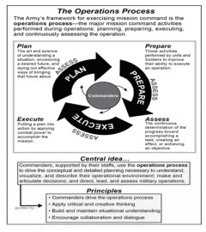
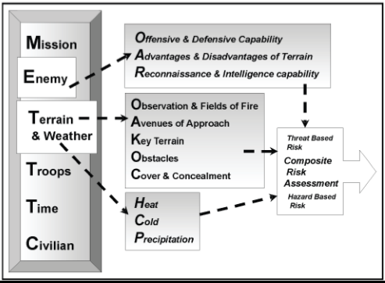
Terrain Analysis and the Operations Process
Notes:
I’ll now discuss how terrain analysis fits into the army operations process, or how the army continuously plans and executes operations.
By Army definition, the Operations process is the major mission command activities performed during operations: planning, preparing, executing, and continuously assessing the operation. Commanders supported by their staff use the operations process to understand, visualize, and describe their operational environment; make decisions and articulate decisions; and direct, lead, and assess military operations.
As part of the operations process is the ability to understand, visualize, and describe the operational environment, which is where terrain analysis comes into play. During the plan portion of the process, the intelligence officer and his/her staff conduct intelligence preparation of the battlefield, or IPB. This is a four step process in which step two is describe the operational environment and its effects on threat and friendly forces. In this step, the intelligence section conducts terrain analysis to aid in the understanding of the operational environment.
The outcome of terrain analysis is the ability to answer the questions related to terrain and weather on the right side of the screen. This encompasses an evaluation of the military aspects of terrain and how they affect operations, and how the enemy or friendly forces can use terrain to their advantage.

Slide 6
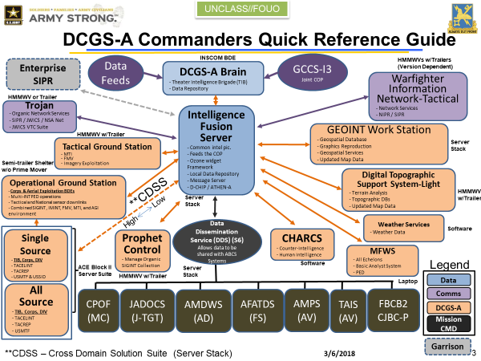
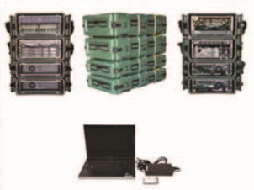
DCGS Overview
DCGS-A Commander’s Quick Reference Sheet and Primary MFWS System (DCGS-A, 2018).
Notes:
Now that we have an understanding of how we got to where we are and how terrain fits into the operations process, I’ll now discuss some individual systems.
DCGS – A is a system of systems as showed in the chart above. The primary “weapon system” of an intelligence analyst is his / her Multifunction Workstation (MFWS). This pulls intelligence from the Intelligence Fusion Server or IFS stacks located in the center, and enables sharing of information at all echelons. Each maneuver battalion is issued numerous MFWS and their own IFS, enabling one central storage location for a battalion intelligence section.
Within the MFWS are over 100 tools that enable intelligence analysts to gather feeds of information and conduct the required analyst to enable commanders to make decisions.
To communicate to your higher headquarters or sister units, each unit headquarters must be at the halt, and have satellite connectivity via a massive satellite dish. Only when this occurs can each formation communicate with each other digitally and share information. As you can imagine, the army is always on the move so the chances this occurs are extremely small.

Slide 7
Claims vs. Reality
Claims:
“Gather over 700 intelligence feeds / data sources”
“Analyze weather, terrain, process geospatial intelligence, and feed it to the commander”
One size fits all approach: over 100 tools on the system
Reality
Connectivity to higher echelons does not work due to limited bandwidth
No effective tools for digital terrain analysis
Inundation of sources / information bogs down analysts
Notes:
DCGS-A claims to gather over 700 intelligence feeds and centrally locate them on one application. The reality is that at the tactical level, Soldiers are inundated with such vast amounts of information, it is difficult if not impossible to derive what information is of value to their commander. Additionally, due to significant connectivity issues at lower echelons, bandwidth does not support access to said databases.
DCGS-A claims to be able to enable terrain analysis via use of the several tools on the system. This is incorrect as intelligence analysts are 1) not trained how to execute digital terrain analysis (only few Soldiers at the brigade level are) 2) the system does not have a program of record for terrain analysis, leaving a conglomerate of partial resources to execute the task without a set standard.
DCGS-A uses a one size fits all approach and comes with the large server stack for even light infantry and airborne infantry units who require much more mobility than a mounted or armored unit. Within the MFWS are over 100 tools to enable the analyst to do intelligence analysts. Analysts at the tactical level do not require the vast amounts of tools or information, again inundating them and slowing down the analytical process.

Slide 8
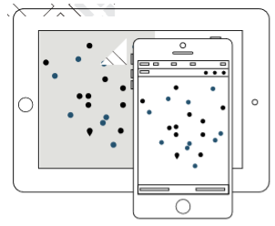
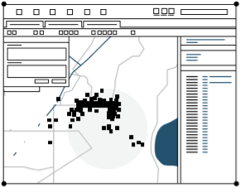
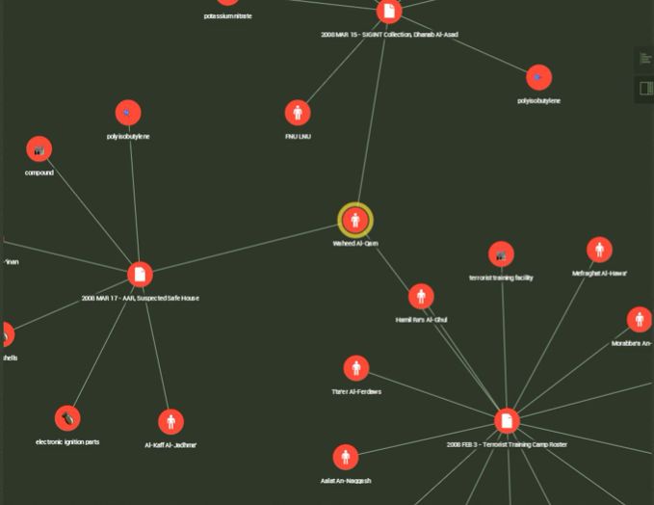
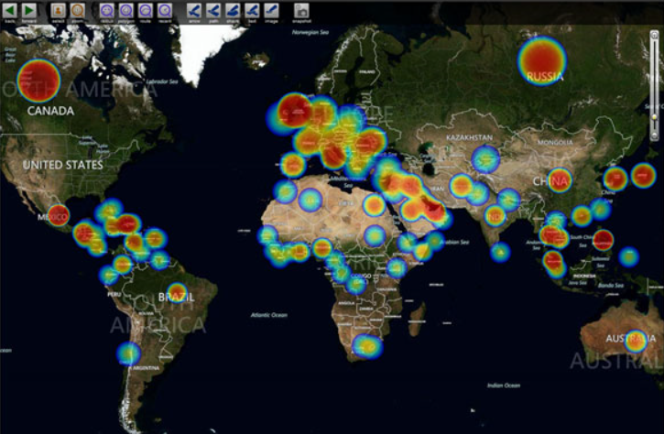
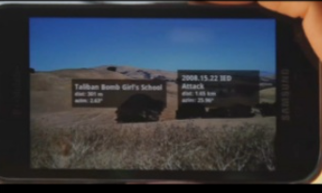
Palantir GEOINT Capabilities
Notes:
A few of the applications displayed on Palantir’s Project Gotham are Mobile, Graph, and Map.
Mobile enables for real-time, distributed operations in the field. Available on both Android and iOS, enables real-time coordination. You can share photos/videos, access data integrated into the Project Gotham platform.
Graph helps explore semantic relationships between data. You can create a timeline, time wheel to understand the periodicity and frequency of repeating events, and see how they are geographically connected.
Map provides visualization of geo-located objects on a map. You can switch between sources of imagery, import KML and shapefiles.
*** The key here is that the Map application does not have any capability for a tactical level intelligence analyst to conduct terrain analysis, providing a unique opportunity to recommend possible commercial off the shelf solutions to fill the capability gap.

Slide 9
Project Development Steps
Needs Assessment
GIS Requirements/Uses
Concept Development
Literature review to evaluate current COTS options
Recommendation of Best Options
Design
Options
Evaluate needs & design system
GIS Data Requirements
Basic system design and evaluation process (Robinson, n.d.)
Notes:
This is where the project development process comes into play:
In overview, this is the process that I utilized to complete the process:
I, as well as the United States Government, conducted the needs assessment and both came to the conclusion that DCGS-A needs replacing instead of continual inundation of funding without quality outputs. For this project, the needs assessment discusses the key uses of the GIS which drives the GIS requirements. It also discusses which data types are required to conduct the terrain analysis.
The concept development phase is comprised of a thorough literature review to evaluate the effectiveness of current commercial off the shelf applications to conduct terrain analysis. These applications include ArcGIS’ Military Analyst, Situational Awareness Geospatially Enabled (SAGE), and Harris’ ENVI software.
In the design phase is a study and discussion of the best hardware and connectivity solutions to enable mobile terrain analysis and communication throughout adjacent units and both higher and subordinate unit headquarters.
The options phase recommends the best COTS software to use for this GIS.

Slide 10
Needs Assessment - Terrain Analysis
Definition of Military Aspects of Terrain | Description | Required Data
Obstacles | Any natural or man-made obstruction designed or employed to disrupt, fix, turn, or block the movement of an opposing force, and to impose additional losses in personnel, time, and equipment on the opposing force. Examples: buildings, mountains, mines, wire obstacles, rivers | Controlled Image Base (CIB) of digital ortho-mosaic images. GSD of 1-meter resolution and orthorectified using NGA Digital Terrain Elevation Data level 2 (DTED Level 2)
Avenues of Approach | Ground routes used by an attacking force leading to its objective or to key terrain in its path. AAs are identified by categorizing and grouping mobility corridors. See table 2 for mobility corridor sizes. | Shuttle Radar Topography Mission Version 2 (SRTM V2) digital topographic data
Key Terrain | Any locality, or area, the seizure or retention of which affords a marked advantage to either combatant | Shuttle Radar Topography Mission Version 2 Void Filled (SRTM2VF)
Observation and Fields of Fire | The condition of weather and terrain that permits a force to see friendly, enemy, and natural personnel, systems, and key aspects of the operational environment. | Controlled Image Base (CIB) of digital ortho-mosaic images. GSD of 1-meter resolution and orthorectified using NGA Digital Terrain Elevation Data level 2 (DTED Level 2)
Cover and Concealment | Cover is the physical protection from bullets, fragments of exploding rounds, flame, nuclear effects, and biological and chemical weapons. Concealment is protection from observation and surveillance. | Topographical Line Maps (TLM) 1:50K
Notes:
Above is a chart explaining the military aspects of terrain that help commanders visualize their operating environment and understand how terrain affects military operations. Intelligence analysts are required to depict all of these military aspects of terrain both on analog maps and digitally using GIS. Intelligence analysts (35F) in the Army are not trained on digital terrain analysis, only Geospatial Engineers (12Y) are trained to do the complex terrain analysis on a GIS. This brings us to our primary requirement: a GIS that is intuitive and enables beginner GIS users to conduct basic terrain analysis at the battalion level.
Included in the military aspects of terrain are obstacles, avenues of approach, key terrain, observation and fields of fire, and cover and concealment. You can also see here the data required to conduct the analysis on a GIS.

Slide 11
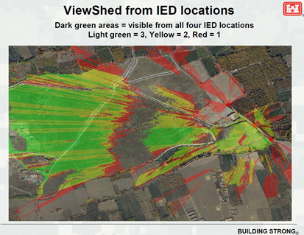
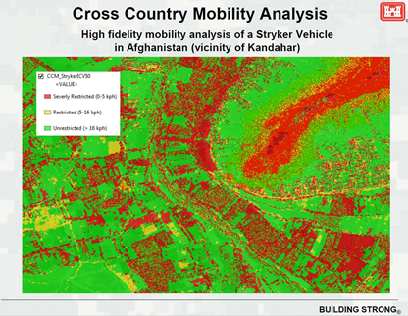
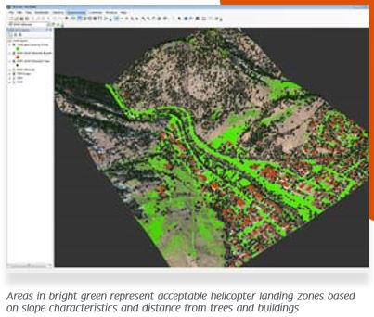
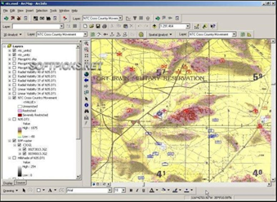
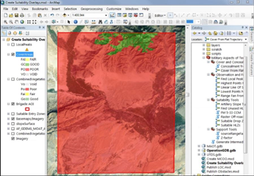
Example Products
Notes:
The upper left image is an example of identifying avenues of approach based on cross country mobility corridors.
Cross country mobility corridors are terrain that enables natural movement across terrain features without impeding movement. These are combined together to determine avenues of approach, or where threat or friendly forces can maneuver formations.
Next is a viewshed from an IED location which would help identify where possible observers are located.
Next is an example of a possible helicopter landing zone overlay.
Next is an identification of obstacles that are broken down into restricted and severely restricted terrain.
This helps a commander determine possible kill zone that he/she can force the enemy into by tying in obstacles with terrain, and numerous other possibilities.
Last is an example product of cover and concealment based off the input of a land cover dataset.
This product helps a commander plan a reconnaissance mission to avoid detection, where he/she can maneuver forces to the objective without detection, and with maximum cover to protect from indirect and direct fires.

Slide 12
Needs Assessment - Architecture
Current Architecture
Ideal Architecture
Notes:
To break down this slide, the image on the left is our current intelligence architecture, how we communicate top / down and laterally. To the right is the ideal intelligence architecture to enable mobile communications and information sharing.
The problem with the current system is that in general, it requires every unit, both adjacent units and your higher unit headquarters to have satellite connectivity to be able to communicate digitally and share information. This eliminates the ability to communicate on the move. There is no cloud or central data hub that enables units to pull information that was previously uploaded.
The image to the right shows the future of the army’s communications systems. The system is called Warfighter Integrated Network – Tactical. With this system, there is a cloud based system that enables users to pull and upload data. There is also a wide area network, 4G connectivity, and a wireless LAN network that provides numerous options for communication, both on the halt and on the move.

Slide 13
Needs Assessment – key takeaways
Under Palantir, there is no GIS capable of conducting digital terrain analysis.
Intelligence analysts are not GIS professionals, thus do not have the training to conduct the extensive GIS analysis that is required to support commanders.
The current architecture does not enable information sharing while on the move and it is also extremely bulky.

Slide 14
Concept Development
Evaluation | Summary of features | Advantage/Disadvantage
Ease of Use | Simple add-on to ArcMap. Requires fewer clicks to create products, however requires extensive manual analysis. | Identifies obstacles based on terrain for over 10 vehicles types and over 100 NATO vehicles Requires manual analysis of mobility corridors, avenues of approach, and key terrain
Ability to perform OAKOC | Foundation tools include: Obstacles; slope/aspect; cross country mobility | Obstacles Avenues of Approach Key Terrain Observation and fields of fire Cover and concealment
Service type | Standalone; requires ArcMap | Compatible with already existing ArcMap licenses Not portable
 | Situational Awareness Geospatially Enabled (SAGE) Tool | Harris’ EXELIS Terrain Analysis Software - ENVI | ESRI’s Military Analyst
Software Dependencies | ESRI’s ArcMap | ESRI’s ArcMap (for imagery analysis) | ESRI’s ArcMap
Inputs | Elevation (DTED 2) 30 M resolution; Land Cover (NASA) 30 M resolution; Road Network (OSM) | Elevation (DTED 2) 30M resolution | Elevation (DTED 2) 30M resolution
Outputs | See Fig 1 | See Fig 2 | See Fig 3
Service | Standalone | Standalone | Standalone
Customizable | Yes | No | Yes
Cloud server technology | Available | Available | Available
Notes:
The chart to the right shows a basic overview of each of the three tools I selected to evaluate. The tools include SAGE, ENVI by Harris and ESRI’s Military Analyst. It shows software dependencies, required data inputs, what type of service it provides, whether it is customizable and whether it comes with a cloud server technology or supports one.
I then next evaluated each one of those tools based on the format to the right with input from the needs assessment. The first criteria is the ease of use, second is the tool’s ability to conduct terrain analysis based on the military aspects of terrain, and the service type.
To complete the concept development phase, I’ll use this approach for the three previously mentioned tools for terrain analysis.

Slide 15
ESRI’s Military Analyst
Evaluation | Summary of features | Advantage/Disadvantage
Ease of Use | Simplest of the three tools to use. Primary tools include: Raster Map Tool; Vector Map Tool; DTED Tool; Terrain Tools; Geodesy Tools | Uses military standard symbology Free ESRI training available Available at no cost to ArcGIS users Additional tools to identify spectral anomalies Simple and requires few clicks to generate products
Ability to perform OAKOC | Contains tools required to complete OAKOC analysis. Requires manual avenues of approach and key terrain analysis, however, identifies possibilities. | Obstacles Avenues of Approach Key Terrain Observation and fields of fire Cover and concealment
Service type | Standalone; requires ArcMap | Compatible with already existing ArcMap licenses

Slide 16
Harris’ ENVI
Evaluation | Summary of features | Advantage/Disadvantage
Ease of Use | Most difficult of the three to use; requires extensive GIS knowledge. Key tools include: Classification, CCD, DEM extraction, target detection. | Product is focused on spectral analysis Requires ArcMap to process imagery Additional tools to identify spectral anomalies Feature extraction tool
Ability to perform OAKOC | Foundation tools include: Obstacles; slope/aspect; cross country mobility | Obstacles Avenues of Approach Key Terrain Observation and fields of fire Cover and concealment
Service type | Standalone; requires ArcMap | Compatible with already existing ArcMap licenses

Slide 17
SAGE
Evaluation | Summary of features | Advantage/Disadvantage
Ease of Use | Simple add-on to ArcMap. Requires fewer clicks to create products, however requires extensive manual analysis. | Identifies obstacles based on terrain for over 10 vehicles types and over 100 NATO vehicles Requires manual analysis of mobility corridors, avenues of approach, and key terrain
Ability to perform OAKOC | Foundation tools include: Obstacles; slope/aspect; cross country mobility | Obstacles Avenues of Approach Key Terrain Observation and fields of fire Cover and concealment
Service type | Standalone; requires ArcMap | Compatible with already existing ArcMap licenses Not portable

Slide 18
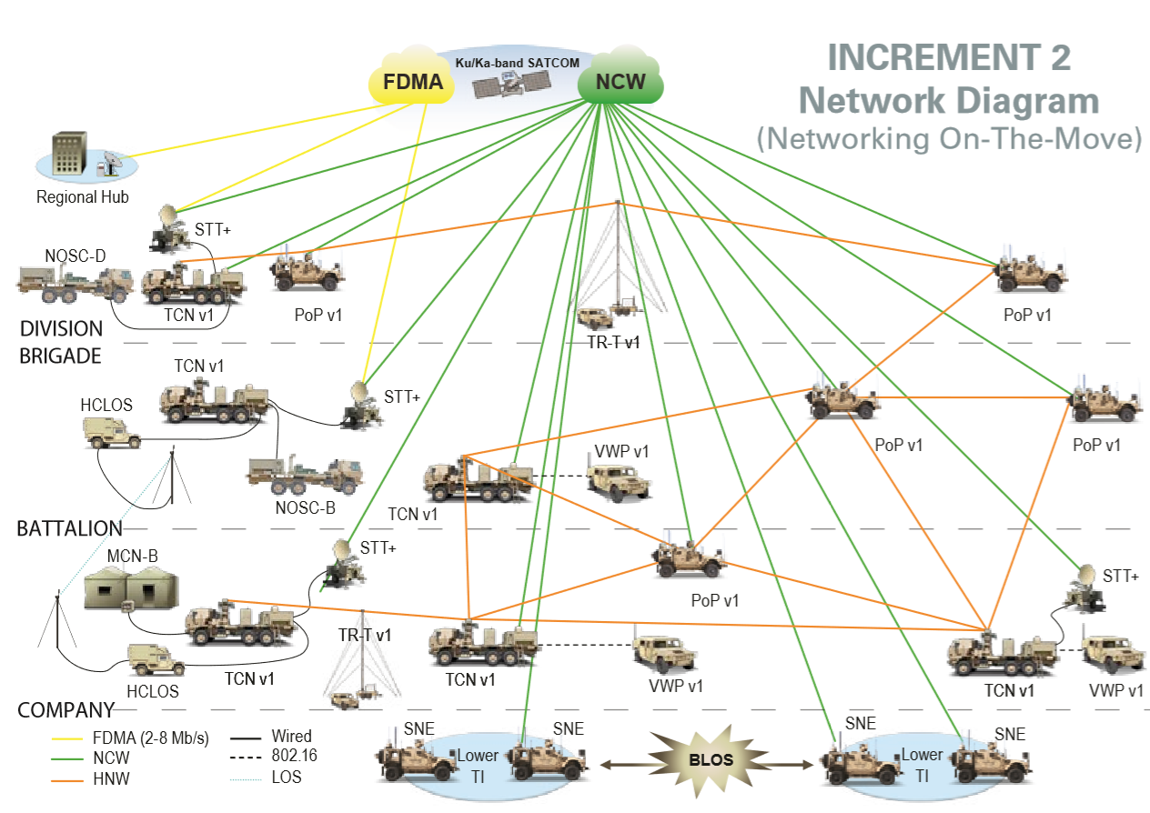
Evaluate Needs and System Design
Notes:
This portion of the project will discuss the requirement for the new system, Palantir, to fit within the Army’s battlefield communications systems, specifically the WIN-T network as previously discussed.
I’ll also briefly look into some hardware solutions to enable communications and analysis on the move rather than restricting this analysis to while at the halt or stationary.

Slide 19
Recommendation
Notes:
Based on the criteria with the assigned weights as shown in the slide, I’ll determine which of the assessed tools is the recommended to partner with Palantir and the Army to provide the next terrain analysis tool.
The tool with the lower score is the one that best meets the selected criteria.
Based on the literature review conducted thus far, the recommended tool is Esri’s Military Analyst pending a further accuracy assessment of the mentioned tools.

Slide 20
References

