Slide 1
Identifying Paleotopography in the Cretaceous/Tertiary (K/T) Angular Unconformity and its Influence on Uranium Mineralization, Shirley Basin, Wyoming
James Covington
GEOG 596A
Pennsylvania State University
12/14/2016

Slide 2
Study Area Location

Slide 3
Objectives
Use GIS to create a topographic map of the erosional surface on the Cretaceous/Tertiary (K/T) unconformity using electronic logs from drill hole data.
Identify topographic features, specifically paleo tributary or fluvial features.
Determine if paleo-tributary system influences the uranium mineralization in the overlying Wind River Formation (Twr) sandstone.

Slide 4
Methodologies
Use electronic logs (e-logs) to locate the ground surface to K/T unconformity depth.
Identify K/T subsurface elevation for each drill hole.
Use kriging or natural neighbor interpolation methods to create a 3-D elevation map of the K/T erosional surface in ArcGIS Spatial Analyst or Surfer.
Perform QA/QC analysis to remove outlier data points (bulls eyes).
Identify paleo-topographic features in the subsurface, such as hills and paleo-valleys.
Investigate uranium mineralization and determine if mineralization is influenced by paleo-topographic features.

Slide 5
Nicholas Steno’s Three Laws of Stratigraphy
Law of Original Horizontality - Sedimentary rocks are deposited horizontally in layers under the influence of gravity.
Law of Superposition - Oldest sedimentary rock deposited first and will be at the bottom, while the youngest sedimentary rock is deposited last at the top.
Law of Lateral Continuity – Sedimentary rocks extend laterally until they thin to zero thickness (i.e. pinch out) at the edges of their depositional basin.
2
1

Slide 6
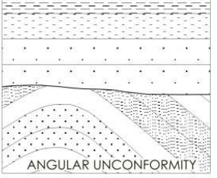
Unconformity
Missing geological time due to non-deposition, erosion or tectonic changes.
Angular Unconformity – deposition of younger sedimentary beds occurs after uplift and erosion of older underlying sedimentary beds.
In the Shirley Basin area, older Cretaceous deep-marine sedimentary units were deposited then uplifted to form a basin structure.
Relatively younger Tertiary units of fluvial sediments and volcanic ash are deposited over angular Cretaceous units.
Erosional Surface
Image source http://earthphysicsteaching.homestead.com/principles_structural_geology_ii.html

Slide 7
Geological Map of Shirley Basin Area
Syncline Basin Axis
Cross Section Line
A
A’
Harshman, 1968

Slide 8
Geological Map of Shirley Basin Within Project Area
Twrl
Cross Section Line A – A’
Twdr
Modified from Harshman, 1968

Slide 9
Geological Cross-Section of Shirley Basin Within Project Area
Twdr
Ks
Kn
Kf
Cretaceous beds (various green colors) are generally dipping west between 5 – 7 degrees and are unconformable
with the overlying Tertiary Wind River Formation and White River Formation (tan and orange beds). The erosional
surface is shown as red dashed line.
Modified from Harshman, 1968

Slide 10
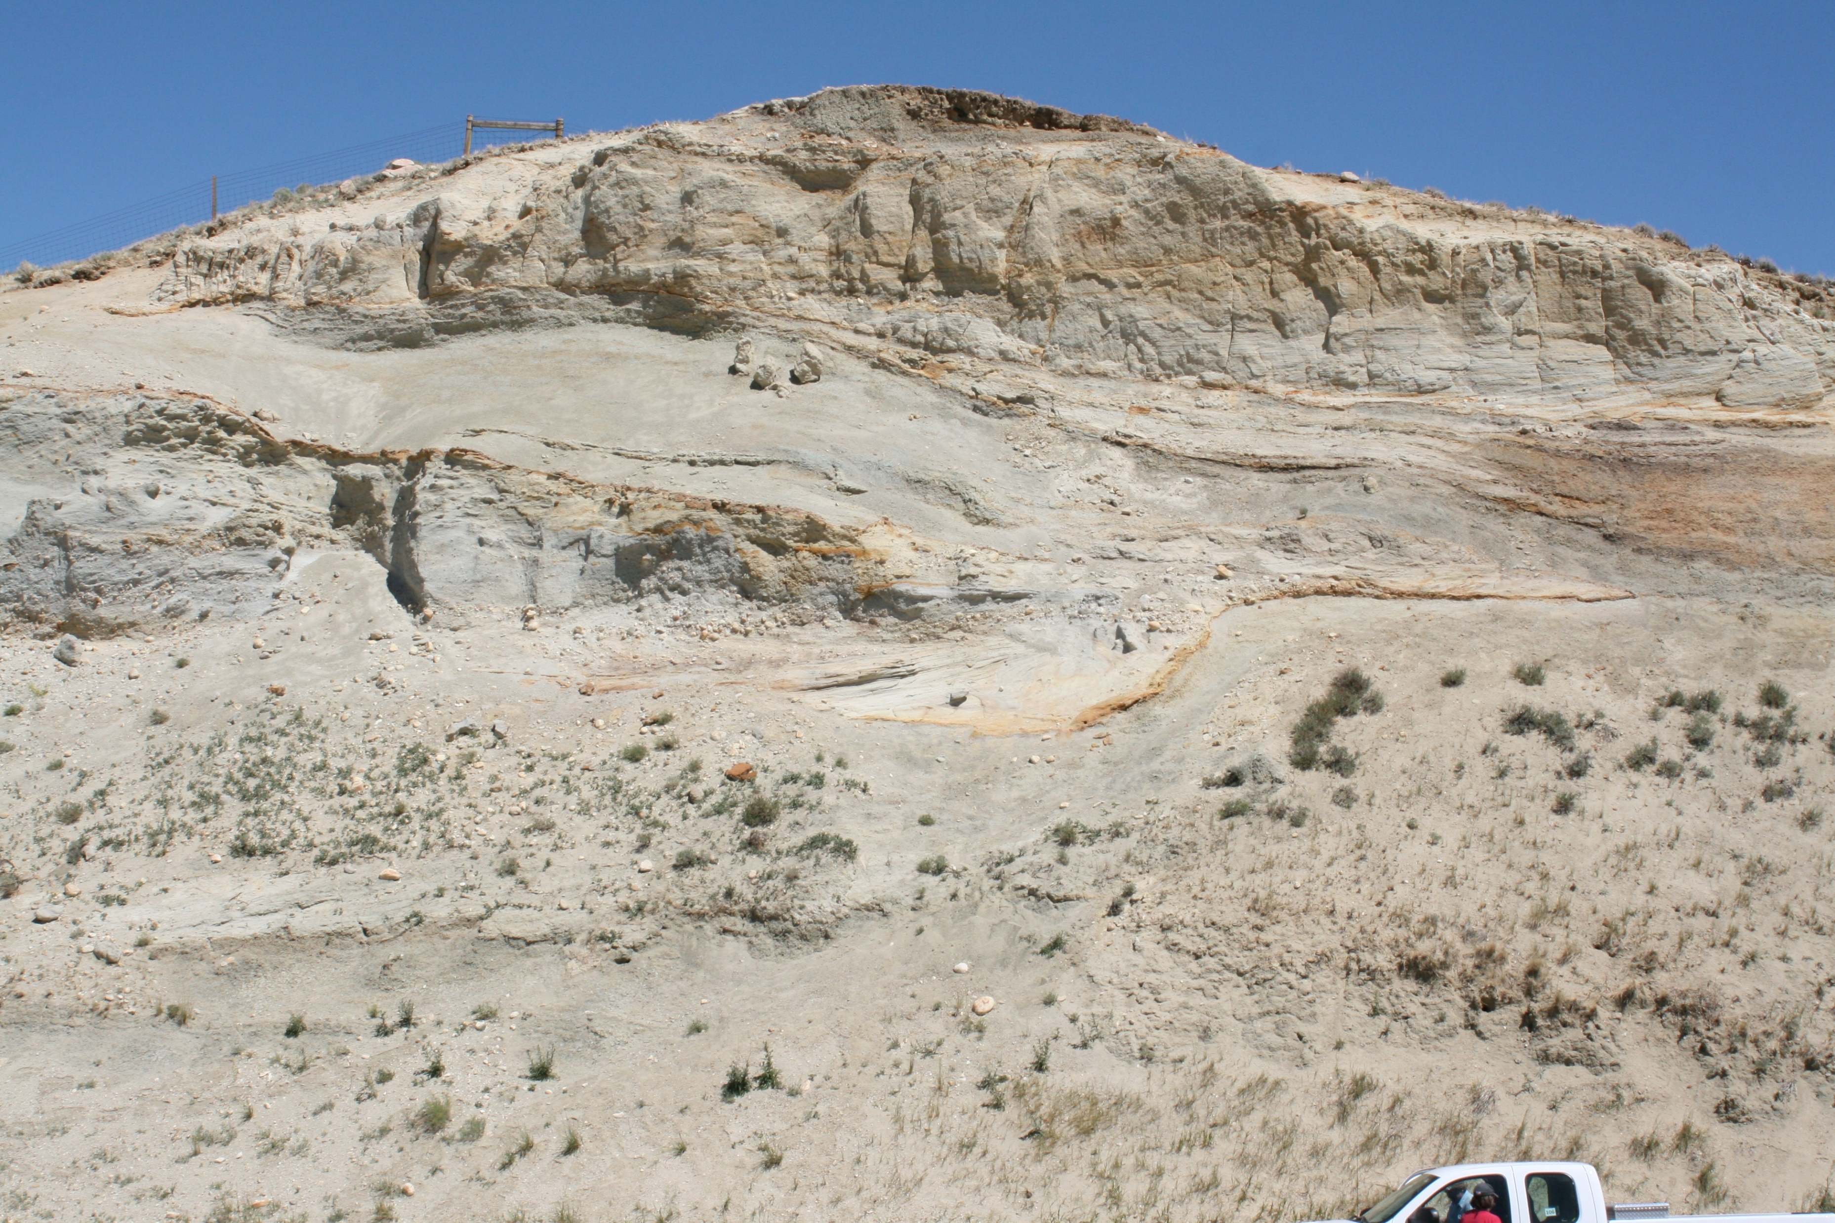
K/T Boundary in Outcrop
Wind River Formation (Twdr)
Wind River Formation (Twdr)
Channel Scour
Steele Shale (Ks)
Steele Shale (Ks)
Close-up of K/T Boundary (dashed line) between
Tertiary Wind River Formation (top) and Cretaceous
Steel Shale (bottom)

Slide 11
Regional Geological Column for Shirley Basin
Modified from VanHolland, 2015

Slide 12
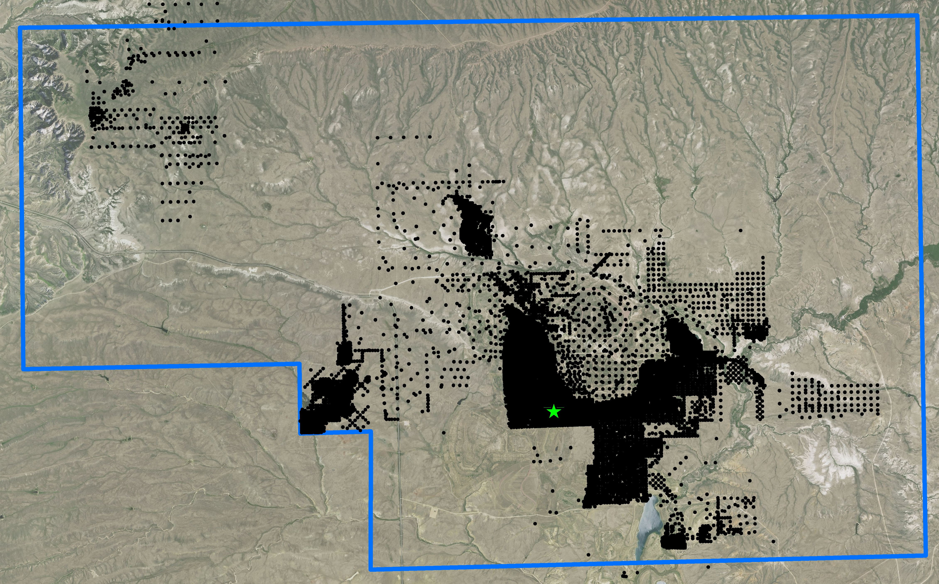
Type Log within East Shirley Basin

Slide 13
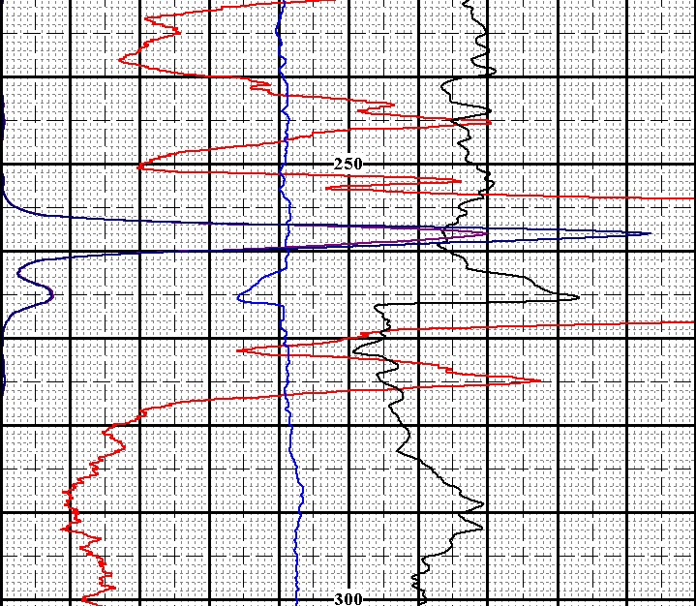
How to Identify Cretaceous/Tertiary Boundary Location and Uranium Mineralization in E-Logs
Gamma counts measure presence of uranium decay products.
Resistivity indicates rock type. Low resistivity = shale/clay, high resistivity = sand/silt.
Gamma “kick”
Indicating U presence
Gamma re-run at
higher scale
Gamma Curve
Resistivity Curve
K/T Boundary
@ 267 feet below
ground surface
Depth below surface (ft)

Slide 14
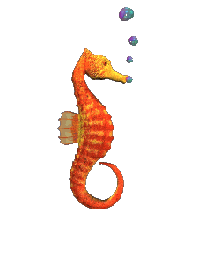
How to Generate K/T Subsurface Elevation Data
Drill Hole
Ground Elevation
Ground Elevation = Distance above MSL
0’
Ground Elevation = 7380’ - 0’
Ground Elevation = 7380’
K/T Depth
K/T Erosional Contact
380’
Subsurface Elevation = Ground Elevation – K/T Depth
Subsurface elevation = 7380’ – 80’
Subsurface elevation = 7000’
Total Depth (TD)
500’
Mean Sea Level (MSL)
0’

Slide 15
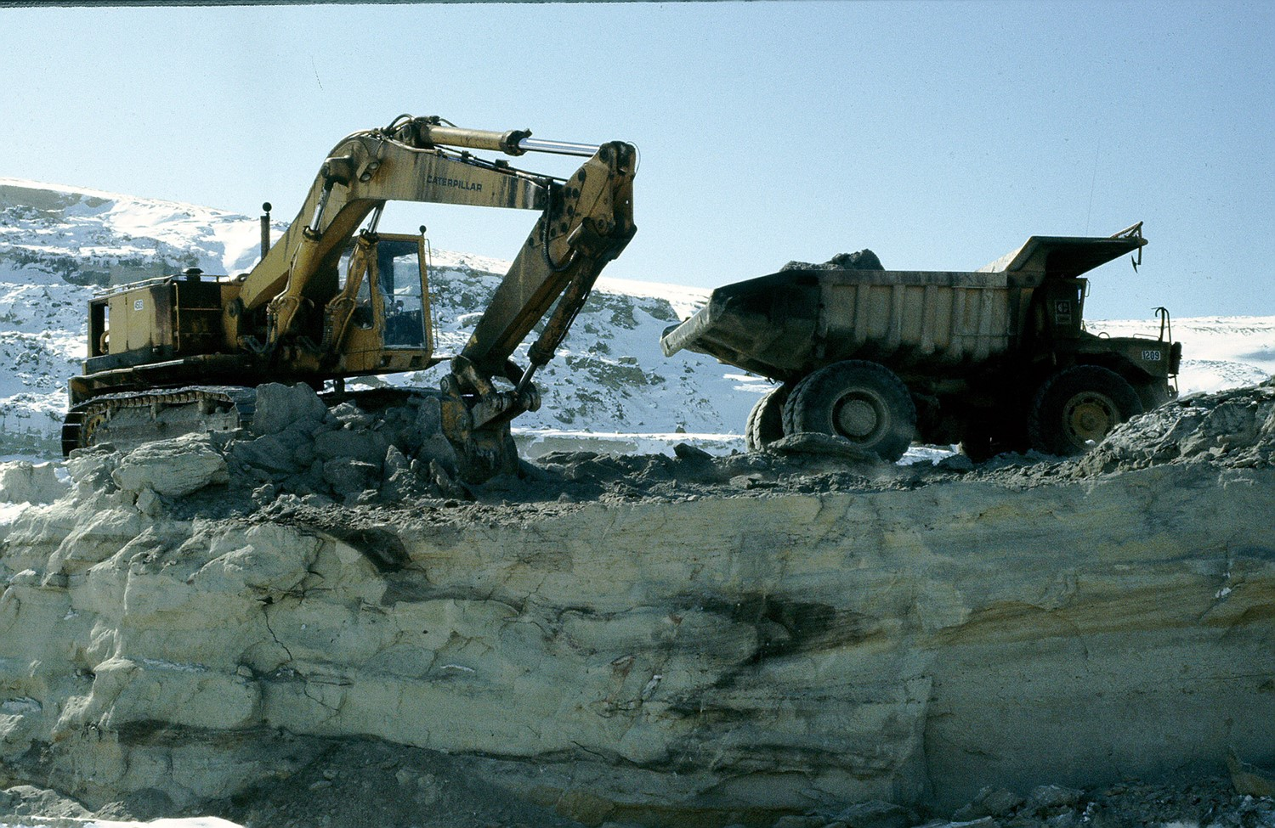
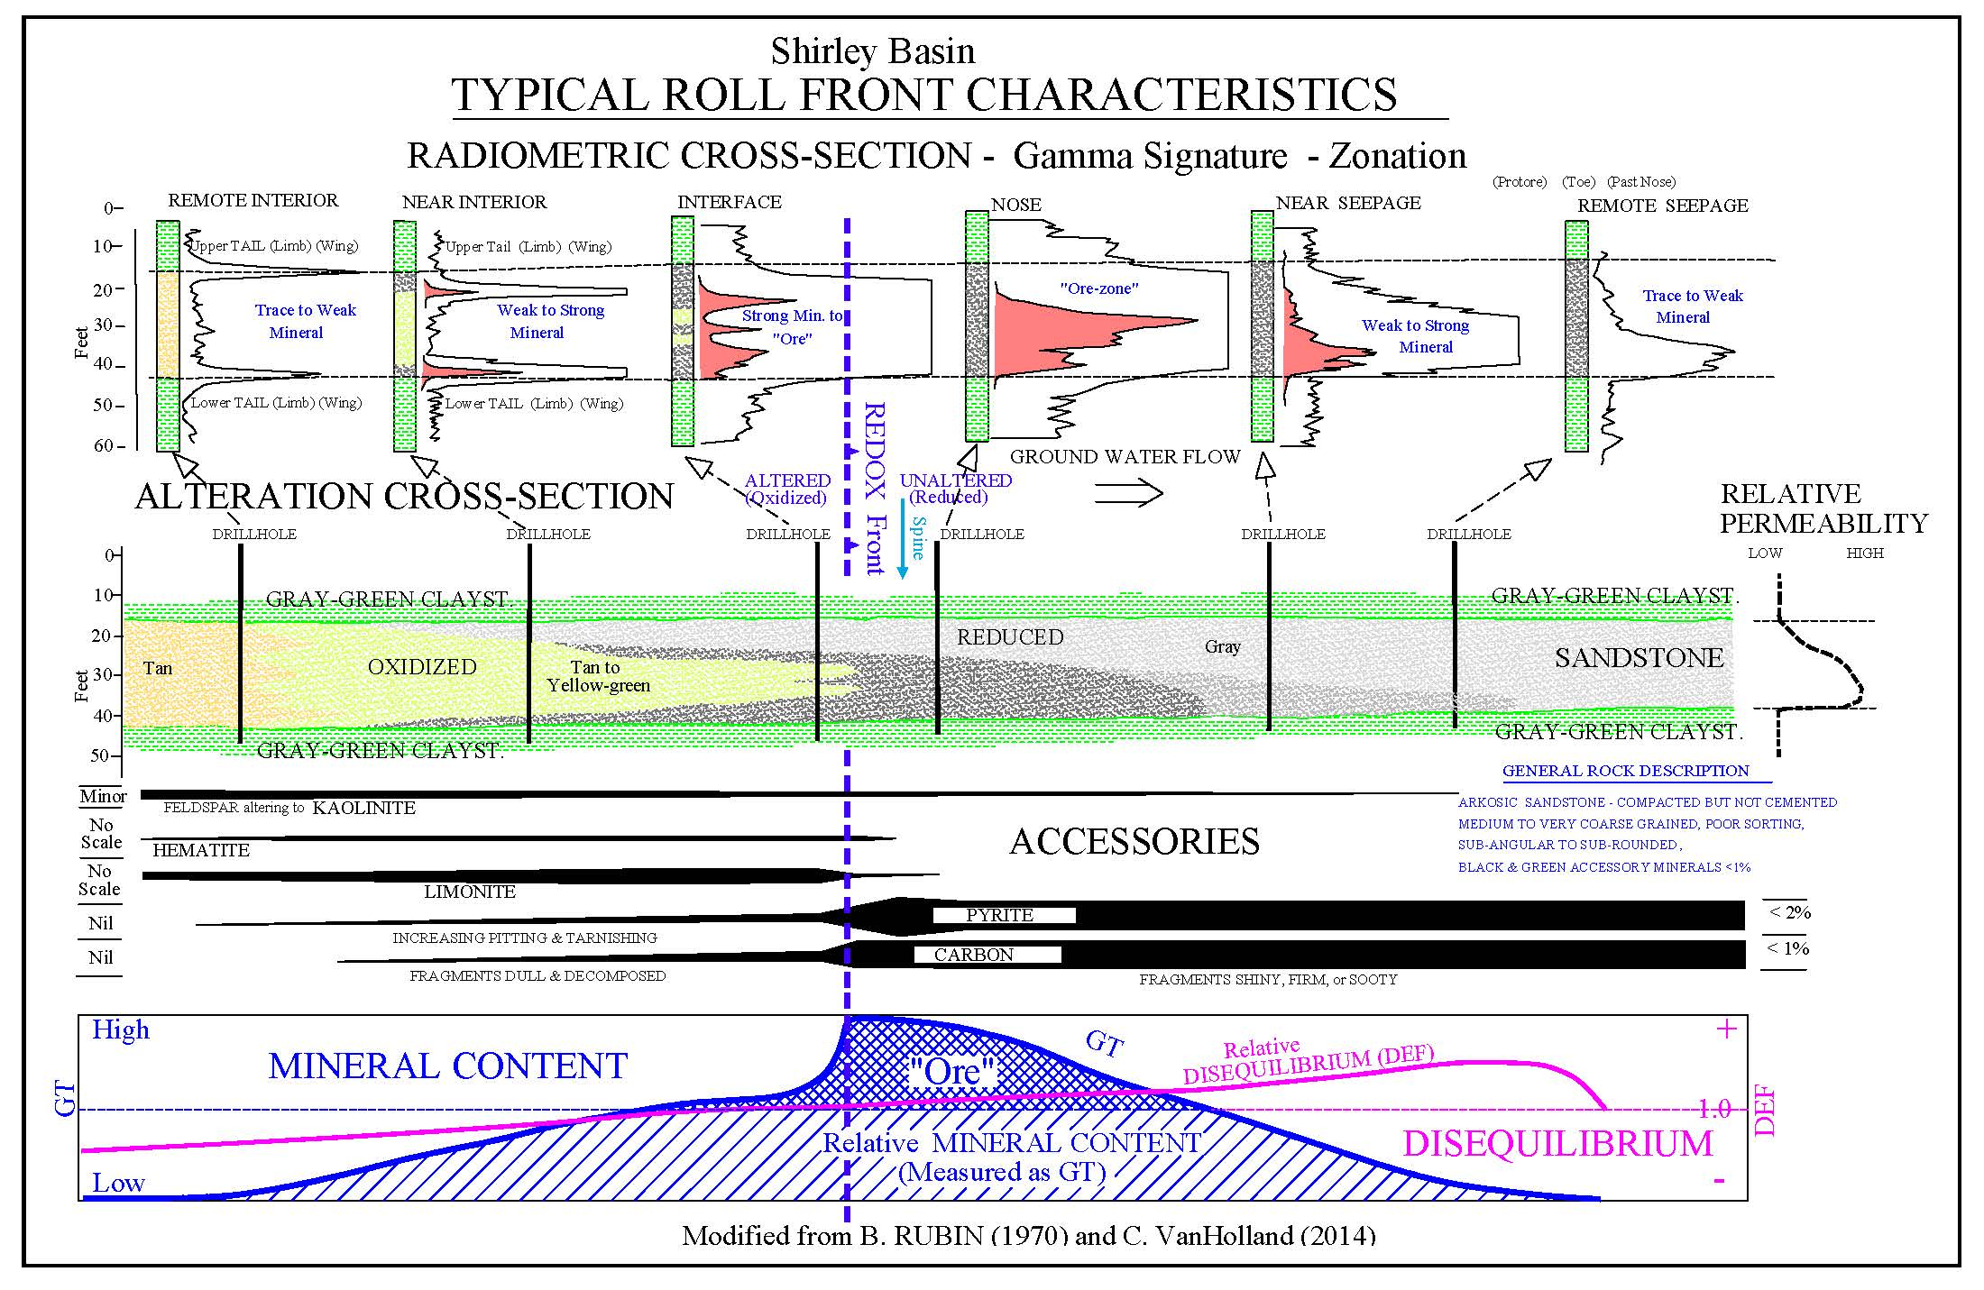
Basic Roll Front Uranium Mineralization Model
Gamma log shape used as a ‘finger print’ to identify drill hole position relative to redox boundary.
Minerals such as Pyrite and Limonite also used to help identify redox boundary.
Oxidized
Reduced
Roll Front redox boundary (green line) found in Shirley Basin open pit with black uranium ore on the reduced (right) side. Water flow is from left to right. Photographer unknown.

Slide 16
Typical In-situ Recovery (ISR) Uranium Mining

Slide 17
Drill Hole Distribution in Study Area
14,159 Drill Holes
~7,000 have K/T info

Slide 18
Expected Outcomes
Generate a paleo-topographic map of K/T erosional surface.
Identify topographic highs (red) and lows (purple) using color contours.
Use paleo-topographic lows to identify river channels and interpret river flow direction (black arrows added for illustration)
Identify river bend (meanders) features where carbonaceous material is most likely to occur (orange star)
Overlay drill holes onto pale-topographic map and observe any intersections of fluvial features with uranium mineralization areas.
Example of paleo-stream mapping from MAP 578 Paleotopography of the Sub-Cretaceous Unconformity Surface, Peace River - Slave Lake Region, Alberta (NTS 83N, 83O, 84C and 84B)
Produced by J.T. Peterson and K. E. MacCormack
URL http://ags.aer.ca/publications/MAP_578.html

Slide 19
Acknowledgements:
James Bonner, Vice President of Geology, Ur-Energy
John Cooper, Senior Geologist, Ur-Energy
Pat Kennelly, Advisor, Penn State University
http://www.wsgs.wyo.gov/
http://www.ur-energy.com/
http://www.wyogeo.org/index.html

Slide 20
Resources
Bailey, R.V. and Gregory, Robert W., The Shirley Basin Mine and the Development of the Roll-Front Model of Uranium Ore Deposits: A Historical Perspective. Wyoming Geological Survey Memoir 6. December 2011
Boberg, W.W. Some Speculations on the Development of Central Wyoming as a Uranium Province. Wyoming Geological Association, 32nd Annual Field Conference Guidebook. Pgs. 161 -180. 1981
Galloway, William E. Early Tertiary-Wyoming Intermontane Basins. (NEED MORE SOURCE INFO)
Harshman, E.N. Geology and Uranium Deposits, Shirley Basin Area, Wyoming. United States Geological Professional Paper 745. US Printing Office, Washington, D.C. 1972
Harshman, E.N. Short Papers in the Geologic and Hydrologic Sciences, Articles 147 – 292, USGS Professional Paper 424-C: Article 148 - Paleotopographic Control of A Uranium Mineral Belt, Shirley Basin, Wyoming. 1961
Harshman, E.N. Short Papers in the Geologic and Hydrologic Sciences, Articles 120 – 179, USGS Professional Paper 450-D: Article 122 - Alteration as a Guide to Uranium Ore, Shirley Basin, Wyoming. 1962
MacCormack, K.E. and Peterson, J. Map 578: Paleotopography of the Sub-Cretaceous Unconformity Surface, Peace River – Slave Lake Region, Alberta (NTS 83N, 830, 84C and 84B). Alberta Geological Survey. 28 MAR 2016. URL: http://ags.aer.ca/publications/MAP_578.html accessed 21NOV2016.
Melin, Robert E. Uranium Deposits in Shirley Basin, Wyoming. Contributions to Geology: Wyoming Uranium Issue, Vol 8, No 2, Pt I. Summer 1969. Pgs 143-149
Michael P. Klimetz. The Regents Earth Science, Regents Physics and AP Physics 1 and AP Physics 2 Online Resource. 4 Types of Unconformities. URL http://earthphysicsteaching.homestead.com/. Retrieved Oct 25, 2016
Seeland, David. Relationships Between Early Tertiary Sedimentation Pattern and Uranium Mineralization in the Powder River Basin, Wyoming. Wyoming Geological Association, 28th Annual Field Conference Guidebook. Pgs. 53 - 64. 1976
Seeland, David. Sedimentology and Stratigraphy of the Lower Eocene Wind River Formation, Central Wyoming. Wyoming Geological Association, 30th Annual Field Conference Guidebook. Pgs. 181 -198. 1978
Shirley Basin 2015 WDEQ Report, Ur-Energy
Tearpock, Daniel J. and Bischke, Richard E. Applied Subsurface Geological Mapping With Structural Methods. 2nd Edition. Pearson Education, Inc. 2003

