Slide 1
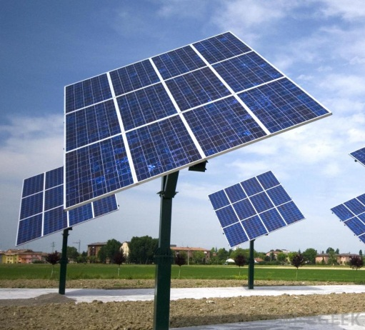
Estimating solar pv potential in the cloud
Jonathan Coy
GEOG 596A
Advisor: jeffrey brownson

Slide 2
Project Background
Concept started during GEOG586 – Geographical Information Analysis capstone project
Solar rooftop potential project for a subdivision in Flagstaff, AZ
Processing time too intensive
Classification of results inaccurate
Experimentation with cloud processing during capstone project for GEOG897C – Cloud Server and GIS
LAS Dataset to Raster (Digital Surface Model, DSM)
9 hours processing time to 6 minutes

Slide 3
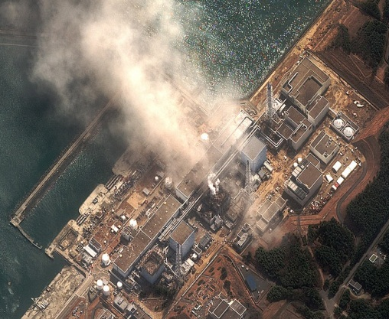
overview
Photovoltaics (PV) is a method of generating electricity by collecting solar radiation from solar panels
Represents a sustainable energy resource
Increasingly important with rising energy costs, global warming, recent increases in technology and events such as the Fukushima nuclear disaster in Japan

Slide 4
ArcGIS “area solar radiation”
Irradiation: is a measure of solar radiation received on a given surface and recorded for a specific time period (energy density units of kWh/m²)
Tool derives incoming insolation from a raster surface
Located within ArcToolbox Spatial Analyst Tools
Extremely processing intensive. Calculations can take hours of even days to run for large scale areas depending on the input parameters
Documentation of input parameters is poor

Slide 5
The amazon cloud advantage
Amazon Web Services offers an easy to use and affordable Infrastructure as a Service (IaaS) called Amazon Elastic Compute Cloud (EC2)
Amazon houses, administers and maintains the hardware, the client pays on a per-use basis
Setup can take minutes and uses ESRI’s pre-configured Amazon Machine Image (AMI). Services can be started and stopped as needed all over a web connection
Allows access to powerful server processing as needed
9 hours versus 5 minutes
High-Memory Double Extra Large Instance
34 GB memory, 13 processors, 64-bit, 850 GB storage, Windows
$1.02 per hour

Slide 6
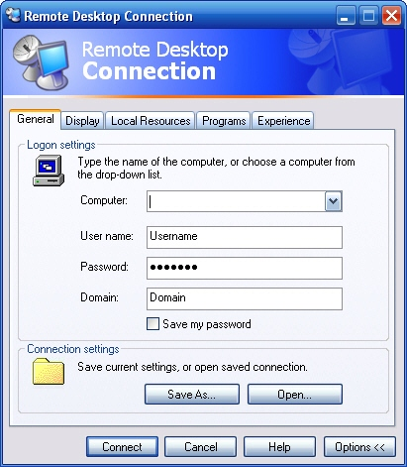
The amazon cloud Disadvantage
Upload and download time of large geospatial datasets
>30 hours upload time
Restrictions with storing datasets offsite
Administration and setup
Remote Desktop access denied through firewall

Slide 7
Arcgis “area solar radiation” Deficiencies
With the help of Brownson group several potential deficiencies have been identified within current methodology that the Area Solar Radiation Tool uses to calculate irradiation compared to the “solar community”
Community uses “irradiation” units of J/m² not kWh/m²
Area Solar Tool does not calculate what is happening in the real sky day to day; uses fixed global estimations from the user instead of local meteorological data
Results will show how much sun an area receives but will not show what you actually get

Slide 8
Solar Community Methods
National Renewable Energy Laboratory (NREL)
System Advisor Model (SAM)
Simulate many locations as points
Rooftop orientation and slope (obtained from slope and aspect)
Shading factors (tree heights from LiDAR data)
Financials
Typical Meteorological Year (TMY) data
Hourly values of solar radiation and meteorological elements for an entire year
kWh/m² or J/m²

Slide 9
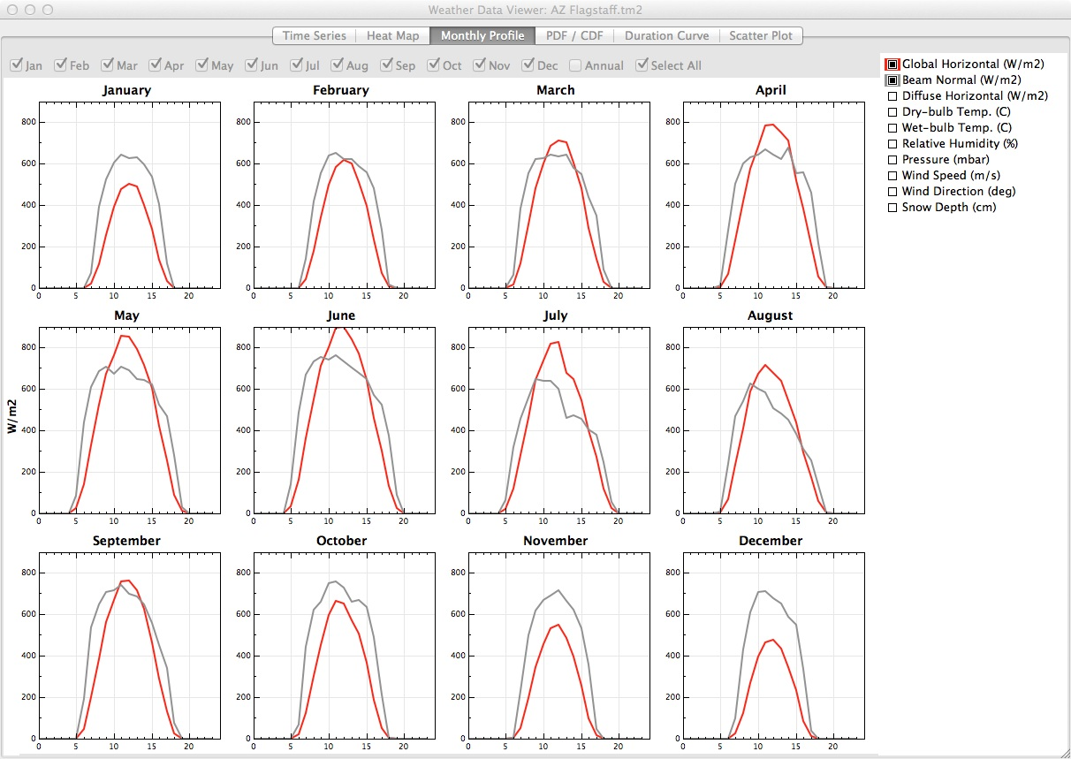
Meteorological Data Example
Flagstaff hourly data per month for Beam Normal (amount of solar radiation from the direction of the sun) and Global Horizontal (the sum of direct and diffuse radiation)

Slide 10
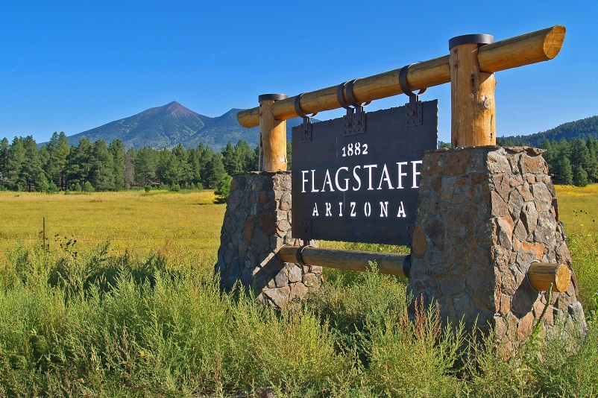
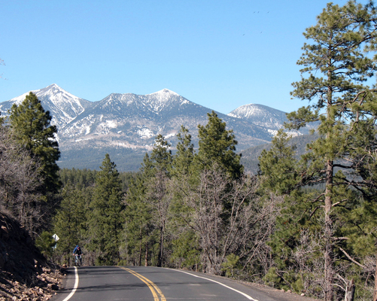
Locale: FLagstaff
Flagstaff offers an ideal setting to discover shortages of the ArcGIS Solar Radiation tool due to:
Clear skies
Meteorology is likely fairly stable, not complex

Slide 11
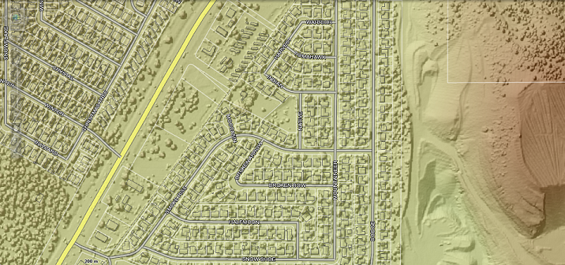
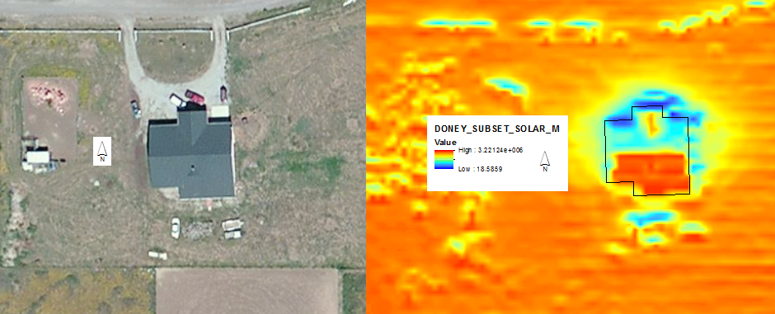
Project concept
In the cloud process a digital surface model (DSM) from a LiDAR dataset which covers a portion of NE Flagstaff, Arizona
LiDAR dataset has a 2.38 foot point spacing
Use the DSM as the input raster to calculate incoming insolation for three residential building rooftops in the cloud using “ArcGIS Area Solar Radiation” tool
Outputs will be compared to an energy analysis of the same rooftops using SAM to investigate the differences between

Slide 12
Hypothesis
Total calculated irradiation for the test rooftops using the ArcGIS Area Solar tool will greatly differ from the results produced using SAM and therefore should not be used as a tool by GIS professionals to determine rooftop solar potentials.

Slide 13
Results
If true, recommendations will be made to ESRI regarding how to improve results and why the shortcomings with the tool exist
If false, results will be compared to industry standard practices with explanations as to why the tool produces accurate results

Slide 14
Potential Impact to GIS Community
As more communities and cities use this tool to determine solar potential and share it with the public to push green initiatives it is important the results are accurate or the limitations of the tool are better understood
CH2M Hill Solar Portals – Los Angeles
Risk with small communities with small budgets with access to LiDAR data and ArcGIS start producing such maps on a large scale
Results are not vetted due to processing time and lack of understanding by GIS professionals

Slide 15
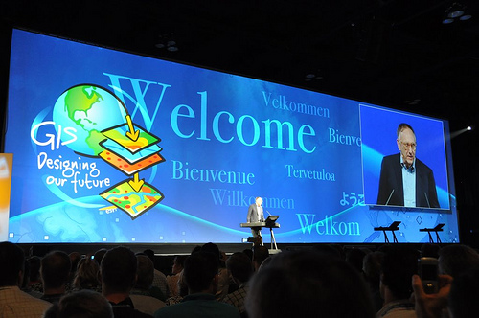
Final results
Professional Conference
Solar
GIS/Geography
Journal Article

Slide 16
Questions?

