Slide 1
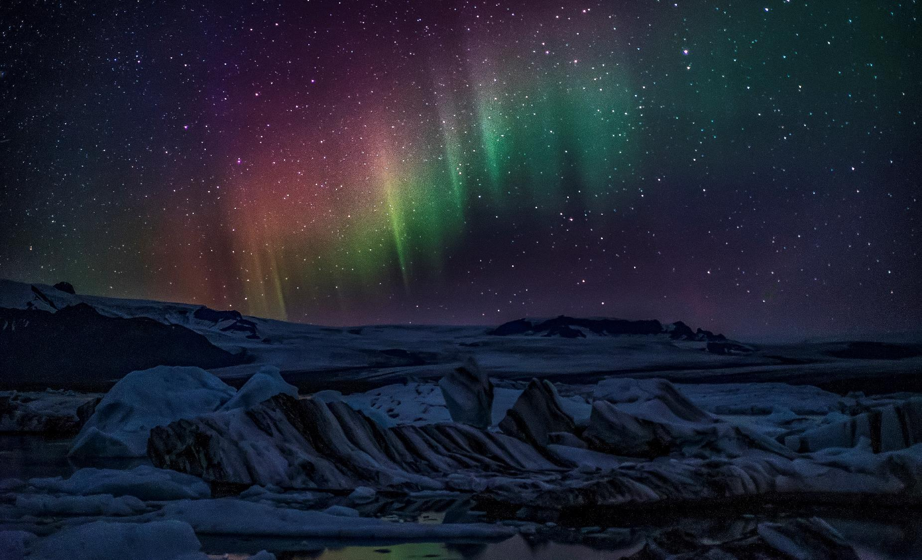
Preliminary Findings:
Spatio-Temporal Analysis of Greenland’s Climate
Kenneth Crager

Slide 2

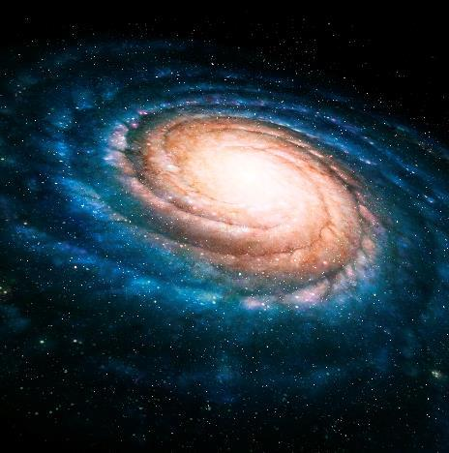
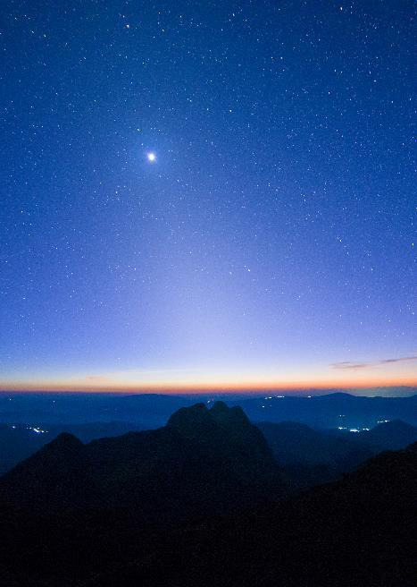
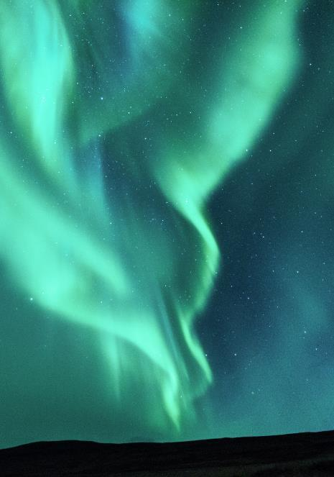
Agenda
Motivation
Process
Findings…thus far
Work to be Done
Challenges

Slide 3

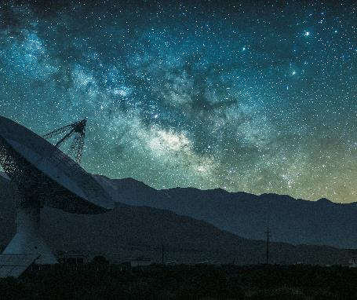
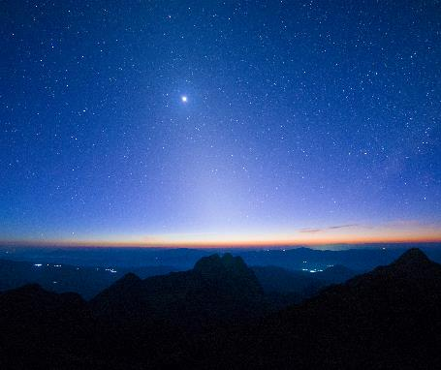
Motivation
Tremendous amounts of research regarding Greenland’s climate, especially as it pertains to the Greenland Ice Sheet, demonstrate a connection to the global climate and potential for catastrophic sea level rise. This analysis seeks to explore how air temperatures, mean sea level pressure, sea surface temperatures, and 500 mb geopotential heights have changed in and around Greenland over the last 40 years to identify trends in space and time.

Slide 4
Process
Using the R statistical computing language, conduct spatial point pattern analyses, spectral analyses, and spatiotemporal analyses (to include exploratory modeling) to identify statistically significant trends in each meteorological parameter’s monthly anomalies.
(monthly anomaly = monthly mean observed – monthly normal;
monthly normal = monthly mean over the period 1979 – 2018)

Slide 5

The analysis thus far

Slide 6
Normals

Slide 7
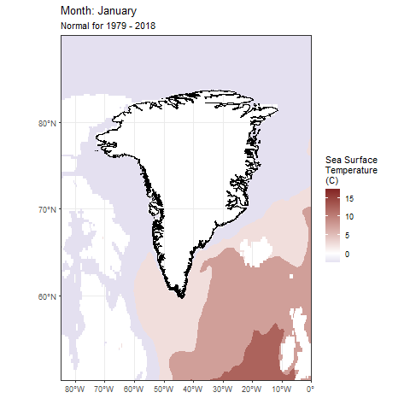
Monthly Normal Sea Surface Temperatures
Little change throughout the year
Follows expected pattern:
  Warmer waters around Iceland, creeps into Labrador Sea and Baffin Bay during meteorological summer (fed by Irminger Current)
  Cooler waters in winter, fed by Baffin Island Current in Baffin Bay (west coast) and East Greenland Current (east coast) from Arctic)

Slide 8
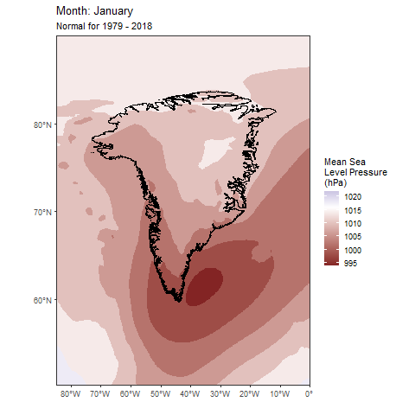
Monthly Normal Mean Sea Level Pressure
Shows semi-permanence of Icelandic Low (seen October – March)
  Northerly winds from western side of Icelandic Low should bring persistently cold air temperatures
  Dissipation of the low allows Azores High to force warmer air poleward during summer
High pressure in summer indicates stronger Greenland Blocking, which affects climate/weather

Slide 9
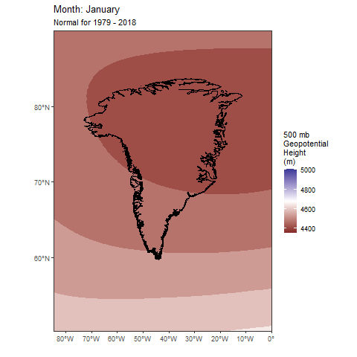
Monthly Normal 500 mb Geopotential Heights
Shows northern changes in North Atlantic Oscillation throughout the year
Reinforces MSLP findings

Slide 10
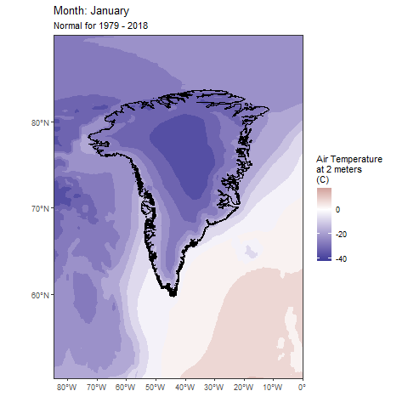
Monthly Normal Air Temperature at 2 meters
Follows expected pattern: Coldest in winter over the Greenland Ice Sheet, warmest in summer near the North Atlantic Current

Slide 11
Anomalies

Slide 12
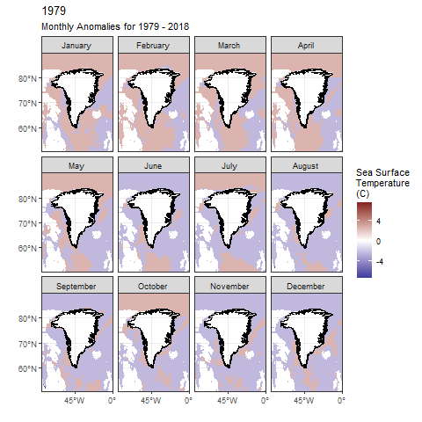
Monthly Anomalies Sea Surface Temperatures
Range of anomalies roughly between -5 and 5 degrees C
Anomalies throughout the year appear to increase closer to present

Slide 13
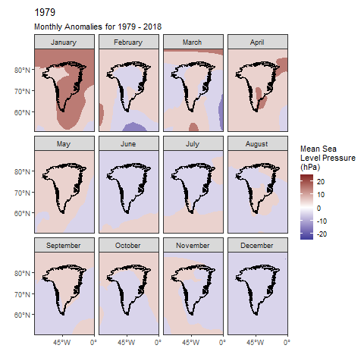
Monthly Anomalies Mean Sea Level Pressure
Stronger anomalies indicate potentially significant fluctuations in:
Icelandic Low
Greenland Blocking
North Atlantic Oscillation

Slide 14
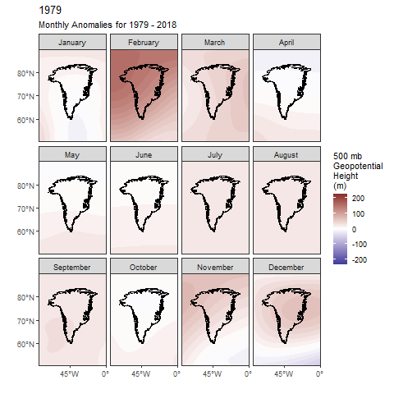
Monthly Anomalies 500 mb Geopotential Heights
Stronger anomalies indicate potentially significant fluctuations in:
Icelandic Low
Greenland Blocking
North Atlantic Oscillation

Slide 15
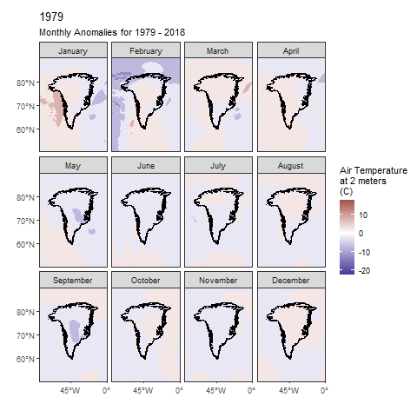
Monthly Anomalies Air Temperature at 2 meters
Autumn and winter anomalies appear to increase closer to the present

Slide 16
Point Pattern Analysis: Air Temperature at 2 meters

Slide 17
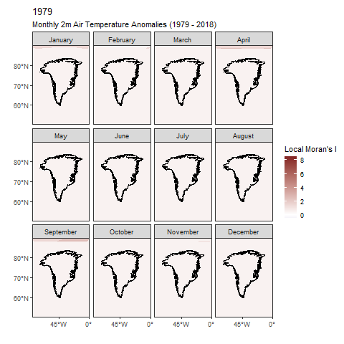
Local Moran’s I: Air Temperature at 2 meters
Neighborhood set to 10 km
95% level of significance
Confirms autocorrelation of meteorological phenomena
  i.e. Nothing appears unusual

Slide 18
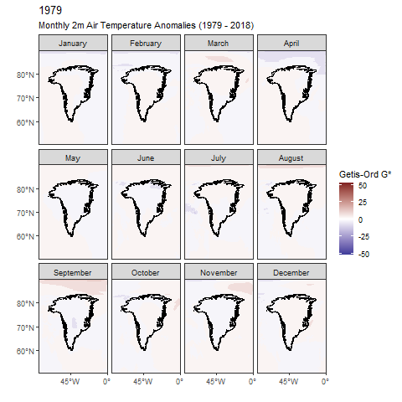
Getis-Ord Gi*:
Air Temperature at 2 meters
Neighborhood set to 10 km
No extremely hot or extremely cold clusters appear near present
Hot spots persist over Greenland in Autumn and Winter

Slide 19
Work to be Done
Continue spatial analysis of other parameters
  Explore other methods (empirical orthogonal functions) and statistics (ELSA)?
  Spatial modeling to examine coefficient surfaces
Conduct spectral analyses of parameters in locations of particular interest
Conduct spatiotemporal analyses
  How does the trend in space change over time?
  How does the trend in time vary in space?
Submit abstract for American Geophysical Union Annual Meeting, December 2021
  Need to investigate deadlines

Slide 20
Challenges
Continuously learning new packages and functions in R
Working within the memory limitations of R
MASSIVE amounts of data to process + complex statistical evaluations = at least one day to calculate statistics (even with multicore computing)
  Small batch tests for debugging
  Nonetheless, constantly monitoring for errors
  Forgetting to disable automatic updates…
  Laptop crashes when R uses all 12 GB of RAM

Slide 21

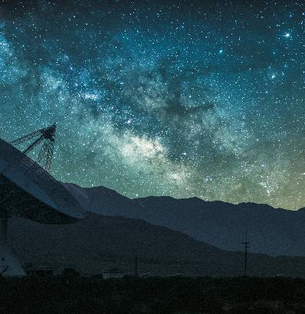
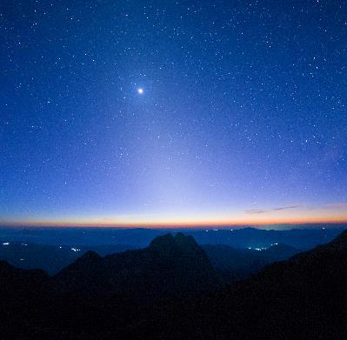
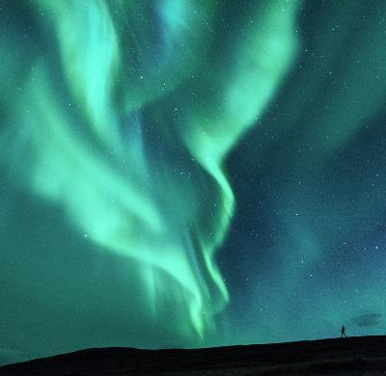
Summary
Data thus far confirms assumed patterns and trends described in literature
No unusual/extraordinary results…yet

Slide 22
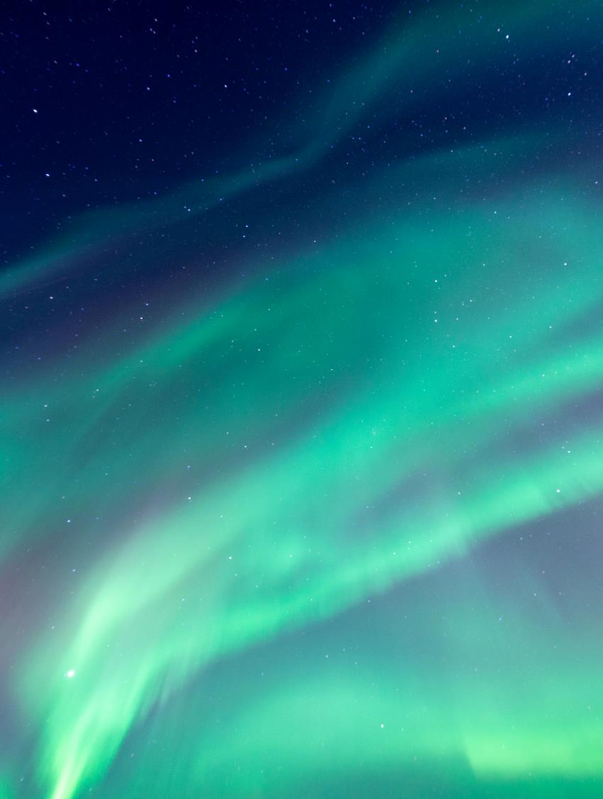
Thank You
Preliminary Findings:
Spatio-Temporal Analysis of Greenland’s Climate
Kenneth Crager

