Slide 1
Spatial analysis and visualization of environmental risk factors for heart disease in rural Appalachia
Alexandra crowe
Advisor: Dr. Louisa Holmes

Slide 2
Overview
Background
Explanation of variables
Appalachia
Methods
Results and Dissemination

Slide 3
Why I chose this topic
Gaps in research
Environmental could explain some spatial element
Close to home

Slide 4
What is heart disease?
Leading cause of death in US
Cardiovascular disease​ (heart disease, stroke, congenital heart defect, myocardial infarction)
Heart disease (coronary artery disease, heart attack, angina, etc)
Poor lifestyle habits and health conditions

Slide 5
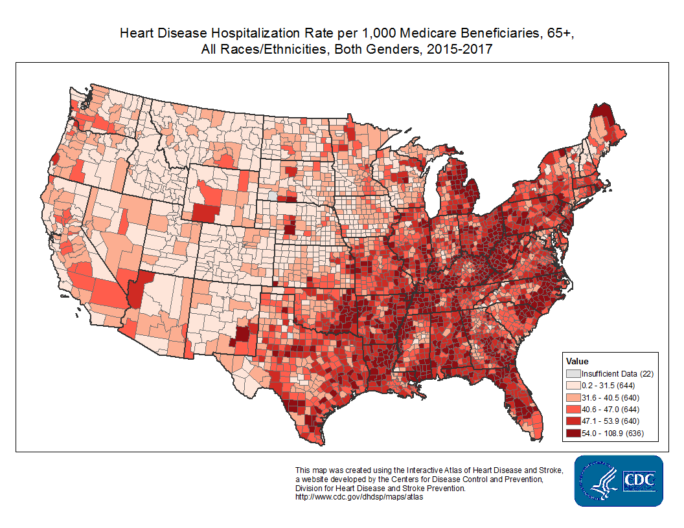
Heart disease across America

Slide 6
Appalachia

Slide 7
Risks of developing heart disease
Health conditions
Behavioral risks
Environmental risks

Slide 8
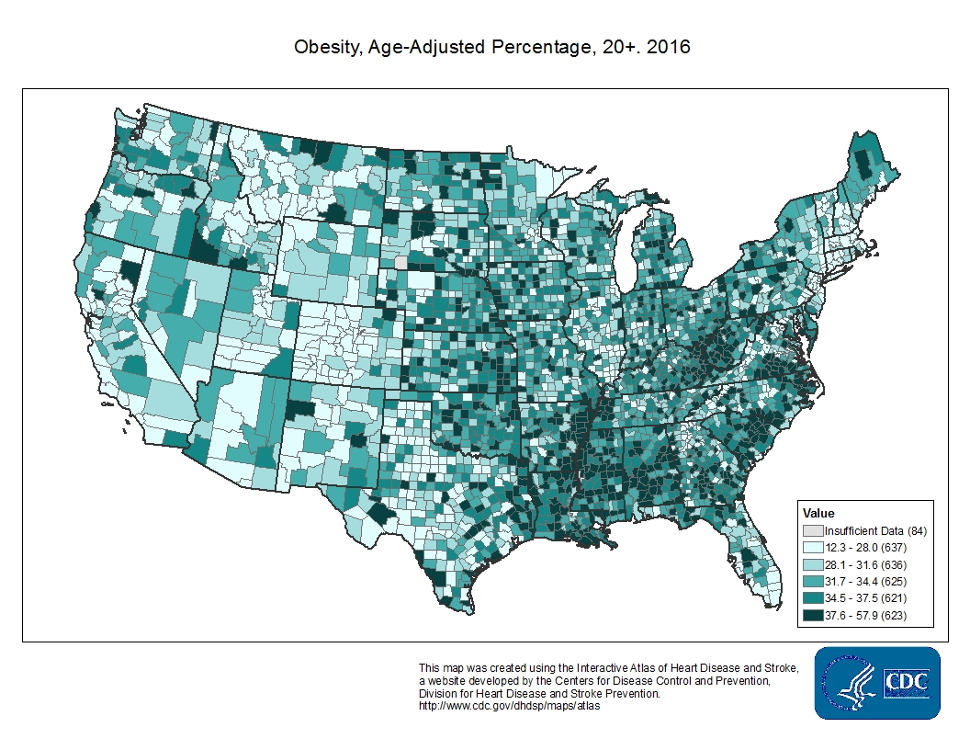
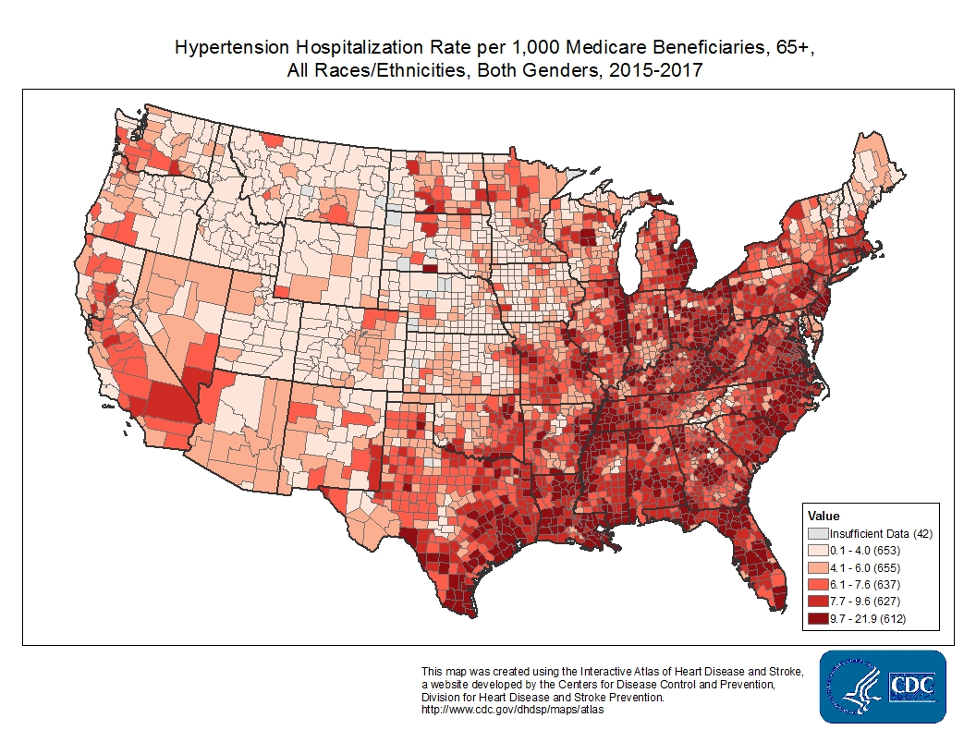
Health conditions
Hypertension
Diabetes
Obesity
Unhealthy cholesterol levels

Slide 9
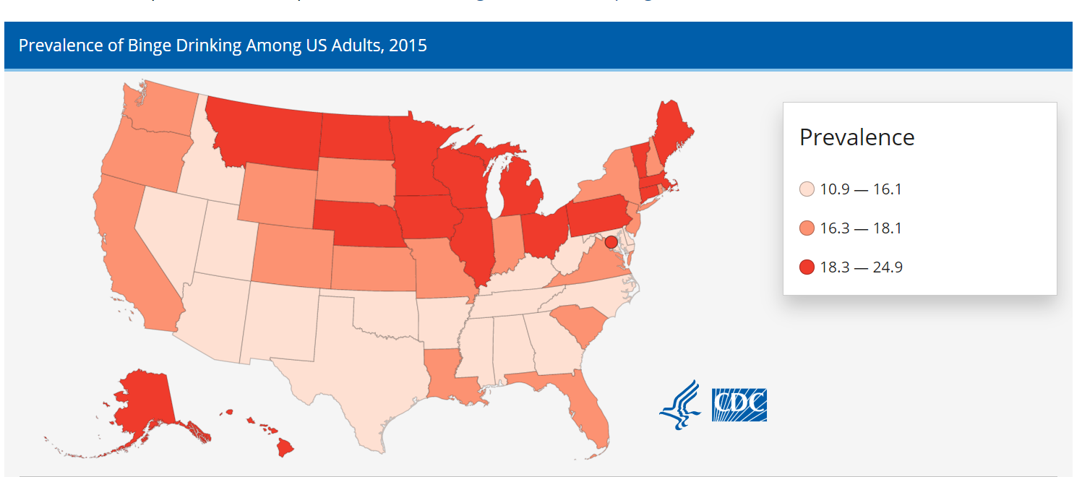
Behavioral risks
Lack of physical activity
Poor eating habits
Alcohol and tobacco use

Slide 10
Variable: Greenness Factor
Recreational parks/forests
Could reduce cardiovascular disease by 37%
NDVI image analysis

Slide 11
Variable: Air quality
Daily exposure to PM2.5
Lower overall life years
Increase rates of CVD
Not just an urban problem

Slide 12
Variable: Seasonal changes
Higher admission rates in Spring
Minimal spatial analysis/research
Climate change could raise rates
Appalachia's climate diversity

Slide 13
Methods
County Environmental Risk Factor Index
Greenness
Air pollution
Seasonal changes
Geographically weighted regression
Hypothesis: Rural areas with a lower environmental risk factor index will show decreased rates of heart disease.
8
0
0
2
0
2
0
2

Slide 14
Data
Health data: 2014-2019 BRFSS
Air Quality: Environmental Protection Agency
Greenness factor: USGS
Seasonal change: NOAAs

Slide 15
Results and Dissemination
Research paper on findings
Interactive web map as visualization of findings
Present in July as ESRI User Conference

Slide 16
Questions

