Slide 1
GIS as Applied to Disaster Management in Outlying and Non-Metro Illinois Counties
James Cueno
596 A Peer Presentation - Spring 2 ‘15
Notes:
Good evening, thanks everyone for attending. Tonight, I would like to present my ideas for a plan to study GIS as Applied to Disaster Management in Outlying and Non-Metro Counties here in Illinois. I’m the GIS Analyst for the City of Galesburg, Illinois and for the last few years one of my goals has been to been to find better ways to support our first responders.

Slide 2
Outline
Introduction to GIS and Disaster Management
Findings from Previous Implementations
Integration of GIS and Disaster Management Study
Potential Impacts and Significance
Notes:
Tonight I will offer:
-> a quick introduction to GIS and Disaster Management
-> findings from previous implementations of GIS to support disaster management
-> a proposal to study existing implementations of GIS and disaster management
-> and finally some potential impacts and significance that I may derive from this work.

Slide 3
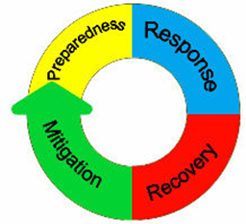
Disaster Management Cycle
http://lincolncountyema.net/images/ema_cycle.jpg
Notes:
There are four standard phases to the Disaster Management Cycle. GIS Can be applied to any of them:
Preparedness is any actions taken pre-incident that will help responders and the affected population during and after the incident including planning and training. For GIS this includes developing a plan to implement GIS during a disaster; training; familiarization and acquiring hardware,software and data.
The Response phase consists of actions taken as a direct result of the incident to preserve and save life, protect property and minimize damage to the environment. This most directly is supporting responders and decision makers.
Actions taken to restore the impacted area to pre-incident conditions happen during the Recovery phase. GIS applications include change analysis, tracking debris removal and general progress tracking.
Mitigation actions are those taken to minimize damage caused by identified threats. This mostly consists of scenario modelling.
Activities may overlap between phases and phases may occur simultaneously - for example is restoring power in the aftermath of an incident response or recovery? Even preparedness and response overlap as plans are developed for later implementation in the response phase.
GIS plugs into any of the four phases. Mitigation and Preparedness are steady-state activities conducted as normal operations. The response phase includes dynamic actions collecting, analyzing and sharing information among responders and decision makers in a time-compressed environment. The recovery phase may be the longest, with a much larger audience.
For my capstone project, I will study the level of integration of GIS and Disaster Management in the less-populated counties of the State.

Slide 4
Problem Focus
Despite attempts by Federal- and State-level agencies to encourage the use of GIS, it is often perceived as an expensive luxury by many local governments.
Similarly, there is a lack of guidance for implementing GIS to support All-Hazards incidents at the local level.
Notes:
-> GIS is often perceived as an expensive tool, even a luxury, for some levels of government. Less-densely populated, non-metropolitan and even outlying counties in metropolitan areas may not have the capabilities to properly exploit GIS to support disaster management. These counties are largely ignored by higher level of government because of their low populations; as dollars spent in more populous counties is understood to be more effective – an example being the National Geospatial-Intelligence Agency’s “133 Cities Urban Areas Initiative”. In 2006, the Illinois Emergency Management Agency granted computers, desktop plotters and copies of ArcView to each County Emergency Management Agency - with minimal training, no data and no direction.
-> The nationally specified Incident Command System evolved out of practices codified by the National Wildfire Coordination Group and includes standards, procedures and qualifications for positions in the command structure. These include a Geographic Information System Specialist (GISS) or Geospatial Information Specialist (GISP) in FEMA’s nomenclature. Many of the positions developed by the NWCG have been migrated into the more generalized “All-Hazards” ICS, but not GIS. In 2013 draft position qualifications for 4 GIS positions were released, but they have since been withdrawn. The NWCG offers a GISS course (S-341 GIS Specialist for Incident Management offered in 2015 once in Colorado to support Wildfire responders and once in the Gulf Coast region, presumably to support Hurricane response), but there is no All-Hazards equivalent. Conversely, the NWCG has dropped several of its courses in favor of FEMA’s All-Hazards versions.

Slide 5
Study Methodology
Review what has already been done or proposed to integrate GIS and Disaster Management.
Investigate what is happening in Illinois by surveying responsible local officials.
Analyze the results, quantifying capabilities and describing deficiencies.
Develop a plan for Knox County that might be used for guidance.
Notes:
In order to maybe do something about those problems, I plan to:
Review what has already been done around the country to integrate GIS and Disaster Management. I have been reviewing After-Action Reports, “Lessons Learned” documents, Federal guidelines, conference presentations and industry proposal looking for clues.
I need to find out just what is being done today around Illinois. Anecdotally, not much, but there could be things going on in different circles.
With that survey in hand, and a good response, I should have an idea of the capabilities that really are in place around the State.
With what I have learned from the review and any ideas from the study, I will write a plan for Knox County, standardizing the use of GIS here.

Slide 6
Review
Six Elements for Effective Integration of GIS into Disaster Management:
Include GIS in Response Plans
Document GIS activities in AARs and plan to review the effectiveness of the GIS support
Build Awareness of Field Conditions in GIS Staff and Developers
Notes:
In my review, I have found 6 elements for effective integration of GIS into Disaster Mangement:
Include GIS in Response Plans
Document GIS activities in AARs and review the effectiveness of any GIS support
Build awareness of Field conditions in GIS staff and developers.

Slide 7
Review
4. Implement Comprehensive and Complementary Training of GIS Staff, Disaster Managers and Responders
5. Standardize Map Products
6. Prepare for GIS Mutual Aid
Notes:
4) Implement a comprehensive and complementary training program for GIS staff, disaster managers and responders
5) Standardized map products
And finally
6) Prepare for GIS mutual aid.

Slide 8
Necessary Elements
Include GIS in Response Plans
Predictable response, sets expectations
Requires contact information
Opportunity for both sides to think about integration
Geospatial Annex or referenced Geospatial SOG
Notes:
-> The first necessary element is simply acknowledging any available GIS resources and planning to use them. Written plans are the best, but there needs to be an agreed upon plan with defined responsibilities and expectations. This allows for a predictable response - for both sides.
-> Most basically, it requires an exchange of contact information and a basic discussion of capabilities. At the 2014 Illinois GIS Association conference there were several session discussing the use of GIS to respond to the November 17, 2013 tornado outbreak that hit central Illinois. The City of Washington made the national headlines, but there were several other communities hit. A few days into the response, GIS practitioners from the Tri-County Regional Planning Commission in nearby Peoria were contacted. At their presentation, one of those practioners made the off-handed remark that was roughly “We weren’t sure the Emergency Management coordinator in Tazewell county knew what GIS was, or at least what our capabilities were.” Tazewell County with a popualtion of 135,000 is one of the eponymous Tri-Counties.
-> Writing a plan forces both parties to think about responsibilities, capabilities and needs. In our Knox County Emergency Operation Plan, the County Assessor is responsible for post-incident Damage Assessment. This plan was implemented with minimal communication and until a few years ago, the new Assessor didn’t know about those responsibilities or how to execute them.
-> This plan can lead to either a full Geospatial Annex in the county Emergency Operations Plan or a set of “standard / suggested operating guidelines” that are referenced from the EOP.
These activities establish relationships and responsibilities.

Slide 9
Necessary Elements
2) Documentation & After-Action Reports
Allows for Institutional Memory
Opportunity for Practitioners & Supported Managers to Review & Discuss
Wiki or Formal Template
CAPSTONE-14 Information: http://www.cusec.org/plans-a-programs/multi-state-planning/173
Notes:
Any incidents or exercises that do include GIS need to be properly documented.
The largest emergency exercise in Illinois last year was the CAPSTONE-14 exercise simulating a large earthquake originating from the nearby New Madrid fault. There are at least two publicly available After-Action Reports documenting that exercise. Also, many of that exercise’s development documents are publicly available.
-> AARs preserve hard-earned institutional knowledge. These AARs can be used to facilitate further development. Any written implementation plan would include provisions for documentation.
-> AARs are often preceded by “hot washes” immediately after the incident or exercise that allow responders and managers to discuss what went right, what went wrong, what needs to be institutionalized and what needs to be corrected. The hot wash becomes part of the AAR, but it might be the only opportunity many of the managers can discuss the incident face-to-face.
-> The documentation can be wikis, document archives or formal After Action Reports that are included in the final incident or exercise documentation.

Slide 10
Necessary Elements
3) Awareness of Field Conditions
Reasonable in the office is not reasonable in the field
Paper maps might be the only reasonable distribution method / Responder preferences
Encourages communication & informal channels
Exercises
Notes:
Sometimes GIS practitioners get too deep into the technology and are not aware of the field implications of their tools. Communications issues might be the most important, but also conditions in general.
-> High speed network connections probably aren’t available in the field to responders and managers. Technology in general might not be available in the field.
-> Paper maps might be the only choice. They need to be clean, clear and explicit. They need to acknowledge responder preferences.
-> The awareness builds communication and informal channels. Not to mention respect.
-> The best way for this to happen will be through controlled exercises and feedback.

Slide 11
Necessary Elements
4) Complementary Training
Awareness-level training, familiarization
Set expectations
Exercises
Notes:
Awareness comes in part through complementary training. Not trying to make GIS techs out of firefighters, or put GIS practitioners out in the operations, but build understanding. Years ago, I was told “Cops just want to be cops” when I tried to roll out a GIS tool to them.
-> Awareness-level training (the formal concept of awareness is common in the Fire service) and familiarization is necessary. I’m Hazardous Materials Awareness-level trained. I know how to identify a possible Hazmat release, how to protect myself, the limitations of my training and how to communicate the information I have to those who are Operations- or Technician-level trained.
-> This training sets expectations. Both directions. It lets GIS practitioners understand what responders need to know, and responders can understand the capabilities of their GIS support.
-> Again, exercises are a great tool for this.

Slide 12
Necessary Elements
5) Standardized Map Products
Most important in mutual aid responses, allows foreign responders to quickly gain situational awareness
Consistency
Notes:
Standardization allow for consistent products during an incident and between incidents.
-> It encourages a shared visual language.
-> It also ensures that basic data are on hand.

Slide 13
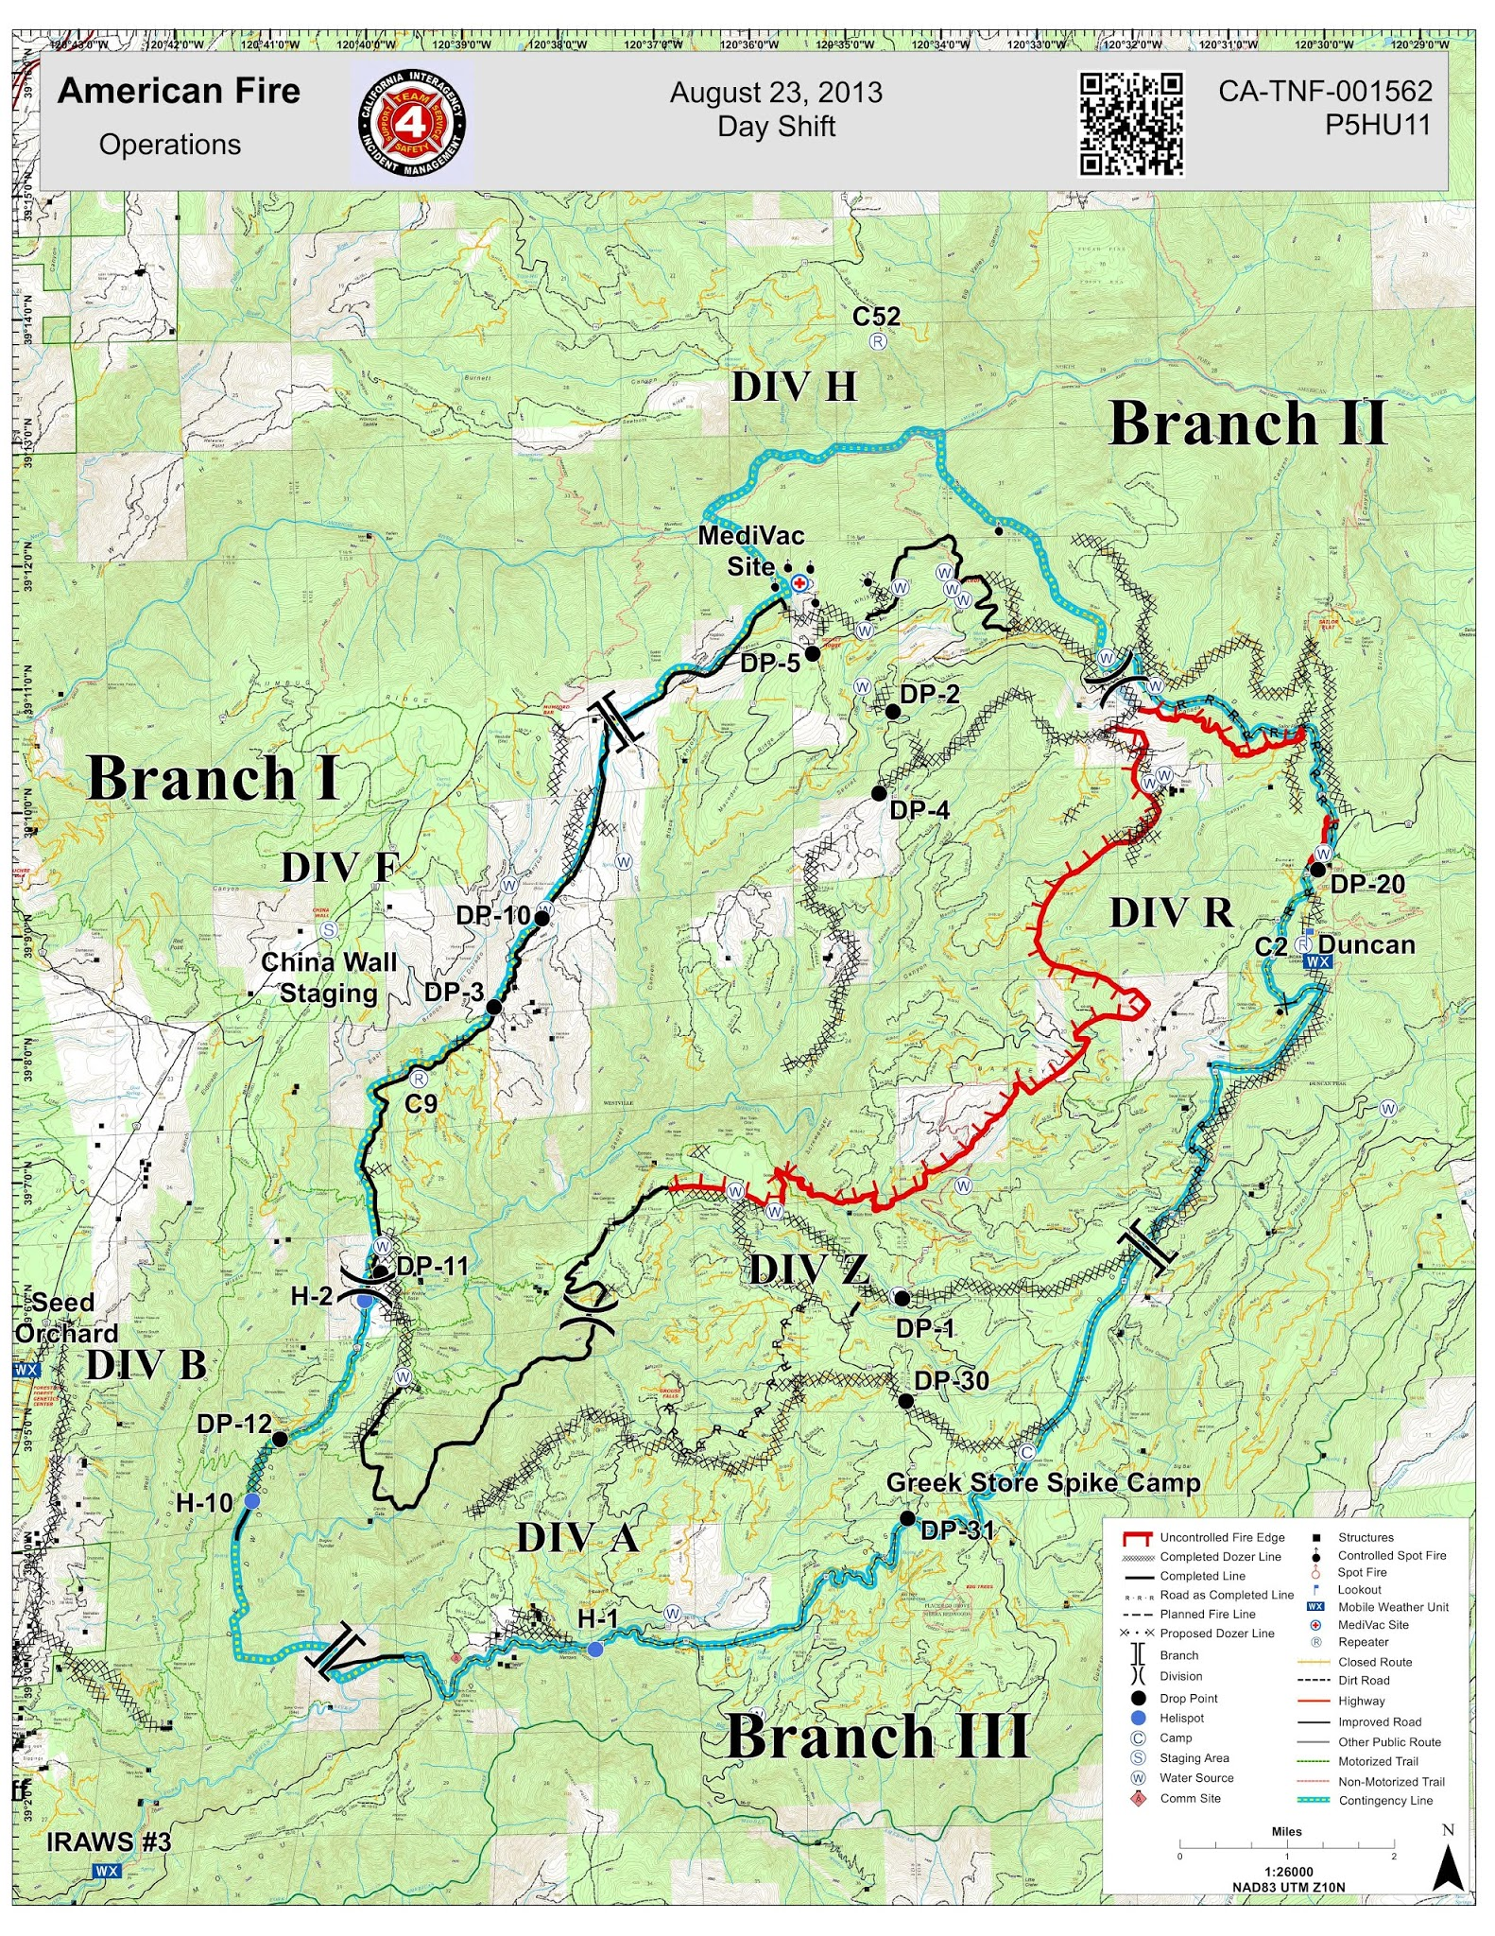
http://inciweb.nwcg.gov/photos/CATNF/2013-08-11-1142-American/picts/2013_08_25-09.48.48.319-CDT.jpeg
Notes:
This Operations map was developed by the California Interagency Incident Management Team to support operations against the American Fire in the Tahoe Nat’l Forest between Sacremento, CA and Reno, NV in the summer of 2013. The Operations map is used for strategy, tactics and planning in the Incident Command Post and in the field.
It uses the NWCG standard symbol sets. At first look, this map is a mess. To a trained user, it communicated volumes of inforamtion about the overall strategy and situation of the incident response. Standardization shortens the learning curve as responders and managers will see the same information presented the same way every time.
The QR code is broken - the fire was almost two years ago - but it was a link to a PDF of this map that responders could download to their smart devices.

Slide 14
Necessary Elements
6) Prepare for Mutual Aid
Some mutual aid assets bring GIS / mapping resources
Dependence on unavailable tools & communications
GIS as mutual aid
Notes:
Disasters can be formally defined as “an event…[that] exceeds the capacity of the government or governments in whose jurisdiction it occurs. Dealing with a disaster therefore requires outside resources” (National Research Council “Successful Response…”, 2007, pg 47). Outside resources in the form of mutual aid is the defining characteristic of a disaster.
-> Some mutual aid asset bring their own GIS & mapping resources. In Illinois Firefighter mutual-aid Hazmat teams supported by the Illinois Mutual Aid Box Alarms System bring the EPA’s CAMEO suite including the ALOHA modeling software and the MARPLOT mapping system.
-> However effective, mutual aid responders can be shut out from locally developed and deployed tools thereby decreasing effectiveness.
-> Finally, GIS as mutual aid: bringing in GIS techs from outside. This calls for a plan to absorb the new techs, including required skills, a data access process, standard map products, a management structure and possible hard- and software needs.

Slide 15
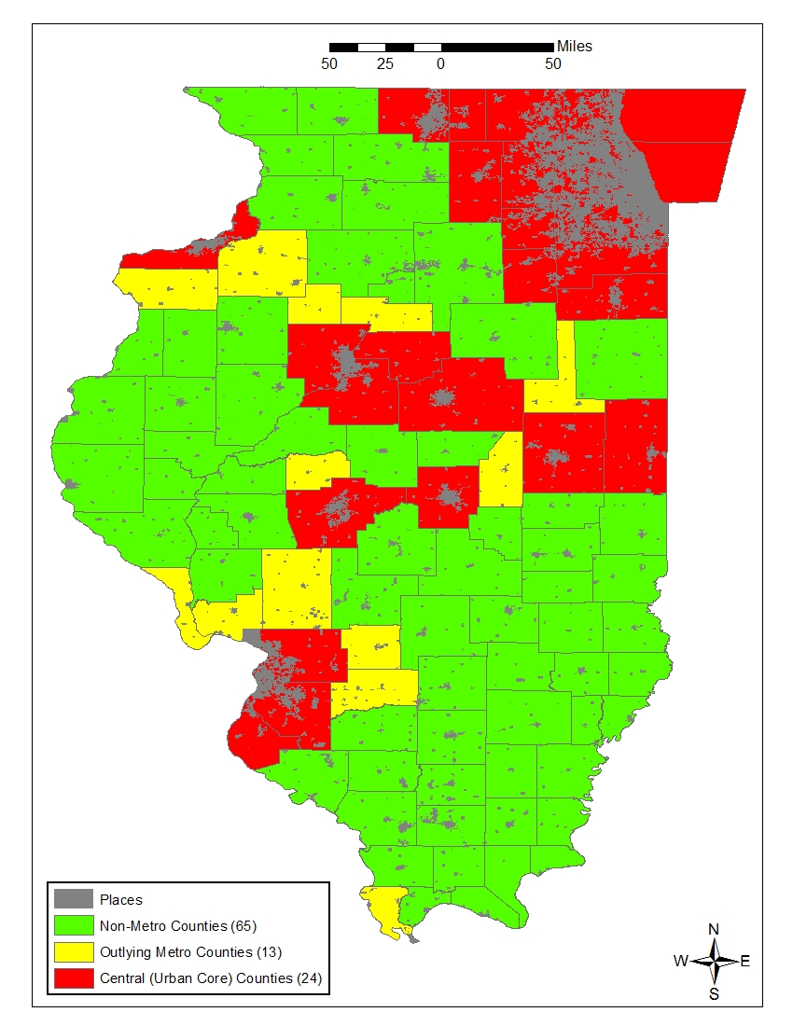
Study Area
Outlying Metro Counties
Non-Metro Counties
Notes:
I am working on the assumption that the counties with dense urban cores have both financial means and political leadership to have comprehensive integration of GIS into their Disaster Management processes already.
For a solid definition of those counties, I used the Office of Management and Budget’s Metropolitan Statistical Areas. The MSAs are further subdivided into Central and Outlying counties.
-> The Central counties have the large urban cores,
-> while the Outlying counties are basically Non-Metropolitan counties that are tied to the Central counties economically and socially.
My study area consists of the 13 Outlying counties and the remaining 65 independent Non-Metropolitan counties in Illinois.

Slide 16
Study Population
Emergency Managers
By Illinois Statute, each County is required to have a trained Emergency Management Coordinator
GIS / Mapping Managers
Some GIS Managers or Coordinators, mostly County Assessors
Notes:
For the first part of my study I will invite the designated County Emergency Management coordinators and the County official I can identify in each county that is most responsible for the management of any GIS or mapping program to take a survey discussing their GIS. There are 29 questions, so far, some targeted specifically at one group or the other and some joint questions.
-> By Illinois statute each County is expected to have a designated, trained Emergency Management coordinator in order to be accredited by the Illinois Emergency Management Agency and to receive state aid in the event of a disaster. These coordinators are partially funded by IEMA and have specific training requirements.
-> The GIS and mapping officials I have identified include those identified as some kind of GIS manager or Zoning officer, but most are Chief County Assessment Officers. As very few are members of the Illinois GIS Association, I can assume that their GIS responsibilities are an additional responsibility, rather than a career path.

Slide 17
Sample Questions
Do you have contact information for the person responsible for GIS / Mapping in your jurisdiction?
Does your County Emergency Operation Plan include the use of GIS in your EM workflows?
Notes:
In the survey, I try to keep the questions simple, particularly with respect to established integration:
-> For the EM coordinators: “Do you have contact information for the person responsible for GIS / Mapping in your jurisdiction?”
For the mappers: “Do you have contact information for you jurisdiction’s Emergency Management coordinator?”
This would establishes some contact and maybe the beginning of discussions.
-> “Does your County Emergency Operation Plan include the use of GIS in your workflows?”
Has there been any formal action taken to integrate the two? Any formal plan would imply there is also documentation in place with a specified format because documentation is so important to disaster management already. The disaster declaration and any re-imbursements from the State or Federal gov’t depend on good documentation.

Slide 18
Sample Questions
Do Emergency Management exercises in your jurisdiction include the use of GIS?
Do you have an awareness-level training program for your GIS staff regarding emergency management concepts and procedures?
Notes:
Some questions regarding field awareness and complementary training:
-> Do your EM exercises include GIS? Establishes basic awareness, in both directions.
-> Do you have an awareness-level training program for your GIS staff regarding emergency management concepts and procedures? And the converse for responders. Have you made an effort to bring the two sides together?
This might lead to functional, well thought out products and realistic expectations at both ends.

Slide 19
Sample Questions
What is the highest level of EM training for your GIS staff?
None
Intro to ICS (100)
Initial Action Incidents (200)
Intermediate ICS (300)
Advanced ICS (400) / CGSFLIMT
Situation Unit Leader
Planning Section Chief
Notes:
What is the highest level of EM training for you GIS staff?
None
ICS 100 / Intro to ICS
ICS 200 / Initial Action Incidents
ICS 100 & 200 are both available on-line at FEMA’s training website.
ICS 300 / Intermediate ICS
ICS 400 or Command and General Staff Functions for Local Incident Management Teams
ICS 300, 400 and CGSFLIMT are usually offered by State EMA’s and training agencies
Situation Unit Leader
Planning Section Chief
Are residential classes offered by both State EMA’s, training agencies and FEMA.

Slide 20
Sample Questions
Does your GIS staff use predeveloped map templates for emergency support?
Reference:
GSTOP - http://gis.nwcg.gov/documents/gstop/documents/gstop.pdf
HSWG Symbols- http://www.fgdc.gov/HSWG/index.html or “ERS Homeland Security” style in ArcGIS
NAPSG Incident Symbology Set- http://www.napsgfoundation.org
Notes:
-> National Wildfire Coordinating Group’s GIS Standard Operating Procedures on Incidents (GSTOP) - defines procedures, map templates, symbol sets, basic data, directory structure and naming conventions to ensure a deliberate, comprehensible response consistent across incidents.
-> Homeland Security Working Group symbol set was developed at Penn State’s GeoVISTA Center as a standard set of symbols to be used across all incidents and at all levels of control.
-> National Alliance for Public Safety GIS foundation’s symbol set was developed for very low-level tactical mapping, with an understanding that mapping may need to be done by hand.

Slide 21
Sample Questions
Which critical infrastructure data layers are available in your jurisdiction?
What responders in your jurisdiction deploy with mobile computers or smart devices with mobile / wireless data capability?
Which mutual aid networks are represented in your jurisdiction?
Notes:
-> Data inventories are necessary to identify shortfalls in data, and also identify ways to share those with others.
-> I need to establish if local responders can use on-line tools. There won’t be anything for mutual aid responders to use if they don’t.
-> I want to know if they already participate in Mutual Aid. Absolutely they do, but which ones, it might help identify a host for GIS as mutual aid.

Slide 22
GIS as Mutual Aid
Allows practitioners with disaster experience to share that hard-earned knowledge.
Promotes documentation
Experienced professionals available for support or multiple shifts during long events.
Notes:
Having trained GIS professionals available to respond to incidents from outside has been discussed for years.
-> It would make expereinced professionals available to help.
-> It would promote documentation, to encourage training and spread lessons learned.
-> It would allow for multiple shifts during long incidents.
Formal calls for the development of these teams go back at least as far as 2007 and the National Research Council’s “Successful Response Starts with a Map: Improving Geospatial Support for Disaster Management”.
The closest example may be regional response teams developed in Kansas by their Nat’l Guard as state-level assets. There is also the pool of carded GIS Specialists available in the Wildfire community, but there does not appear to be any low level, all hazards, peer-to-peer mutual aid networks that include GIS. The interstate Emergency Management Assistance Compact discusses GIS assets, but GIS support seems to be only available as a part of a large, 16 member “Local Government Recovery Team” that includes 2 or 3 IT staff that are expected to manage networking and GIS.

Slide 23
GIS as Mutual Aid
Standard products
Reach out on your own
URISA GIS Corps & other volunteer Crisis Mapping groups
Notes:
-> Need familiarity with standard map products to ensure a smooth operation.
-> Reach out on your own.
-> Volunteer for URISA’s GIS Corps or any of the volunteer crisis mapping groups.

Slide 24
What’s Next?
Release Survey
One Month to
Complete Surveys
Discuss Survey results w/ Mutual Aid Networks and GIS practitioners
Analyze Surveys
Develop GSOG for Knox County incl. ideas submitted from survey

Slide 25
Impacts & Significance
With the survey results in hand, and hopefully some good ideas from respondents, I will assemble a set of written Standard Operating Guidelines for the 2016 Knox County Emergency Operations Plan.
That document will be include elements of the NWCG GSTOP and the NAPSG SOG.
http://www.napsgfoundation.org/wp-content/uploads/2014/08/NAPSG-SOG-V-3-FINAL.docx

Slide 26
GeoCONOPS
US Dept. of Homeland Security has published a Geospatial Concept of Operations (GeoCONOPS) that defines lead agencies for all Federal geospatial support operations and authoritative data sources.
My SOG will have a localized version.
https://www.geoplatform.gov/geoconops-home
Notes:
-> The GeoCONOPS is an intricately, detailed document that defines how Federal government GIS assets should respond to a disaster.
-> It details authoritative data sources and I will use it as a model for a section of the SOG.
-> This diagram from the GeoCONOPS document illustrates the flow of information from the incident up through the various levels through the Federal agencies.

Slide 27
Integration
An important step for proper integration is going to be simply testing the system on a regular basis.
The SOG will include provisions for at least quarterly exercise (workshops, drills, functional exercises or full scale exercises).
With the results of the exercises or any real-world incidents, managers will then re-evaluate the plans.
Notes:
-> Exercises will both identify problems in the plans and lead to familiarization from both ends.
-> Workshops: conferences with all of the pertinent parties to develop procedures, identify problems and generally plan.
Drills: an exercise that evaluates the execution of one activity - might just be generating an incident map and then evaluating it with responders
Functional: command exercise in which managers react as if they were controlling assets in the field. The actions of field assets are simulated.
Full scale: an exercise that includes assets in the field reacting to an incident, with most levels of the response fully manned.
->The Disaster Cycle can be simulated, but needs to be followed.

Slide 28
Project Schedule
Now - Institutional Review Board for the Survey
June - Distribute Survey, available for one month
July - Review & Summarize Survey Results
July / August - Write SOG for Knox County
14-16 September - ILGISA conference
Fall - Mutual Aid Discussions?

Slide 29
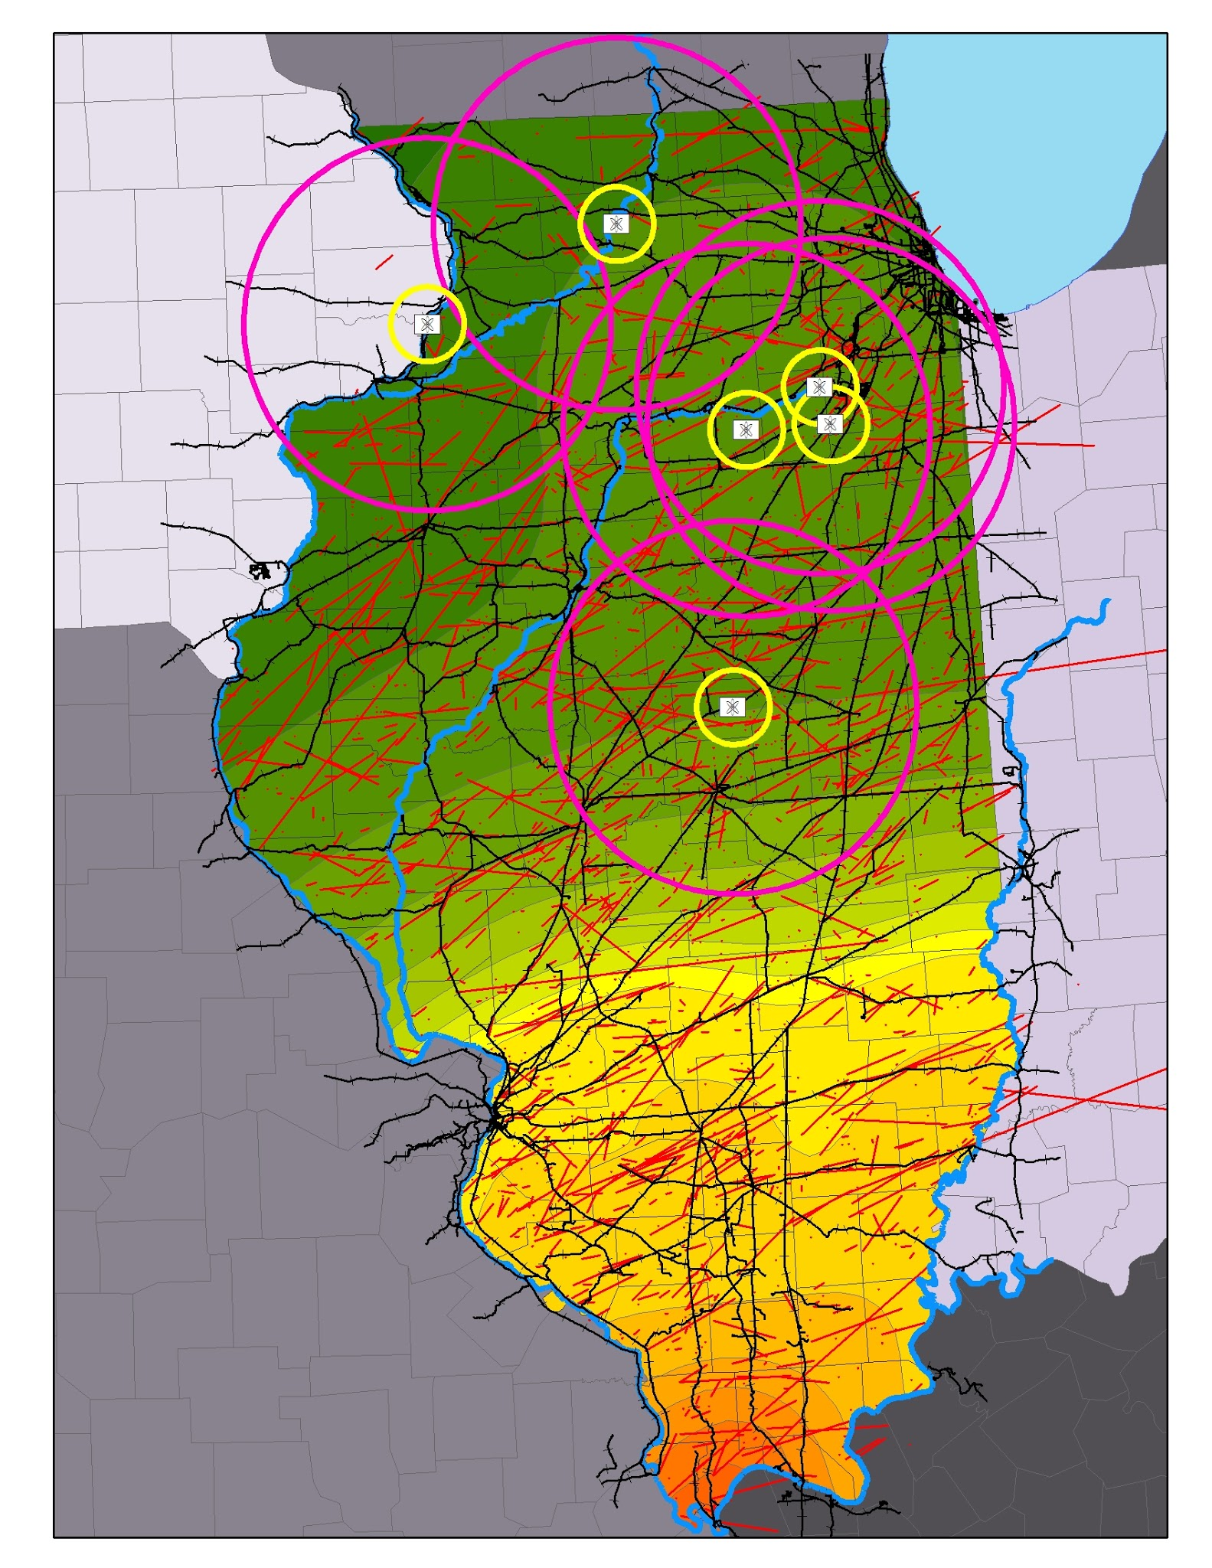
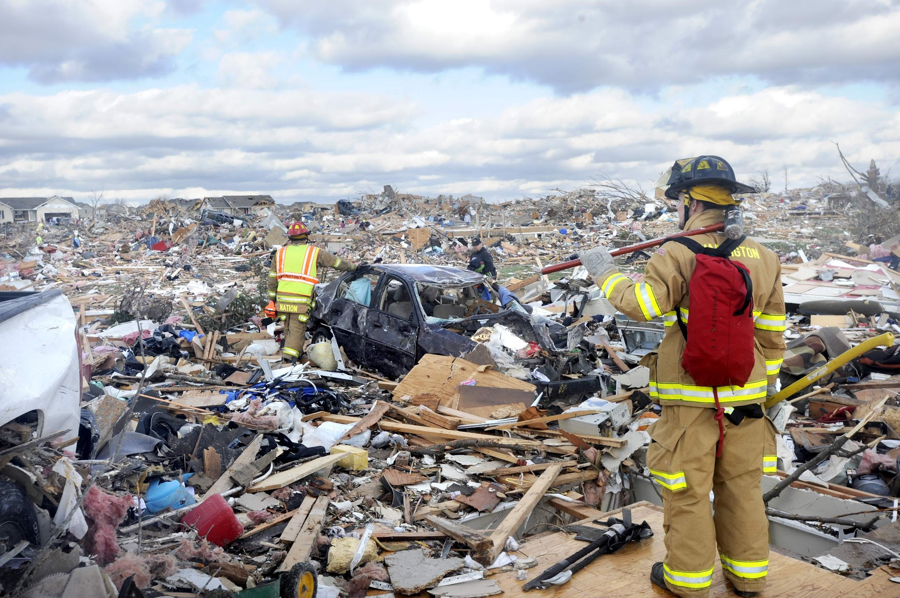
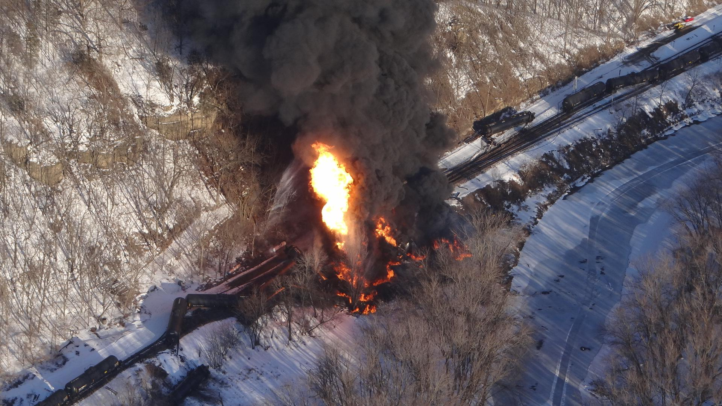
Notes:
-> Ugly map of risks:
6 Nuclear generating stations w/ 11 total reactors.
Regularly flooding rivers
Historic tornado tracks - 1950-2014
Railroad tracks - transportation disasters with chemicals
Horizontal acceleration isolines - earthquake damage risk from the New Madrid fault in the Missouri bootheel. The 1811-2 swarm rang church bells in Boston (est 7.7 magnitude), should it go off that large again there will be an estimated $200 Billion in total direct economic losses with at least 75,000 casualties in the eight state NMSZ.
-> Burning tanker cars from 5/March/2015 Galena derailment. Bakken crude.
-> Firefighters in Washington, IL on 17/November/2013 - 800 homes destroyed.

Slide 30
GIS as Applied to Disaster Management in Outlying and Non-Metro Illinois Counties
James Cueno
596 A Peer Presentation - Spring 2 ‘15

