Slide 1
Planning and implementing a GIS based asset management system for local government: Moving from a Reactive to Proactive Approach for Stormwater Pipes
GeoG. 596A-May 4th, 2021
By: Katy Cyr
Advisor: Dan Steiner

Slide 2
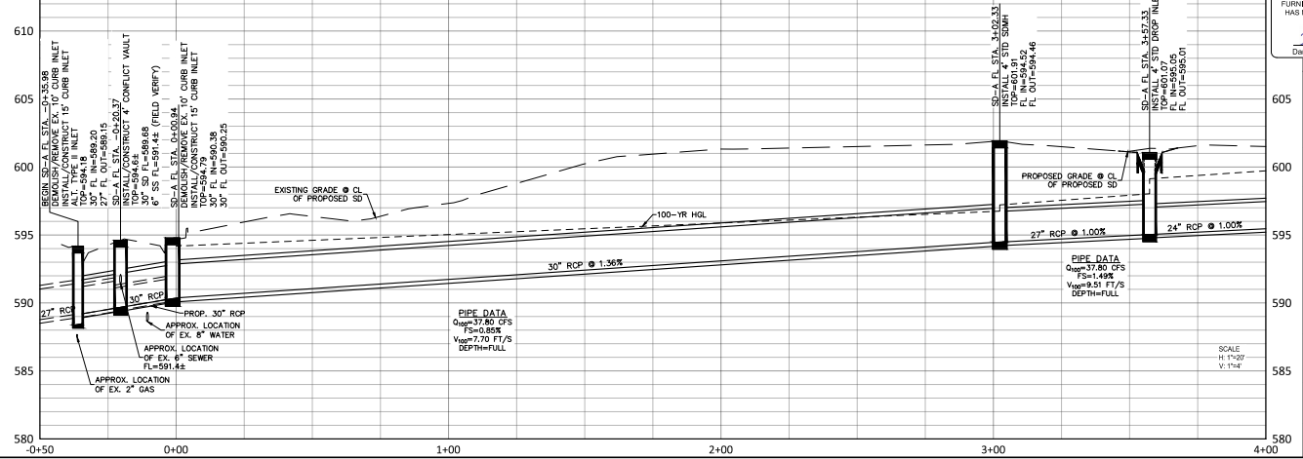
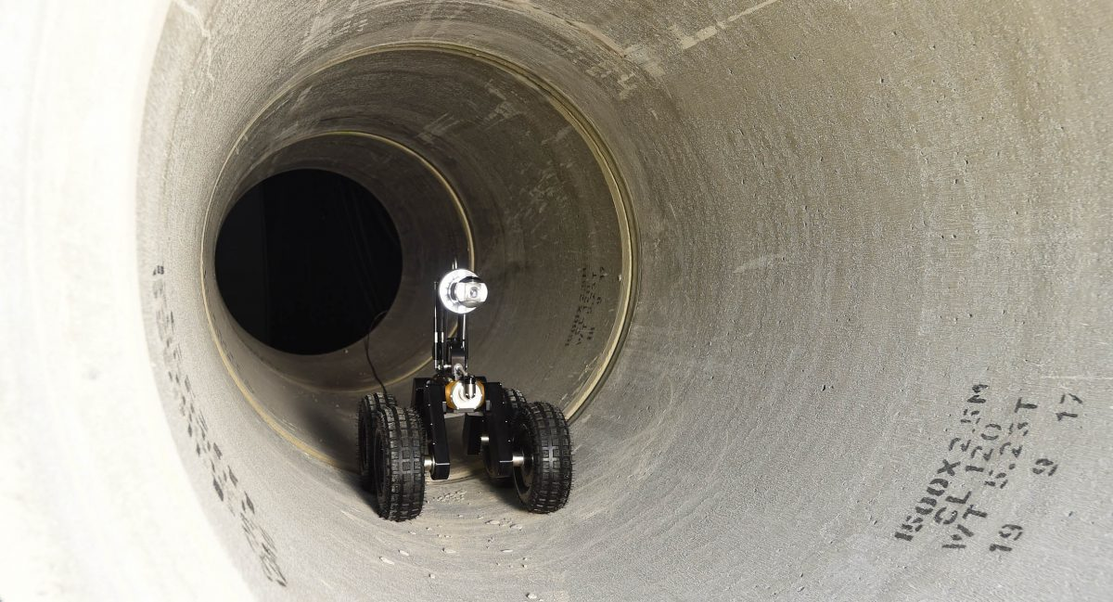
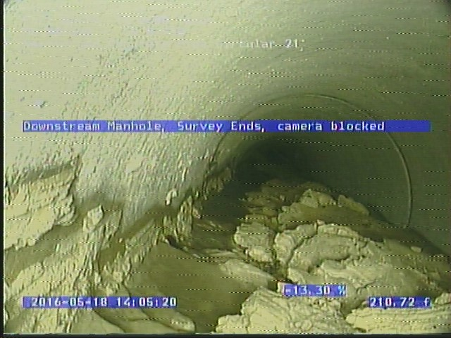
Project Model
Proactive
Modeling a proactive approach to stormwater pipe inspection & CCTV
City of Fort Worth
Pipe Asset
CCTV
Condition/Ranking
Plan
City of Fort Worth, 2021
Reactive
Cavein/Sinkhole
Emergency Repair
All Pipe Technologies, n.d.
City of Fort Worth, 2021

Slide 3
What is Asset Management?
Definition
Example
Lifecycle Diagram
Asset Management Lifecycle, FTMaintenance, 2019

Slide 4
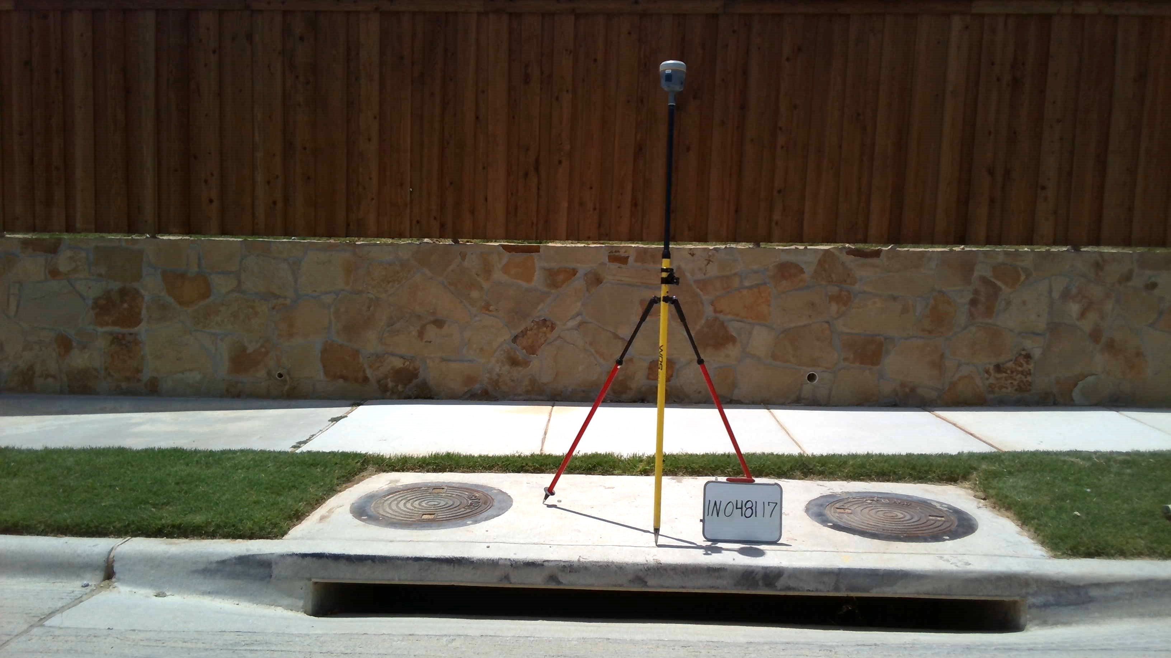
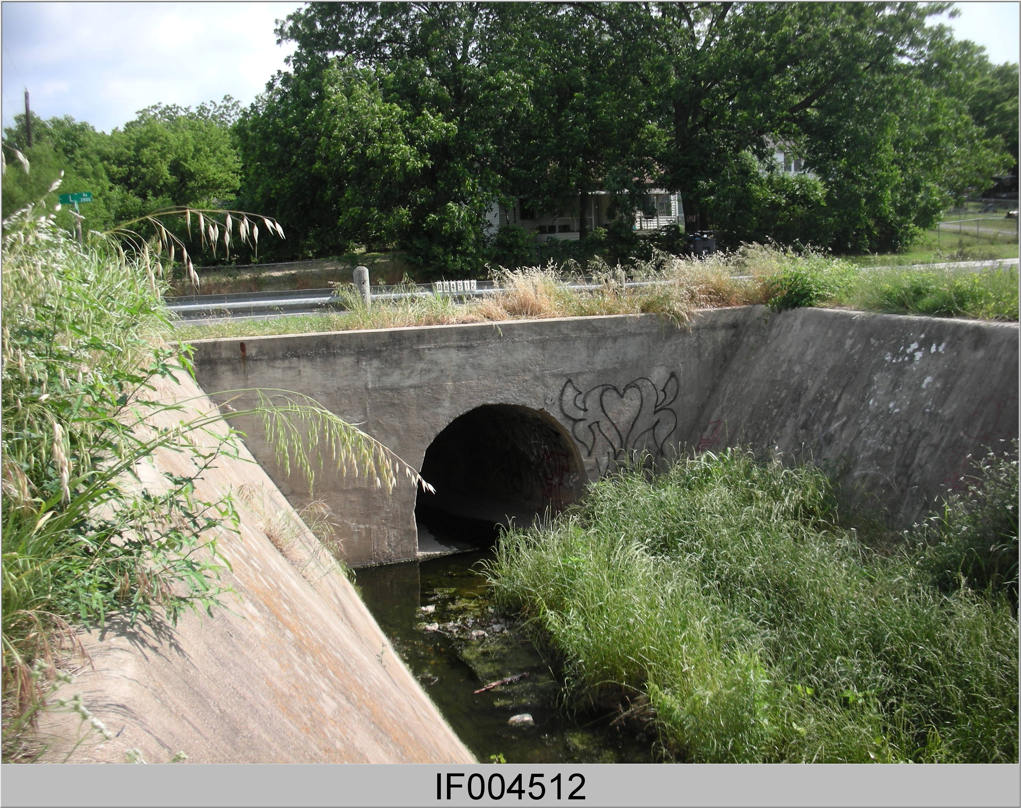
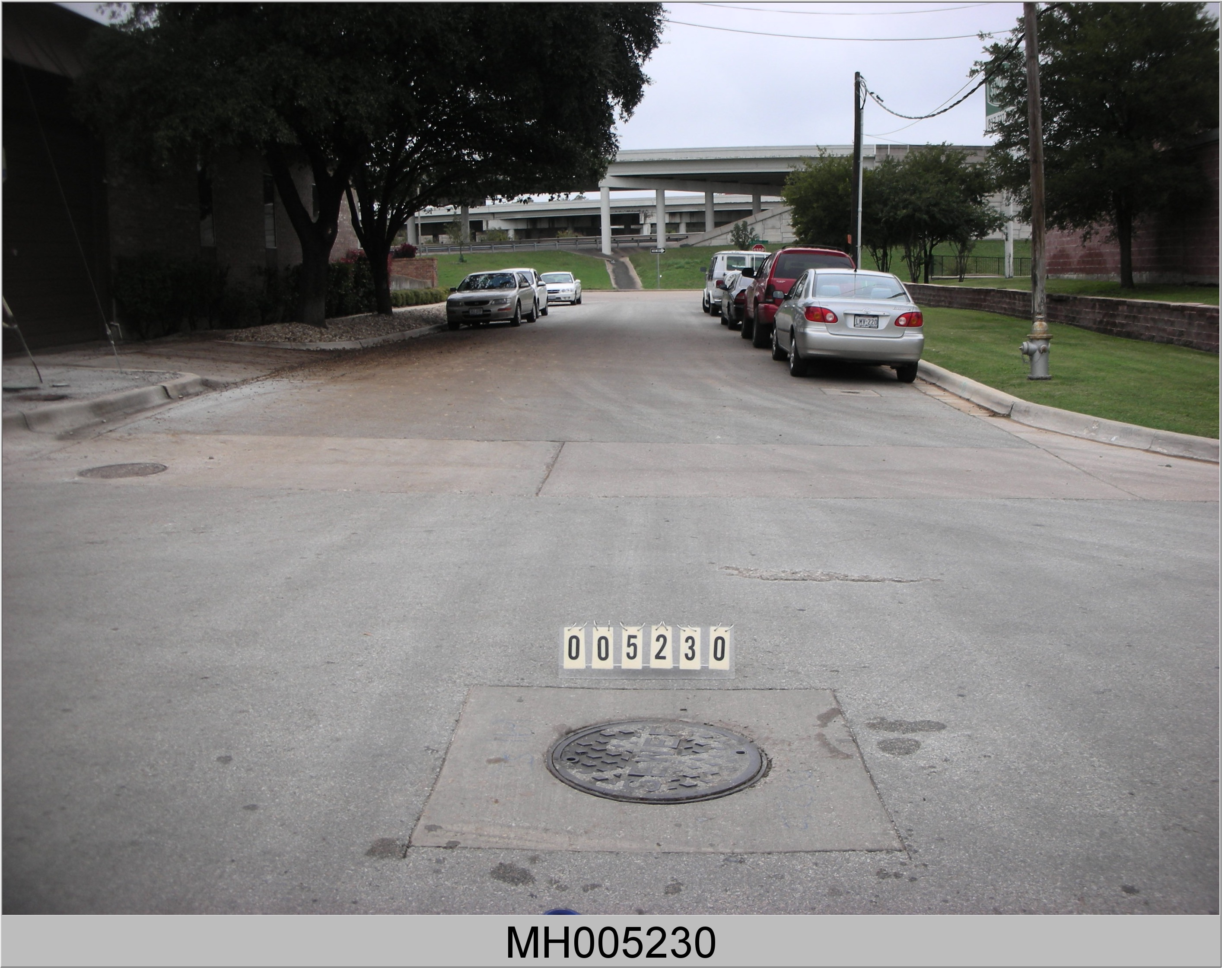
What is a stormwater system?
Fort Worth, Texas
997.3 Miles of Stormwater Pipe
27,640 Inlets
7,499 Manholes
Infall Asset. City of Fort Worth, 2021
Inlet Asset. City of Fort Worth., 2021
Manhole Asset. City of Fort Worth, 2021

Slide 5
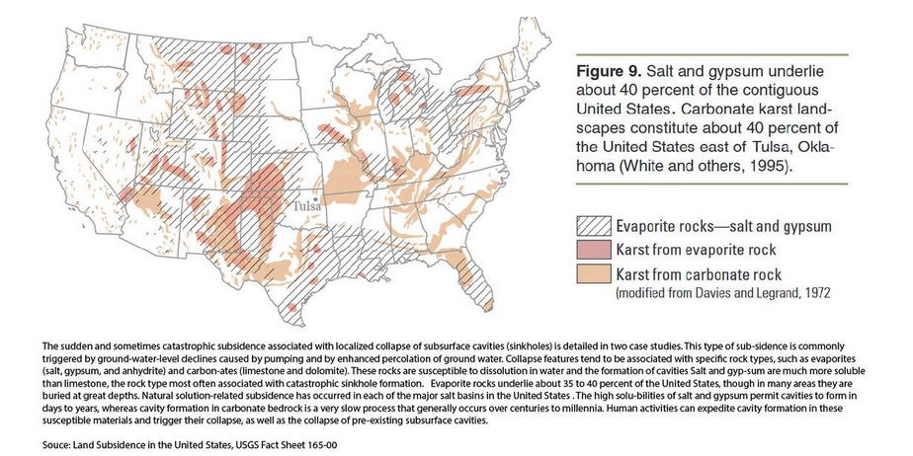
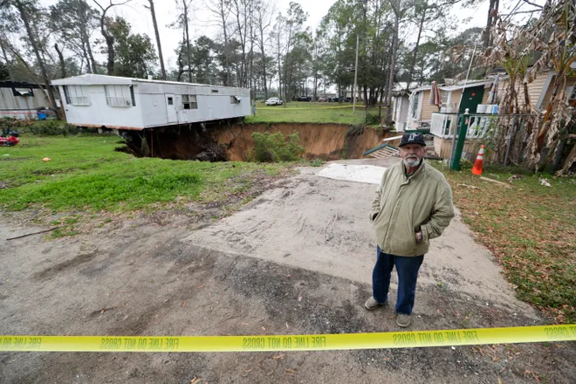
What is a cave in or sinkhole?
Natural occurrences
Common in limestone subsurface
Human impact
Urban Infrastructure
Combination
Land Subsidence in the United States, USGS, 2019
Sinkhole, Florida. Hiers, 2020

Slide 6
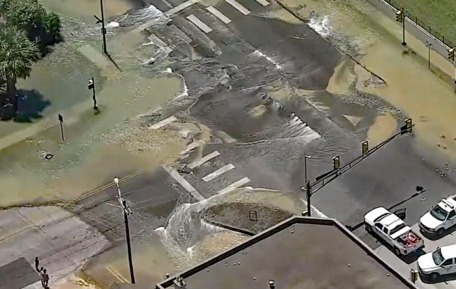
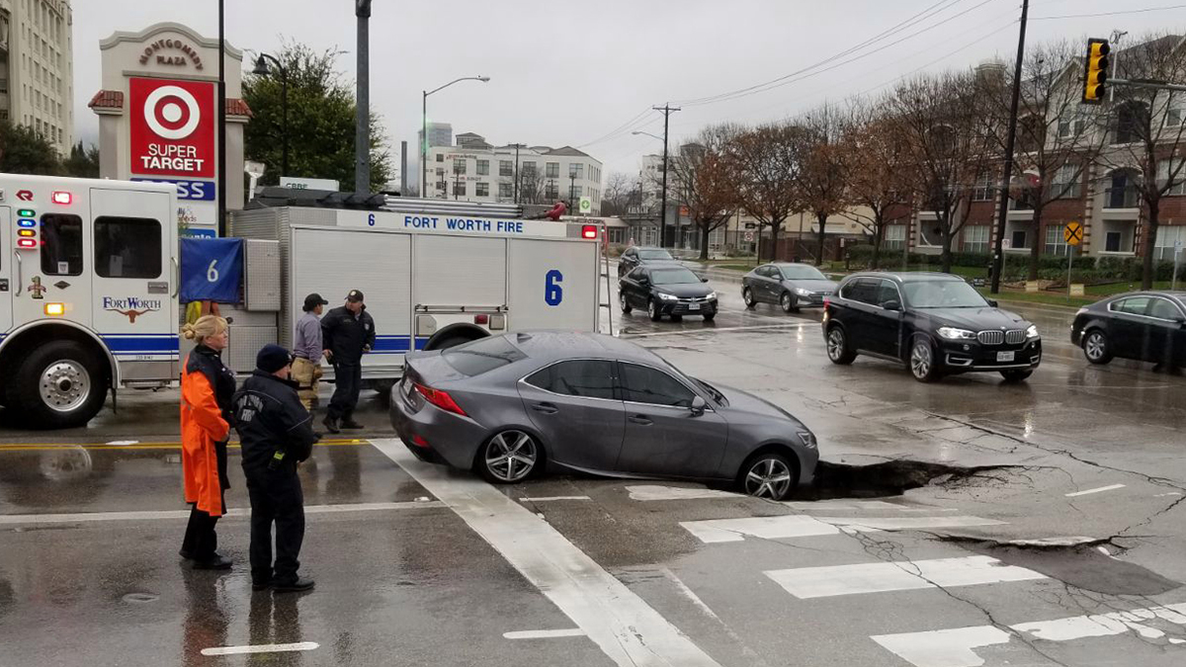
What is a cave in or sinkhole?
Early-stage cave in , Fort Worth. City of Fort Worth, 2019
Cave in with water pipe breach, Fort Worth. Heinz, 2019
Cave in stormwater pipe, Fort Worth. CBSDFW, 2019
Notes:
Mention snow storm…?
For the urban element these can be something as minor as the image on the right or more severe cases as shown in the middle and left images.
Figure 1:Engulfs an entire 3-way intersection, water pipe infrastructure,
Figure 2: Estimated 20ft by 12 ft sinkhole at the surface. Stormwater pipe collapse caused by heavy rainfall.
Figure 3: Small early stages of a sinkhole in the roadway., small hole with surrounding area beginning to sink.; at this stage the site is being evaluated and the cause is undetermined.
Figures 1-3, are all from the Fort Worth, Texas Area and provide a broad spectrum of

Slide 7
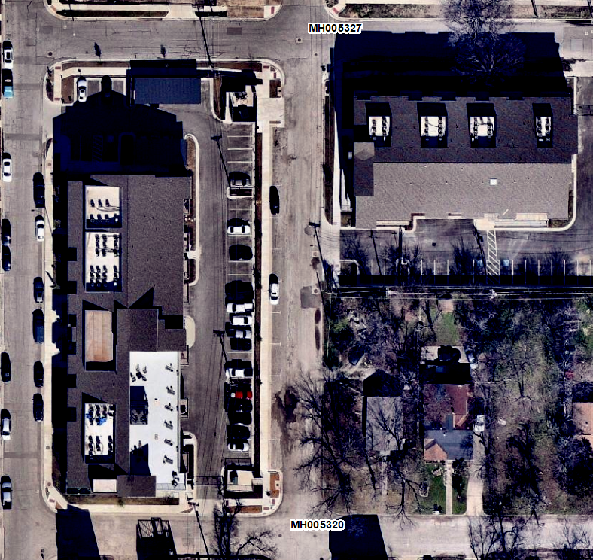
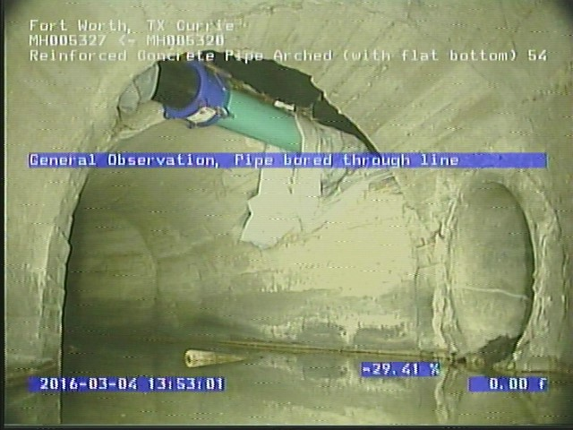
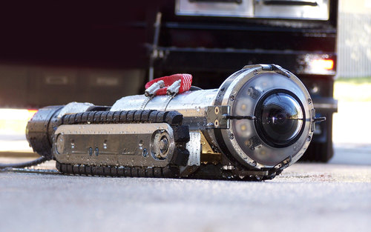
Why is this important?
Unpredictable, Hazardous and Costly
Geospatial Problem
Proactive vs Reactive Approach
Reactive-cave in can happen at any point
Proactive advantages
Identify faults before an emergency happens
Digital Universal Camera, CUES, n.d
CCTV Image, City of Fort Worth, 2021

Slide 8
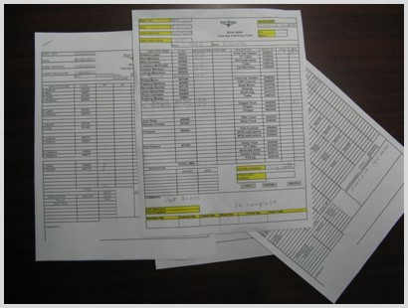
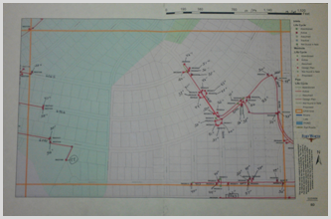
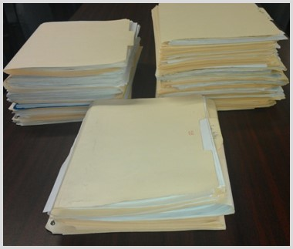
Example For Many Entities
Paper Tracking, City of Fort Worth, 2021
Paper Maps, City of Fort Worth., 2021
Paper Tracking Files, City of Fort Worth, 2021

Slide 9
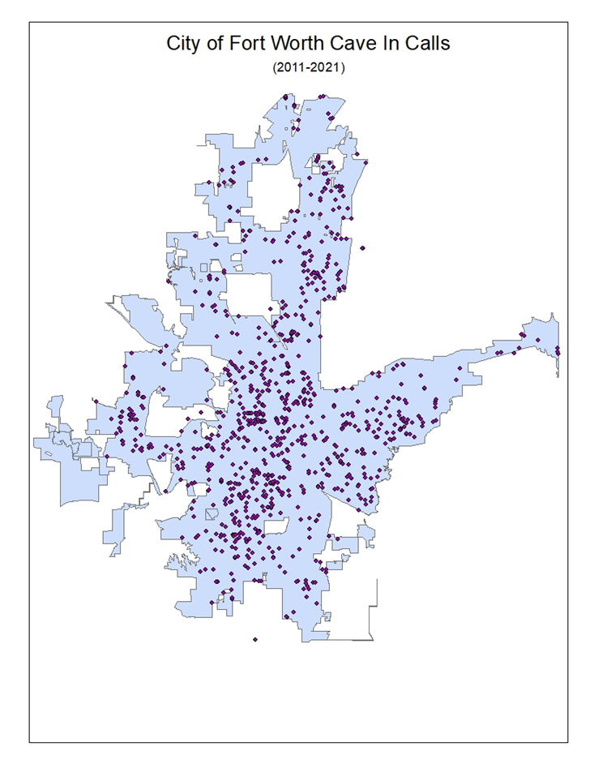
Data Example
City of Fort Worth
~1000 Calls for cave ins to the street department since 2011
Street Department
Emergency Services
Water Department
Stormwater Department

Slide 10
Methods Proposal
GIS Data Collection
Data Quality Control/Assurance
Project Management
Process/Implementation
Design
Use of CCTV to inspect stormwater pipe and identify faults
Asset management and GIS
Relating condition and locations of assets
End Users/Training
Approach for field staff
Manual on asset management and mobile applications

Slide 11
Project Goals
Creating a model (proactive approach to stormwater pipe asset management)
Goals
Analysis of emergency vs. routine repair
Field manual draft
Business process flow

Slide 12
Expected Results
Research Results (Assumed)
GIS Inventory
Asset and Attributes List
CCTV Attributes (what data should be collected)
GIS Layer (would a supplemental GIS layer be required)
Evaluate
Time Savings
Cost Savings
Reduced Risk
Digital Maps
Work/Job Management

Slide 13
My Project Timeline
596a Spring 2 2021
596b Fall 1 2021
Graduation December 2021
Capstone Presentation
TNRIS-Texas Natural Resource Information System
Penn State Peers

Slide 14
References
All Pipe Technologies (n.d). Step-by-Step Process of CCTV Pipe Inspection. Retrieved April 20, 2020 from https://www.allpipetechnologies.com.au/step-by-step-process-of-cctv-pipe-inspection/
CBSDFW. (August 9, 2019). Large Water Main Break Shyts Down Streets Amid Flooding. Retrieved March 28, 2021 from https://dfw.cbslocal.com/2019/08/09/large-water-main-break-shuts-down-streets-amid-flooding/
City of Fort Worth, (2021). Stormwater Infrastructure. Storm Water. Retrieved April 2, 2021.
CUES. (n.d). Cameras. Retrieved April 20, 2020 from CUES Sewer Inspection Cameras (cuesinc.com)
EPA. (n.d). Asset Management for Water and Wastewater Utilities. Retrieved April 4, 2021 from
Asset Management for Water and Wastewater Utilities | Sustainable Water Infrastructure | US EPA
FTMaintenance. (September 2019). What is Asset Management in Maintenance? Retrieved April 17, 2021 from https://ftmaintenance.com/maintenance-management/what-is-asset-management-in-maintenance/
Heinz, Frank. (January 3, 2019). Sinkhole Opens Up Near Fort Worth Cultural District. Retrieved April 2, 2021 from https://www.nbcdfw.com/news/local/sinkhole-opens-up-near-fort-worth-cultural-district/487/
Hiers, Davidson. (January 29, 2020). ‘Unbelievable’: Giant sinkhole threatens to swallow two homes in Florida. Retrieved April 1 2021 from https://www.usatoday.com/story/news/nation/2020/01/29/sinkhole-opens-florida-mobile-home-park-threatens-swallow-homes/4615904002/
Landry, S., Campbell, K & Oliver, N. (n.d). Stormwater Asset Management: Rapid Completion of a GPS-based Infrastructure Inventory and Consolidation of Inventory Information into GIS. Retrieved April 5, 2021 from https://proceedings.esri.com/library/userconf/proc01/professional/papers/pap818/p818.htm
USGS (n.d). Sinkholes. Retrieved March 18, 2021 from https://www.usgs.gov/special-topic/water-science-school/science/sinkholes?qt-science_center_objects=0#qt-science_center_objects
The Institute of Asset Management. (December 2015). Asset Management-an anatomy. (V3, IAM).

Slide 15
Questions?
Katy Cyr
kvc5854@psu.edu

