Slide 1
THE PENNSYLVANIA STATE UNIVERSITY
An Intergovernmental
GIS Web Application
for Zoning and Subdivision
Regulatory Review in
Suffolk County, New York
Jim Daly
Advisor: Jim Detwiler
GEOG 596A: Individual Studies – Peer Review
December 13, 2018

Slide 2
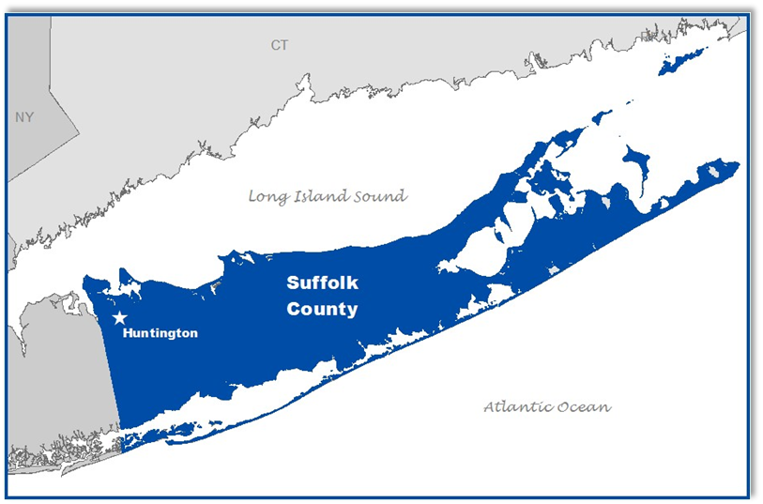
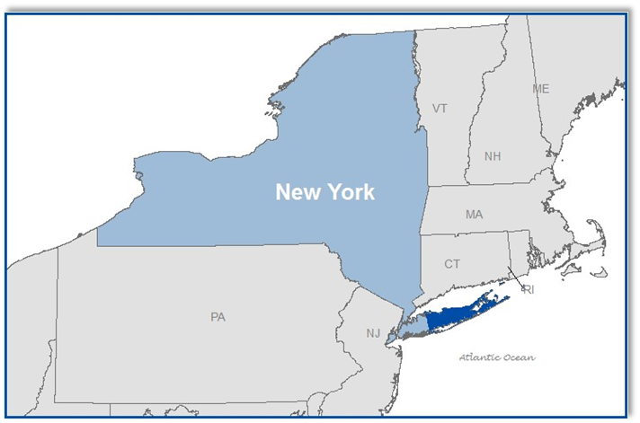
INTRODUCTION
Jim Daly, GISP
Suffolk County GIS Manager
Suffolk County, New York

Slide 3
INTRODUCTION
Jim Daly, GISP
Suffolk County GIS Manager
Suffolk County, New York
1994 – 2006
2006 – Present
Suffolk County Planning Dept.
GIS Support for Planning Staff
Experienced with Planning workflows
Suffolk County IT Dept.
GIS Support for all County Departments

Slide 4
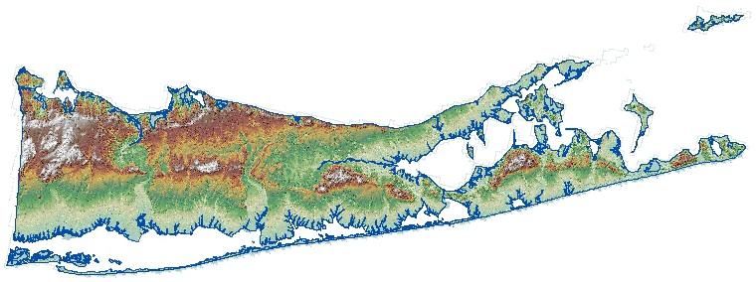
AGENDA
Background
The Problem
Objectives
Methodology
Timeline
Research
SWOT

Slide 5
Background
New York State
General Municipal Law (GML) 239m & 239n
Land Use Controls
Exercises of a Municipality’s “Police Powers”
GML 239m : Zoning Amendments
What the land my be used for; i.e. Commercial, Residential, Industrial, etc.
GML 239n : Subdivision
How the land is used; encourages the provision of adequate services and facilities
“GML 239 Review”
Albany

Slide 6
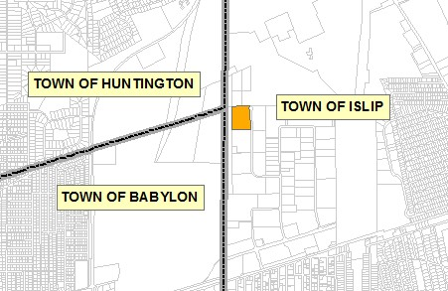
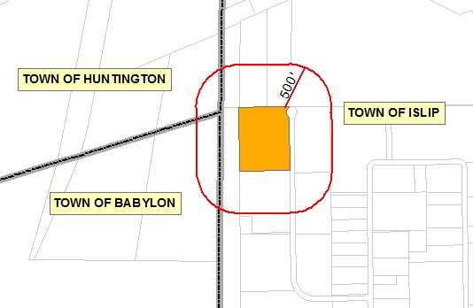
Background
What is the Purpose of GML 239 Review?
Local municipalities consider the countywide and inter-municipal impacts of their local land use decisions.
A.k.a. “The Good Neighbor Laws”

Slide 7
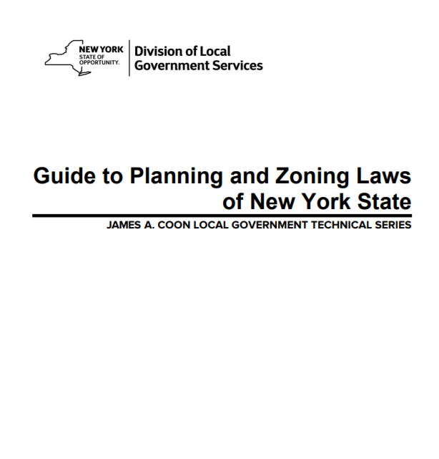
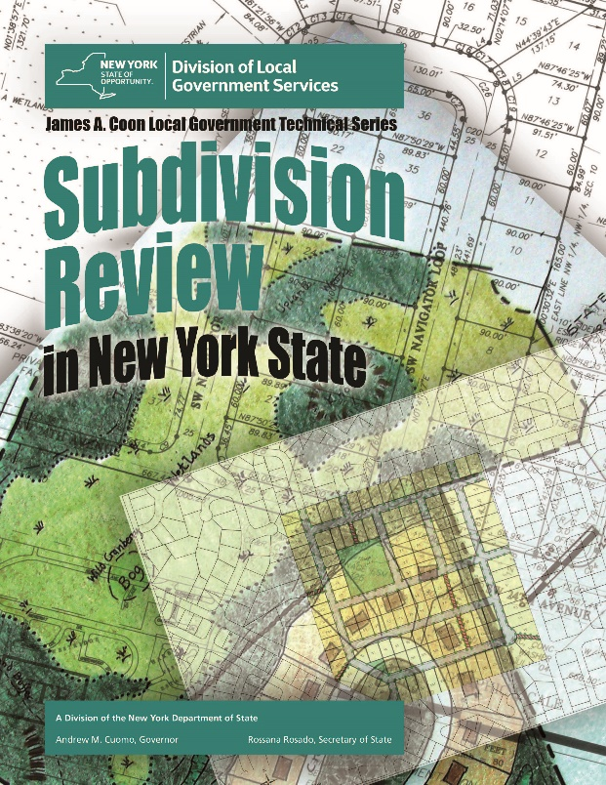
Background
What does GML 239 Review require a
municipality to do?
IF certain spatial conditions are true, GML 239 requires a municipality (the Referring Body) to refer a proposed zoning or subdivision action to the County Planning Board for review before making a decision
This referral is known as “GML 239 Review”

Slide 8
Background
What are the spatial conditions?
Another Municipality
New York State
Park
Roadway
Owned Land
Ag District
When the Subject Property is
within 500 feet of:
Suffolk County
Park
Roadway
Owned Land
Stream
Water Drainage
500’
And also…

Slide 9
Background
What are the spatial conditions?
1 mile
When the Subject Property is
Within 1 mile of:
Airport
Heliport

Slide 10
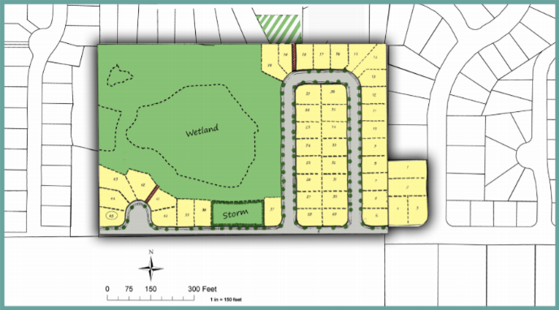
Background
What are the spatial conditions?
All Municipal Boundaries
Boundaries for all County and State Parks
Right-of-Ways for County and State Roads
Right-of-Ways for County Stream or Drainage Channels
Boundaries of County and State Owned Land
Boundaries of NYS Agricultural Districts
Airports and Heliports
Jurisdictional Requirements Data
“Jurisdictional Data”

Slide 11
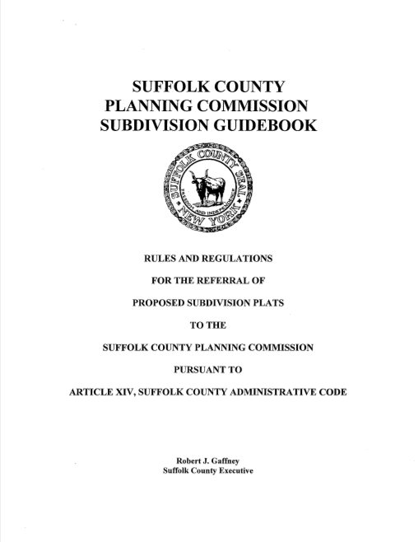
Background
GML 239 Review In Suffolk County
Who’s Who?
The County Planning Agency is the Suffolk County Planning Commission
The Referring Body is any
Town Planning Department
Incorporated Village Planning Department
There are 10 Townships and 32 Inc. Villages
42 municipal agencies to coordinate with the Suffolk County Planning Commission for GML 239 Review.

Slide 12
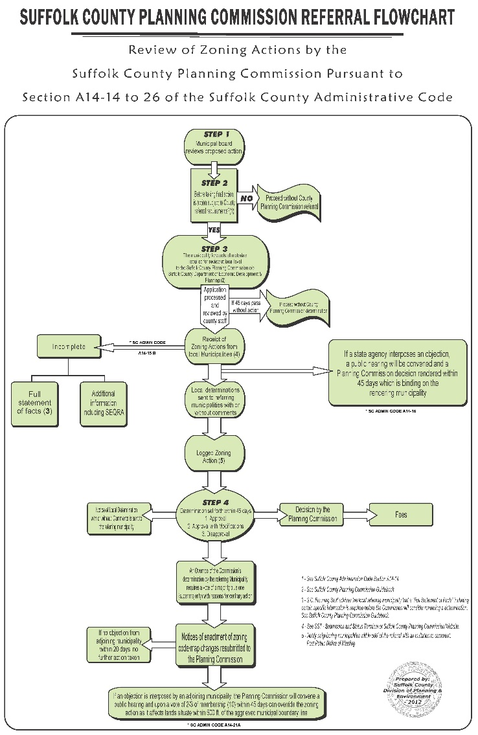
Background
GML 239 Review In Suffolk County
What happens if a referral is needed?
Municipality sends to Planning Dept for review
If it has regional impacts – goes to Planning Commission for determination – Yea or Nay.
Can be challenged/appealed
Article 78
If it has no regional impacts - sent back to municipality for a local determination.

Slide 13
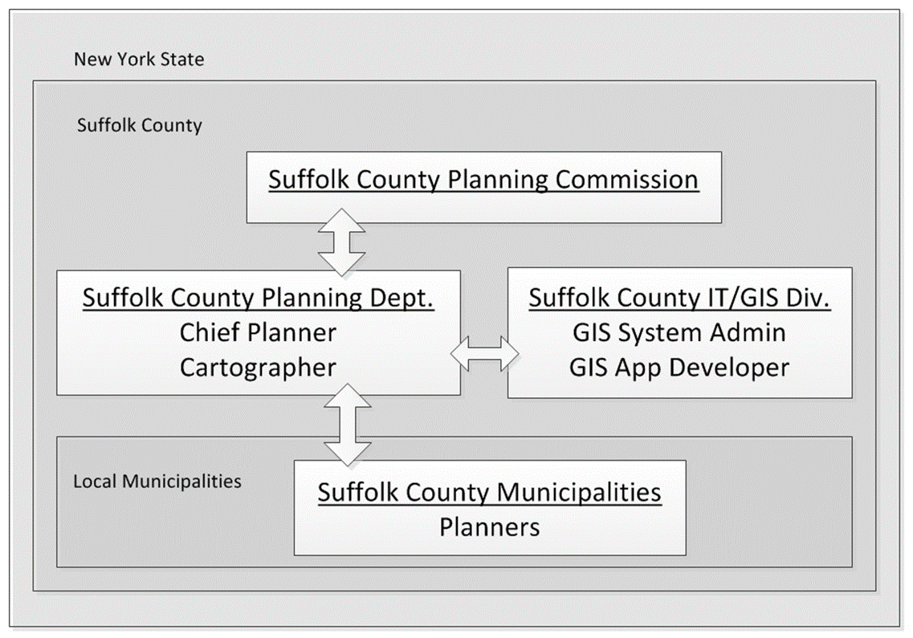
Background
Project Stakeholders
Suffolk County Planning Commission
Suffolk County Planning Department
Suffolk County IT/GIS
Municipalities within Suffolk County
GML 239 Review

Slide 14
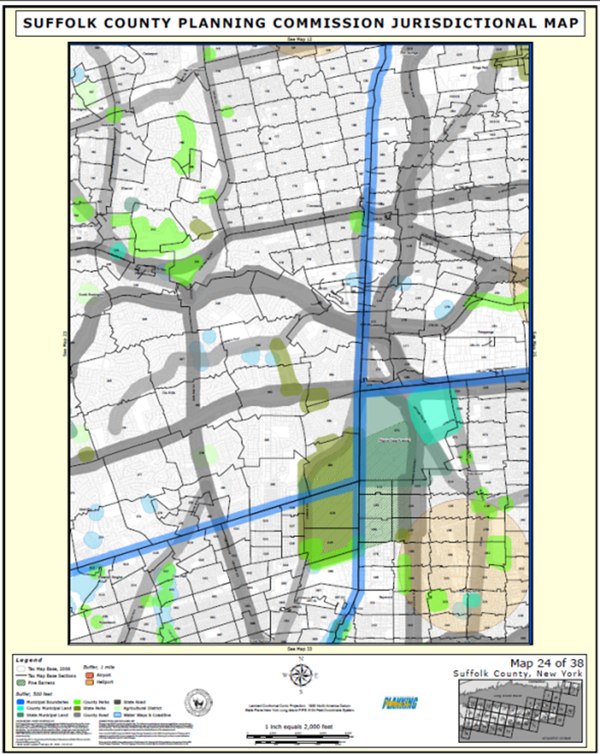
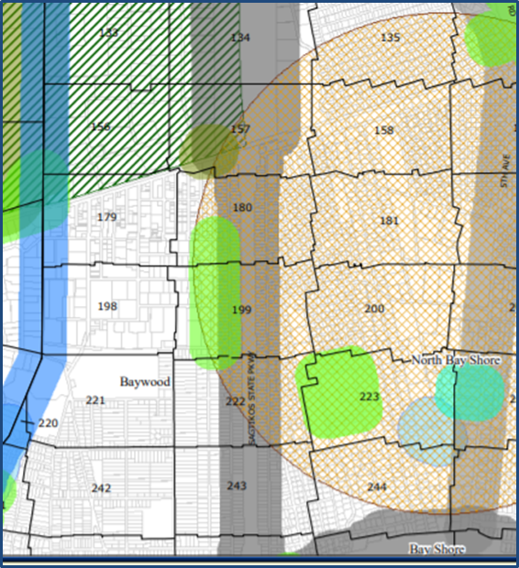
Background
GML 239 Review in Suffolk County is An Uncoordinated Process
County and muni planners “ballpark it” using a 1:24,000 “Jurisdictional” PDF map to determine if a 239 Referral is needed.
A poor assessment of a subject property’s position in reference to the jurisdictional requirements.
A centralized authoritative source of the jurisdictional requirements data has not been established.
County and muni planners do not use the same version of the jurisdictional requirements data.

Slide 15
The Problem
County and local municipal planners do not have a centralized environment where they can make spatially accurate real property determinations and collaborate for efficient GML 239 Review

Slide 16
Research
Validating the Problem
Suffolk County Planning Department
“Speaking in my capacity as Chief Planner and senior staff for Suffolk County Planning Commission GML 239 reviews, I would say that the application proposed is outstanding in its potential to create certainty with respect to the applicability of the GML 239 process on certain properties and projects. The application would lessen the number of procedural defects regarding jurisdictional referrals that plague the process and would reduce process inefficient Article 78 challenges. The interactive potential to add functions like permit tracking applications etc. to the proposed application and make rapid centralized amendments to the Jurisdictional Map is exciting, to say the least!”
- Andrew Freleng, Chief Planner
Zoning and Subdivision Review
Suffolk County Planning Department
Town of Huntington
“Many land development projects occur within the Town of Huntington each year. Our Department of Planning and Environment processes over 150 applications for zoning, site plan, and subdivisions annually and we strive to manage these applications in the most efficient manner possible. In addition, each application is carefully reviewed for compliance with volumes of statutes, standards, and environmental rules. Oftentimes our applications are controversial and opponents of a project will focus on the legal requirements of the approval process, not just the merits of the application itself. Therefore, we would certainly benefit from any system that can help us comply with the County Planning referral process required under New York State General Municipal Law.”
- Dave Genaway, Deputy Director/GIS Manager
Town of Huntington
Department of Planning and Environment,
New York State
“Hi Jim, Thanks you for reaching out and for your time on the phone. I really like and support your idea. My office has some services which may help immediately, and are amenable to hosting others. See http://gis.ny.gov/webservices/.”
- Frank Winters, NYS Geographic Information Officer
Office of Information Technology Services
“An Article 78 proceeding serves as a uniform device to challenge the activities of an administrative agency in court.” ⁴

Slide 17
Research
Does this application presently exist somewhere?
From the New York State GIS Program Office? No.
ShareGIS – The Statewide Potential
Pros:
Support from NYS GIO
Potential authoritative cloud-based application for all NY State counties.
Potential to host and publish NY State jurisdictional data services.
Cons:
Not in production due to pre-existing contracts still in effect with NYS data stakeholders – waiting for legal procedures to dissolve these contracts.

Slide 18
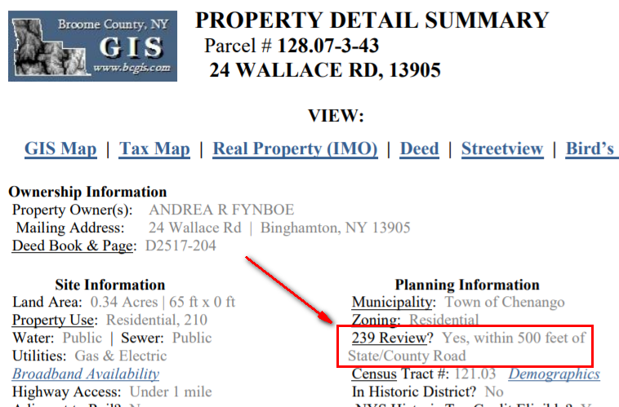
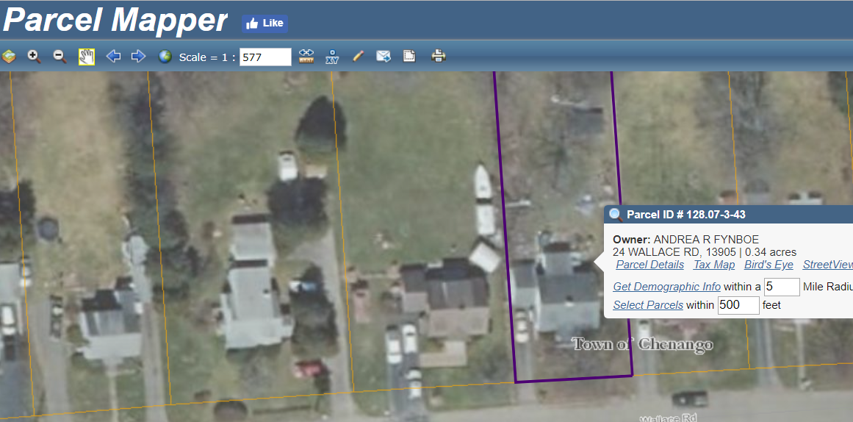
Research
Does this application presently exist somewhere?
In Other New York State Counties?
Broome County GIS
http://www.bcgis.com/Website/GISWeb/Portal.htm
Pros:
A NY county effort to address GML 239 review to assist public and municipalities.
Open application.
Cons:
Not a collaborative application.
One sided review determination of a parcel.

Slide 19
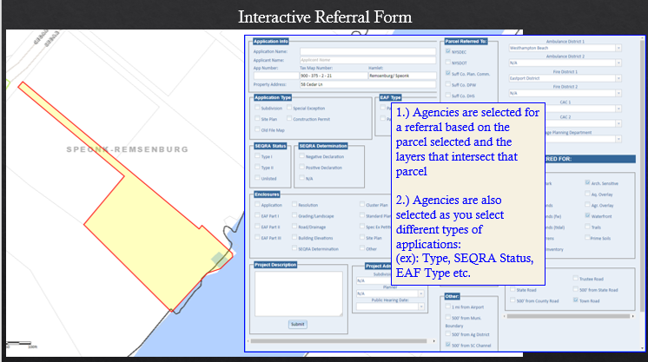
Research
Does this application presently exist somewhere?
In Any Municipalites?
Town of Southampton
https://www.southamptontownny.gov/
Referral Module
Pros: Identifies the Town’s process to ensure GML 239 review.
Cons: Not a collaborative application. For internal use only. Complex custom app dedicated to the organization’s operations.

Slide 20
Objectives
Primary
(Short Term)
A Working Prototype of the Application
Suffolk County Planning Dept. collaborating with at least two local municipalities with the application.
Town of Huntington
Town of Southampton.

Slide 21
Objectives
Secondary
(Long Term)
Scale to the State Level
NYS GIS Program Office Agrees to Deploy the Application based on Suffolk County’s Working Application
All Counties and Local Governments In NYS Use NY State’s GML 239 Review Application

Slide 22
Methodology

Slide 23
Methodology
Create Database
Test Application
Identify Criteria Data
Confirm Positional Accuracy
Build Web API
HTML/JavaScript API
Esri Web App Builder
Deploy
Collect Feedback
Sample Checking
Suffolk County Web GIS Platform
ArcGIS Online

Slide 24
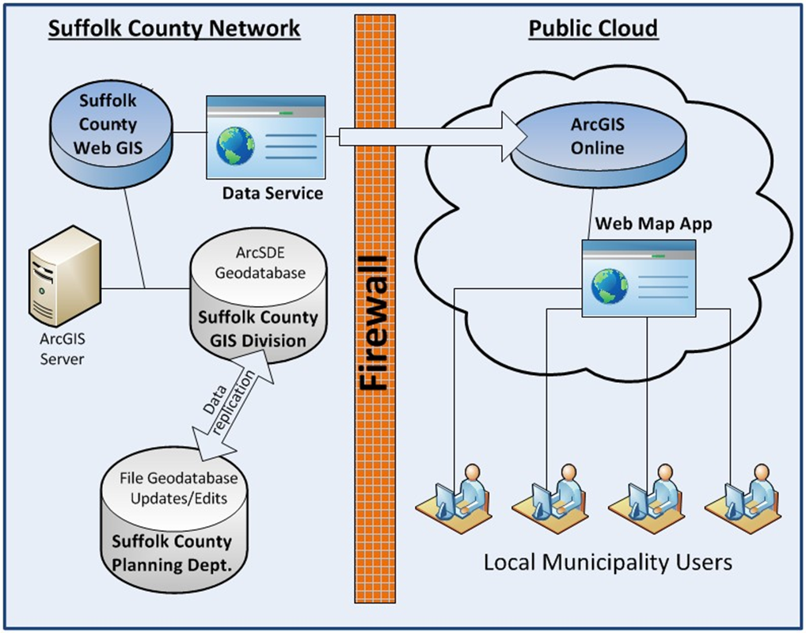
Methodology
Application Platform
Hybrid Platform
Suffolk County IT/GIS Cloud
Esri’s ArcGIS Online

Slide 25
Methodology
Suffolk County Web GIS Platform
Hybrid Platform
Suffolk County IT/GIS Cloud
ArcGIS Server
County GIS Enterprise Geodatabase
Suffolk Planning Geodatabase
Jurisdictional Data Service
GIS Web Server

Slide 26
Methodology
Esri’s ArcGIS Online
Hybrid Platform
Esri’s ArcGIS Online
Suffolk County GIS Org. Account
Hosted Application
Consumes Jurisdictional Data Service from County IT/GIS
Access point for both County and Local Planners.

Slide 27
Methodology
Creating the Database
Data Requirements
Identifying Jurisdictional Data
Correcting Positional Accuracy

Slide 28
Methodology
Creating the Database
Data Requirements
Identifying Jurisdictional Data
All Municipal Boundaries
Boundaries for all County and State Parks
Right-of-Ways for County and State Roads
Right-of-Ways for County Stream or Drainage Channels
Boundaries of County and State Owned Land
Boundaries of NYS Agricultural Districts
Airports and Heliports
Correcting Positional Accuracy
Aligning with Tax Parcel Layer

Slide 29
Methodology
Build the Web Application Programming Interface (API)
HTML / JavaScript
Esri Web App Builder Template
Customize Template

Slide 30
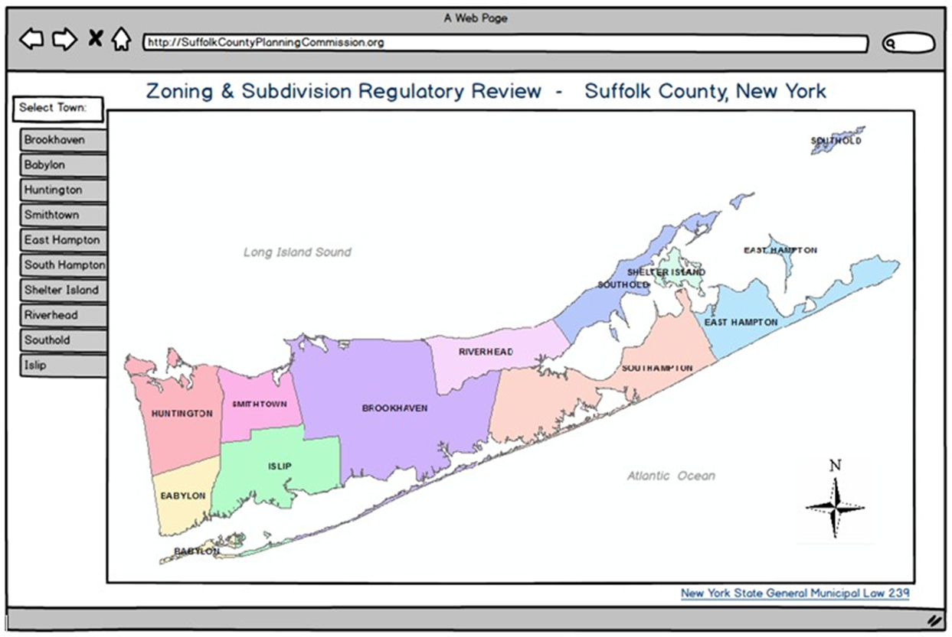
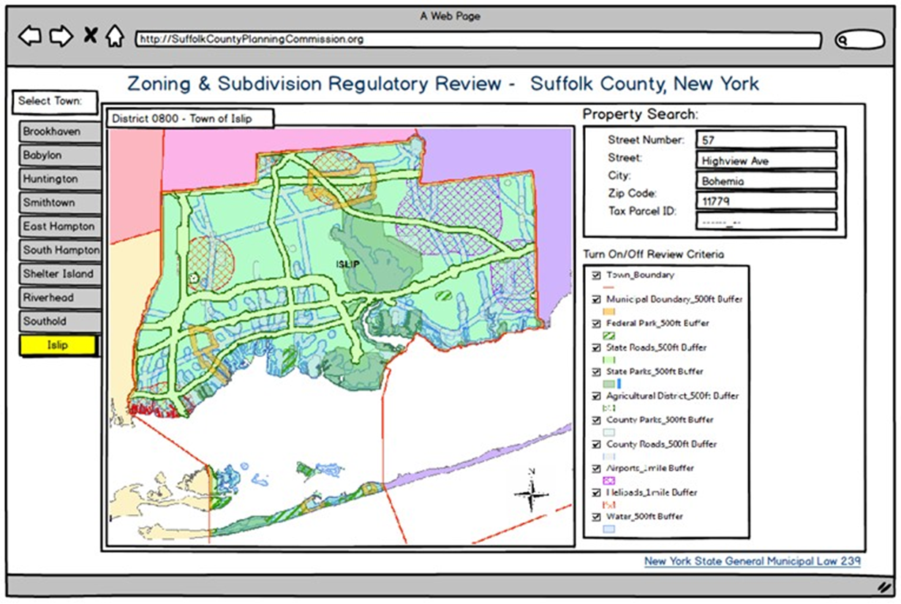
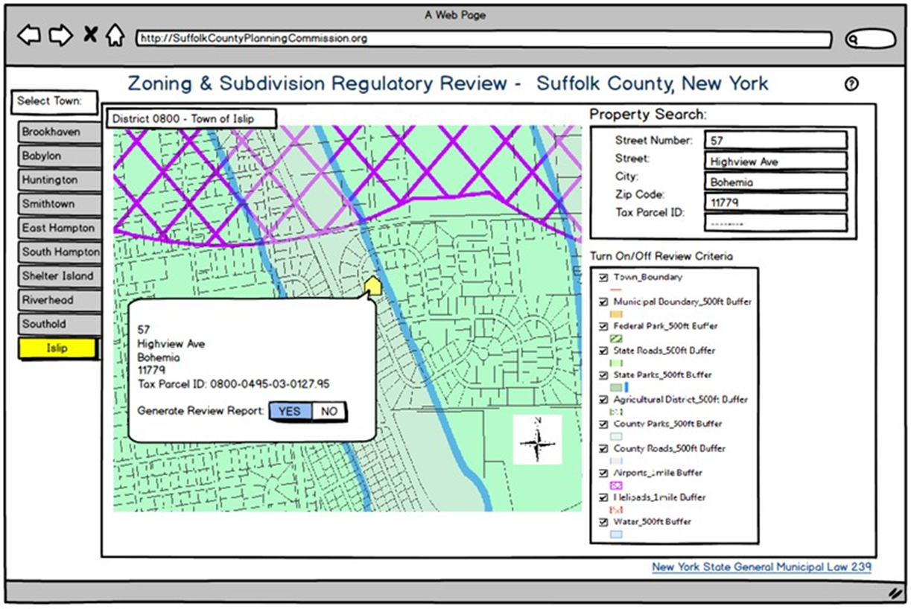
Methodology
Testing the Application
Functionality
API
Data Service
Geoprocessing Tasks
Spatial Accuracy
Coincident Geometry with Tax Map Layer
Positional Accuracy of Environmental Data
GML 239 Review Required: YES

Slide 31
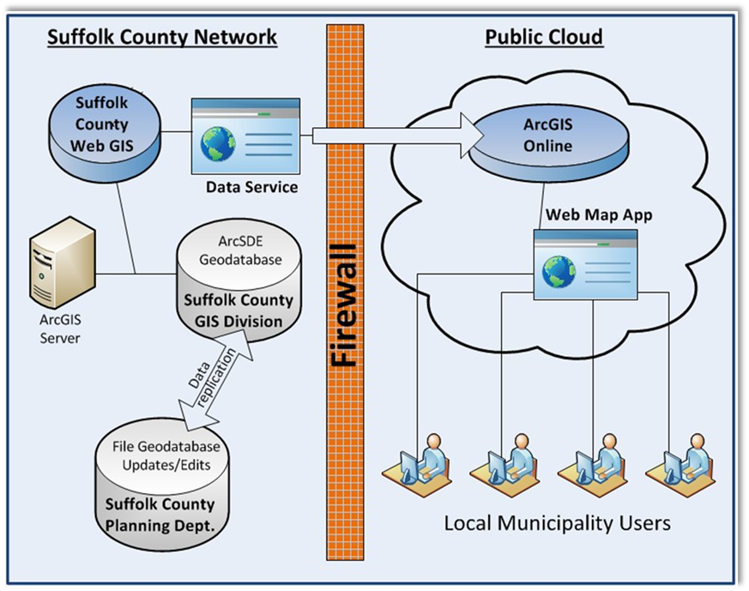
Methodology
Deploy Application
Suffolk County Planning
Municipalities
Town of Huntington
Town of Southampton

Slide 32
Methodology
GML 239 Review
Deploy Application
Suffolk County Planning
Municipalities
Town of Huntington
Town of Southampton

Slide 33
S. W. O. T.
Strengths
Web GIS Hybrid Platform Exists
Support from 3 Levels of Government
$0 Needed to Build Prototype
Weaknesses
Esri’s ArcGIS Online – Licensing Costs
Positional Accuracy of Jurisdictional Data
No Coordination of Data Maintenance
Opportunities
Efficiencies in 239 Review
Improve Collaboration
Reduce Law Suits – Art. 78 Proceeding's
Improve Government Transparency
Scalable to All NYS Counties
Threats
Unwilling of Most to Change Workflow
Suffolk County Drops Esri ELA

Slide 34
Timeline - 2019
Create Jurisdictional Geodatabase
Collect Feedback
Test Application
Jan
Feb/March
March/April
Feb
March
April 19
Create Web API
Deploy to Planners
Present at Conference

Slide 35
Anticipated Results
County and Local Planners will use the Application for GML 239 Review
All Planners Using Same Source Authoritative Data
Foster Intergovernmental Collaboration for GML 239 Review
Gain Workflow Efficiencies for GML 239 Review for both County and Local Planning Departments
Significantly Decrease Law Suits - Article 78 Legal Preceedings;
A Lawsuit Alleging Review Process was Procedurally Defective.
Extend GIS Technology to Government Agencies with Limited GIS Capabilities.
When open to public, create Government Transparency for GML 239 Review

Slide 36
Project Presentation
THE PENNSYLVANIA STATE UNIVERSITY
Long Island GIS (LIGIS)
Spring 2019 Conference
Farmingdale State College
Farmingdale, NY
April 19, 2019
www.ligis.org
Jim Daly
Advisor: Jim Detwiler
GEOG 596A: Individual Studies – Peer Review
December 13, 2018

Slide 37
Thank You!
THE PENNSYLVANIA STATE UNIVERSITY
Questions?
Jim Daly
Advisor: Jim Detwiler
GEOG 596A: Individual Studies – Peer Review
December 13, 2018

Slide 38
References
THE PENNSYLVANIA STATE UNIVERSITY
New York State (2015) Subdivision Review in New York State (Dept. of State, Division of Local Government Services Report). Page 1. Retrieved October11, from NYS DOS website.
Wikipedia.org. Suffolk County, NY. Retrieved from: https://en.wikipedia.org/wiki/Suffolk_County,_New_York (October, 2018)
Census Reporter.org. Suffolk County, NY. Retrieved from: https://censusreporter.org/profiles/05000US36103-suffolk-county-ny/ (October, 2018)
Suffolk County Government. Suffolk County Planning Commission Subdivision Guidebook. Retrieved from: http://www.suffolkcountyny.gov/Departments/Planning/Boards/SuffolkCountyPlanningCommission.aspx (October, 2018)
Law Office of Kevin P. Sheerin. Understanding Article 78. Retrieved from:
www.sheerinlaw.com/pdf/sheerinlaw.com-Article_78_eBook.pdf (Dec., 2018)

